Slide 1
API Design Procedure
Jason Sullenger
09 June 2019
WEB-420 RESTful APIs

Slide 2
Business Use
Genetic Calculator
- Focus on Crested Geckos
- No current options of easy genetic calculations
Parents have a 50/50 chance of passing it’s genetics to child
Recessive genes - require two of that gene to be visual
Dominant/Incomplete Dominate - visual with just one gene
Some morphs offer “super” forms - requiring two of that gene
Normal genes- No abnormal genetic morphs
Possible genes - Unproven genes. May not be visible

Slide 3
Return on Investment
Increased profit
Knowing the genetic possibilities of breeding pairs
Exact odds of desired outcome
Prevents negative breeding pairs
Lethal combinations
Unwanted genetic combinations

Slide 4
Step 1
List the information that will come from or be put in to your API
Semantic Descriptors
id- identifier of the genetics possibilities
geneticsRecessive - morphs classified as recessive genetics
geneticsIncDominant - morphs classified as Incomplete Dominant genetics
geneticsNormal - morphs classified as Normal genetics
geneticsPossible - morphs classified as Possible/unproven genetics
geneticsDam - morph characteristics of female gecko
geneticsSire - morph characteristics of Male gecko

Slide 5

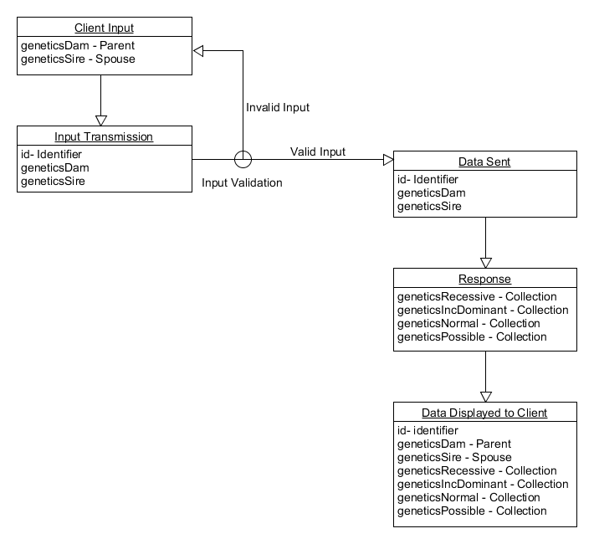
Step 2
Draw a state diagram of your API
“Each box on the diagram represents one kind of representation - a document that groups together some of your semantic descriptors.” (Richardson, Amudsen, & Ruby, 2015, p. 158)
Genetic Calculator

Slide 6
Step 3
Reconcile your string with string from existing profiles
geneticsDam – Parent - Schema.org/parent
geneticsSire – Spouse - Schema.org/spouse
id- identifier - Schema.org/identifier
geneticsRecessive – Collection - Schema.org/collection
geneticsIncDominant - Collection
geneticsNormal - Collection
geneticsPossible - Collection

Slide 7
Step 4
Choose the media type
HTML - HyperText Markup Language
Supports all of the elements for this genetic calculator (e.g., <ol>, <li>, <img>, and <a> )
HTTP - HyperText Transfer Protocol
Search Capabilities - “Although HTTP is a simple messaging protocol, it includes the ability to search a database with a single request.” (Cooper)
Easy to use - “...easier to follow and implement than protocols that make use of codes that require lookups” (Cooper)

Slide 8
Step 5
Create a profile designed for your application
This should explain how the predefined profiles are used as well as any that you have created yourself
ALPS - Application-Level Profile Semantics
Focuses on interface-level interactions
“It does this without addressing implementation details like protocol (HTTP, XMPP, etc.), format (HTML, JSON, etc.) or even resource URLs.” (Amundsen, 2015)

Slide 9
Step 6
Develop an HTTP server that implements your state diagram
Design information is now provided to the developers
HTTP server should mimic the State Diagram
Client requests should use the profiles listed in Step 3
“Responses should include the appropriate hypermedia controls that implement the actions shown in the state chart and described in the profile document.” (Amundsen, 2014)

Slide 10
Step 7
Publish your billboard URL
Prepare the information users will need to use your API
“Web APIs should publish at least one URL that is promised to always respond to clients” (Amundsen, 2014)
The URL it will be known by
Publishing documentation and tutorials will allow developers to use this service

Slide 11
Works Cited
Amundsen, M. (2014, December 07). A Web API Design Methodology. Retrieved from
https://www.infoq.com/articles/web-api-design-methodology/
Amundsen, M. (2015, May 22). Description, Discovery, and Profiles: A Primer. Retrieved from
https://www.infoq.com/articles/description-discovery-profiles-primer/
Cooper, S. B. (n.d.). The Advantages of Hypertext Transfer Protocol. Retrieved from https://www.techwalla.com/articles/the-advantages-of-hypertext-transfer- protocol
Richardson, L., Amudsen, M., & Ruby, S. (2015). RESTful Web APIs. Sebastopol, CA: OReilly Media.

