Slide 1
JSON APIs
Jason Sullenger
04 May 2019
WEB-420 RESTFul APIs

Slide 2
What are JSON APIs
“...API enables you to access a website’s data without going near its databases. It gives us a user-friendly way to read and write data to and from a website’s databases.” (Howdle, 2012)
JSON - JavaScript Object Notation
Popular and effective data format for data exchanges
Human and machine readable
Consists mostly of name/value pairs (similar to an object) and ordered lists of values (array)
APIs offer “...a user-friendly way to read and write data to and from a website’s databases.” (Howdle, 2012)
You send a request and receive your document

Slide 3
What are JSON APIs cont.
JSON API’s utilize HTTP
HTTP (HyperText Transfer Protocol)
Data formatting and transmission as well as server/browser actions in response to commands are controlled by HTTP
“Twitter, Facebook and Flickr all send back data in JSON format.” (Howdle, 2012)
Consistent formatting of your JSON is a key benefit to JSON APIs
“With the goal being to increase productivity and efficiency, JSON API has been touted for its efficient caching features that can eliminate superfluous server requests.” (Doerrfeld, 2017)

Slide 4
jSON APIs compared to SOAP APIs
“SOAP is a standardized protocol that sends messages using other protocols such as HTTP and SMTP. The SOAP specifications are official web standards, maintained and developed by the World Wide Web Consortium (W3C).” (Monus, 2018)
SOAP Protocol
“strict rules and advanced security features such as built-in ACID compliance and authorization.” (Monus, 2018)
More complex – additional bandwidth and resources can cause slower page load times
JSON is not limited exclusive to JS
“JSON is a more lightweight and less verbose format, and it’s easier to read and write as well. In most cases, it’s ideal for data interchange over the internet. However, XML still has some advantages. For example, XML lets you place metadata within tags and also handles mixed content better—especially when mixed node arrays require detailed expressions.” (Monus, 2018)

Slide 5
jSON APIs compared to SOAP APIs cont.
SOAP - Data format - XML
Acceptable transfer protocols: HTTP, SMTP, TCP, or UDP
Advantages - “High security, standardized, extensibility.” (Monus, 2018)
Disadvantages - “Poorer performance, more complexity, less flexibility.” (Monus, 2018)
JSON - Data format -JSON
Acceptable transfer protocols: HTTP
Advantages - “Scalability, better performance, browser-friendliness, flexibility.” (Monus, 2018)
Disadvantages - “Less security, not suitable for distributed environments.” (Monus, 2018)

Slide 6
JSON Request Header
Header parameters will be included in an API call
A call can require an HTTP request to include a custom header
Some possible parameters used in a Header:
Name - should match the path
Type - value parameters (string, integer, etc.)
Authorization - Used for authentication

Slide 7
JSON Request Header cont.
Other possible parameters of a request header:
Content-Type
“application/x-www-form-urlencoded (used to POST primitive values and arrays of primitive values).” (Swagger, "Describing Parameters")
“multipart/form-data (used to upload files or a combination of files and primitive data).” (Swagger, "Describing Parameters")
Accept
The header can accept a list of values
“A multi-value parameter must be defined with type: array and the appropriate collectionFormat.” (Swagger, "Describing Parameters")

Slide 8
JSON Request Body
“Request bodies are typically used with “create” and “update” operations (POST, PUT, PATCH).” (Swagger, "Describing Request Body")
Originally body is now requestBody
requestBody is more flexible and permits more data types.
The Request Body is optional
It can be designated as required though
“When creating a resource using POST or PUT, the request body usually contains the representation of the resource to be created” (Swagger, "Describing Request Body")

Slide 9
JSON Response Body
“A response is defined by its HTTP status code and the data returned in the response body and/or headers.” (Swagger, "Describing Responses")
The body can contain the following:
An object or Array
A data type (Boolean, String, or Integer)
Files
A response can exclude having a body

Slide 10
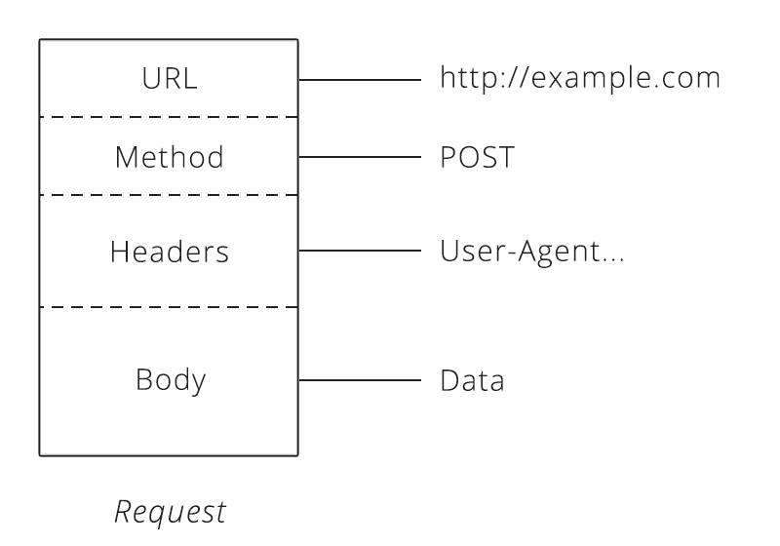
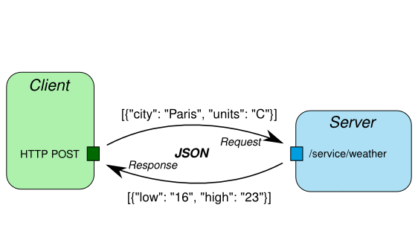
Data flow and request/response model – json api

Slide 11
Doerrfeld, B. (2017, November 22). The Benefits of Using JSON API. Retrieved from https://nordicapis.com/the-benefits-of-using-json-api/ Howdle, B. (2012, February 09). A Beginner's Guide To jQuery-Based JSON API Clients. Retrieved from https://www.smashingmagazine.com/2012/02/beginners-guide-jquery-based-json-api-clients/ Monus, A. (2018, August 02). SOAP vs REST vs JSON comparison. Retrieved from https://raygun.com/blog/soap-vs-rest-vs-json/ Swagger. (n.d.). Describing Request Body. Retrieved from https://swagger.io/docs/specification/describing-request-body/ Swagger. (n.d.). Describing Responses. Retrieved from https://swagger.io/docs/specification/describing-responses/ Swagger. (n.d.). Describing Parameters. Retrieved from https://swagger.io/docs/specification/2-0/describing-parameters/
Works cited

