Slide 1
The Technology Value Stream
Jason Sullenger
14 July 2019
WEB-430 DevOps

Slide 2
What is DevOps
DevOps are development and operations practices
Assists in getting a polished finished product rolled out more quickly, efficiently, and with more agility
Utilizes some of the ideology behind the Agile movement
“Individuals and interactions over processes and tools” (The Agile Alliance)
“Working software over comprehensive documentation” (The Agile Alliance)
“Customer collaboration over contract negotiation” (The Agile Alliance)
“Responding to change over following a plan” (The Agile Alliance)

Slide 3
DevOps continued
Collaboration, automation, and cooperation driven
The goal is to be easily adaptable without sacrificing the stability of the application
DevOps is the solution to Having two different areas of activity
Development and Operations now work together
Previously each group had two different outcomes
These different groups seeking different results refers to something called the “wall of confusion”
The “wall of confusion” can be easily summarized as a struggle between two forces, change and stability

Slide 4
The Value Stream
The steps used by an organization to build an application - Focal point of providing continuous flow of value to a customer
Identification of the parties involved must be completed
Different teams accomplish different tasks with different goals
Examples of the parties involved: Product owner, dev team, operations team, QA team, etc.
Having these parties labelled helps to ensure accurate and complete information is provided in the mapping
The Dev team isn’t who should provide information about QA tasks
Specific information, while widely available, should come from the team responsible for it

Slide 5
Value Stream Mapping
A roadmap for the tasks at hand and the time to completion
A projected schedule for each area of this new project
Reduces down-time while improving efficiency
Features of this map:
The steps involved in development and operations
Who handles each step

Slide 6
Value Stream Mapping continued
The percentage of complete/accurate items
Items done right the first time
No refactoring required
The lead time for each step
The total amount of time to complete a task
Value added + Non-value added
The value added
The amount of time spent on this item
The tools involved
This can help find more efficient tools or find ways to automate steps

Slide 7
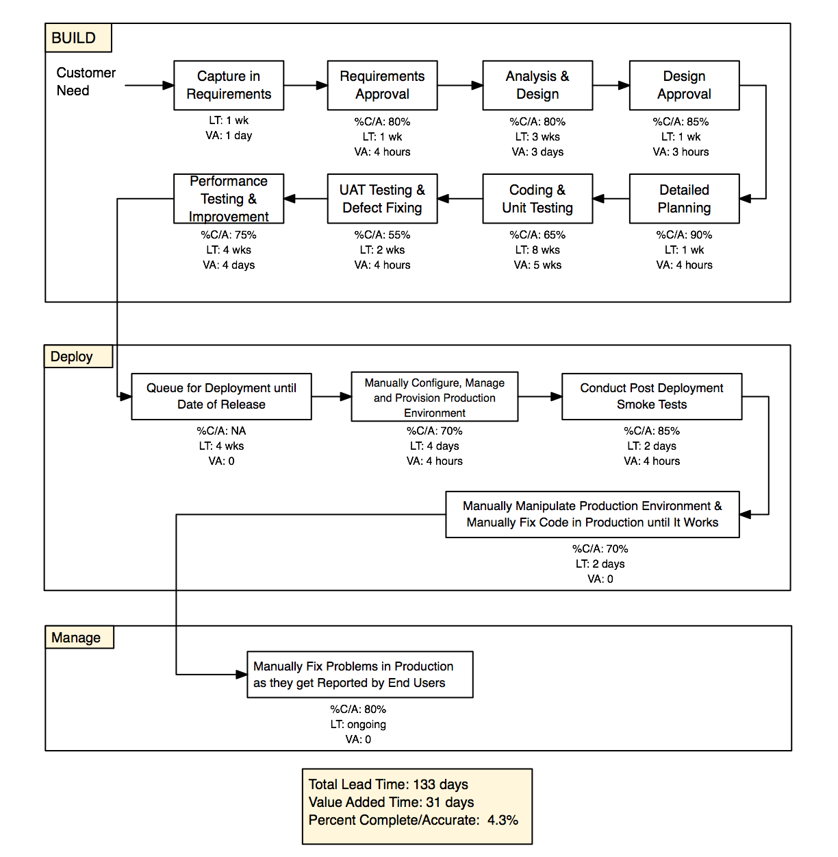
Value Stream Map

Slide 8
Lead Time and Processing Time
Lead time is the amount of time an item takes to be tasked, developed, and deployed
“...the amount of time that occurs between starting on a work item until it is deployed.” (Watson, 2017)
Goal is to figure out how long until something can be to production.
Time starts as soon as the ticket is created
Reducing lead time usually comes down to reducing the amount of time a task is in queue.
Results in faster workflow

Slide 9
Lead Time and Processing Time continued
Processing time
AKA task time/touch time
Included in lead time
Only includes actual time spent on task.
Sitting in the queue only applies to lead time

Slide 10
The Common Scenario
Deployment Lead Times Requiring Months
Manual testing
When the pieces are put together:
The code can be broken
New bugs are found
Fixing is time and labor intensive

Slide 11
The DevOps Ideal
Deployment Lead Times of Minutes
Frequent feedback/Open communication
Small code changes
Automated testing
Frequent deployment
Results in quickly identifying and fixing bugs

Slide 12


Works Cited
Kim, G., Debois, P., Willis, J., Humble, J., & Allspaw, J. (2017). The DevOps handbook: How to create world-class agility, reliability, and security in technology organizations. Portland, OR: IT Revolution Press, LLC.
The Agile Alliance. (n.d.). Manifesto for Agile Software Development.Retrieved from
https://agilemanifesto.org/
Watson, M. (2017, December 11). 15 Metrics for DevOps Success. Retrieved from
https://stackify.com/15-metrics-for-devops-success/

