Slide 1
The Two-Pizza Team
Jason Sullenger
20 July 2019
WEB-430 DevOps

Slide 2
What is “The Two-Pizza Team Rule”
If a team can’t be fed with two pizzas, it’s too big
A team that’s too big will get nothing done.
Fights the norm of “bigger teams get more done”
“... emphasis on decentralization and independent decision-making.” (Dutt, 2018)
Coined by Amazon founder, Jeff Bezos
The idea to restructure Amazon from the top down with this rule was presented in early 2002

Slide 3
Why use it
“... coordination among employees wasted time, and that the people closest to problems were usually in the best position to solve them.” (Dutt, 2018)
More people decreases:
Individual performance
Participation and engagement
The rate of progress
The amount contributed by an individual

Slide 4
Why use it, continued
Prevention of HiPPO
“HiPPO is an acronym for the ‘highest paid person's opinion’ or the ‘highest paid person in the office.’” (Rouse, 2013)
Lower paid employees rally behind the ideas and opinions of employees that are higher up on the pay-scale
Prevention of Group think
“a phenomenon that occurs when group's need for consensus supersedes the judgment of individual group members.” (Rouse, 2012)

Slide 5
The Solution
The benefits of larger groups is the diversity of knowledge and resources
“they also require greater amounts of coordination and management, to the point where size becomes an impediment.” (Choi, 2013)
“... the time and money spent on communication increased in proportion to the number of people on a project.” (Dutt, 2018)
This process works by removing as many managers from the equation as possible
Teams consist of “Doers”
Employees must have a direct impact on the company
“He wanted doers—engineers, developers, perhaps merchandise buyers, but not managers. ” (Dutt, 2018)

Slide 6
How many people
Medium Pizza - 12”
Eight Slices
Feeds three to four
Meeting should consist of six to eight people
Large Pizza - 14”
Eight to ten slices
Feeds four to five
Meeting should consist of eight to ten people

Slide 7
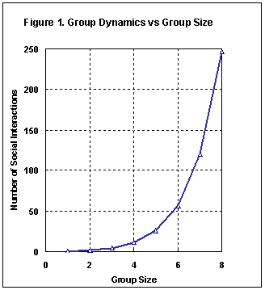
The science behind it
The “team scaling fallacy”
Teams of two and four were asked to assemble 50 pieces into a human figure
Two person teams averaged 36 minutes for a complete build
Four person teams averaged 52 minutes on the same set
Personal Links
Increase the chances of negatively impacting productivity/efficiency

Slide 8
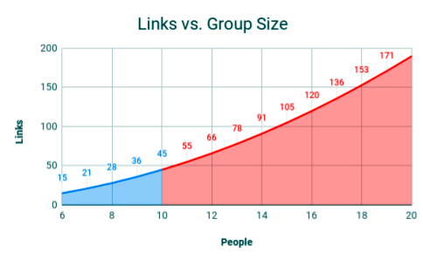
The science behind it, continued
Expenses aren’t linear
Changes, for better or worse, are affected exponentially
This is especially clear with communication
Communication links and social interactions can quickly grow out of hand
Avoiding meeting sizes larger than ten keeps “social costs” manageable

Slide 9
The Science behind it - hippo
Credited to Avinash Kaushik
Reasons that could lead to blindly following senior personnel:
Senior may be more knowledgeable on the topic
Senior may have greater skills
Self preservation – fear of termination as a result of opposing senior personnel
Negative impact
Can result is bad problem solving
Employees may “check-out” mentally

Slide 10
The Science behind it – hippo, continued
Similar to “Authority Bias”
Famous study of Authority Bias – The Milgram experiment
Participants administered electric shocks to individuals as a result of providing a wrong answer
Results individuals tend to trust “experts” more than we should
Authority bias is commonplace in TV ads as well
This can be observed in meetings as we tend to look towards senior personnel during times of uncertainty

Slide 11
The Science behind it – Groupthink
Collaboration can easily be derailed as a result of Groupthink
The purpose of collaboration is to promote members to be, “…creative, speak out and weigh many options before arriving at a consensus” (Rouse, 2012)
Time Constraints are a leading cause of group think
Individuals become less resistant in an effort to make progress
Outspoken members can increase the chances of group think by taking over decision making.

Slide 12
Changes at Amazon
Employees assigned to autonomous teams with no more than 10 members
Not subject to “intracompany communication”
Teams were required to present how their productivity (“Fitness functions”) could be measured against a certain metric
“A group writing software code for the fulfillment centers might home in on decreasing the cost of shipping each type of product and reducing the time that elapsed between a customer’s making a purchase and the item leaving the FC (Fulfillment center) in a truck.” (Dutt, 2018)
This concept can’t be applied successfully to every department
Finance and legal are examples where this concept isn’t the best fit

Slide 13
The results
Success was hit or miss
Negative connotation to “fitness functions”
“Asking groups to define their own fitness functions was a little like asking a condemned man to decide how he’d like to be executed.” (Dutt, 2018)
Too much focus was spent on the fitness functions instead of offering improvement to the company
Time is spent proving the worth of the team instead of solving the problems they are tasked with

Slide 14
Works cited
Choi, J. (2013, July 29). The Science Behind Why Small Teams Work More Productively: Jeff Bezos’ 2 Pizza Rule. Retrieved from
https://buffer.com/resources/small-teams-why-startups-often-win-against-google-and-facebook-the-science-behind-why-smaller-teams-get-more-done
DIRECTORPOINT. (n.d.). Group Dynamic vs Group Size [Digital image]. Retrieved from
http://directorpoint.com/blog/amazon-two-pizza-rule/
DIRECTORPOINT. (n.d.). Links vs Group Size [Digital image]. Retrieved from
http://directorpoint.com/blog/amazon-two-pizza-rule/
Dutt, A. (2018, August 6). The ‘two-pizza rule’ productivity hack by Jeff Bezos was actually a failure. Here’s why. Retrieved from
https://www.techinasia.com/jeff-bezoss-muchdiscussed-twopizza-rule-failure
Rouse, M. (2012, October). Group think. Retrieved from
https://searchcio.techtarget.com/definition/group-think
Rouse, M. (2013, December). HiPPO. Retrieved from
https://whatis.techtarget.com/definition/HiPPOs-highest-paid-persons-opinions

