Slide 1
Service-Oriented Architecture and Enterprise Service Bus
Jason Sullenger
16 June 2019
WEB-420 RESTful APIs

Slide 2
SOA - Service-Oriented Architectures
“SOA is a structure that allows services to communicate with each other across different platforms and languages by implementing what is known as a ‘loose coupling’ system.” (Watts, 2017)
Loose coupling –The ability of a client to remain independent of the service that it requires
“The most important part of this concept is that the client, which in itself can be a service, can communicate with the service even if they are not closely related.” (Watts, 2017)
“This facilitated communication is achieved through the implementation of a specified interface that is able to perform the necessary actions to allow for the transmission of data.” (Watts, 2017)

Slide 3
ESB - Enterprise Service Buses
A middleware used to pass data between components
It’s basically an architecture
“Middleware is software that lies between an operating system and the applications running on it. Essentially functioning as hidden translation layer, middleware enables communication and data management for distributed applications.” (Microsoft Azure)
Used to connect components and their ability to send and receive information from another component
“It is a set of rules and principles for integrating numerous applications together over a bus-like infrastructure.” (MuleSoft, 2018)

Slide 4
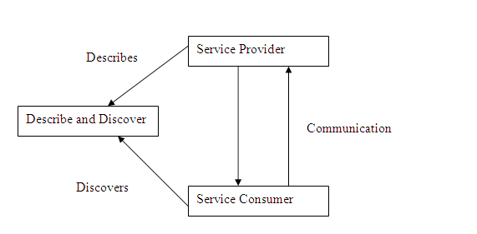
ESB/SOA Relationship
With SOA there is a service provider and service consumer
“In order for this to work, there also needs a mechanism so that they can communicate with each other and also describe and discover themselves” (Bhat, 2008)
ESB allows the implementation of SOA
”Instead of going back again to point to point integration to implement SOA, ESBs extend knowledge gained in EAI work that simplifies the integration and flexible use of business components.” (Bhat, 2008)

Slide 5
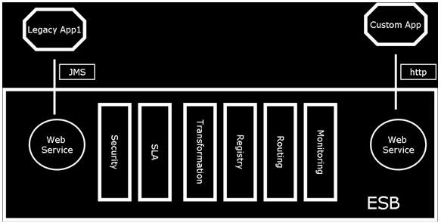
ESB/SOA Relationship, cont.
Not required to use HTTP protocol
ESBs allow the following:
Security mechanisms
Service level agreements (SLA)
Routing/Transformation Capabilities

Slide 6
Data Transfer in an SOA environment
SOA and ESB are transactional integration technologies
“Each application programmatically connects to a common messaging bus, and uses a shared set of messages to exchange data.” (Allen, 2014)
Messaging is real-time
Use SOA when you can’t use “...standard file formats common to the applications you need to integrate.” (Allen, 2014)

Slide 7
Advantages of SOA Architecture
Creates reusable code
Heterogenous environments can reuse code
C, C++, .Net
Reduces time needed for development
Lowers costs
Simplistic communication capabilities
Calls are agnostic

Slide 8
Advantages of SOA Architecture, cont.
Allows for scalability
SOA requires a standard communication protocol to be used
Leads to reduced interaction between clients and services
No added pressure when upscaling
More options pertaining to load balancing
Reduced costs
Maintenance is lower on loosely coupled systems
“...Do not necessitate the need for costly development and analysis.” (Watts, 2017)
Reusable business functions being more widely available also reduce costs

Slide 9
Advantages of SOA Architecture, cont.
Promotes interaction
“Once a standardized communication protocol has been put in place, the platform systems and the varying languages can remain independent of each other, while still being able to transmit data between clients and services.” (Watts, 2017)
SOA can negotiate firewalls
“...Companies can share services that are vital to operations.” (Watts, 2017)
Easy maintenance
Connected/interacting services can easily be updated, upgraded, and maintained

Slide 10
Advantages of SOA Architecture, concluded
Easily Testable
Result of layered architecture
Testing areas include services and security
Automated testing is common practice
Ever-changing enterprise services promote reusable testing
Can be tested independently

Slide 11
Disadvantages of SOA Architecture
Increased Overhead
“Every time a service interacts with another service, complete validation of every input parameter takes place.” (Takale, 2018)
Increases response time and machine load
Reduces performance
Complex Service Management
Larger amounts of services become exponentially harder to task
“...As services keep exchanging messages to perform tasks, the number of these messages can go into millions even for a single application. (Takale, 2018)
High Investment Cost
Upfront costs are high - Investment is technology, development, and manpower are required

Slide 12
Deploying and Managing SOA Architecture
Workflow management systems - Model/Control processes
Schemas are used to explore options
Processes can be altered and removed efficiently with Workflow Management Systems
Compare your architecture to industry standards
Plan for evolving your platform
Analyze benefits of current architecture to help shape future SOA policy

Slide 13
Scaling an SOA environment
Scaling with multiple identical databases
Supporting identical service instances
Handle distribution with load balancing
Offers a failsafe in the event of an issue with one of your instances
Splitting responsibilities and data among different instances
Instances can be distributed to areas with more demand
Splitting instances and services to a set of users
Could be a conflict with users not having access as a result of being linked to another instance

Slide 14


Works Cited
Allen, R. (2014, June 13). Managed File Transfer vs. SOA. Retrieved from
https://blog.ipswitch.com/file-transfer-vs-soa
Bhat, M. (2008, May 02). SOA? ESB? What is all this? Retrieved from
https://software.intel.com/en-us/articles/soa-esb-what-is-all-this
Microsoft Azure. (n.d.). What is Middleware? Retrieved from
https://azure.microsoft.com/en-us/overview/what-is-middleware/
MuleSoft. (2018, November 30). What is an ESB? Retrieved from
https://www.mulesoft.com/resources/esb/what-esb
Takale, S. (2018, April 09). Advantages and Disadvantages of Service-oriented Architecture (SOA). Retrieved from
https://techspirited.com/advantages-disadvantages-of-service-oriented-architecture-soa
Watts, S. (2017, May 31). What is Service-Oriented Architecture. Retrieved from
https://www.bmc.com/blogs/service-oriented-architecture-overview/

