Slide 1

CYBER THREAT PREDICTIVE ANALYTICS FOR IMPROVING CYBER SUPPLY CHAIN SECURITY
PRESENTED BY
ROLL NO: NAME
188X1A05B3 V. SULOCHANA
188X1A0584 S. BHAVANA
188X1A0583 R. HEMASREE
188X1A0565 M. KEERTHI
188X1AO569 N. NANDHINI
Under The Guidance of HOD Principal
Mrs.C.MADHURI, M.TECH Dr.A.SATHIYARAJ.,B.TECH.,ME., DR.N.SUDHAKAR REDDY,
Assistant Professor., M.B.A.,PhD.,Professor., B,E.,M.TECH.,PH.D., MISTE
Department Of Computer Science and Engineering

Slide 2
Abstract
Cyber Supply Chain (CSC) system is complex which involves different subsystems performing various tasks. Security in supply chain is challenging due to the inherent vulnerabilities and threats from any part of the system which can be exploited at any point within the supply chain. This project aims to analyze and predicate threats to improve cyber supply chain security. We have applied Cyber Threat Intelligence (CTI) with Machine Learning (ML) techniques to analyze and predict the threats based on the CTI properties.

Slide 3
Introduction
Cyber Supply Chain (CSC) security is critical for reliable service delivery and ensure overall business continuity of Smart CPS.
CSC systems by its inherently is complex and vulnerabilities within CSC system environment can cascade from a source node to a number of target nodes of the overall cyber physical system (CPS).
A recent NCSC report highlights a list of CSC attacks by exploiting vulnerabilities that exist within the systems.
Organizations outsource part of their business and data to the third-party service providers that could lead any potential threat.

Slide 4
Literature Survey
CYBER SUPPLY CHAIN (CSC) SECURITY
The CSC security provides a secure integrated platform for the inbound and outbound supply chains systems with third party service provider including suppliers, and distributors to achieve the organizational goal.
Cyber security from supply chain context involves various secure outsourcing of products and information between third party vendors, and suppliers.
This outsourcing includes the integration of operational technologies (OT) and Information technologies (IT) running on Cyber Physical Systems (CPS) infrastructures.
However, there are threats, risks and vulnerabilities that are inherent in such systems that could be exploited by threat actors on the operational technologies and information technologies of the supply inbound and outbound chains systems

Slide 5
Literature Survey
CYBER THREAT INTELLIGENCE (CTI)
Cyber threat intelligence (CTI) gatherings and analysis have become one of the relevant actionable intelligences used to understand both known and unknown threats.
The impact of cyber attacks and emerging threats on CSC systems and its devastating effects on business process, data, Intellectual Property, delivery channel, and cost of recovery has increased the surge for CTI approach.
The CTI process includes identification, threat analysis and information disseminating to stakeholders.
Considering CTI for cybersecurity, ENISA in explored the opportunities and limitations of current threat intelligence platforms by considering CTI implementation process and threat intelligence programs (TIP) from strategic, tactical and operational goals.

Slide 6
Existing System
A recent NCSC report highlights a list of CSC attacks by exploiting vulnerabilities that exist within the systems.
Organizations outsource part of their business and data to the third-party service providers that could lead any potential threat.
There are several examples for successful CSC attacks. For instance, Dragonfly, a Cyber Espionage group, is well known for targeting CSC organization.
The Saudi Aramco power station attack halted its operation due to a massive cyber attack.

Slide 7
Disadvantages
Existing works that consider CSC threats and risks but a lack of focus on threat intelligence properties for the overall cyber security improvement.
A limited works emphasize on threat intelligence data for the attack prediction

Slide 8
Proposed System
The novelty of our work is threefold:
Firstly, we consider Cyber Threat Intelligence(CTI) for systematic gathering and analysis of information about the threat actor and cyber-attack by using various concepts such as threat actor skill, motivation, IoC, TTP and incidents. The reason for considering CTI is that it provides evidence-based knowledge relating to the known attacks.
Secondly, we applied ML techniques and classification algorithms and mapped with the CTI properties to predict the attacks. We use several classification algorithms such as Logistic Regression (LG), Support Vector Machine (SVM), Random Forest (RF) and Decision Tree (DT) for this purpose.
Finally, we consider widely used cyberattack dataset to predict the potential attacks.

Slide 9
Advantages
CTI provides intelligence information with the aim of preventing attacks as well as shorten time to discover new attacks.
The result shows the integration of CTI and ML techniques can effectively be used to predict cyberattacks.

Slide 10
SYSTEM REQUIREMENTS
Hardware Requirements
Processor - Dual Core 1.6 Ghz
RAM - 2 GB
HDD - 500GB
Software Requirements
Operating System - Windows 7 or Above
Programming Language - PYTHON
Tools - Google Collab/ Jupyter Notebook

Slide 11
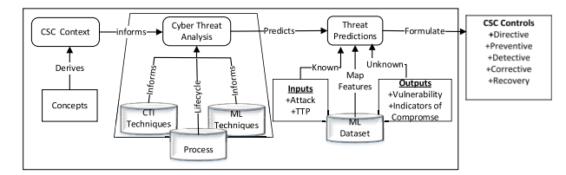
SYSTEM ARCHITECTURE

Slide 12
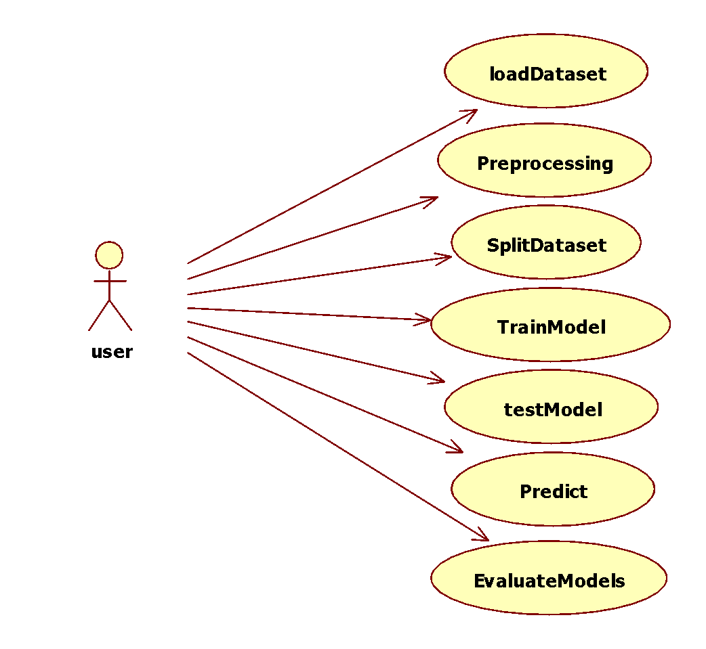
UML Diagrams
Use-case Diagram

Slide 13
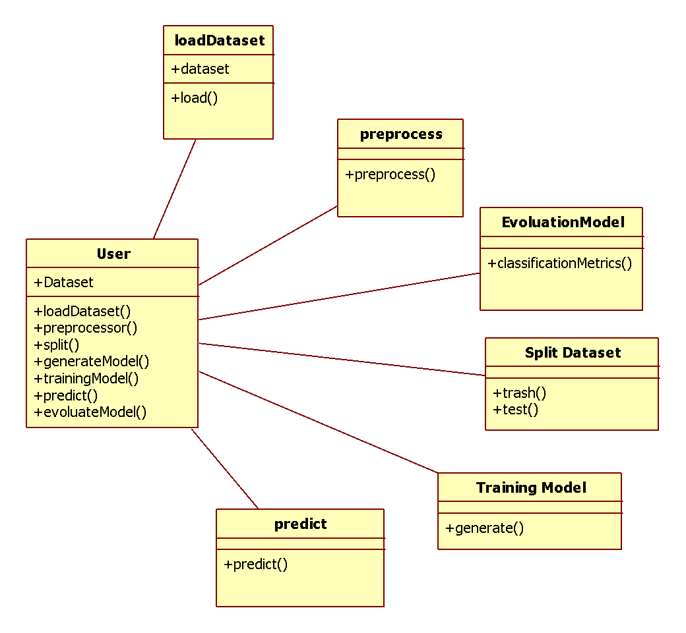
UML Diagrams
Class Diagram

Slide 14
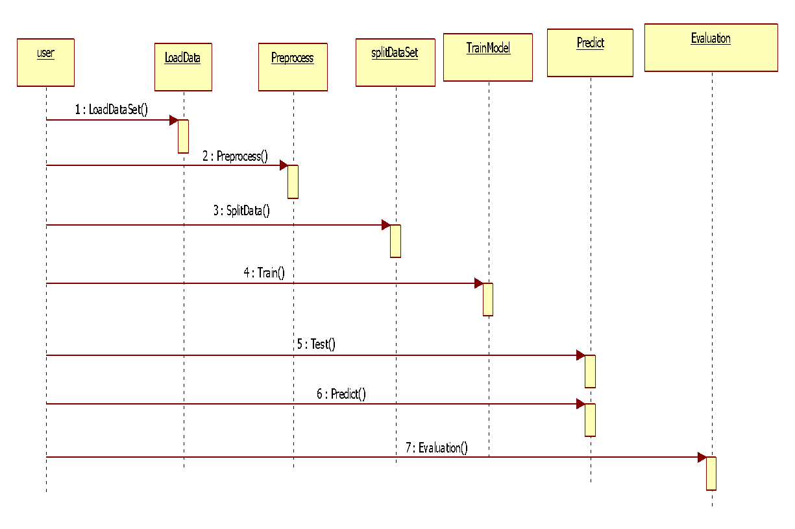
UML Diagrams
Sequence Diagram

Slide 15
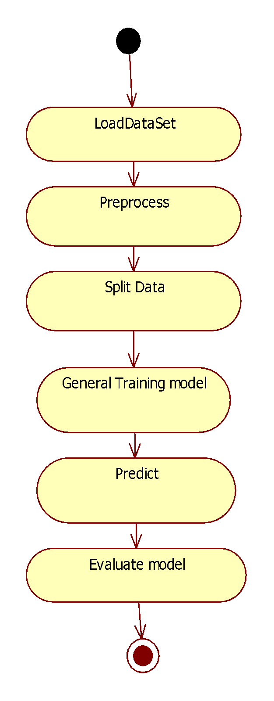
UML Diagrams
Activity Diagram

Slide 16
Modules
Data Collection
Pre-processing
Split Dataset
Prediction
Evaluation

Slide 17
Modules Description
Data collection
In this module, we collect the malware detection dataset from kaggle.com. In the dataset we have 162263 records and 57 features are available.
This data can be used to train and test the applied models performance.
Pre-processing
In this module, we processing the data in which we find the any missing values, check data type of attributes or features that provide information about the data has either continuous data or binary data.
If any continuous data, we need to convert the continuous data into binary data.
After converting data, we perform data normalization process for better understanding of data.

Slide 18
Modules Description
Split dataset
In this module, after processing the data set we split the data as a training and testing data.
The training data is used to train the models to predict malicious data and Test data can be used for check the efficiency of the models.
Prediction
In this module, we apply different ML algorithms such as Logistic Regression, Decision Tree, Naive Bayes and Random Forest.
Using these models, we predict the malware in the dataset. Calculate the prediction accuracies of the applied models for perform comparative analysis.

Slide 19
Modules Description
Evaluation
In this module, we construct and calculate we confusion matrix and classification metrics to further evaluate the models.

Slide 20
Algorithms
Naive Bayes Algorithm
Naive Bayes is a simple technique for constructing classifiers: models that assign class labels to problem instances, represented as vectors of feature values.
All naive Bayes classifiers assume that the value of a particular feature is independent of the value of any other feature, given the class variable.
A naive Bayes classifier considers each of these features to contribute independently to the probability that this fruit is an apple, regardless of any possible correlations between the color, roundness, and diameter features.

Slide 21
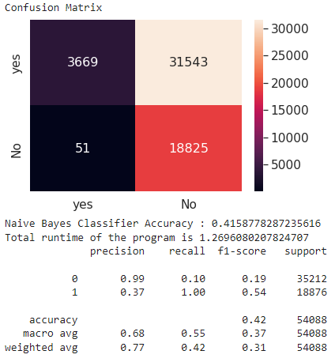
Result of Naive Bayes

Slide 22
AC = TP + TN / TP + FP + TN + FN
2) TPR = TP / FN + TP
3) P = TP / FP + TP
4) F = 2(Precision X Recall) / Precision + Recall

Slide 23
Algorithms
Support Vector Machine
In machine learning, support-vector machines (SVMs, also support-vector networks) are supervised learning models with associated learning algorithms that analyze data for classification and regression analysis.
An SVM training algorithm builds a model that assigns new examples to one category or the other, making it a non-probabilistic binary linear classifier.

Slide 24
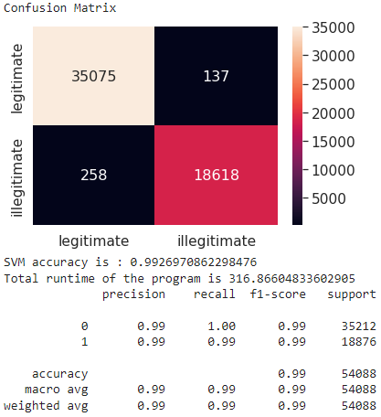
Result of SVM

Slide 25
Algorithms
Logistic Regression
Logistic regression is a statistical model that in its basic form uses a logistic function to model a binary dependent variable, although many more complex extensions exist.
In regression analysis, logistic regression is estimating the parameters of a logistic model.
Mathematically, a binary logistic model has a dependent variable with two possible values, such as pass/fail which is represented by an indicator variable, where the two values are labelled "0" and "1".

Slide 26
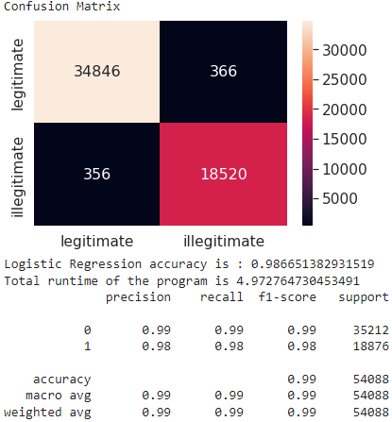
Result of Logistic Regression

Slide 27
Algorithms
Random Forest
Random Forest is a popular machine learning algorithm that belongs to the supervised learning technique.
It can be used for both Classification and Regression problems in ML.
It is based on the concept of ensemble learning, which is a process of combining multiple classifiers to solve a complex problem and to improve the performance of the model.

Slide 28
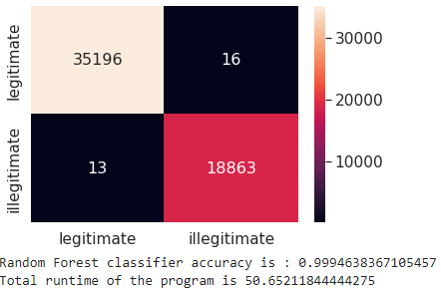
Result of Random Forest

Slide 29
Algorithms
Decision Tree
Decision trees use multiple algorithms to decide to split a node into two or more sub-nodes.
The creation of sub-nodes increases the homogeneity of resultant sub-nodes.
In other words, we can say that the purity of the node increases with respect to the target variable.

Slide 30
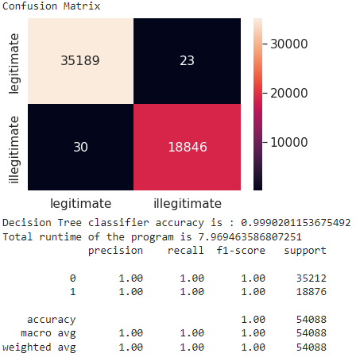
Result of Decision Tree

Slide 31
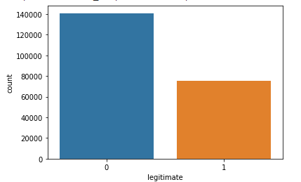
SCREENSHOTS

Slide 32
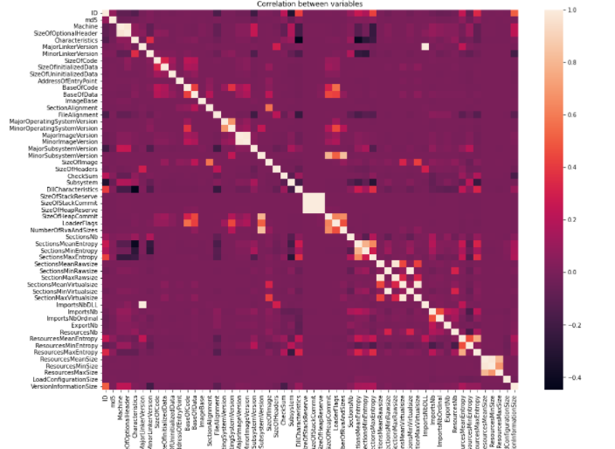
Correlation Between Variables

Slide 33
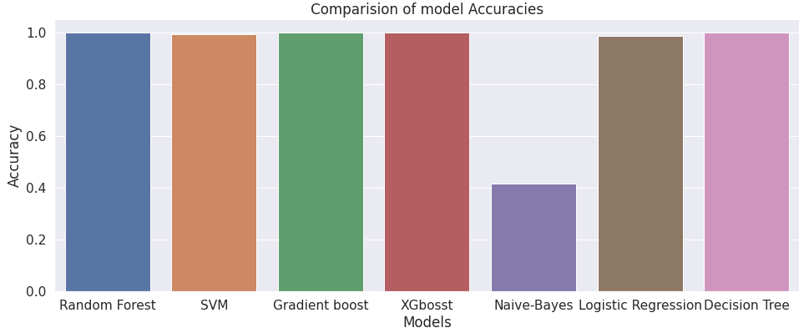
Comparison of Accuracies

Slide 34
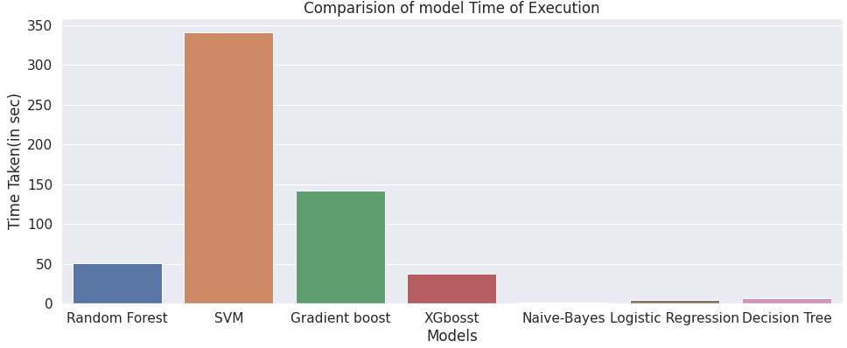
Comparison of Time of Execution

Slide 35
Conclusion
This project aims to improve CSC security by integrating CTI and ML for the threat analysis and prediction. We considered the necessary concepts from CSC and CTI and a systematic process to analyze and predicate the threat. The experimental results showed that accuracies of the LG, DT, and RF algorithms in Majority Voting and identified a list of predicated threats.

Slide 36
References
National Cyber Security Centre. (2018). Example of Supply Chain Attacks. [Online] Available: https://www.ncsc.gov.uk/collection/supplychain-security/supply-chain-attack-examples
A. Yeboah-Ofori and S. Islam, ‘‘Cyber security threat modelling for supply chain organizational environments,’’ MDPI. Future Internet, vol. 11, no. 3, p. 63, Mar. 2019. [Online]. Available: https://www.mdpi.com/1999- 5903/11/3/63
B. Woods and A. Bochman, ‘‘Supply chain in the software era,’’ in Scowcroft Center for Strategic and Security. Washington, DC, USA: Atlantic Council, May 2018.

Slide 37


