Slide 2
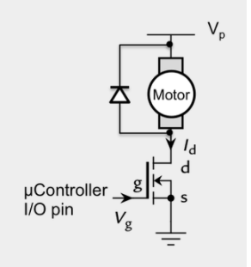
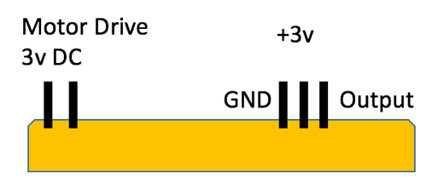
Stirring
Designed the circuit and code to fit the requirements – (500 – 3000 rpm)
Circuit research for similar task.
Research on driving high current motors and tested sub-circuits to ensure they worked.

Slide 3
Measuring RPM
We used an external library called Timer to measure the rpm calculations however as we loaded all subsystems one MSP we didn't have enough memory, so we had to adopt a new approach.
Attach-Interrupt() with rising edge to detect a half-rotation
Measuring the time interval between each rotation and doing. One minute / interval in microseconds

Slide 4
Controlling the Motor
The first thing that we did was to send a high signal from the output to see if it turns on the MOSFET therefore turning on the motor, and then a low signal to turn it off.
Encountered errors: Faulty breadboard, unsupportive software version.
If the actual rpm reading was below the required we incremented the PWM duty cycle by 1, that we sent to the MOSFET, hence increasing the revolutions and vice versa.

Slide 5
Testing
When the whole circuit was complete:
We used a tachymeter to measure the rpm.
Compared it with actual value.
Change the value from user interface and tested again.

