Slide 1
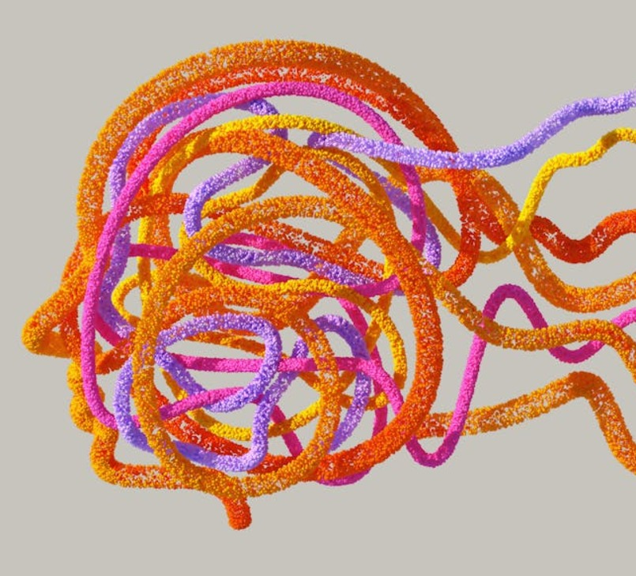

Face Attendance System
Team 8 DATE: April - 2025

Slide 2
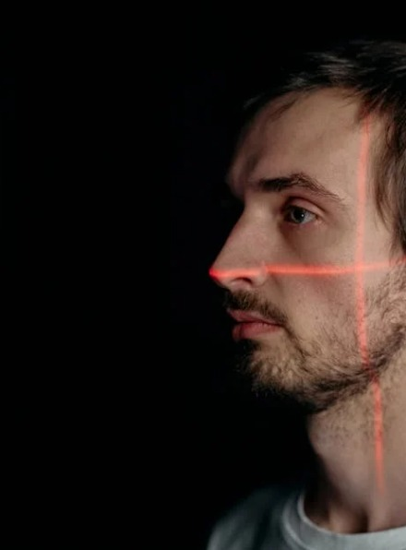

System Overview
Overview of System Functionality
The Face Attendance System revolutionizes how educational institutions track attendance. Utilizing advanced facial recognition technology, this system allows for instantaneous logging of student presence. It not only enhances accuracy but also streamlines information retrieval, saving time and reducing administrative burdens while ensuring comprehensive attendance records.

Slide 3

Dynamic Updates
Visual Representation
Attendance data is represented through intuitive visuals and graphics, making it easy to assess the attendance status at a glance for teachers and administrators.
Real-time Status Displays
Attendance figures are continuously updated to ensure real-time accuracy, allowing educators to track student presence instantaneously during lessons.

Slide 4


User Registration
Capture and Username Input
Users engage in a seamless registration process by utilizing their webcams for face capture. They simultaneously enter their chosen username, ensuring a personalized experience. Upon successful capture and submission of details, instantaneous feedback confirms successful registration, making it user-friendly and efficient, paving the way for quick access to the face attendance features.

Slide 5

Login Functionality
Face Recognition Login
The login functionality utilizes advanced face recognition technology. Registered users can easily access their accounts by having their faces scanned. If a match is found in the database, the user is authenticated, and a personalized welcome message greets them, enhancing user experience and efficiency in the attendance process.

Slide 6
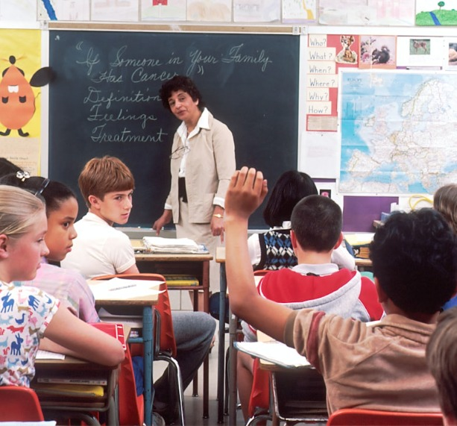


Webcam Integration
Webcam Usage
The application uses a webcam to facilitate user verification through image capture. During registration, users take photos that will be stored securely. For logging in, the webcam captures a live image for real-time matching, allowing an efficient and user-friendly approach to authentication. This system enhances security by using biometrics instead of traditional passwords.

Slide 7

Error Handling
Face Detection Errors
If the system fails to detect a face during login or registration, users receive immediate alerts, ensuring they understand the problem and can take corrective actions promptly.
Unrecognized Users
When users attempt to log in and their face is not recognized, the system provides clear feedback with a message to guide them, enhancing user experience and reducing frustration.

Slide 8

Attendance Logging
Creating Attendance Records
From login logs, comprehensive attendance records are generated, serving as valuable documentation for monitoring user engagement and managing attendance effectively.
Recording Logins
Every successful login is meticulously recorded in a log file, ensuring accurate tracking of user access times and enhancing security protocols for system integrity.

Slide 9
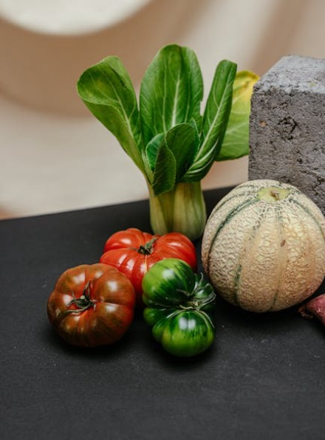

Image Classification on Distinct Food
• What is Image Classification?
A task where a model categorizes images based on visual features.
• Focus: Classifying fruits and vegetables using a trained deep learning model.
• Applications:
- Food Industry: Automating food recognition
- Healthcare: Assisting in medical imaging
- Automation: Smart systems for inventory or quality control

Slide 10

Building the Model with TensorFlow
• We used TensorFlow with Keras to build the classification model.
• Sequential Architecture:
- Convolutional layers detect important features like edges and textures
- Fully connected layers classify the image based on the extracted features
• TensorFlow provides the flexibility and power to design complex models efficiently

Slide 11
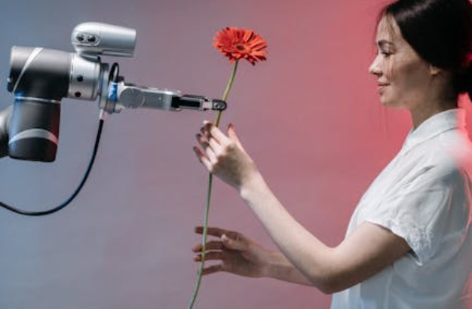
Data Preprocessing and Training
• Data Preprocessing:
- Images are resized and normalized for consistent input.
• Training Process:
- The dataset is split into training, validation, and testing sets.
• The model achieves 99.95% accuracy on fruit images, such as apples

Slide 12


Deploying the Model as a Web Application
• After training, the model is deployed as a web app.
• Users can upload images of fruits and vegetables for real-time classification.
• Web Application Features:
- Easy image upload
- Instant prediction of the food item (e.g., apple, banana)

Slide 13

Team Information
Umme Qulsum Afifa (ID: 011221582) Baijid Salah Monmoy (ID: 011221596)
Sultan Mahmud Shanto (ID: 011221558)

Slide 14

Thank You

