Slide 1
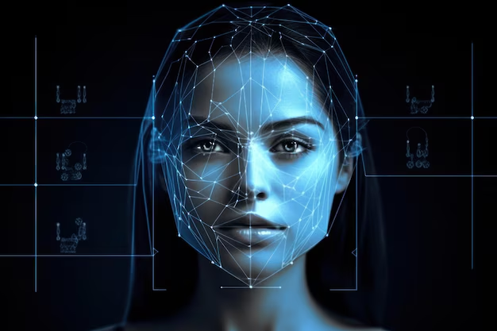
Face Recognition Using FaceNet-PyTorch

Slide 2
Introduction:
Face recognition identifies people by analyzing facial features in images
Widely used in biometrics, security, and surveillance
This project aims to implement face recognition using deep learning in Google Colab
Constraint: No OpenCV allowed
Solution: Use Facenet-pytorch for facial embedding, and scikit-learn for classification

Slide 3
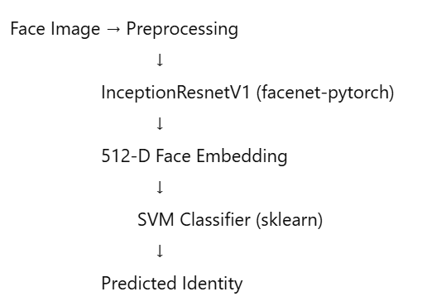
Face Embedding Model:
Model flow Diagram
Model Name: InceptionResnetV1
Library: Facenet-pytorch
Pretrained On: VGGFace2 dataset
Output: 512-dimensional vector representing facial features
Purpose: Converts each face image into a numerical feature vector that can be compared and classified
Classifier Model:
Type: Support Vector Machine (SVM)
Library: scikit-learn
Kernel: Linear
Purpose: Classifies embeddings into known identities

Slide 4
InceptionResnetV1
It was pretrained on the VGGFace2 dataset (a large celebrity face dataset) with the input of 160 x 160 photo size and output of 512-dimensional embedding vector(a compact numerical representation of the face)
SVM the 512-d embeddings were fed into SVM to learn boundaries between faces (e.g., Akshay vs Amitabh). SVM works well with high-dimensional data like embeddings.

Slide 5
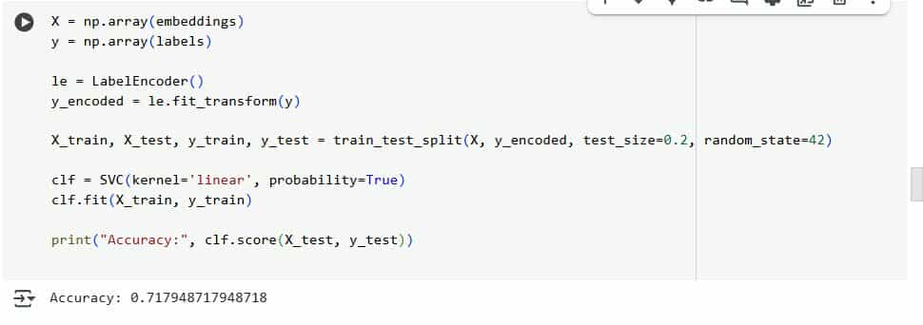
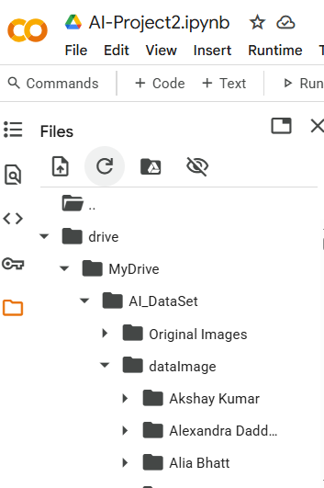
Data and Training
Training Procedure
Dataset Description
To maximize model performance, the data undergoes preprocessing and augmentation. Includes code snippets to illustrate the comprehensive training setup in FaceNet-PyTorch.
The dataset comprises numerous facial images sourced from Google Drive, ensuring a diverse representation of facial features for robust model training purposes.

Slide 6

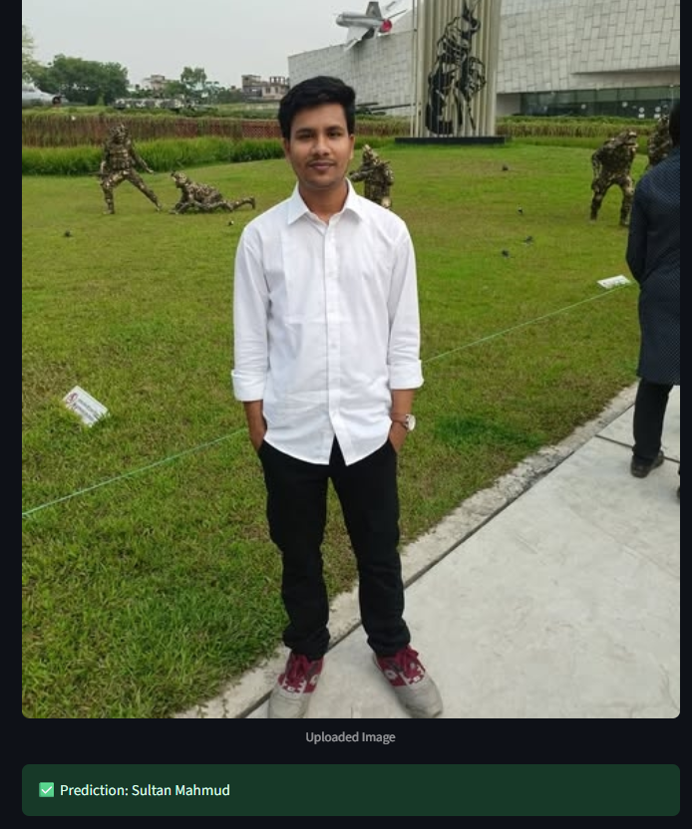
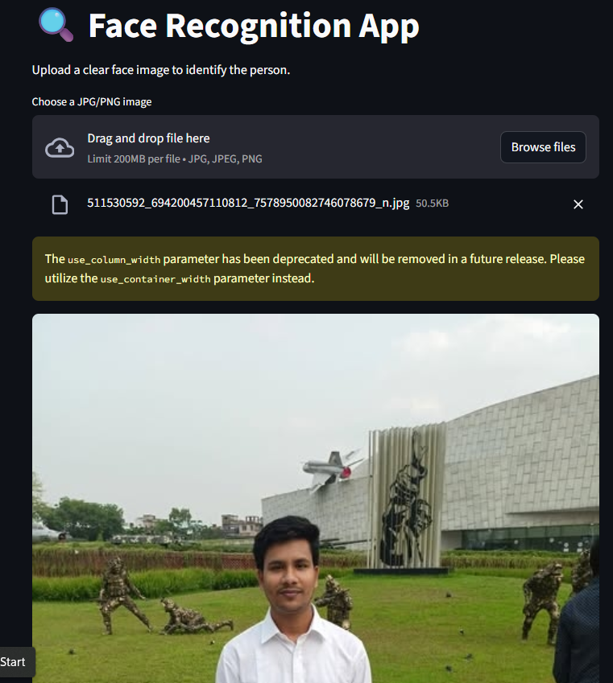

User Interface

Slide 7
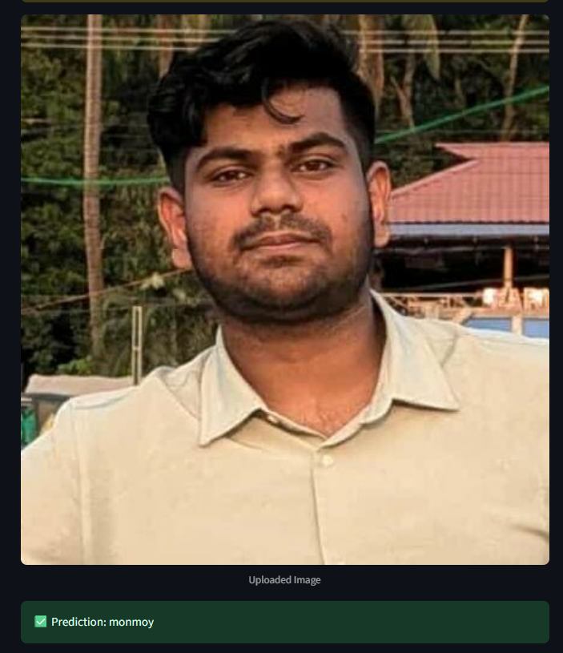

User Interface

Slide 8
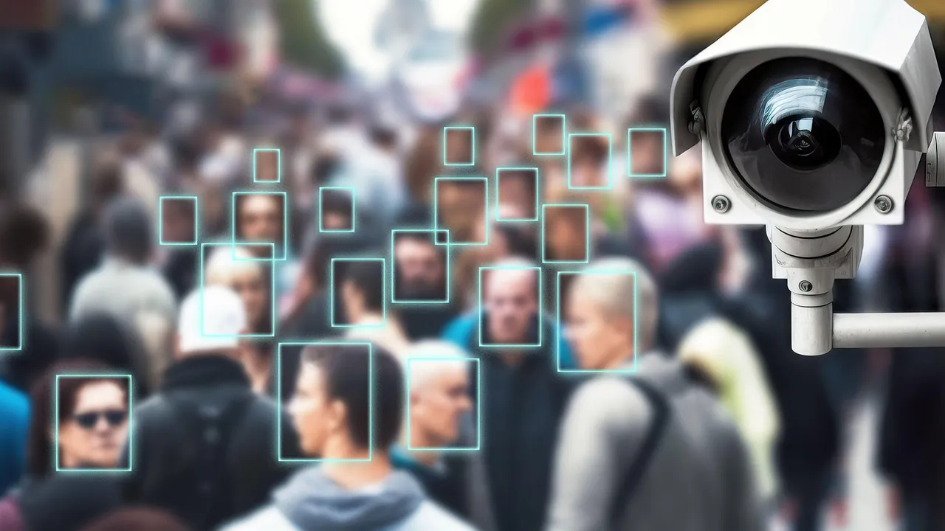
Future Directions
In the future, this project can be extended to support multiple face detection and recognition in a single image, allowing the system to identify and label several individuals at once. Additionally, implementing real-time face detection using a webcam can make the system more interactive and practical for applications such as live surveillance, classroom attendance, or event monitoring. These enhancements would require optimization for speed and accuracy while handling multiple faces dynamically.

Slide 9
Thank you

