Slide 1

ECO
E-Commerce Platform
A Full-Stack Spring Boot MVC Web Application
Spring Boot
Thymeleaf
MySQL
Razorpay
Session Auth
Built with Java • RESTful Controllers • Paginated Catalog • Integrated Payments

Slide 2
PROJECT OVERVIEW
5+
3
6
100%
Controllers
User Roles
Items / Page
Session Secured
What is ECO?
ECO is a full-featured online shopping platform built with Spring Boot MVC. It supports two distinct roles — Admin and User — each with dedicated dashboards, authentication flows, and capabilities.
Product catalog with pagination (6 products/page)
Secure session-based login for both Admin & User
Shopping cart with real-time stock management
Razorpay payment gateway integration + email confirmation

Slide 3
SYSTEM ARCHITECTURE
Browser / Client
Controllers
Thymeleaf Templates
ProductController
CRUD, pagination, image upload
Controller Layer
Spring MVC @Controller
AdminController
Registration & login
Service Layer
UserController
Business Logic
Registration, login, logout
CartController
Repository Layer
Add/remove, stock sync
JPA / Spring Data
PaymentController
MySQL Database
Razorpay checkout & orders
Persistent Storage
MailController
Email notifications

Slide 4
ADMIN FEATURES
Product Management
Inventory Control
Add new products with image upload
Add stock (+1 per click)
Edit existing product details
Real-time quantity tracking
Delete products from catalog
Out-of-stock prevention
Auto-timestamp image naming
Stock sync with cart orders
Dashboard & Security
Order Management
Paginated product grid (6/page)
View all customer orders
Session-based admin auth
Track order status
Cache-control headers
Payment verification
Redirect-on-unauthorized
Customer contact info

Slide 5
USER EXPERIENCE & CART FLOW
Register / Login
Browse Catalog
Add to Cart
Checkout
Payment
Confirmation
Cart Intelligence
🛒 Smart Cart
📦 Stock Guard
Detects duplicate products and increments qty automatically
Blocks add-to-cart when quantity is 0; redirects with error
🔄 Live Sync
🗑️ Easy Remove
Reduces product inventory on every add-to-cart action
One-click item removal with instant cart refresh

Slide 6
PAYMENT & NOTIFICATIONS
💳 Razorpay Integration
✉️ Email Notifications
Dynamic order creation via Razorpay API
Automated email confirmation sent to the customer's registered address immediately after successful payment using a dedicated EmailService.
Amount passed in paise (total × 100)
Unique receipt ID per transaction
Test mode with rzp_test credentials
User phone & email passed to payment page
🔒 Session Security
Success handler saves Order to DB
Session invalidation on logout
Payment status stored as 'SUCCESS'
JSESSIONID cookie cleared
Cache-control headers on all routes
Role-based route protection

Slide 7
TECHNOLOGY STACK
Backend
Web Layer
View Layer
Persistence
Spring Boot
Spring MVC
Thymeleaf
Spring Data JPA
Auto-config, embedded Tomcat
@Controller, @GetMapping, @PostMapping
Server-side HTML template engine
Pageable queries, CRUD repositories
Database
Payments
Email
Build Tool
MySQL
Razorpay SDK
JavaMail
Maven
Relational data, product & order storage
Order creation & payment processing
SMTP-based transactional email
Dependency management & build

Slide 8
🖥️
Live Project
Screenshots
See the actual running application — all pages built and tested
Home
Auth
Admin
User
Cart
Payment
Orders
10 pages • Spring Boot MVC • localhost:8081

Slide 9
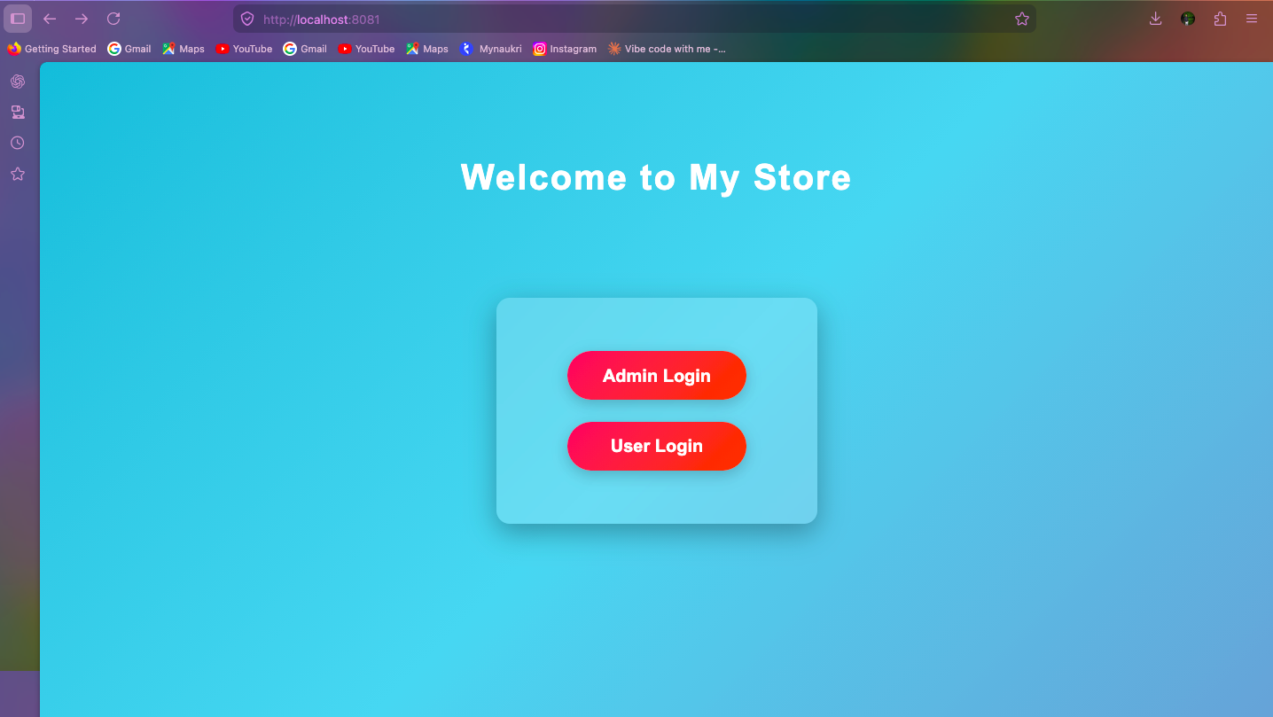
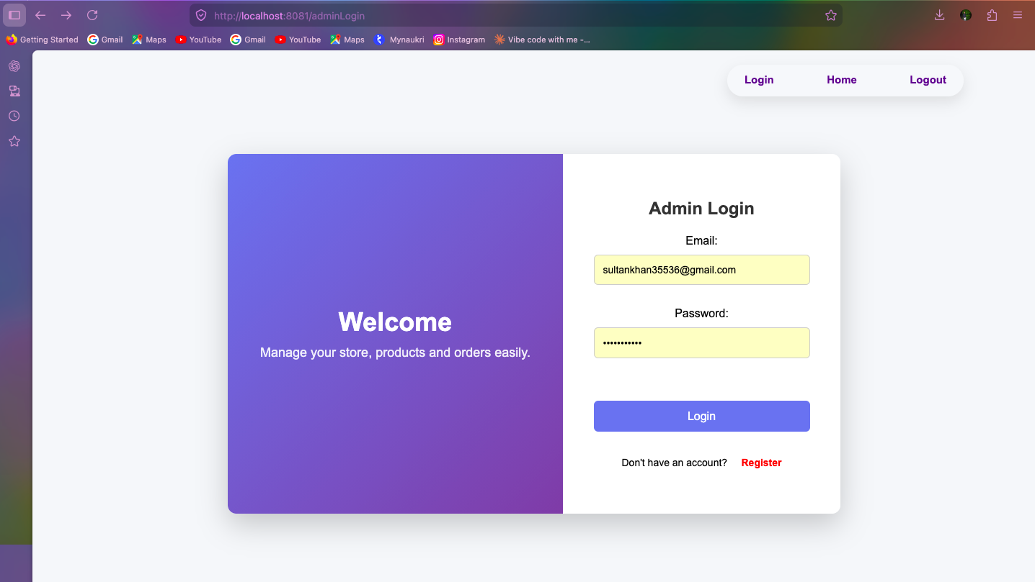
HOME & ADMIN LOGIN
🏠 Home Page — Role Selection
🔐 Admin Login — Secure Auth
Entry point with Admin Login & User Login buttons
Session-based authentication with credential validation

Slide 10
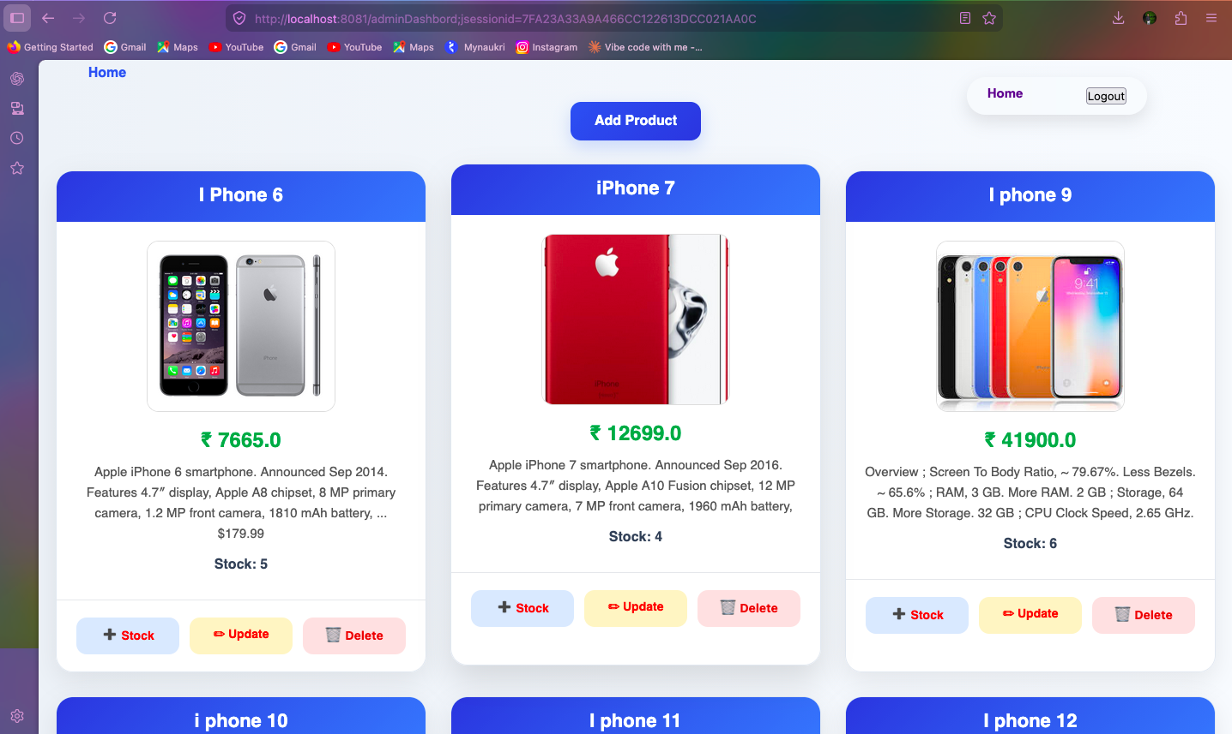
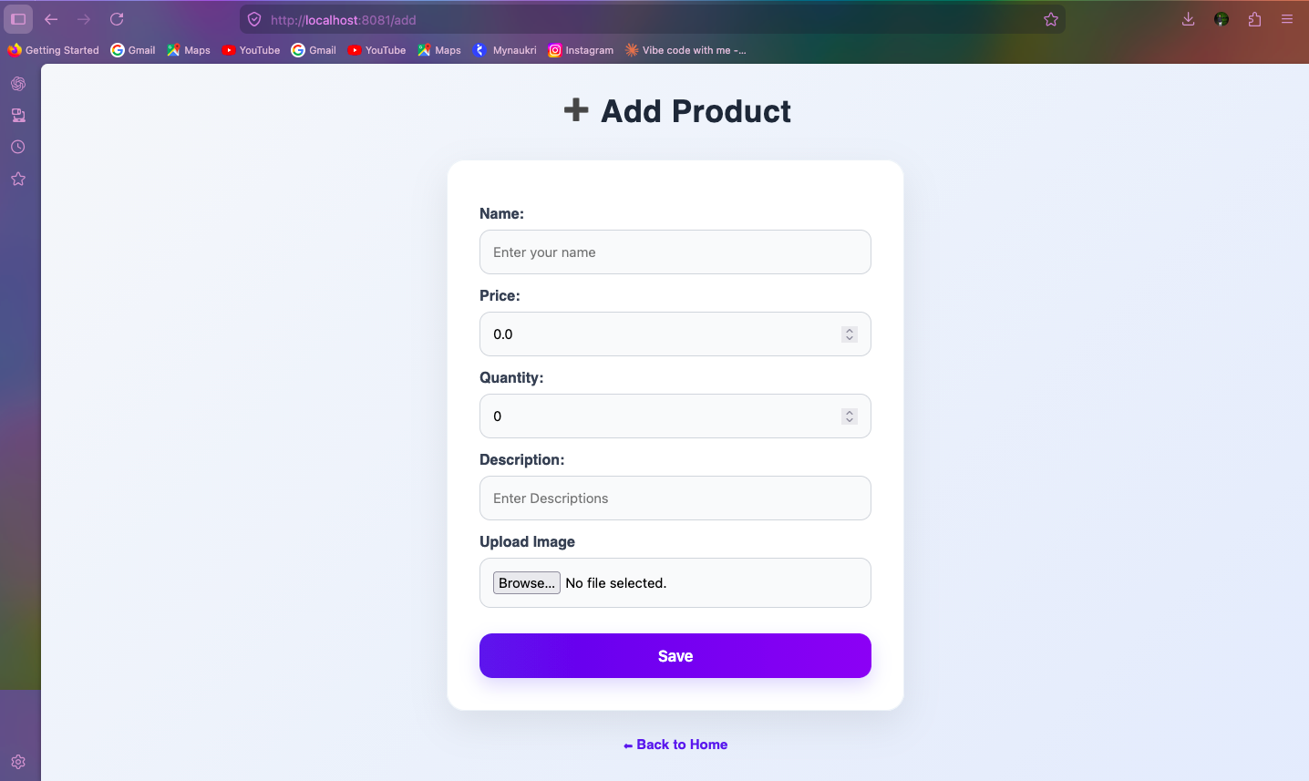
ADMIN DASHBOARD & PRODUCT MANAGEMENT
📊 Admin Dashboard — Product Grid
➕ Add Product — Form with Image Upload
Stock • Update • Delete controls for each product
Name, Price, Quantity, Description & image file

Slide 11
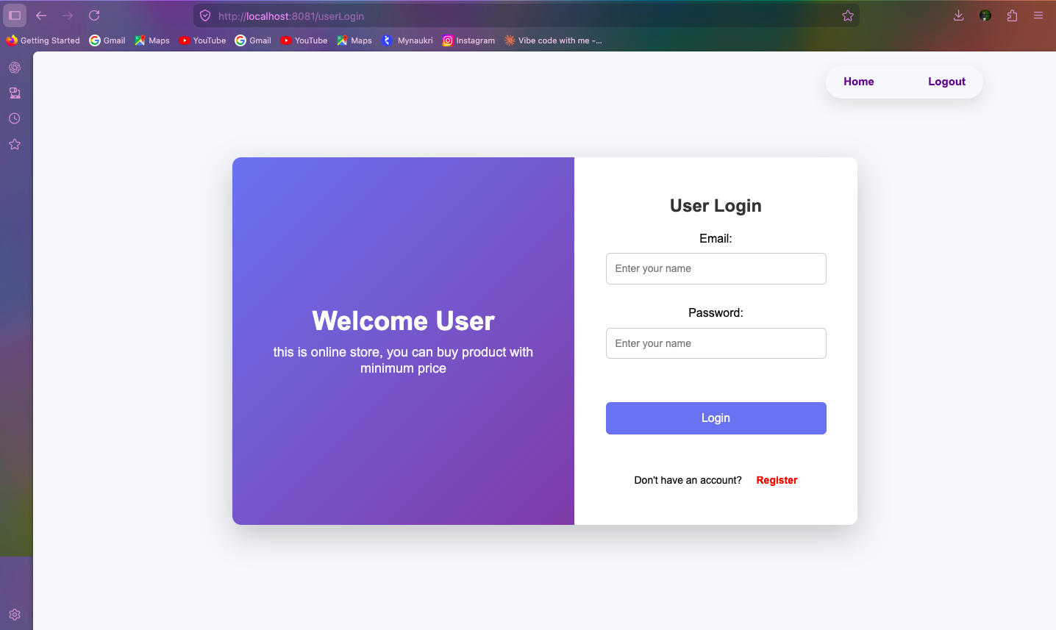
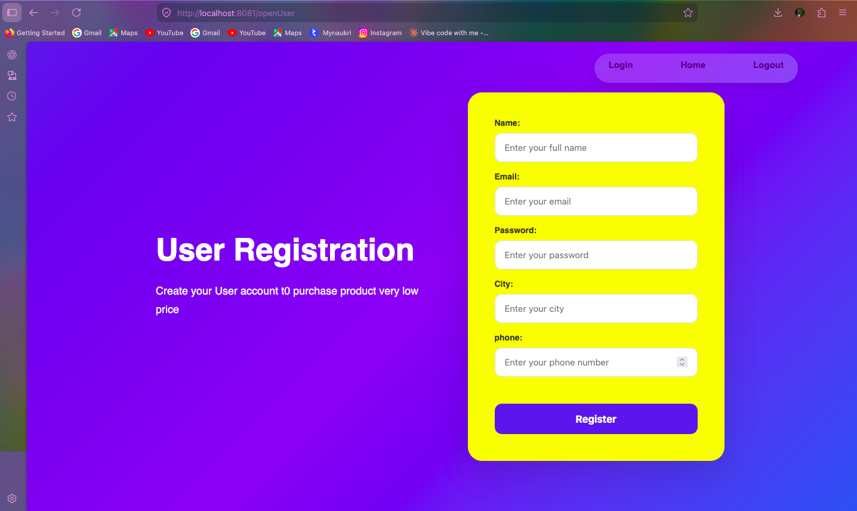
USER LOGIN & REGISTRATION
👤 User Login Page
📝 User Registration Form
Email + Password login with session creation
Name, Email, Password, City & Phone fields

Slide 12
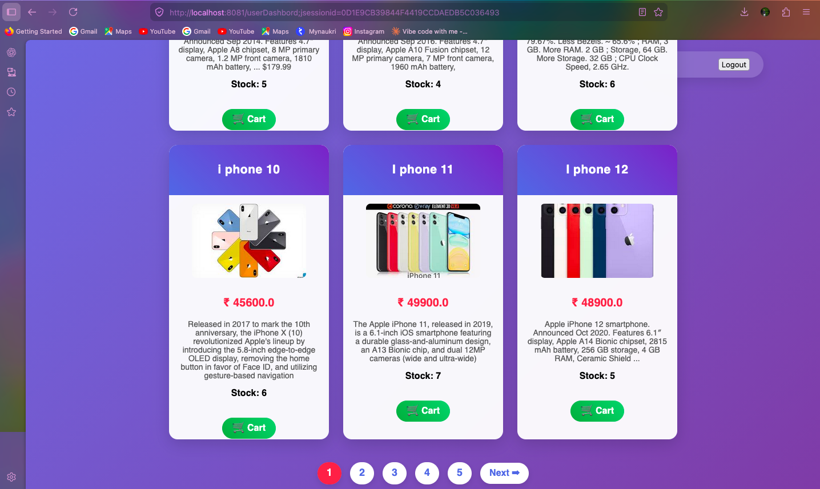
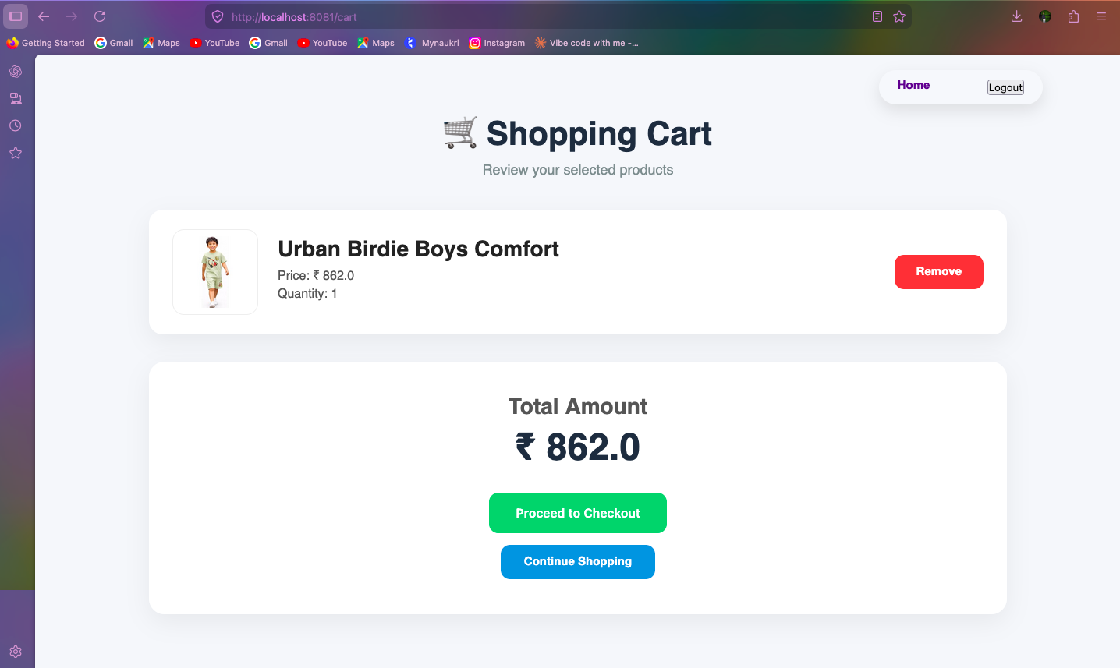
USER DASHBOARD & SHOPPING CART
🛍️ User Dashboard — Product Catalog
🛒 Shopping Cart — Review & Checkout
Paginated catalog with Add to Cart & stock display
Product items, qty, total amount & checkout button

Slide 13
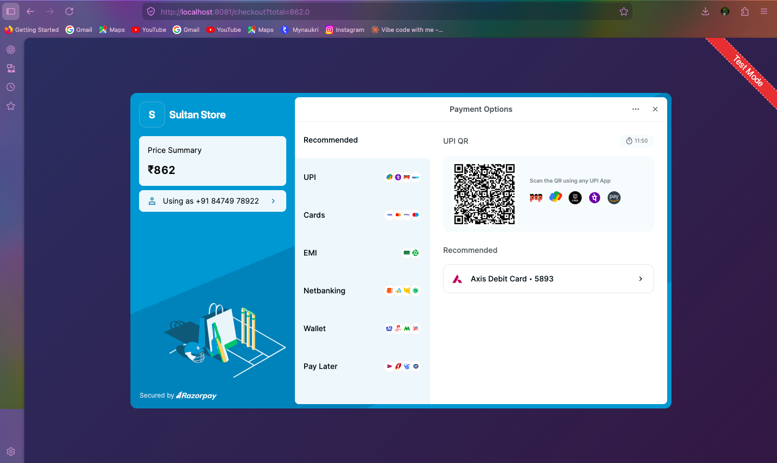
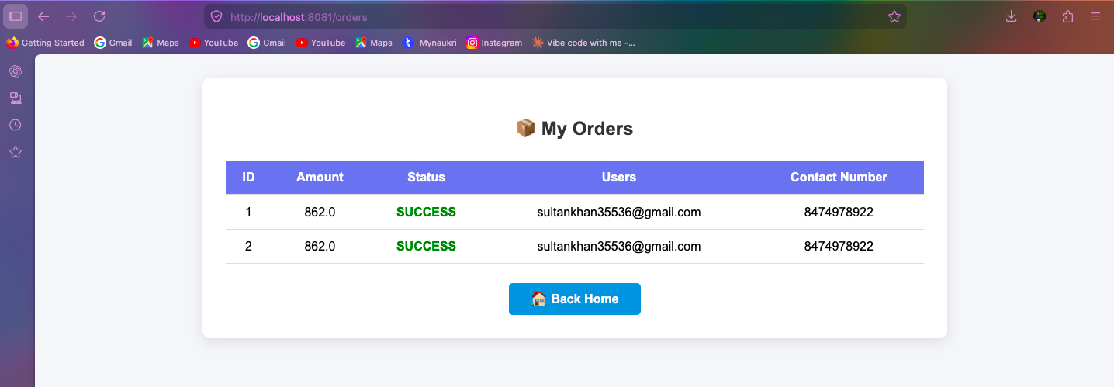
RAZORPAY PAYMENT & ORDERS
💳 Razorpay — Payment Gateway
📦 My Orders — Order History
UPI, Cards, EMI, Netbanking, Wallets & Pay Later
Order ID, Amount, Status, Email & Contact details

Slide 14
🌿
ECO Platform
is Production-Ready
✅ Secure Auth
✅ Real Payments
✅ Email Alerts
✅ Paginated UI
✅ Stock Control
Spring Boot MVC • Thymeleaf • MySQL • Razorpay • JavaMail

