Slide 1
Capstone 2
Sultana Rafique

Slide 2
A list of components in the architecture:
a) Technical Skills:
i) Python 3.7 - programming language
ii) Flask - Framework
iii) HTML - To structure web page
iv) CSS - To Style web page
b) DevOps Tools:
i) Virtual Machine with Ubuntu server - to deploy application
ii) Git/Git Hub - Source Control Management

Slide 3
A list of components in the architecture:
iii) Jenkins - Integration tool
iv) Docker/ DockerHub - For Containerization
v) Terraform - IaC tool
vi) Kubernetes - (Minikube) Container Orchestration
vii) ELK (ElasticSearch, Logstash, Kibana, metricbeat) - Monitoring Tool

Slide 4
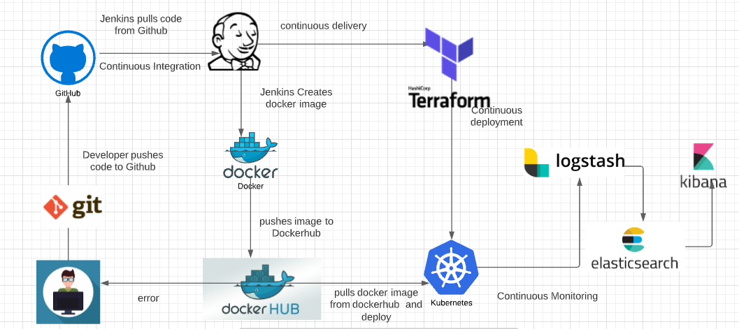
Architecture Design:

Slide 5
Dockerfile:
FROM python:3.7
RUN mkdir /app
WORKDIR /app/
ADD . /app/
RUN pip install -r requirements.txt
CMD ["python", "/app/app.py"]

Slide 6
Requirement File:
flask

Slide 7
Jenkinsfile:
pipeline {
agent any
stages {
stage('Docker Build') {
steps {
sh 'docker build -t srafique001/capstone2:latest .'
}
}
stage('Docker Login') {
steps {
withCredentials([usernamePassword(credentialsId: 'dockerHub', passwordVariable: 'dockerHubPassword', usernameVariable: 'dockerHubUser')]) {
sh "docker login -u ${env.dockerHubUser} -p ${env.dockerHubPassword}"
}
}
}

Slide 8
stage('Docker Push') {
steps {
sh 'docker push srafique001/capstone2:latest'
}
}
stage('Testing') {
steps {
echo 'Testing....'
}
}
stage('Deploying') {
steps {
sh ' cd /home/sultana/learn-terraform-deploy-nginx-kubernetes && terraform apply -auto-approve -lock=false'
}
}
}
}

Slide 9
Challenges:
Set up all environment in local, but was having access denied issues, so had to move to virtual machine on ubuntu server.
I was having difficulties integrating Jenkins with ubuntu server, access issue, permission denied, added user to group.
.tfstate file was not accessible so added -lock= false to command.

Slide 10
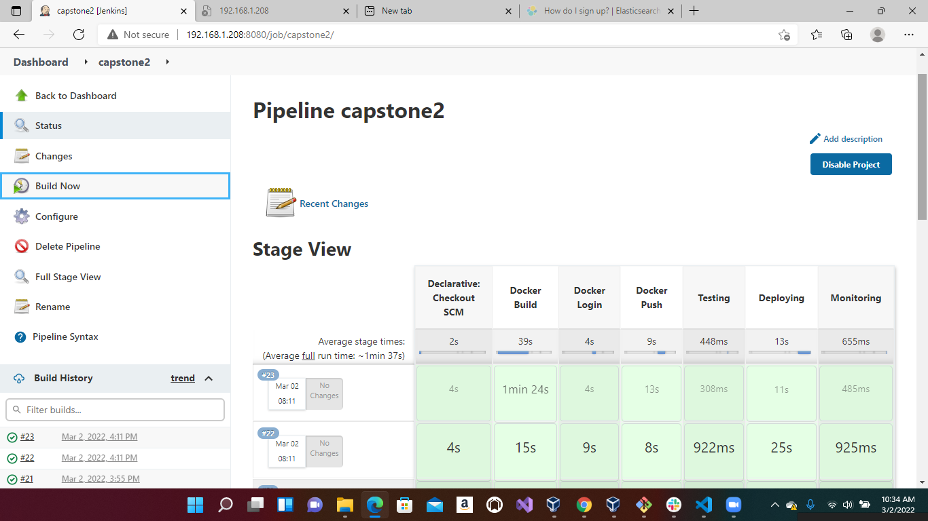
Pipeline

Slide 11
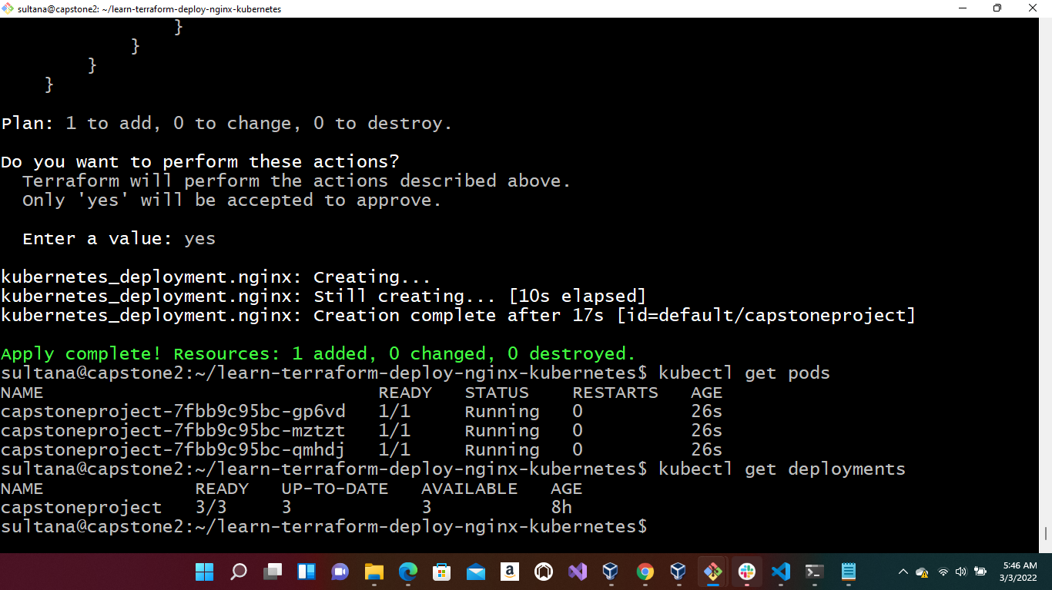
Deployment:

Slide 12
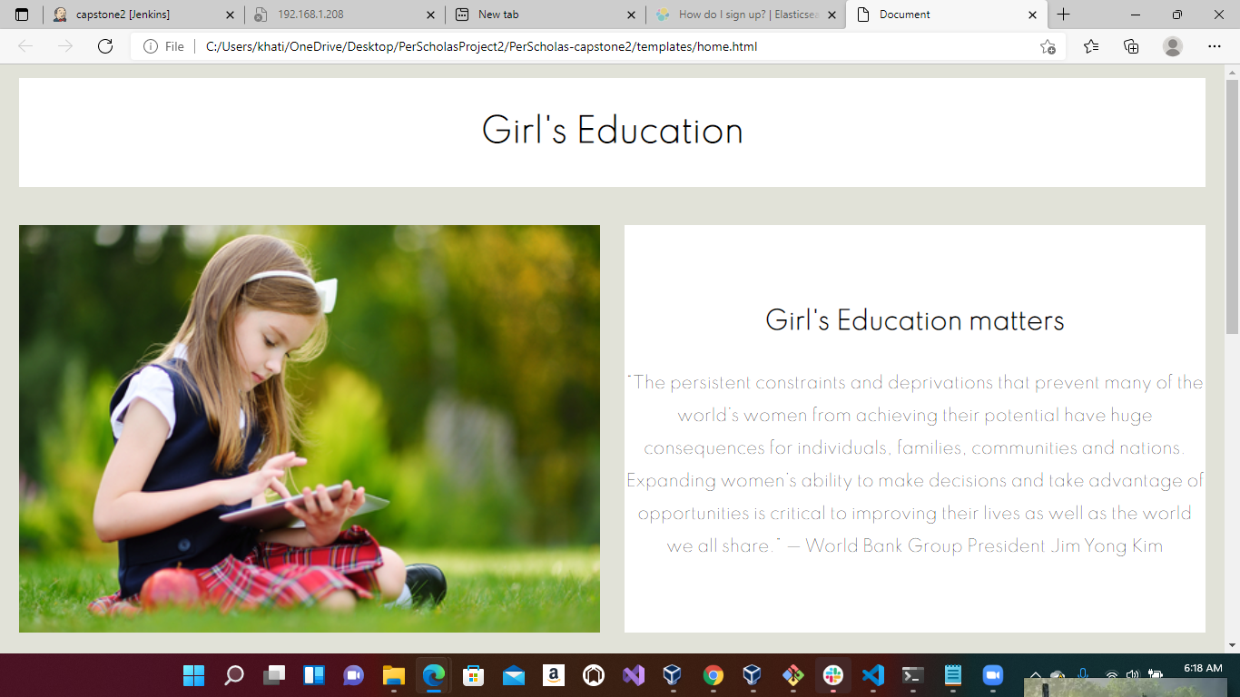
Webpage:

Slide 13
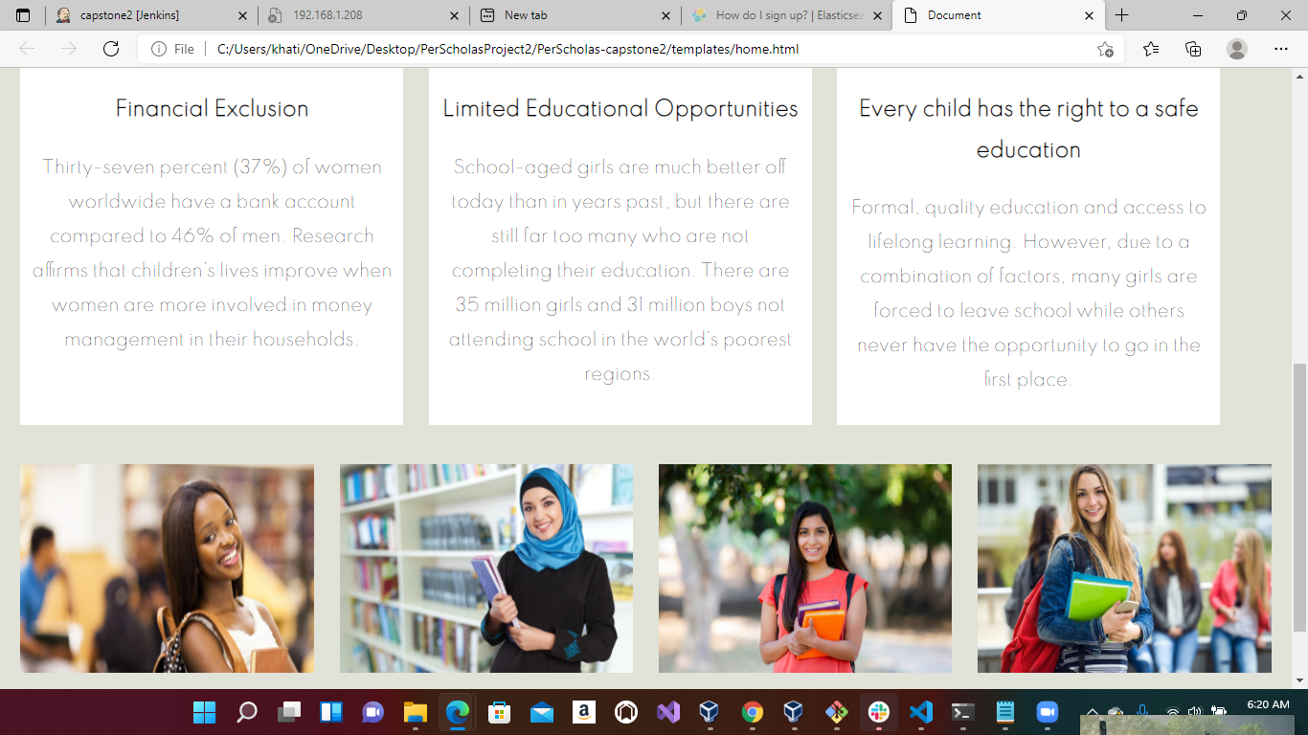

Slide 14
Thank you

