Slide 1
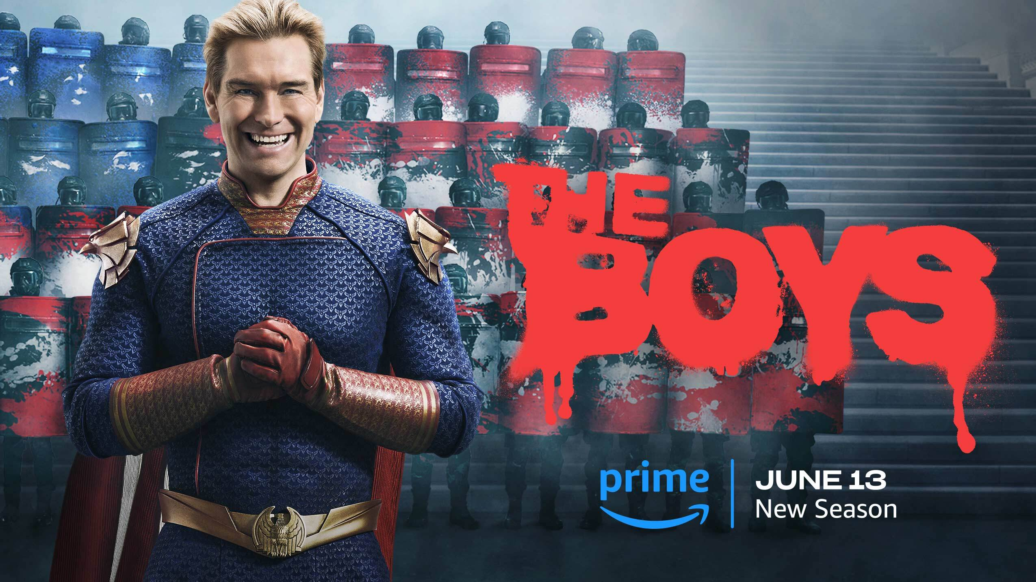

Slide 2
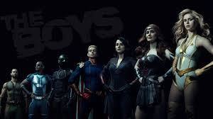
The Boys is a dystopian view of a world where superheroes, while wielding enormous power and popularity, are not idealized protectors of humanity, but corrupt and morally dubious individuals. The main idea of ​​the series is to show that power is irresponsible when it is not controlled by society.

Slide 3
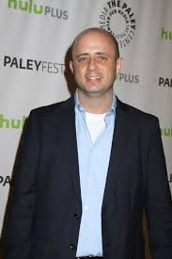
CREW
Producers:
Seth Rogen and Evan Goldberg
Main Writing Team:
Includes Eric Kripke, Rebecca Sonnenshine, Craig Rosenberg, Anne Cofell Saunders
Directors:
Among the directors of the episodes are Phil Sgriccia, Fred Toye, Dan Trachtenberg, Stefan Schwartz, Sarah Boyd, Alex Graves, and others.
Showrunner:
Eric Kripke

Slide 4


Slide 5
Primetime Emmy Awards:
2021: Nominated for Outstanding Drama Series — a major recognition for the show’s quality and impact.
2021: Won Outstanding Sound Editing for a Comedy or Drama Series (1 Hour) for the episode "What I Know".
Critics' Choice Super Awards (2021):
Best Superhero Series.
Best Actor in a Superhero Series — Antony Starr (for his portrayal of Homelander).
Best Villain in a Series — Antony Starr (Homelander).
Saturn Awards:
2021: Won Best Television Presentation (Streaming) for Season 2.
Hollywood Critics Association TV Awards (2021):
Won Best Streaming Series, Drama.
Antony Starr also won for Best Actor in a Streaming Series, Drama.
Nominations:
Golden Globe Awards:
The series was nominated for Best Television Series – Drama in 2021.
Screen Actors Guild Awards:
Nominated for Outstanding Performance by a Stunt Ensemble in a Comedy or Drama Series.
People's Choice Awards:
Nominated for Favorite Sci-Fi/Fantasy Show

Slide 6
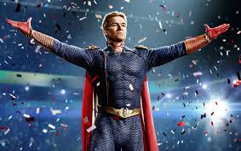
Thank you for attention

