Slide 1

Group 6 Maze Game
Contributor:
Besmillah Sultani
Caleb Presto
Jason Mock
Rahim Mirzada

Slide 2
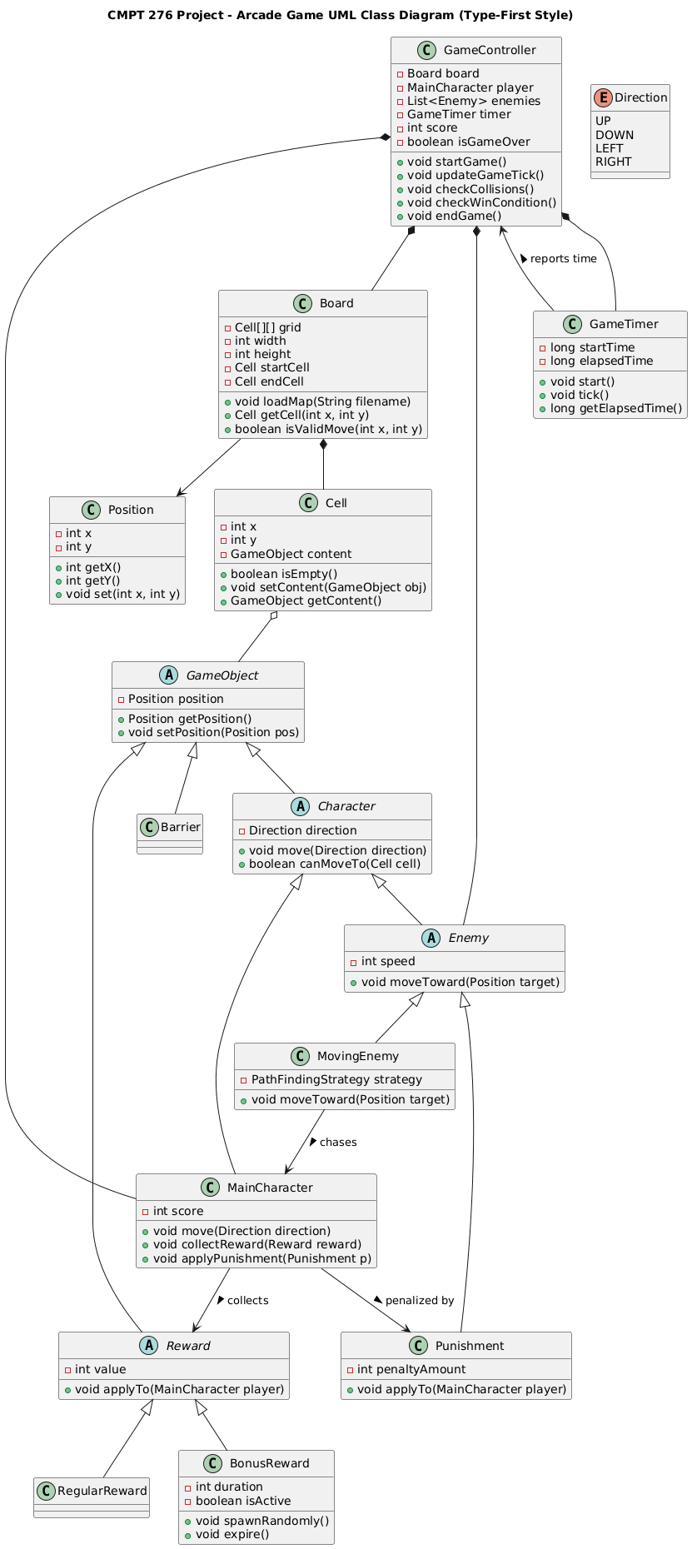
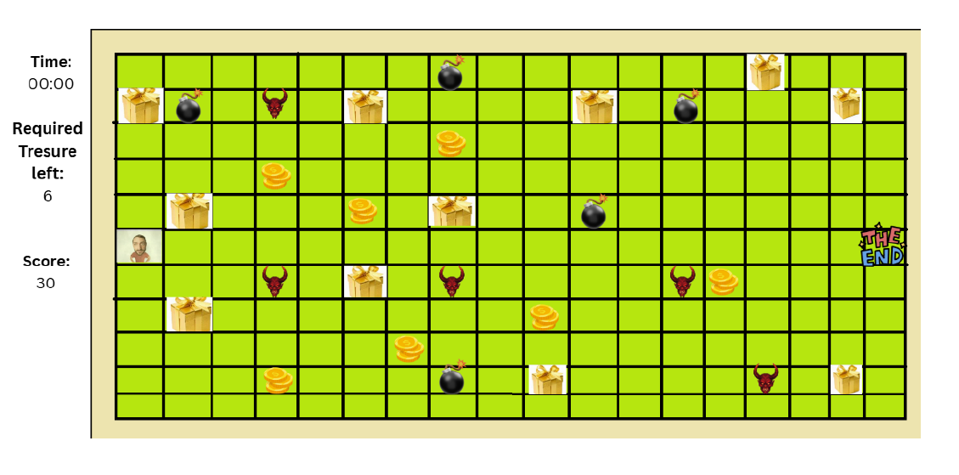
Initial UML/GUI

Slide 3

Challenging Part
Communication
Agreement on Console/GUI

Slide 4
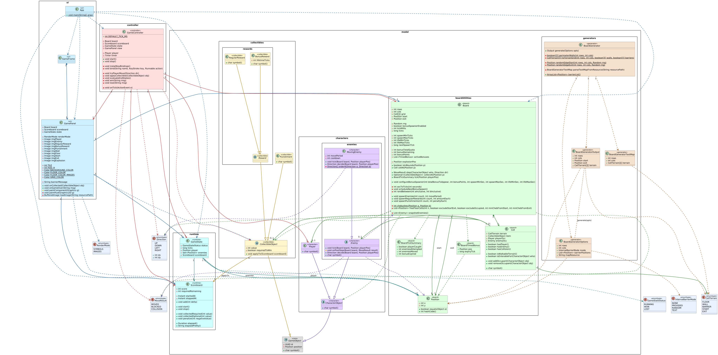
Refactored UML
Scalability and Flexibility
Game Controls
Random Punishment / Enemy / Barrier placements

Slide 6
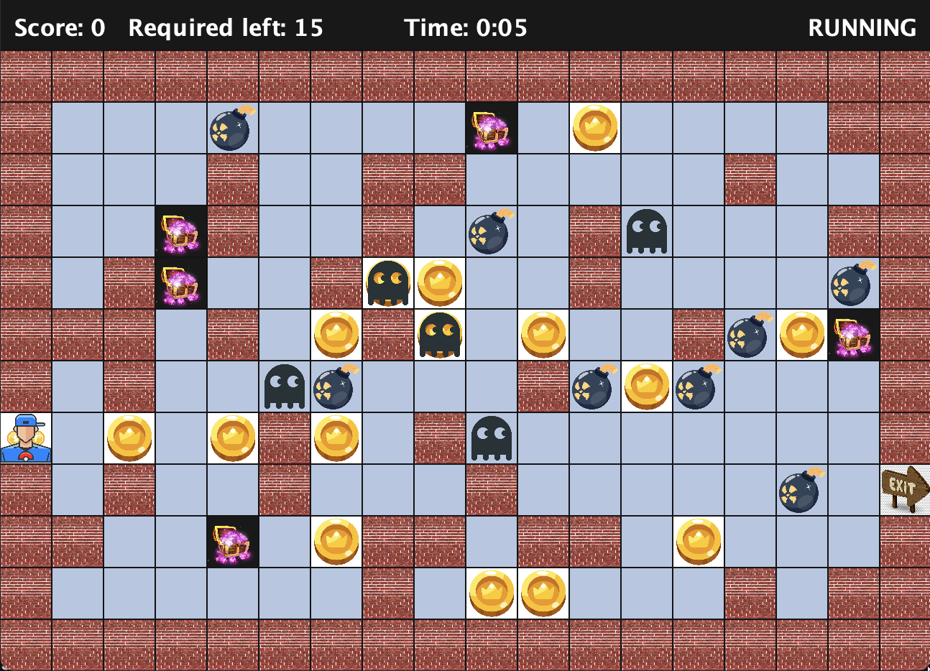
Final GUI: 12 x 18

Slide 7
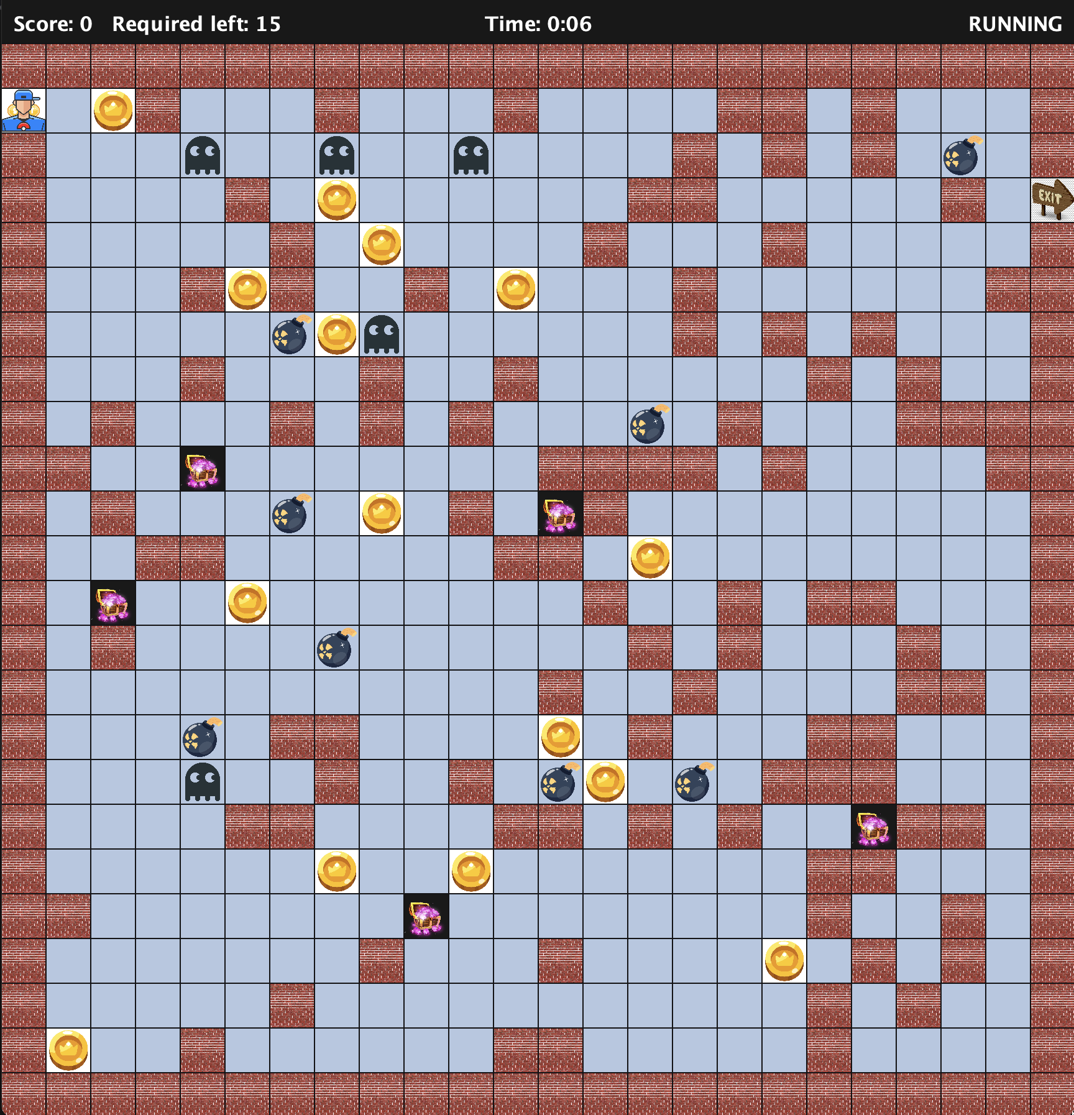
Final GUI

Slide 8
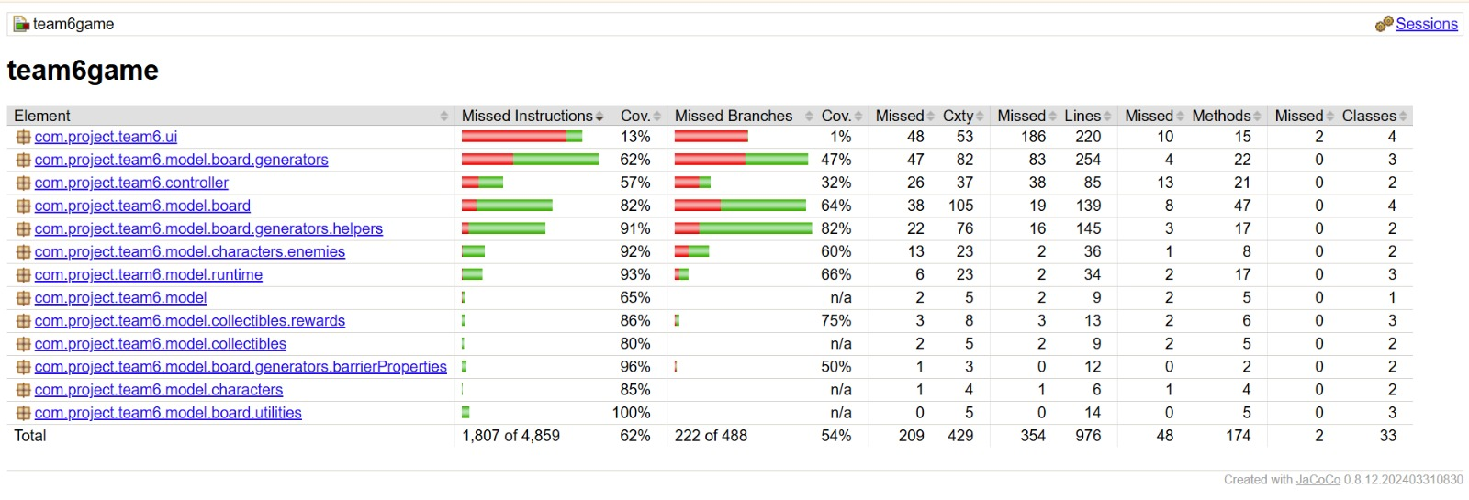
Testing
⁠Game grew more complex as we added features
Manual playtesting was not enough to catch every issue
We built automated tests for quick checks with one command
Key bug found: some maps had no valid path to the exit
We fixed the map generation and added a test to guarantee a path exists
⁠Total: 34 tests
Covers movement, items and score, timer, and win or lose rules
Coverage report: green = tested, red = not yet tested
Core game logic is mostly covered; UI is mainly checked by playing

