Slide 1

Comprehensive Analysis of U.S. Airline Flight Delays, Cancellations, and Operational Performance
SULTHAN N
AF05102984
ANP-D4856

Slide 2
Project Overview
• Analyze airline operational performance
• Identify patterns in flight delays and cancellations
• Understand major causes of delays
• Provide insights to improve airline efficiency

Slide 3
Dataset Description
Dataset includes:
• Total Flights
• Delayed Flights
• Cancelled Flights
• Airlines and Airports
• Delay Causes
• Month and Year information

Slide 4
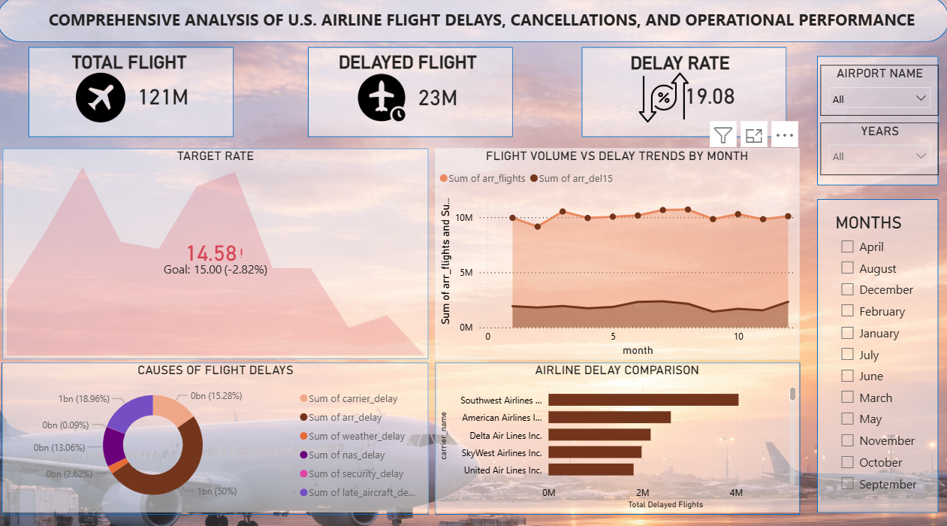
Flight Delay Analysis Dashboard

Slide 5
Delay Dashboard Insights
• Shows total flights and delayed flights
• Displays delay rate compared with target
• Monthly delay trend identifies seasonal patterns
• Airline comparison highlights airlines with more delays
• Delay causes visualization explains operational issues

Slide 6
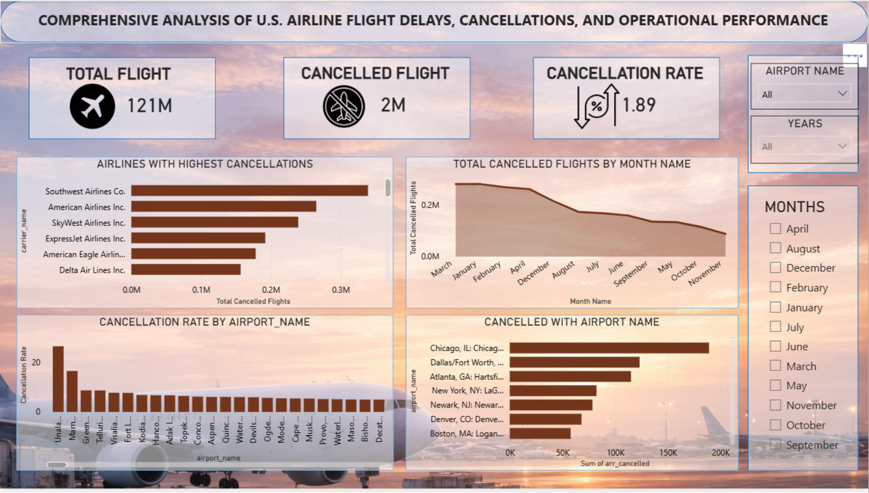
Flight Cancellation Analysis Dashboard

Slide 7
Cancellation Dashboard Insights
• Displays total cancelled flights and cancellation rate
• Shows airlines with highest cancellations
• Monthly cancellation trend analysis
• Airport level cancellation comparison

Slide 8
Key Insights
• Certain airlines experience higher delays and cancellations
• Seasonal patterns affect flight operations
• Major delays are caused by carrier and late aircraft issues
• Airport analysis helps identify operational bottlenecks

Slide 9
Conclusion
This Power BI dashboard provides insights into airline operational performance.
It helps identify delay patterns, cancellation trends, and improvement opportunities.

