Slide 1

Load the newest version

Slide 2
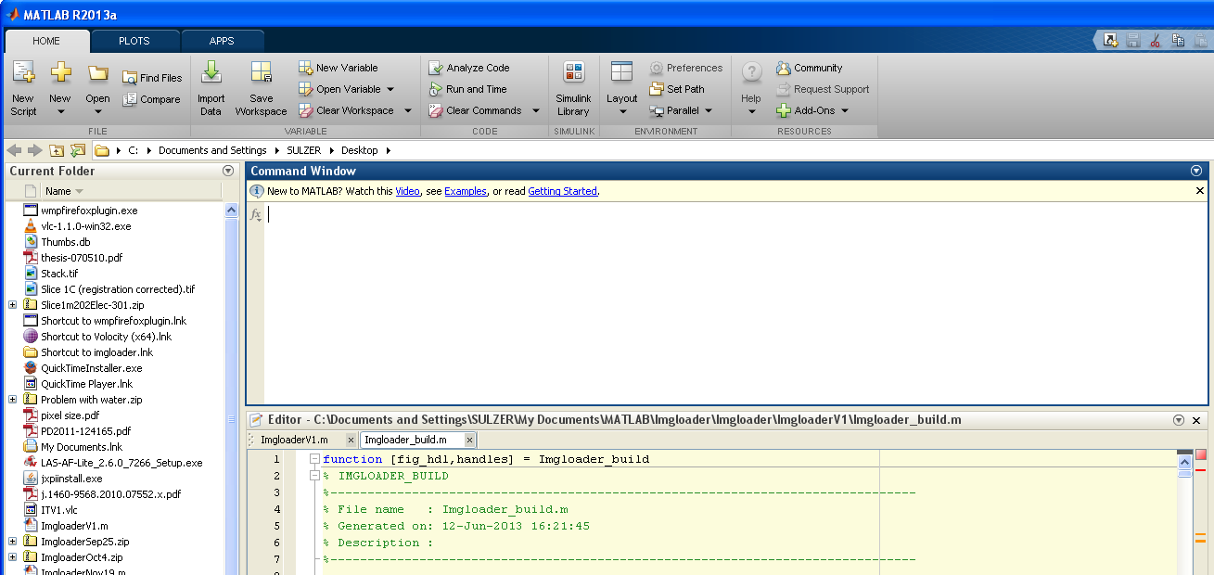
If other files are open, click on the tab for ImgloaderV1.m

Slide 3
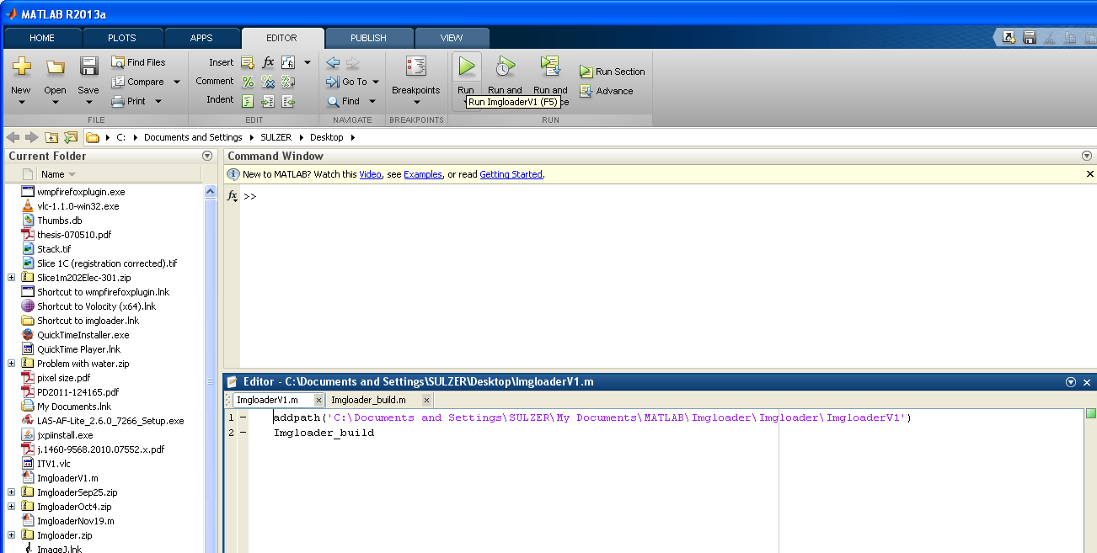
Run the ImgloaderV1.m file

Slide 4
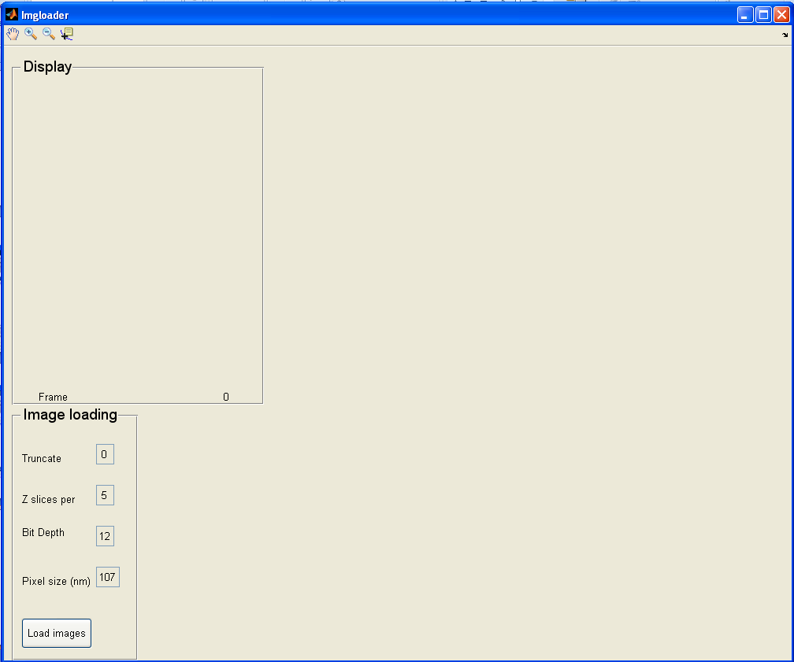
Do you need to load fewer than the total images in your image series? Specify how many to chop off at the end
This parameter will be helpful for locating puncta
After setting parameters, click here

Slide 5
Do you need to load fewer than the total images in your image series? Specify how many to chop off at the end
This parameter will be helpful for locating puncta
After setting parameters, click here

Slide 6
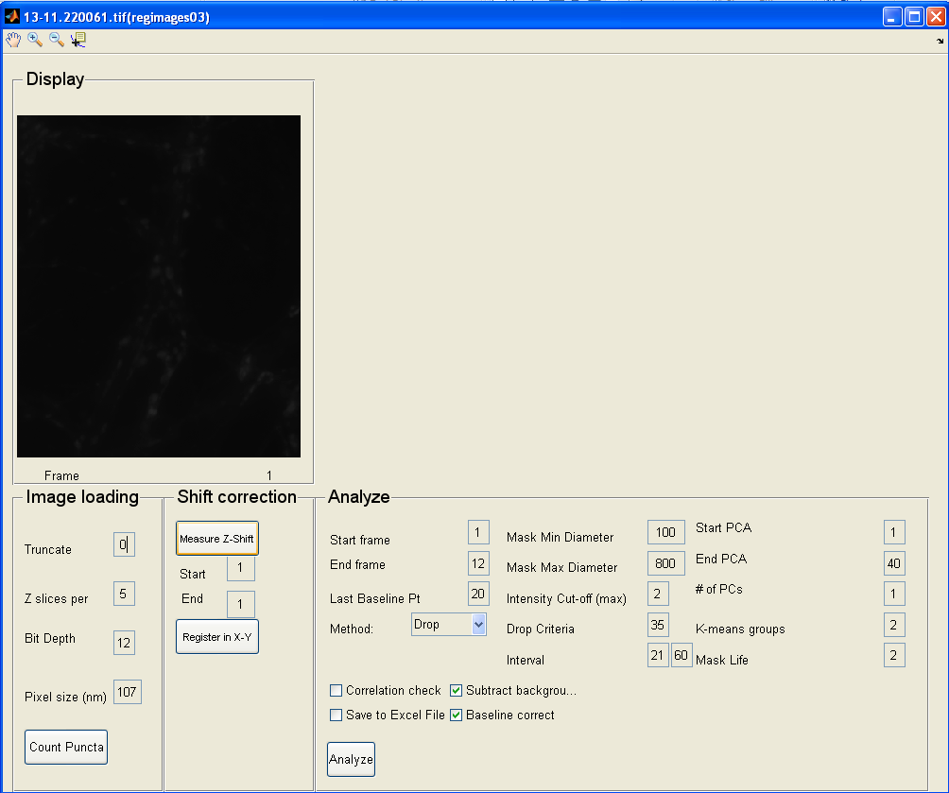
If the image is too dim, consider decreasing the bit depth
You’ll need to close the program and re-start

Slide 7
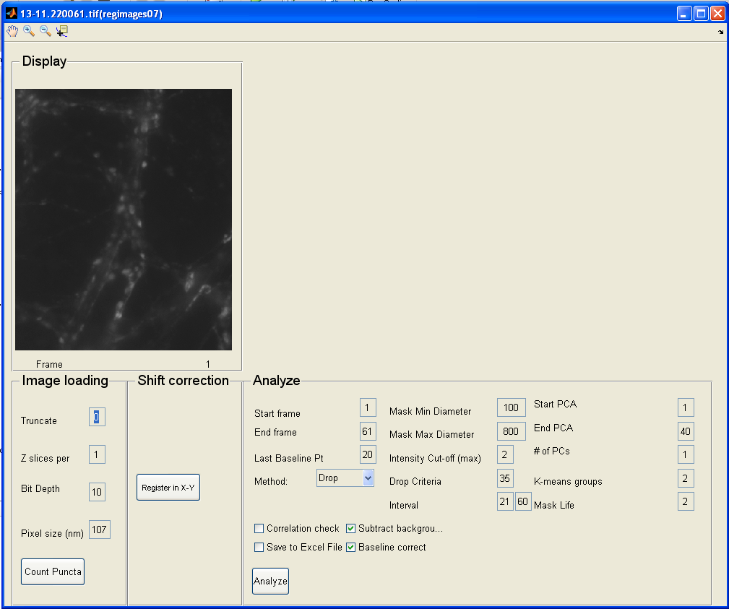
You must register your image. Even if it’s already registered. It’s harmless.

Slide 8
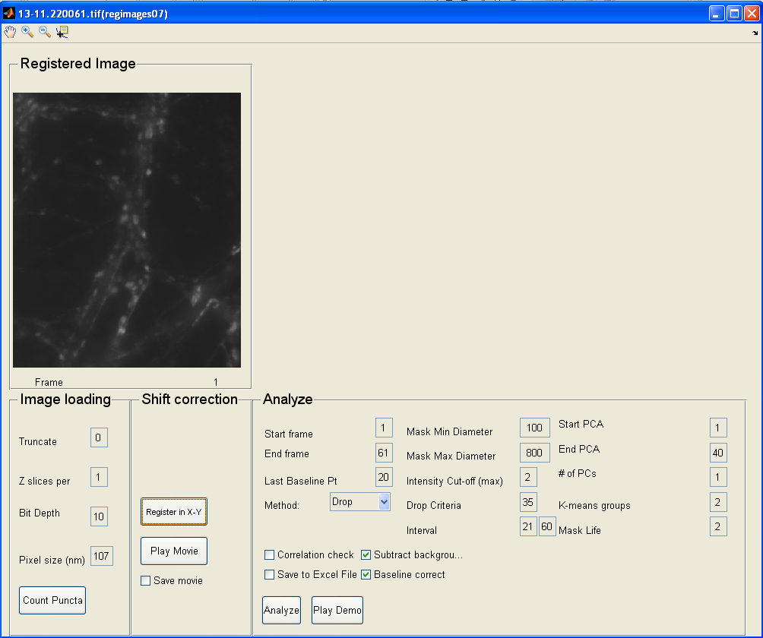
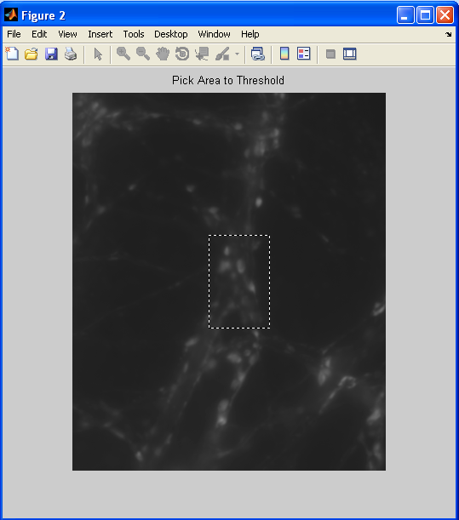
Once registered, you can try out the thresholding quality by clicking here
Hold down the right mouse button and drag over an area to see how it will be selected

Slide 9
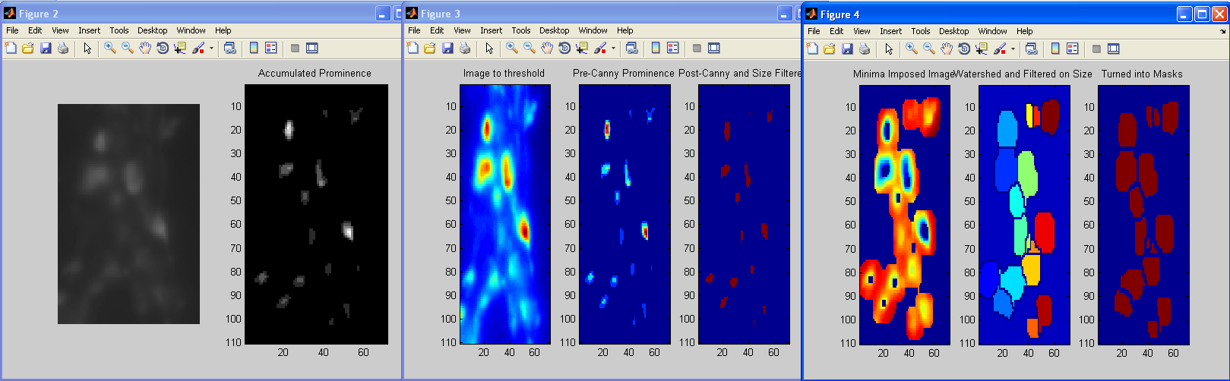
Prominence: How many gray levels does each puncta (within the size constraints) occupy

Slide 10
These are the puncta that are chosen as the “centers” of your selection

Slide 11
The centers are then expanded into a mask around the puncta without overlapping with other puncta’s masks

Slide 12
Finally, these are the masks chosen

Slide 13
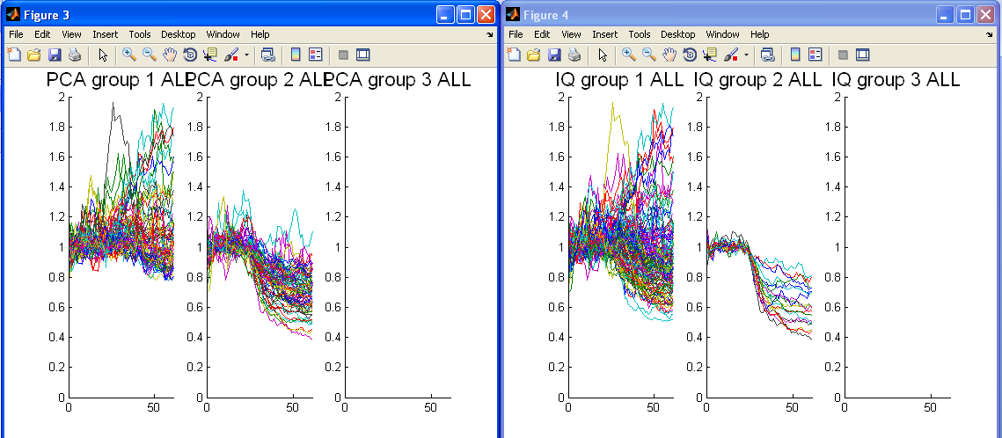
Press Analyze to analyze all puncta chosen within the masks

Slide 14
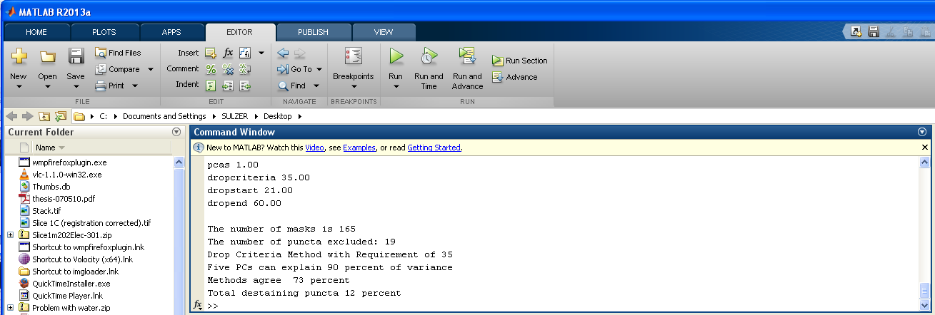
All of the puncta are sorted into three groups using either the PCA method or the IQ method. To sort, PCA focuses on the shape of the destaining, while IQ focuses on relative drops
Check the Command Window in Matlab for information about the total pool of puncta

Slide 15
Focus on just these two output figures. Notice the large values. If these are spurious, you might chose to exclude masks in which the puncta exceed 1.4 (in this example)

Slide 16
Set intensity cut-off to 1.4. You can rerun the analysis now.

Slide 17
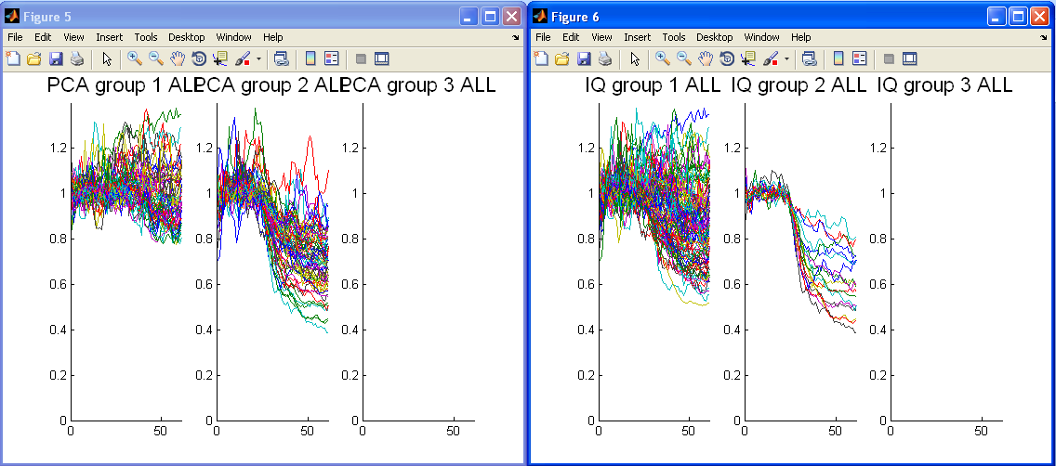
Original
Total destaining puncta 12 percent
Max Limited
Total destaining puncta 14 percent

Slide 18
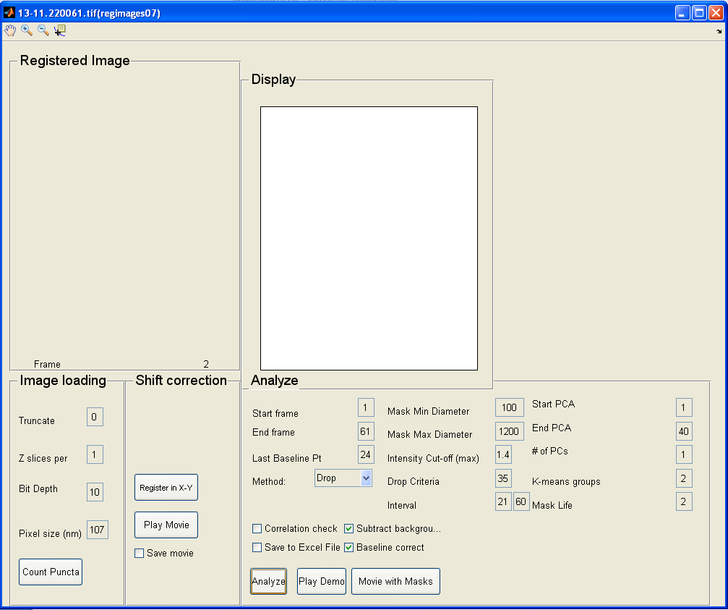
Watch a movie showing where the groups of puncta are

Slide 19
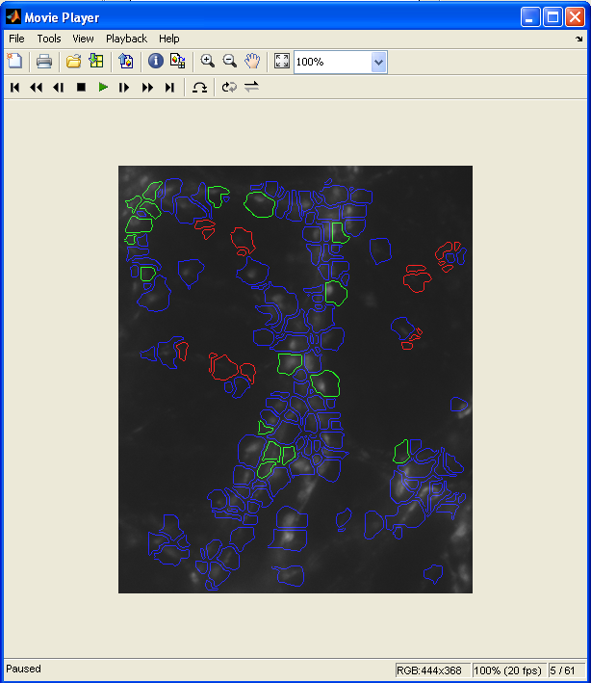
Blue puncta are non-destaining. Green are destaining.

Slide 20
Corresponds to the plot generated by the program

