Slide 1
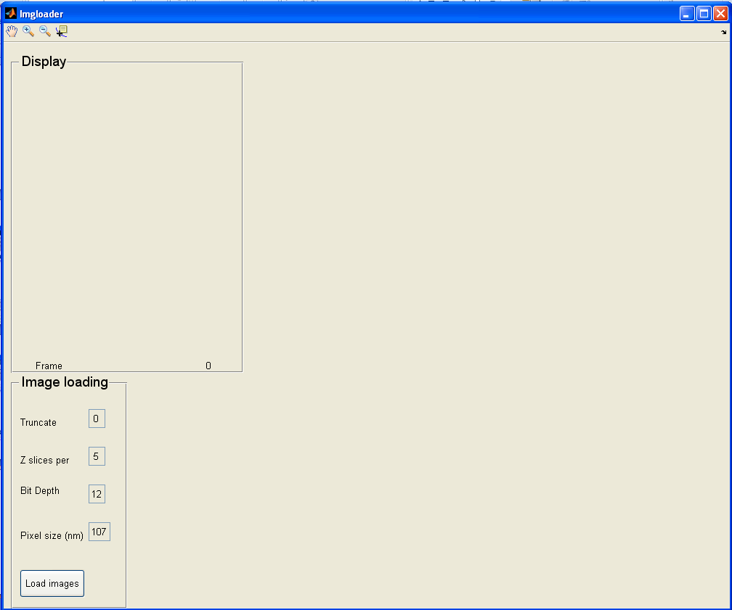
User selects image from an image sequence on drive
Set initial parameters:
Truncate Specifies how many frames to cut off from beginning
Z slices If your image is a z-stack, specify the number of z-slices at each time point
Bit depth and Pixel size are parameters of your images
GUIloadimgs
Loads every image and scales intensity (0 → 0; 2^bitdepth→1)
Click “Load images” once parameters are correctly set
Image sequence
Image preprocessing

Slide 2
Imgloader_build Jozsef Meszaros & Daniela Periera
This is a help file in Powerpoint format to lead you through all of the usage and data structures created by the GUI
Basic proficiency in Matlab is essential for properly understanding the code and this Powerpoint
Credits: To Manuel Guizar for developing DFT registration and Jonathan Lansey for logfit.

Slide 3
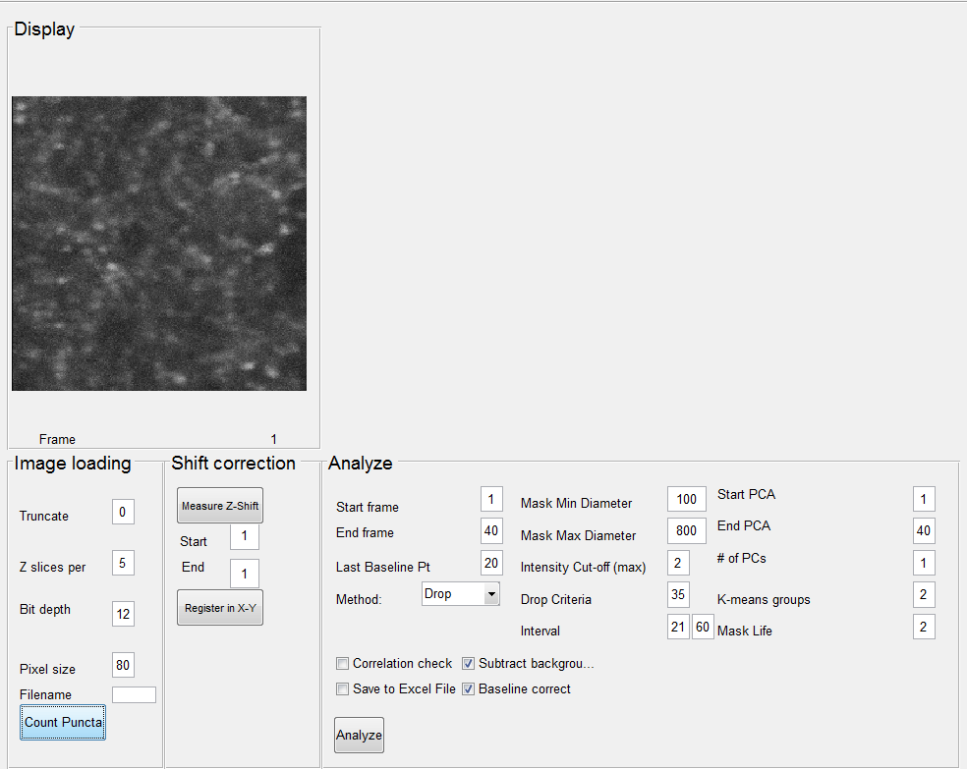
User selects image from an image sequence on drive
GUImeasureshift
Measure any z-shift (if Z-slices > 1)
Loads every image and scales intensity (0 → 0; 2^bitdepth→1)
If the sequence is a z-stack, click “Measure Z-shift”
Image sequence
Image preprocessing

Slide 4
User selects image from an image sequence on drive
GUImeasureshift
Measure any z-shift (if Z-slices > 1)
How to interpret: Your z=4 level has drifted up to the fifth position by the last frame.
What to do? Conservatively, set “Start” to 1 and “End” to 4
Loads every image and scales intensity (0 → 0; 2^bitdepth→1)
Alternatives: You may have drift downward, in which case, you would see the dots move in the opposite direction, then set “Start” to a number greater than 1
Image sequence
Image preprocessing

Slide 5
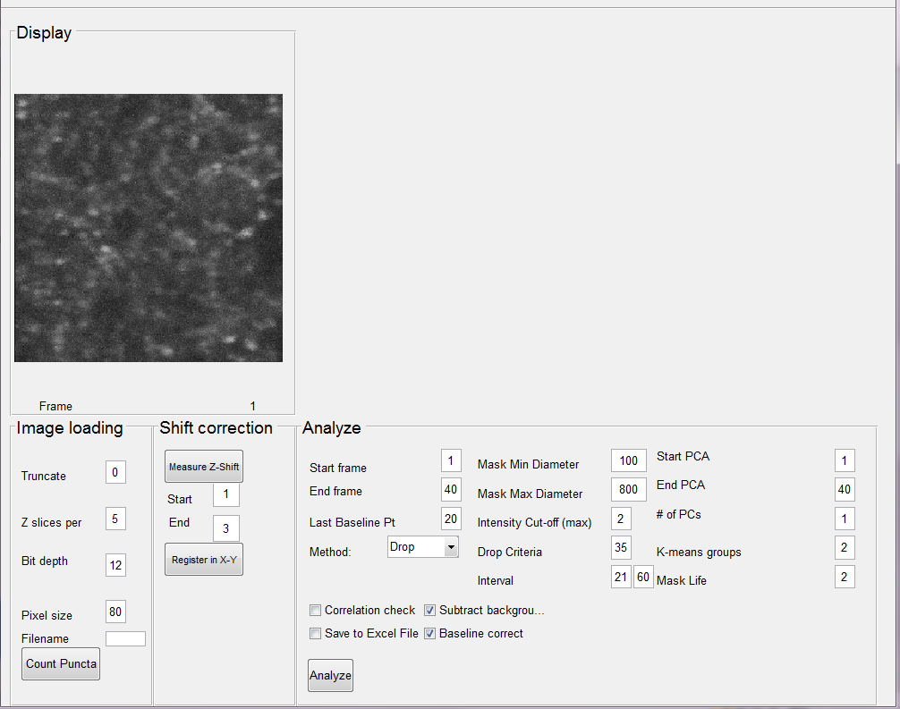
User selects image from an image sequence on drive
GUImeasureshift
Measure any z-shift (if Z-slices > 1)
Registered images
Registers every frame (or selected frames if z stack)
GUIdftregister
Loads every image and scales intensity (0 → 0; 2^bitdepth→1)
Image sequence
Image preprocessing

Slide 6
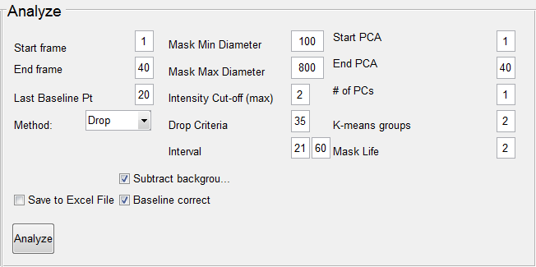
Mask Min and Max Diameter: The minimum diameter of what you might consider a puncta in your image. (Note: the software will choose things slightly outside of this range, these are just initialization parameters.)
Intensity cut-off: If a puncta’s fluorescence ever exceeds this cut-off, that puncta is not included in any subsequent analysis.
Drop Criteria and Interval: If drop criteria is used, then the puncta is selected as “Destaining” only when it is below 2 standard deviations of its baseline at least as many frames as “Drop Criteria” value within the “Interval” specified by the user.
Start and End PCA: Typically you want a large range, but if you have a lot of correlated variability in your baseline or after-stimulation, you may want to set a smaller range. Recommended settings = First frame to the frame corresponding to the end of the stimulation.
Number of PCs: This number will determine how many “features” distinguish puncta from each other. Typically set to 1 or 2.
K-Means groups: This number allows you to cluster puncta based on PC features. Recommended value is 2.
Mask Life: When set to 2, this criteria deletes any puncta that are not present in at least the first baseline frame and the last baseline frame. If set to 3, the puncta would have to be present in the first two baseline frames and the last baseline frame. Setting the value to a number much greater than 10% of your baseline frames may diminish the total puncta located.
Check boxes: Subtract background removes uneven lighting (highly recommended), baseline correct removes slow exponential trends in baseline, and save to Excel file will output an Excel file (the name and location of the file will be specified in your Matlab command window).
Start frame: Analysis of puncta begins at this frame of the registered images
End frame: Analysis of puncta end at this frame of the registered images
Last baseline point: The last image frame in registered images before stimulation begins. This number should be determined by your experimental setup and does not depend on what you entered for start frame and end frame.
Method: A way to threshold puncta either by specifying the number of frames that must “Drop” below 2 standard deviations of the puncta’s baseline, or the “IQ Method” which selects puncta by comparing average fluorescence after stimulation to fluorescence during the baseline.

Slide 7
Thresholds average image to obtain masks
All puncta
Registered images
Compares and keeps only masks present in all thresholded images
Thresholds first and last image to obtain masks
Background
Forms background image from everything other than masks
Mask extraction

Slide 8
Thresholds average image to obtain masks
puncta.mask
Registered images
Compares and keeps only masks present in all thresholded images
Thresholds first and last image to obtain masks
bg.mask
Forms background image from everything other than masks
Mask extraction

Slide 9
Puncta masks
Puncta intensities
Gets intensities in these masks
If ‘remove background’ is selected, subtracts background intensities from puncta intensities
Puncta background
removed intensities
Background mask
Background
intensities
Gets intensities in this mask
Normalizes to intensities at the stimulus timepoint
Puncta background
removed intensities;
normalized
Your analyzed data
Puncta intensity extraction

Slide 10
Puncta.mask
Puncta.int
Get intensities in these masks
If remove background is selected, subtract background intensities from puncta intensities
Puncta.bgrem_int
Bg.mask
Bg.int
Get intensities in this mask
Normalize to intensities at the stimulus timepoint
Puncta.norm_bgrem_int
Puncta intensity extraction

Slide 11
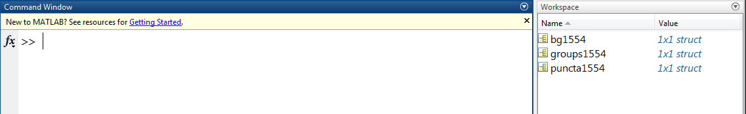
All of your data is located here in the workspace; the number in each structure corresponds to the time when the data was saved (15:54)
Matlab Output

Slide 12
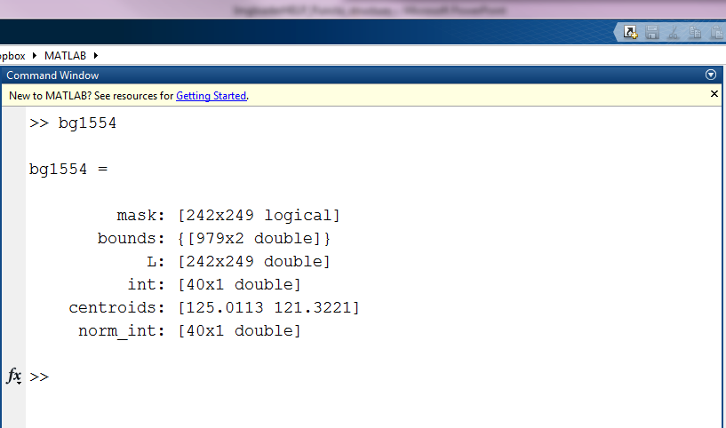
Type the name of the background structure, in our case, bg1554.
Mask: Black and white image corresponding to the area of your images that was considered “background”.
Bounds: The boundary of this area.
L: Same as mask, but with color.
Int: The “raw” intensity (scaled to your bit depth).
Centroids: The center of your background in the image frame.
Norm_int: The background intensity normalized to the first point.
Matlab Output: Background

Slide 13
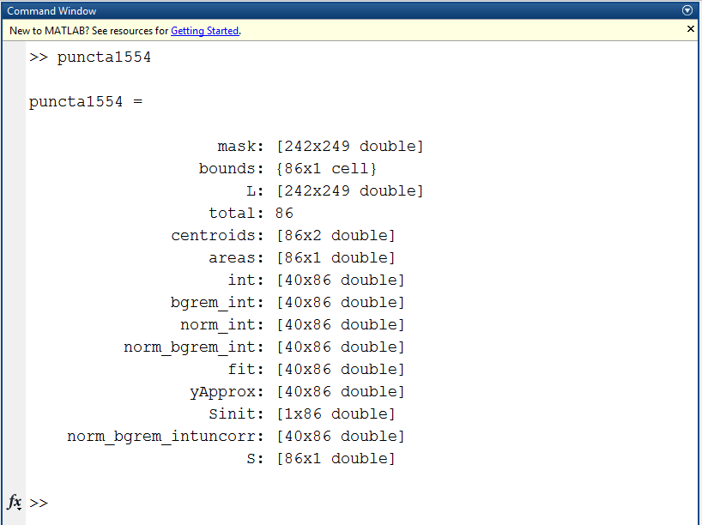
Mask: Black and white image corresponding to the area of your images that was considered “puncta”.
Bounds: The boundary of this area, numbers correspond to the intensities.
L: Same as mask, but with color.
Int: The “raw” intensity (scaled to your bit depth).
Centroids: The center of each puncta in the image frame.
Norm_int: The puncta intensity normalized to the baseline.
Bgrem_int: The puncta intensity with the background subtracted.
Norm_bgrem_int: The puncta intensity normalized to the baseline and with the background subtracted.
Fit: If baseline correction is requested, this is the result of dividing each puncta’s fluorescence by the expontential fit.
yApprox: This contains the exponential fits for each puncta (for more information, consult Pereira, 2016).
Sinit: Exponential constant (output of logfit) before baseline correction.
Norm_bgrem_intuncorr: If correct for baseline was chosen, this contains the uncorrected intensities for comparison.
S: Exponential constant after baseline correction.
Type the name of the puncta structure, in our case, puncta1554.
Matlab Output: Puncta

Slide 14

Total: Every puncta with an identifying code. The column descriptions follow: Column 1: an index of all of the masks found. Column 2: This is 0 if this puncta’s intensity exceeded the intensity cut-off set by the user. Column 3: Of those masks with 1 in column 2, the respective PCA group (non-destaining = 1; slowly destaining = 2; fast destaining = 3). Column 4: Of those masks with 1 in column 2, sorted by IQ group 1= drop < 1.5 * IQ range %
2= drop is between 1.5 and 3 of IQ range %
3= drop is > 3 * IQ range
Disagree: Indices (corresponding to column 1 of total) of all puncta that disagree between PCA and IQ/Drop method analysis.
Totalkey: Columns 3 and 4 of total (above) translated into “ND”, “Slow” and “Fast”.
Agree: Puncta where PCA and IQ method agreed, sorted into non-destaining and slowly destaining groups.
Matlab Output: Groups

