Slide 1
F1 ERS Deployment Analysis — Monza
Generated: 2025-09-21T19:14:46.696025

Slide 2
Key Lap Summary
Lap summary (lap_time / saved / pred_no_deploy / efficiency_s_per_MJ):
Lap 0: 95.700s | saved 2.221s | pred_no_deploy 97.921s | eff 0.600 s/MJ
Lap 1: 95.740s | saved 2.345s | pred_no_deploy 98.085s | eff 0.600 s/MJ
Lap 2: 95.668s | saved 2.170s | pred_no_deploy 97.838s | eff 0.600 s/MJ
Lap 3: 95.628s | saved 2.343s | pred_no_deploy 97.971s | eff 0.600 s/MJ
Lap 4: 95.636s | saved 2.616s | pred_no_deploy 98.252s | eff 0.600 s/MJ
Lap 5: 95.632s | saved 2.391s | pred_no_deploy 98.023s | eff 0.600 s/MJ

Slide 3
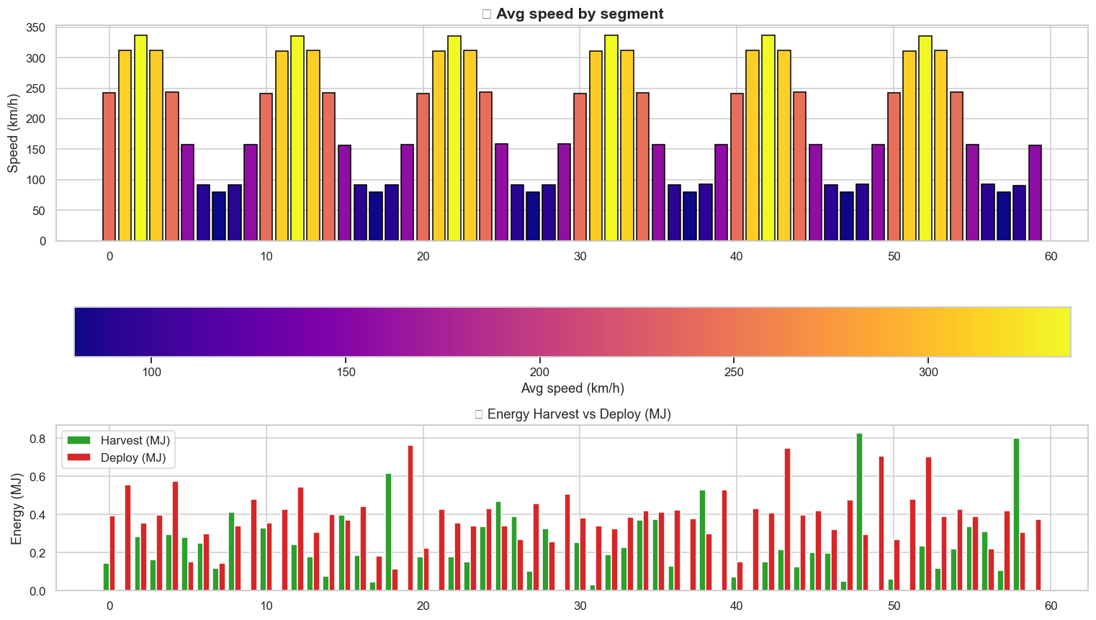
Segments Bars

Slide 4
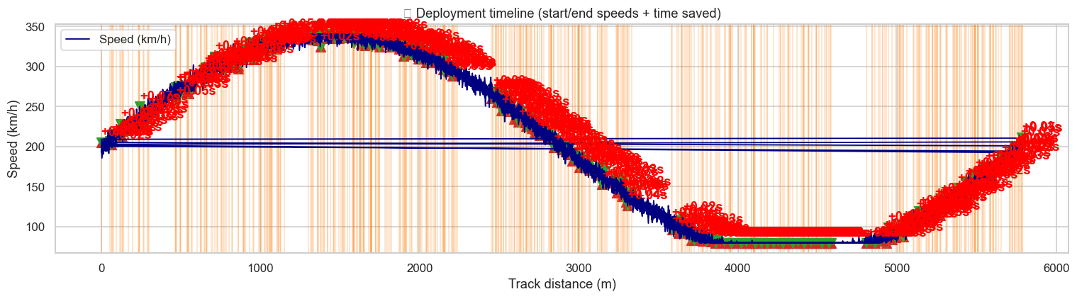
Deploy Timeline

Slide 5
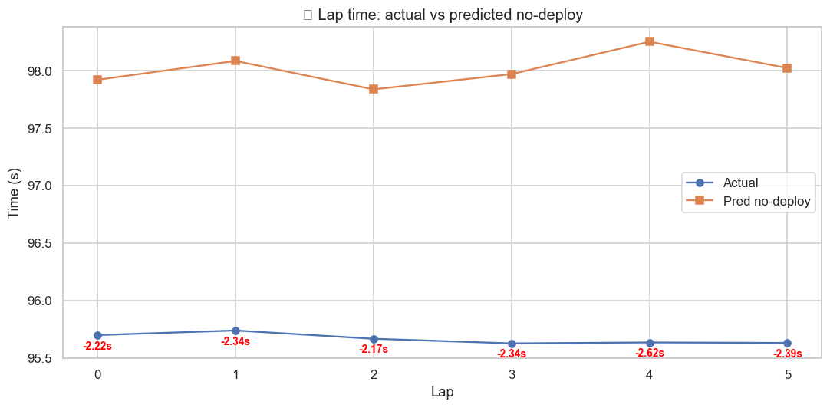
Race Summary

Slide 6
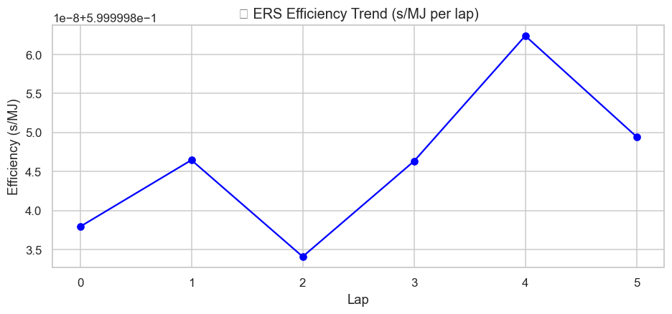
Ers Eff Trend

Slide 7
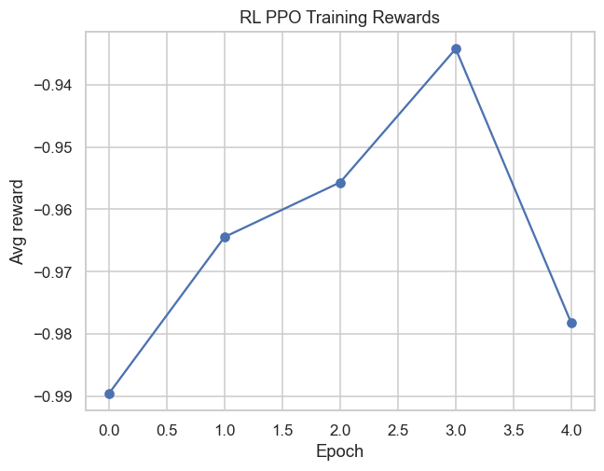
Ppo Epoch Rewards

