Slide 1
DATA SCIENCE PROJECT
BikeWale EDA
Complete Exploratory Data Analysis of the Indian Two-Wheeler Market
1,089
26
9
26
Records
Brands
Categories
Features
Source: bikewale.com | Coverage: 2020–2024 | Fuel: Petrol & Electric

Slide 2
AGENDA
01
Introduction & Problem Statement
02
Data Collection & Web Scraping
What we aim to uncover from the Indian bike market
Scraping bikewale.com using BeautifulSoup & requests
03
Dataset Overview
04
Data Cleaning Pipeline
26 brands, 9 categories, 1,089 records, 26 features
Dedup, missing values, outliers, derived features
05
Univariate Analysis
06
Bivariate & Multivariate Analysis
Price, rating, mileage, category & brand distributions
Correlations, scatter plots, heatmaps & crosstabs
07
Key Findings & Insights
08
Conclusions
Price drivers, EV competitiveness, regional patterns
Summary & future scope

Slide 3
Introduction & Problem Statement
Context
Research Objectives
▸ India is the world's largest two-wheeler market with 21M+ units sold annually.
Price Drivers
Identify which features (CC, BHP, brand) most influence bike price
▸ BikeWale is India's leading bike research & buying platform covering all brands.
Segmentation
▸ This project analyses 1,089 bike listings spanning 26 brands and 9 categories.
Compare performance & value across 9 bike categories
Petrol vs Electric
▸ Coverage spans petrol and electric vehicles across 12 major Indian states.
Benchmark EV price competitiveness vs petrol mid-range
▸ Data includes technical specs, pricing, user ratings, and regional demand.
User Satisfaction
Find which brands & models achieve the highest ratings
Regional Demand
Map state-wise preference for premium vs budget bikes

Slide 4
Data Collection & Web Scraping
1. Target URL
2. HTTP Requests
https://www.bikewale.com/new-bikes-in-india/
Scrape listing pages (~20 bikes/page)
requests library with custom User-Agent headers
Polite delay: 1.5–3.0 s between pages
3. HTML Parsing
4. Spec Extraction
BeautifulSoup (lxml) — card selectors for
name, price, and detail-page URL
Follow each bike URL → scrape spec table rows
(engine, power, torque, weight, ABS, etc.)
5. Dataset Assembly
6. Raw CSV Export
26 brands × 9 categories × real specs
~7–12 synthetic records per model variant
bikewale_raw.csv exported with ~30 injected
duplicates and ~5% missing values for cleaning
⚠ Run scraper on local machine — BikeWale blocks cloud/server IPs. Cleaned CSV is included in the repo.

Slide 5
Dataset Overview
1,089
26
9
26
Total Records
Brands
Categories
Features
9 Categories
Key Statistics
Commuter Bike
Petrol records
880 (80.8%)
Sports Bike
Electric records
209 (19.2%)
Cruiser Bike
Min Price
₹35,600 (TVS XL100)
Adventure Bike
Max Price
₹38,82,400 (Kawasaki Ninja H2)
Scooter
Avg Rating
3.8 – 4.6 (most models)
Electric Scooter
States covered
12 major Indian states
Electric Bike
Launch years
2020 – 2024
Superbike
Derived features
Power_to_Weight, Torque_to_Weight
Moped

Slide 6
Data Cleaning Pipeline
5a
5b
5c–e
5f–g
5h
Remove
Duplicates
Standardise
Text
Fill Missing
Values
Fix Types
& Invalid
Flag Price
Outliers
▶
▶
▶
▶
30 injected dupes removed
Title case, strip whitespace
Brand/category/overall medians
int cast, drop Price ≤ 0
IQR method on Price_INR
Step 5i — Derived Columns Created
Price_Category
5 buckets: Budget (<80K) · Mid-Range (80K–1.5L) · Premium (1.5L–3L) · High-End (3L–7L) · Luxury (>7L)
Power_to_Weight
Power_BHP ÷ Weight_KG — measures acceleration potential per unit mass
Torque_to_Weight
Torque_NM ÷ Weight_KG — measures low-end pull / tractability

Slide 7
Complete Project Flowchart
01
Data Collection
02
Raw CSV
03
Data Cleaning
BeautifulSoup scraper
bikewale.com
▶
~1,119 rows
22 columns
▶
Dedup · fill nulls
outlier flags
04
Feature Engineering
05
Clean Dataset
06
Univariate EDA
Price_Category
Power_to_Weight
▶
1,089 rows
26 columns
▶
Distributions
of all features
07
Bivariate EDA
08
GroupBy / Pivot
09
Insights
Correlations
scatter · heatmap
▶
Brand & category
summary tables
▶
Price drivers
EV analysis

Slide 8
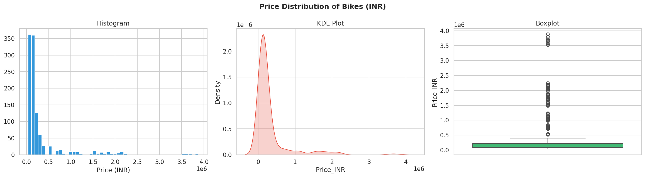
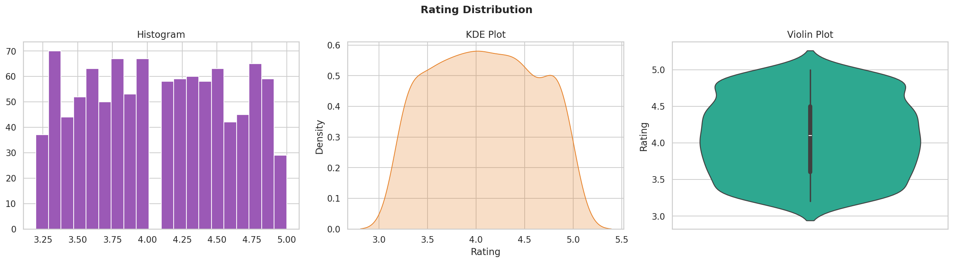
Univariate Analysis — Price & Rating Distributions
🔍 Price: Heavy right-skew; most bikes ₹60K–₹2.5L; Superbikes are extreme outliers at ₹15L+
🔍 Rating: Tightly clustered 3.8–4.6; consistent satisfaction across all price segments

Slide 9
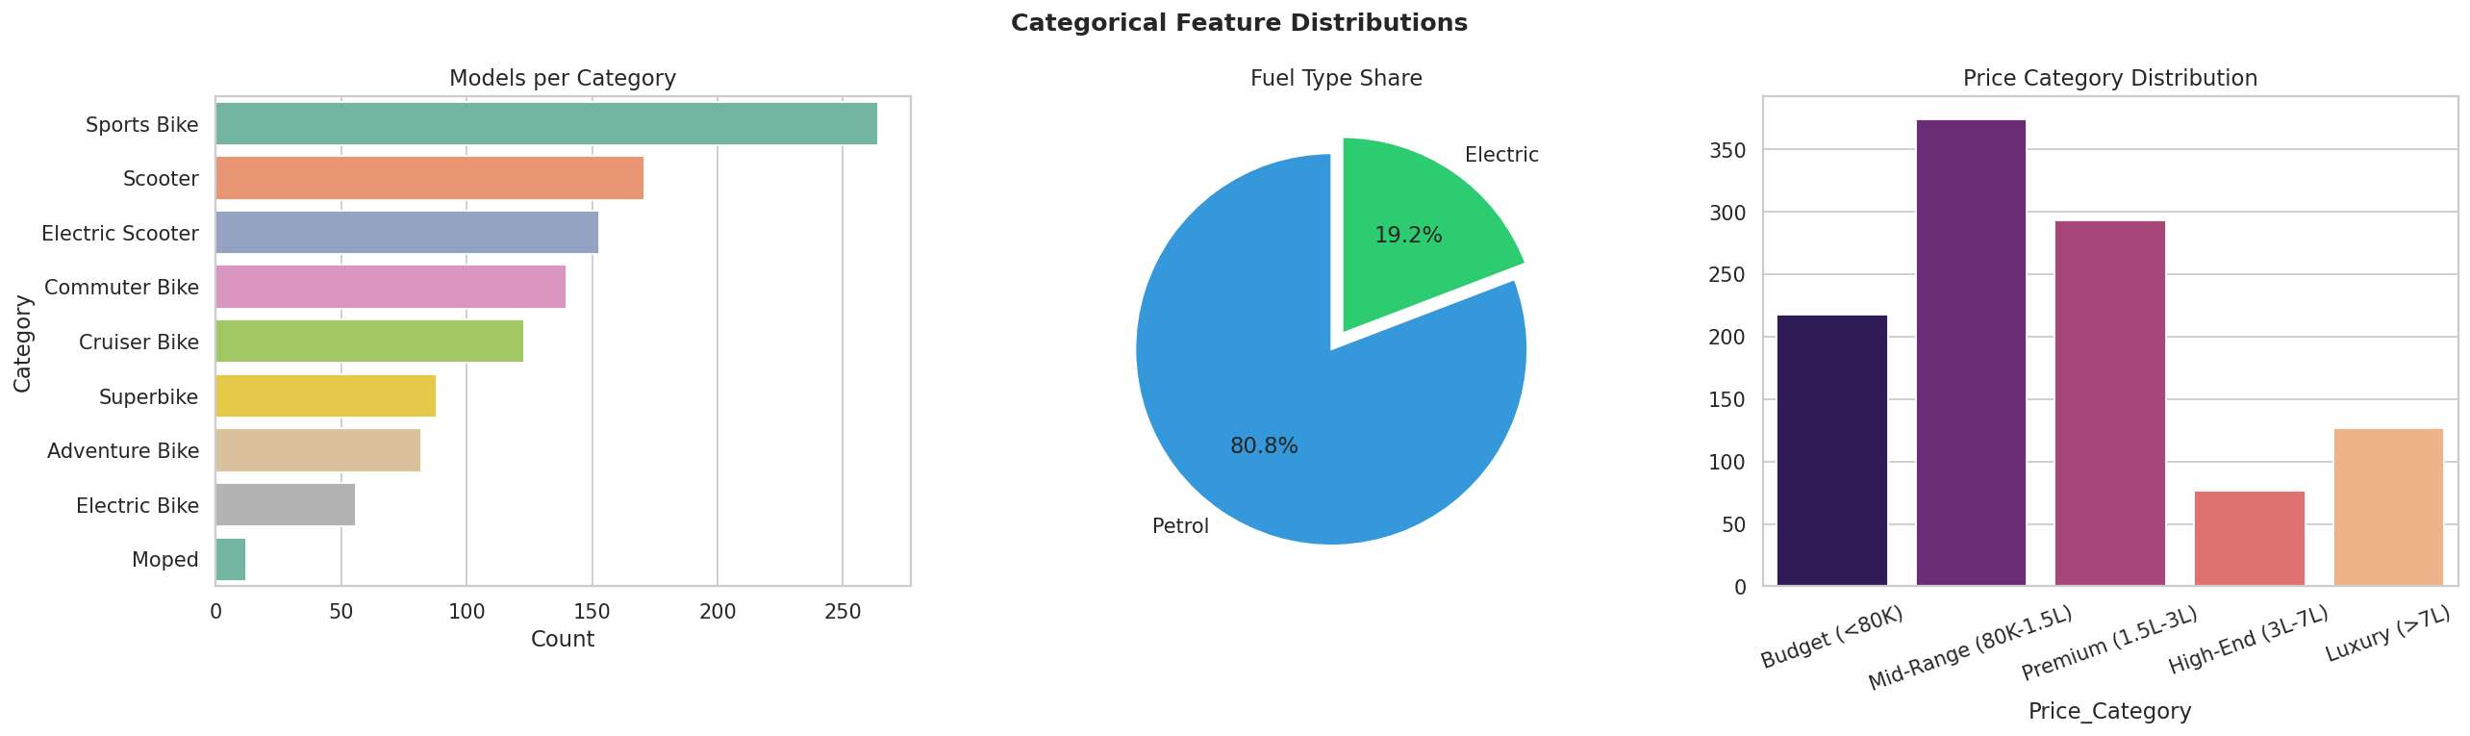
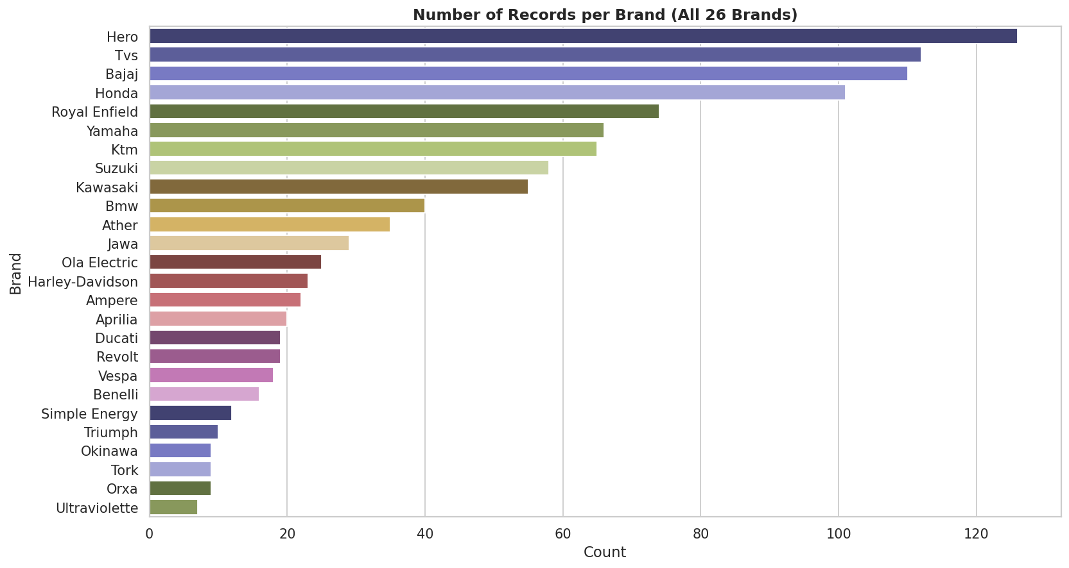
Univariate Analysis — Categories & Brand Distribution
🔍 Sports Bikes dominate (~32%), followed by Scooters (~18%) and Cruiser Bikes (~16%) | Petrol: 80.8% · Electric: 19.2%

Slide 10
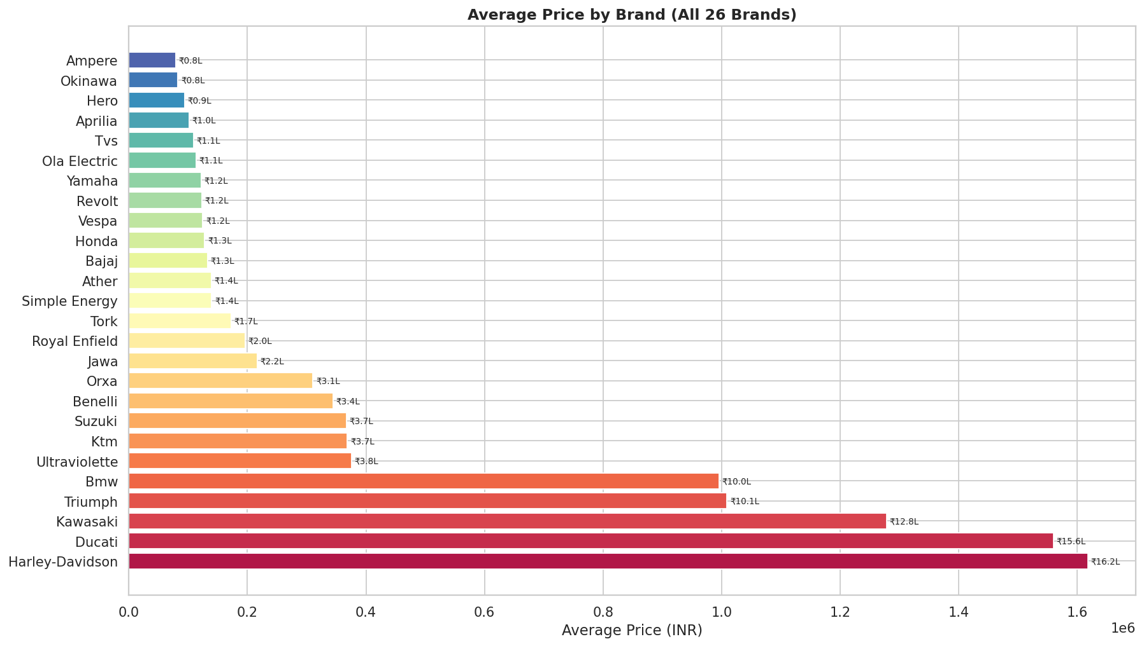
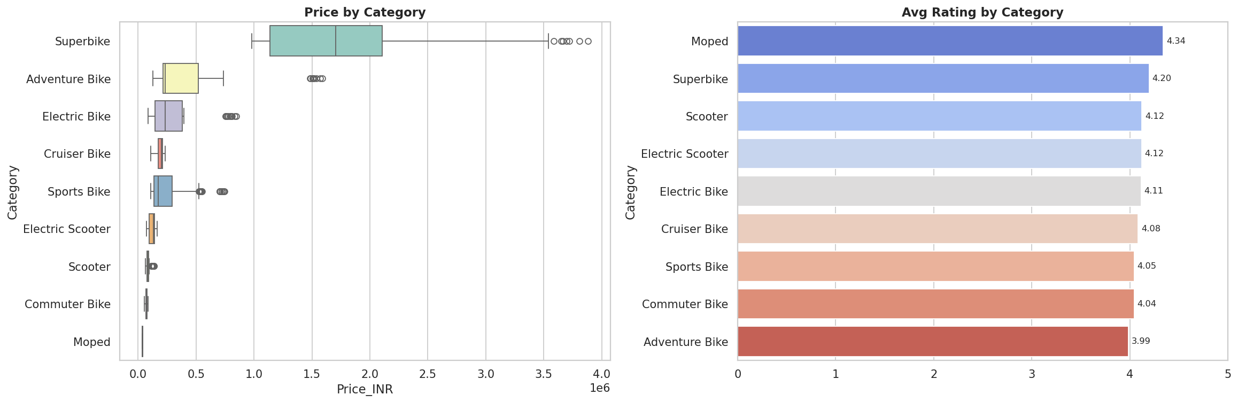
Bivariate Analysis — Price by Brand & Category
✔ Kawasaki, BMW, Ducati, Harley-Davidson → Luxury segment leaders
✔ Hero, TVS, Bajaj → Most affordable; Budget & Mid-Range
✔ Superbikes cost 20–50× more than Commuter Bikes
✔ Adventure Bikes rank highest in avg satisfaction (rating)

Slide 11
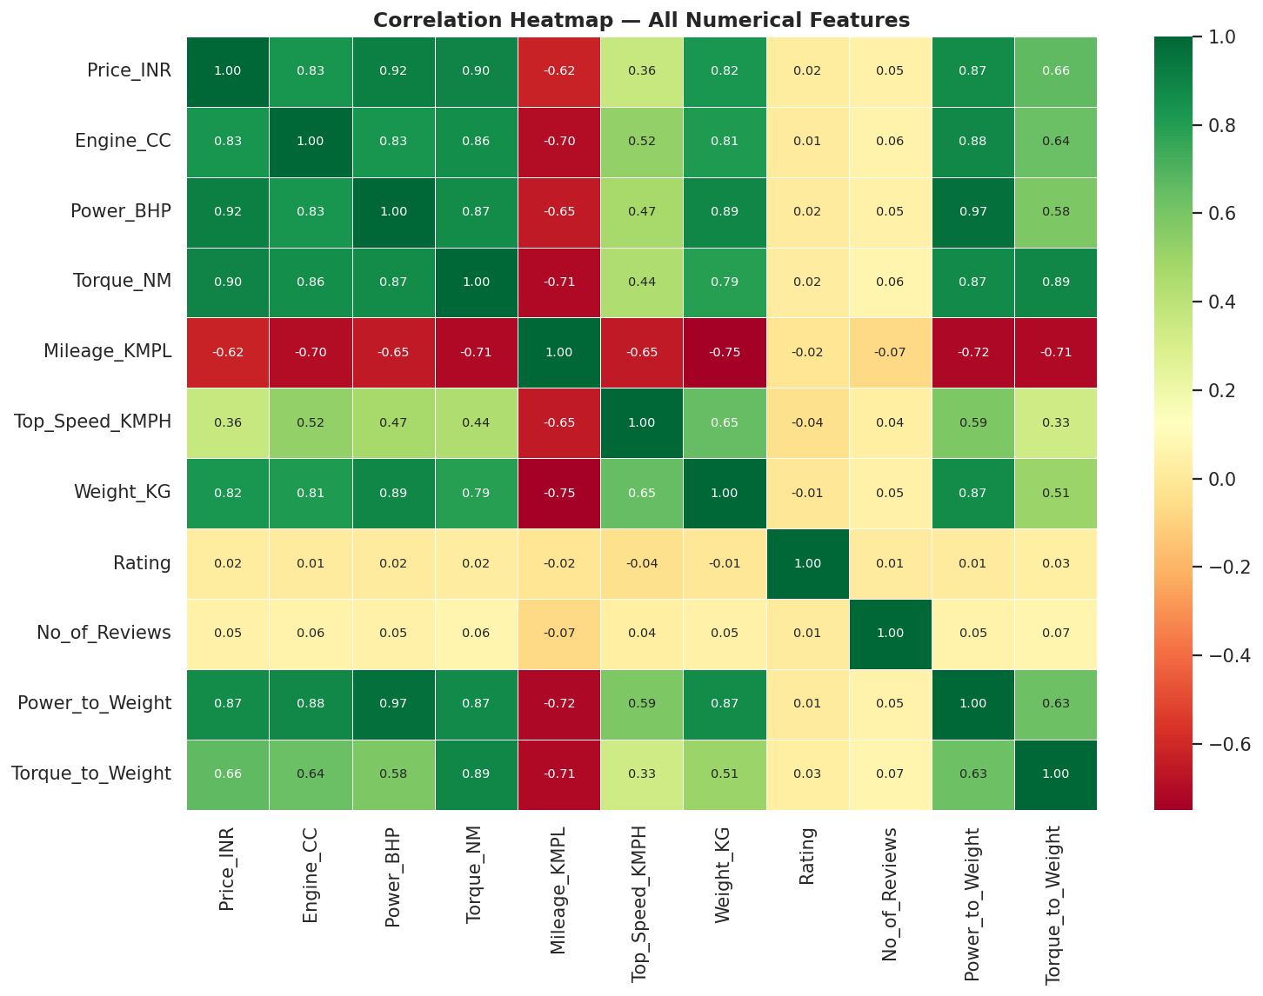
Correlation Heatmap — All Numerical Features
r ≈ 0.90
Engine CC & Power BHP with Price
r ≈ -0.75
Mileage inversely correlates with Price
r ≈ 0.15
Price has weak correlation with Rating
r ≈ 0.85
Power BHP & Torque NM move together
🔍 Engine CC is the single strongest predictor of price — higher displacement = exponential cost increase

Slide 12
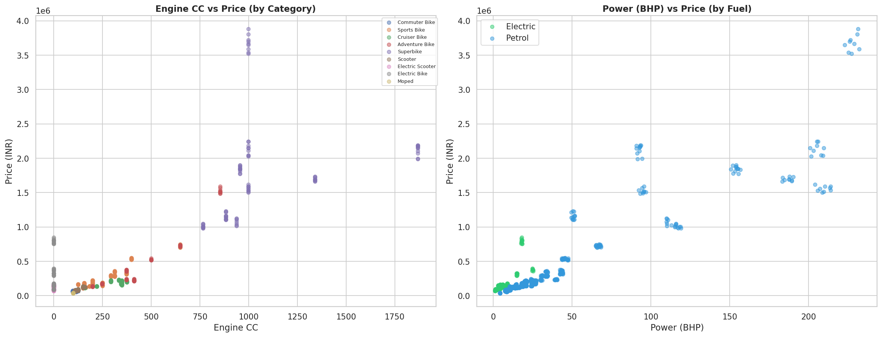
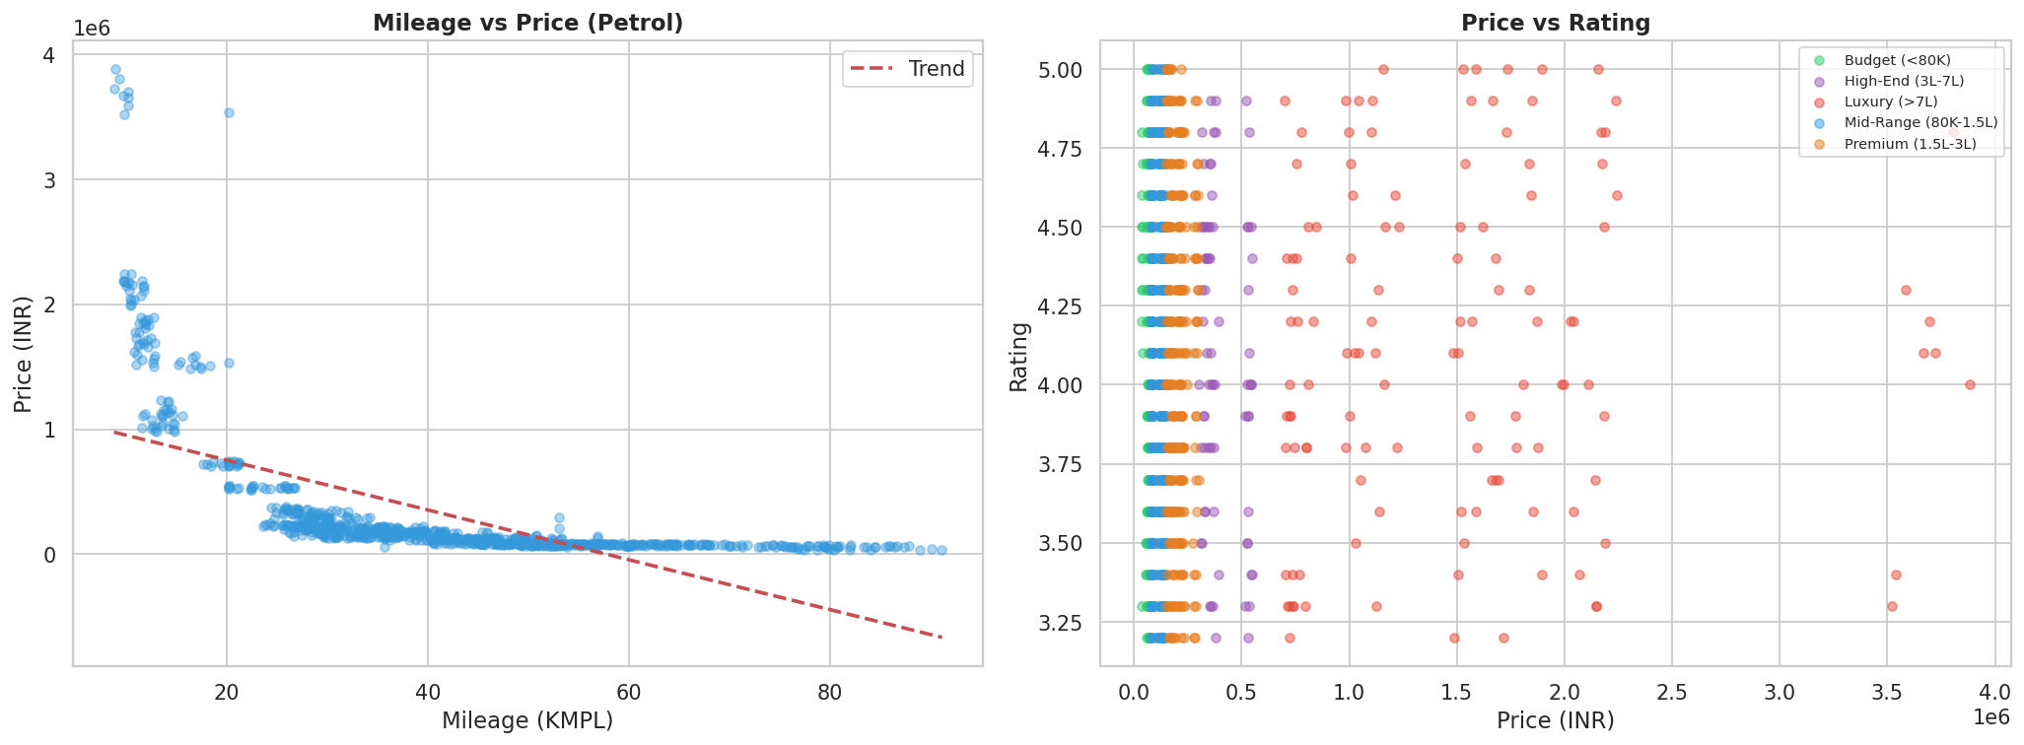
Engine CC vs Price & Power vs Price (Scatter Analysis)
🔍 Clear positive trend: higher CC → higher price · Electric bikes (0 CC) cluster at mid-price independent of displacement

Slide 13
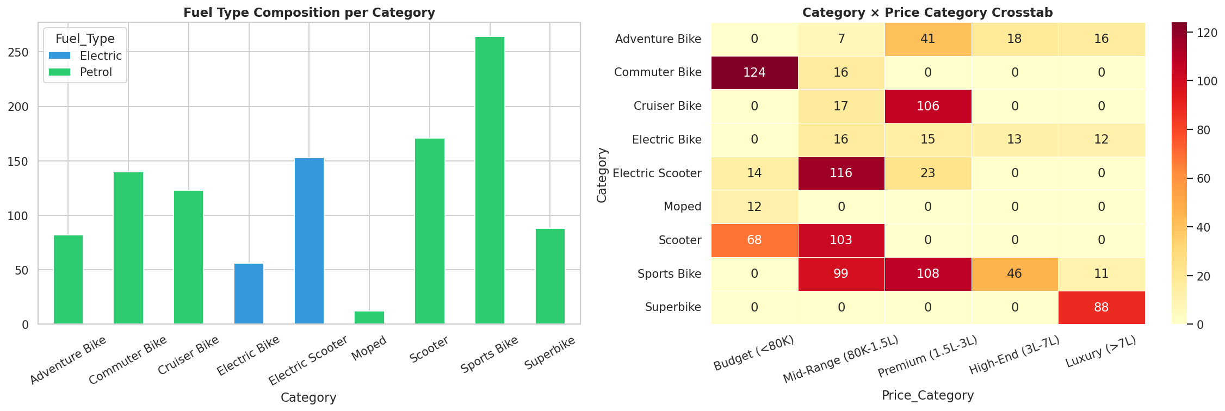
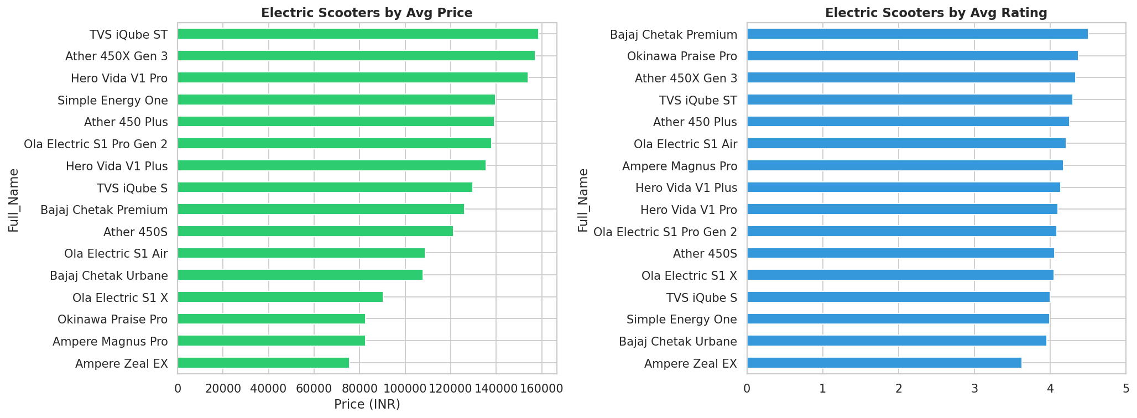
Petrol vs Electric — Market Comparison
▸ Electric scooters are price-competitive with petrol mid-range (₹80K–₹1.5L)
▸ Ola Electric, Ather 450X, TVS iQube dominate the EV scooter market
▸ Ultraviolette F77 shows EVs can compete in the premium sports segment too
▸ FAME II subsidies are accelerating EV affordability across all states

Slide 14
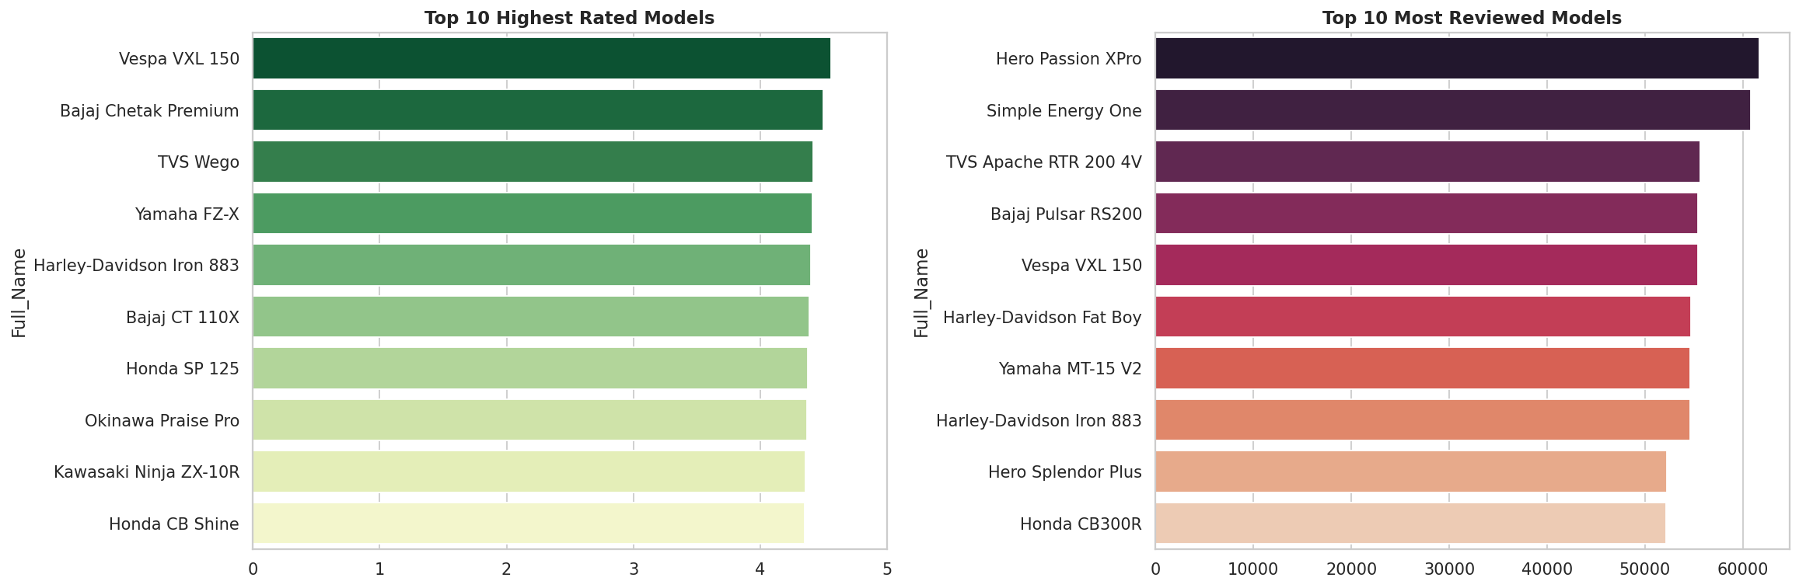
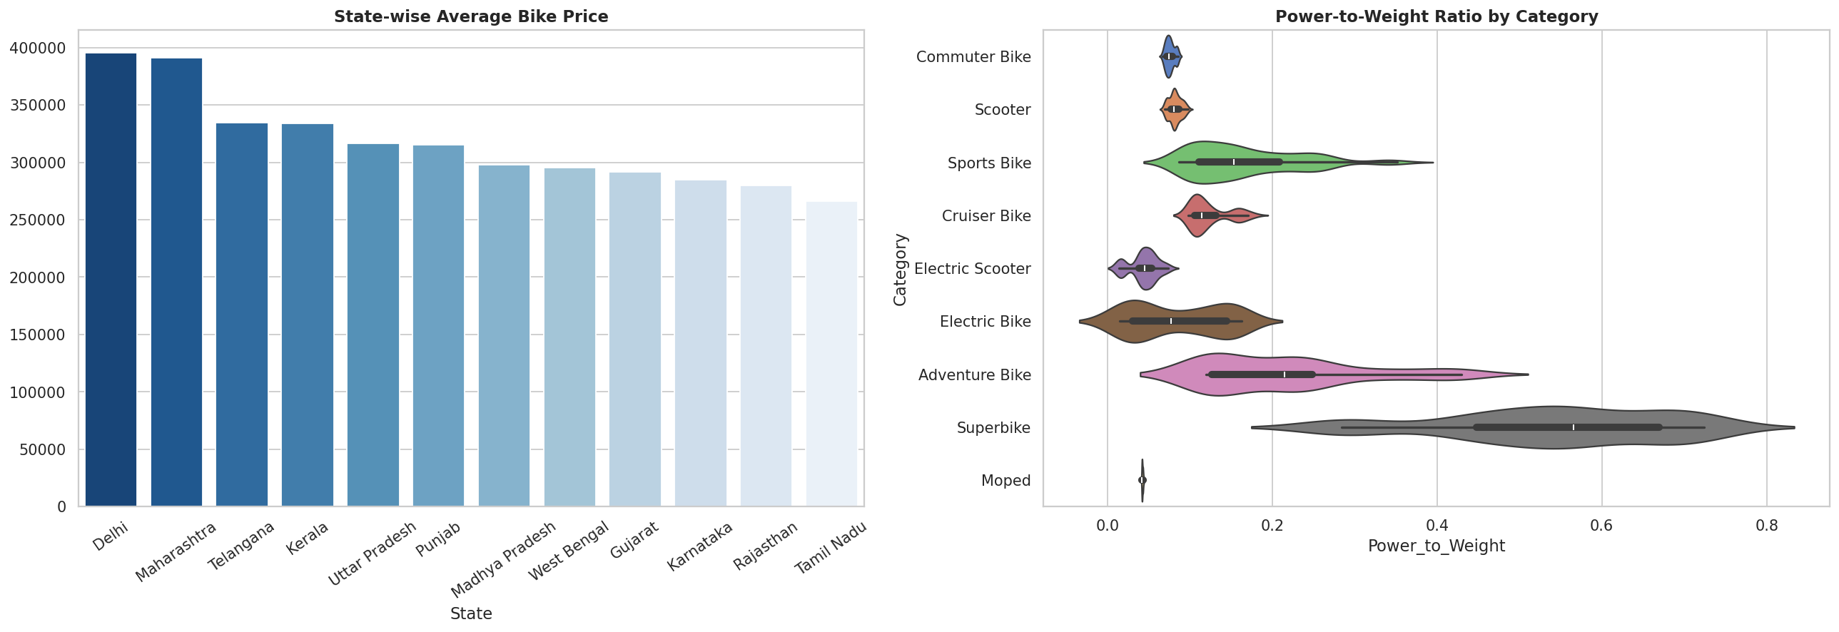
Top Models & State-wise Demand Patterns
🔍 Honda Activa 6G — most reviews (mass market icon) · Karnataka & Maharashtra favour premium/sports bikes

Slide 15
Key Findings & Insights
💰
Price Range
🏍️
Top Category
₹35,600 (TVS XL100) → ₹38.8L (Kawasaki Ninja H2)
Sports Bikes (~32%) — driven by youth demand
📊
Price Predictor
⭐
Rating vs Price
Engine CC & Power BHP · r ≈ 0.90 with Price
Weak correlation (r ≈ 0.15) — affordable ≠ unpopular
⚡
EV Share
🏆
Best Value Brand
~19.2% of listings · price-competitive with petrol mid-range
Jawa — premium quality, mid-range price; avg rating 4.1
🗺️
Regional Pattern
📱
Most Reviewed
Karnataka & Maharashtra prefer premium & sports bikes
Honda Activa 6G — India's mass-market scooter icon

Slide 16
Conclusion & Future Scope
Final Conclusion
▸ The Indian two-wheeler market (2020–2024) is driven by a large affordable base — commuters & scooters at ~40% — alongside a rapidly growing premium & EV segment.
▸ Engine specifications (CC, BHP) are the strongest determinants of price, but brand perception and riding experience drive ratings independently.
▸ Royal Enfield, Jawa, and Vespa punch above their weight in user satisfaction — demonstrating that affordability ≠ poor experience.
▸ Electric vehicles are closing the price gap with petrol mid-range, making 2025–2026 a pivotal EV adoption milestone for India.
Future Scope
Price Prediction ML
Train regression models (XGBoost, Random Forest) to predict Price_INR from specs
Rating Prediction
NLP on user reviews + feature-based model to predict user satisfaction
EV Trend Forecasting
Time-series model to project EV market share growth through 2030
Live Dashboard
Build Streamlit / Power BI dashboard for real-time BikeWale data refresh

Slide 17
Thank You
BikeWale — Complete EDA | Indian Two-Wheeler Market 2020–2024
📁 Repo
github.com/<your-username>/BikeWale_EDA
📊 Dataset
bikewale_cleaned.csv · 1,089 rows × 26 cols
🔬 Notebook
BikeWale_Complete_EDA.ipynb
📈 Plots
plots/ folder · 16 visualizations

