Slide 1

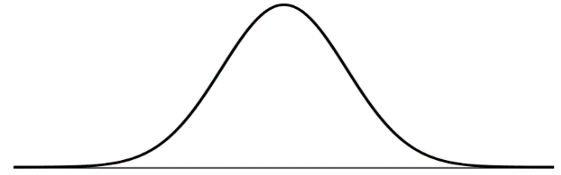
End-to-End Threshold Tuning Methodology
0
Introduction
sss
Background introduction
1
Statistical analysis
Threshold values are suggested based on statistical analysis. Candidate thresholds are suggested for later determination
General rule of thumbs
1. Tuning by broader segments
2. Stringent threshold for med/ high risk transactions
Statistical analysis is performed by18(6x3) scenarios, categorized by 3 dimensions:
An optimal percentile is selected as threshold for LOW Risk transactions, a more stringent threshold is applied for MEDIUM and HIGH Risk transactions by choosing a risk-based factor, i.e. (threshold for low risk) * (risk-based factor), ranging from xxx% to xxx%
Private Bank
Company Type
Risk Profile
High Med Low
Corporate
Low Risk
PB
Financial Institution
Moderate Risk
Non-PB
Individual
High Risk
E.g. BANK

