Slide 1
Secure data hiding in images using steganography
CAPSTONE PROJECT
Presented By: Suma Shivu Mukri
Student Name : Suma Shivu Mukri
College Name & Department : N.M.A.M. Institute of Technology, Nitte & Computer Science and Engineering

Slide 2
OUTLINE
Problem Statement
Technology used
Wow factors
End users
Result
Conclusion
Git-hub Link
Future scope

Slide 3
Problem Statement
In today's digital world, securing sensitive information is a major challenge. Traditional encryption methods can make secret communication noticeable, increasing the risk of interception. This project, "Secure Data Hiding in Images Using Steganography," embeds confidential messages within images without altering their appearance. It ensures covert, password-protected communication, making data transmission more secure and undetectable.

Slide 4
Technology used
Programming Language:
Python – For implementing encryption and decryption logic
Libraries & Modules:
OpenCV (cv2) – For image processing (reading, modifying, and saving images)
OS Module – For file handling (managing password storage)
Encryption Method:
Pixel Value Manipulation – Encoding and decoding the message within image pixel values
Tools:
VS Code (Visual Studio Code)

Slide 5
Wow factors
Invisible Data Storage:
The message is hidden inside an image without altering its visible appearance.
Password Protection:
Unauthorized access is prevented using a passcode.
Lossless Encoding:
Using PNG format prevents data loss due to compression.
Simplicity & Efficiency:
Lightweight and quick encoding/decoding mechanism.

Slide 6
End users
Cyber security professionals.
Secret communication users (military, journalists, etc.).
Individuals who need to store confidential information securely.

Slide 7
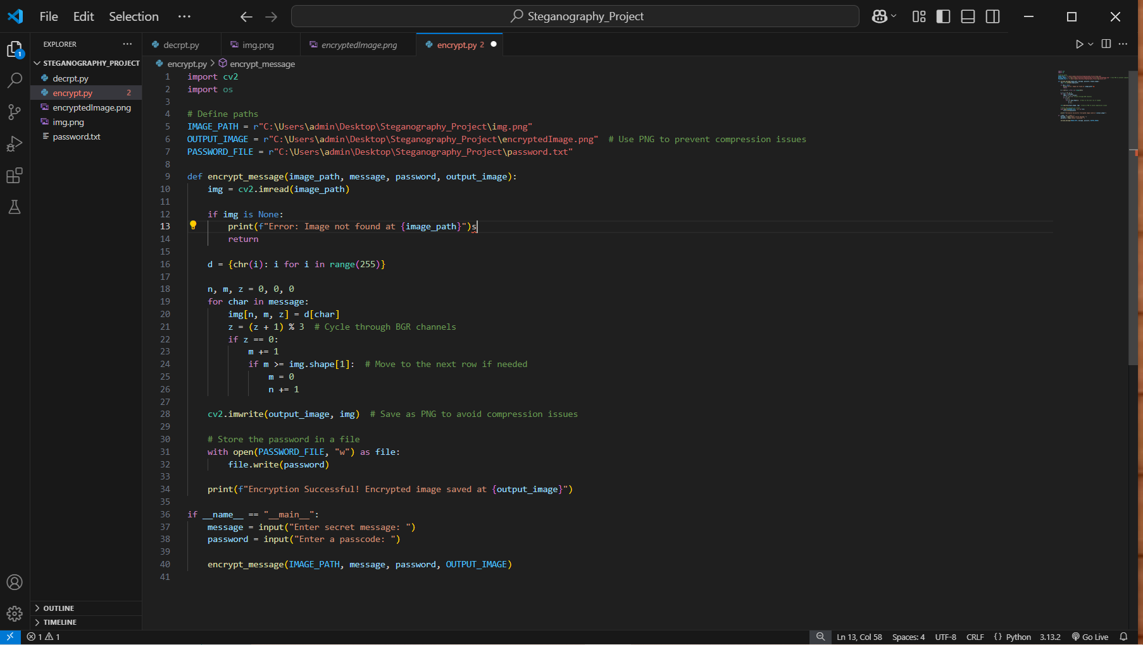

Results
Figure1 : Code for Encryption
Figure2 : Code for Decryption

Slide 8
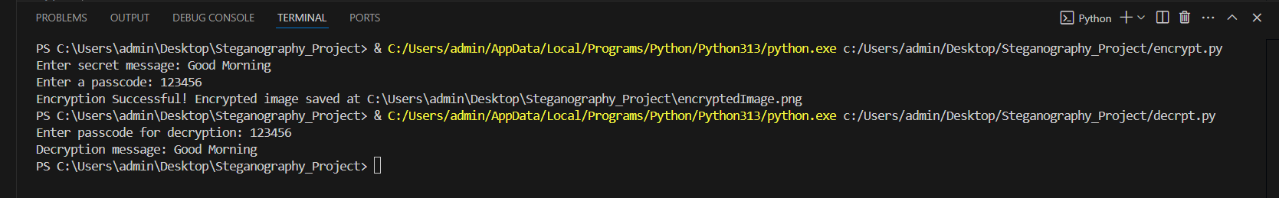
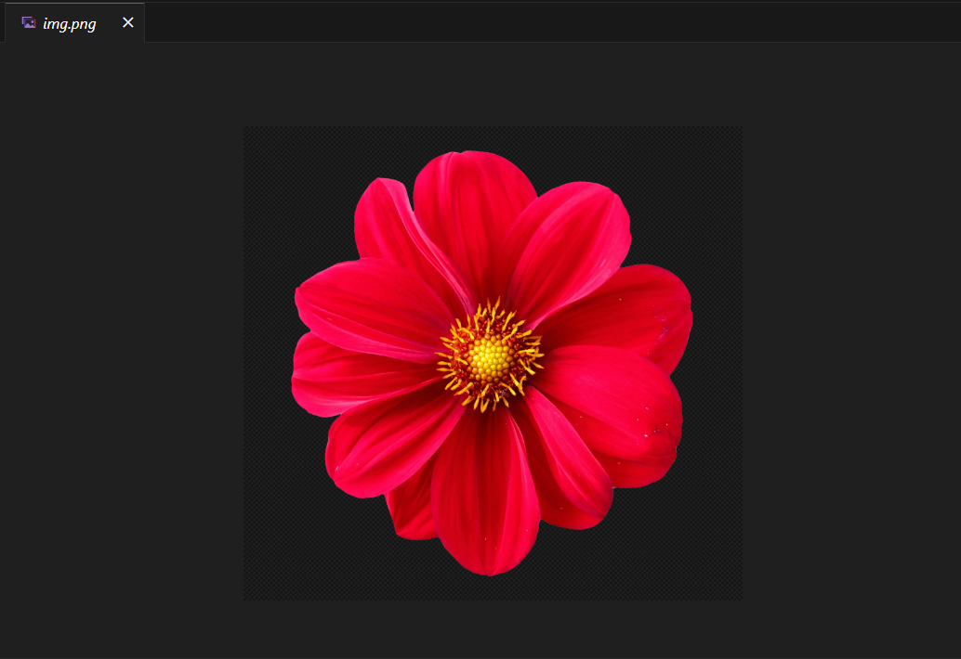
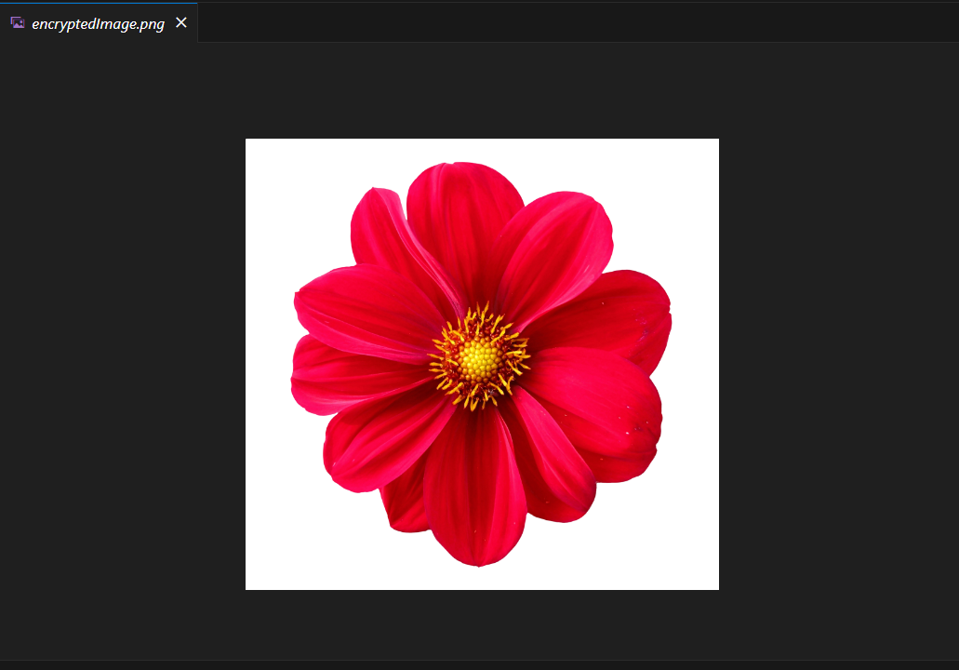
Figure3 : Output for Encryption and Decryption
Figure4 : Original Image
Figure5 : Encrypted Image

Slide 9
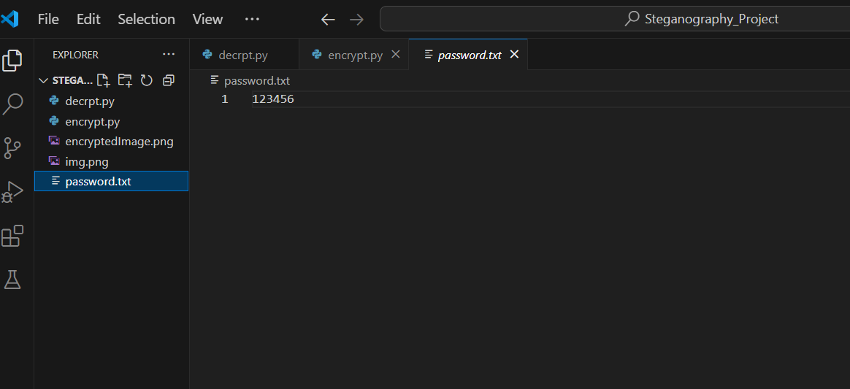
Figure6 : Passcode stored in a text file

Slide 10
Conclusion
This project, successfully embeds secret messages within images while keeping them visually unchanged. The encryption and decryption process ensures secure, password-protected communication. By using image steganography, this method provides an efficient and undetectable way to transmit sensitive information safely.

Slide 11
GitHub Link
https://github.com/Suma-SM3/Secure-Data-Hiding-in-Images-Using-Steganography2.git

Slide 12
THANK YOU

