Slide 1
IBM University Engagement Project Submission
Course Content Simplification Agent “Exploring the Power of Agentic AI with IBM Cloud and Orchestrate”

Slide 2


Project Title – Course Content Simplification Agent
Domain of Project – Education
Student Name | Recent Passport Photo | Email ID | Mobile number [WhatsApp]
Sumadwa Kulkarni |  | Sumadwakulkarni@gmail.com | 8277188531
Platform: IBM watsonx Orchestrate Implementation status: Evaluated, versioned and deployed to Live

Slide 3
Problem Statement – Course Content Simplification Agent
The Challenge Many students, especially learners with different levels of prior knowledge, struggle with complex academic material. Textbooks, lecture notes and technical resources can contain dense explanations and unfamiliar terminology. The Objective Develop an AI-powered agent that analyzes academic questions or course content and reframes explanations in clear, concise, beginner-friendly language while preserving the important concepts. Expected impact • Better comprehension and confidence • Easier access to technical subjects • Support for different learner levels • More inclusive and personalized learning

Slide 4
Proposed Solution – Course Content Simplification Agent
The solution is an AI educational assistant built in IBM watsonx Orchestrate. Workflow 1. Student submits an academic question or difficult concept. 2. The agent understands the topic and the need for a simple explanation. 3. Course knowledge is used to support relevant, grounded answers. 4. The AI generates a concise, structured explanation using beginner-friendly terminology. 5. Important concepts are preserved while unnecessary complexity is reduced. The result is a practical learning companion that turns difficult course content into explanations students can understand and use.

Slide 5
Technology Used
IBM watsonx Orchestrate – Platform used to build, evaluate, version and deploy the AI agent. IBM Granite / Generative AI – Provides language understanding and generation for clear explanations. Knowledge Source – Course content is supplied as knowledge so responses can stay aligned with the learning material. Evaluation – Test created: “Explain machine learning in simple words for a beginner.” Deployment – Version v1.0 – Course Content Simplification was deployed to the Live environment. Interface – Orchestrate Chat / agent preview is used to interact with the solution.

Slide 6
Orchestrate Components Used
1) Chat Input – Student enters a question or academic concept. 2) AI Agent – Interprets the request and generates a simplified response. 3) Knowledge – Course material is available as a knowledge source. 4) Chat Output – Displays the final simplified explanation. 5) Evaluation – Test: “Explain machine learning in simple words for a beginner.” 6) Version & Deployment – v1.0 created and successfully deployed to the Live environment.

Slide 7
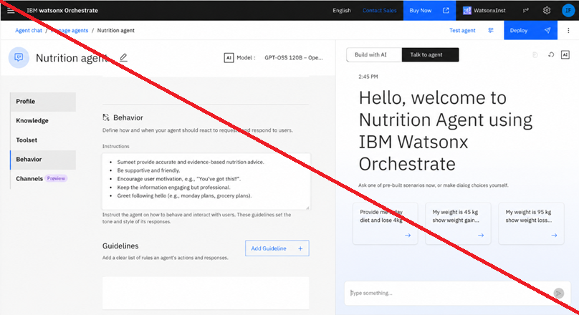
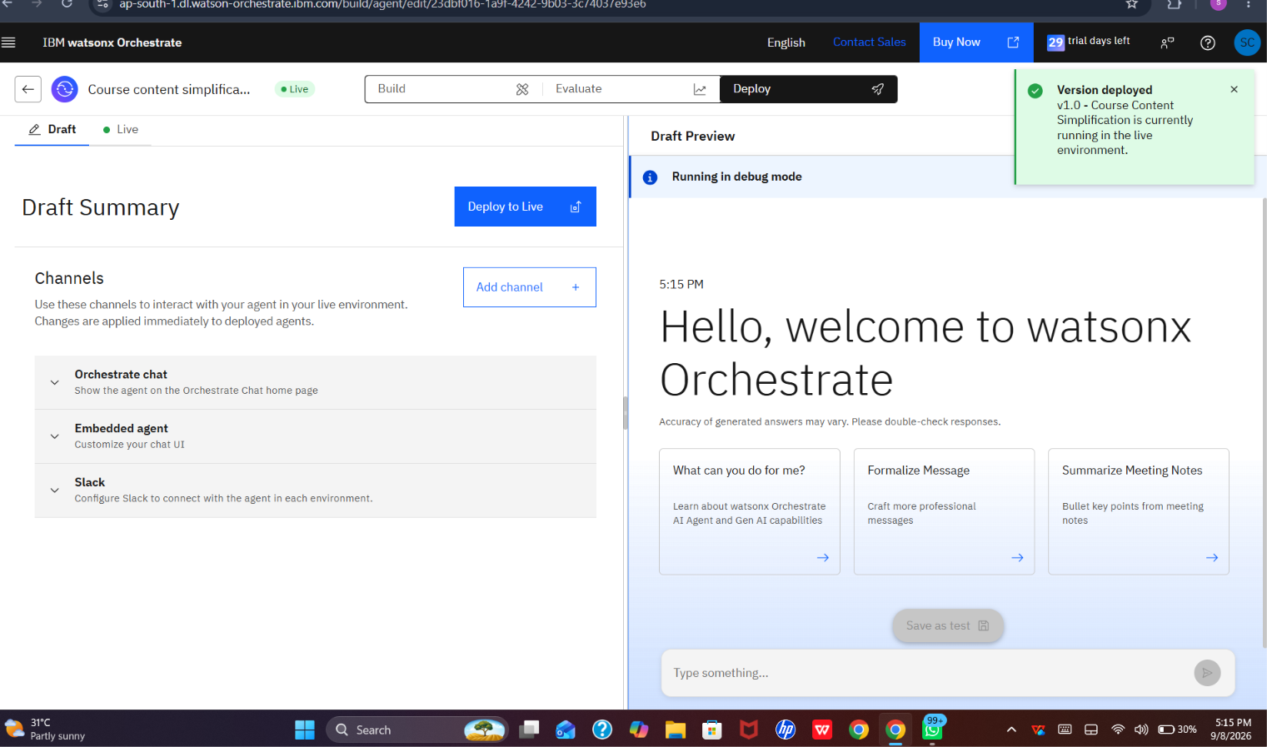
Deployment Evidence
The agent version is shown running in the Live environment.

Slide 8
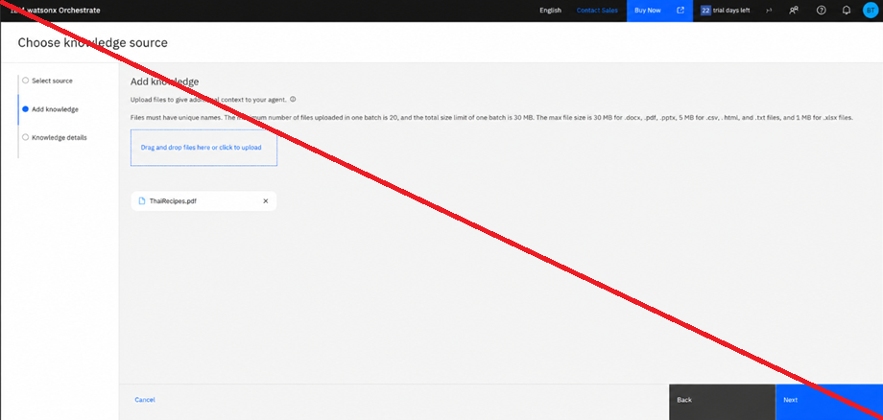
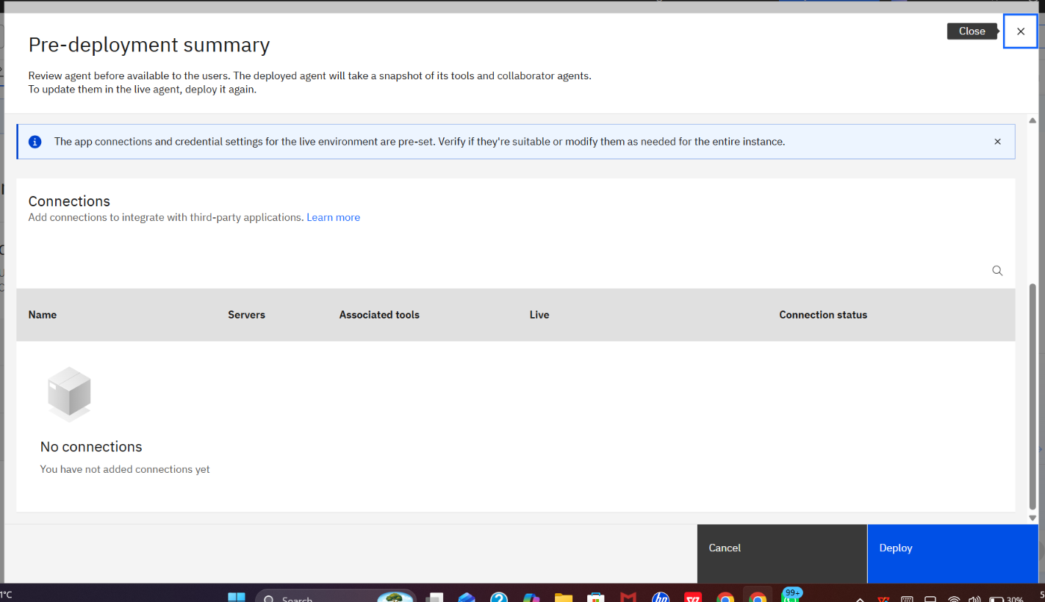
Pre-Deployment Check
The pre-deployment summary was reviewed before release.

Slide 9
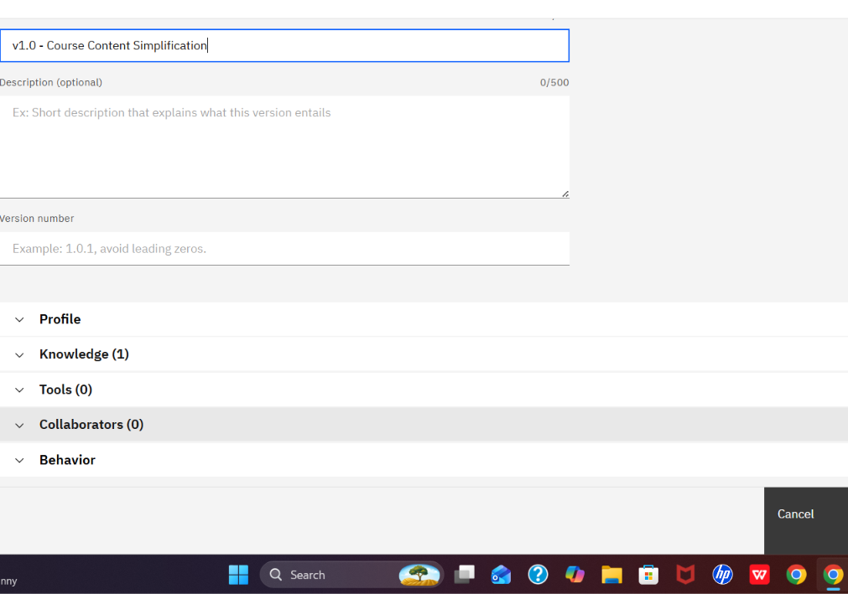
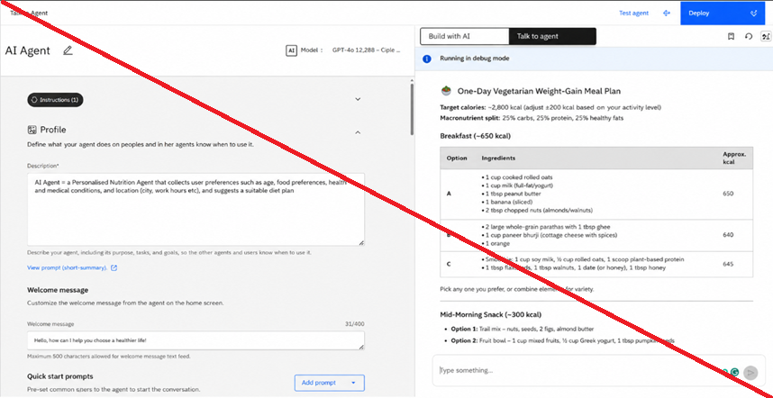
Version Creation
Version v1.0 – Course Content Simplification was created.

Slide 10
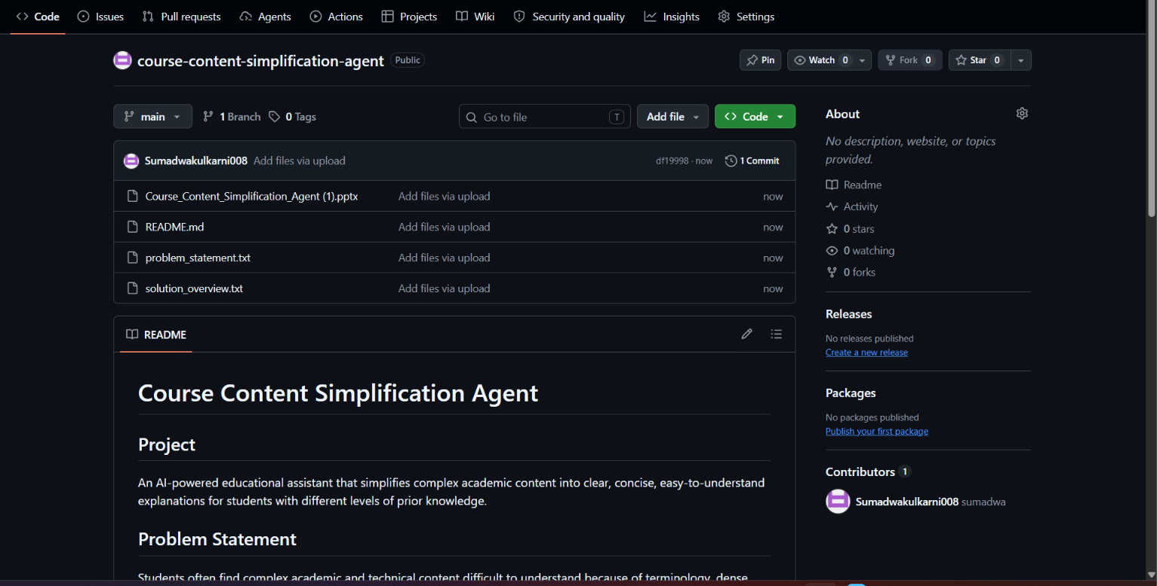
GitHub Repository
The public GitHub repository contains the project submission files.

Slide 11

Orchestrate Architecture Blueprint
End-to-end flow of the Course Content Simplification Agent
Student Question / Content
watsonx Orchestrate Agent
Course Knowledge
Simplified Answer
Evaluate 1 test → 100% success
Version v1.0 → Live Deployment

Slide 12

Role of Agentic AI in the Solution
Agentic AI makes the solution more than a basic question-and-answer chatbot. • Understands the student's request and required level of explanation. • Uses available course knowledge to support relevant responses. • Decides how to structure the explanation for clarity. • Generates concise, beginner-friendly responses while preserving core concepts. • Supports repeatable evaluation, versioning and deployment. The result is a goal-oriented learning assistant that adapts its explanation style to the student's need.

Slide 13
Novelty and Uniqueness
1. Learner-Centered Simplification – Focuses on how difficult a concept is for the learner. 2. Concept Preservation – Simplifies language while keeping important technical ideas. 3. Knowledge-Grounded Learning – Uses course knowledge as a supporting source. 4. Structured Responses – Presents concepts in clear steps, examples and simple terminology. 5. Deployable Agent – Built, evaluated, versioned and deployed using IBM watsonx Orchestrate.

Slide 14
GitHub Link
Public GitHub Repository https://github.com/Sumadwakulkarni008/course-content-simplification-agent Repository contents: • README.md – project documentation • problem_statement.txt – problem statement • solution_overview.txt – solution and implementation overview • Course_Content_Simplification_Agent.pptx – project presentation The repository is public and can be used to review the submitted project materials.
·
·
·
github.com/Sumadwakulkarni008/course-content-simplification-agent

Slide 15
Future Scope
1. Difficulty-Level Selection – Beginner, Intermediate or Advanced explanations. 2. Multilingual Learning – Regional-language support for broader accessibility. 3. PDF / PPT / Notes Input – Upload learning materials and ask questions directly from them. 4. Examples & Practice Mode – Generate examples, quizzes and short practice questions. 5. Learning Progress – Track frequently asked topics and recommend revision material. 6. Voice Interaction – Add voice input and spoken explanations.
·
·
·

Slide 16
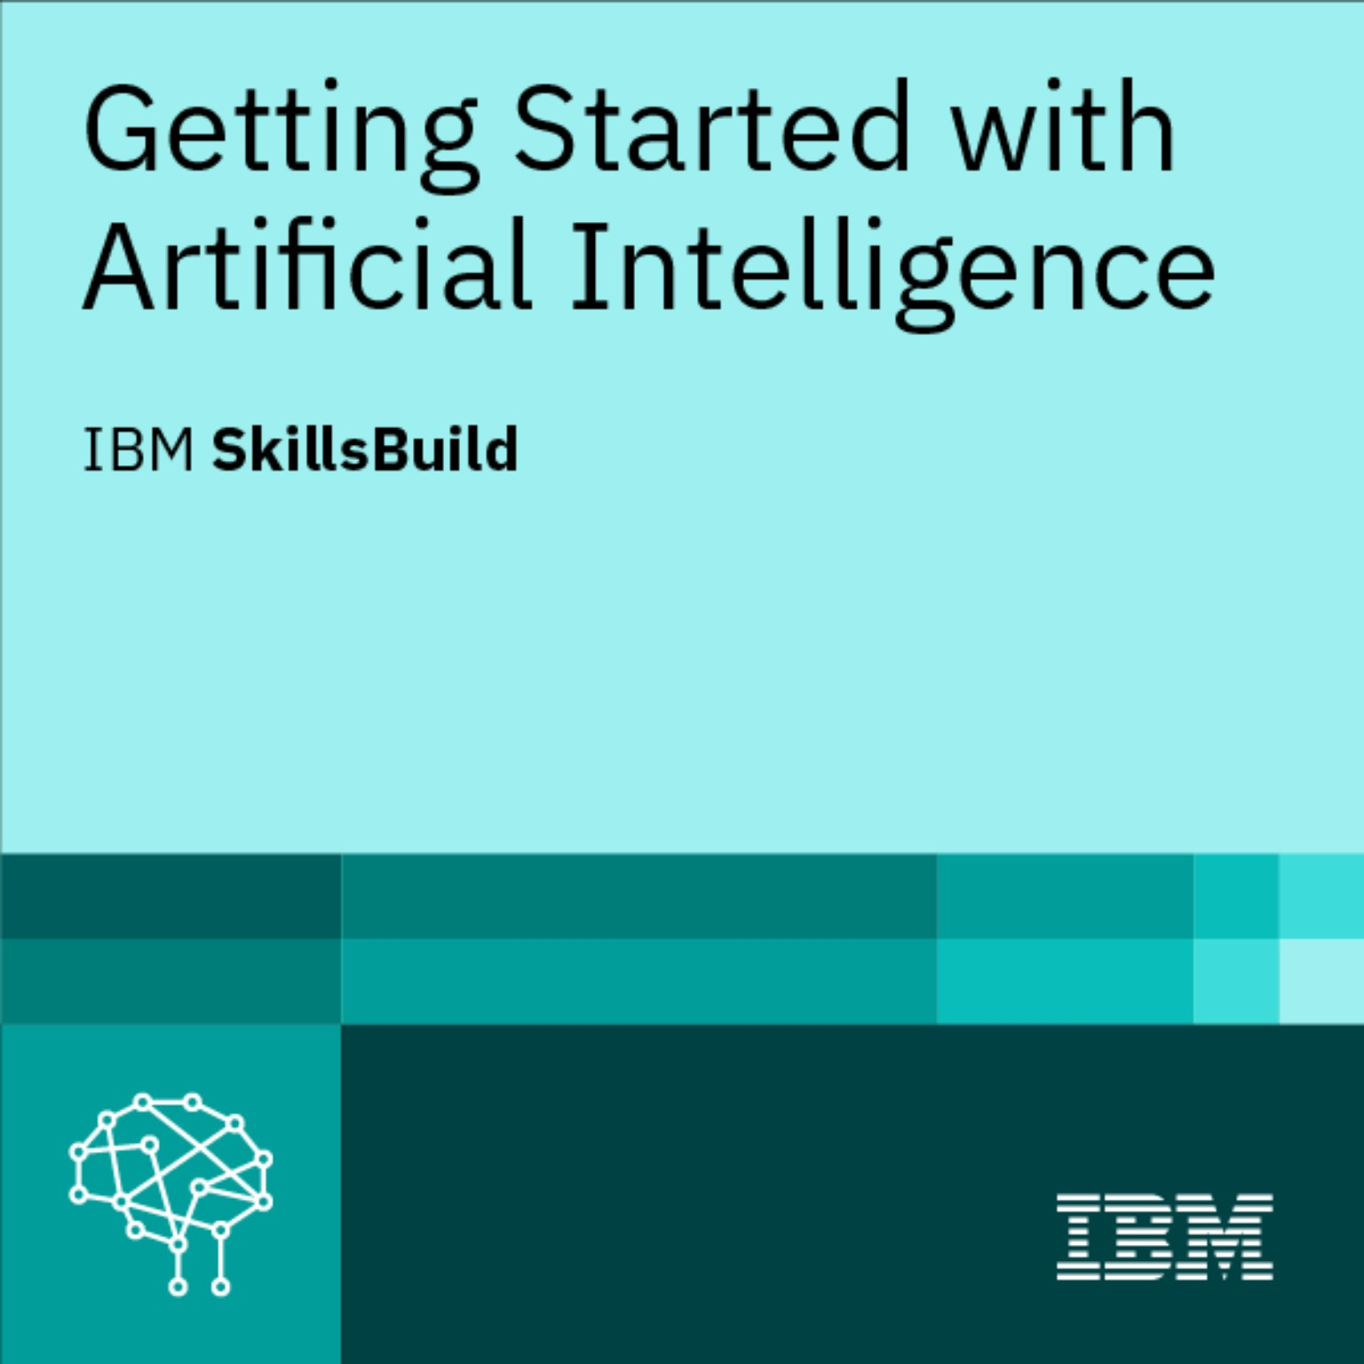
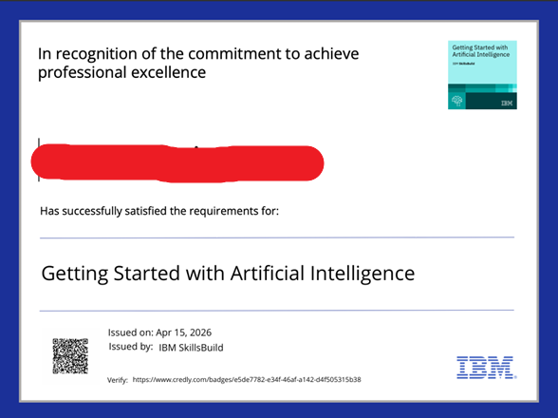
IBM SkillsBuild Certificate

Slide 17
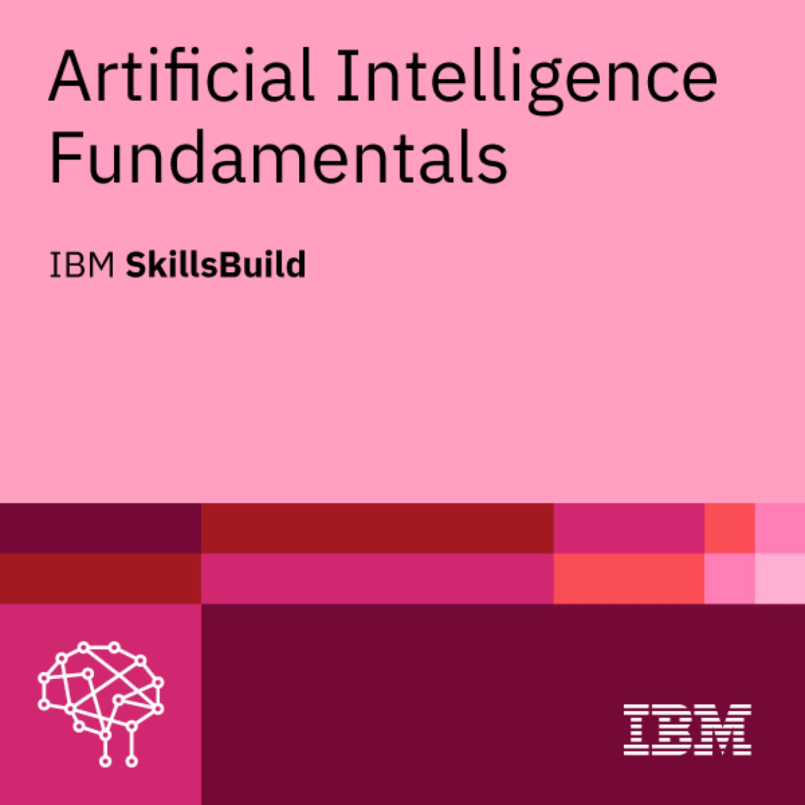
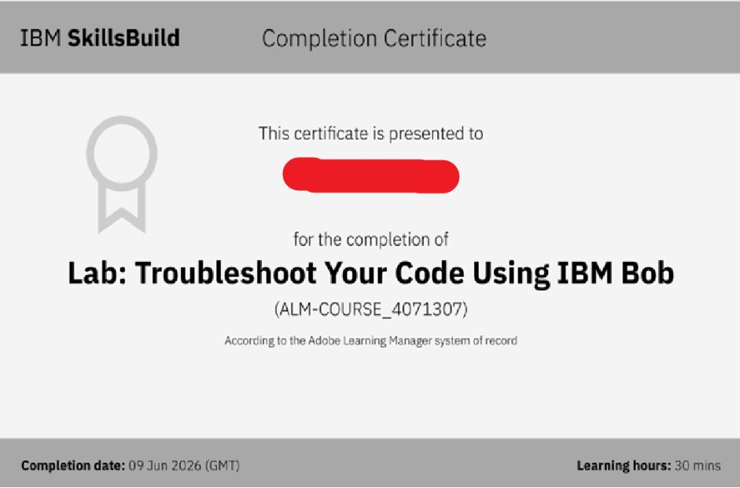
IBM SkillsBuild Certificate

Slide 18

Thank You
Course Content Simplification Agent
Sumadwa Kulkarni • 8277188531 • Sumadwakulkarni@gmail.com

