Slide 1
SEE BEYOND An assistive smart glasses and cane system that combines real-time vision AI with audio and haptic feedback to empower visually impaired individuals with safer navigation and independent living
Guided by sound, Empowered by touch

Slide 2
TEAM MEMBERS
01
01
Malaika Mustafa CS-006 3.78
02
Sumaika Imran CS-009 3.85
03
Qurratul ain CS-018 3.6
04
Urooj Fatima CS-022 3.0

Slide 3
BACKGROUND
01

Slide 4
An Overview of Visual Impairment in Pakistan
~9,028,073
Around 9 million people in Pakistan have some degree of vision impairment (from mild to total blindness).
~484,027
Out of these, around 4 million people are blind (significant vision loss)
According to the Third National Survey of Blindness conducted from 2019–2021

Slide 5
SOLUTION WHAT WE OFFER?
02

Slide 6

SEE BEYOND
“An assistive smart glasses and cane system that combines real-time vision AI with audio and haptic feedback to empower visually impaired individuals with safer navigation and independent living”
SEE BEYOND

Slide 7
KEY FEATURES
Object Recognition
People Recognition
Obstacle Detection
Optical
Character Recognition (OCR)
Currency Recognition (PKR)

Slide 8
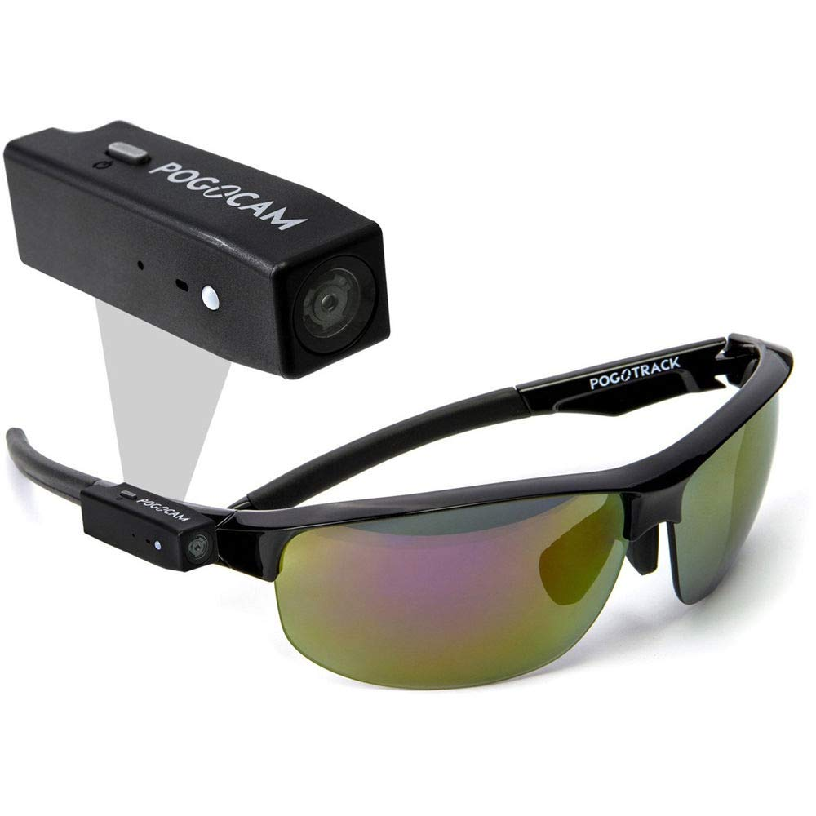
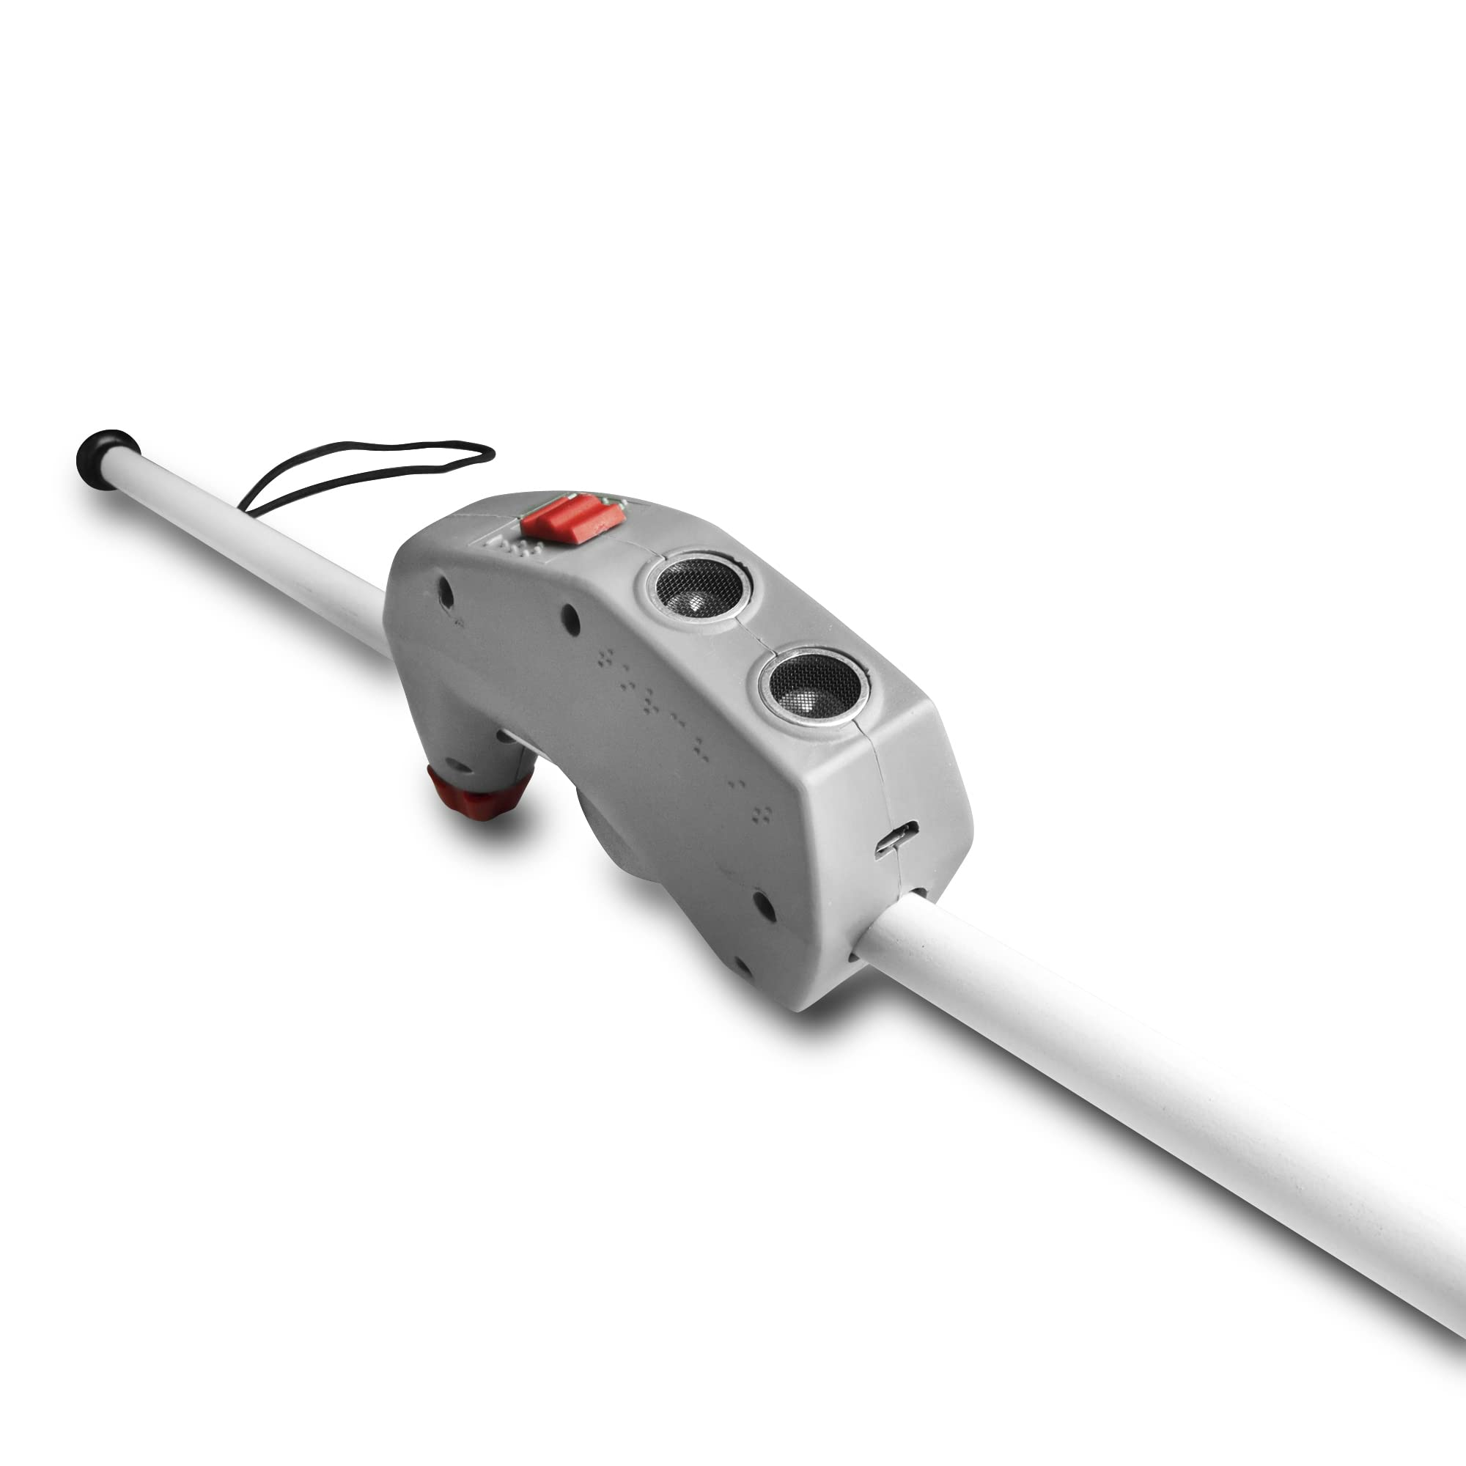
PRODUCT OVERVIEW
SEE BEYOND
MOBILE APPLICATION
SMART GLASSES
SMART CANE
The central processing hub of the system-receives visual data and processes commands through voice input and delivers results through real-time audio feedback
Equipped with a mounted camera that continuously captures images of the user’s surroundings from a natural, eye-level perspective. Transfers captured images directly to the mobile application
Integrated with ultrasonic sensors to detect nearby obstacles, Provides haptic (vibration) feedback to alert users and works independently

Slide 9
03
USP WHAT SETS SEE BEYOND APART?

Slide 10
KEY DIFFERENTIATOR
All-in-One Assistive Platform
Unlike most tools that address a single task (navigation, reading, or object detection), See Beyond integrates multiple essential functions like obstacle detection, optical character recognition, currency recognition and people recognition into one unified system

Slide 11
KEY DIFFERENTIATOR
Cost Effectiveness
Unlike smart glasses, smart canes, or sensor-based wearables that require expensive custom hardware, See Beyond runs entirely on commonly available devices (e.g., smartphones), eliminating upfront hardware costs.

Slide 12
TASK DIVISION
04

Slide 13
SUMAIKA CS-OO9 Focused on Object Detection, developing and training models to accurately identify and classify various objects in the user’s environment.
Problem identification and feature selection
Dataset selection,
Dataset Extraction and Organization
Class Filtering and Controlled Download,
Image and Annotation Flattening
Annotation Format Conversion
Class Mapping and Label Generation
Dataset Splitting
YOLO Configuration file Creation
Model Training, and Integration with device

Slide 14
QURRATUL-AIN CS-O18 Leading the People Recognition module, designing algorithms to detect and identify people around the user, enhancing situational awareness.
Data Collection
Live facial data captured via PC webcam with multiple samples per person
Pre-processing
Face detection and normalization performed using OpenCV DNN
Feature Extraction
FaceNet (OpenFace) model used to generate 128-D facial embeddings
Embedding Database
Facial embeddings stored locally in a JSON database with associated identities
Recognition & Decision
Real-time matching using cosine similarity with threshold-based identification

Slide 15
UROOJ FATIMA CS-O22 Responsible for Currency Detection, ensuring reliable recognition of different currency notes (PKR), aiding VI users in financial transactions.
Problem Identification
Early Approaches:
Tested pre-trained models and YOLOv8n
Custom Dataset Creation
Data Preprocessing and Augmentatiom
Model Training
(YOLOv8s)
Final Results:
Achieved overall 96.5% accuracy with F1-score 93.5%

Slide 16
MALAIKA MUSTAFA CS-006 Handling Optical Character Recognition (OCR), enabling the system to read and interpret text from captured images.
Image Acquisition Scene images captured using a wearable or mobile camera
Pre-processing Image enhancement and normalization to improve text visibility
Text Detection Identification of text or character regions in unconstrained scenes
Feature Extraction Extraction of visual features from detected text regions
Recognition & Decision Word-level text recognition using confidence-based matching
Output Recognized text displayed or provided as audio feedback

Slide 17
This clear division of tasks allows us to work in parallel while integrating our modules seamlessly, creating a robust and efficient assistive device.

Slide 18
MILESTONE SUMMARY
05

Slide 19
PEOPLE RECOGNITION
Objective:
Enable real-time identification of known individuals for assistive use and Preserve user privacy by avoiding raw image storage

Slide 20
MILESTONES ACHIEVED
Implemented Functionalities
Real-time face detection using OpenCV DNN
Face embedding extraction using pre-trained FaceNet (OpenFace)
Local enrollment of multiple individuals
JSON-based embedding storage
Real-time identification using cosine similarity
Threshold-based unknown person detection
System Characteristics
No GPU required
Runs in real time on a PC
Scalable

Slide 21
CURRENCY RECOGNITION

Slide 22
MILESTONES ACHIEVED
High Model Accuracy Achieved Overall system accuracy reached 96.5%, demonstrating reliable performance across real-world scenarios.
Strong Detection Precision Achieved 0.94 precision, indicating a low false-positive rate and accurate identification of objects and text.
Robust Model Performance Recorded an F1-score of 93.5%, reflecting a balanced trade-off between precision and recall.
Successfully Validated on Real-World Data Models tested under varying lighting, environments, and usage conditions to ensure practical reliability.

Slide 23
OBJECT RECOGNITION

Slide 24
OBJECT RECOGNITION
The object recognition feature is activated through a voice command using the microphone, enabling hands-free operation. The camera captures real-time images of the user’s surroundings, and the trained object recognition model identifies known objects and provides audio feedback to the user. If an object is not recognized, the system automatically captures images of the new object and improves its understanding through a reinforcement learning–based approach, allowing the model to learn and recognize new objects over time with better accuracy.

Slide 25
OPTICAL CHARACTER RECOGNITION

Slide 26
OPTICAL CHARACTER RECOGNITION
This feature help to read any print such as in a book, magazine, newspaper, etc. The role of the English language in education, empowerment, and media is significant, and the optical character recognition (OCR) technology of the device was designed to extensively support the English language. It is also designed to support urdu language.

Slide 27
FUTURE PLAN
06

Slide 28
FUTURE PLANS
Integration with Mobile App
Voice Assistant Functionality
Smart Cane Development
We will integrate these trained models into a user-friendly mobile application. The app will serve as the central processing unit, communicating with the camera on the glasses and the smart cane.
The device will be enhanced with a voice assistant interface. For example, when the user says, “Which note is this?”, the system will activate the currency detection model and provide an immediate audio response through headphones
Alongside the app, a smart cane equipped with sensors for independent obstacle detection will be developed, offering real-time feedback to the user to navigate safely

Slide 29
GOAL
To create a seamless, affordable assistive system that empowers visually impaired users with accurate environmental awareness, enhanced mobility and greater independence.

Slide 30
THANKS!

