Slide 1
OBJECT ORIENTED PROGRAMMING
(MISS MARIA RAHIM)
Group Members:
Muhammad Sumair – 22995
Muhammad Usman Ahmed Tirmizi - 22888

Slide 2
PROJECT DESCRIPTION
Banking System
The program is the representation of the way in which the bank operates.
It contains the customers and their accounts with detailed information.
It contains different features or functions like signup forms for both current and savings account, deposit and withdrawal of money etc.
It contains both current and savings account.

Slide 3
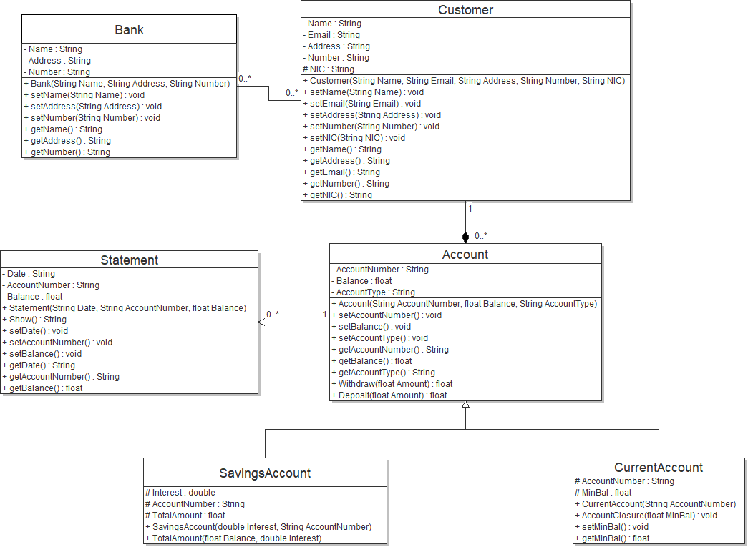
OLD UML DIAGRAM
Bank is the parent class as shown in the UML diagram.
The rest of the classes are connected to each other in an order of child class of the preceding class.
Aggregation and composition between two classes can be seen in the UML diagram.

Slide 4
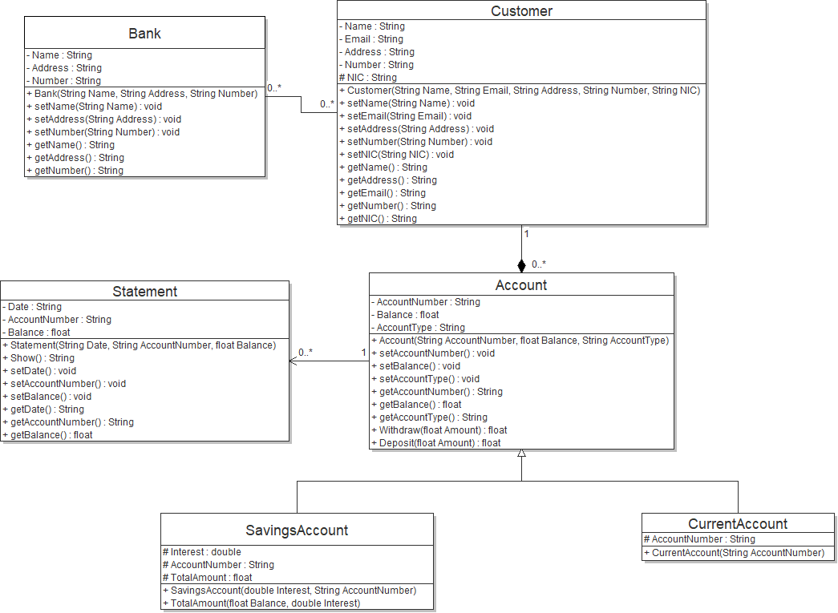
NEW UML DIAGRAM
Only current account has been modified.
The minimum balance and the account closure functions has been removed.

Slide 5
CONCEPTS USED IN THIS PROJECT
Encapsulation.
Inheritance.
Association(Aggregation and Composition).
Polymorphism.
Graphical User Interface.
Filing.
Exception Handling.

Slide 6
CODE PREVIEW

