Slide 1

Numerical Methods
Lecture 10

Slide 2
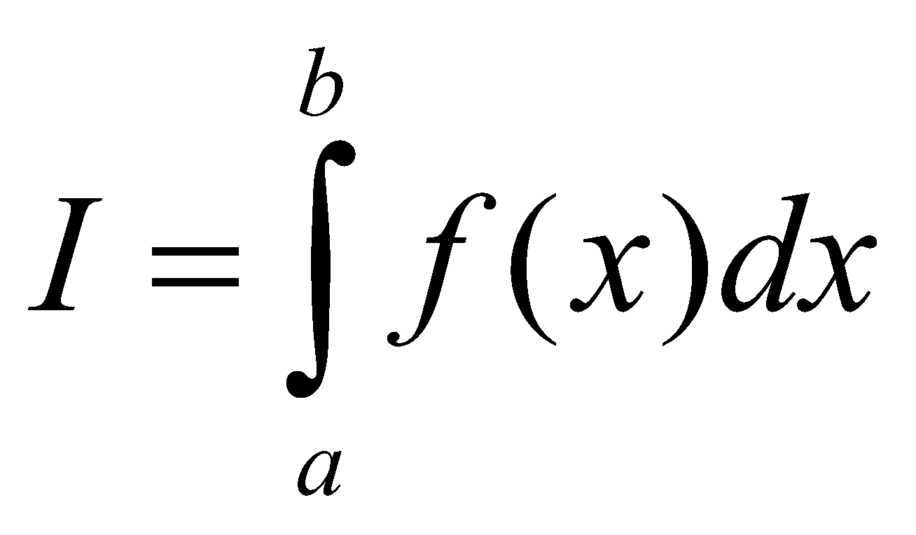
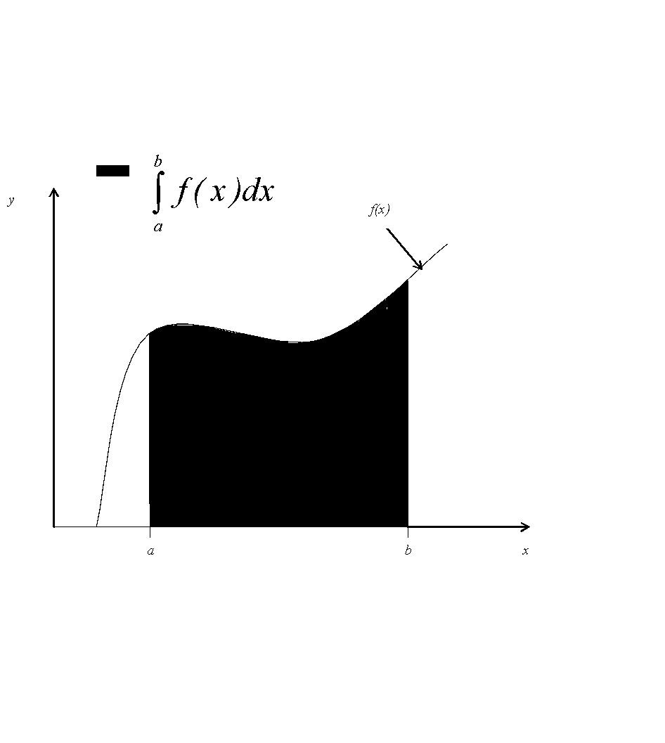
Numerical Integration
Integration
The process of measuring the area under a curve.
Where
f(x) is the integrand
a= lower limit of integration
b= upper limit of integration

Slide 3
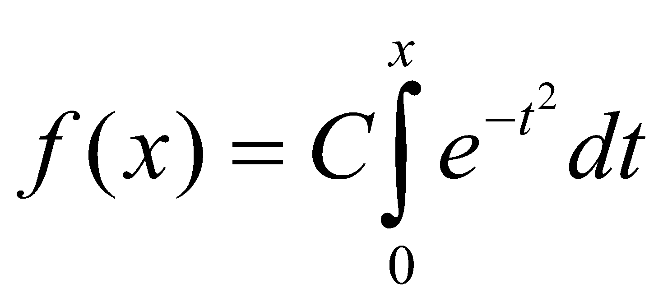
Numerical Integration
Why Numerical Integration?
We need to seek the help of numerical integration techniques in the following situations:
Functions don’t possess closed form solutions. Example:
Closed form solutions exist but these solutions are complex and difficult to use for calculations.
Data for variables are available in the form of a table, but no mathematical relationship between them is known.

Slide 4
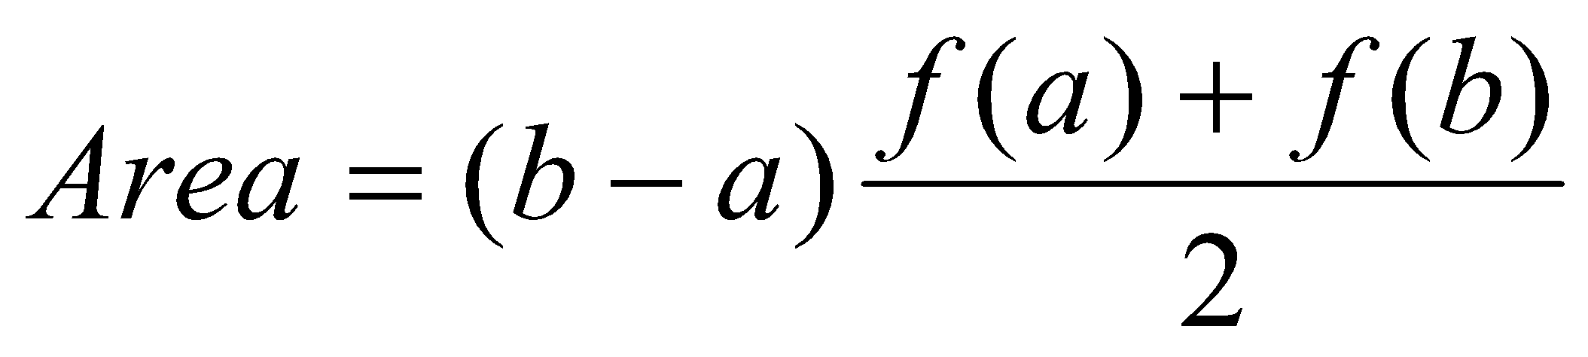
Numerical Integration
TRAPEZOIDAL RULE (Two-point formula)
The trapezoidal rule is the first and the simplest of the Newton-Cotes formulae.
Since it is a two point formula, it uses the first order interpolation polynomial p₁(x) for approximating the function f(x) and assumes x₀=a and x₁=b.
This is illustrated in the following figure.
f(x)
p₁(x)
f(b)
f(x)
f(a)
x₀= a
x₁= b
x
Fig.: Representation of trapezoidal rule

Slide 5
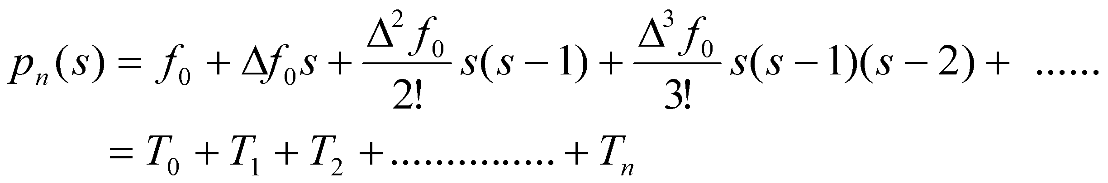
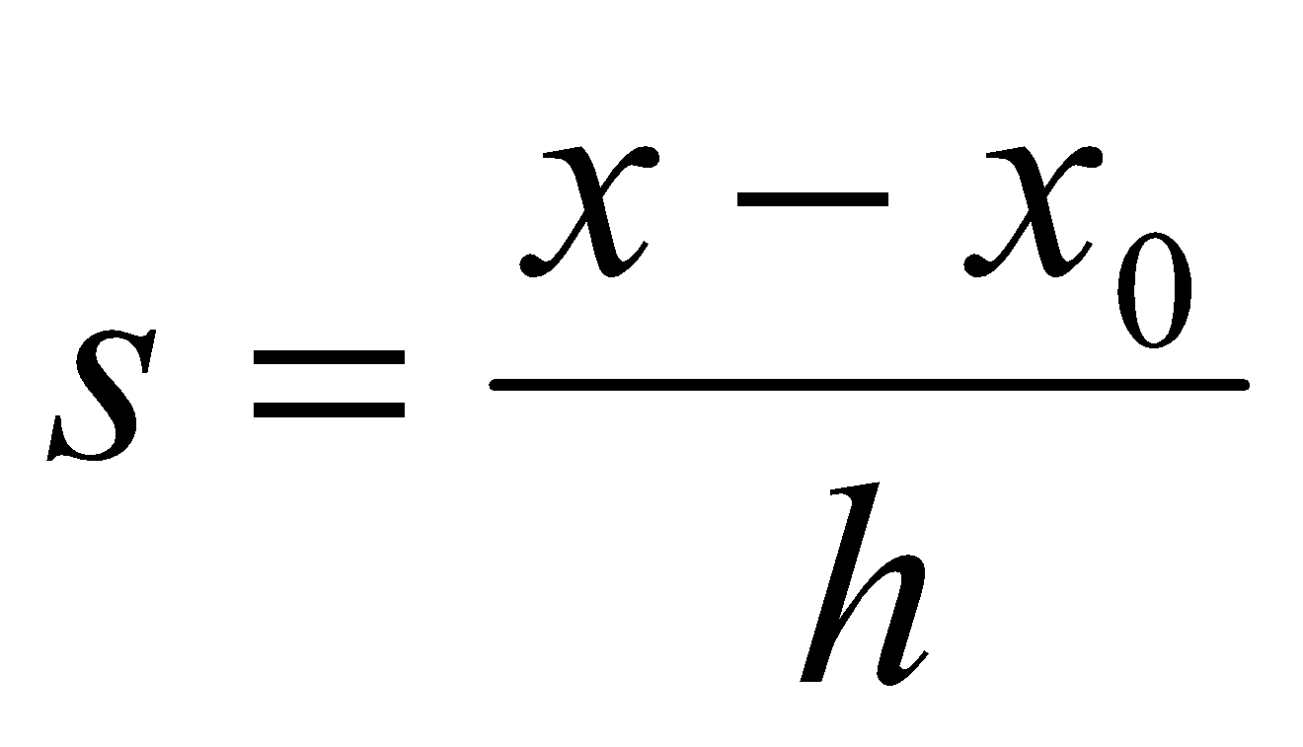
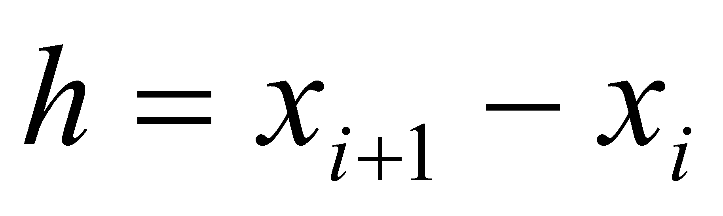
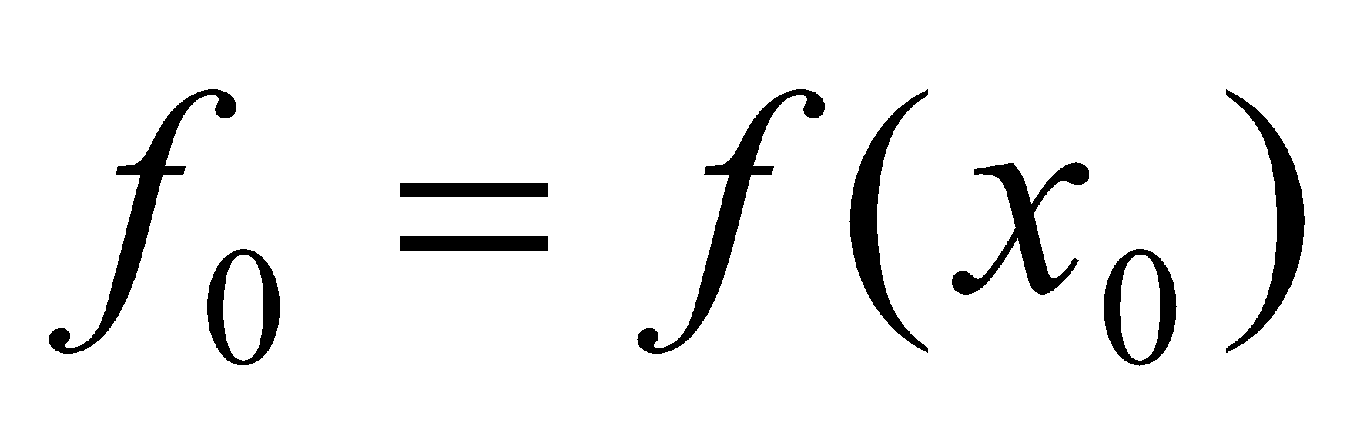
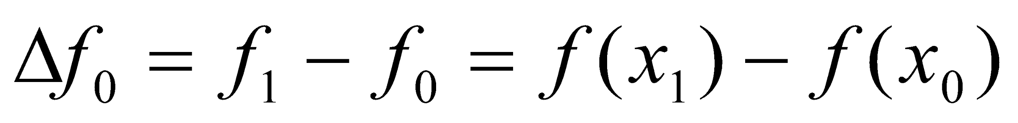
Numerical Integration
,
,
TRAPEZOIDAL RULE (Two-point formula)
Newton-Gregory forward formula (polynomial):
Where,

Slide 6
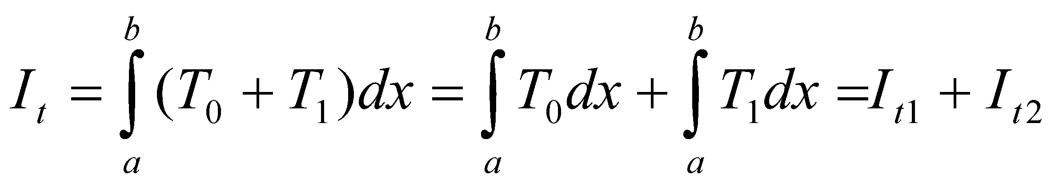
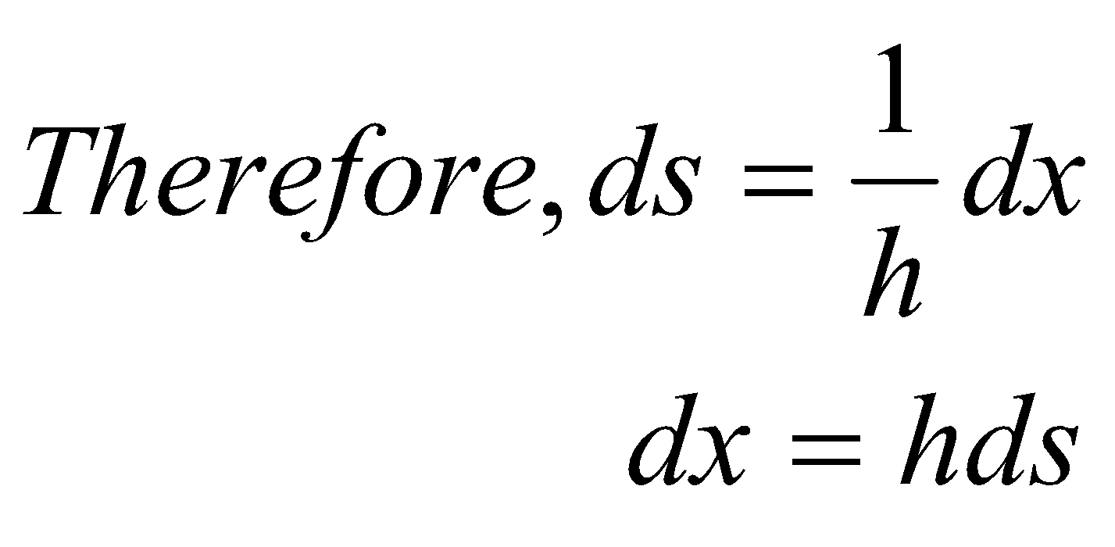
Numerical Integration
TRAPEZOIDAL RULE (Two-point formula)
p₁(x) consists of the first two term T₀ and T₁. Therefore, the integral for trapezoidal rule is given by:
Since T_{i} are expressed in terms of s, we need to use the following transformation:

Slide 7
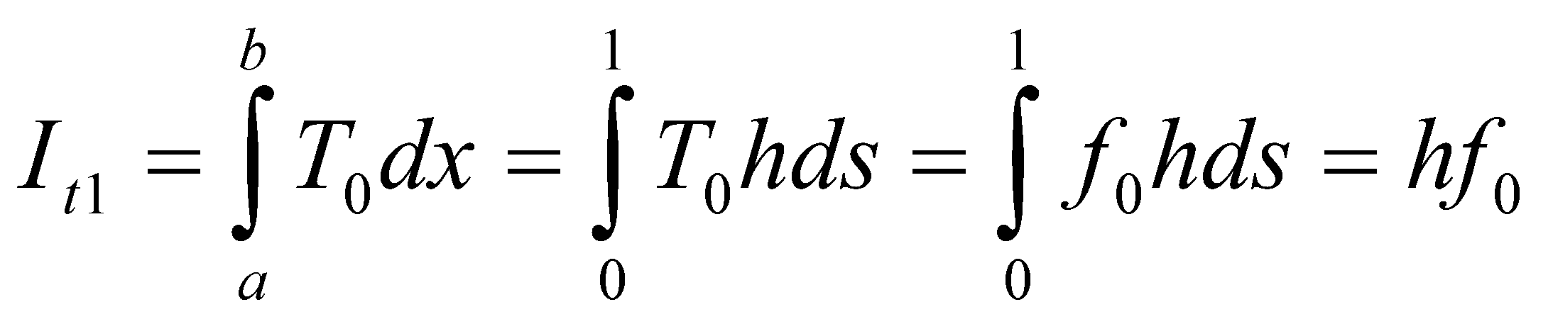
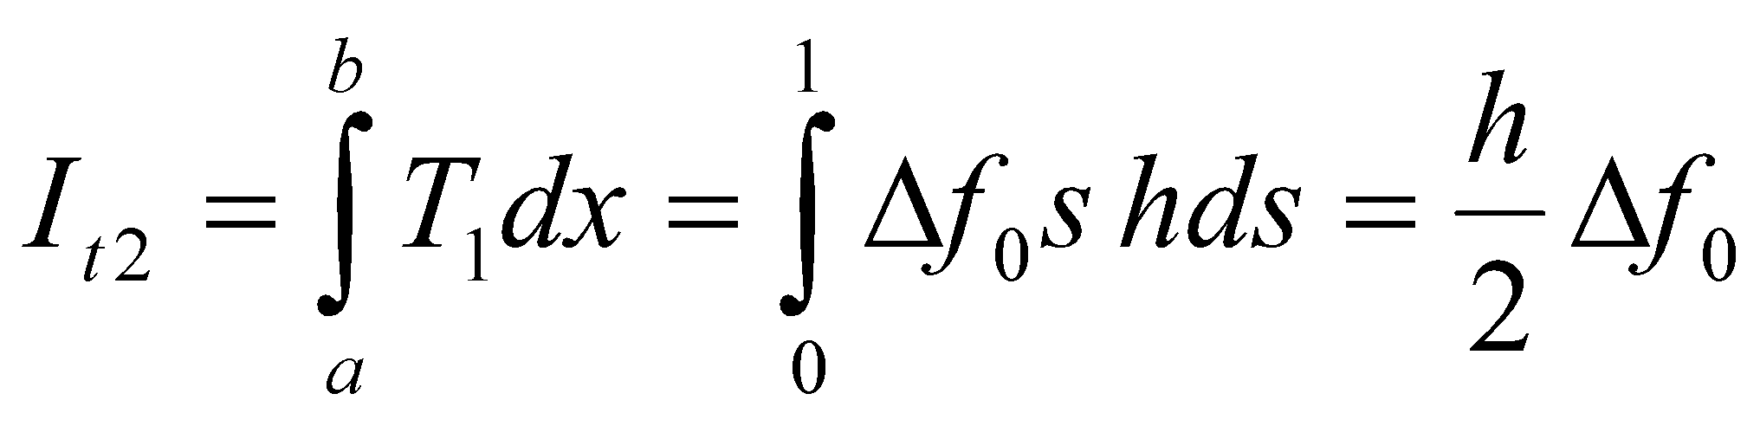
Numerical Integration
TRAPEZOIDAL RULE (Two-point formula)
x₀ = a, x₁ = b, and h = b – a
At x = a, s = (a - x₀)/h = (a - a)/h = 0
At x = b, s = (b - x₀)/h = (b - a)/h = h/h = 1
Then,
and

Slide 8
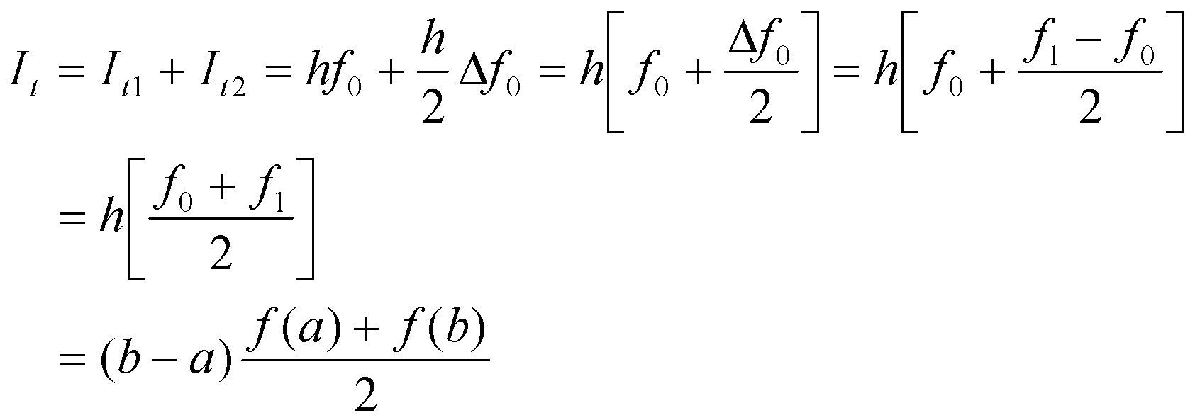
Numerical Integration
TRAPEZOIDAL RULE (Two-point formula)
Therefore,
The area is the product of width of the segment (b - a) and average height of the points f(a) and f(b) .

Slide 9
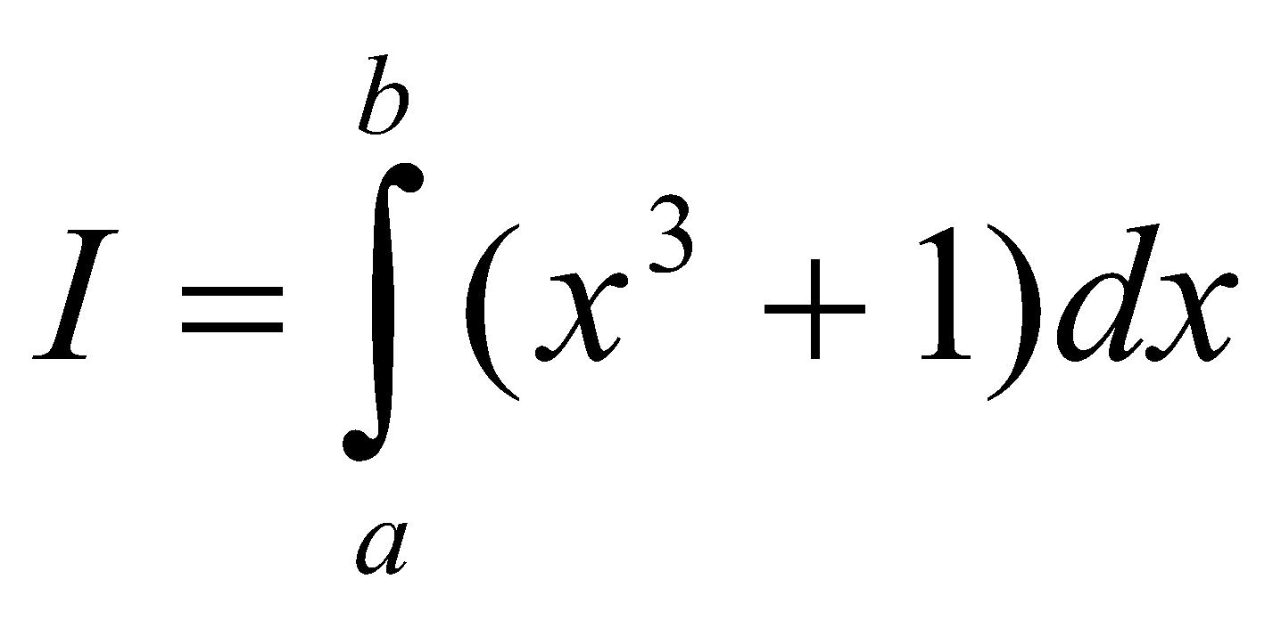
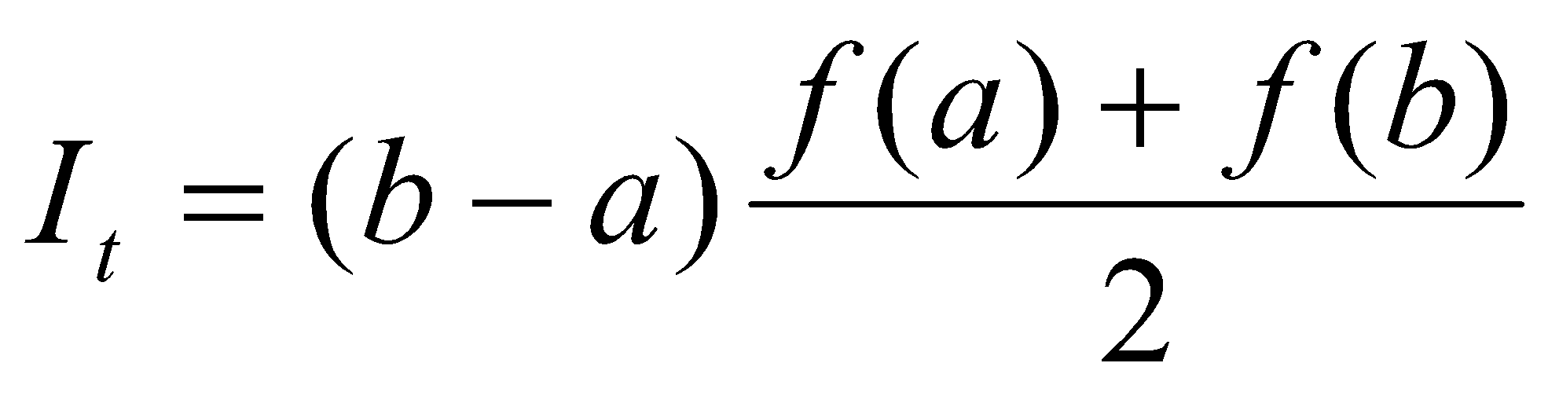
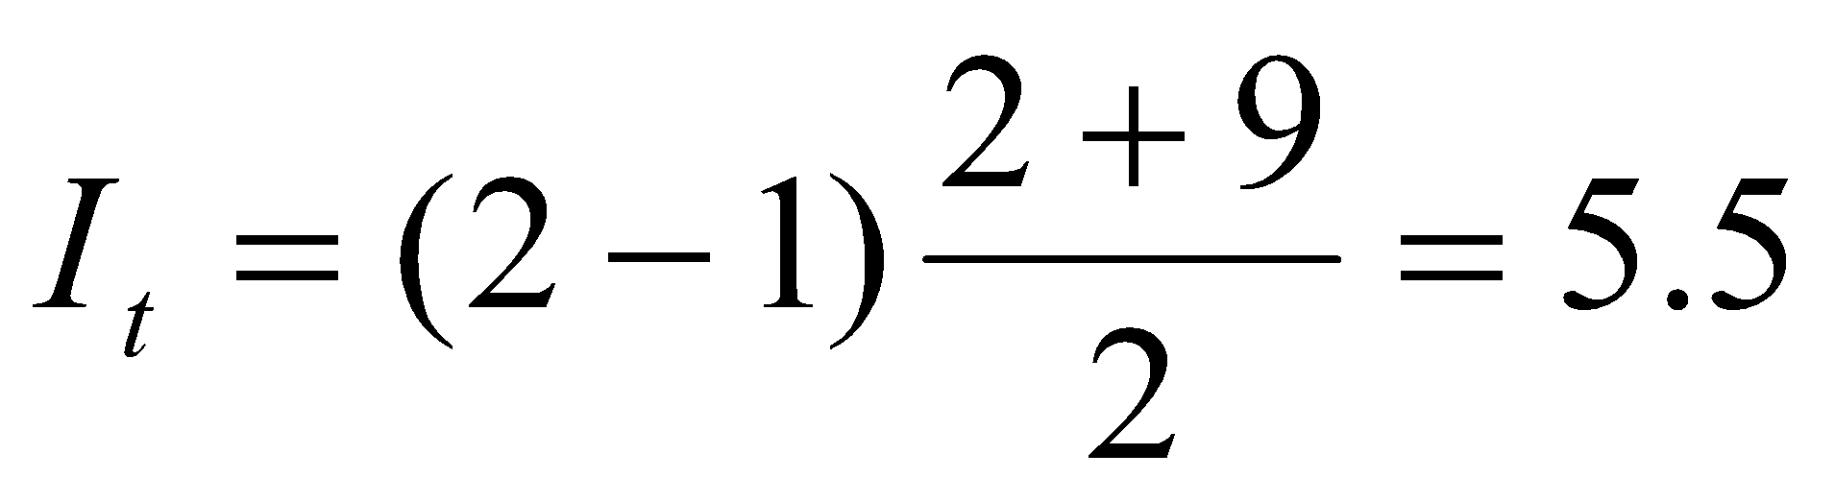
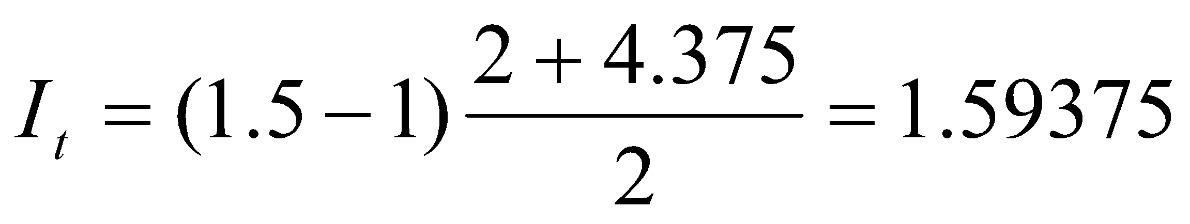
Numerical Integration
Example:
Evaluate the integral for the intervals (i) (1, 2) and (ii) (1, 1.5).
Solution:
(i)
Here, a = 1 and b = 2, and h = b - a = 2 - 1 = 1
Therefore,
(ii) Here, a=1 and b=1.5, and h=b-a=1.5-1=0.5

Slide 10
Numerical Integration
COMPOSITE TRAPEZOIDAL RULE
If the range to be integrated is large, the trapezoidal rule can be improved by dividing the interval (a, b) into a number of small intervals and applying the rule.
The sum of areas of all the subintervals is the integral of the interval (a, b). This is known as composite or multi-segment approach.
f(x)
f₃
f₁
f₂
f_{n-1}
f_{n}
f₀
. . . .
x₀= a
x₁
x₂
x₃
x_{n-1}
x_{n}= b
x
Fig.: Multi-segment trapezoidal rule

Slide 11
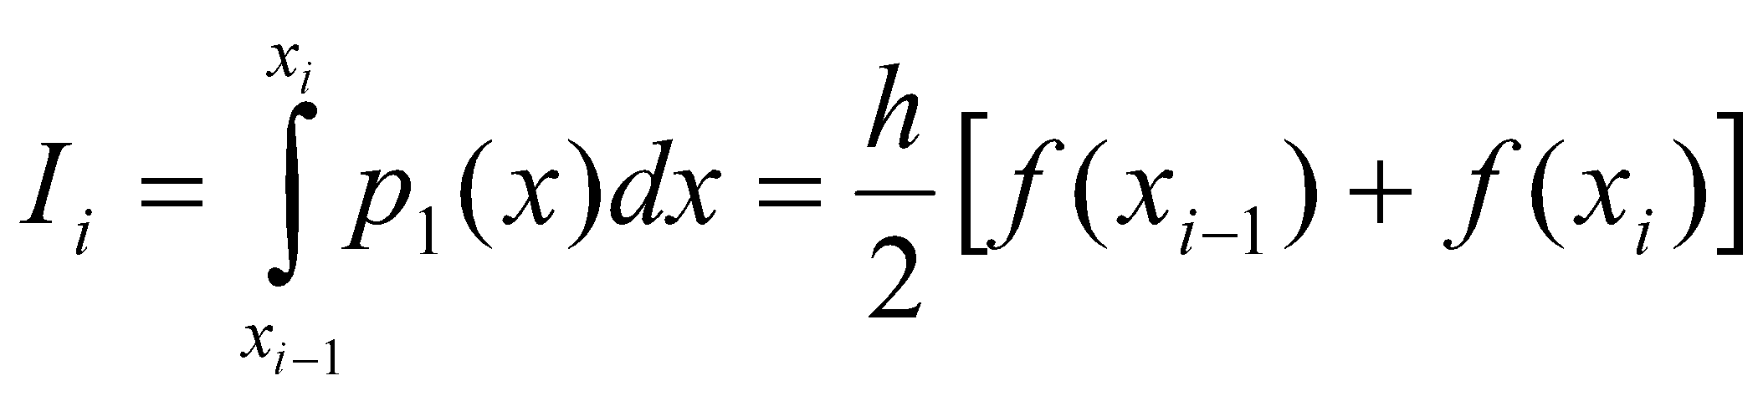
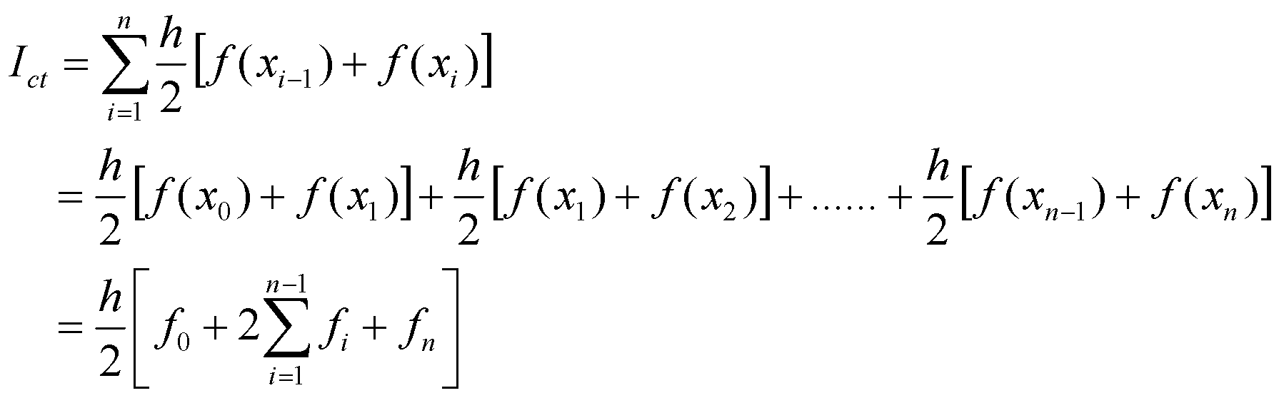
Numerical Integration
COMPOSITE TRAPEZOIDAL RULE
There are n+1 equally sampling points.
No. of segments = n
Segment width, h = (b – a)/n
x_{i} = a + ih ; i = 0, 1, 2, . . . ., n
Therefore, area of the subinterval with the nodes x_{i-1} and x_{i} is given by:
Thus, the total area of all the n segments is

Slide 12
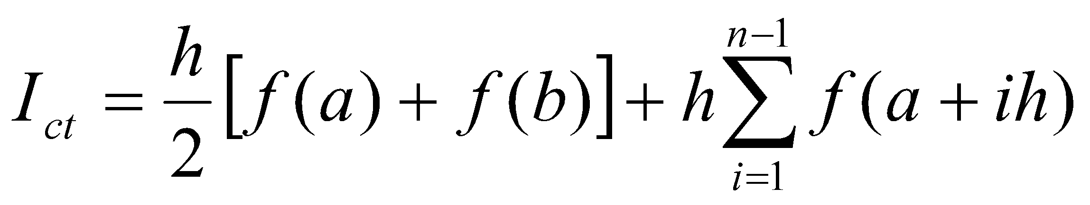
Numerical Integration
COMPOSITE TRAPEZOIDAL RULE
This is known as composite trapezoidal (ct) rule.

Slide 13
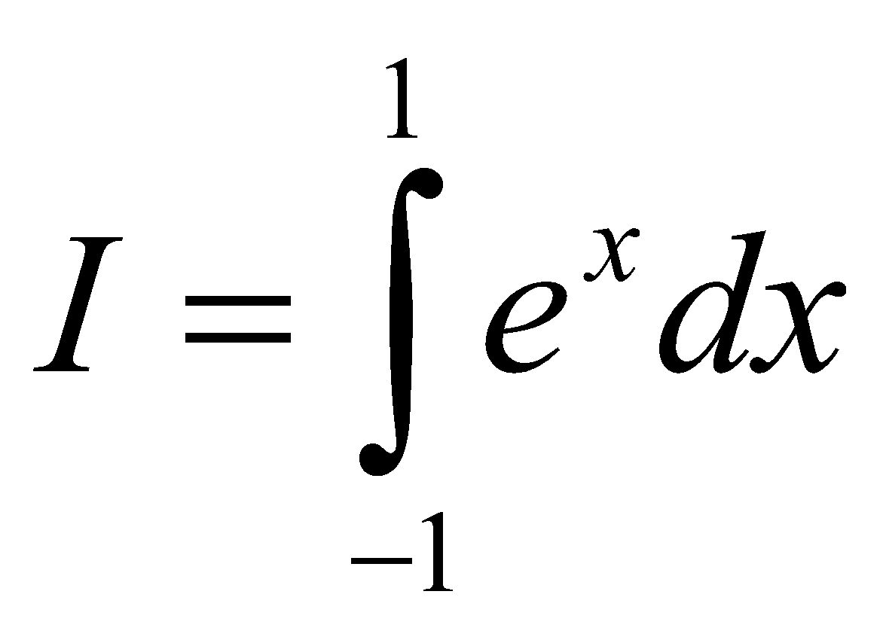
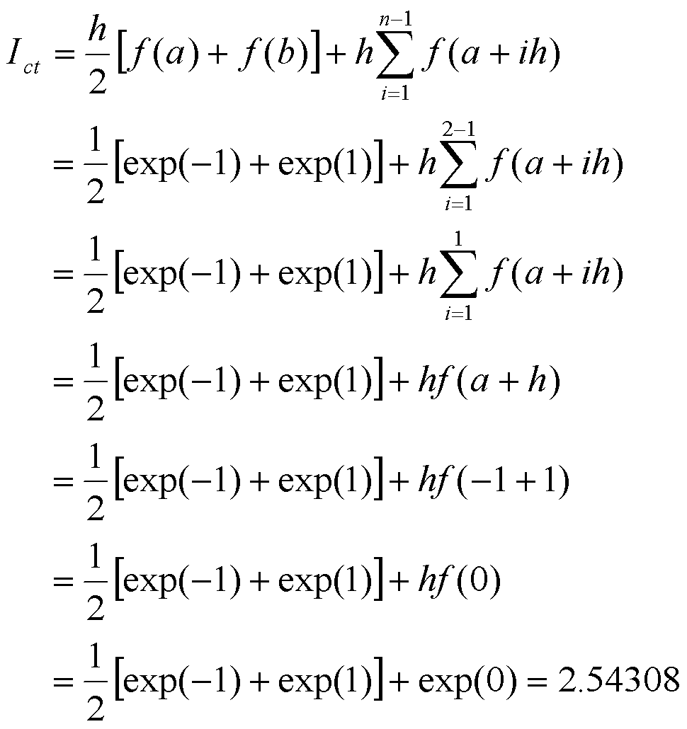
Numerical Integration
Example:
Compute the integral using composite trapezoidal rule for (i) n = 2 and
(ii) n = 4.
Solution:
(i) For n = 2,
h = (b-a)/n = 1

Slide 14
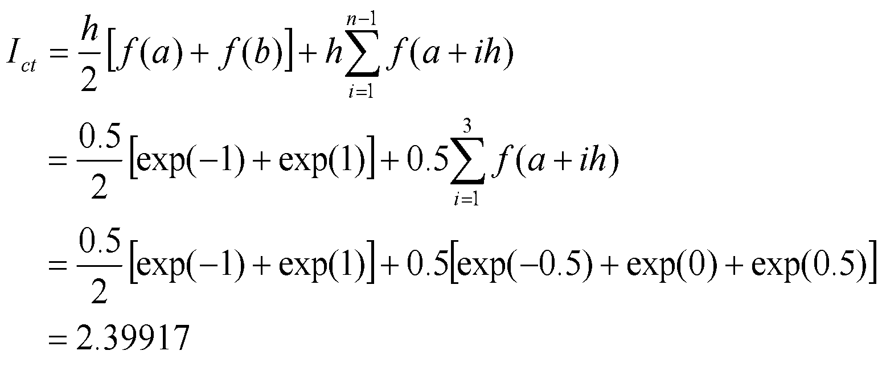
Numerical Integration
Example:
Compute the integral using composite trapezoidal rule for (i) n = 2
and (ii) n = 4.
Solution:
(ii) For n = 4,
h = (b-a)/n = 0.5
Exact value, I_{exact} = 2.35040. Thus, n=4 gives better results.

Slide 15
Numerical Integration
SIMPSON’s 1/3 RULE (Three-point formula)
This is another popular method.
Here the function f(x) is approximated by a second order polynomial p₂(x) which passes through three sampling points.
The three points include the end points a and b and a mid-point between them, i.e. x₀= a and x₂= b and x₁=(a + b)/2.
This is illustrated in the following figure.
f(x)
f(x₁)
f(x)
f(a)
f(b)
p₂(x)
x₀= a
x₁
x₂= b
x
Fig.: Representation of Simpson’s 1/3 rule

Slide 16
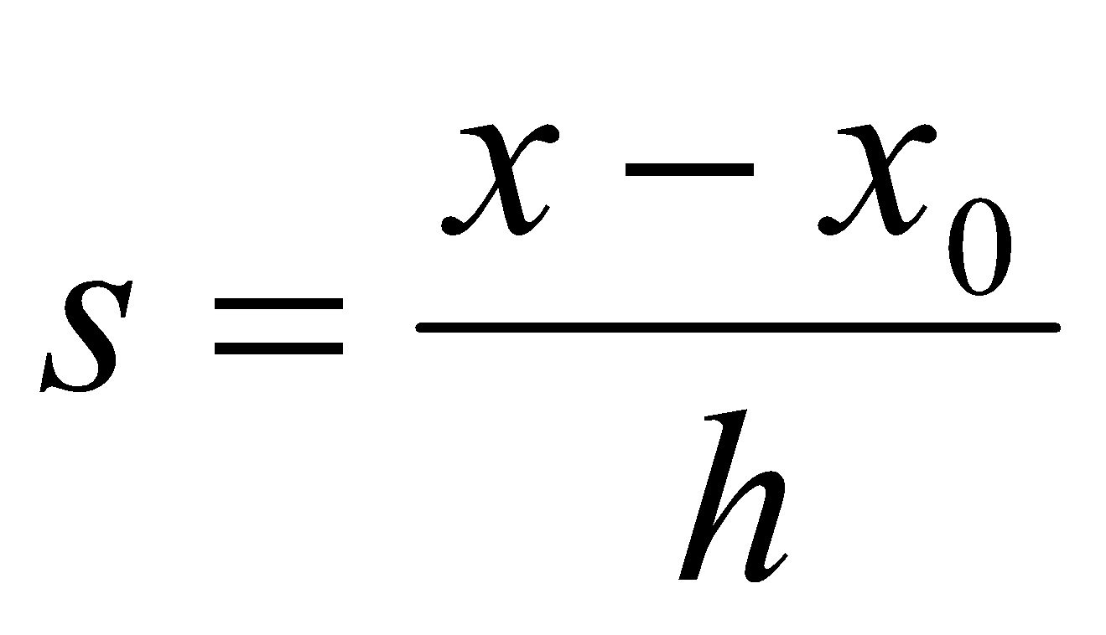
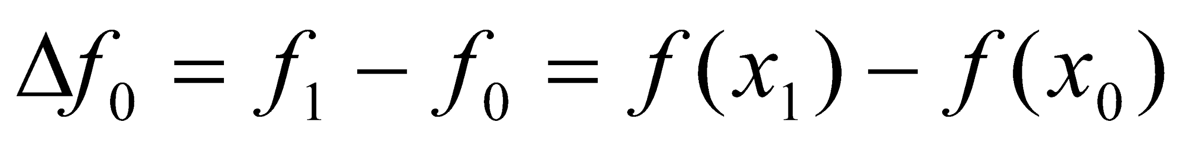
Numerical Integration
,
,
SIMPSON’s 1/3 RULE (Three-point formula)
The width h is given by
h = (b - a)/2
Newton-Gregory forward formula (polynomial):
Where,

Slide 17
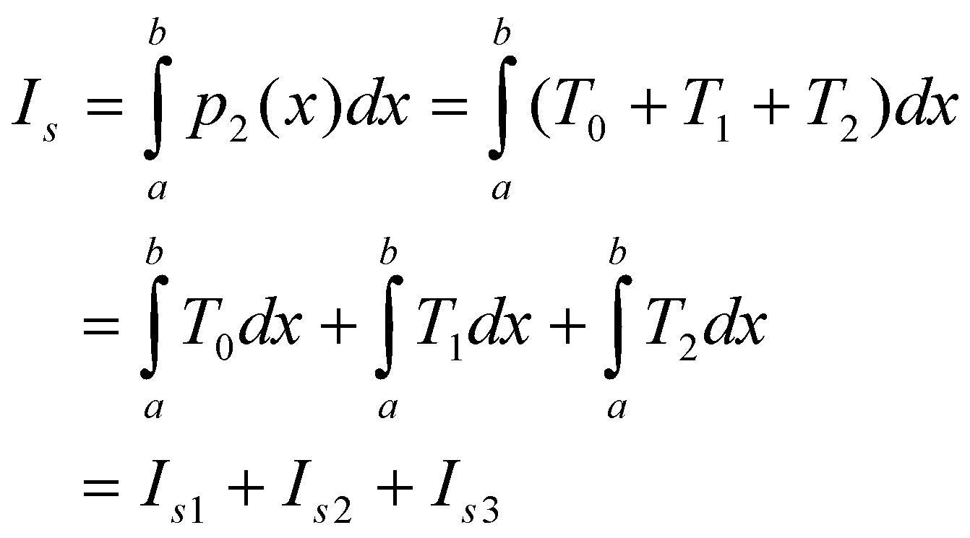
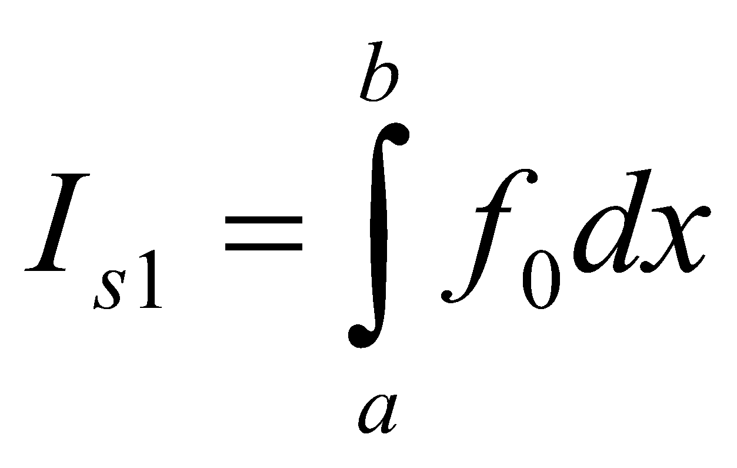
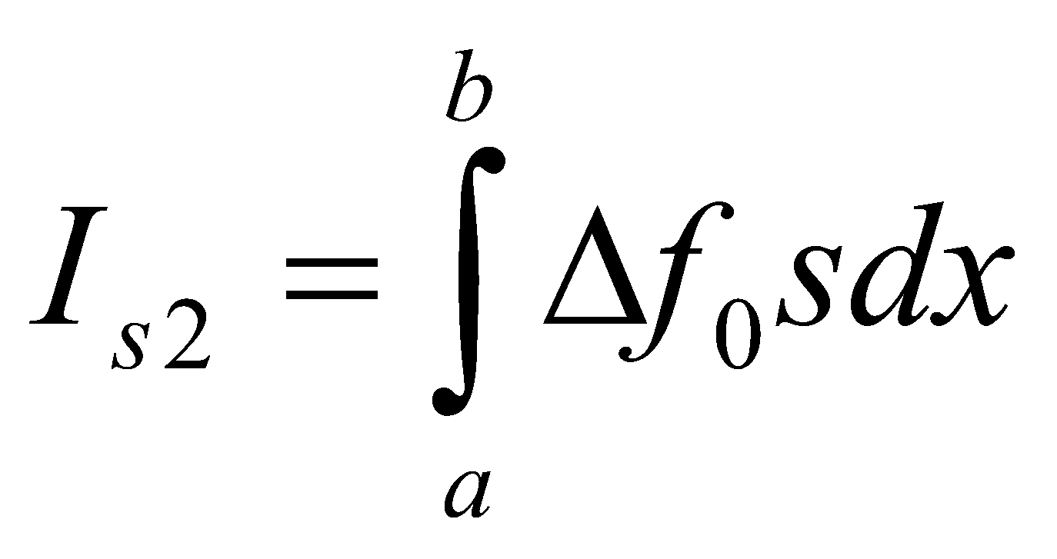
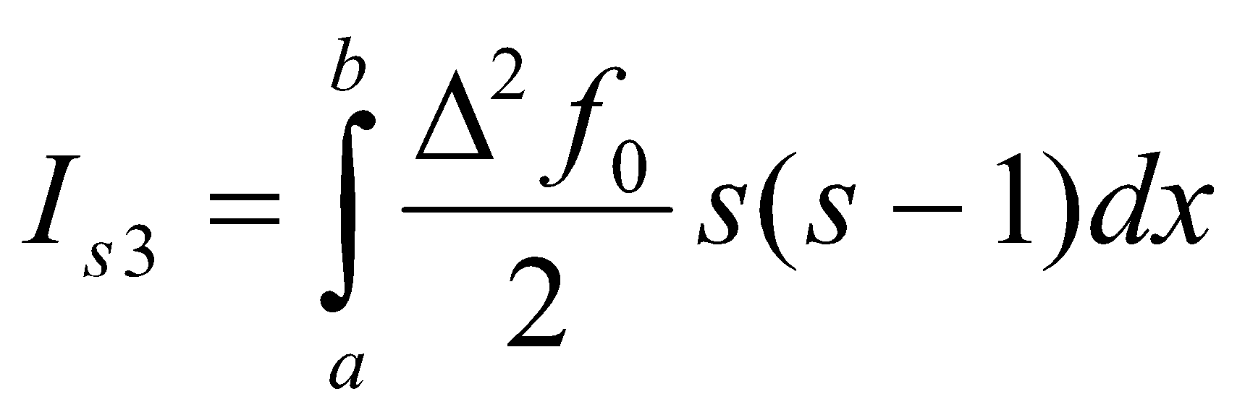
Numerical Integration
,
,
SIMPSON’s 1/3 RULE (Three-point formula)
p₂(x) consists of the first three term T₀, T₁ and T₂. Therefore, the integral for Simpson’s 1/3 rule is given by:
Where,

Slide 18
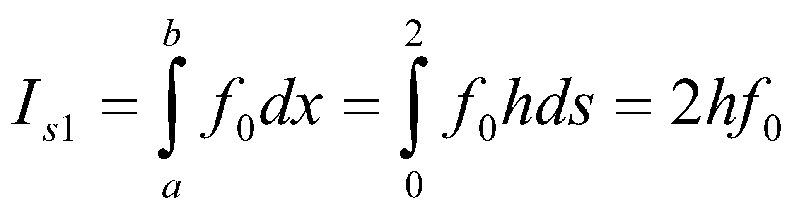
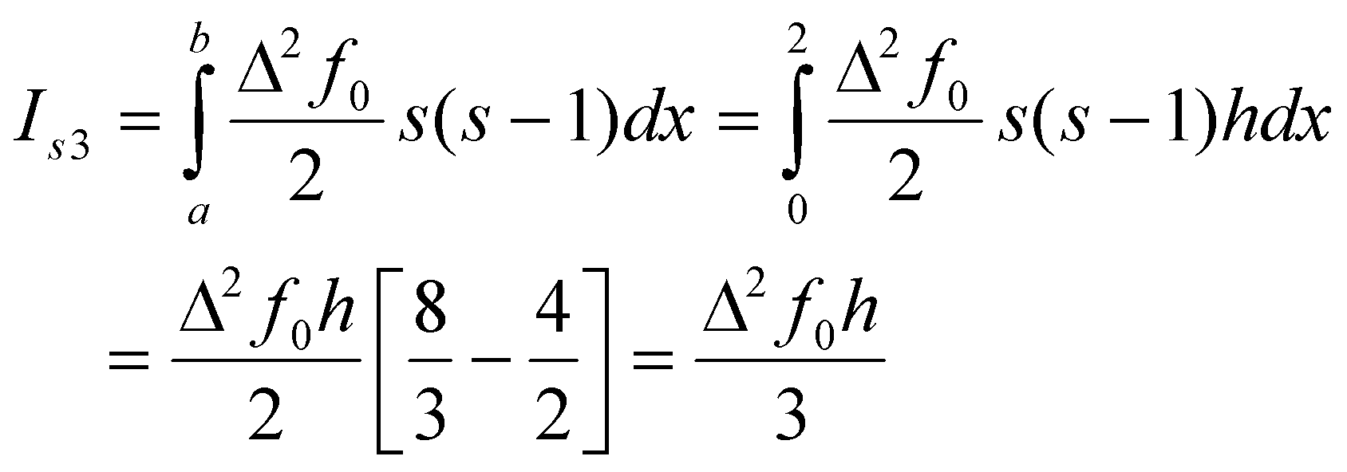
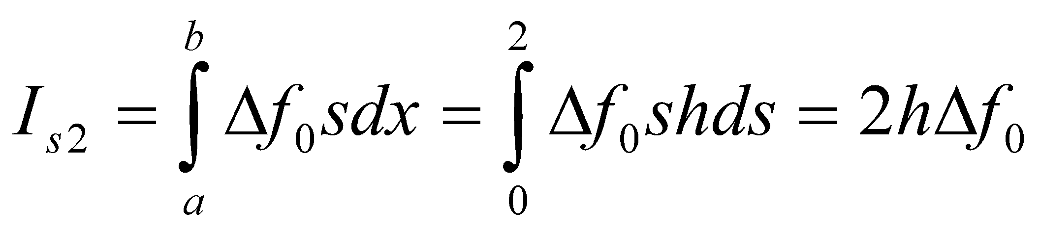
Numerical Integration
,
,
SIMPSON’s 1/3 RULE (Three-point formula)
Since T_{i} are expressed in terms of s, we need to use the following transformation:
x₀ = a, x₂ = b, and h = (b – a)/2
At x = a, s = (a - x₀)/h = (a - a)/h = 0
At x = b, s = (b - x₀)/h = (b - a)/h = 2h/h = 2
Then,

Slide 19
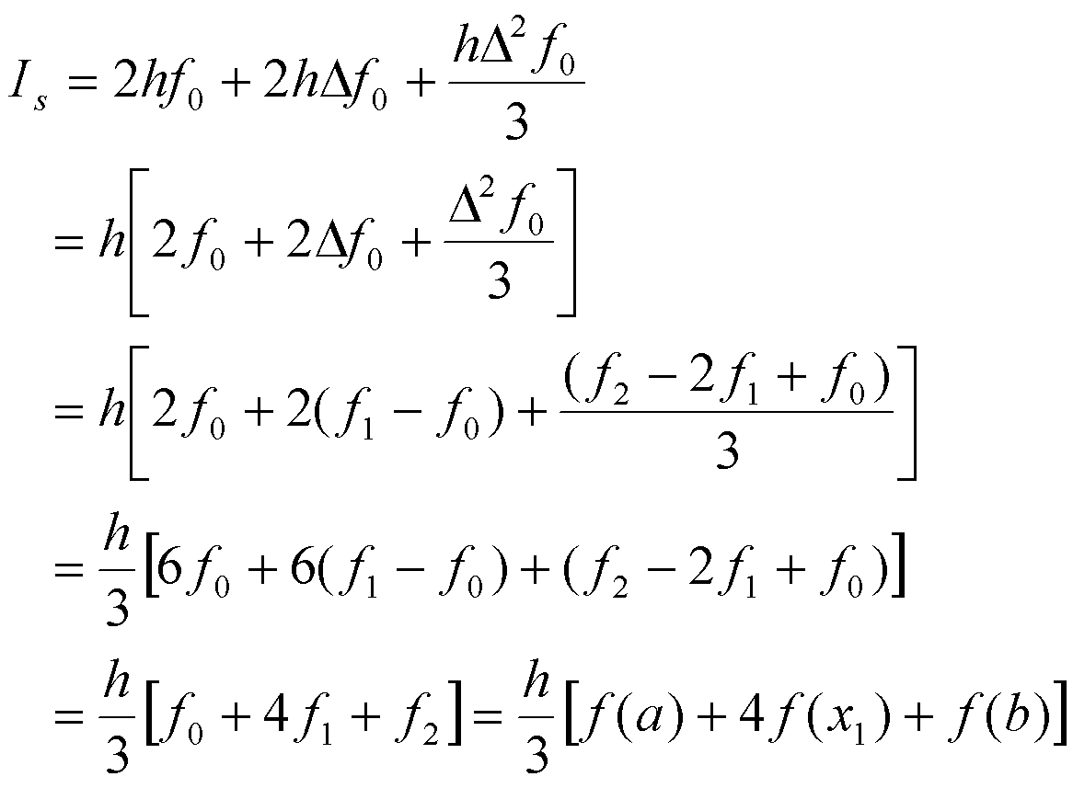
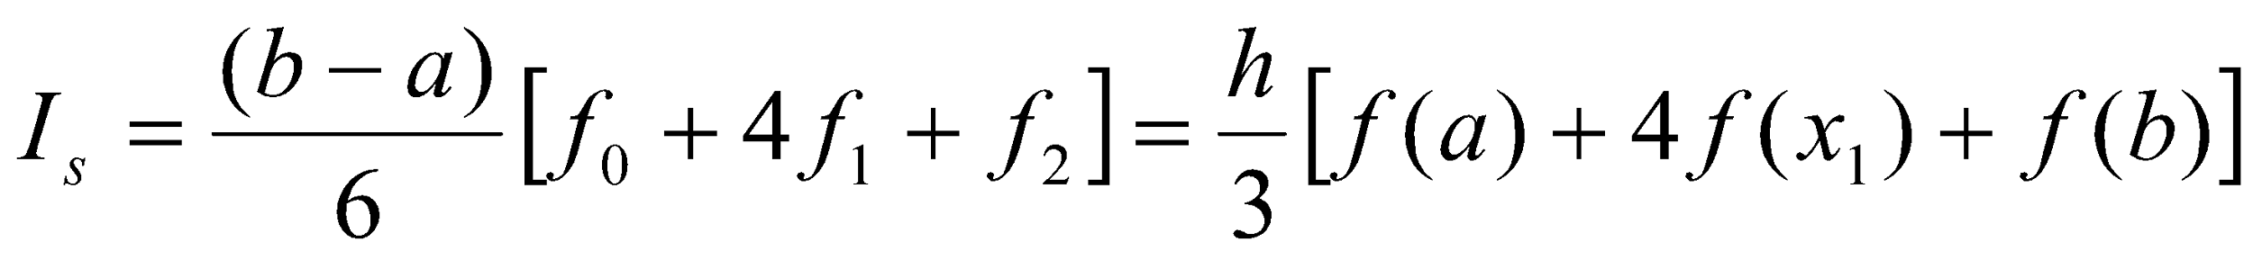
Numerical Integration
,
,
SIMPSON’s 1/3 RULE (Three-point formula)
Therefore,
--------- (1)
This equation is called Simpson’s 1/3 rule. This shows that the area is given by the product of total width of the segments and the weighted average of heights f(a), f(x₁) and f(b).

Slide 20
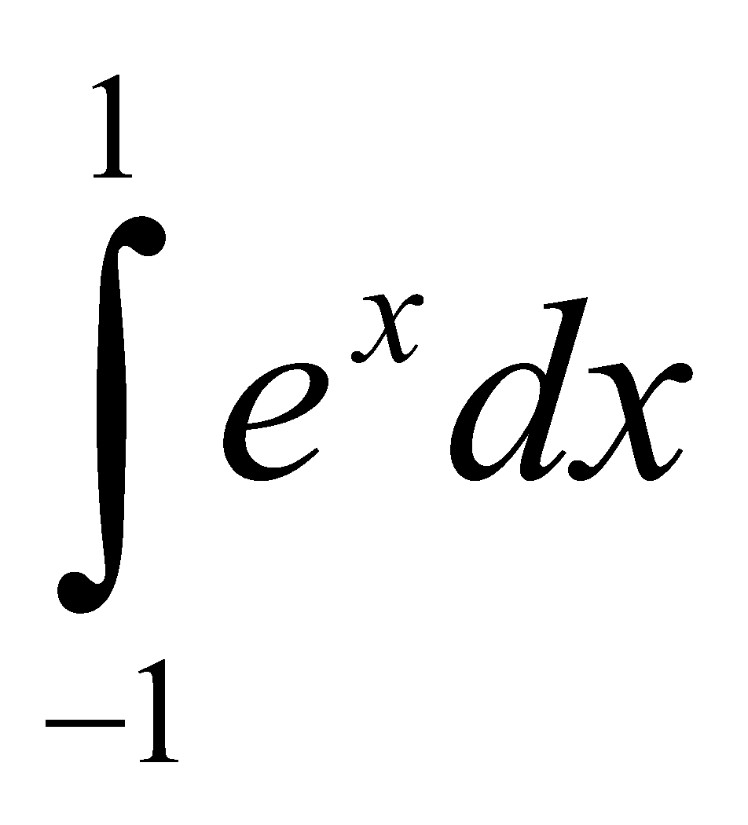
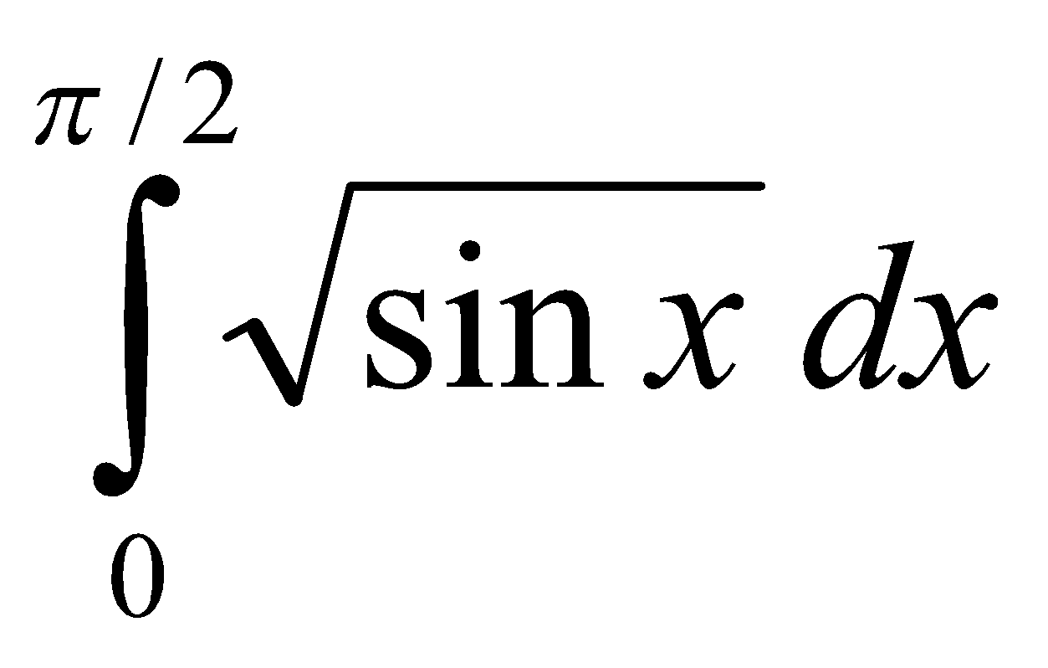
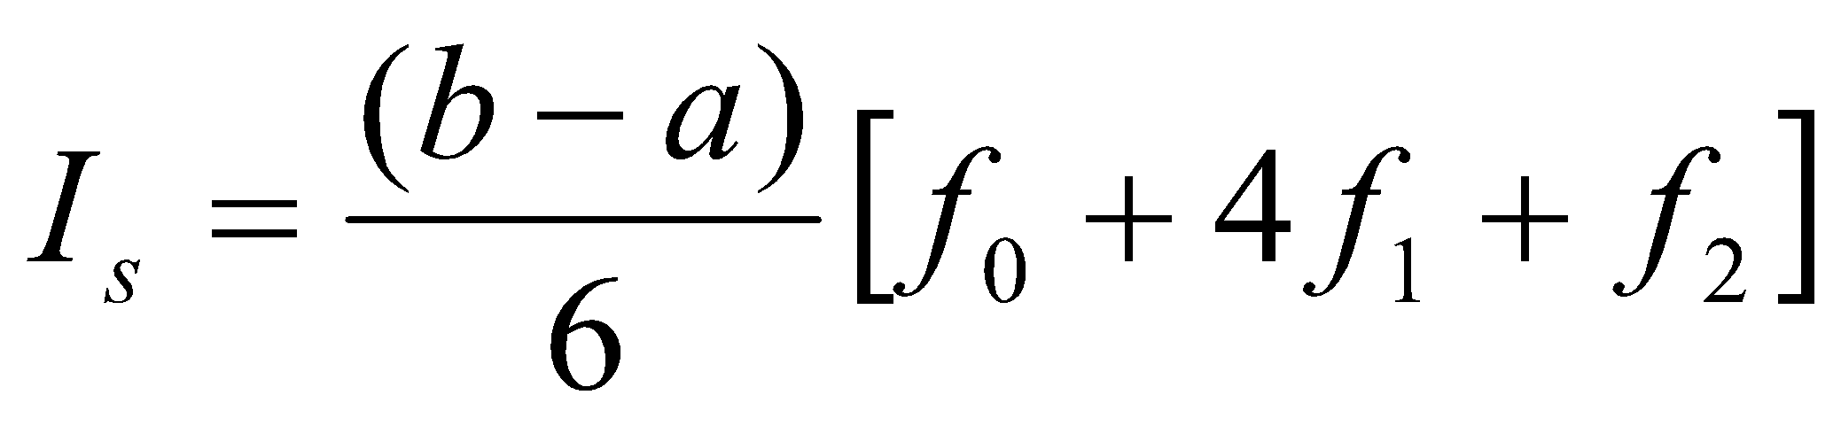
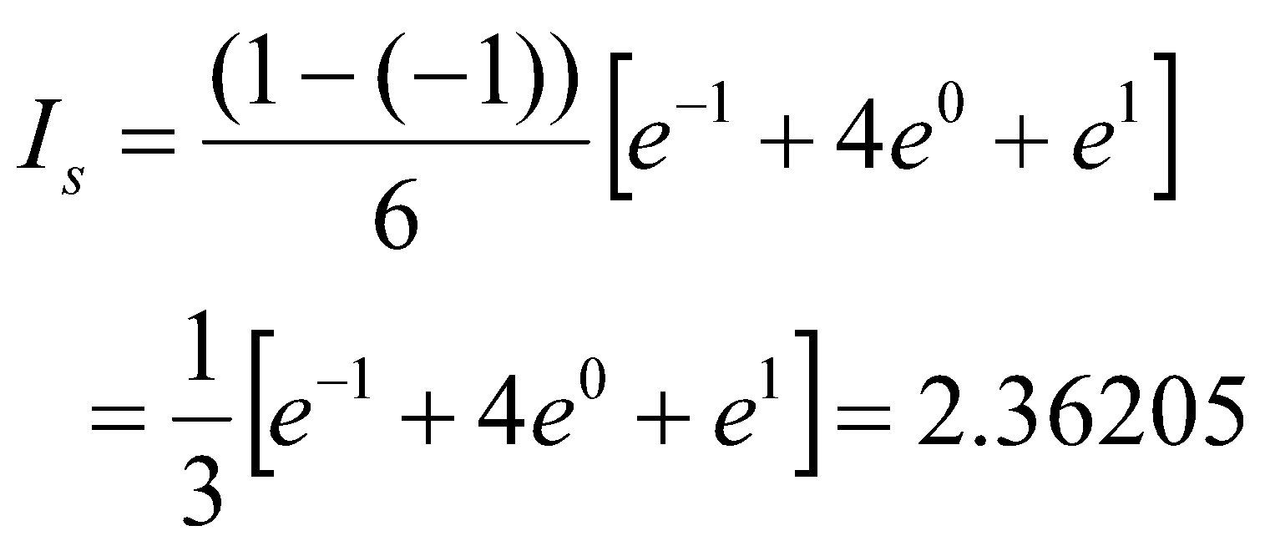
Numerical Integration
,
,
Example:
Evaluate the following integrals using Simpson’s 1/3 rule:
(i) (ii)
Solution:
(i)
Here, a = -1, b = 1, x₁ = (a + b)/2 = 0
h = (b - a)/2 = 1

Slide 21
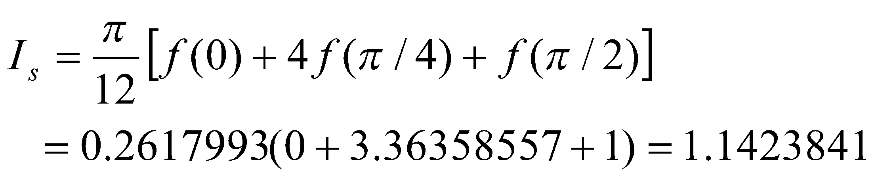
Numerical Integration
,
,
Example:
Evaluate the following integrals using Simpson’s 1/3 rule:
(i) (ii)
Solution:
(ii)
Here, a = 0, b = π/2, x₁ = (a + b)/2 = π/4
h = (b - a)/2 = π/4

Slide 22
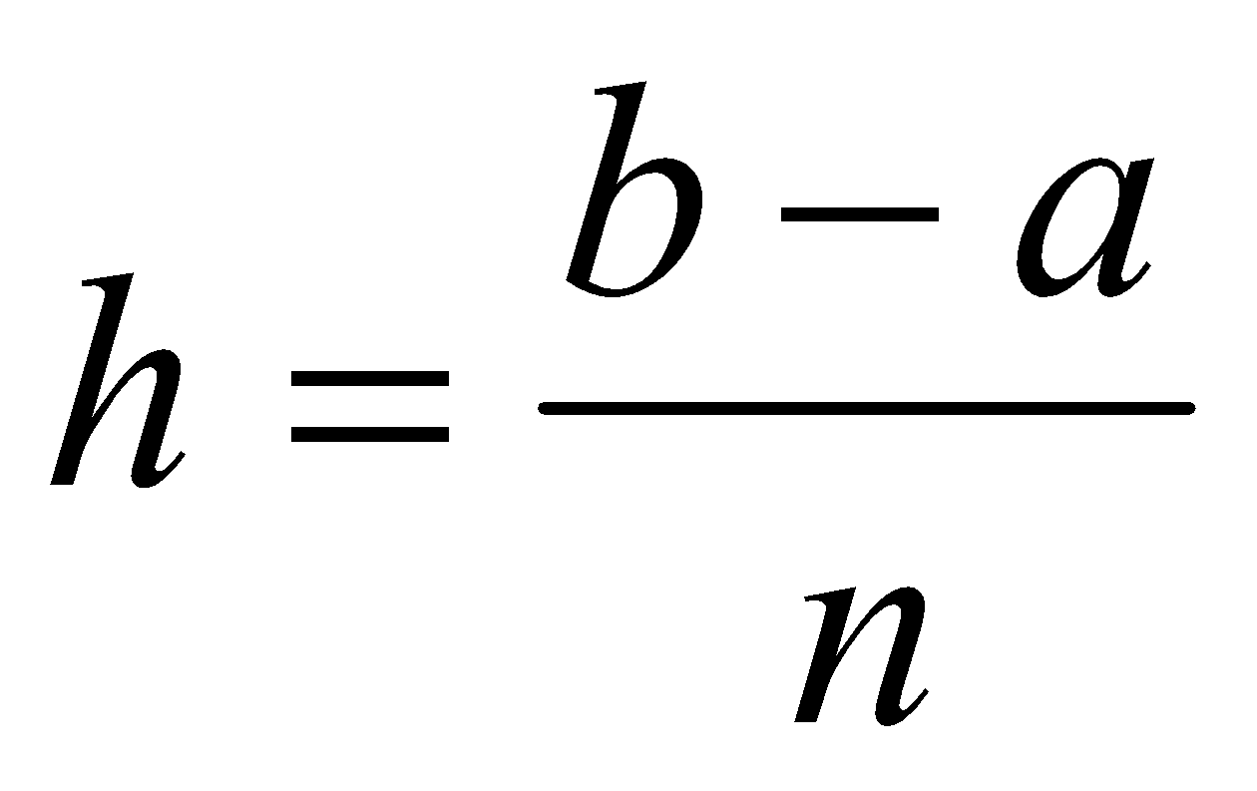
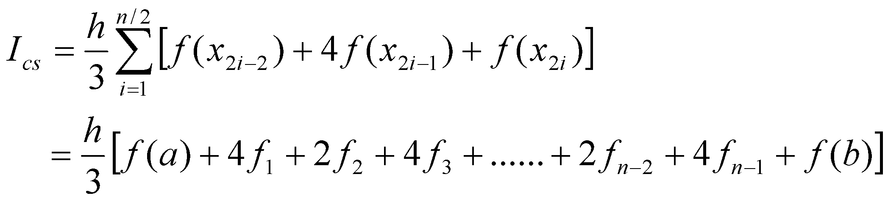
Numerical Integration
,
,
COMPOSITE SIMPSON’s 1/3 RULE (Three-point formula)
To improve the accuracy.
The interval is divided into n number of segments of equal width, where n is an even number.
The step size is
x_{i} = a + ih ; i = 0, 1, . . . n
Now we can apply equation (1) to each of the n/2 pairs of segments or subintervals (x_{2i-2}, x_{2i-1}), (x_{2i-1}, x_{2i}).
Therefore,

Slide 23
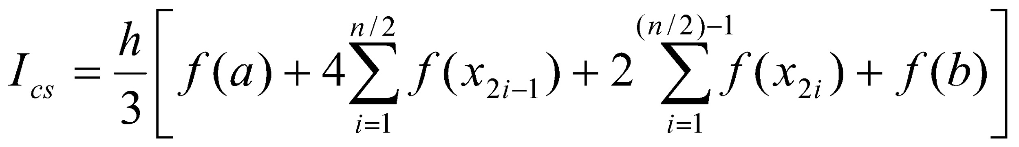
Numerical Integration
,
,
COMPOSITE SIMPSON’s 1/3 RULE (Three-point formula)
On regrouping terms,

Slide 24
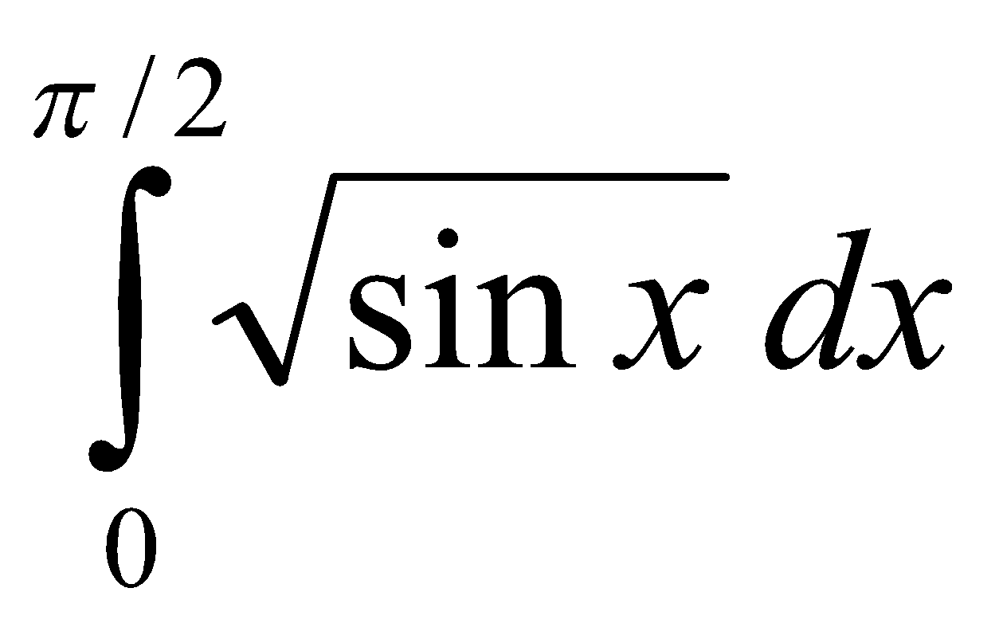
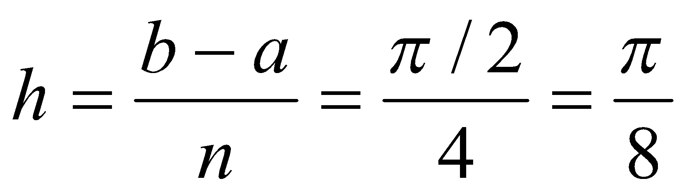
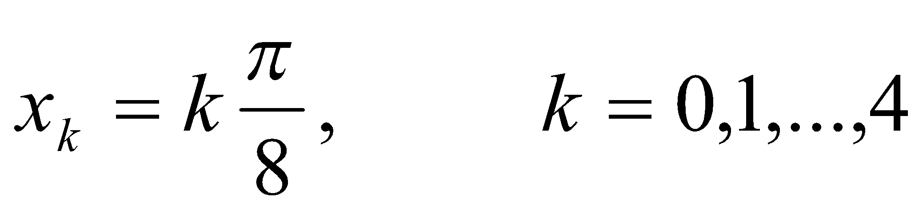
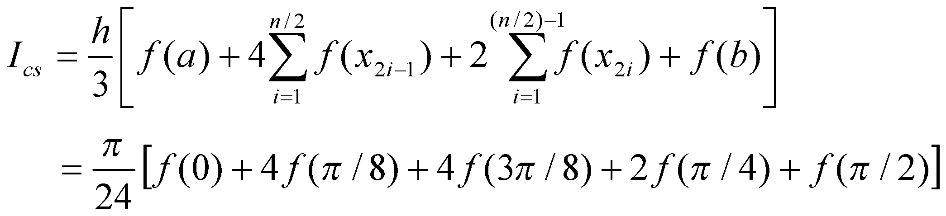
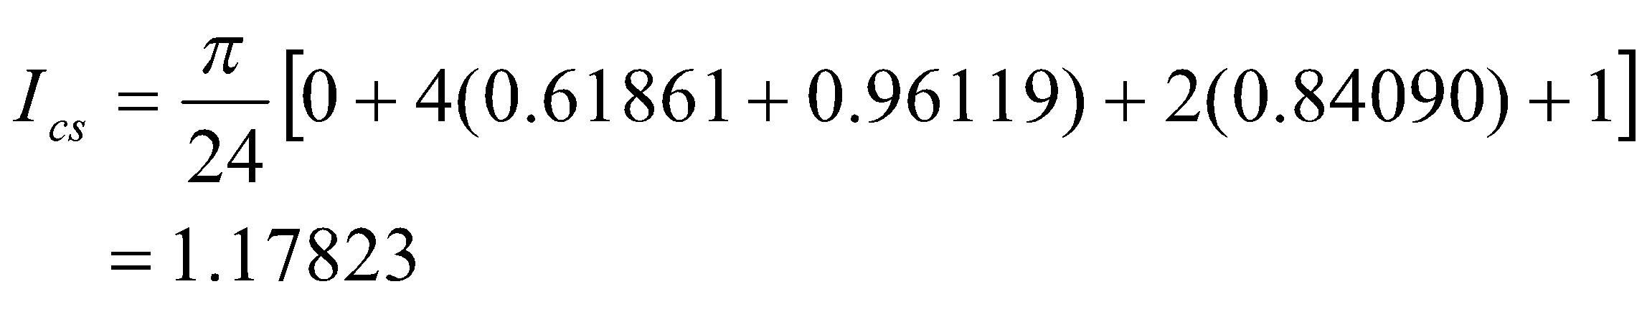
Numerical Integration
,
,
Example:
Compute the integral applying Simpson’s 1/3 rule for n = 4 and n = 6 with an accuracy to five decimal places.
Solution:
i) For n = 4
There are five sampling points given by

Slide 25
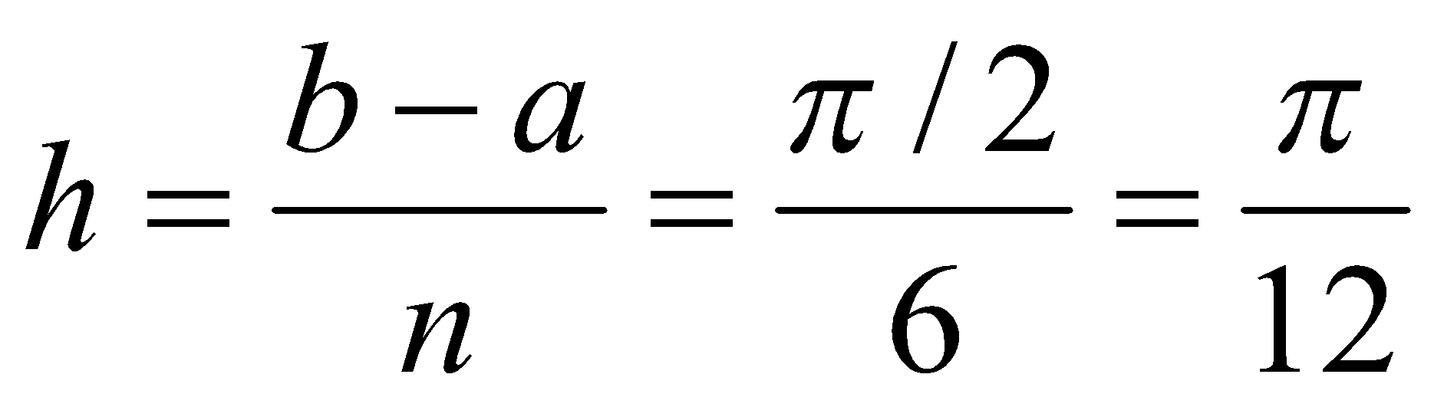
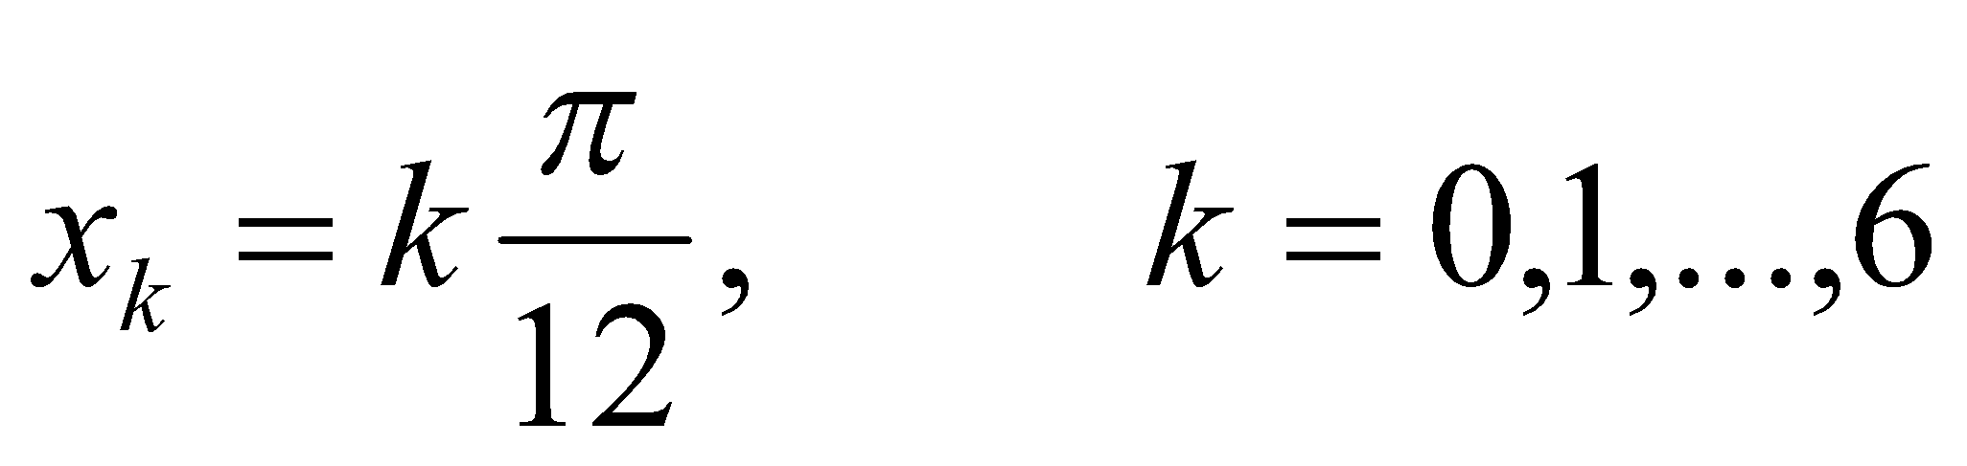

Numerical Integration
,
,
Example:
Compute the integral applying Simpson’s 1/3 rule for n = 4 and n = 6 with an accuracy to five decimal places.
Solution:
ii) For n = 6,
There are 7 sampling points given by

