Slide 1

Numerical Methods
Lecture 11

Slide 2
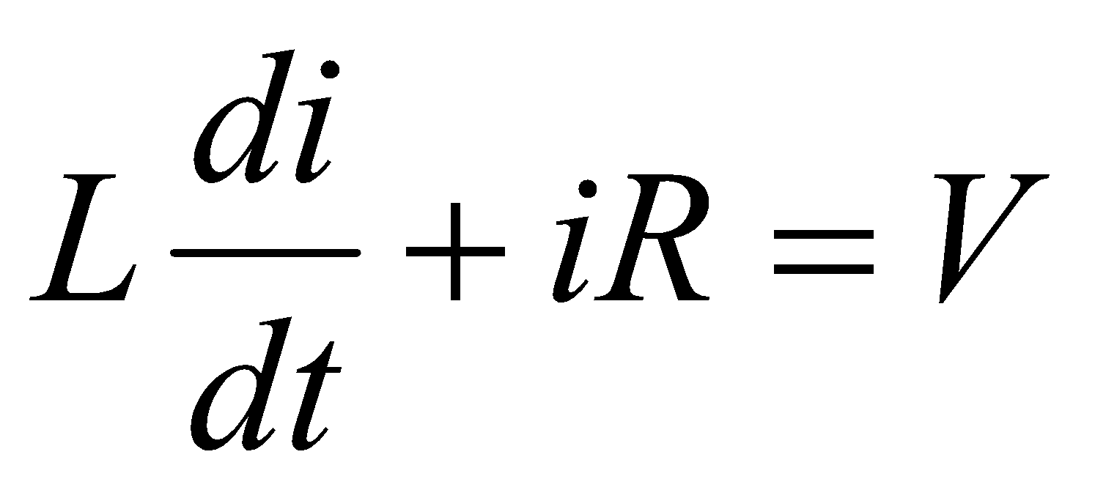
Numerical Solution of Ordinary Differential Equations
Why?
Many of the laws in Physics, Chemistry, Engineering, Biology and Economics are based on empirical observations that describe changes in the states of systems.
Mathematical models that describe the state of such systems are often expressed in terms of not only certain system parameters but also their derivatives.
For example:
Kirchhoff’s law for an electric circuit: The voltage across an electric circuit containing an inductance L and a resistance R is given by:
This is an ordinary differential equation.

Slide 3
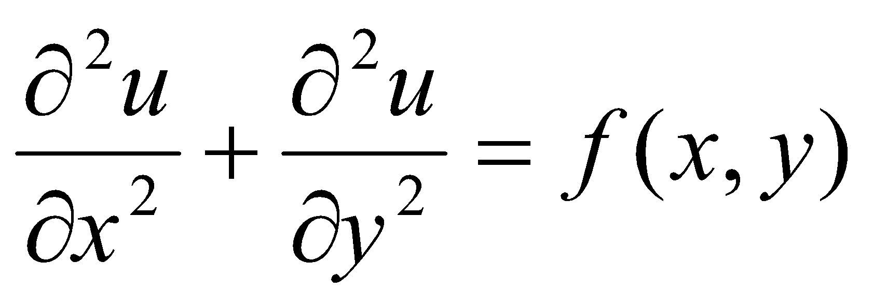
Numerical Solution of Ordinary Differential Equations
Number of Independent Variables
The quantity being differentiated is called the dependent variable.
The quantity with respect to which the dependent variable is differentiated is called the independent variable.
If there is only one independent variable, the equation is called an ordinary differential equation.
If it contains two or more independent variables, the derivatives will be partial and therefore, the equation is called a partial differential equation.
This is a partial differential equation.

Slide 4
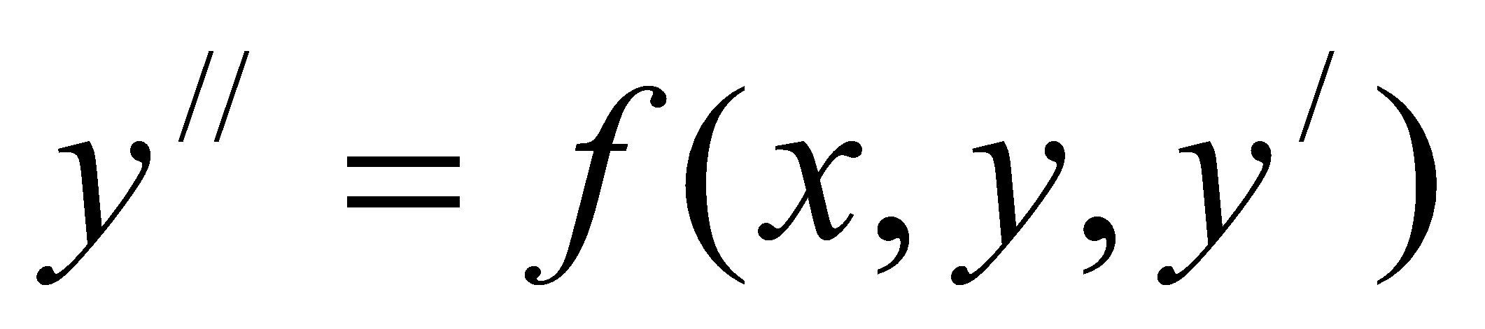
Numerical Solution of Ordinary Differential Equations
Order of Equations
The order of a differential equation is the highest derivative that appears in the equation.
When the equation contains only a first derivative, it is called a first-order differential equation.
If the highest derivative is a second derivative, the equation is called a second-order differential equation.
is a first-order differential equation.
is a second-order differential equation.

Slide 5
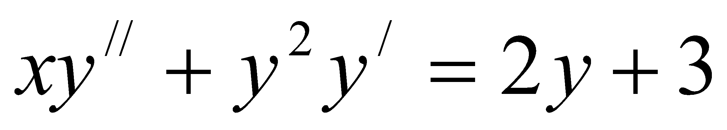
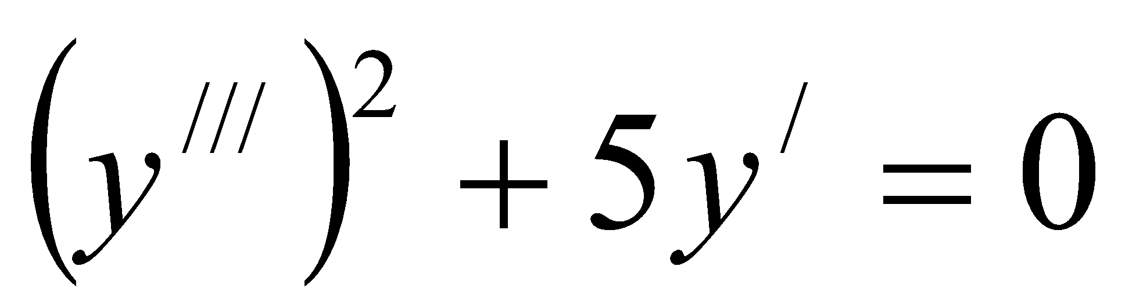
Numerical Solution of Ordinary Differential Equations
Degree of Equations
Sometimes, the equations are referred to by their degree.
The degree of a differential equation is the power of the highest-order derivative.
For example:
is a first-degree, second-order diff. equation.
is a second-degree, third-order diff. equation.

Slide 6
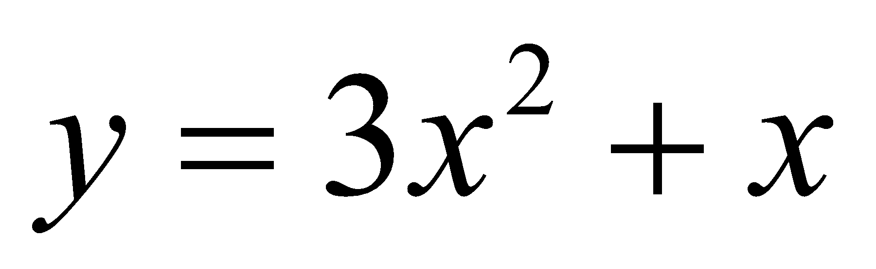
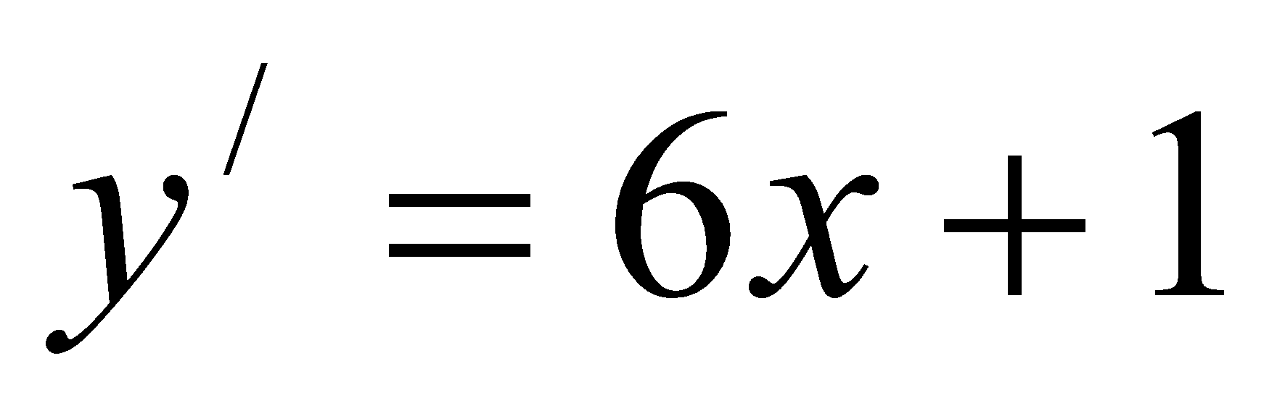
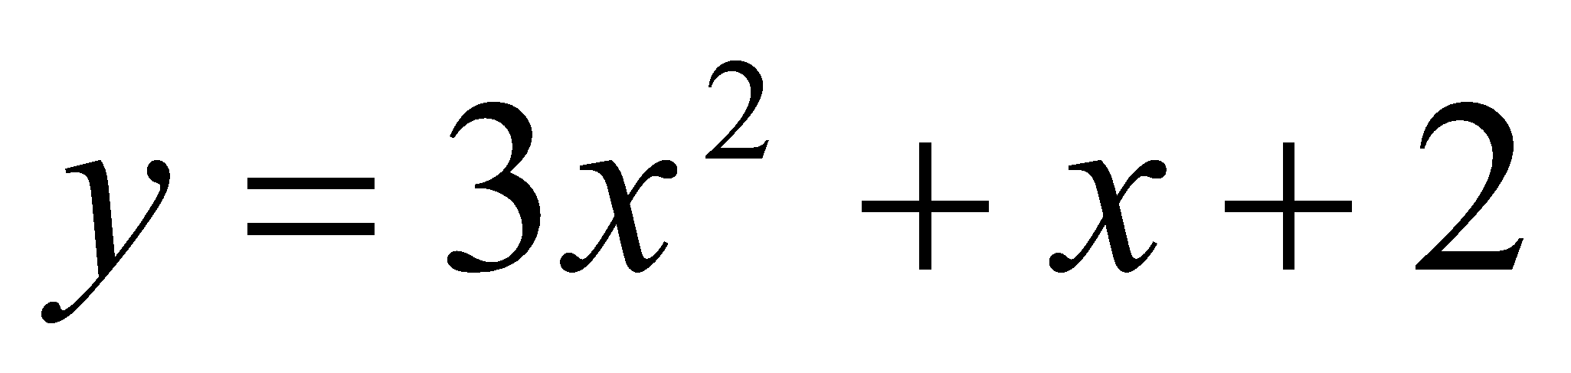
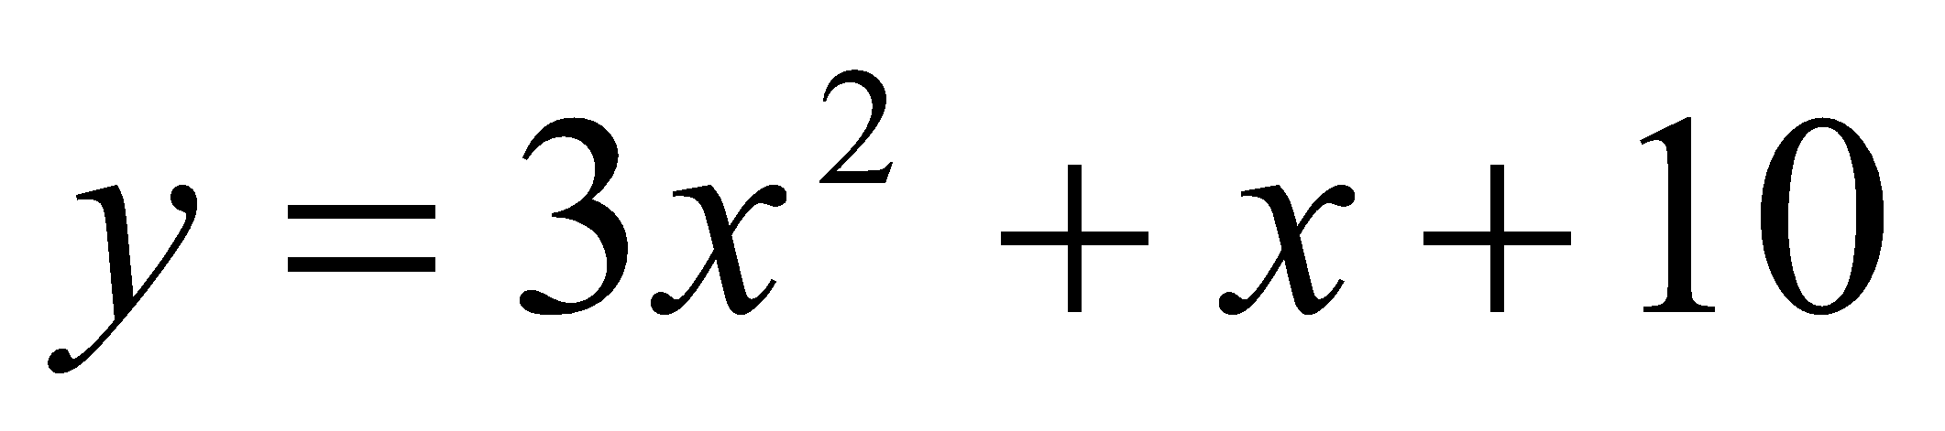
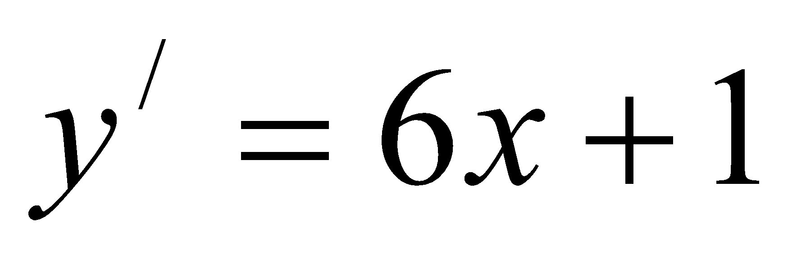
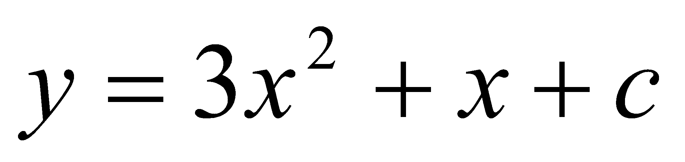
Numerical Solution of Ordinary Differential Equations
General and Particular Solutions
A solution to a differential equation is a relationship between the dependent and independent variables that satisfy the differential equation.
For example:
is the solution of .
These are also solutions of . In general has a solution of the form: . Where c is a constant of integration.
The solution that contains arbitrary constants is not unique and is therefore known as the general solution.
If the values of the constants are known, then, on substitution of these values in the general solution, a unique solution known as particular solution can be obtained.

Slide 7
Numerical Solution of Ordinary Differential Equations
Initial Value Problems
In order to obtain the values of the integration constants, we need additional information.
If the order of the equation is n, we will have to obtain n constants and therefore, we need n conditions in order to obtain a unique solution.
When all the conditions are satisfied at a particular value of the independent variable x, then the problem is called an initial-value problem.
Boundary Value Problems
It is also possible to specify the conditions at different values of the independent variable x. Such problems are called the boundary-value problems.

Slide 8
Numerical Solution of Ordinary Differential Equations
One-step and Multistep Methods
All numerical techniques for solving differential equations involve a series of estimates of y(x) starting from the given conditions.
There are two basic approaches to estimate the values of y(x):
ii) One-step methods and ii) Multistep methods
In one-step methods, we use information from only one preceding point.
Multistep methods use information at two or more previous steps to estimate a value.
Methods
Taylor Series Method
Euler’s Method
Heun’s Method
Polygon Method
Runge-Kutta Method
Milne-Simpson Method
Adams-Bashforth-Moulton Method

Slide 9
Numerical Solution of Ordinary Differential Equations
Taylor Series Method
We can expand a function y(x) about a point x = x₀ using Taylor’s theorem of expansion
Where y^{i}(x₀) is the ith derivative of y(x) at x = x₀.
The value of y(x) can be obtained if we know the values of its derivatives.
If we are given the equation
y/ = f (x, y)
we must repeatedly differentiate f (x, y) with respect to x and evaluate them at x₀. Substituting these values in the above equation, we get the solution.

Slide 10
Numerical Solution of Ordinary Differential Equations
Example:
Use the Taylor method to solve the differential equation:
y/ = x² + y²
for x = 0.25 and x = 0.5, given y(0) = 1.
Solution:
A function y(x) about a point x = x₀ using Taylor’s theorem of expansion:
Where y^{i}(x₀) is the ith derivative of y(x) at x = x₀.
The differential equation is:
y/ = x² + y²
Thus, y// = 2x + 2yy/
y/// = 2 + 2yy// + 2(y/)².

Slide 11
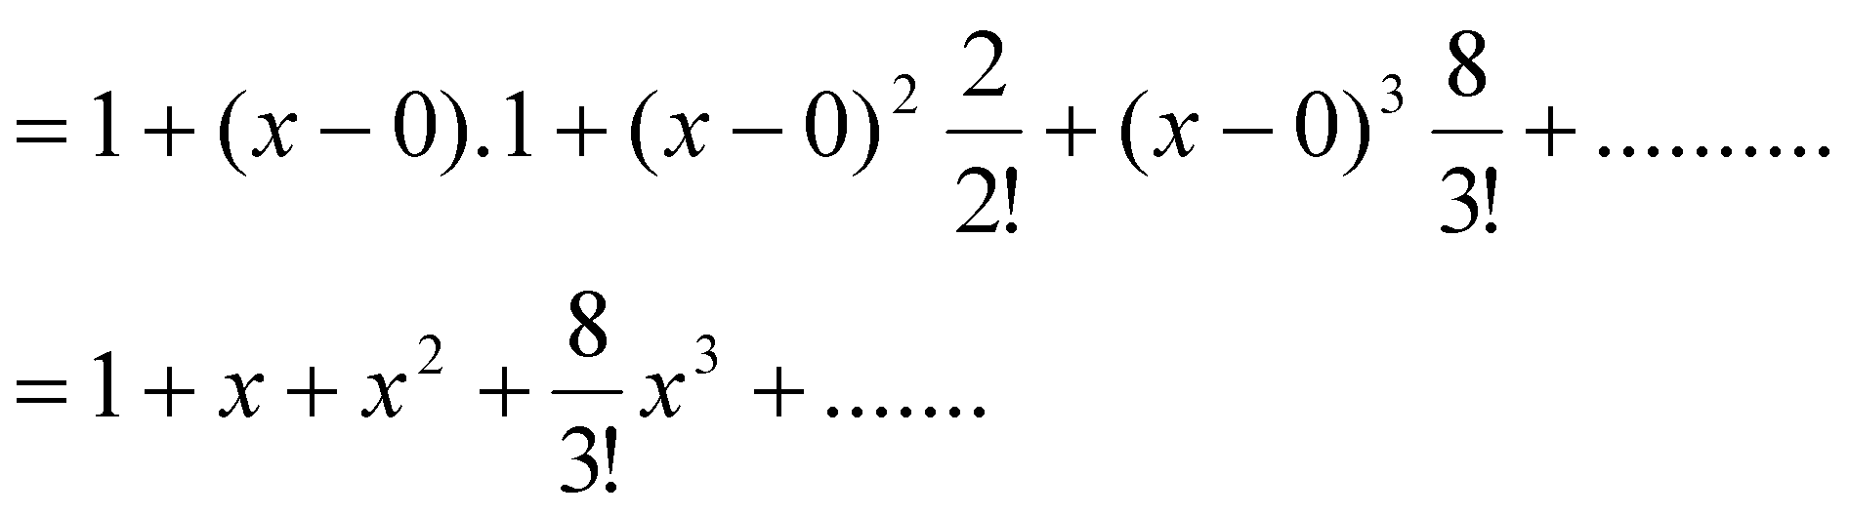
Numerical Solution of Ordinary Differential Equations
Example:
Use the Taylor method to solve the differential equation:
y/ = x² + y²
for x = 0.25 and x = 0.5, given y(0) = 1.
Solution:
At x = x₀= 0, y/ = x² + y² = (0)² + (1)² = 1
y// = 2x + 2yy/ = 2(0) + 2(1)(1) = 2
y/// = 2 + 2yy// + 2(y/)² = 2 + 2(1)(2) + 2(1)² = 8
Thus, the series becomes

Slide 12
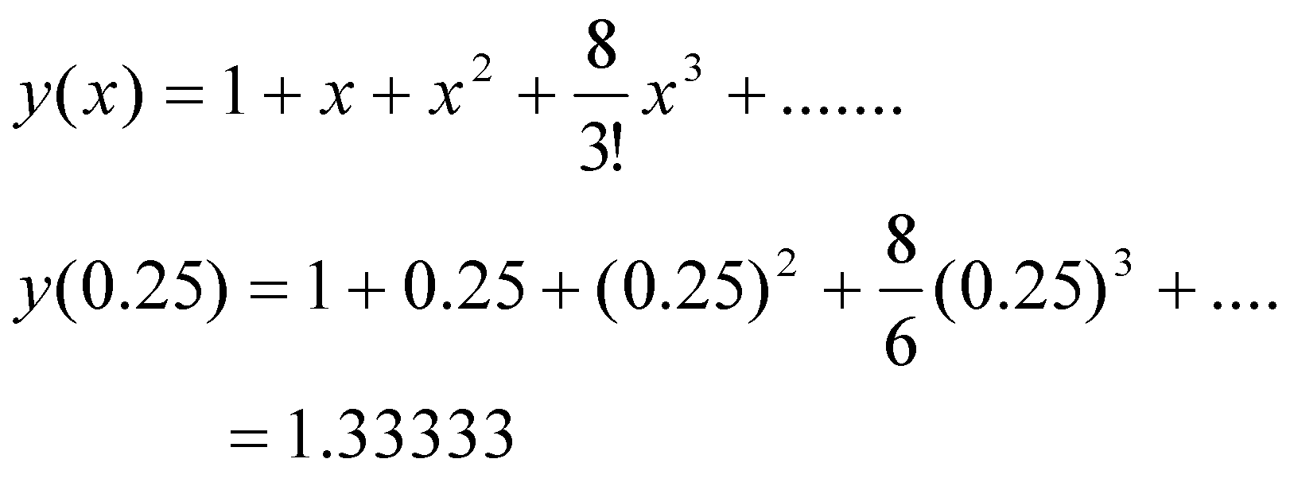
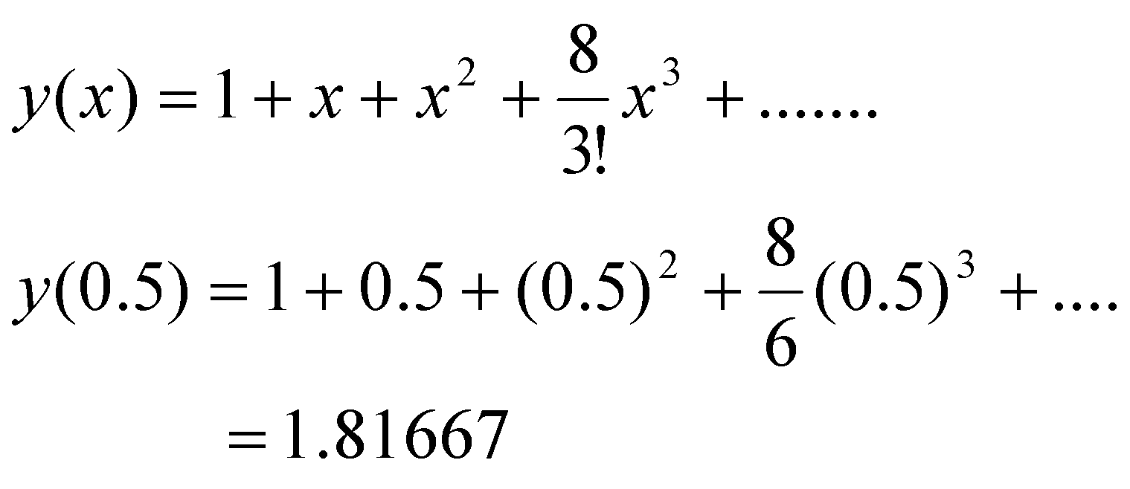
Numerical Solution of Ordinary Differential Equations
Example:
Use the Taylor method to solve the differential equation:
y/ = x² + y²
for x = 0.25 and x = 0.5, given y(0) = 1.
Solution:
Now calculate the values of the function at x = 0.25 and x = 0.5:
At x = 0.25
At x = 0.5

Slide 13
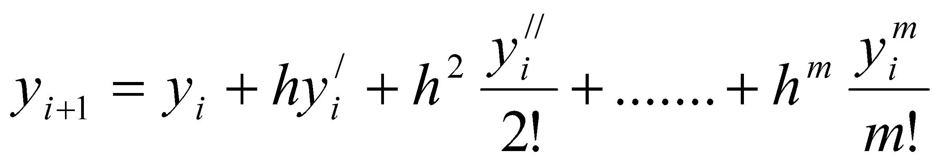
Numerical Solution of Ordinary Differential Equations
Improving Accuracy of Taylor Series Method
The accuracy can be improved by dividing the entire interval into subintervals (x₀, x₁), (x₁, x₂), (x₂, x₃), . . . . of equal length and computing y(x_{i}), i = 1, 2, 3 . . . n successively using the Taylor series expansion. Thus the series becomes,
y(x_{i}) is the initial value.
If we denote the size of each subinterval as h
h = x_{i+1} – x_{i} for i = 0, 1, . . . . n-1
then, the series becomes,

Slide 14
Numerical Solution of Ordinary Differential Equations
Example
Use the Taylor method recursively to solve the equation
y/=x²+y², y(0)=0
for the interval (0, 0.4) using two subintervals of size 0.2.
Solution:
Subinterval, h = 0.2
The derivatives of y are given by
y/ = x² + y²
y// = 2x + 2yy/
y/// = 2 + 2yy// + 2(y/)²
y⁴ = 6 y/ y// + 2yy///

Slide 15
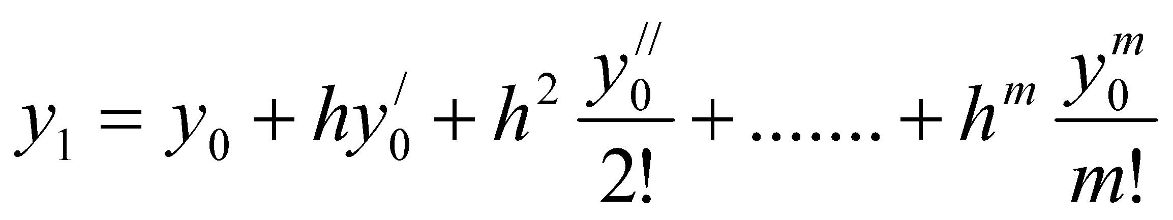
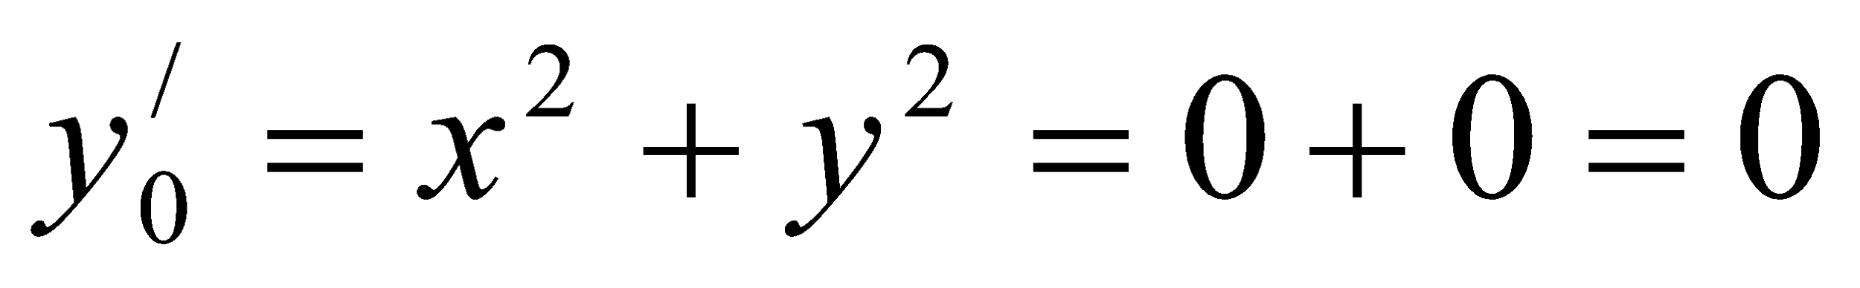
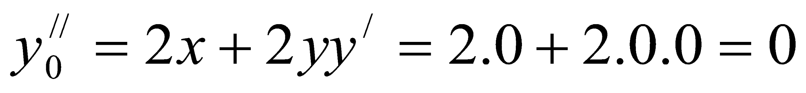
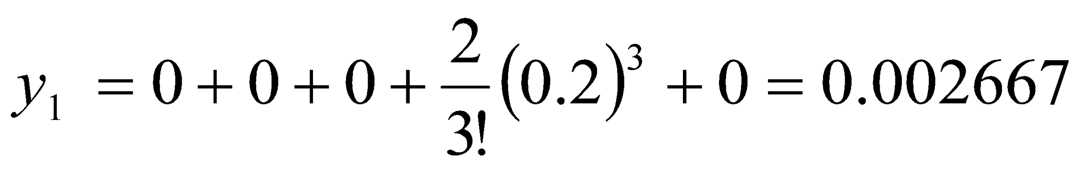
Numerical Solution of Ordinary Differential Equations
Example
Use the Taylor method recursively to solve the equation
y/=x²+y², y(0)=0
for the interval (0, 0.4) using two subintervals of size 0.2.
Solution:
Iteration 1:
Given h = 0.2, x₀ = 0, y₀ = y(x₀) = 0
So,
Therefore, at x = 0.2,

Slide 16
Numerical Solution of Ordinary Differential Equations
Example
Use the Taylor method recursively to solve the equation
y/=x²+y², y(0)=0
for the interval (0, 0.4) using two subintervals of size 0.2.
Solution:
Iteration 2:
Given h = 0.2, x₁ = 0.2, y₁ = 0.002667
So,

Slide 17
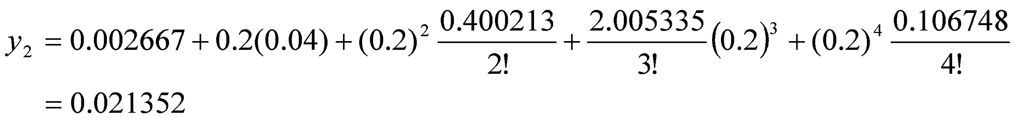
Numerical Solution of Ordinary Differential Equations
Example
Use the Taylor method recursively to solve the equation
y/=x²+y², y(0)=0
for the interval (0, 0.4) using two subintervals of size 0.2.
Solution:
Iteration 2:
Therefore, at x = 0.4,
That is, y(0.4) = 0.021352.
If we use h = 0.4, y(0.4) = 0.021333. The correct answer is y(0.4) = 0.021359.
It shows that the accuracy has been improved by using subintervals. The accuracy can be further improved by reducing h.

Slide 18
Numerical Solution of Ordinary Differential Equations
Disadvantage:
Evaluation of higher order derivatives.
This is a semi-numeric method.

Slide 19
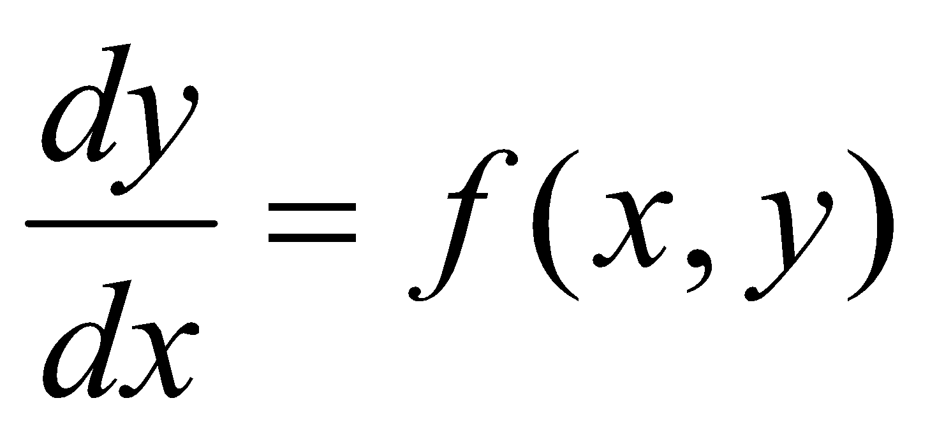
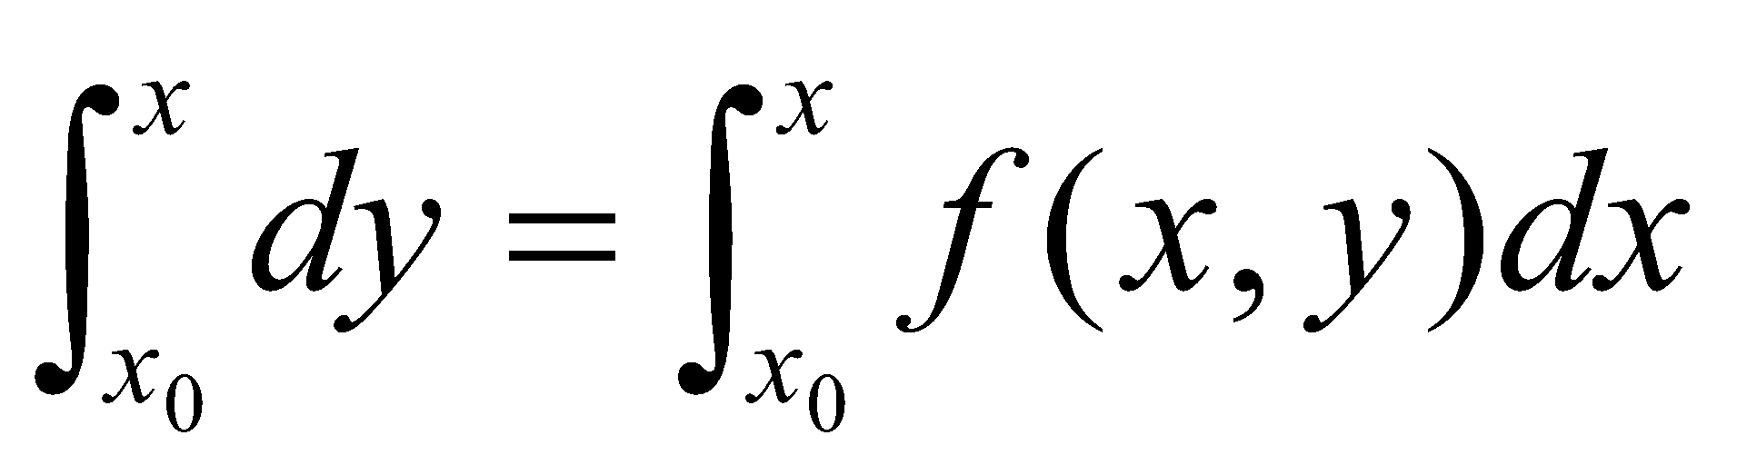
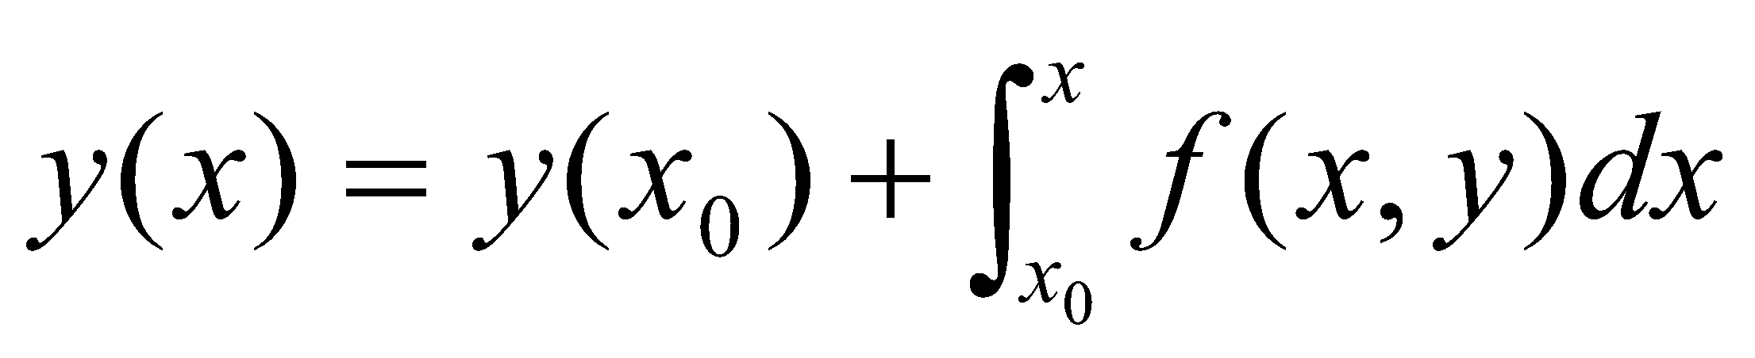
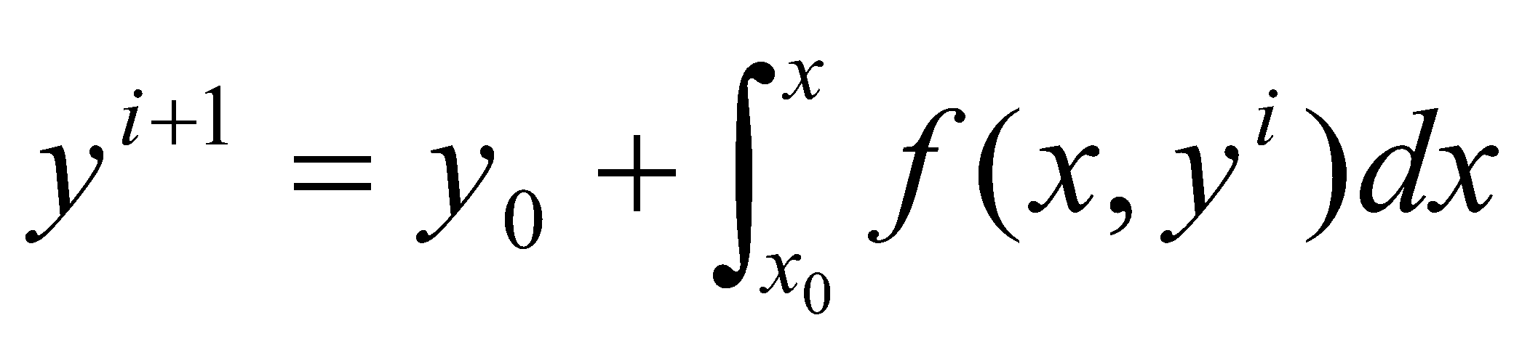
Numerical Solution of Ordinary Differential Equations
Picard’s Method
Consider the differential equation:
To obtain the solution, integrate this in the interval (x₀, x):
Since y appears under the integral sign on the right, the integration cannot be formed. The dependent variable y should be replaced by either a constant or a function of x.
Since we know the initial value of y (at x = x₀), we can use this as a first approximation to the solution. And the result can be used on the right hand side to obtain the next approximation. The iterative equation is written as:
This equation is known a Picard’s method.

Slide 20
Numerical Solution of Ordinary Differential Equations
Picard’s Method: Disadvantage
Sometimes it may not be possible to carry out the integration.
Like Taylor’s series method, this is also a semi-numeric method.

Slide 21
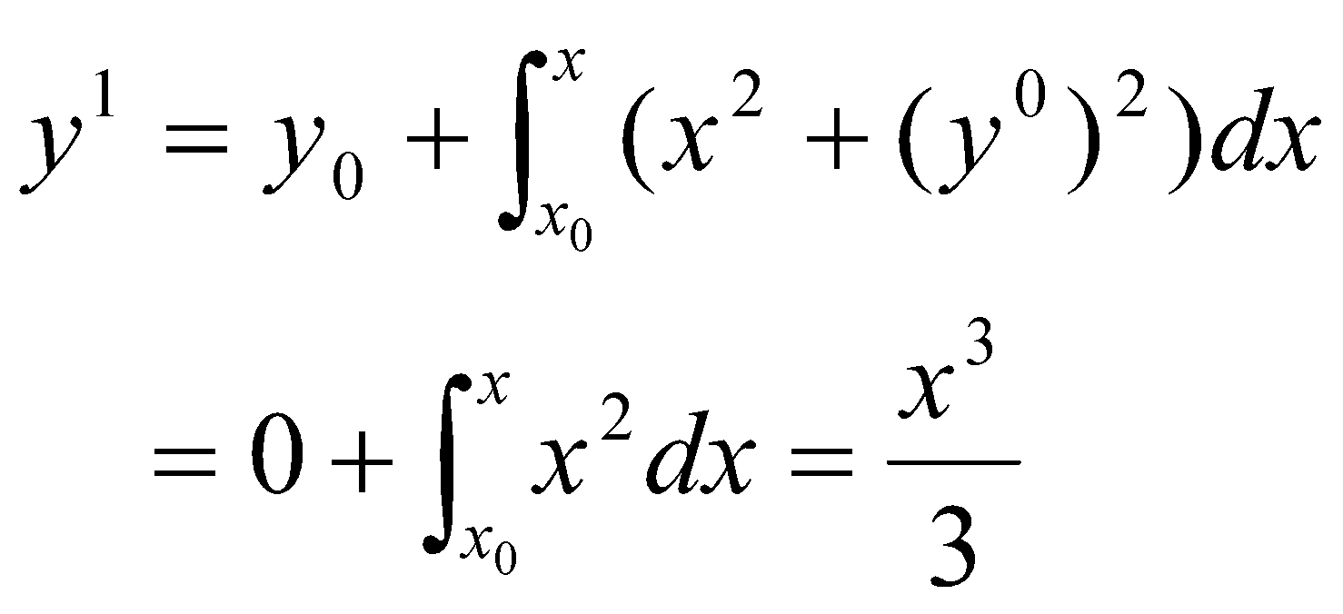
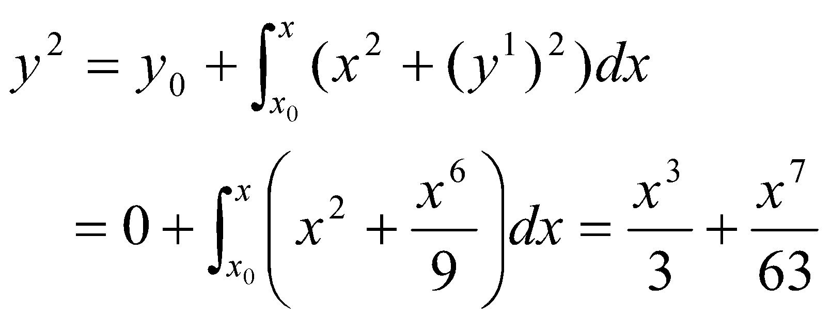
Numerical Solution of Ordinary Differential Equations
Example:
Solve the differential equation by Picard’s method:
y/(x) = x² + y² , y(0) = 0
and estimate y(0.1), y(0.2) and y(1).
Solution:
y/(x) = x² + y²
y₀ = 0, x₀ = 0

Slide 22
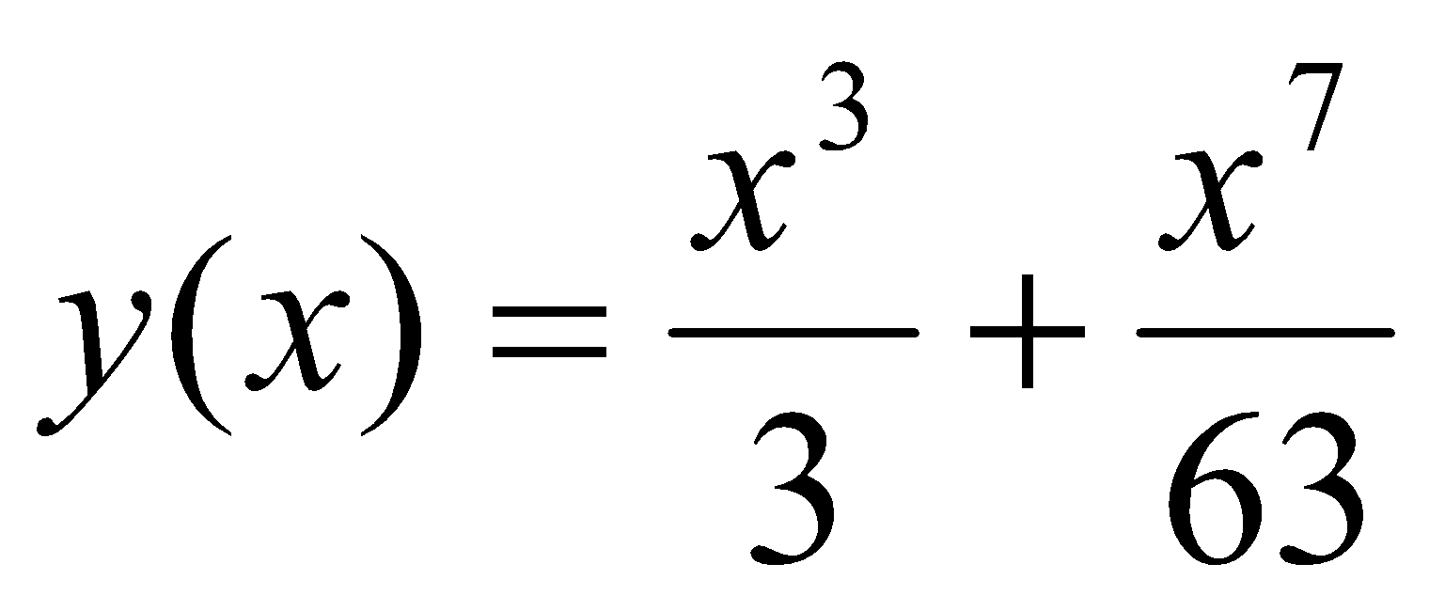
Numerical Solution of Ordinary Differential Equations
Example:
Solve the differential equation by Picard’s method:
y/(x) = x² + y² , y(0) = 0
and estimate y(0.1), y(0.2) and y(1).
Solution:
This process can be continued further. But it may be a difficult task. If we stop at y², then
Therefore,
y(0.1) = 0.00003333
y(0.2) = 0.0026667
y(1) = 0.3492063

Slide 23
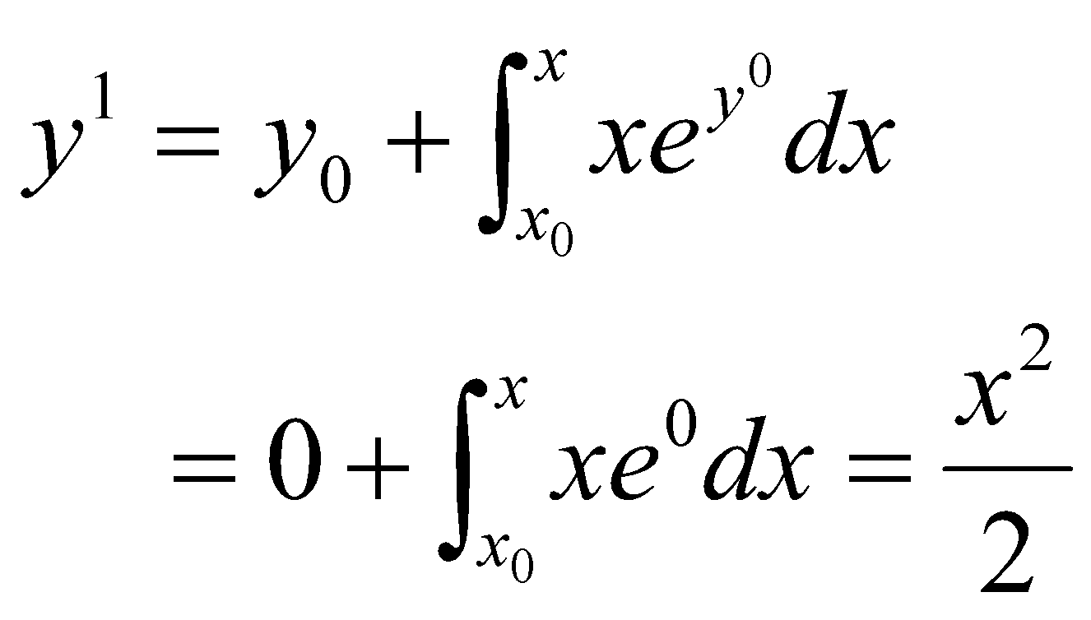
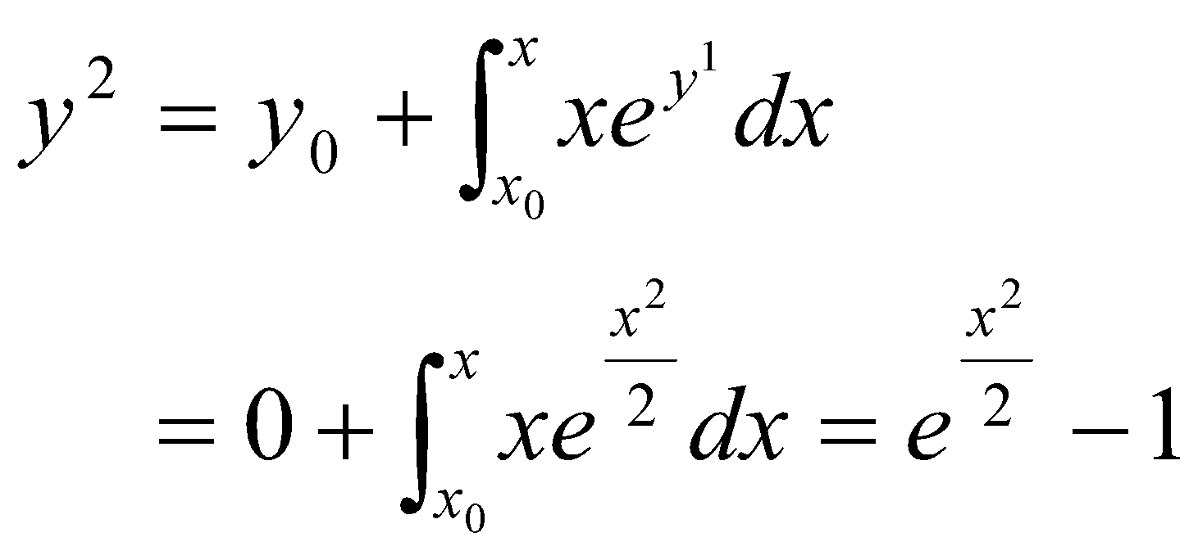
Numerical Solution of Ordinary Differential Equations
Example:
Solve the differential equation by Picard’s method:
y/(x) = xe^{y}, y(0) = 0
and estimate y(0.1), y(0.2) and y(1).
Solution:
y/(x) = xe^{y}
y₀ = 0, x₀ = 0

Slide 24
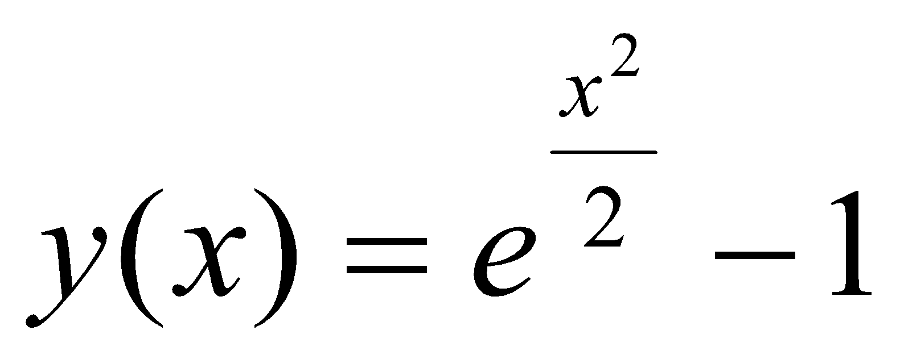
Numerical Solution of Ordinary Differential Equations
Example:
Solve the differential equation by Picard’s method:
y/(x) = xe^{y}, y(0) = 0
and estimate y(0.1), y(0.2) and y(1).
Solution:
If we stop here,
Therefore,
y(0.1) = 0.0050125
y(0.2) = 0.0202013
y(1) = 0.6487213

Slide 25
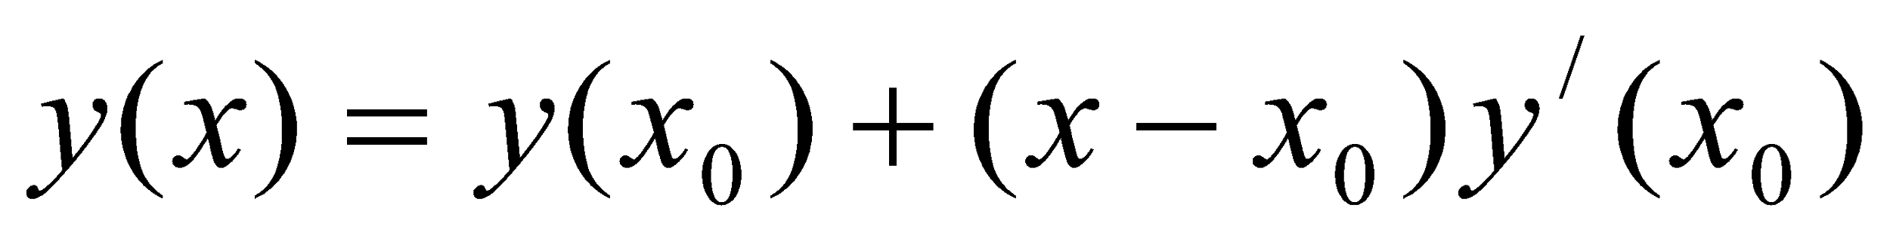
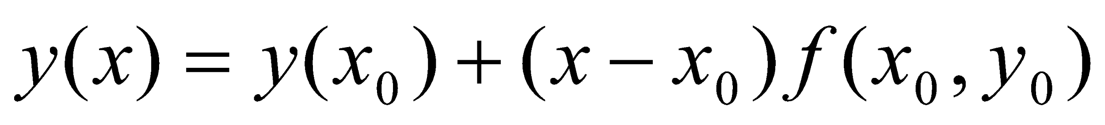
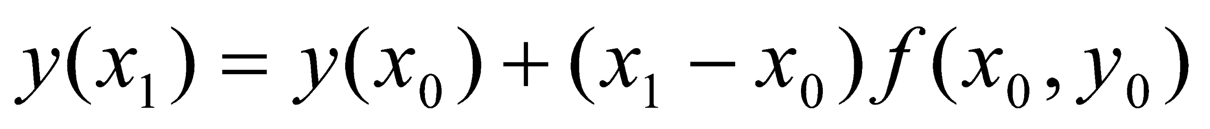
Numerical Solution of Ordinary Differential Equations
EULER’S Method
Euler’s method is the simplest one-step method.
It has limited applications because of its low accuracy.
Consider the first two terms of the Taylor’s series
Given the differential equation
y/(x) = f(x, y) with y(x₀) = y₀
We have, y/(x₀) = f(x₀, y₀)
Therefore,
Then the value of y(x) at x = x₁ is given by,

Slide 26
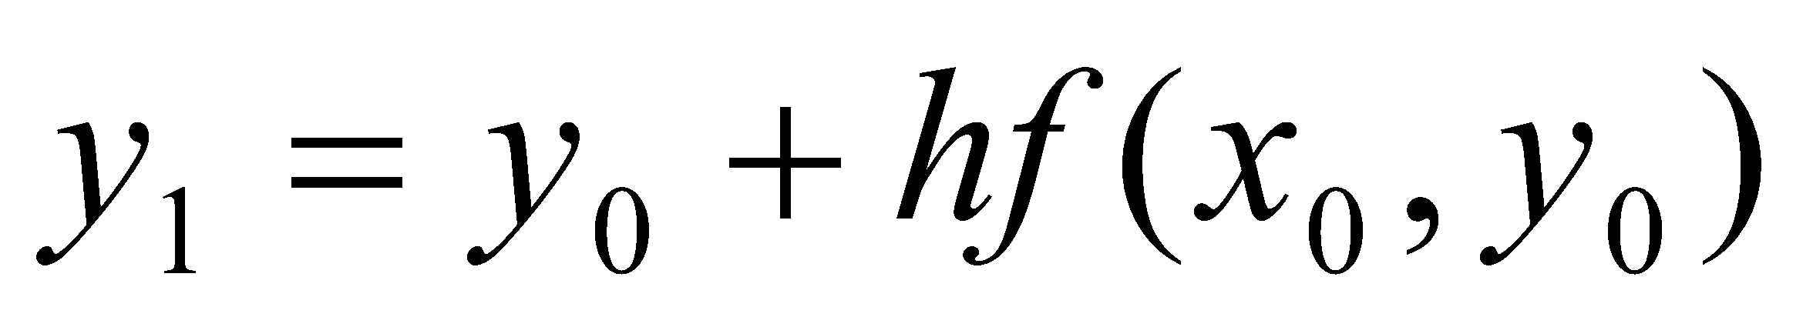
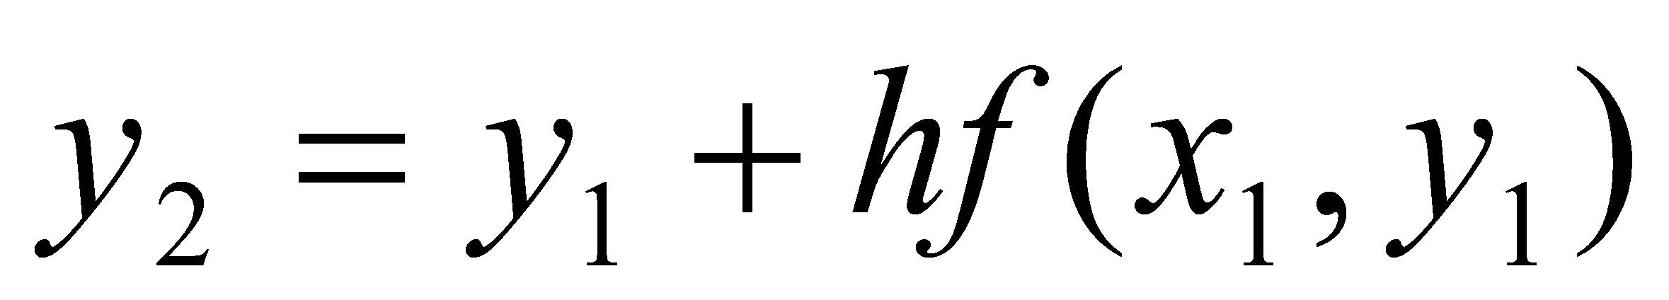
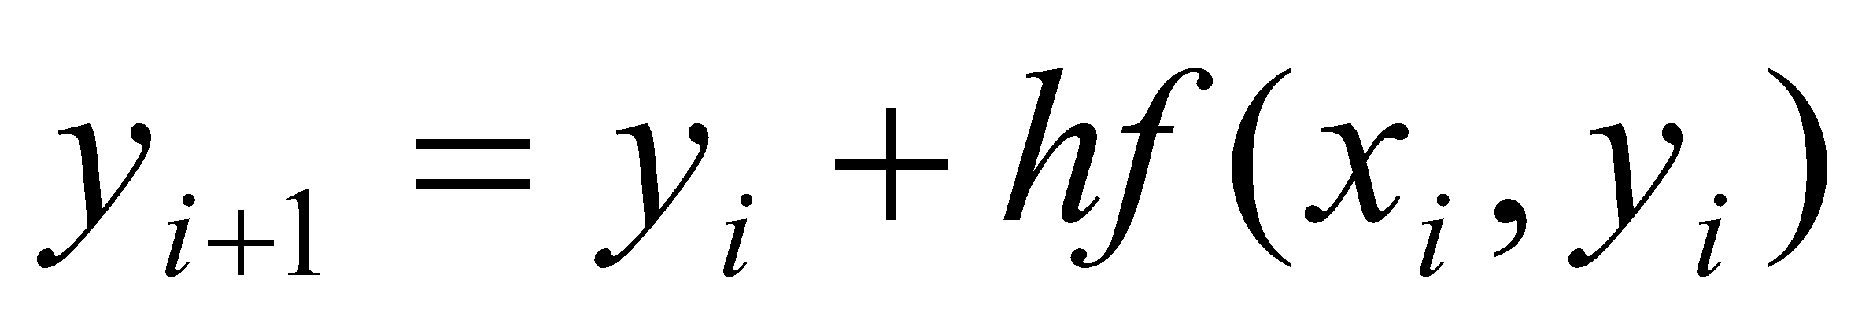
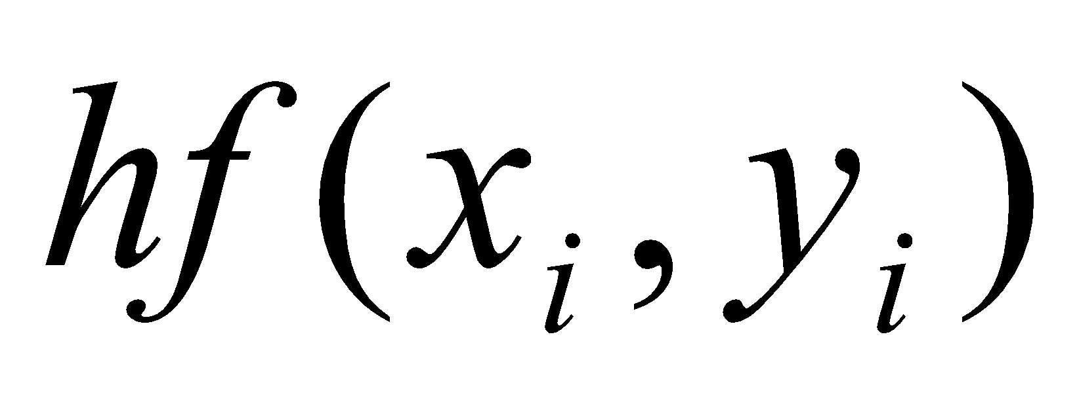
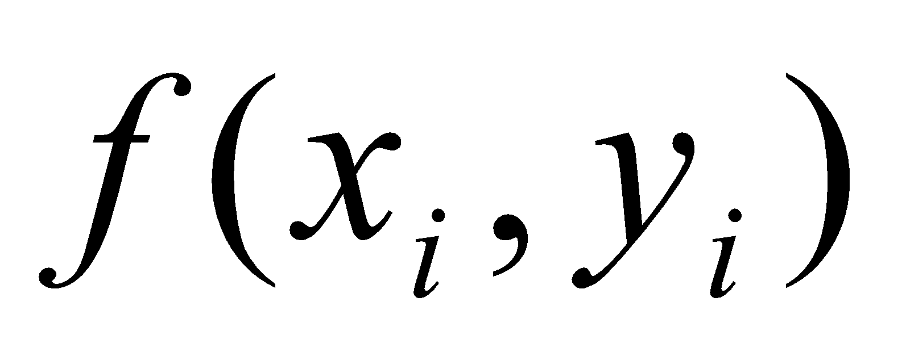
Numerical Solution of Ordinary Differential Equations
EULER’S Method
Let h = x₁ – x₀, we get
Similarly, the value of y(x) at x = x₂ is given by,
In general, we obtain a recursive relation as
This formula is known as Euler’s method.
Here is the increment value of y.
is the slope of y(x) at (x_{i}, y_{i}),
h is the step size.
Therefore,
New value = Old value + slope × step size

Slide 27
Numerical Solution of Ordinary Differential Equations
EULER’S Method
Illustration:
Actual solution y(x)
y(x)
Exact value
Error
y(x₂)
Tangent Line at (x₁, y₁)
y(x₁)
(x₂, y₂)
(x₀, y₀)
(x₁, y₁)
Tangent Line at (x₀, y₀)
x₀
x₁
x₂
x
h
h
Fig. Illustration of Euler’s method for two steps

Slide 28
Numerical Solution of Ordinary Differential Equations
EULER’S Method
Euler’s method is illustrated in the above figure. y₁ approximates y(x₁) and y₂ approximates y(x₂). The difference between them is the error introduced by the method.

Slide 29
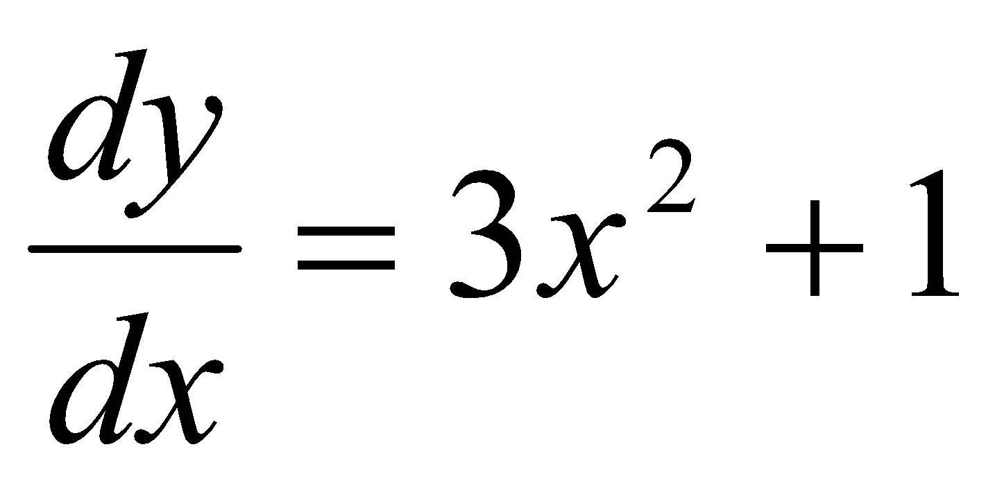
Numerical Solution of Ordinary Differential Equations
Example: Given the differential equation:
, y(1) = 2
estimate y(2) by Euler’s method using i) h = 0.5 and ii) h = 0.25
Solution: (i) for h = 0.5
y(1) = 2
y(1.5) = 2 + 0.5 [3(1)² +1] = 4
y(2) = 4 + 0.5 [3(1.5)² +1] = 7.875
(ii) for h = 0.25
y(1) = 2
y(1.25) = 2 + 0.25 [3(1)² +1] = 3
y(1.50) = 3 + 0.25 [3(1.25)² +1] = 5.42188
y(1.75) = 5.42188 + 0.25 [3(1.5)² +1] = 7.35938
y(2) = 7.35938 + 0.25 [3(1.75)² +1] = 9.90626

Slide 30
Numerical Solution of Ordinary Differential Equations
HEUN’S Method
Euler’s method is the simplest of all one-step methods.
It does not require any differentiation and easy to implement on computers.
But major weakness is large truncation errors.
It uses only the first two terms of the Taylor series.
Heun’s method is an improved version of Euler’s method.

Slide 31
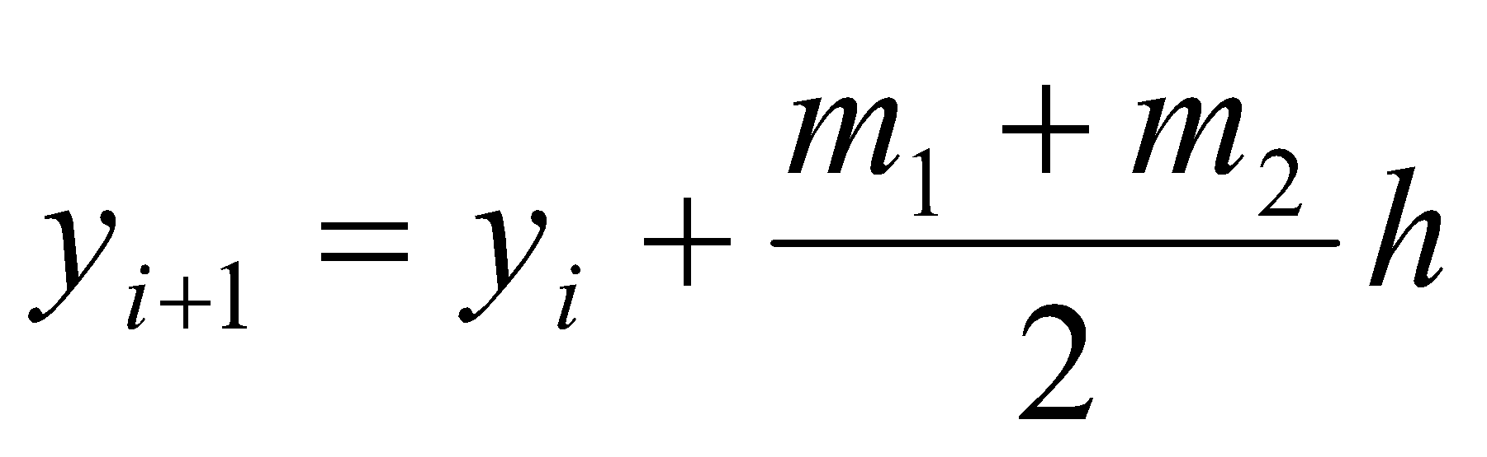
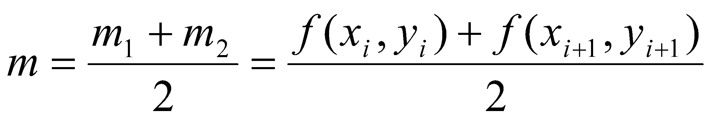
Numerical Solution of Ordinary Differential Equations
HEUN’S Method: Working Principle
This method uses a line whose slope is the average of the slopes at the end points of the interval. Then,
- - - - - - - - - - - - - - (1)
Where m₁ is the slope at (x_{i}, y_{i})
m₂ is the slope at (x_{i+1}, y_{i+1})
Given the differential equation:
y/(x) = f(x, y)
Therefore, m₁ = y/(x_{i}) = f(x_{i}, y_{i}) and
m₂ = y/(x_{i+1}) = f(x_{i+1}, y_{i+1})
Thus, we obtain,

Slide 32
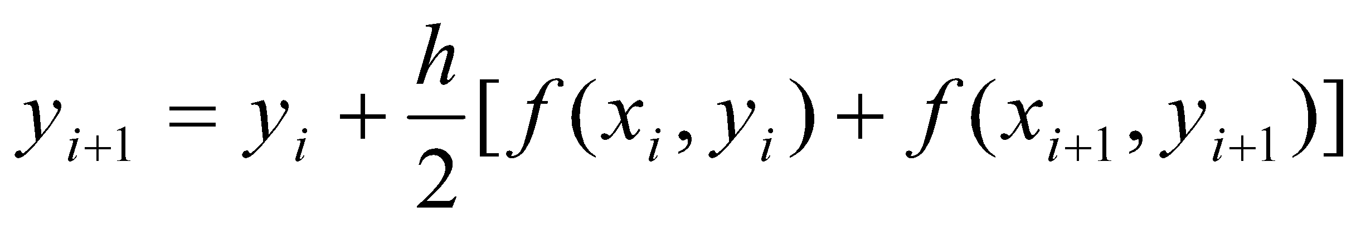
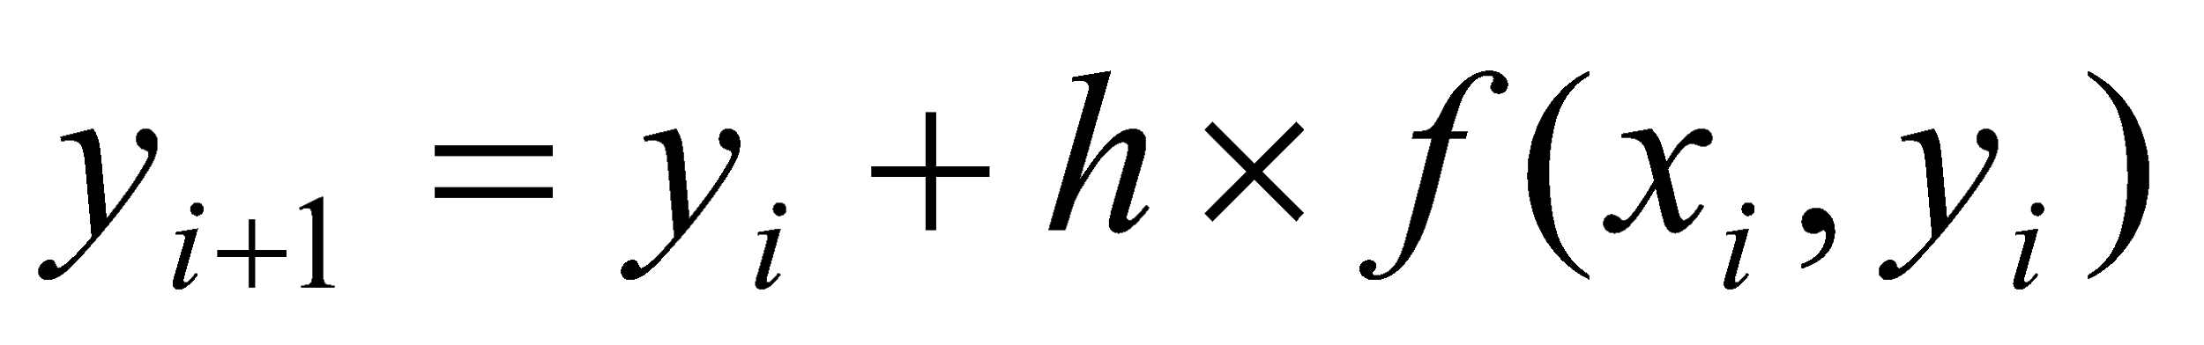
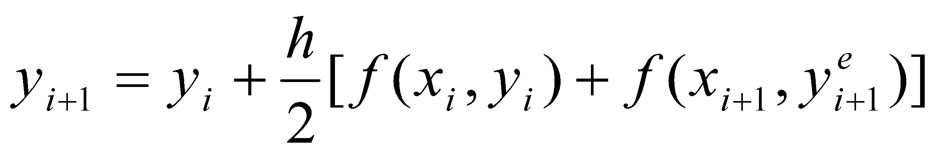
Numerical Solution of Ordinary Differential Equations
HEUN’S Method: Working Principle
Equation (1) becomes
- - - - - - - - - (2)
Since the term y_{i+1} appears on both sides of the equation (2), the value of y_{i+1}, inside the function can be predicted using the Euler’s formula as
- - - - - - - - - - (3)
Then, Heun’s formula becomes finally,
- - - - - - - - - - (4)
Equation (4) is an improved version of Euler’s method. Since it attempts to correct the value of y_{i+1} using the predicted value of y_{i+1} by Euler’s method, it is classified as a one-step predictor-corrector method.
Equation (3) is known as the predictor and equation (4) is known as the corrector.

Slide 33
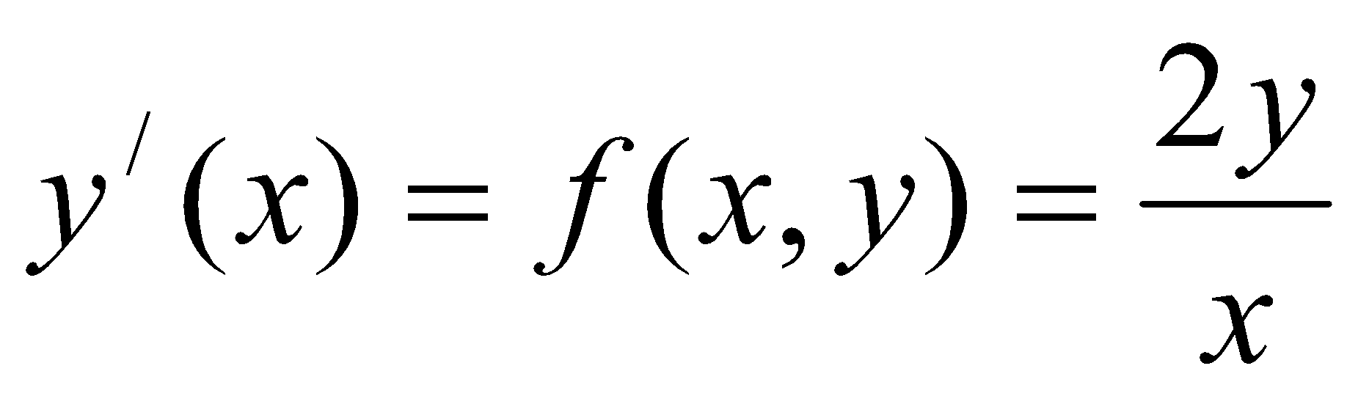
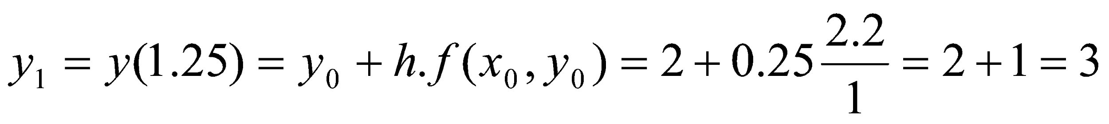
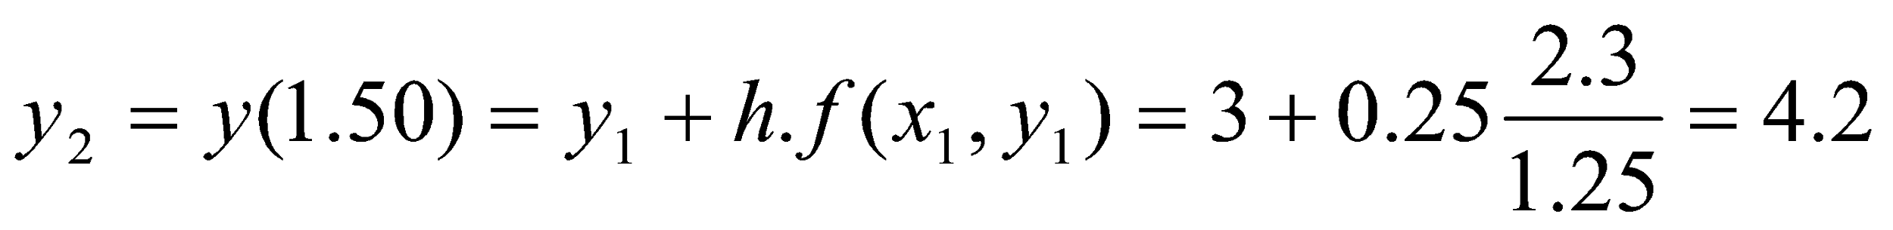
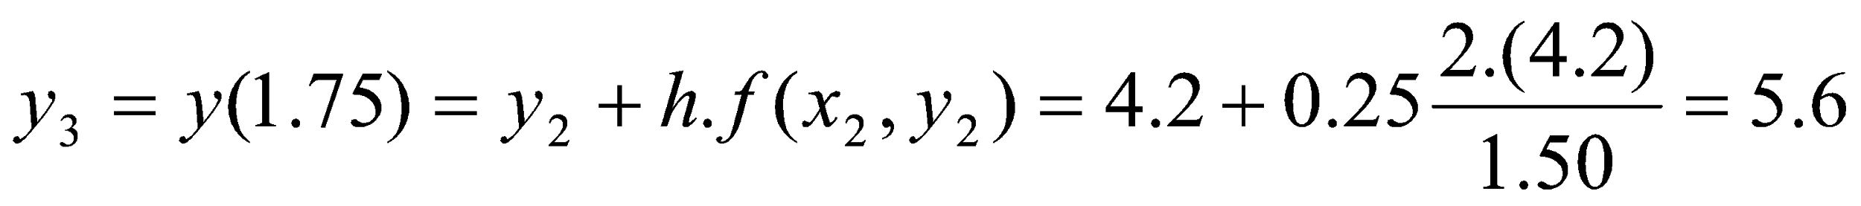
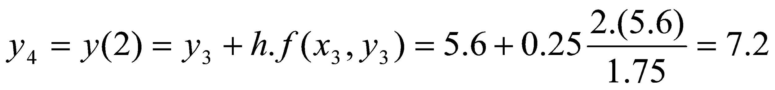
Numerical Solution of Ordinary Differential Equations
Example:
For the following differential equation, estimate y(2) using i) Euler’s method and ii) Heun’s method using h = 0.25. Compare the results with exact answers.
y/(x) = 2y/x with y(1) = 2.
Solution:
Given , x₀ = 1, y₀ = 2, h = 0.25
(i) Using Euler’s method

Slide 34
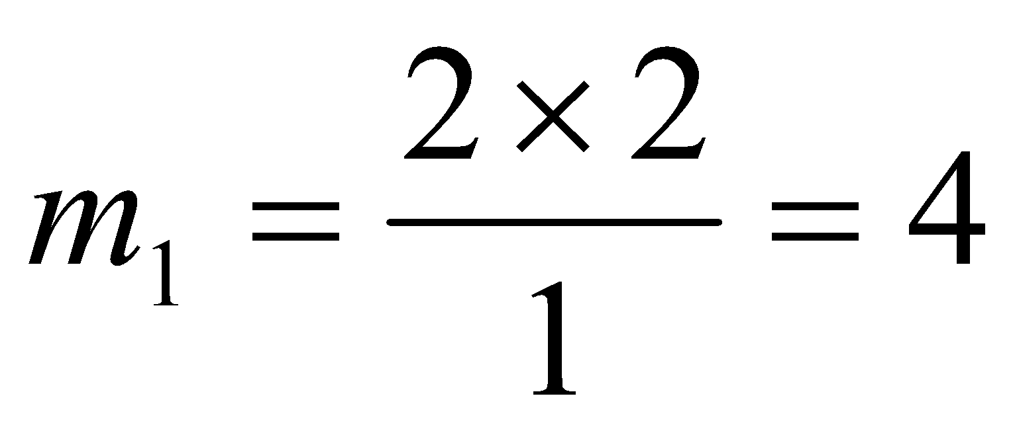



Numerical Solution of Ordinary Differential Equations
Example:
For the following differential equation, estimate y(2) using i) Euler’s method and ii) Heun’s method using h = 0.25. Compare the results with exact answers.
y/(x) = 2y/x with y(1) = 2.
Solution:
Given , x₀ = 1, y₀ = 2, h = 0.25
(ii) Using Heun’s method
Iteration 1:

Slide 35




Numerical Solution of Ordinary Differential Equations
Example:
For the following differential equation, estimate y(2) using i) Euler’s method and ii) Heun’s method using h = 0.25. Compare the results with exact answers.
y/(x) = 2y/x with y(1) = 2.
Solution:
Given , x₀ = 1, y₀ = 2, h = 0.25
(ii) Using Heun’s method
Iteration 2:

Slide 36




Numerical Solution of Ordinary Differential Equations
Example:
For the following differential equation, estimate y(2) using i) Euler’s method and ii) Heun’s method using h = 0.25. Compare the results with exact answers.
y/(x) = 2y/x with y(1) = 2.
Solution:
Given , x₀ = 1, y₀ = 2, h = 0.25
(ii) Using Heun’s method
Iteration 3:

Slide 37




Numerical Solution of Ordinary Differential Equations
Example:
For the following differential equation, estimate y(2) using i) Euler’s method and ii) Heun’s method using h = 0.25. Compare the results with exact answers.
y/(x) = 2y/x with y(1) = 2.
Solution:
Given , x₀ = 1, y₀ = 2, h = 0.25
(ii) Using Heun’s method
Iteration 4:

Slide 38
Numerical Solution of Ordinary Differential Equations
Example:
For the following differential equation, estimate y(2) using i) Euler’s method and ii) Heun’s method using h = 0.25. Compare the results with exact answers.
y/(x) = 2y/x with y(1) = 2.
Solution:
Exact solution: y(x) = 2x²
Comparison:
It is clear that Heun’s method provides better results compared to Euler’s method.
x | y(x)
 | Euler’s Method | Heun’s Method | Analytical
1.00 | 2.00 | 2.00 | 2.00
1.25 | 3.00 | 3.10 | 3.125
1.50 | 4.20 | 4.44 | 4.50
1.75 | 5.60 | 6.03 | 6.125
2.00 | 7.20 | 7.86 | 8.00

Slide 39
Numerical Solution of Ordinary Differential Equations
RUNGE-KUTTA Method
Runge-Kutta methods refer to a family of one-step methods used for numerical solution of initial value problems.
Runge-Kutta (RK) methods are known by their order. For instance, an RK method is called the r-order Runge-Kutta method when slopes at r points are used to construct the weighted average slope m. In Euler’s method we used only one slope at (x_{i},y_{i}) to estimate y(i+1) and therefore, Euler’s method is a second-order Runge-Kutta method . Similarly, Heun’s method is a Runge-Kutta method because it employs slops at two end points of the interval.
Higher the order, better would be the accuracy of estimates. Therefore, selection of order for using RK methods depends on the problem under consideration.

Slide 40





Numerical Solution of Ordinary Differential Equations
Runge-Kutta 4th Order Method
It is possible to construct RK methods of different orders. The most commonly used is the 4th order Runge-Kutta method. The classical fourth-order Runge-Kutta method is given below:
where

Slide 41



Numerical Solution of Ordinary Differential Equations
Example:
Use the classical RK method to estimate y(0.4) when:
y/(x) = x² + y² , with y(0) = 0
assume h = 0.2.
Solution:
Iteration 1:
i = 0, x₀ = 0, y₀ = y(0) = 0, h = 0.2
y/(x) = f(x, y) = x² + y²

Slide 42

Numerical Solution of Ordinary Differential Equations
Example:
Use the classical RK method to estimate y(0.4) when:
y/(x) = x² + y² , with y(0) = 0
assume h = 0.2.
Solution:
Iteration 1:

Slide 43

Numerical Solution of Ordinary Differential Equations
Example:
Iteration 2:
i = 1, x₁ = 0.2, y₁ = y(0.2) = 0.002667, h = 0.2
y/(x) = f(x, y) = x² + y²

Slide 44

Numerical Solution of Ordinary Differential Equations
Example:
Iteration 2:
Answer: 0.021360
The exact answer is 0.021359. If we use h = 0.1, then y(0.4) will be 0.021359.

Slide 45

Numerical Solution of Ordinary Differential Equations
Example:
A ball at 1200K is allowed to cool down in air at an ambient temperature of 300K. Assuming heat is lost only due to radiation, the differential equation for the temperature of the ball is given by
Find the temperature at t = 480 seconds using Runge-Kutta 4th order method. Assume a step size of h = 240 seconds.

Slide 46



Numerical Solution of Ordinary Differential Equations
Example:
Solution:
Iteration 1:
i = 0, t₀ = 0, θ₀ = θ(0) = 1200 K, h = 240

Slide 47


Numerical Solution of Ordinary Differential Equations
Example:
Solution:
Iteration 1:
i = 0, t₀ = 0, θ₀ = θ(0) = 1200 K, h = 240

Slide 48

Numerical Solution of Ordinary Differential Equations
Example:
Solution:
Iteration 1:

Slide 49



Numerical Solution of Ordinary Differential Equations
Example:
Iteration 2:
i = 1, t₁ = 240, θ₁ = θ(t₁) = θ(240) = 675.65 K, h = 240

Slide 50


Numerical Solution of Ordinary Differential Equations
Example:
Iteration 2:
So,
θ₂ is the approximate temperature at t = 480.

Slide 51

Numerical Solution of Ordinary Differential Equations
Example:
Error:
The exact solution of the ordinary differential equation is given by the solution of a non-linear equation as
The solution to this nonlinear equation at t = 480 seconds is

Slide 52

Numerical Solution of Ordinary Differential Equations
Example:
Effect of step size:
Table 1. Temperature at 480 seconds as a function of step size, h
Exact solution
Step size, h | θ (480) | E_{t} | |є_{t}|%
480 240 120 60 30 | −90.278 594.91 646.16 647.54 647.57 | 737.85 52.660 1.4122 0.033626 0.00086900 | 113.94 8.1319 0.21807 0.0051926 0.00013419

