Slide 1

Numerical Methods
Lecture 04

Slide 2
Roots of Nonlinear Equations
Basic Concepts
Mathematical models for a wide variety of problems in science and engineering can be formulated into equations of the form
f(x) = 0
where x and f(x) may be real, complex, or vector quantities. The solution process often involves finding the values of x that would satisfy the equation. These values are called the roots of the equation. Since the function f(x) becomes zero at these values, they are also known as the zeros of the function f(x).

Slide 3
Roots of Nonlinear Equations
Types of Equations
Algebraic equations
Polynomial equations
Transcendental equations
Linear and Nonlinear Function
Consider the function y = f(x). f(x) is a linear function, if the dependent variable y changes in direct proportion to the change in independent variable x.
For example, y = 3x + 5 is a linear function.
f(x) is said to be nonlinear, if the response of the dependent variable y is not in direct or exact proportion to the changes in the independent variable x.
For example, y = x² + 1 is a nonlinear function.

Slide 4
Roots of Nonlinear Equations
Algebraic Equations
An equation of type y = f(x) is said to be algebraic if it can be expressed in the form
Where f_{i} is an ith order polynomial in x. The above equation can be thought
of as having a general form:
f(x,y) = 0
Some examples are:
3x + 5y - 21 = 0 (linear)
2x + 3xy - 25 = 0 (non-linear)
x³ - xy - 3y³ = 0 (non-linear)
These equations have an infinite number of pairs of values of x and y which satisfy them.

Slide 5
Roots of Nonlinear Equations
Polynomial Equations
Polynomial equations are a simple class of algebraic equations that are represented as follows:
This is called n^{th} degree polynomial and has n roots. The roots may be:
real and different
real and repeated
complex numbers
Some examples of polynomial equations are:
5x⁵- x³ + 3x² = 0
x³ - 4x² + x + 6 = 0
x²- 4x + 4 = 0

Slide 6
Roots of Nonlinear Equations
Transcendental Equations
A non-algebraic equation is called a transcendental equation.
These equations include trigonometric, exponential and logarithmic functions. Examples of transcendental equation are:
2 sin x - x = 0
e^{x} sin x - 1/2x = 0
log x² - 1 = 0
x – e^{1/x} = 0
A transcendental equation may have a finite or an infinite number of real roots or may not have real root at all.

Slide 7
Roots of Nonlinear Equations
METHODS OF SOLUTION
There are a number of ways to find the roots of nonlinear equations:
Direct analytical methods
Graphical methods
Trial and error methods
Iterative methods

Slide 8
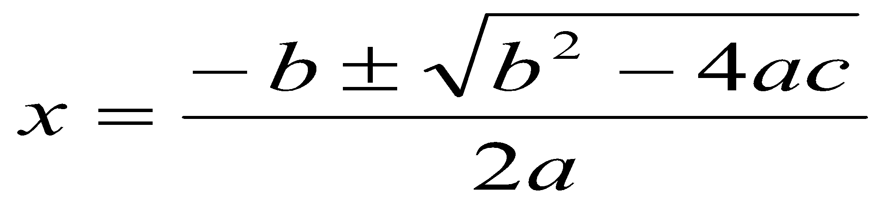
Roots of Nonlinear Equations
Direct Analytical Methods
In certain cases, roots can be found by using direct analytical methods. For example, consider a quadratic equation such as
ax² + bx + c = 0
Solution of this equation is
This gives two roots.
However, there are equations that cannot be solved by analytical methods. For example, the simple transcendental equation
2 sin x - x = 0
cannot be solved analytically.
Direct analytical methods for solving non-linear equations do not exist except for certain simple cases.

Slide 9
Roots of Nonlinear Equations
Graphical Methods
Graphical methods are useful when we are satisfied with approximate solution for a problem.
This method involves plotting the given function and determining the points where it crosses the x-axis. These points represent approximate values of the roots of the function.
Trial and Error Methods
This is another approach to obtain approximate solution.
This method involves a series of guesses for x, each time evaluating the function to see whether it is close to zero. The value of x that causes the function value closer to zero is one of the approximate roots of the equation.

Slide 10
Roots of Nonlinear Equations
Iterative Methods
Although graphical and trial and error methods provide satisfactory approximations for many problem situations, they become cumbersome and time consuming.
Moreover, the accuracy of the results are inadequate for the requirements of many engineering and scientific problems.
An iterative technique usually begins with an approximate value of the root, known as the initial guess, which is then successively corrected iteration by iteration. The process of iteration stops when the desired level of accuracy is obtained.

Slide 11
Roots of Nonlinear Equations
Iterative Methods
Iterative methods, based on the number of guesses they use, can be grouped into two categories:
Bracketing methods
Open end methods.
Bracketing Methods
Also known as interpolation methods.
These methods start with two initial guesses that ‘bracket’ the root and then systematically reduce the width of the bracket until the solution is reached.
Two popular methods under this category are:
Bisection method
False position method

Slide 12
Roots of Nonlinear Equations
Open End methods
Also known as extrapolation methods.
These methods use a single starting value or two values that do not necessarily bracket the root.
Some methods under this category:
Newton-Raphson method
Secant method
Muller’s method
Fixed-point method
Bairstow’s method

Slide 13
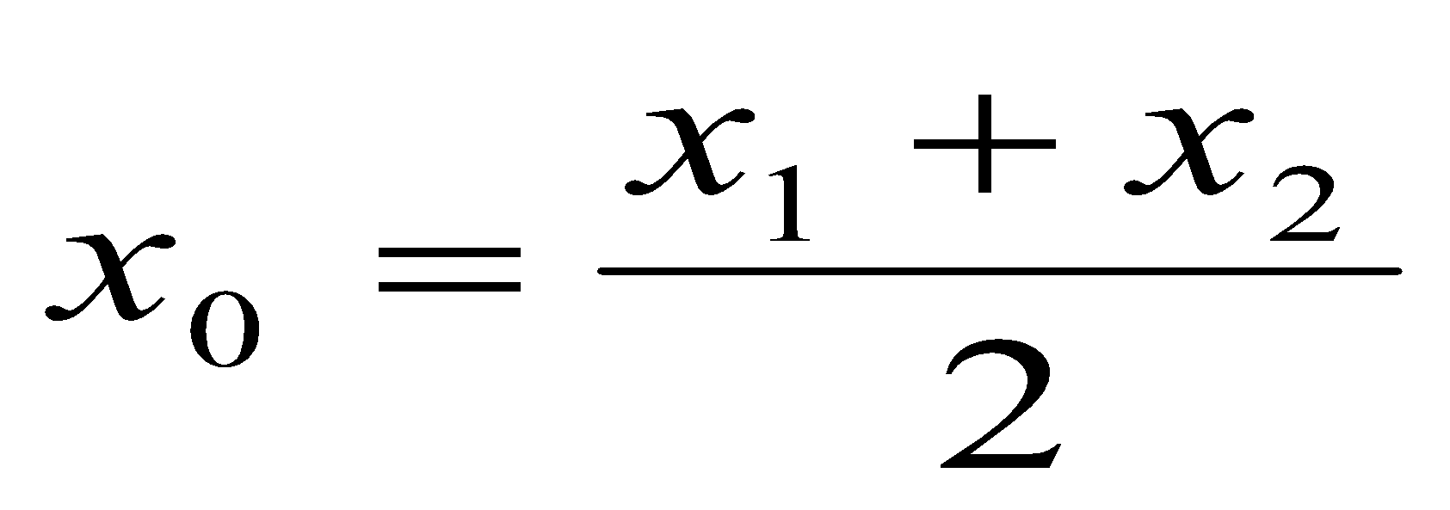
Roots of Nonlinear Equations
BISECTION METHOD
This is one of the simplest and most reliable of iterative methods for the solution of nonlinear equations.
This method, also known as binary chopping or half-interval method, relies on the fact that if f(x) is real and continuous in the interval a < x < b, and f(a) and f(b) are of opposite signs, that is,
f(a) . f(b) < 0
then there is at least one real root in the interval between a and b.
Let x₁ = a and x₂ = b. Let us also define another point x₀ to be the midpoint between a and b. That is,
Now, there exists the following three conditions:
If f(x₀) = 0, we have a root at x₀.
If f(x₀) . f(x₁) < 0, there is a root between x₀ and x₁.
If f(x₀) . f(x₂) < 0, there is a root between x₀ and x₂.

Slide 14
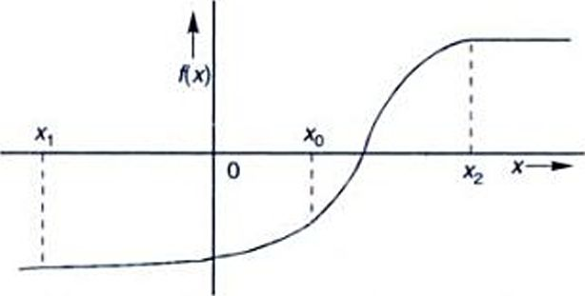
Roots of Nonlinear Equations
BISECTION METHOD
Testing the sign of the function at midpoint, we can deduce which part of the interval contains the root. This is illustrated in the following Fig.
It shows that since f(x₀) and f(x₂) are of opposite sign, a root lies between x₀ and x₂. We can further divide this subinterval into two halves to locate a new subinterval containing the root. This process can be repeated until the interval containing the root is as small as we desire.
Illustration of Bisection Method

Slide 15
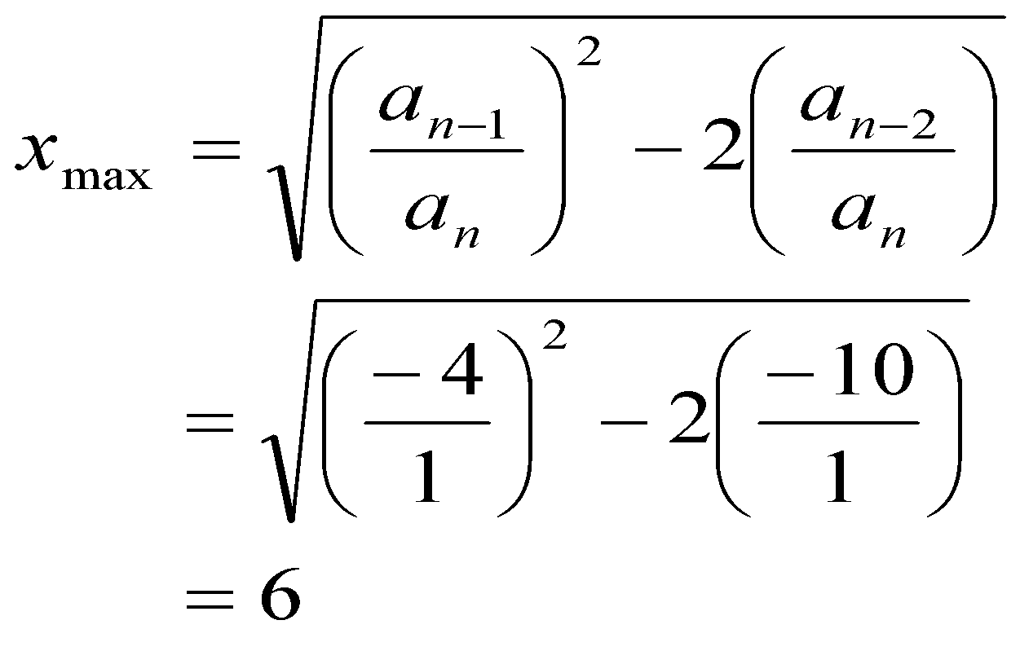
Roots of Nonlinear Equations
Example: Find a root of the equation x² - 4x - 10 = 0 using bisection method.
Answer:
Guess two initial values that would bracket a root.
Therefore, we have both the roots in the interval (-6, 6).
The table below gives the values of f(x) between -6 and 6 and shows that there is a root in the interval (-2, -1) and another in (5, 6).
x : | -6 | -5 | -4 | -3 | -2 | -1 | 0 | 1 | 2 | 3 | 4 | 5 | 6
f(x) : | 50 | 35 | 22 | 11 | 2 | -5 | -10 | -13 | -14 | -13 | -10 | -5 | 2

Slide 16
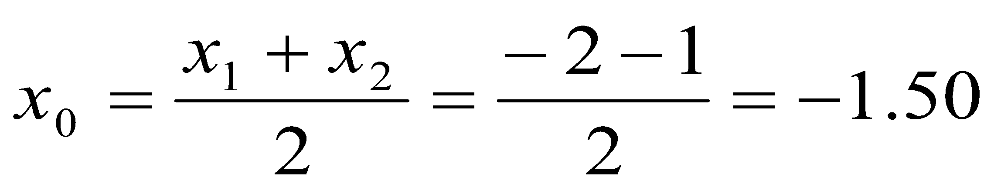
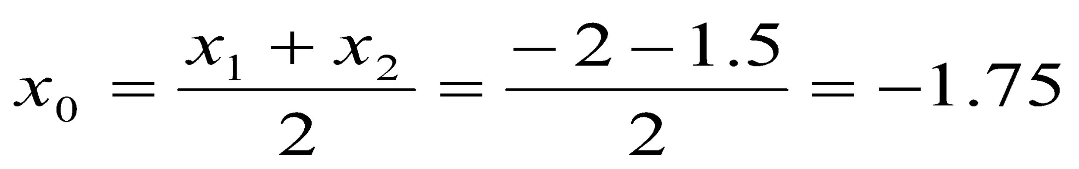
Roots of Nonlinear Equations
Example: Find a root of the equation x² - 4x - 10 = 0 using bisection method.
Let us take x₁ = -2 and x₂ = -1, then
f(x₁) = 2 and f(x₂) = -5
f(x₀) = - 1.75
Since f(x₁) . f(x₀) < 0, the root must be in the interval (-2, -1.5).
Thus, x₁ = -2 and x₂ = x₀ = -1.5
f(x₁) = 2 and f(x₂) = - 1.75
f(x₀) = 0.0625

Slide 17
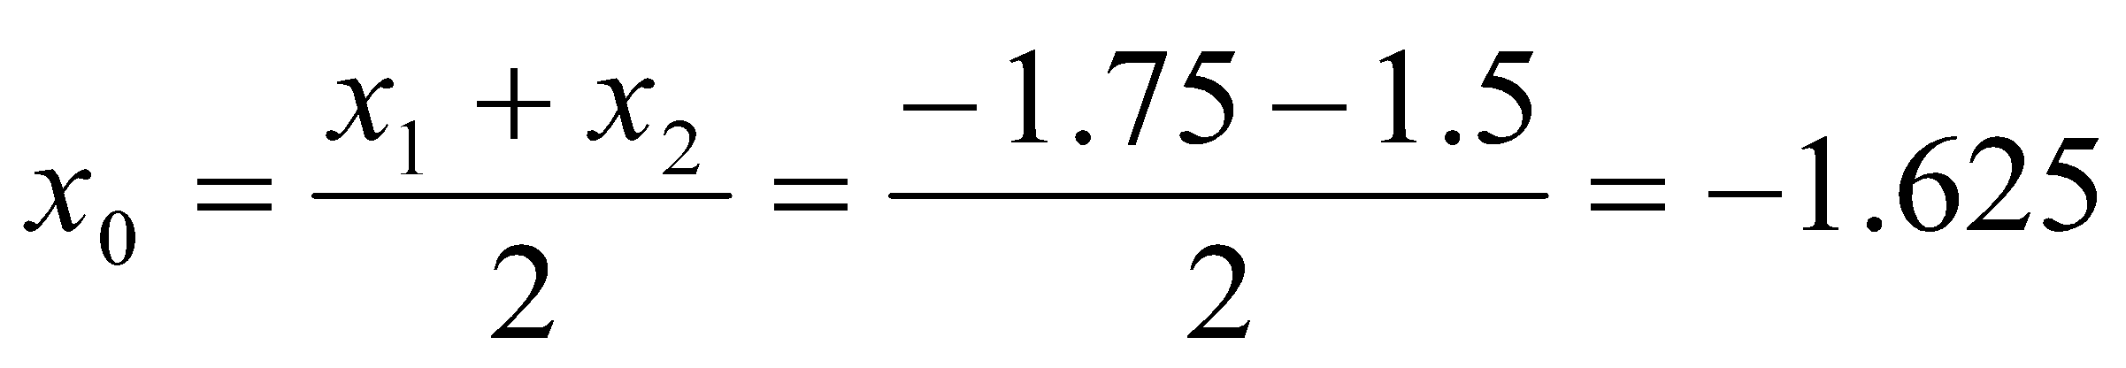
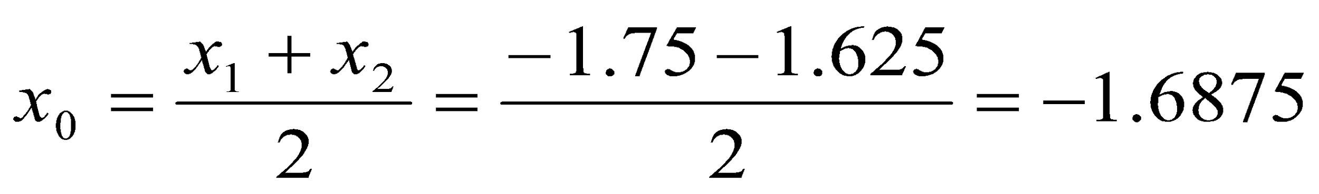
Roots of Nonlinear Equations
Example: Find a root of the equation x² - 4x - 10 = 0 using bisection method.
Since f(x₂) . f(x₀) < 0, the root must be in the interval (-1.75, -1.5).
Thus, x₁ = x₀ = -1.75 and x₂ = -1.5
f(x₁) = 0.0625 and f(x₂) = - 1.75
f(x₀) = - 0.859
Since f(x₁) . f(x₀) < 0, the root must be in the interval (-1.75, -1.625).
Thus, x₁ = -1.75 and x₂ = x₀ = -1.625
f(x₁) = 0.0625 and f(x₂) = - 0.859
f(x₀) = - 0.40

Slide 18
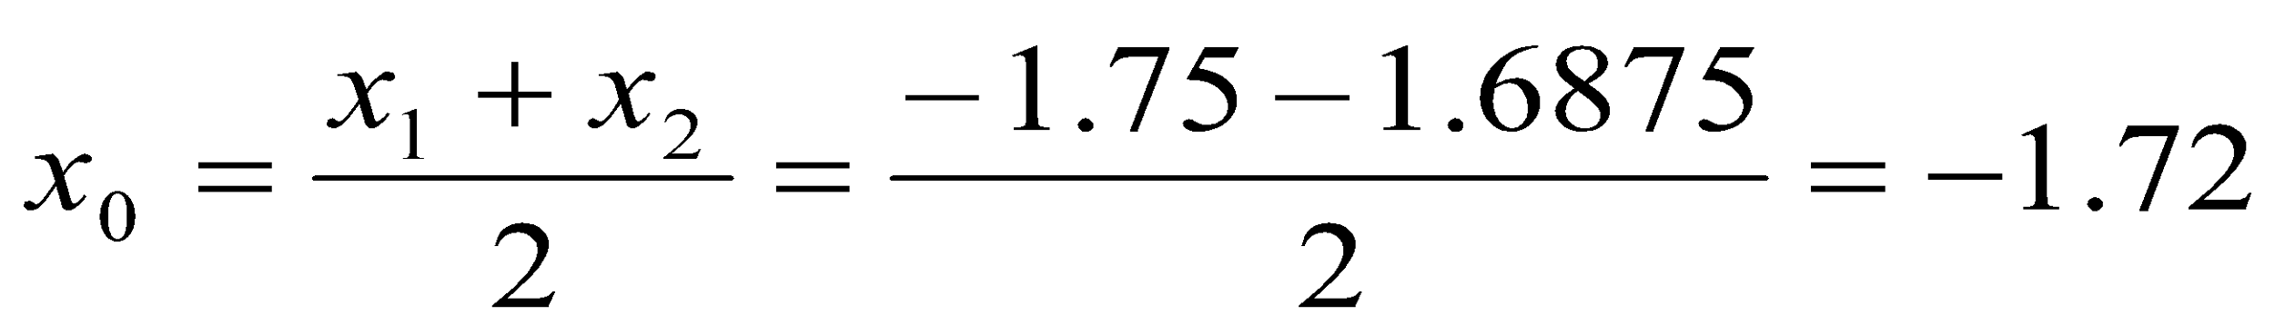
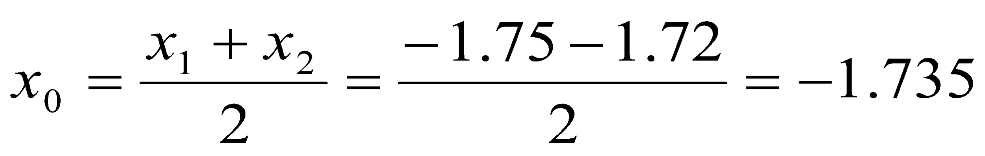
Roots of Nonlinear Equations
Example: Find a root of the equation x² - 4x - 10 = 0 using bisection method.
Since f(x₁) . f(x₀) < 0, the root must be in the interval (-1.75, -1.6875).
Thus, x₁ = -1.75 and x₂ = x₀ = -1.6875
f(x₁) = 0.0625 and f(x₂) = - 0.40
f(x₀) = - 0.1616
Since f(x₁) . f(x₀) < 0, the root must be in the interval (-1.75, -1.72).
Thus, x₁ = -1.75 and x₂ = x₀ = -1.72
f(x₁) = 0.0625 and f(x₂) = - 0.1616
f(x₀) = - 0.05

Slide 19
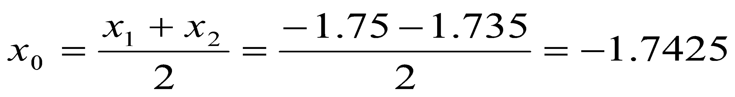
Roots of Nonlinear Equations
Example: Find a root of the equation x² - 4x - 10 = 0 using bisection method.
Since f(x₁) . f(x₀) < 0, the root must be in the interval (-1.75, -1.735).
Thus, x₁ = -1.75 and x₂ = x₀ = -1.735
f(x₁) = 0.0625 and f(x₂) = - 0.05
f(x₀) = 0.0063
Since f(x₂) . f(x₀) < 0, the root must be in the interval (-1.7425, -1.735).
Approximate root is - 1.7416

Slide 20
Roots of Nonlinear Equations
Algorithm: Bisection Method
Decide initial values for x₁ and x₂ and stopping criterion, E.
Compute f₁ = f(x₁) and f₂ = f(x₂)
If f₁ x f₂ > 0, then x₁ and x₂ do not bracket any root and go to step 7; otherwise continue.
Compute x₀ = (x₁ + x₂)/2 and compute f₀ = f(x₀).
If f₁ x f₀ <0 then
set x₂ = x₀.
else
set x₁ = x₀
set f₁ = f₀.
6. If absolute value of (x₂ - x₁)/x₂ is less than error E, then
root = (x₁ + x₂)/2
Write the value of root
Go to step 7
else
Go to step 4
7. Stop.

Slide 21
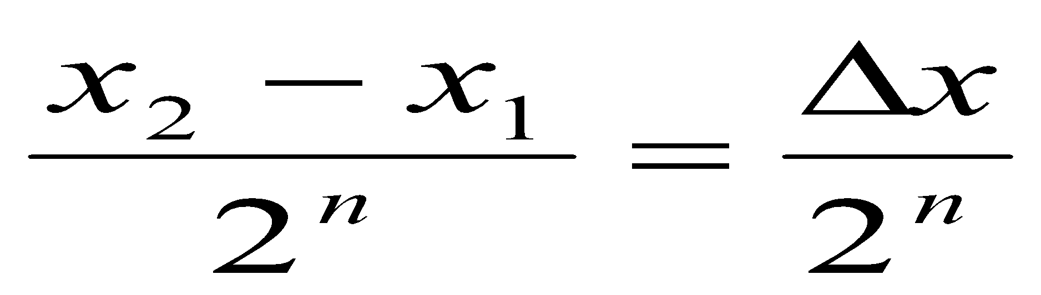
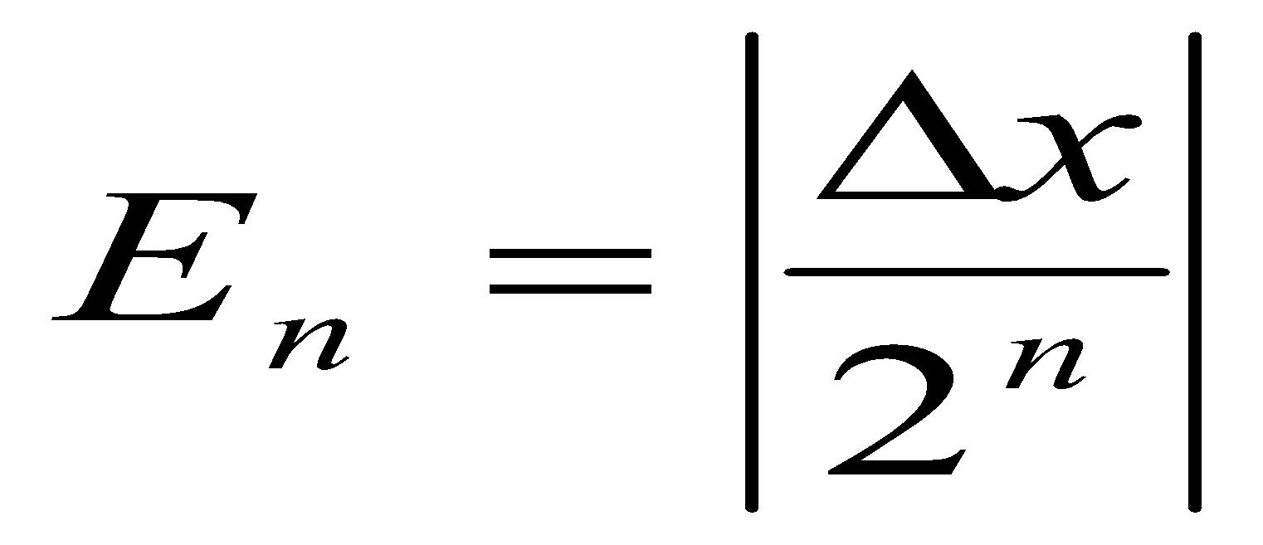
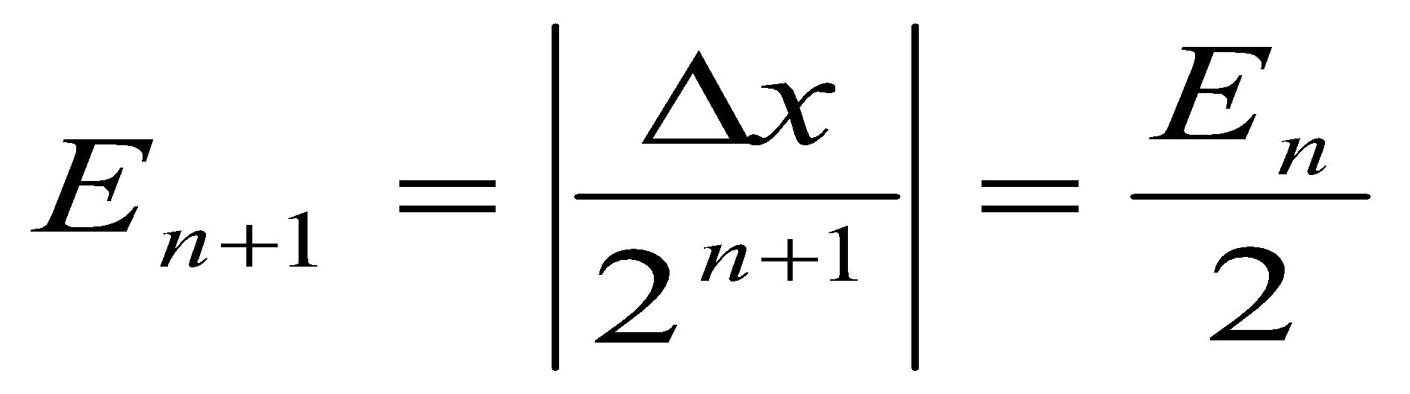
Roots of Nonlinear Equations
Convergence of Bisection Method
In the bisection method, we choose a midpoint x₀ in the interval between x₁ and x₂. Depending on the sign of functions f(x₀), f(x₁), and f(x₂), x₁ or x₂ is set equal to x₀ such that the new interval contains the root. In either case, the interval containing the root is reduced by a factor of 2. The same procedure is repeated for the new interval. If the procedure is repeated n times, then the interval containing the root is reduced to the size
After n iterations, the root must lie within . This means that the error bound at n^{th} iteration is
Similarly,
That is, the error decreases linearly with each step by a factor of 0.5. The bisection method is, therefore, linearly convergent.

Slide 22
Roots of Nonlinear Equations
Bisection Method
Since the convergence is slow to achieve a high degree of accuracy, a large number of iterations may be needed. (Disadvantage)
However, the bisection algorithm is guaranteed to converge. (Advantage)
In bisection method, the interval between x₁ and x₂ is divided into two equal halves, irrespective of location of the root. It may be possible that the root is closer to one end than the other. (Disadvantage)

Slide 23
Roots of Nonlinear Equations
False Position Method
The basic principle of false position method is illustrated in the following figure.
Suppose the root lines between x₁ and x₂.
Let us join the points x₁ and x₂ by a straight line.
(x₂, f(x₂) )
f(x)
(x₀, f(x₀) )
x₁
x₀
x₂
x
(x₁, f(x₁) )
Fig.: Illustration of false position method

Slide 24
Roots of Nonlinear Equations
False Position Method
The point of intersection of this line with the x-axis (x₀) gives an improved estimate of the root and is called the false position of the root.
This point then replaces one of the initial guesses that has a function value of the same sign as f(x₀).
This process is repeated with the new values of x₁ and x₂.
Since this method uses the false position of the root repeatedly, it is called the false position method.

Slide 25
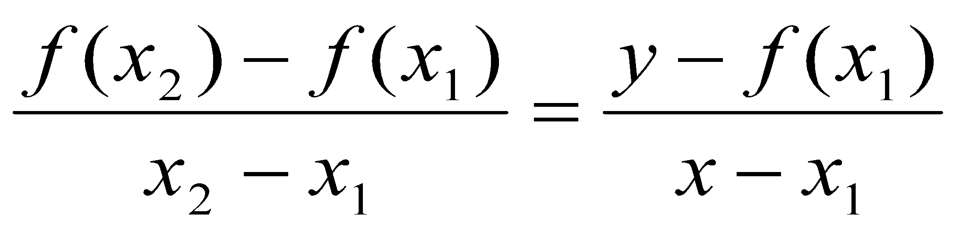
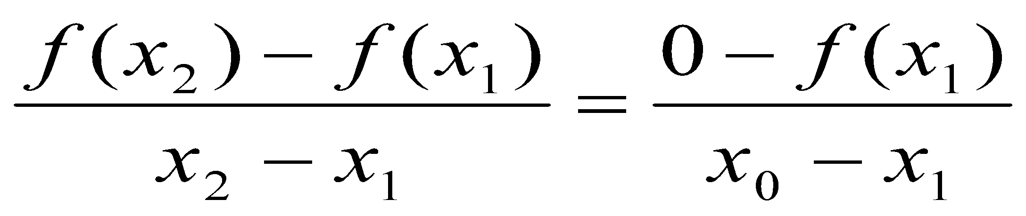
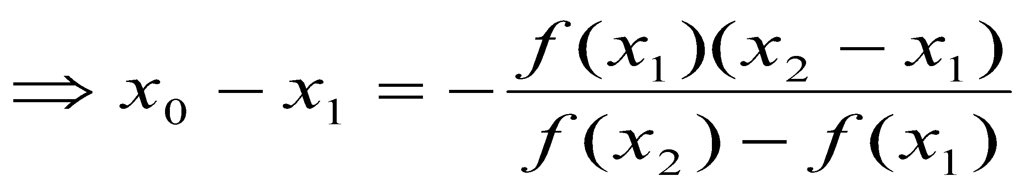
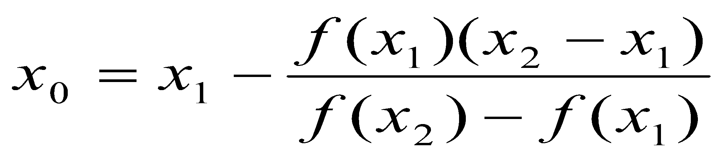
Roots of Nonlinear Equations
False Position Formula
We know that equation of the line joining the points (x₁, f(x₁)) and (x₂, f(x₂)) is given by
Since the line intersects the x-axis at x₀, when x = x₀, y = 0, we have
Therefore,
This equation is known as the false position formula.

Slide 26
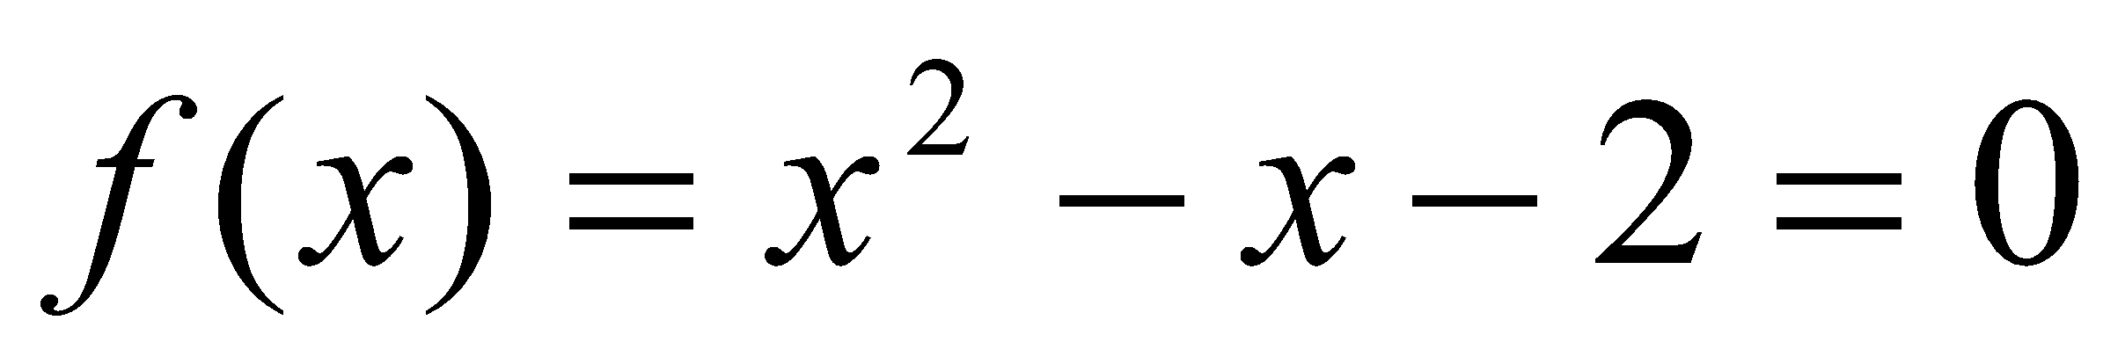
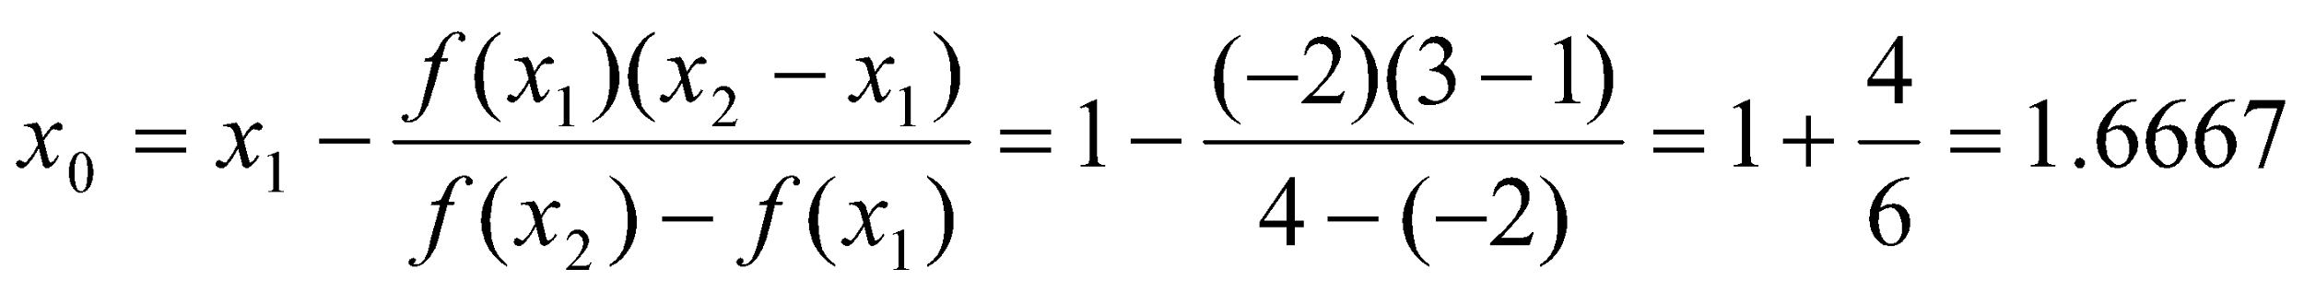
Roots of Nonlinear Equations
Example: Use the false position method to find a root of the function
in the range 1<x<3
Solution:
Iteration 1:
x₁ = 1, x₂ = 3,
f(x₁) = -2, f(x₂) = 4

Slide 27
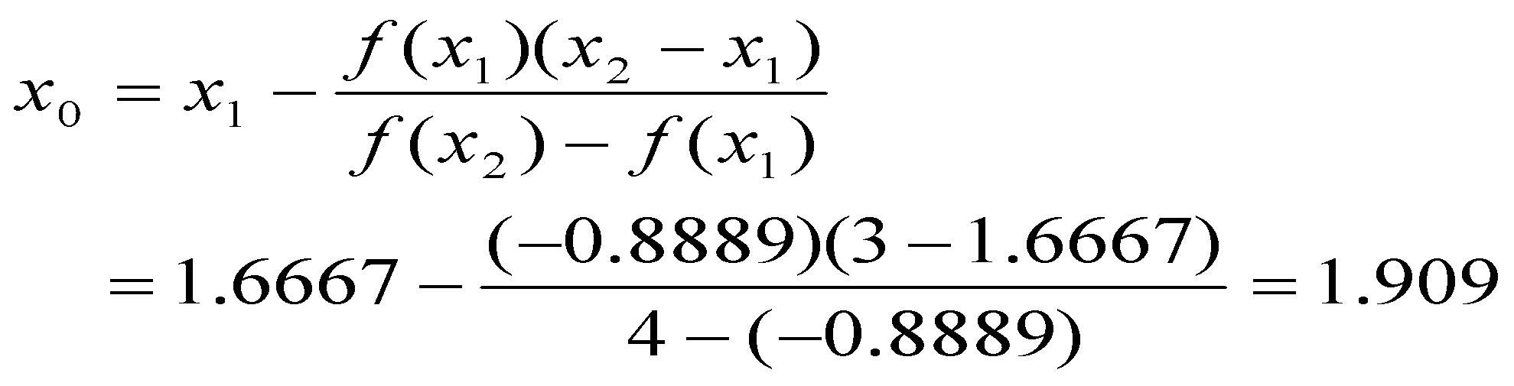
Roots of Nonlinear Equations
Example: Use the false position method to find a root of the function
in the range 1<x<3
Solution:
Iteration 2:
f(x₀) = f(1.6667) = - 0.8889
Sign is negative. So, the root lies between x₀ = 1.6667 and x₂ = 3. Thus,
x₁ = 1.6667, x₂ = 3,
f(x₁) = - 0.8889, f(x₂) = 4

Slide 28
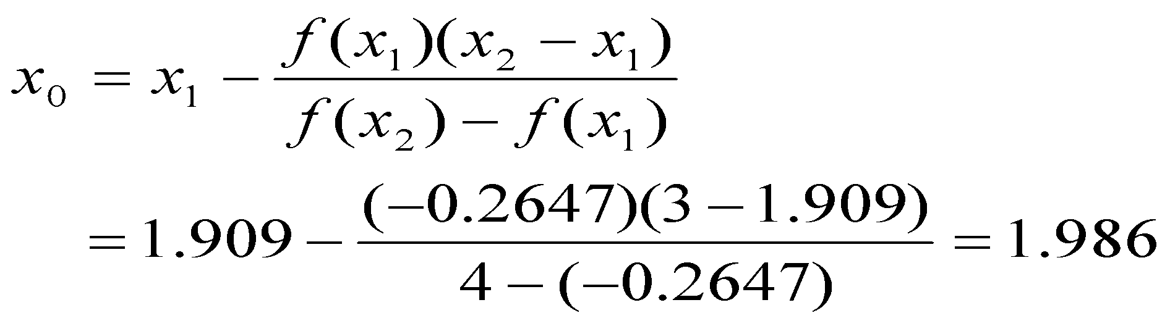
Roots of Nonlinear Equations
Example: Use the false position method to find a root of the function
in the range 1<x<3
Solution:
Iteration 3:
f(x₀) = f(1.909) = - 0.2647
Sign is negative. So, the root lies between x₀ = 1.909 and x₂ = 3. Thus,
x₁ = 1.909, x₂ = 3,
f(x₁) = - 0.2647, f(x₂) = 4
After 3rd iteration, the estimated root is: 1.986.
Actual root is 2.

Slide 29
Roots of Nonlinear Equations
Newton-Raphson Method
Consider the following graph. Let us assume that x₁ is an approximate root of f(x) = 0.
Now draw a tangent at the curve f(x) at x = x₁.
x₁, f(x₁)
f(x)
x₂, f(x₂)
f(x₁)
α
x₃
x₂
x₁
x
Fig. Newton-Raphson Method

Slide 30
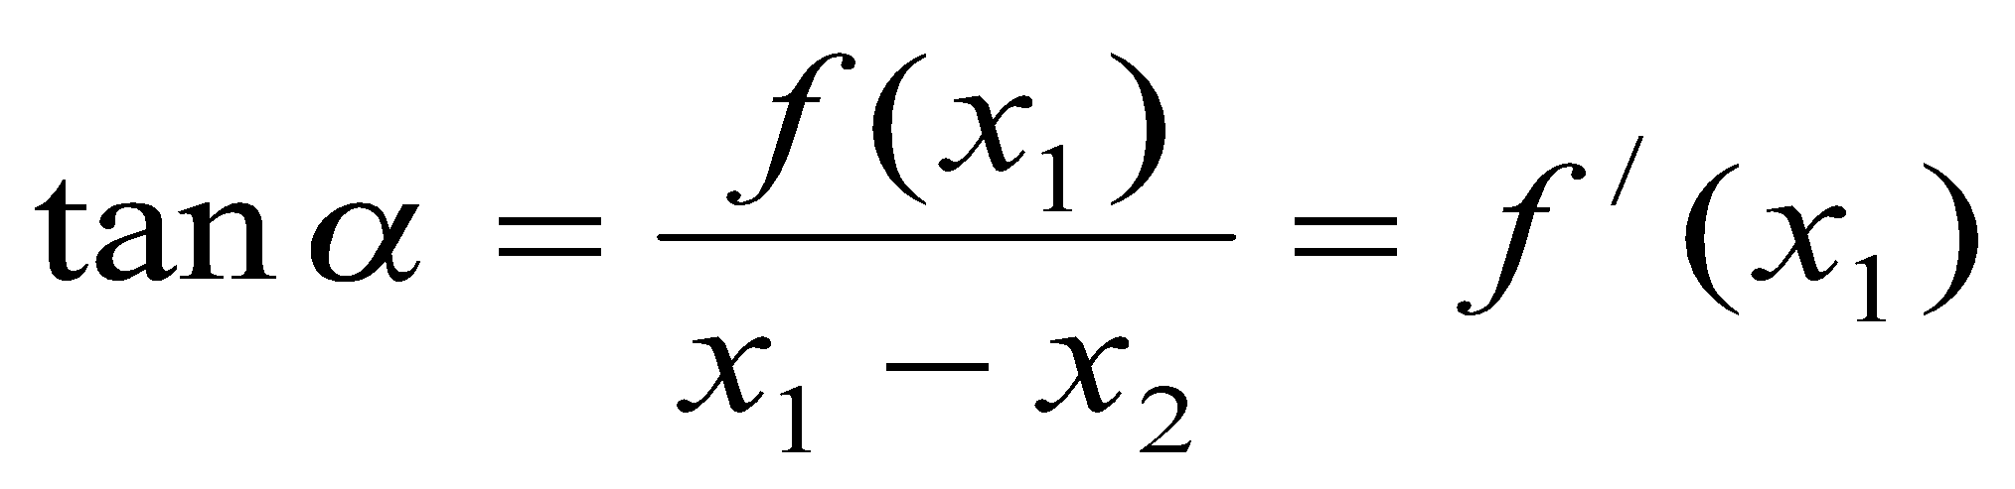
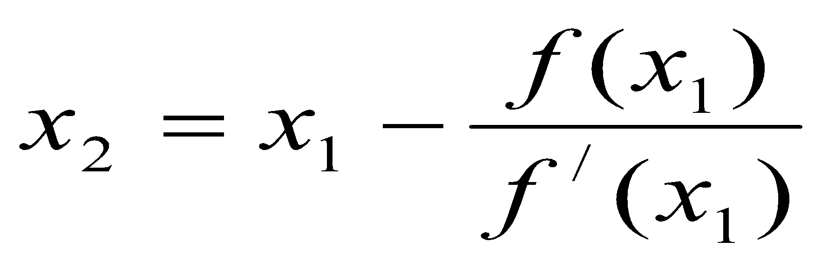
Roots of Nonlinear Equations
Newton-Raphson Method
The point of intersection of this tangent with the x-axis gives the second approximation to the root. Let the point of intersection be x₂. The slope of the tangent is given by
where f/(x₁) is the slope of f(x) at x = x₁.
Solving for x₂ we obtain
This is called the Newton-Raphson formula.

Slide 31
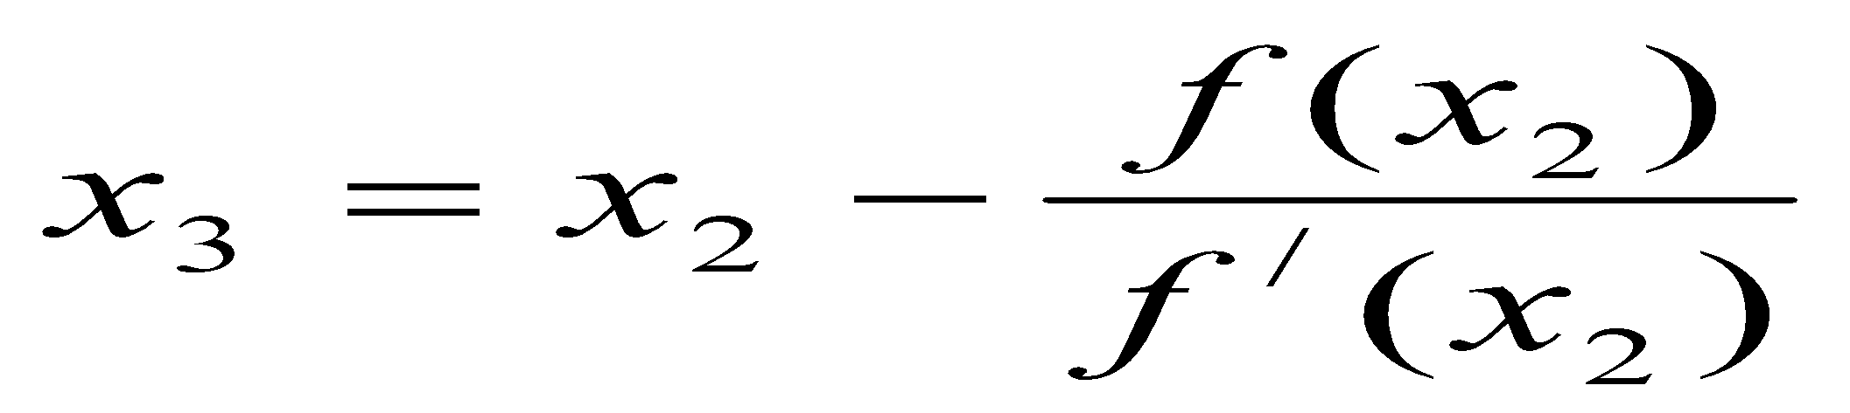
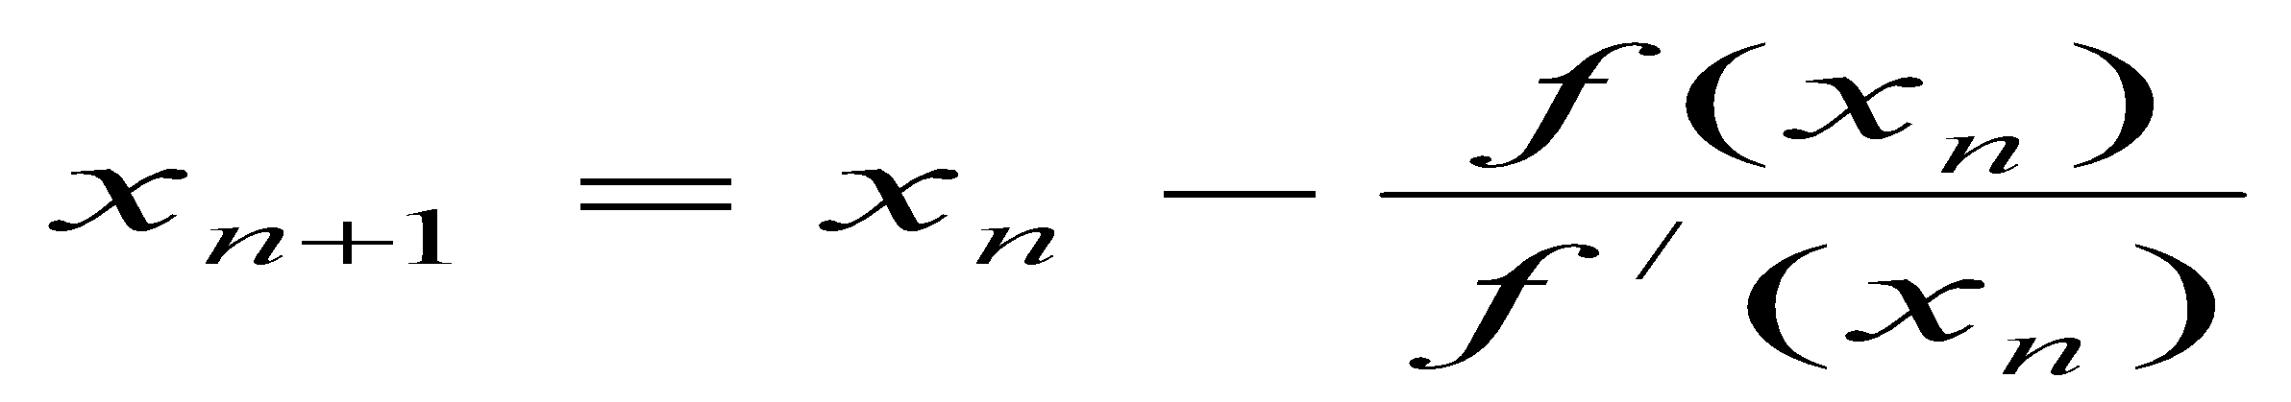
Roots of Nonlinear Equations
Newton-Raphson Method
The next approximation would be
In general,
This method of successive approximation is called the Newton-Raphson method. The process will be terminated when the difference between two successive values is within a prescribed limit.

Slide 32
Roots of Nonlinear Equations
Newton-Raphson Method
Limitations
Complications will arise if the derivative is zero. In such case, a new initial value for x must be chosen to continue the procedure.
If the initial guess is too far away from the required root, the process may converge to some other root.
A particular value in the iteration sequence may repeat, resulting in an infinite loop. This occurs when the tangent to the curve f(x) at x = x_{i+1} cuts the x-axis again at x = x_{i}.

Slide 33
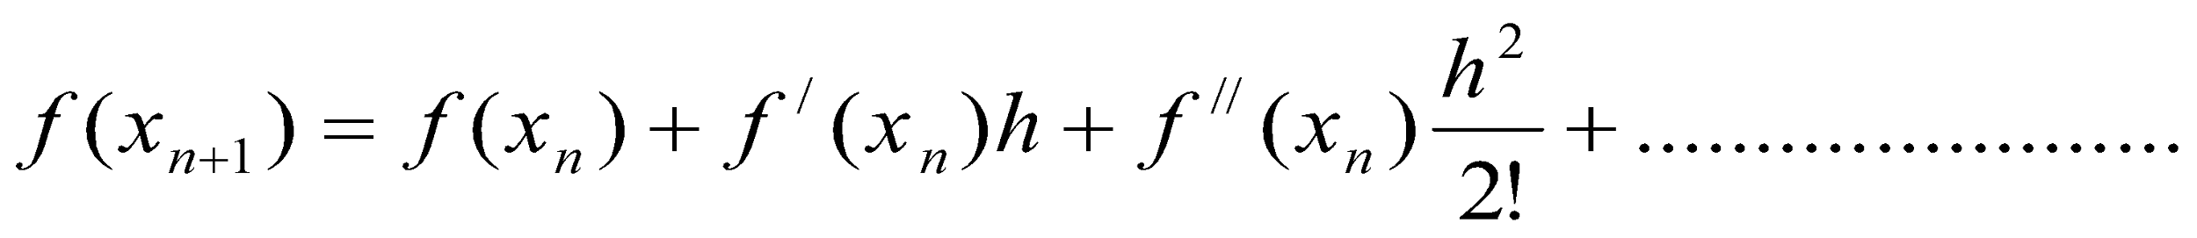
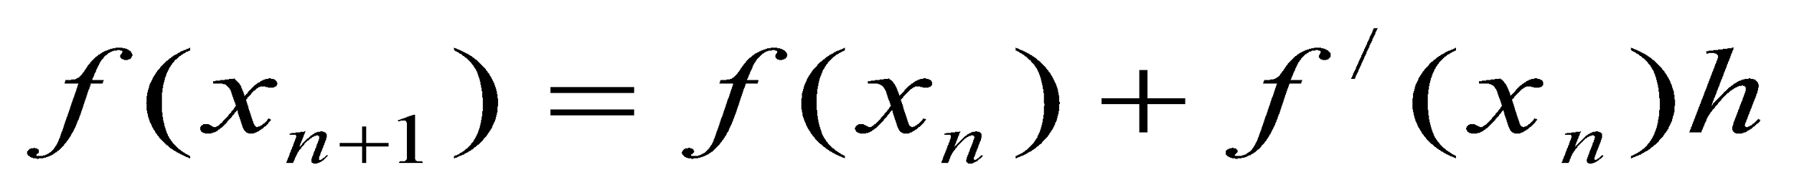
Roots of Nonlinear Equations
Newton-Raphson Method
Derivation from Taylor Series Expansion
Assume that x_{n} is an estimate of a root of the function f(x).
Consider a small interval h such that
h = x_{n+1} - x_{n} - - - - - - ---------------------------------------------- (1)
We can express f(x_{n+1}) using Taylor series expansion as follows:
If we neglect the terms containing the second order and higher derivatives, we get,

Slide 34
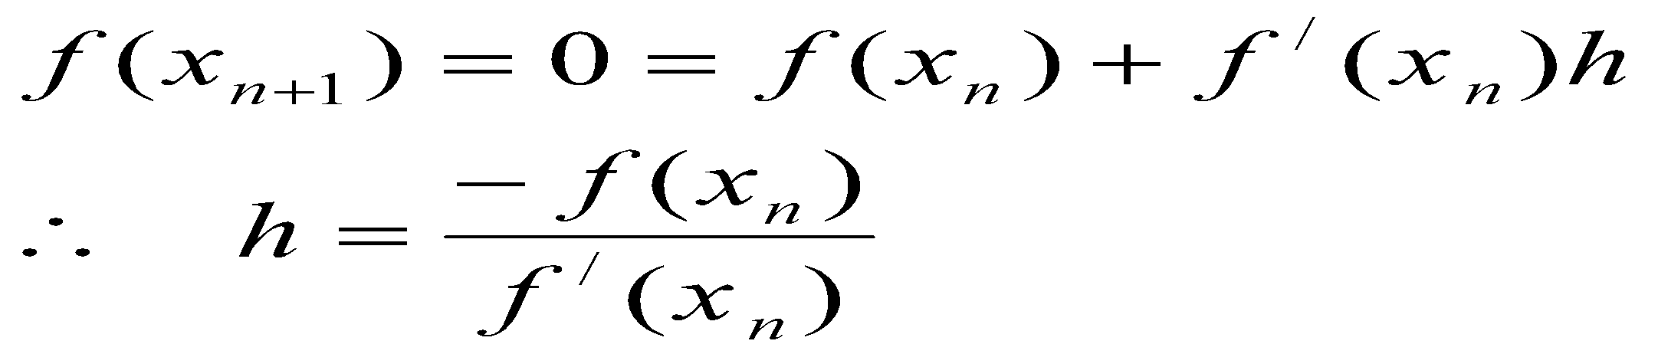
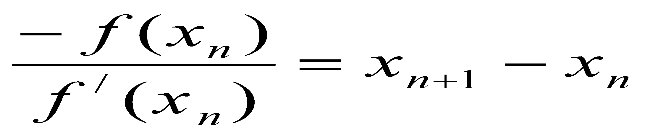
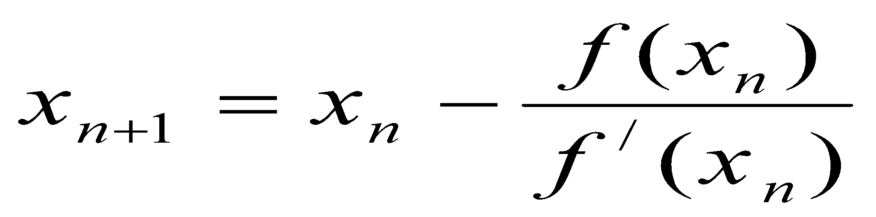
Roots of Nonlinear Equations
Newton-Raphson Method
Derivation from Taylor Series Expansion
If x_{n+1} is a root of f(x), then
-------------------------------------------------(2)
From (1) and (2),
Therefore,
This is the Newton-Raphson formula.

Slide 35
Roots of Nonlinear Equations
Newton-Raphson Algorithm

Slide 36
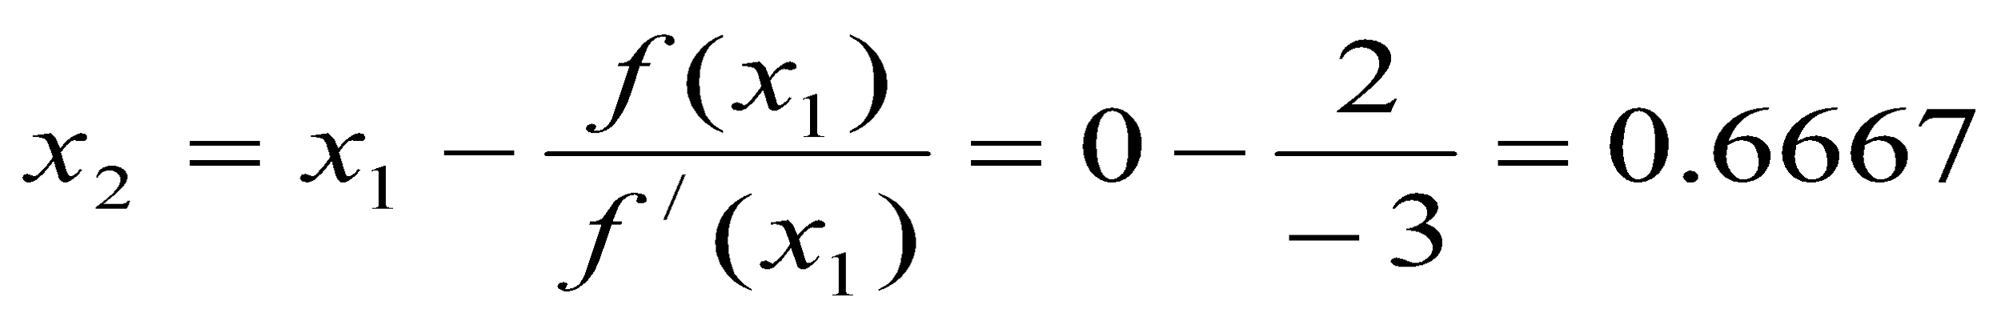
Roots of Nonlinear Equations
Example: Find the root of the equation
f(x) = x² – 3x + 2
in the vicinity of x = 0 using Newton-Raphson method.
Solution:
f(x) = x² – 3x + 2
f/(x) = 2x – 3
x₁ = 0 (First approximation)
Therefore,

Slide 37
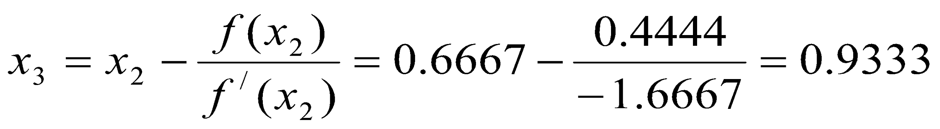
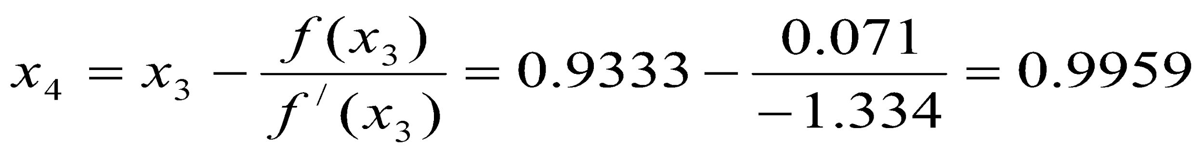
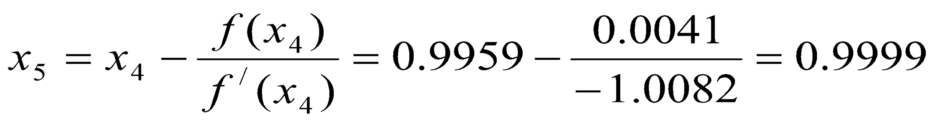
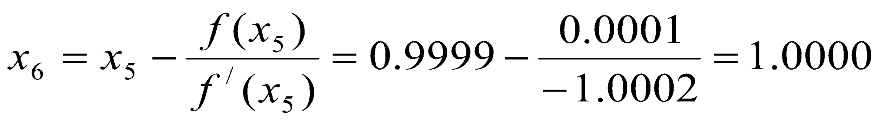
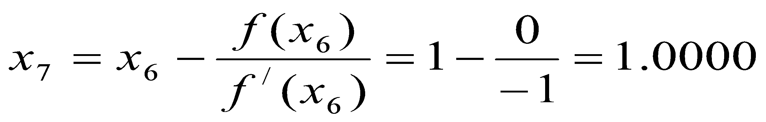
Roots of Nonlinear Equations
Example: Find the root of the equation
f(x) = x² – 3x + 2
in the vicinity of x = 0 using Newton-Raphson method.
Similarly,
So, Root is 1.0

Slide 38
Roots of Nonlinear Equations
Secant Method
Secant method uses two initial estimates but does not require that they must bracket the root.
The basic concept is illustrated in the following figure.
Consider the points x₁ and x₂ as starting values. They don’t bracket the root.
Scant line
f(x₁)
f(x)
f(x)
f(x₂)
x₃
x₂
x₁
x
Fig. Scant Method

Slide 39
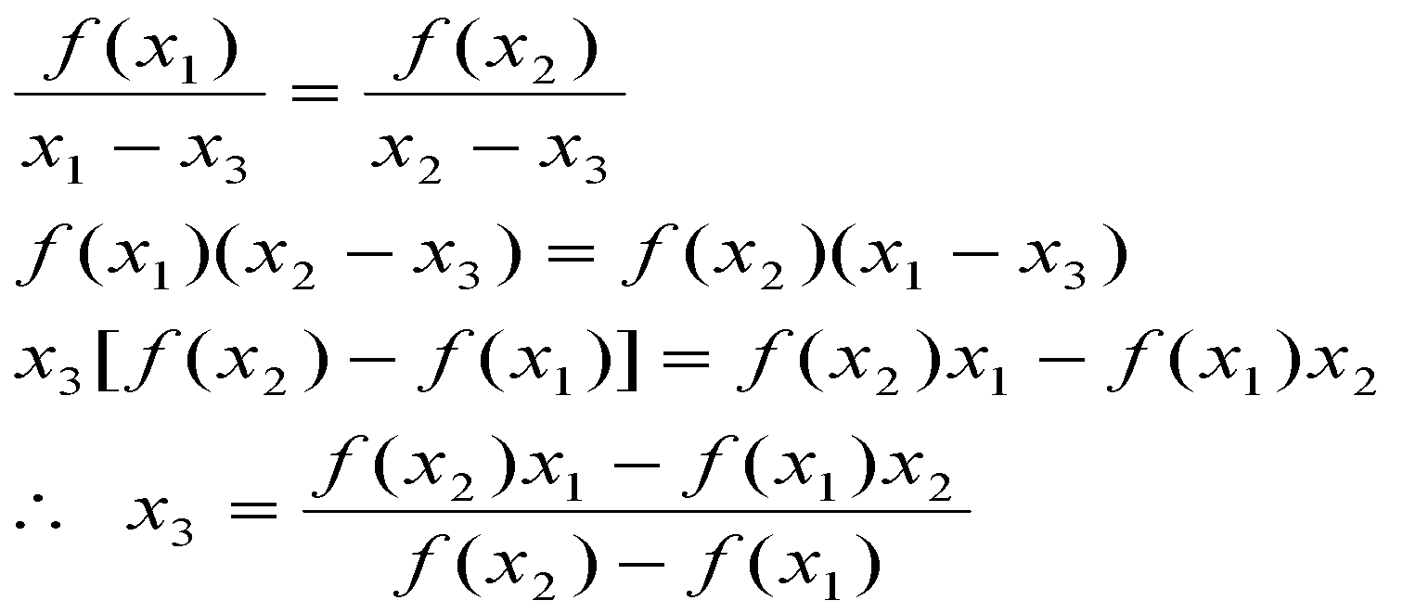
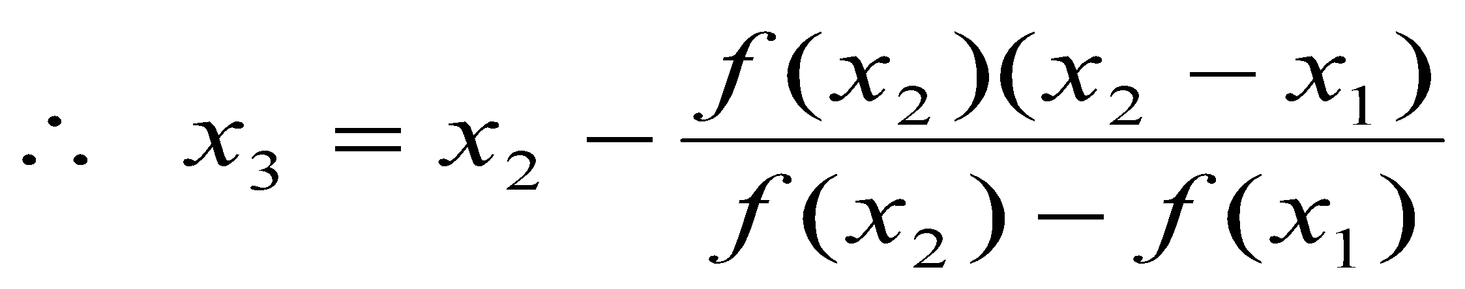
Roots of Nonlinear Equations
Secant Method
Slope of the secant line passing through x₁ and x₂ is given by
After rearranging,
-------------------------(1)
This is known as the secant formula.

Slide 40
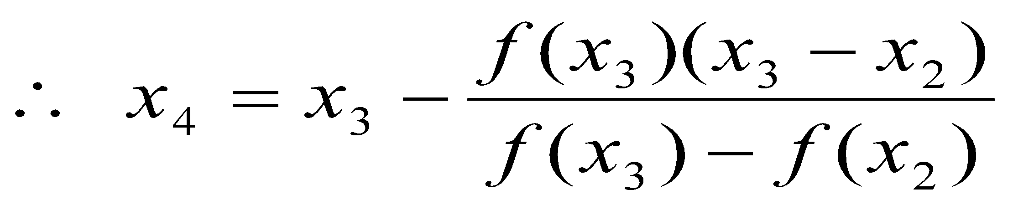
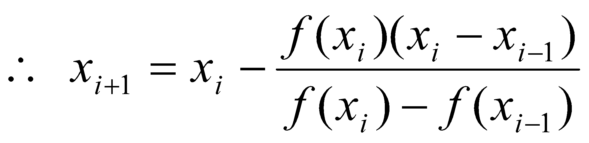
Roots of Nonlinear Equations
Secant Method
The approximate value of the root can be refined by repeating this procedure by replacing x₁ and x₂ by x₂ and x₃ respectively. That is, the next approximate value is given by,
This procedure is continued till the desired level of accuracy is obtained.
We can express the Secant formula in general form:

Slide 41
Roots of Nonlinear Equations
Secant Algorithm

Slide 42
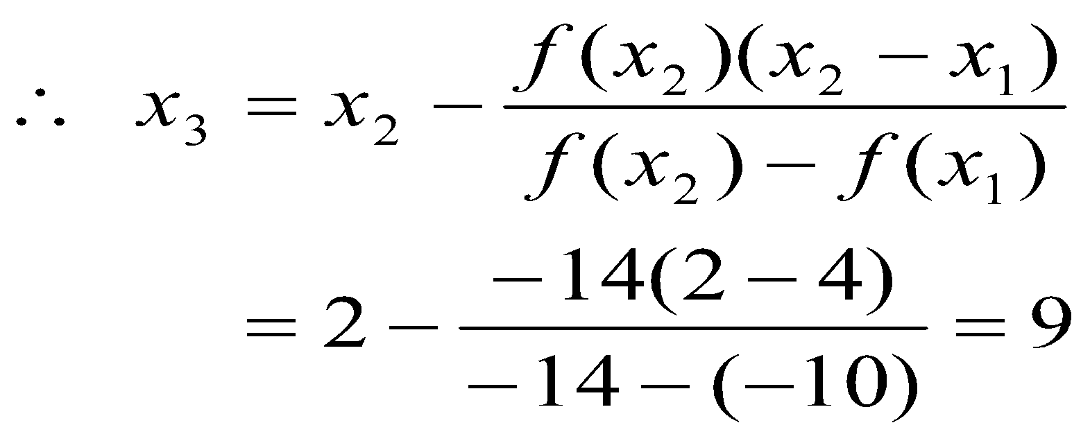
Roots of Nonlinear Equations
Example: Use the Secant method to estimate the root of the equation:
f(x) = x² - 4x - 10 with the initial estimates of x₁ = 4 and x₂ = 2.
Answer:
x₁ = 4 and x₂ = 2
f(x₁) = -10 and f(x₂) = -14
Now calculate x₃:

Slide 43
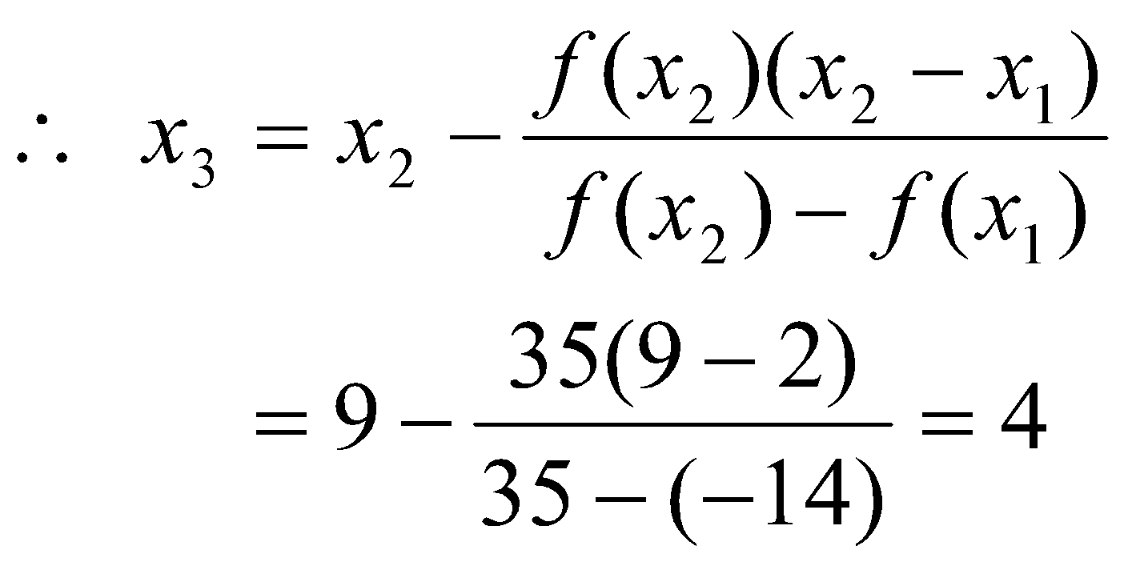
Roots of Nonlinear Equations
Example: Use the Secant method to estimate the root of the equation:
f(x) = x² - 4x - 10 with the initial estimates of x₁ = 4 and x₂ = 2.
For 2nd iteration,
x₁ = x₂ = 2
x₂ = x₃ = 9
f(x₁) = -14 and f(x₂) = 35

Slide 44
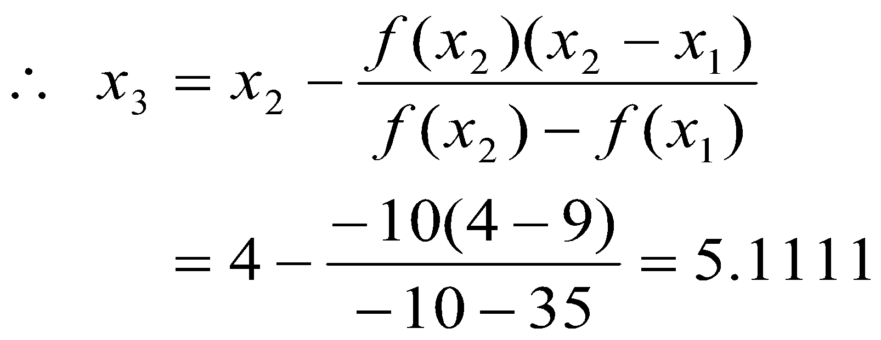
Roots of Nonlinear Equations
Example: Use the Secant method to estimate the root of the equation:
f(x) = x² - 4x - 10 with the initial estimates of x₁ = 4 and x₂ = 2.
For 3rd iteration,
x₁ = x₂ = 9
x₂ = x₃ = 4
f(x₁) = 35 and f(x₂) = -10

Slide 45
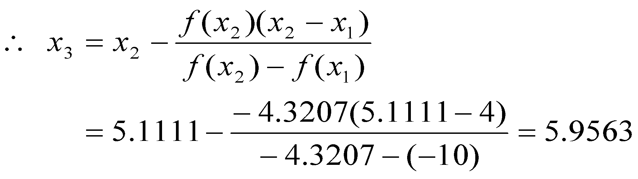
Roots of Nonlinear Equations
Example: Use the Secant method to estimate the root of the equation:
f(x) = x² - 4x - 10 with the initial estimates of x₁ = 4 and x₂ = 2.
For 4th iteration,
x₁ = x₂ = 4
x₂ = x₃ = 5.1111
f(x₁) = -10 and f(x₂) = -4.3207

Slide 46
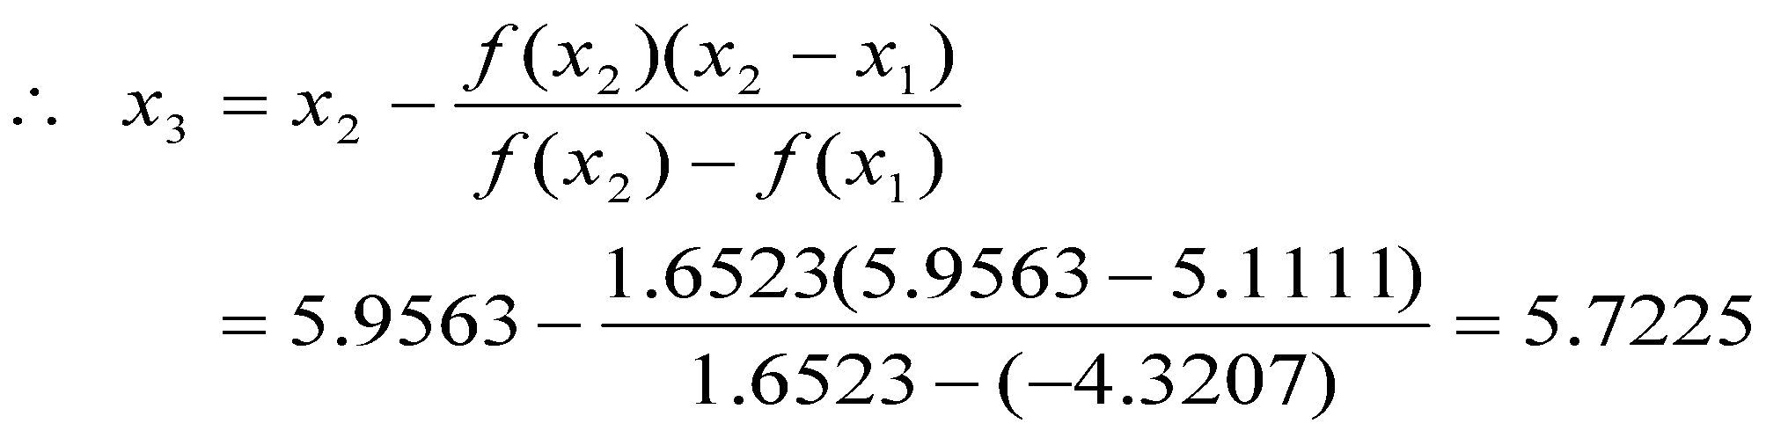
Roots of Nonlinear Equations
Example: Use the Secant method to estimate the root of the equation:
f(x) = x² - 4x - 10 with the initial estimates of x₁ = 4 and x₂ = 2.
For 5th iteration,
x₁ = x₂ = 5.1111
x₂ = x₃ = 5.9563
f(x₁) = -4.3207 and f(x₂) = 1.6523
The value can be further refined by continuing the process, if necessary.

Slide 47
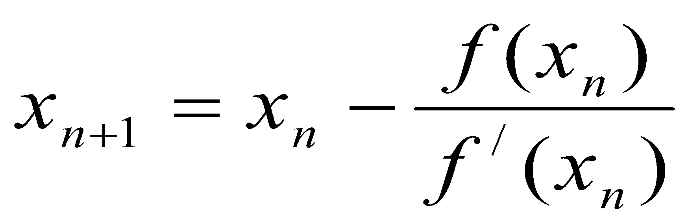
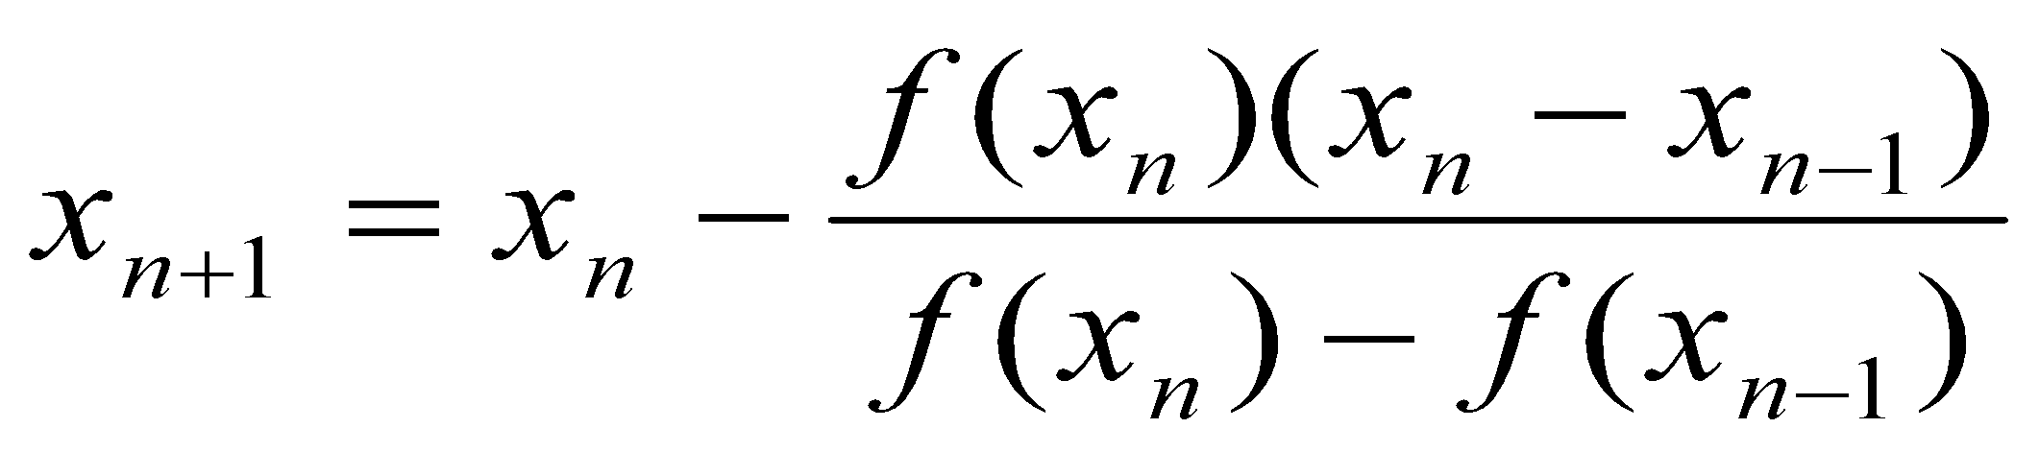
Roots of Nonlinear Equations
Secant Method VS Newton-Raphson Method
Newton formula:
Secant formula:
In Newton formula, it needs derivative. There are many functions whose derivative may be difficult to evaluate. Secant formula needs no derivatives.
Secant formula needs two initials. Again its convergence rate is slower than that of Newton formula.

