Slide 1

Numerical Methods
Lecture 05

Slide 2
Direct Solution of Linear Equations
Necessity
Analysis of linear equations is significant for a number of reasons:
Mathematical models of many of the real world problems are either linear or can be approximated reasonably well using linear relationships.
The analysis of linear relationship of variables is generally easier than that of nonlinear relationships.
Linear Equation
A linear equation involving two variables x and y has the standard form:
ax + by = c
Where a, b and c are real numbers and a and b cannot both equal zero.
Some examples of linear equations:
4x + 7y = 15
- x - 2/3y = 0

Slide 3
Direct Solution of Linear Equations
Non-Linear Equation
Some examples of nonlinear equations:
2x – xy + y = 2
x² + y² = 25
In practice, linear equations occur in more than two variables. A linear equation with n variables has the form:
a₁x₁ + a₂x₂ + a₃x₃ + . . . . . . . . . . + a_{n}x_{n} = b
Where a_{i} are real numbers and at least one of them is not zero.
The main concern is to solve for x_{i}, given the values of a_{i} and b.
An infinite set of x_{i} values will satisfy the above equation. There is no unique solution.

Slide 4
Direct Solution of Linear Equations
Direct Solution of Linear Equations
The techniques and methods for solving systems of linear algebraic equations belong to two fundamentally different approaches:
Elimination Approach
Iterative Approach
Elimination Approach
Elimination approach, also known as direct method, reduces the given system of equations to a form which the solution can be obtained by simple substitution.
Some elimination methods are given:
Basic Gauss elimination method
Gauss elimination with pivoting
Gauss-Jordan method
LU decomposition methods
Matrix inverse method

Slide 5
Direct Solution of Linear Equations
Iterative Approach
Iterative approach involves assumptions of some initial values which are then refined repeatedly till they reach some accepted level of accuracy.
Existence of Solution
Given an arbitrary system of equations, it is difficult to say whether the system has a solution or not. Sometimes there may be a solution but it may not be unique. There are four possibilities:
System has a unique solution
System has no solution
System has a solution but not a unique one (i.e. it has infinite solutions)
System is ill-conditioned

Slide 6
Direct Solution of Linear Equations
Unique Solution
Consider the system
x + 2y = 9
2x – 3y = 4
The system has a solution: x = 5 and y = 2.
Since no other pair of values of x and y would satisfy the equations, the solution is said to be unique. The system is shown in the fig.
3x – 1.5y = 4
4.5
x + 2y = 9
2x - 3y = 4
y
2x - y = 5
y
(x = 5, y = 2)
0
2
x
9
0
x
System with unique solution
System with no solution

Slide 7
Direct Solution of Linear Equations
No Solution
Consider the system
2x – y = 5
3x – 3/2y = 4
The system has no solution. These two lines are parallel as shown in the fig. Therefore, they never meet. Such equations are called inconsistent equations.
Infinite Solution (No Unique Solution)
Consider the system
-2x + 3y = 6
4x – 6y = -12
The system has many different solutions. We can see that these are two different forms of the same equation and therefore, they represent the same line. Such equations are called dependent equations.

Slide 8
Direct Solution of Linear Equations
Ill-Conditioned System
Consider the system
x – 2y = -2
0.45x – 0.91y = -1
The system has a solution but it is very difficult to identify the exact point at which the lines intersect. Such system are said to be ill-conditioned.
y
y
x - 2y = -2
-2x + 3y = 6
0.45x – 0.91y = -1
4x - 6y = -12
0
x
0
x
System with infinite solutions
Ill-Conditioned System

Slide 9
Direct Solution of Linear Equations
Basic Gauss Elimination Method
Gauss elimination method proposes a systematic strategy for reducing the system of equations to the upper triangular form using the forward elimination approach and then for obtaining values of unknowns using the back substitution process.
The strategy consists of two phases:
Forward elimination phase: This phase is concerned with the manipulation of equations in order to eliminate some unknowns from the equations and produce an upper triangular system.
Back substitution phase: This phase is concerned with the actual solution of the equations and uses the back substation process on the reduced upper triangular system.

Slide 10
Direct Solution of Linear Equations
Algorithm for Basic Gauss Elimination Method
Example: Solve the following system using the basic Gauss elimination method.
3x₁ + 6x₂ + x₃ = 16
2x₁ + 4x₂ + 3x₃ = 13
x₁ + 3x₂ + 2x₃ = 9
Solution:
3x₁ + 6x₂ + x₃ = 16
0 + 0 + x₃ = 1 ( R₂ = R₂ - (2/3)R₁ )
0 + 3x₂ + 5x₃ = 11 ( R₃ = R₃ - (1/3)R₁ )
Now reorder the equations:
3x₁ + 6x₂ + x₃ = 16
0 + 3x₂ + 5x₃ = 11
0 + 0 + x₃ = 1
Solution is
x₃ = 1, x₂ = 2 and x₁ = 1

Slide 11
Direct Solution of Linear Equations
Gauss Elimination with Pivoting
In the basic Gauss elimination method, the element when i = j is known as a pivot element. Each row is normalized by dividing the coefficients of that row by its pivot element. That is,
= j=1, ……, n
If = 0, k-th row cannot be normalized. Therefore, the procedure fails. One way to overcome this problem is to interchange this row with another row below it which does not have a zero element in that position. It can be proved that round-off errors would be reduced if the absolute value of the pivot element is large. Therefore, it is suggested that the row with zero pivot element should be interchanged with the row having the largest (absolute value) coefficient in that position.
In general, the reordering of equations is done to improve accuracy, even if the pivot element is not zero.
The procedure of reordering involves the following steps:
Search and locate the largest absolute value among the coefficients in the first column.
Exchange the first row with the row containing that element.
Then eliminate the first variable in the second equation.
When the second row becomes the pivot row, search for the coefficients in the second column from the second row to the nth row and locate the largest coefficient. Exchange the second row with the row containing the large coefficient.
Continue this procedure till (n – 1) unknowns are eliminated.
This process is referred to as partial pivoting.
In complete pivoting, at each stage, the largest element in any of the remaining rows is used as the pivot. Complete pivoting requires a lot of overhead and therefore, it is not generally used.

Slide 12
Direct Solution of Linear Equations
Gauss Elimination with Pivoting
The procedure of reordering involves the following steps:
Search and locate the largest absolute value among the coefficients in the first column.
Exchange the first row with the row containing that element.
Then eliminate the first variable in the second equation.
When the second row becomes the pivot row, search for the coefficients in the second column from the second row to the nth row and locate the largest coefficient. Exchange the second row with the row containing the large coefficient.
Continue this procedure till (n – 1) unknowns are eliminated.
This process is referred to as partial pivoting.
In complete pivoting, at each stage, the largest element in any of the remaining rows is used as the pivot. Complete pivoting requires a lot of overhead and therefore, it is not generally used.

Slide 13
Direct Solution of Linear Equations
Example: Solve the following system of equations using partial pivoting technique:
2x₁ + 2x₂ + x₃ = 6
4x₁ + 2x₂ + 3x₃ = 4
x₁ - x₂ + x₃ = 0
Solution:
Original system
2 2 1 6 (R1 and R2 are interchanged)
4 2 3 4
1 -1 1 0
Interchange row-1 and row-2:
4 2 3 4 (pivot row)
2 2 1 6
1 -1 1 0

Slide 14
Direct Solution of Linear Equations
Example: Solve the following system of equations using partial pivoting technique:
2x₁ + 2x₂ + x₃ = 6
4x₁ + 2x₂ + 3x₃ = 4
x₁ - x₂ + x₃ = 0
Solution:
Now perform (R₂ = R₂ - (1/2)R₁ ) and ( R₃ = R₃ - (1/4)R₁ )
4 2 3 4
0 1 -0.5 4 (R2 and R3 are interchanged)
0 -1.5 0.25 -1
Interchange row-2 and row-3:
4 2 3 4
0 -1.5 0.25 -1 (pivot row)
0 1 -0.5 4

Slide 15
Direct Solution of Linear Equations
Example: Solve the following system of equations using partial pivoting technique:
2x₁ + 2x₂ + x₃ = 6
4x₁ + 2x₂ + 3x₃ = 4
x₁ - x₂ + x₃ = 0
Solution:
Now perform, R₃ = R₃ + (1/1.5)R₂
4 2 3 4
0 -1.5 0.25 -1
0 0 -1/3 10/3
Therefore, solution is:
x₃ = -10, x₂ = -1 and x₁ = 9

Slide 16
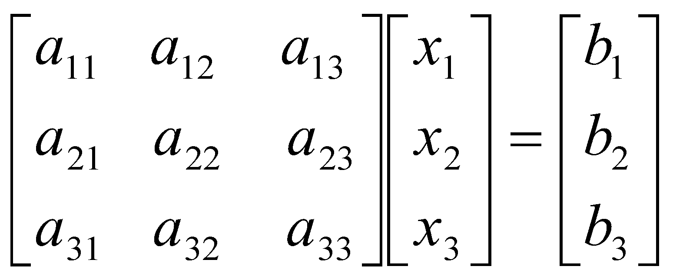
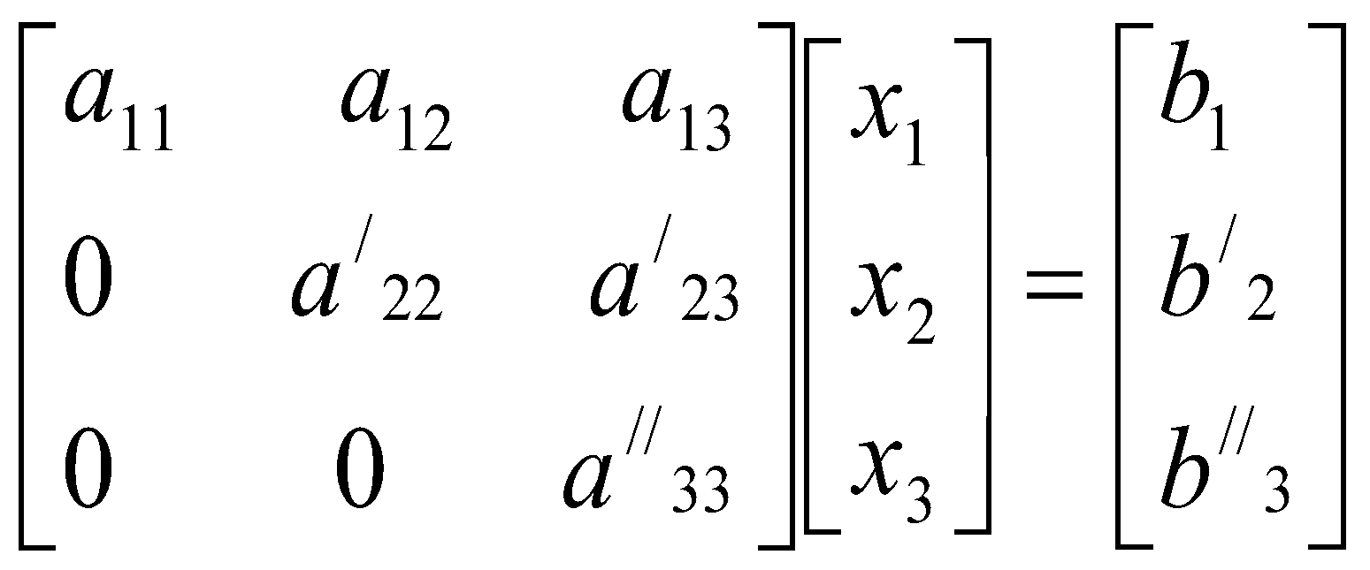
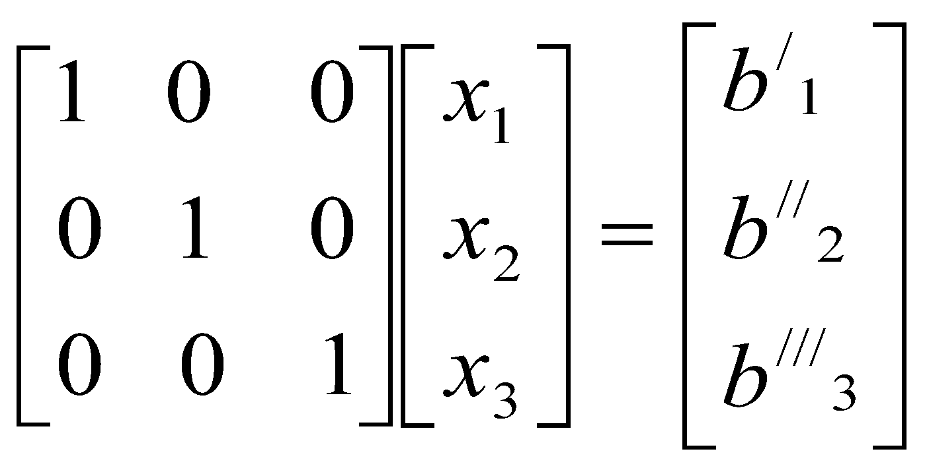
Direct Solution of Linear Equations
Gauss-Jordan Method
In Gauss elimination method, a variable is eliminated from the rows below the pivot equation. But in Gauss-Jordan method, it is eliminated from all other rows (both below and above). This process thus eliminates all the off-diagonal terms producing a diagonal matrix rather than a triangular matrix.
Result of Gauss elimination Result of Gauss-Jordan elimination

Slide 17
Direct Solution of Linear Equations
Algorithm of Gauss-Jordan elimination Method
Example: Solve the following system of equations using Gauss-Jordan method:
2x₁ + 4x₂ - 6x₃ = -8
x₁ + 3x₂ + x₃ = 10
2x₁ - 4x₂ - 2x₃ = -12
Solution:
Normalize row-1 by dividing by 2 (pivot element).
x₁ + 2x₂ - 3x₃ = -4
x₁ + 3x₂ + x₃ = 10
2x₁ - 4x₂ - 2x₃ = -12

Slide 18
Direct Solution of Linear Equations
Example: Solve the following system of equations using Gauss-Jordan method:
2x₁ + 4x₂ - 6x₃ = -8
x₁ + 3x₂ + x₃ = 10
2x₁ - 4x₂ - 2x₃ = -12
Solution:
Perform R₂ = R₂ - R₁ and R₃ = R₃ - 2R₁
x₁ + 2x₂ - 3x₃ = -4
0 + x₂ + 4x₃ = 14
0 - 8x₂ + 4x₃ = -4
Normalize row-2 (it is already in normalized form).
Perform R₁ = R₁ – 2R₂ and R₃ = R₃ + 8R₂
x₁ + 0 - 11x₃ = -32
0 + x₂ + 4x₃ = 14
0 - 0 + 36x₃ = 108

Slide 19
Direct Solution of Linear Equations
Example: Solve the following system of equations using Gauss-Jordan method:
2x₁ + 4x₂ - 6x₃ = -8
x₁ + 3x₂ + x₃ = 10
2x₁ - 4x₂ - 2x₃ = -12
Solution:
Normalize row-3.
x₁ + 0 - 11x₃ = -32
0 + x₂ + 4x₃ = 14
0 - 0 + x₃ = 3
Perform R₁ = R₁ + 11R₃ and R₂ = R₂ - 4R₃
x₁ + 0 - 0 = 1
0 + x₂ + 0 = 2
0 - 0 + x₃ = 3
Therefore, solution is: x₁ = 1, x₂ = 2 and x₃ = 3

Slide 20
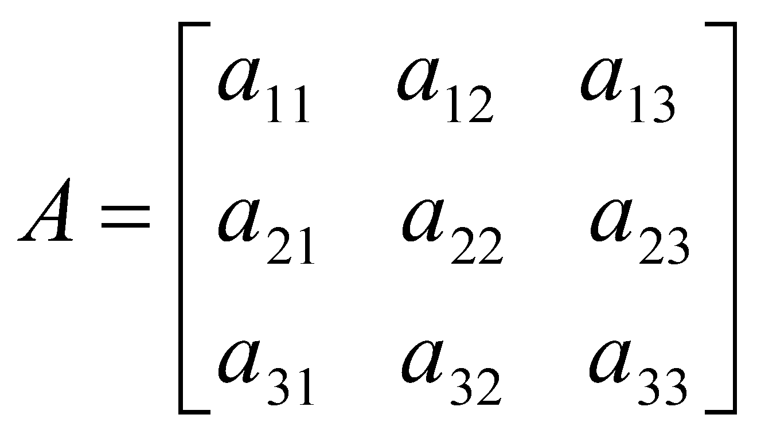
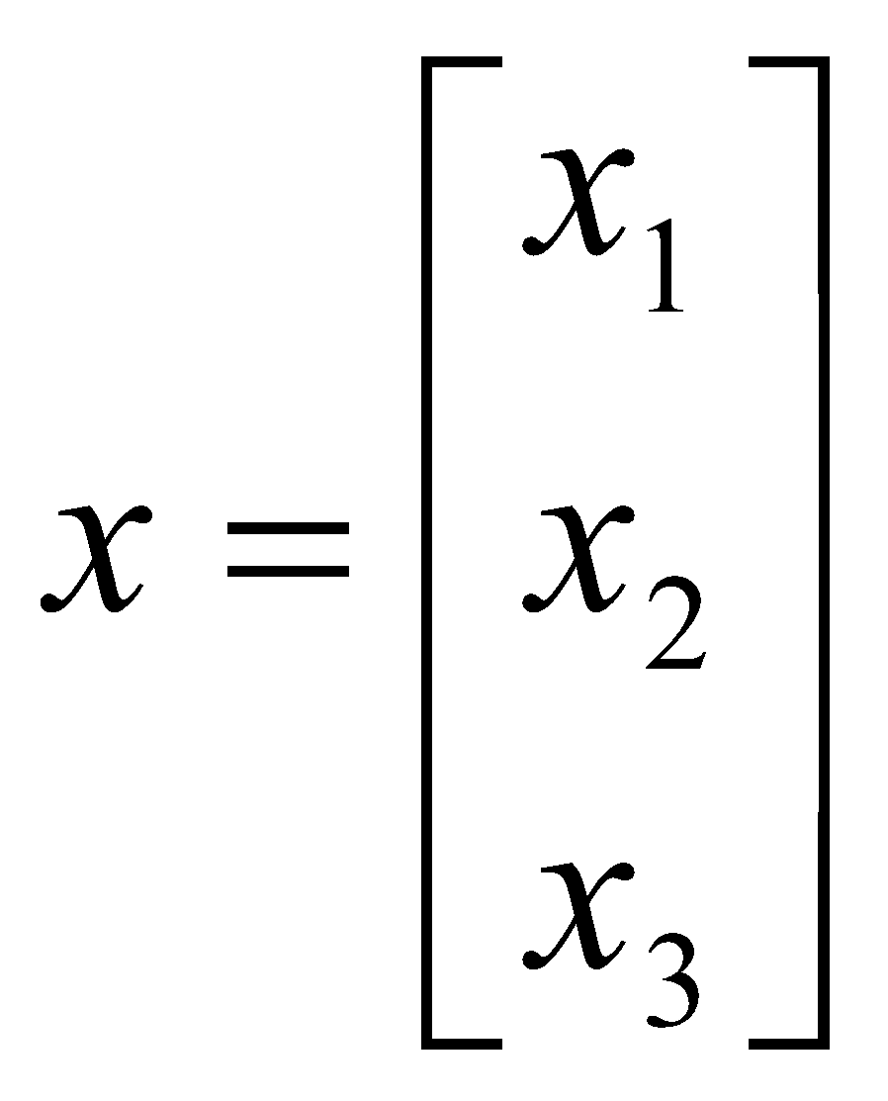
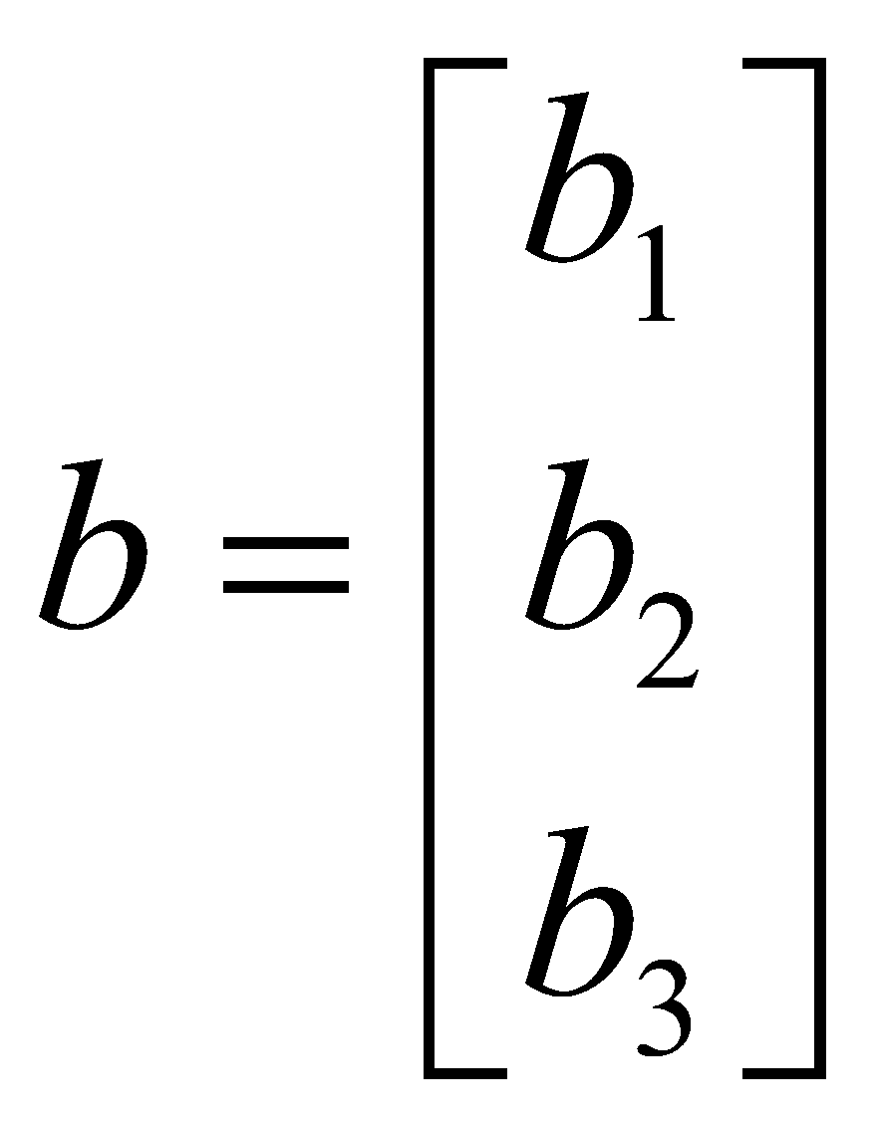
Direct Solution of Linear Equations
Matrix Inversion Method
Consider the following system of equations:
a₁₁x₁ + a₁₂x₂ + a₁₃x₃ = b₁
a₂₁x₁ + a₂₂x₂ + a₂₃x₃ = b₂
a₃₁x₁ + a₃₂x₂ + a₃₃x₃ = b₃
In matrix form:
Ax = b - - - - - - - - - - - - - - - - - - - - - - - - (1)
Where
and
Multiply each side of equation (1) by the inverse of A. This yields
A⁻¹Ax = A⁻¹b
Therefore, x = A⁻¹b
This gives the solution for x.

Slide 21
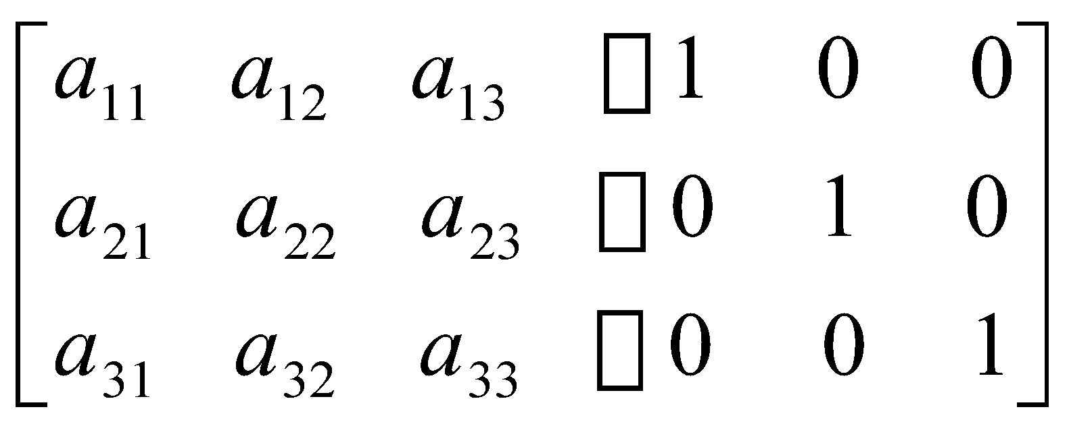
Direct Solution of Linear Equations
Matrix Inversion Method
Computing Matrix Inverse
Gauss-Jordan method is more complicated compared to Gauss elimination method.
Matrix inversion method provides a simple approach for obtaining the inverse of a matrix.
This is done as follows:
Argument the coefficient matrix A with an identity matrix as shown below:

Slide 22
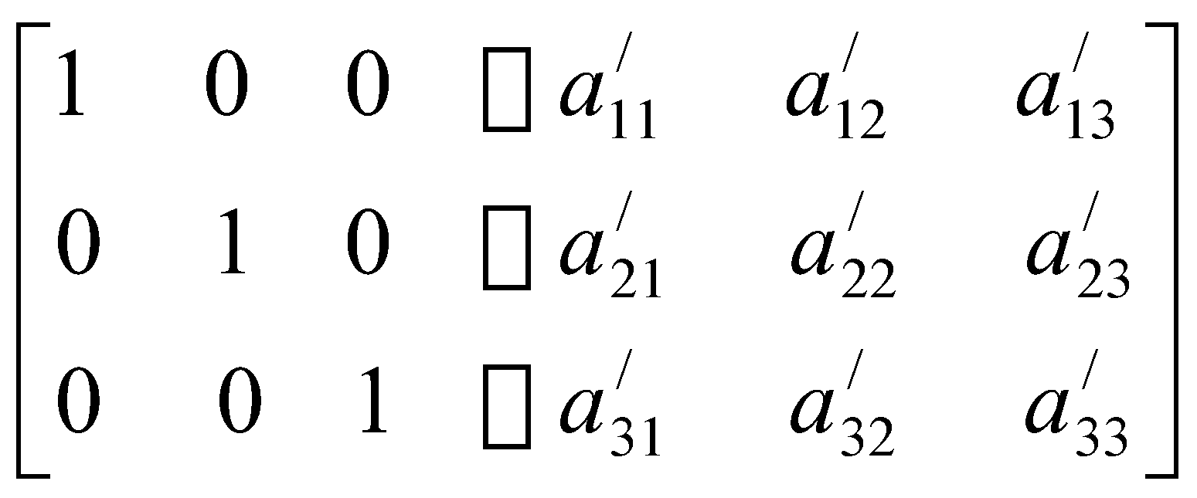
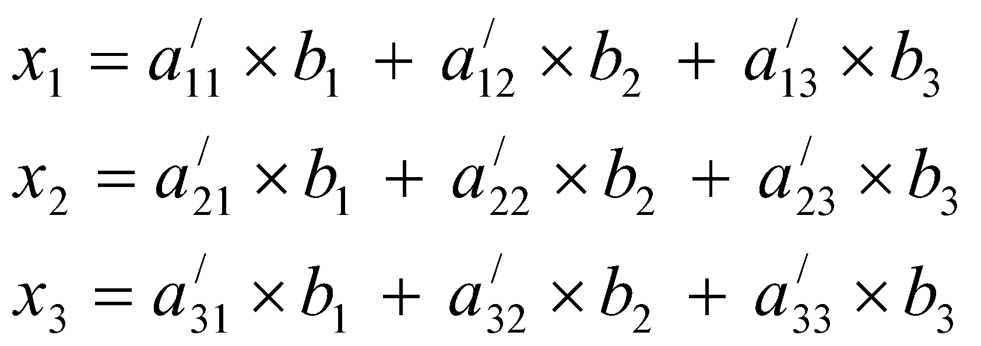
Direct Solution of Linear Equations
Matrix Inversion Method
Computing Matrix Inverse
2. Apply the Gauss-Jordan method to the augmented matrix to reduce A to an identity matrix. The result will be as shown below:
The right–hand side of the augmented matrix is the inverse of A. Now, we can obtain the solution as follows:

Slide 23
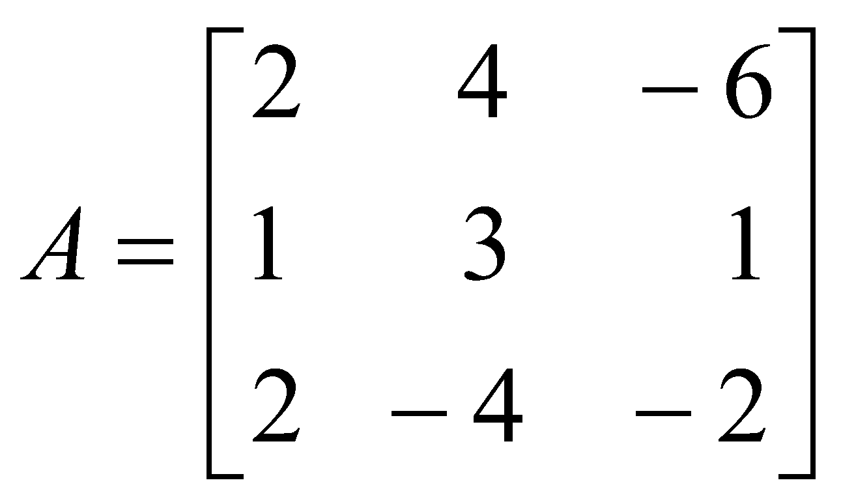
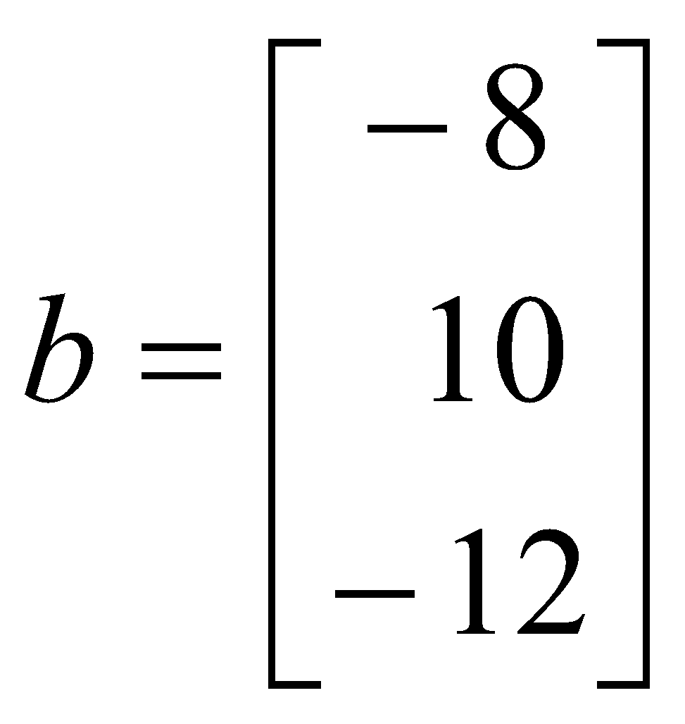
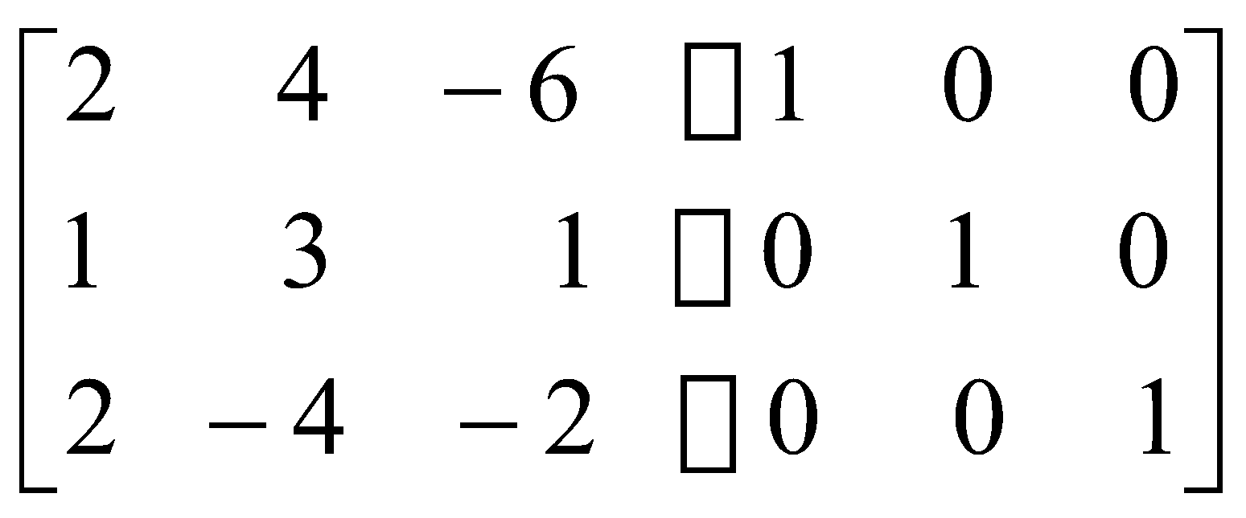
Direct Solution of Linear Equations
Example: Solve the following system of equations using Matrix Inversion method:
2x₁ + 4x₂ - 6x₃ = -8
x₁ + 3x₂ + x₃ = 10
2x₁ - 4x₂ - 2x₃ = -12
Solution:
In matrix form:
Ax = b - - - - - - - - - - - - (1)
Where
Augmented matrix:

Slide 24
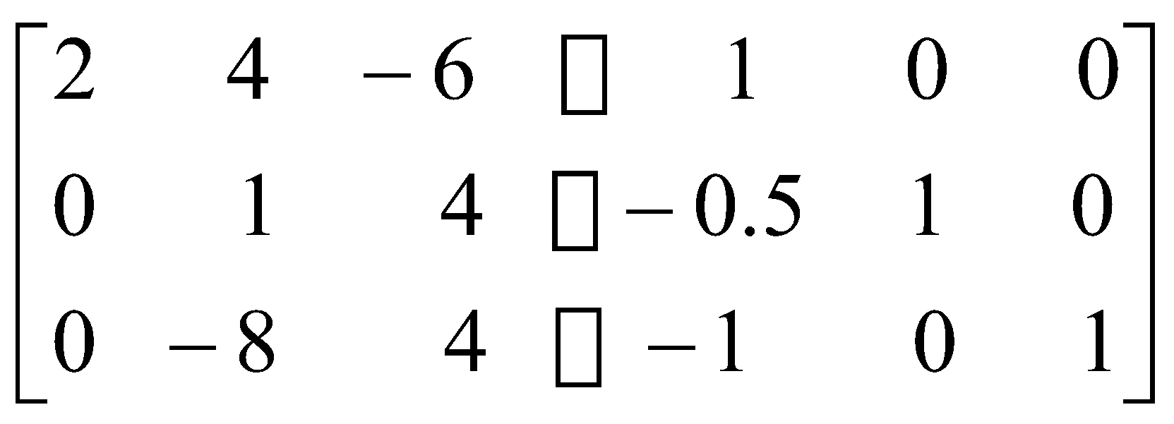
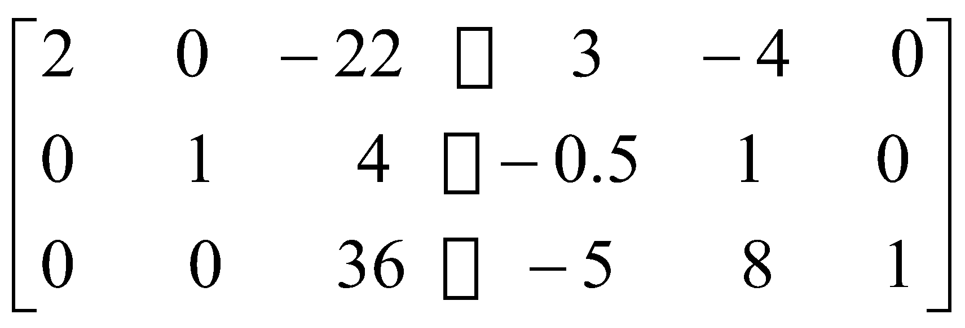
Direct Solution of Linear Equations
Example: Solve the following system of equations using Matrix Inversion method:
2x₁ + 4x₂ - 6x₃ = -8
x₁ + 3x₂ + x₃ = 10
2x₁ - 4x₂ - 2x₃ = -12
Solution:
Perform R₂ = R₂ –(1/2) R₁ and R₃ = R₃ - R₁
Perform R₁ = R₁ – 4R₂ and R₃ = R₃ + 8R₂

Slide 25
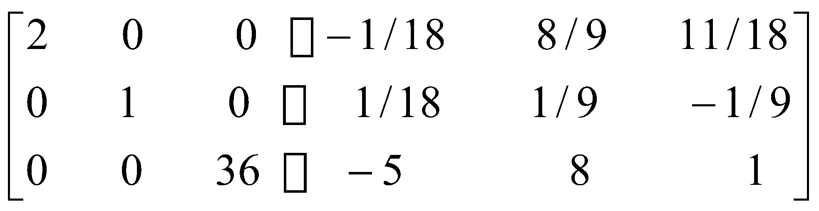
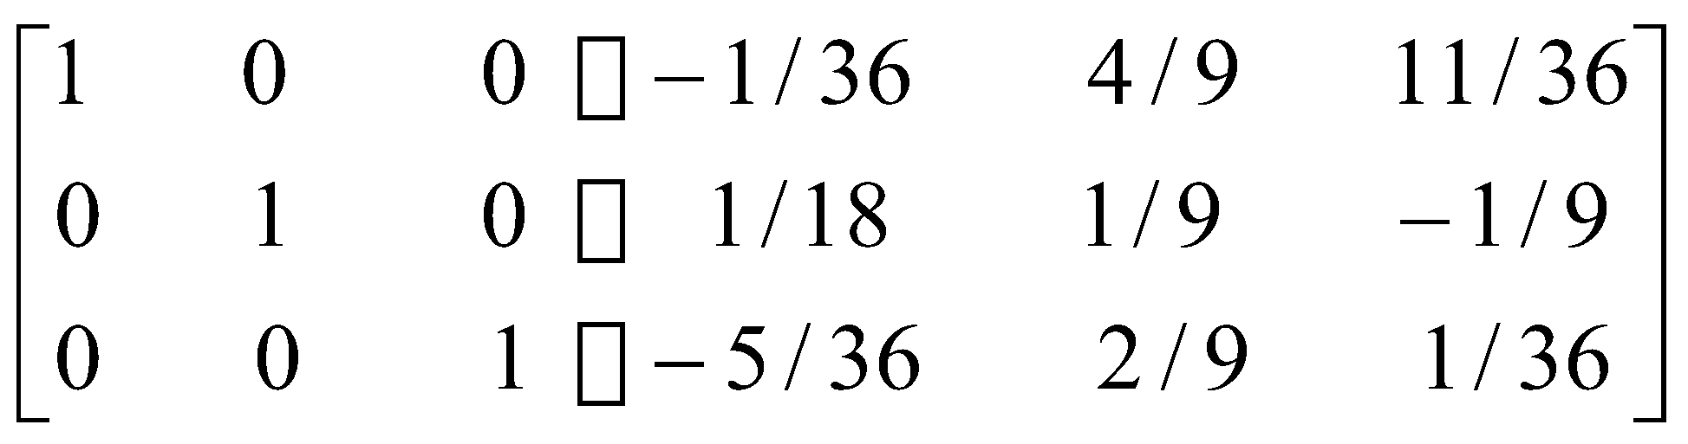
Direct Solution of Linear Equations
Example: Solve the following system of equations using Matrix Inversion method:
2x₁ + 4x₂ - 6x₃ = -8
x₁ + 3x₂ + x₃ = 10
2x₁ - 4x₂ - 2x₃ = -12
Solution:
Perform R₁ = R₁ + (11/18)R₃ and R₂ = R₂ – (1/9)R₃
Normalize row-1 and row-3:

Slide 26
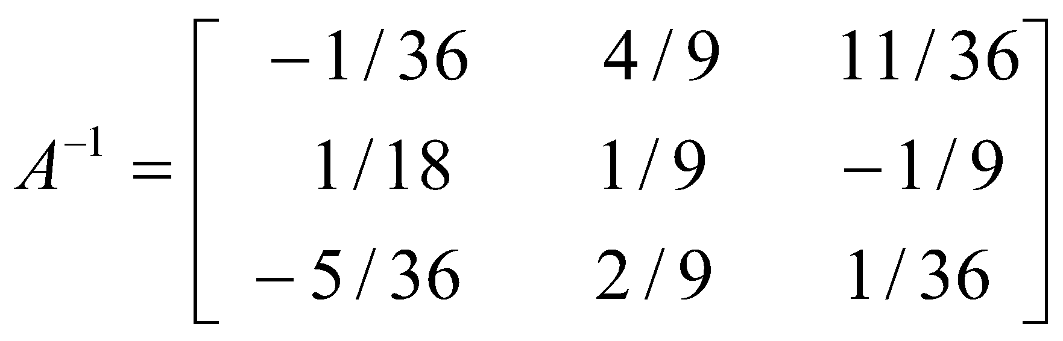
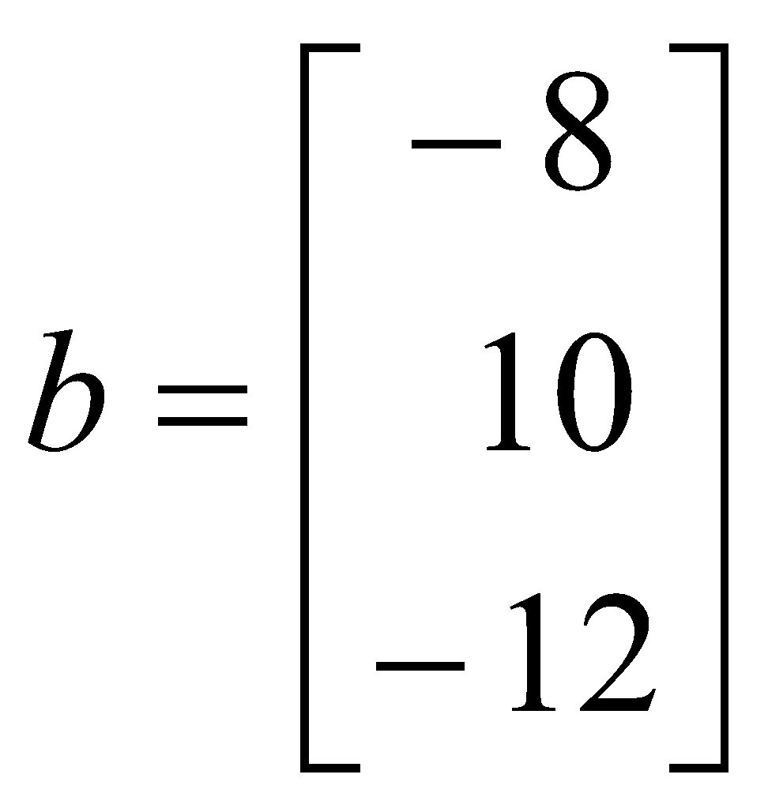
Direct Solution of Linear Equations
Example: Solve the following system of equations using Matrix Inversion method:
2x₁ + 4x₂ - 6x₃ = -8
x₁ + 3x₂ + x₃ = 10
2x₁ - 4x₂ - 2x₃ = -12
Solution:
As we know, x = A⁻¹b
Here,
Therefore,
x₁ = (-1/36)(-8) + (4/9)(10) + (11/36)(-12) = 1
x₂ = (1/18)(-8) + (1/9)(10) + (-1/9)(-12) = 2
x₃ = (-5/36)(-8) + (2/9)(10) + (1/36)(-12) = 3

