Slide 1

Numerical Methods
Lecture 07

Slide 2
Curve Fitting: Interpolation
Curve Fitting
Scientists and engineers are often faced with the task of estimating the value of dependent variable y for an intermediate value of the independent variable x, given a table of discrete data points (x_{i}, y_{i}), i = 0, 1, 2, . . . . . , n. This task can be accomplished by constructing a function y(x) that will pass through the given set of points and then evaluating y(x) for the specified value of x. The process of constructing of y(x) to fit a table of data points is called curve fitting.
A table of data may belong to one of the two categories:
Table of values of well-defined functions: Examples of such tables are logarithmic tables, trigonometric tables, interest tables, etc.
Data tabulated from measurements made during an experiment: Values of the dependent variable are recorded at various values of the independent variable. Example- the relationship between voltage applied and speed of a fan.

Slide 3
Curve Fitting: Interpolation
Curve Fitting: Interpolation
For the table of values of well-defined functions, the function is constructed such that it passes through all the data points. This method of constructing a function and estimating values at non-tabular points is called interpolation.
The functions are known as interpolation polynomials.
Different methods of interpolation:
Lagrange interpolation
Newton’s interpolation
Newton-Gregory forward interpolation
Spline interpolation

Slide 4
Curve Fitting: Interpolation
Curve Fitting: Regression
Data collected from measurements are not accurate and therefore, it will be meaningless to try to pass the curve through every point. The best strategy would be to construct a single curve that would represent the general trend of the data without necessarily passing through the individual points. Such functions are called approximating functions.
One popular approach for finding an approximate function to fit a given set of experimental data is called least-square regression.
The approximating functions are known as least-square polynomials.

Slide 5
Curve Fitting: Interpolation
Interpolation
Linear Interpolation
Simplest form of interpolation.
This considers only two data points: P₁(x₁, f(x₁)) and P₂(x₂, f(x₂)).
These two points can be connected linearly as shown below.
f(x)
f(x₂)
p₂
f(x)
p
p₁
f(x₁)
x₁
x
x₂
x
Graphical representation of linear interpolation

Slide 6
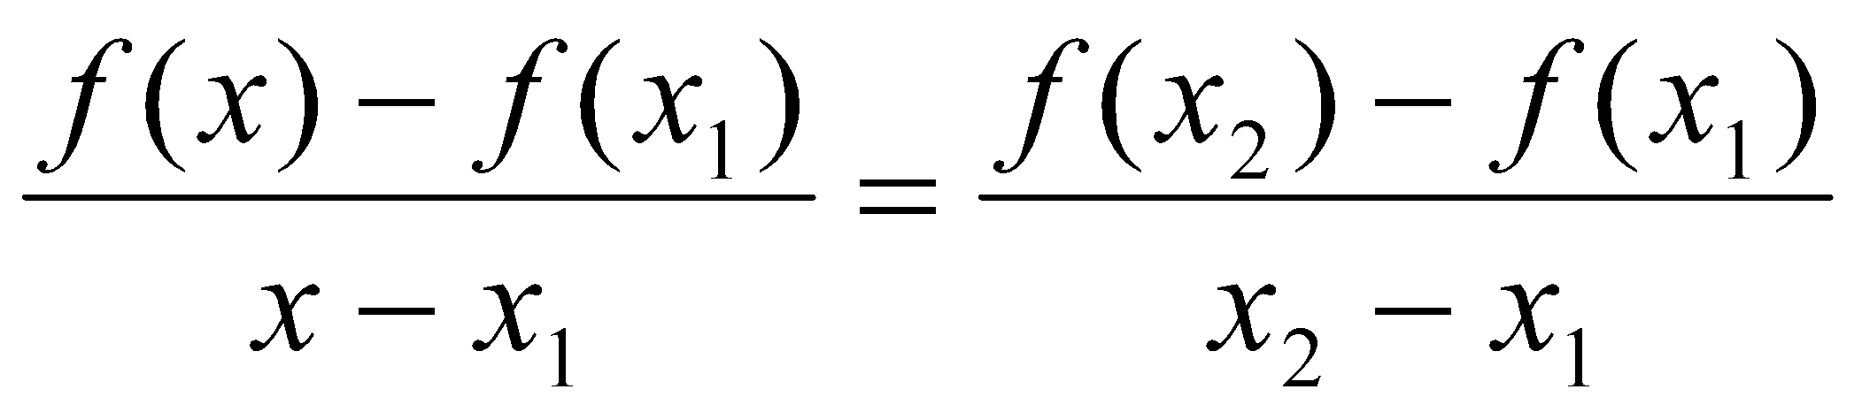
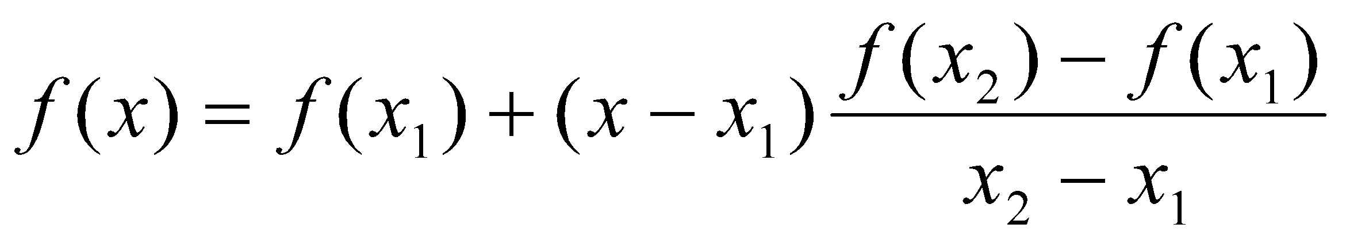
Curve Fitting: Interpolation
Interpolation
Linear Interpolation
Therefore,
This is known as linear interpolation formula.

Slide 7
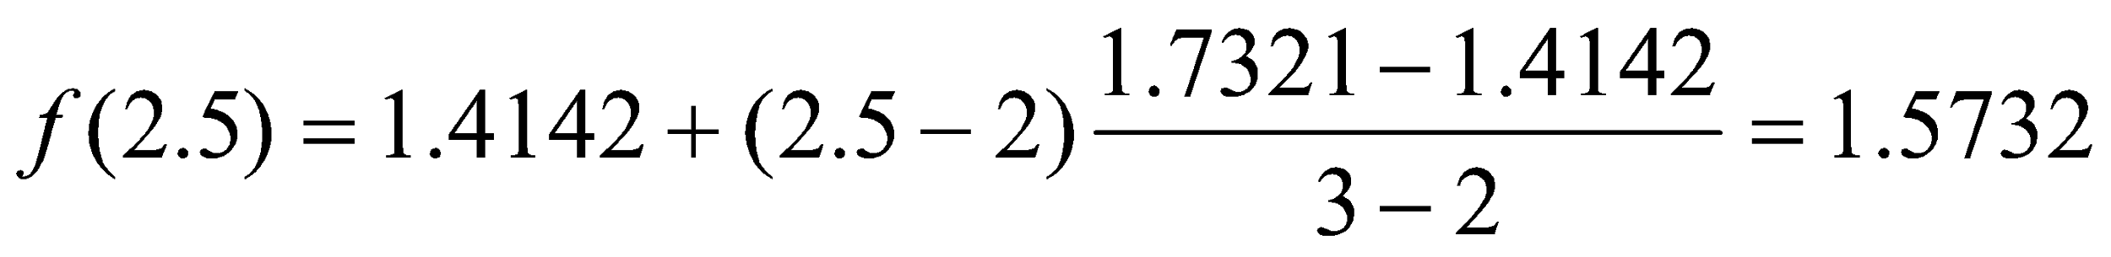
Curve Fitting: Interpolation
Example: The table below gives square roots for integers:
Determine the square root of 2.5.
Solution:
The value of 2.5 lies between the points 2 and 3. Therefore,
x₁ = 2, f(x₁) = 1.4142
x₂ = 3, f(x₂) = 1.7321
Therefore,
x | 1 | 2 | 3 | 4 | 5
f(x) | 1 | 1.4142 | 1.7321 | 2 | 2.2361

Slide 8
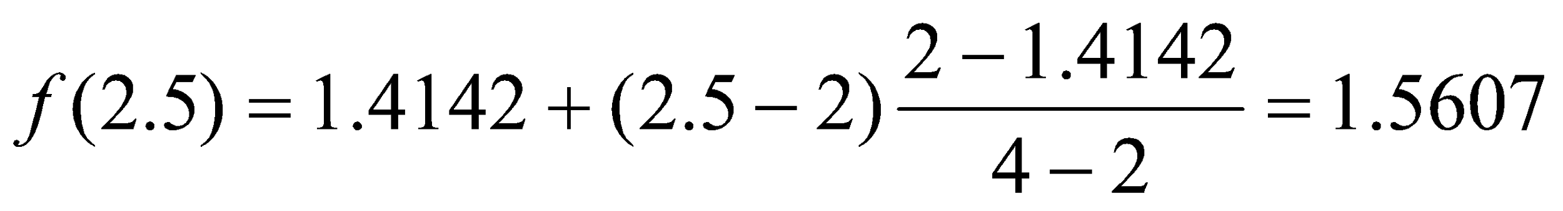
Curve Fitting: Interpolation
Example: The table below gives square roots for integers:
Determine the square root of 2.5.
Solution:
The correct answer is 1.5811. The difference is due to the use of a linear model.
If we consider the points 2 and 4, then
x₁ = 2, f(x₁) = 1.4142
x₂ = 4, f(x₂) = 2
Therefore,
Here the error has increased from 0.0079 to 0.0204. In general, the smaller the interval between the interpolating data points, the better will be the approximation.
x | 1 | 2 | 3 | 4 | 5
f(x) | 1 | 1.4142 | 1.7321 | 2 | 2.2361

Slide 9
Curve Fitting: Interpolation
Lagrange Interpolation Polynomial
Let x₀, x₁, . . . ., x_{n} denote n distinct real numbers and let f₀, f₁, . . . ., f_{n} be arbitrary real numbers. The points (x₀, f₀), (x₁, f₁), (x₂, f₂), . . . . . . ., (x_{n}, f_{n}) can be imagined to be data values connected by a curve. Any function p(x) satisfying the conditions
p(x_{k}) = f_{k} for k = 0, 1, …., n
is called interpolation function. An interpolation function is, therefore, a curve that passes through the data points as pointed out.
Let us consider a second order polynomial of the form

Slide 10
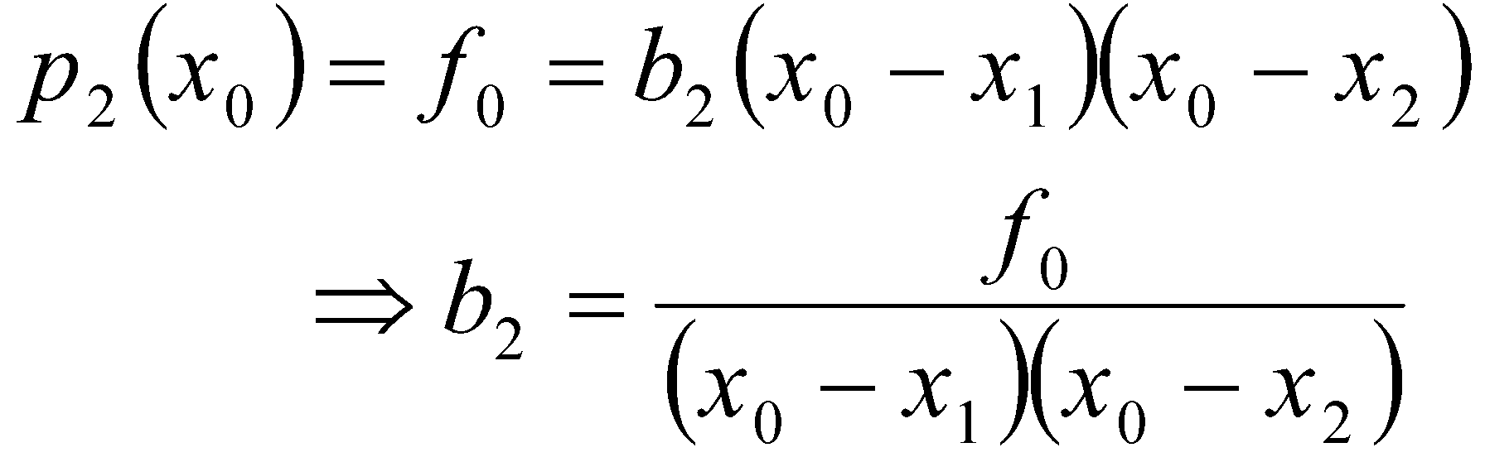
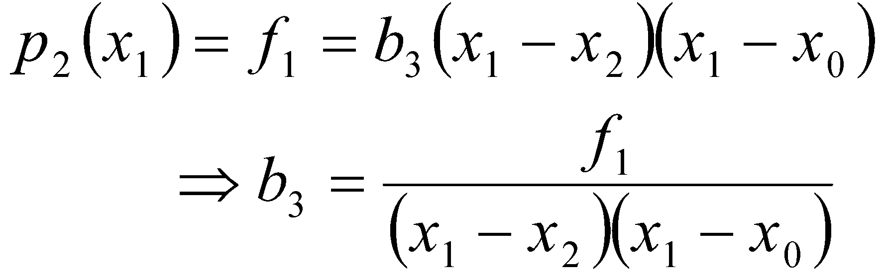
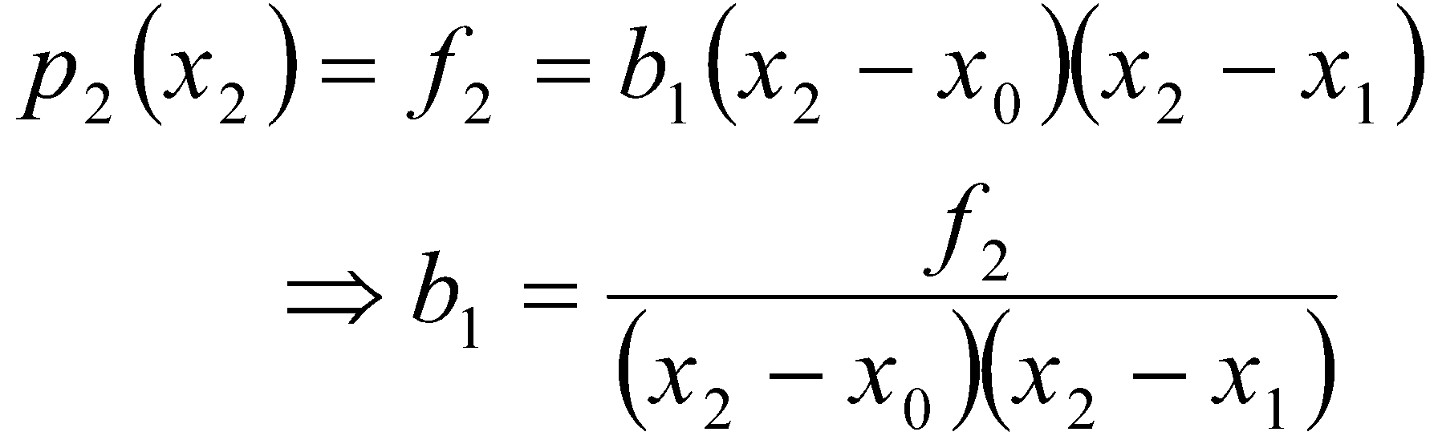
Curve Fitting: Interpolation
Lagrange Interpolation Polynomial
If (x₀, f₀), (x₁, f₁), and (x₂, f₂) are the three interpolating points, then we have

Slide 11
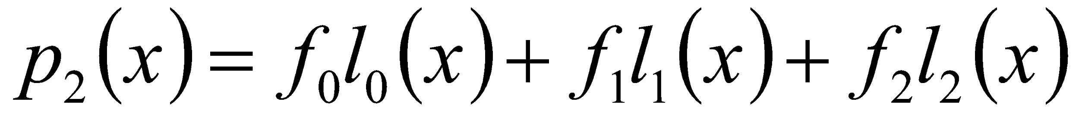
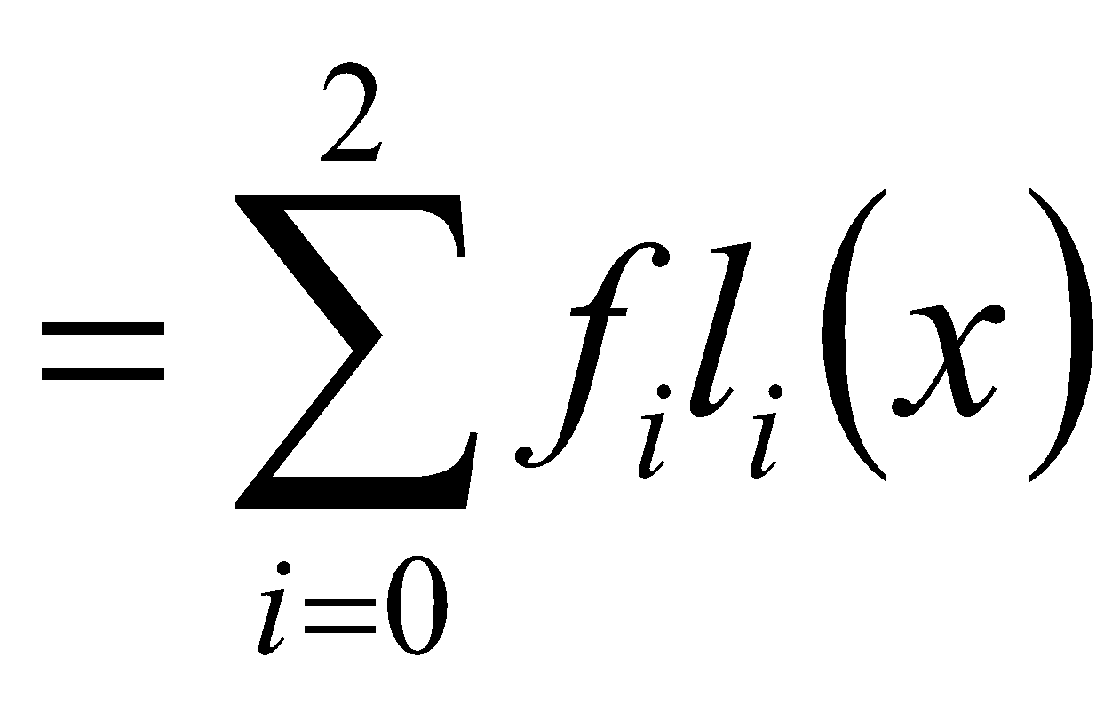
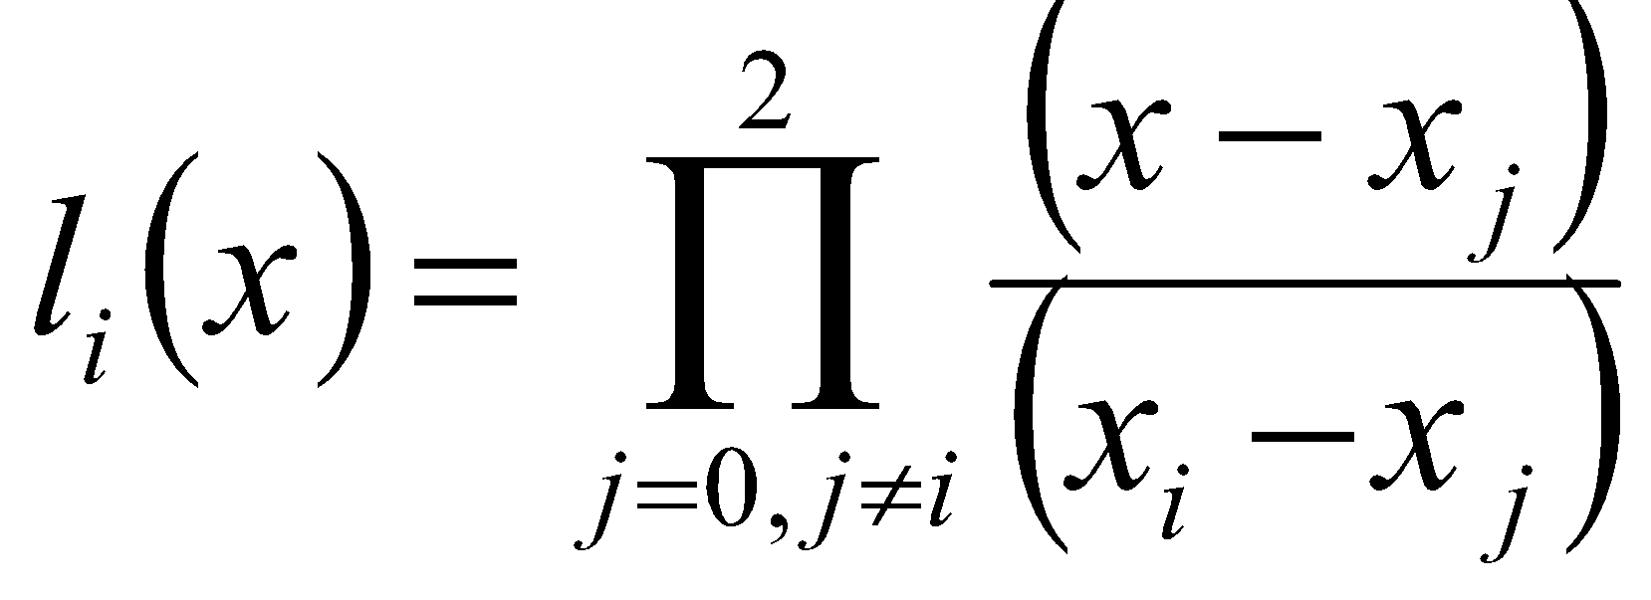
Curve Fitting: Interpolation
Lagrange Interpolation Polynomial
Substituting b₁, b₂ and b₃ in Eq. (1), we get
Eq. (2) may be represented as
Where

Slide 12
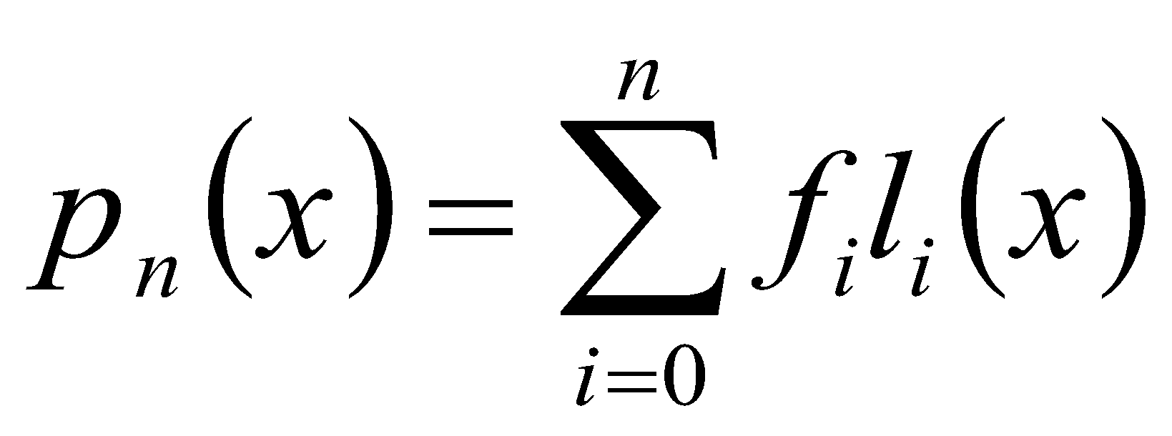
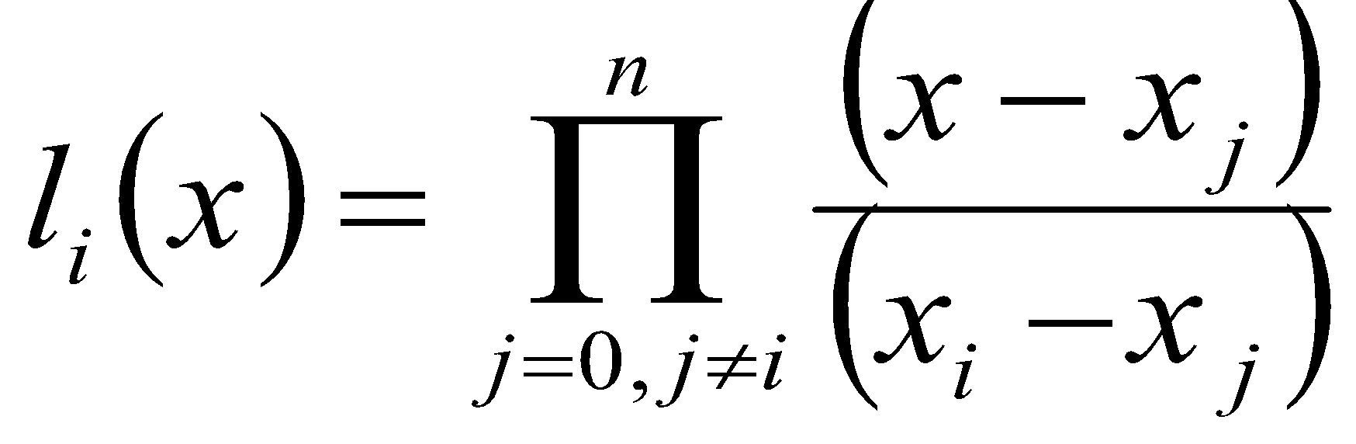
Curve Fitting: Interpolation
Lagrange Interpolation Polynomial
In general, for n+1 points we have n-th degree polynomial as
--------------------------------- (3)
Where
Eq. (3) is called the Lagrange interpolation polynomial. The polynomials l_{i}(x) are known as Lagrange basis polynomials.

Slide 13
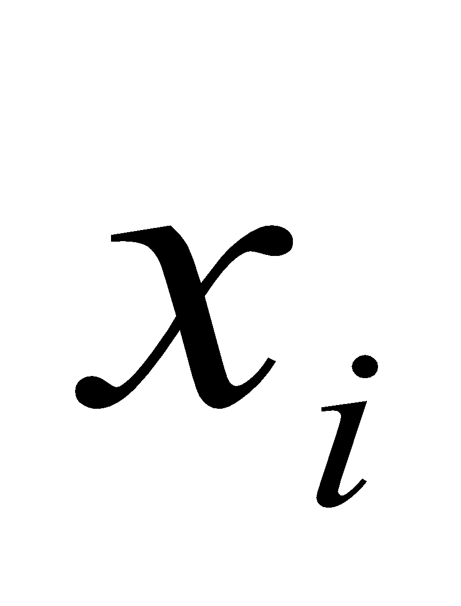
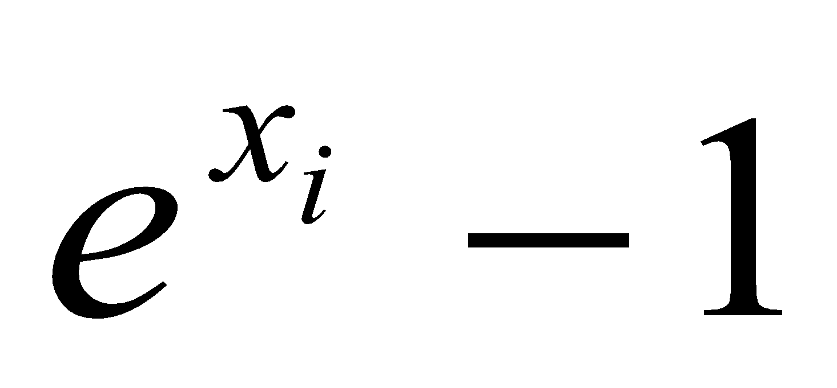
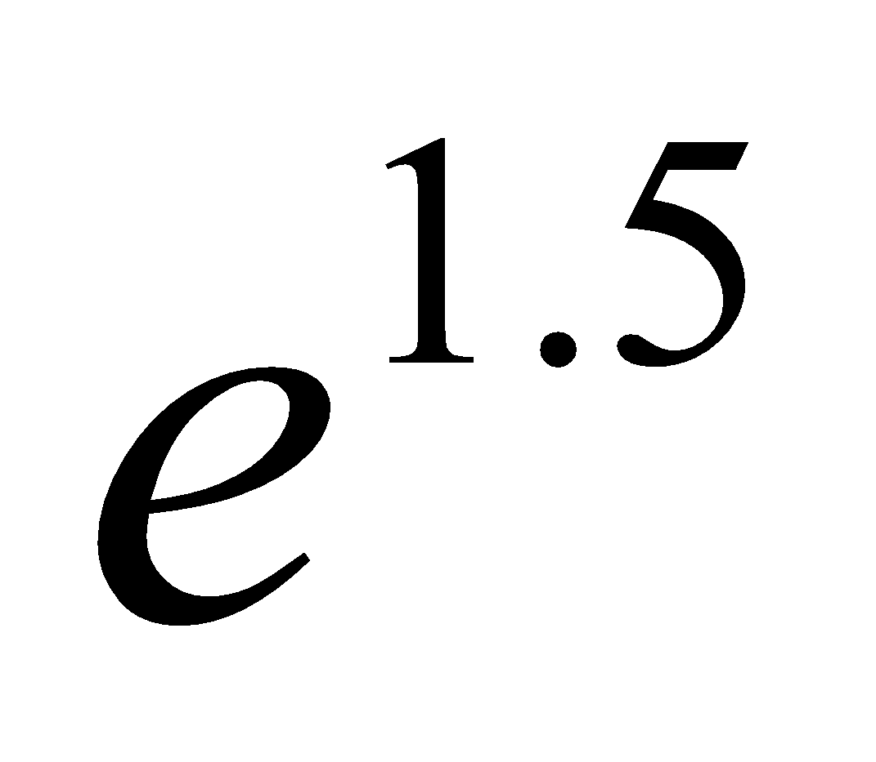

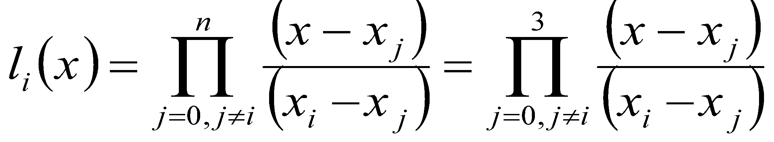
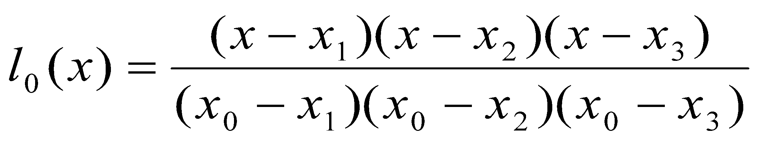
Curve Fitting: Interpolation
Example: Finding the Lagrange interpolation polynomial to fit the following data
using the polynomial to estimate value of
Solution:
Lagrange basis polynomials are:
Therefore,
i | 0 | 1 | 2 | 3
 | 0 | 1 | 2 | 3
 | 0 | 1.7183 | 6.3891 | 19.0855

Slide 14
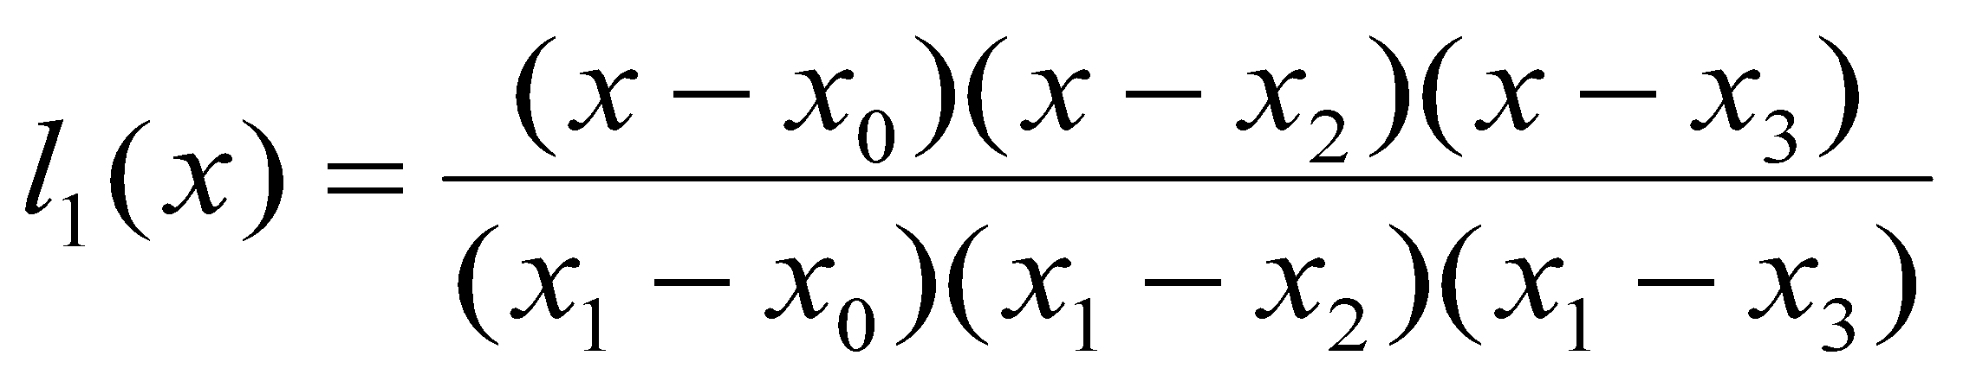
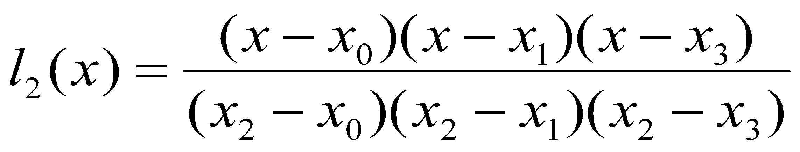
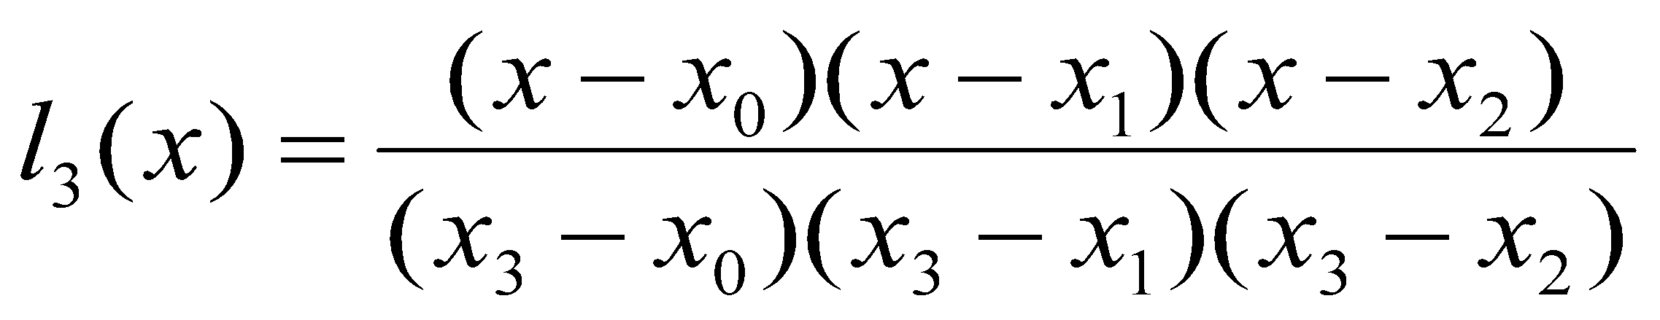
Curve Fitting: Interpolation
Example: Finding the Lagrange interpolation polynomial to fit the following data
using the polynomial to estimate value of
Solution:
i | 0 | 1 | 2 | 3
 | 0 | 1 | 2 | 3
 | 0 | 1.7183 | 6.3891 | 19.0855

Slide 15
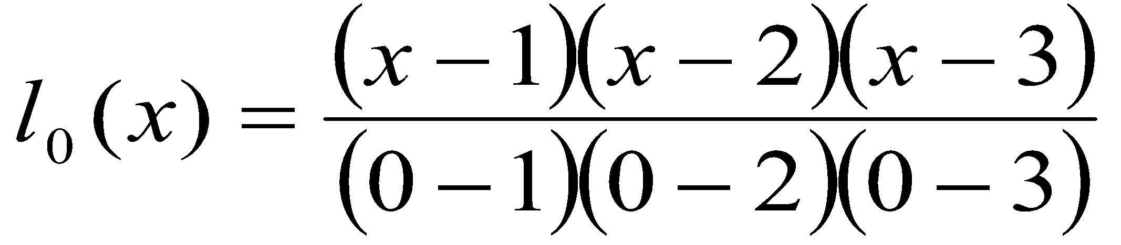
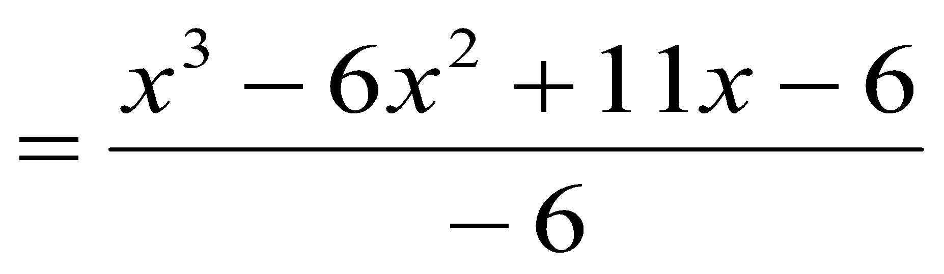
Curve Fitting: Interpolation
Example: Finding the Lagrange interpolation polynomial to fit the following data
using the polynomial to estimate value of
Solution:
i | 0 | 1 | 2 | 3
 | 0 | 1 | 2 | 3
 | 0 | 1.7183 | 6.3891 | 19.0855

Slide 16
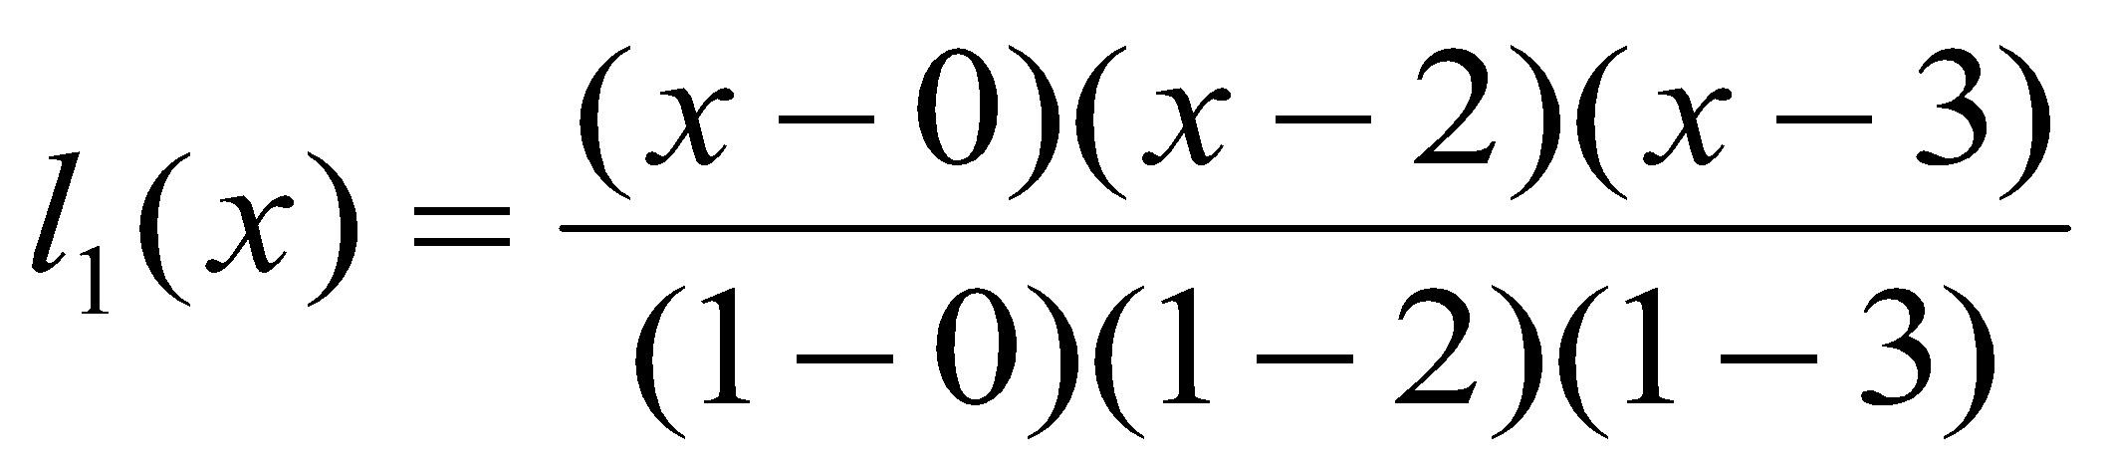
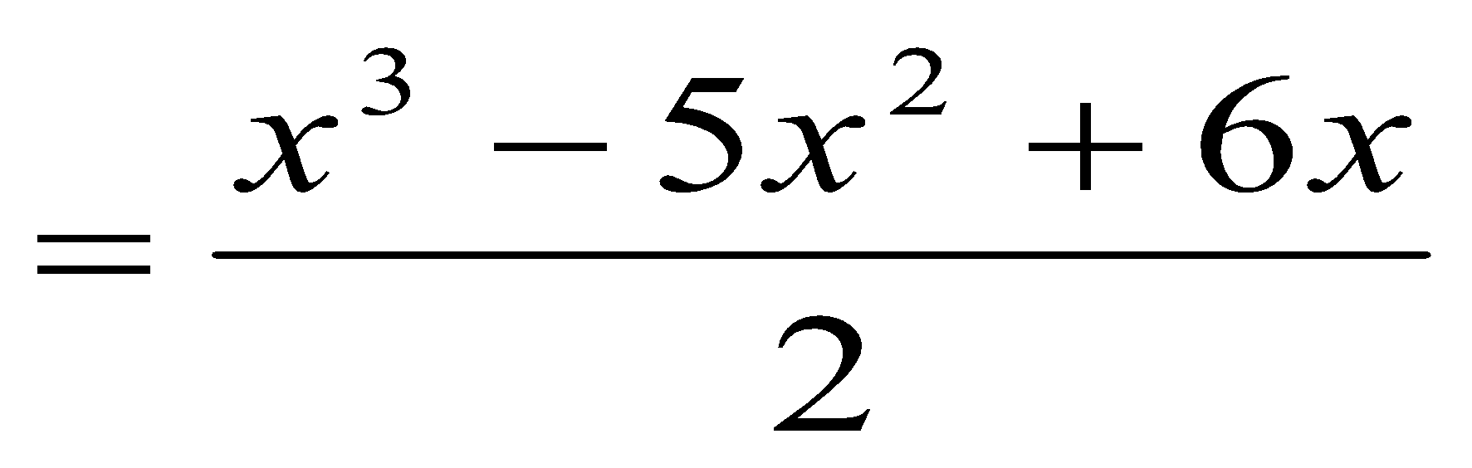
Curve Fitting: Interpolation
Example: Finding the Lagrange interpolation polynomial to fit the following data
using the polynomial to estimate value of
Solution:
i | 0 | 1 | 2 | 3
 | 0 | 1 | 2 | 3
 | 0 | 1.7183 | 6.3891 | 19.0855

Slide 17
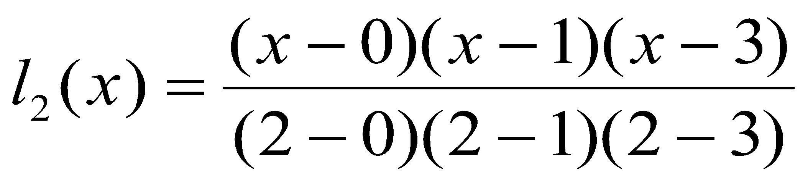
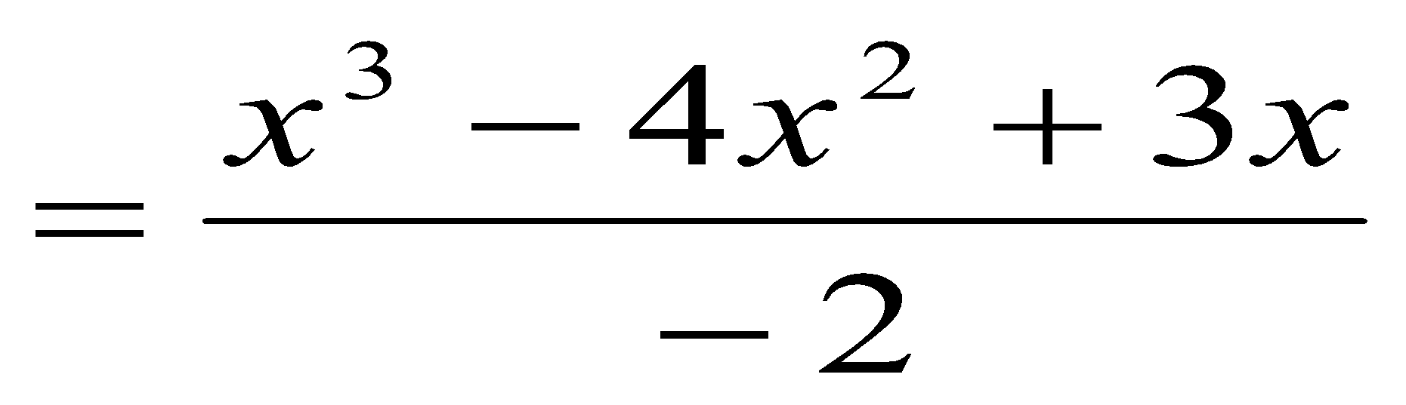
Curve Fitting: Interpolation
Example: Finding the Lagrange interpolation polynomial to fit the following data
using the polynomial to estimate value of
Solution:
i | 0 | 1 | 2 | 3
 | 0 | 1 | 2 | 3
 | 0 | 1.7183 | 6.3891 | 19.0855

Slide 18
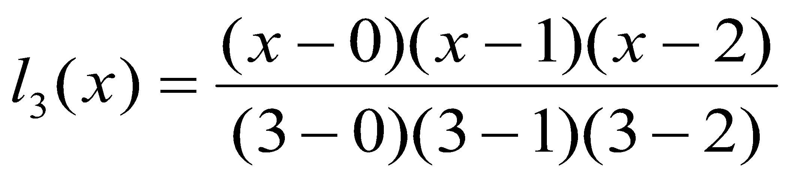
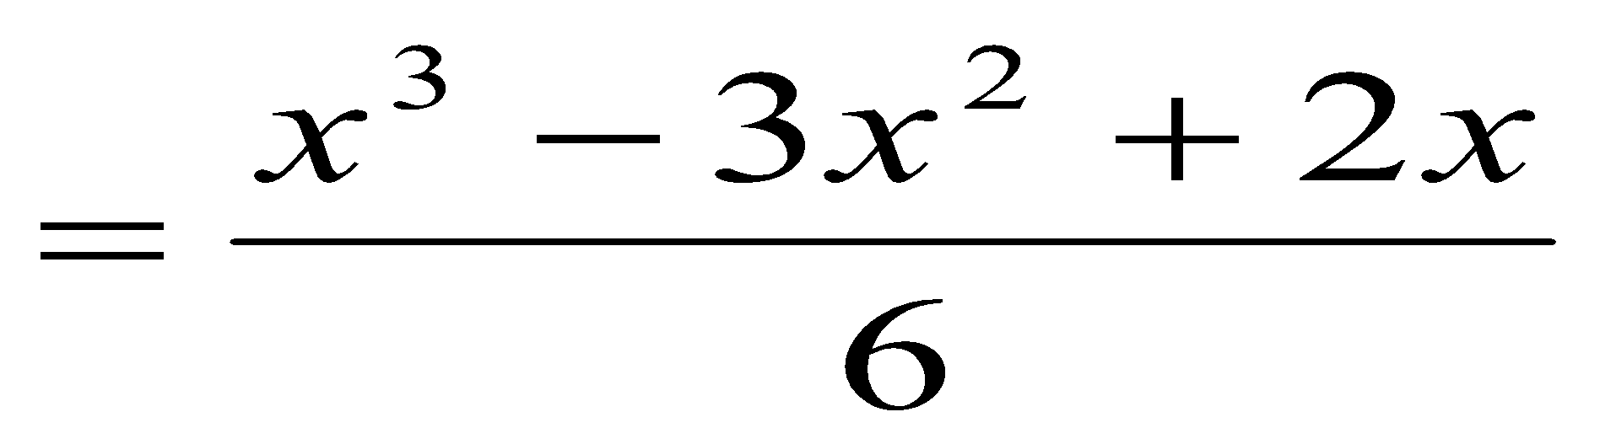
Curve Fitting: Interpolation
Example: Finding the Lagrange interpolation polynomial to fit the following data
using the polynomial to estimate value of
Solution:
i | 0 | 1 | 2 | 3
 | 0 | 1 | 2 | 3
 | 0 | 1.7183 | 6.3891 | 19.0855

Slide 19
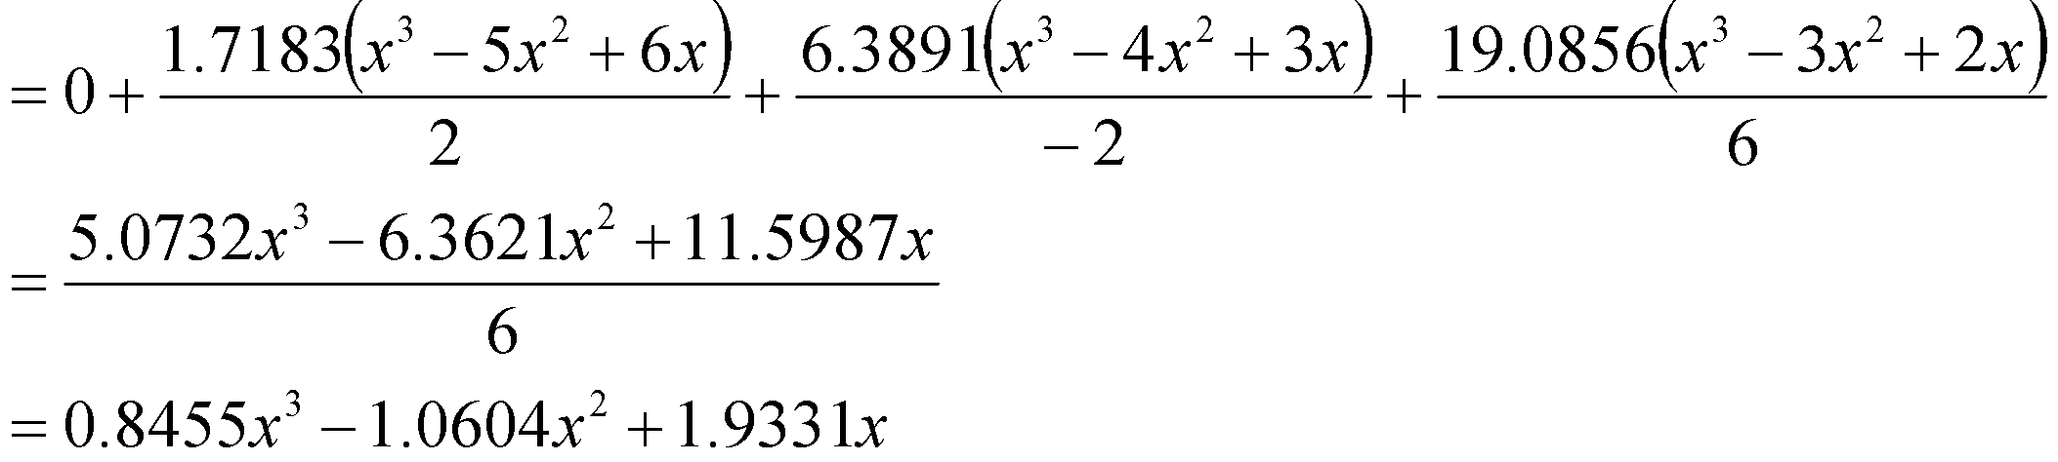
Curve Fitting: Interpolation
Example: Finding the Lagrange interpolation polynomial to fit the following data
using the polynomial to estimate value of
Solution:
The interpolation polynomial is
i | 0 | 1 | 2 | 3
 | 0 | 1 | 2 | 3
 | 0 | 1.7183 | 6.3891 | 19.0855

Slide 20
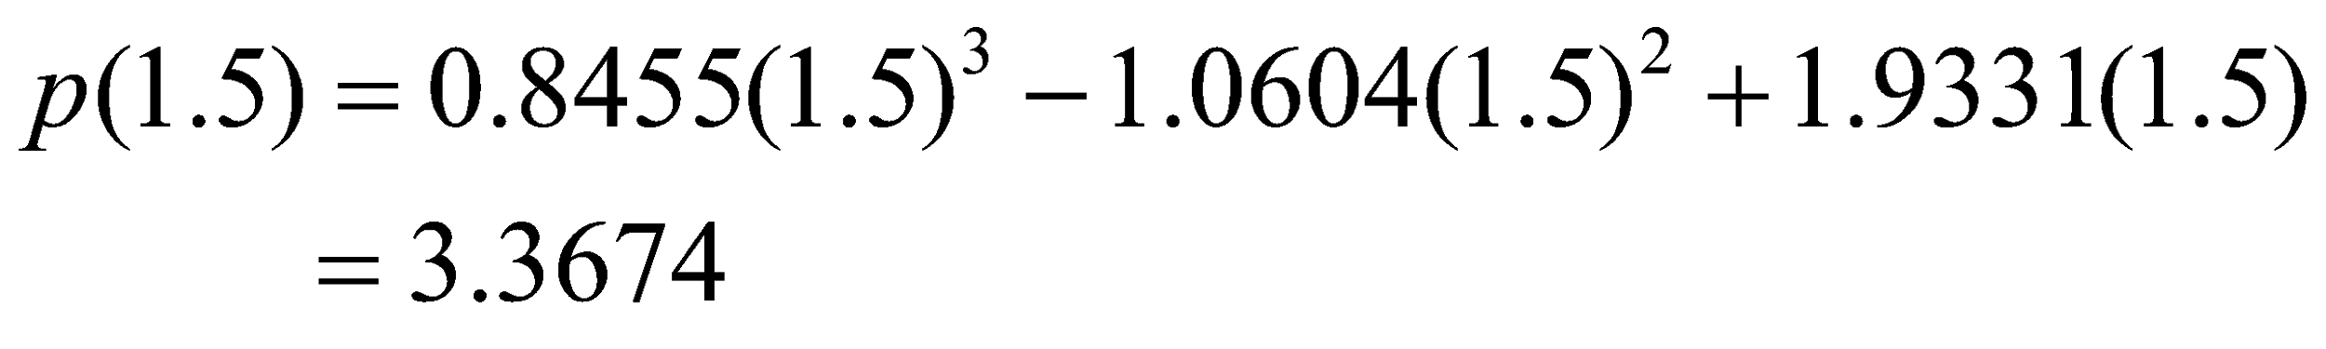
Curve Fitting: Interpolation
Example: Finding the Lagrange interpolation polynomial to fit the following data
using the polynomial to estimate value of
Solution:
The interpolation polynomial is
That is, e^{1.5}-1 = 3.3674
Therefore, e^{1.5} = 3.3674 + 1 = 4.3674
i | 0 | 1 | 2 | 3
 | 0 | 1 | 2 | 3
 | 0 | 1.7183 | 6.3891 | 19.0855

Slide 21
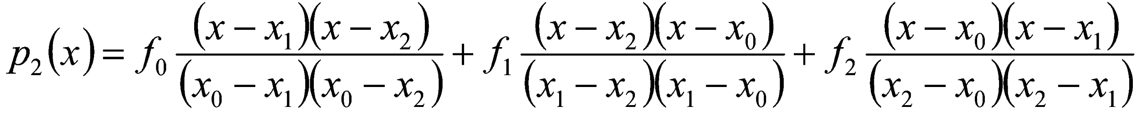
Curve Fitting: Interpolation
Example: The table below gives square roots for integers:
Find the square root of 2.5 using the second order Lagrange interpolation polynomial.
Solution:
Let us consider the following three points:
x₀ = 2 x₁= 3 x₂ = 4
f₀ =1.4142 f₁ = 1.7321 f₂ = 2
Second order Polynomial:
x | 1 | 2 | 3 | 4 | 5
f(x) | 1 | 1.4142 | 1.7321 | 2 | 2.2361

Slide 22
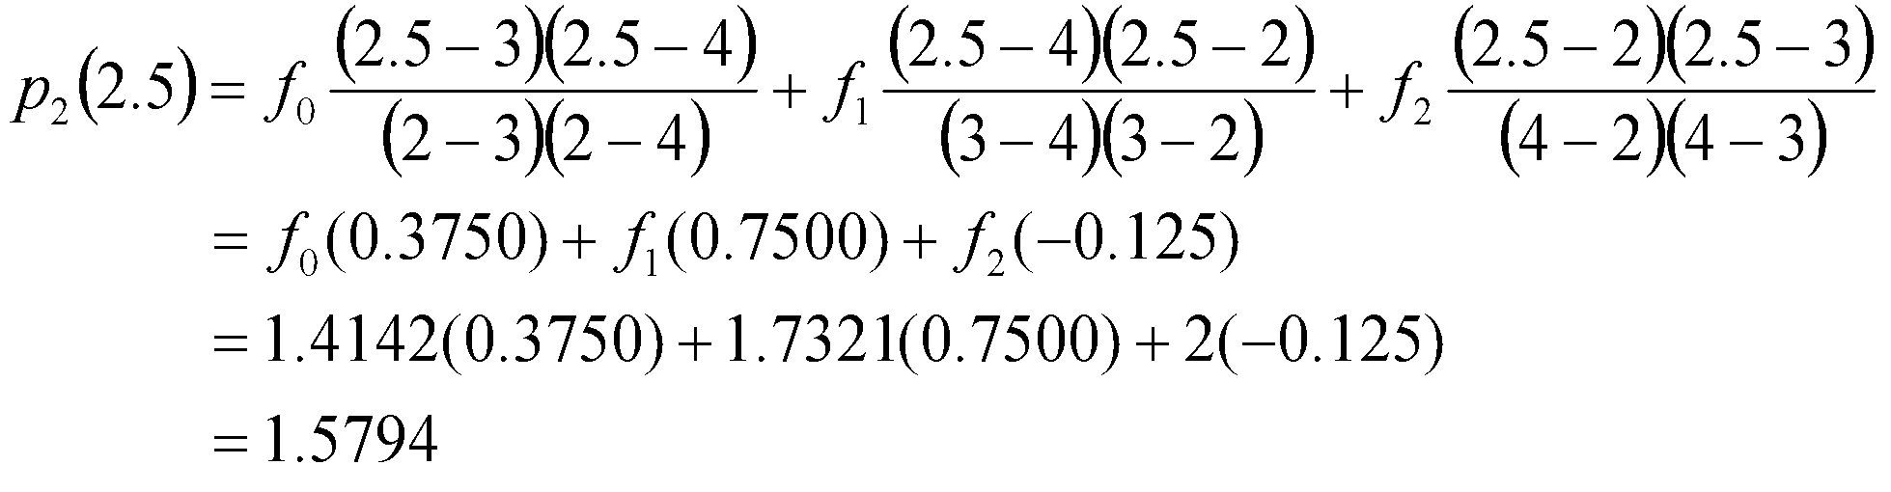
Curve Fitting: Interpolation
Example: The table below gives square roots for integers:
Find the square root of 2.5 using the second order Lagrange interpolation polynomial.
Solution:
For x = 2.5
x | 1 | 2 | 3 | 4 | 5
f(x) | 1 | 1.4142 | 1.7321 | 2 | 2.2361

Slide 23
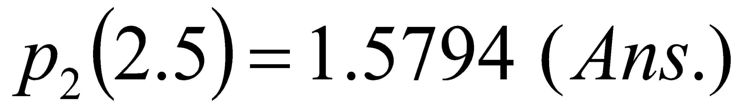
Curve Fitting: Interpolation
Example: The table below gives square roots for integers:
Find the square root of 2.5 using the second order Lagrange interpolation polynomial.
Solution:
The correct answer is 1.5811. The error is 0.0017 which is much less than the error obtained using a linear model.
x | 1 | 2 | 3 | 4 | 5
f(x) | 1 | 1.4142 | 1.7321 | 2 | 2.2361

Slide 24
Curve Fitting: Interpolation
Lagrange Interpolation Polynomial: Limitations
It requires 2(n+1) multiplications/divisions and 2n+1 additions and subtractions.
If we want to add one more data point, we have to compute the polynomial from the beginning. It does not use the polynomial already computed.

Slide 25
Curve Fitting: Interpolation
NEWTON INTERPOLATION POLYNOMIAL
Let us consider another form of polynomial known as Newton form. The Newton form of polynomial is
p_{n}(x) = a₀ + a₁(x – x₀) + a₂(x – x₀)(x - x₁) + ……. + a_{n}(x – x₀)(x - x₁) …..
(x - x_{n-1}) …… (1)
where the interpolation points x₀, x₁, …… x_{n-1} act as centres.
To construct the interpolation polynomial, we need to determine the coefficients a₀, a₁, …… a_{n}. Let us assume that (x₀, f₀), (x₁, f₁), ……… (x_{n-1}, f_{n-1}) are the interpolating points. That is,
p_{n}(x_{k}) = f_{k} k = 0, 1, 2, …….., n-1

Slide 26
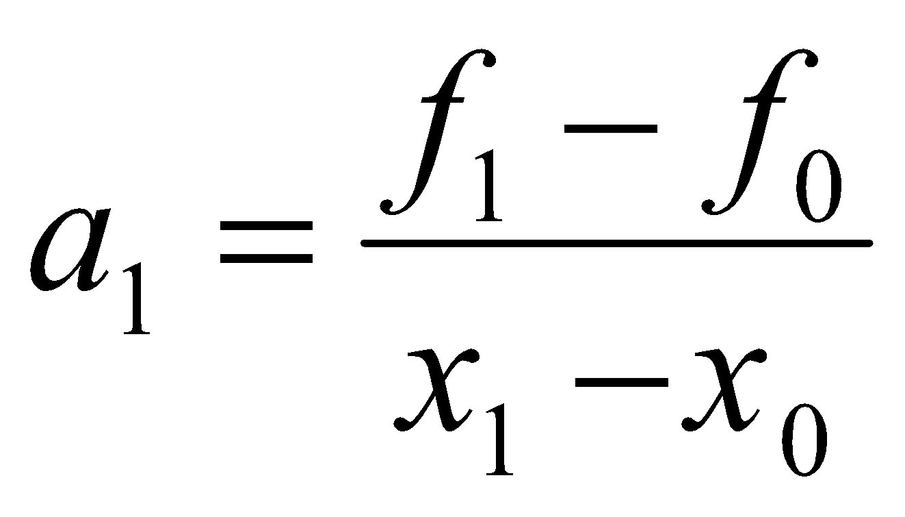
Curve Fitting: Interpolation
NEWTON INTERPOLATION POLYNOMIAL
Now, at x = x₀, we have
p_{n}(x₀) = a₀ = f₀
Similarly, at x = x₁
p_{n}(x₁) = a₀ + a₁(x₁ – x₀) = f₁
Substituting for a₀, we get
Similarly, at x = x₂,
p_{n}(x₂) = a₀ + a₁(x₂ – x₀) + a₂(x₂ – x₀)(x₂ - x₁) = f₂

Slide 27
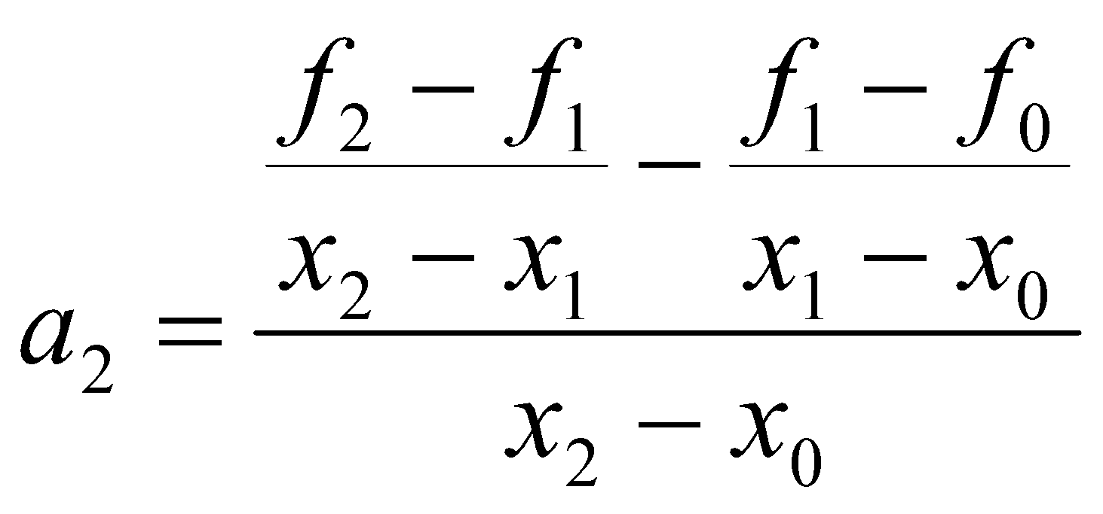
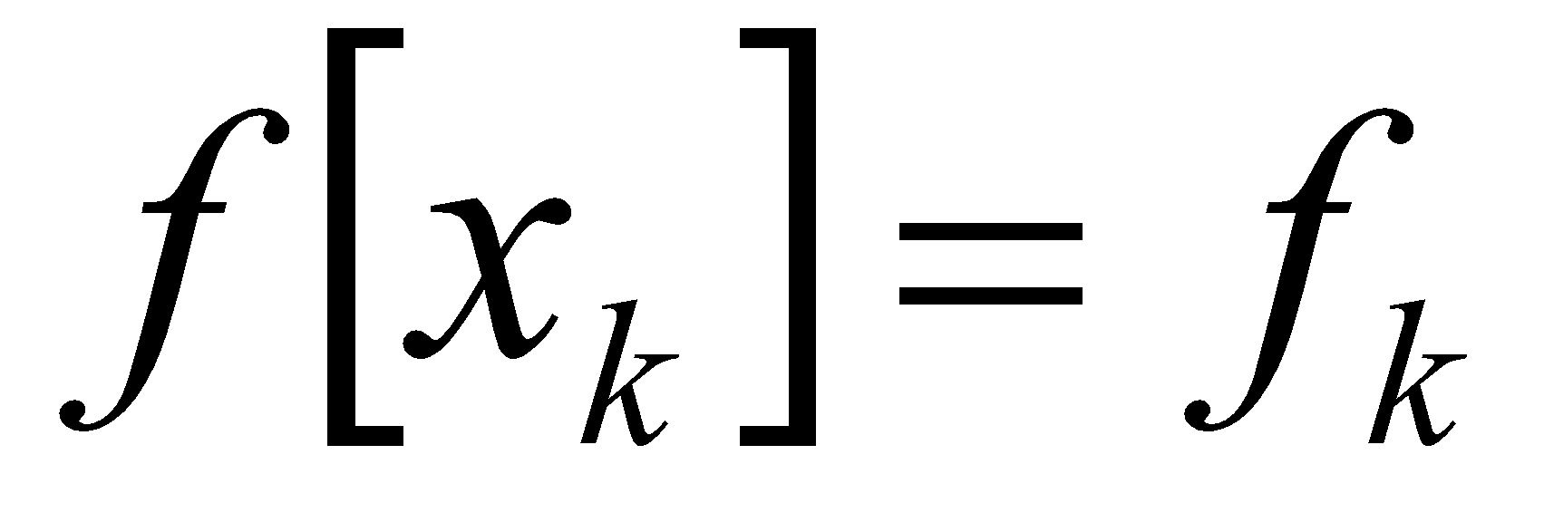
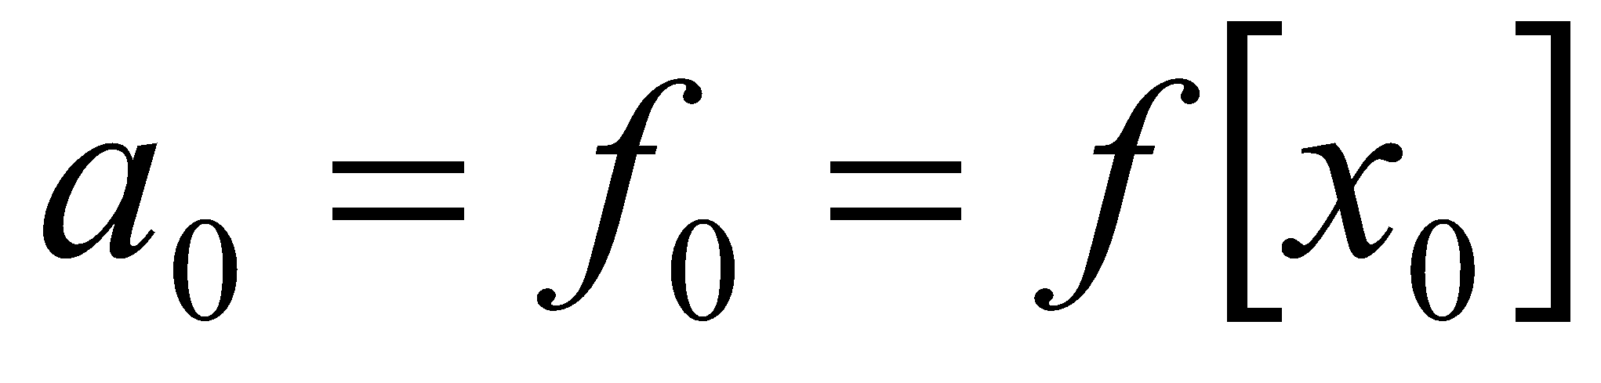
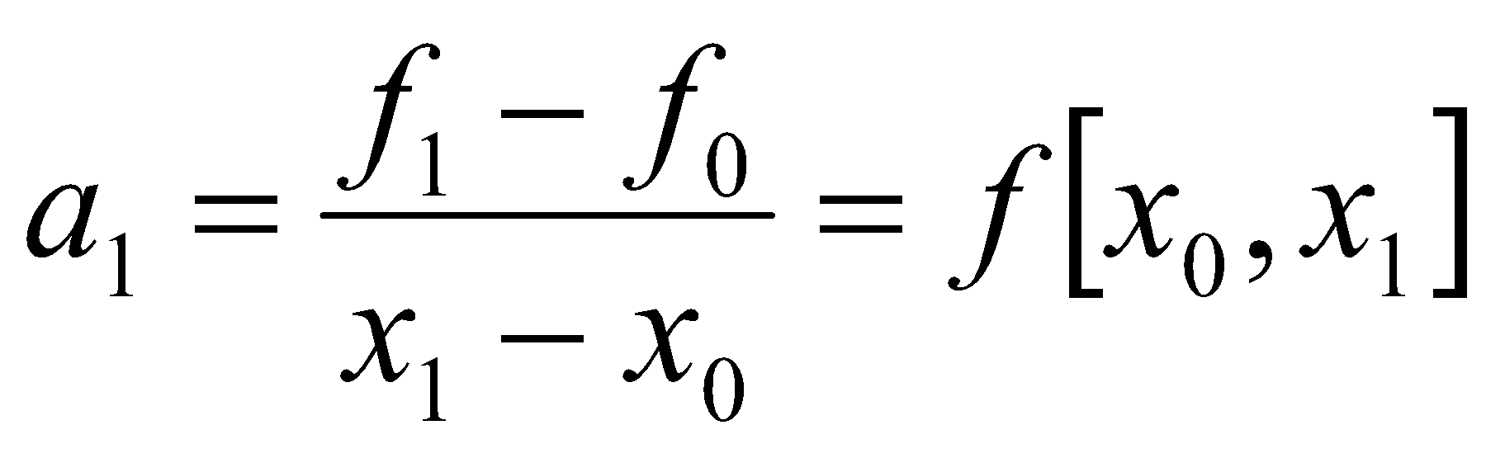
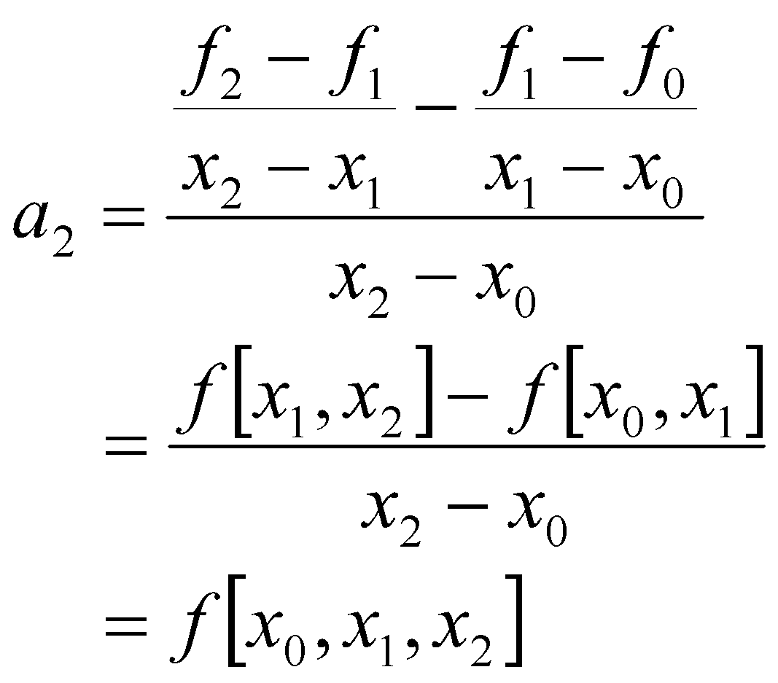
Curve Fitting: Interpolation
NEWTON INTERPOLATION POLYNOMIAL
Substituting for a₀ and a₁, and rearranging the terms, we get,
Let us define a notation,

Slide 28
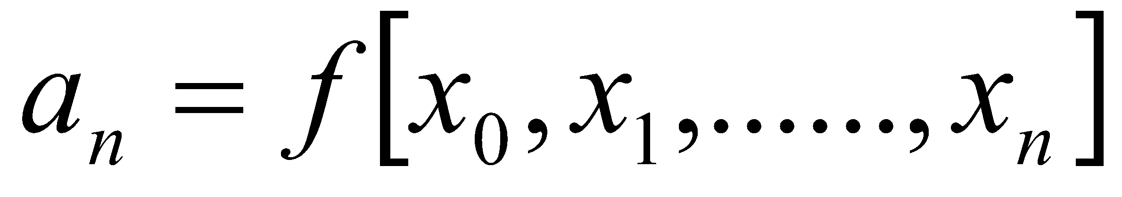
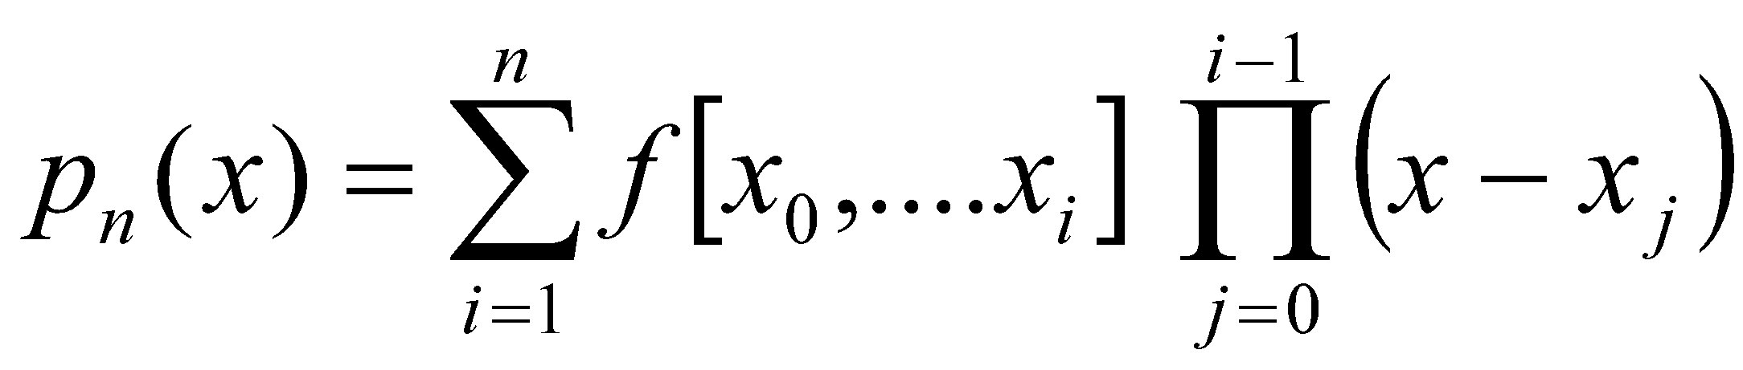
Curve Fitting: Interpolation
NEWTON INTERPOLATION POLYNOMIAL
Thus,
Here a₁ represents the first divided difference and a₂ the second divided difference and so on.
Substituting for a_{i} coefficients in equation (1), we get
p_{n}(x) = f[x₀]+ f[x₀, x₁] (x – x₀) + f[x₀, x₁, x₂] (x – x₀)(x - x₁)
+ …….
+ f[x₀, x₁, ….., x_{n}] (x – x₀)(x - x₁) ….. (x - x_{n-1})
This can be written more compactly as,
----------------- (2)
Equation (2) is called Newton’s divided difference interpolation polynomial.

Slide 29
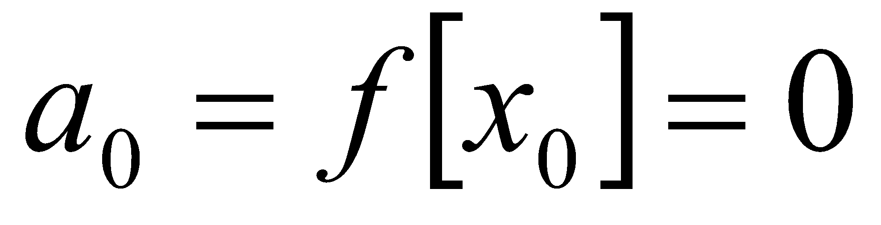
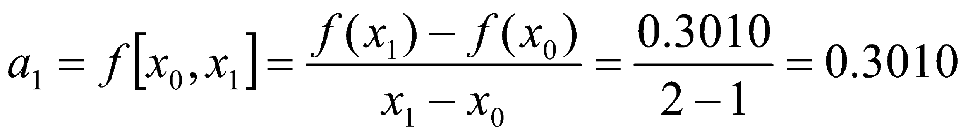
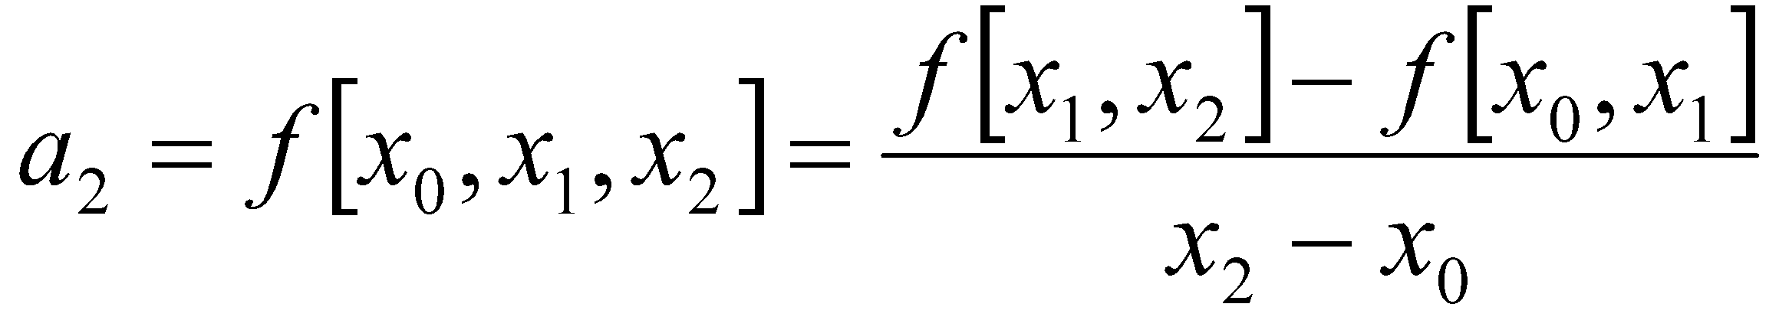
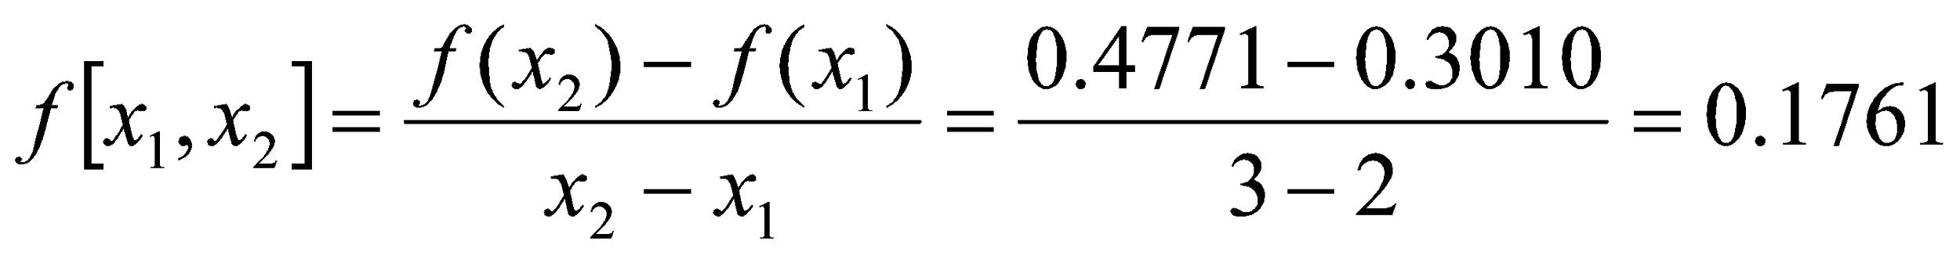
Curve Fitting: Interpolation
Example: Given below is a table of data for log x. Estimate log 2.5 using second order Newton interpolation polynomial.
Solution:
Second order polynomials require only three data points. Here we use the first the points.
i | 0 | 1 | 2 | 3
x_{i} | 1 | 2 | 3 | 4
log x_{i} | 0 | 0.3010 | 0.4771 | 0.6021

Slide 30
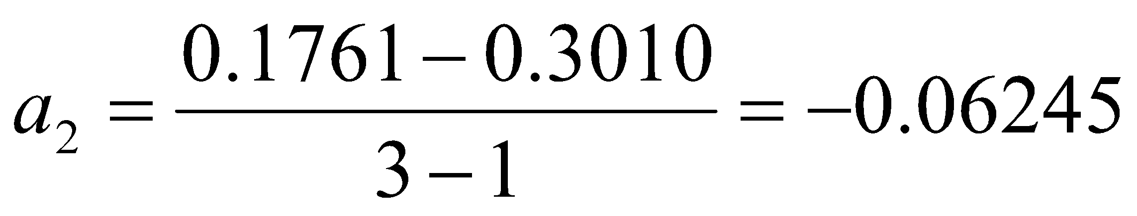
Curve Fitting: Interpolation
Example: Given below is a table of data for log x. Estimate log 2.5 using second order Newton interpolation polynomial.
Solution:
Therefore,
Second order Newton interpolation polynomial:
p₂(x) = a₀ + a₁(x – x₀) + a₂(x – x₀)(x - x₁)
= 0 + 0.3010 (x - 1) + (-0.06245)(x - 1)(x - 2)
Estimated Value of log 2.5:
p₂(2.5) = 0.3010 (1.5) - 0.06245(1.5)(0.5)
= 0.4515 – 0.0468
= 0.4047
i | 0 | 1 | 2 | 3
x_{i} | 1 | 2 | 3 | 4
log x_{i} | 0 | 0.3010 | 0.4771 | 0.6021

Slide 31
Curve Fitting: Interpolation
Example: Given below is a table of data for log x. Estimate log 2.5 using second order Newton interpolation polynomial.

