Slide 1

Numerical Methods
Lecture 08

Slide 2
Regression
Regression
There are various methods of curve fitting for data points of well-defined functions.
There are also various methods of curve fitting for experimental data.
Why is it necessary?
In many applications, it often becomes necessary to establish a mathematical relationship between experimental values. This relationship may be used for either testing existing mathematical models or establishing new ones.
The mathematical equation can also be used to predict or forecast values of the dependent variable.
The process of establishing such relationships in the form of a mathematical equation is known as regression analysis or curve fitting.
Suppose the values of y for the different values of x are given. If we want to know the effect of x on y, then we may write a functional relationship
y = f(x)
The variable y is called the dependent variable and x the independent variable. The relationship may be either linear or nonlinear.

Slide 3
Regression
Least Squares Regression
Least square regression technique is used to fit the data under the following situations:
Relationship is linear.
Relationship is transcendental.
Relationship is polynomial.
Relationship involves two or more independent variables.

Slide 4
Regression
Fitting Linear Equations
Fitting a straight line is the simplest approach of regression analysis.
Lets us consider the mathematical equation for a straight line to describe the data.
y = a + bx = f(x)
a is the intercept of the line and b its slope.
Consider a point (x_{i}, y_{i}) as shown in Fig. The vertical distance of this point from the line f(x) = a + bx is the error q_{i}. Then,
q_{i} = y_{i} – f(x_{i})
= y_{i} – a - bx_{i}

Slide 5
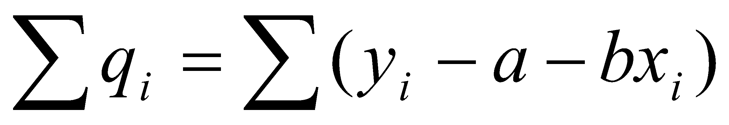
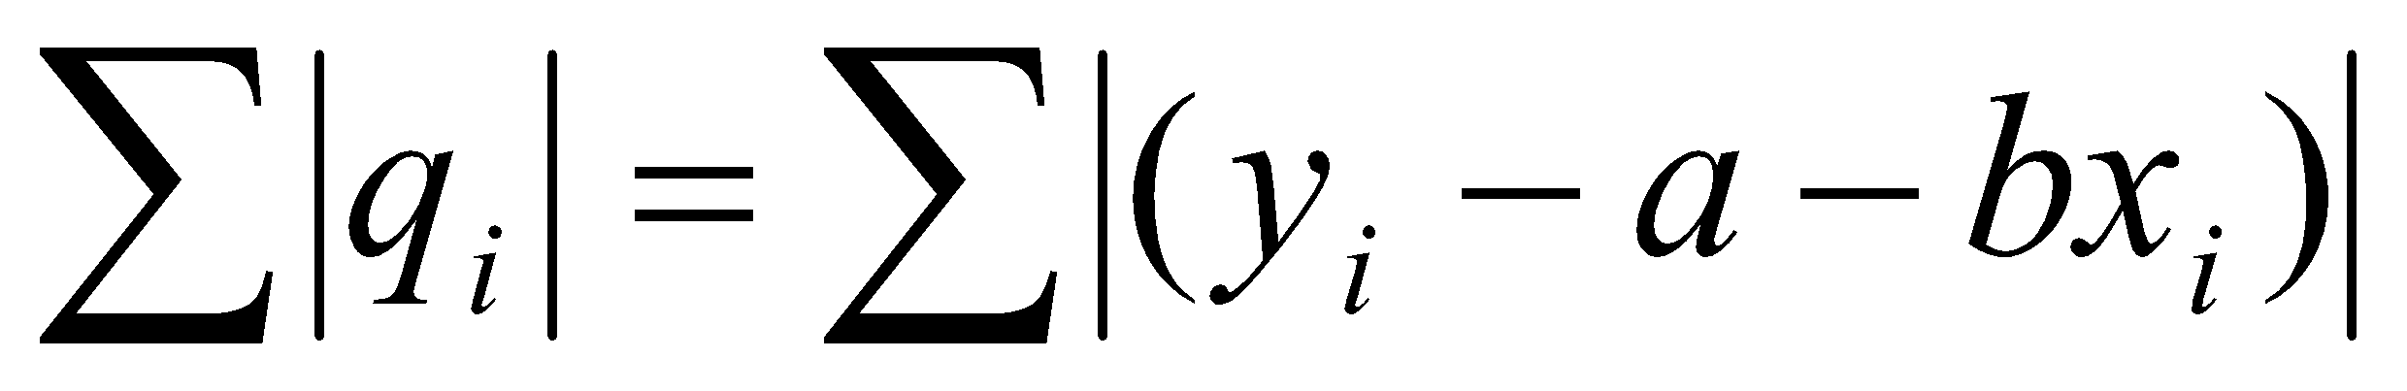
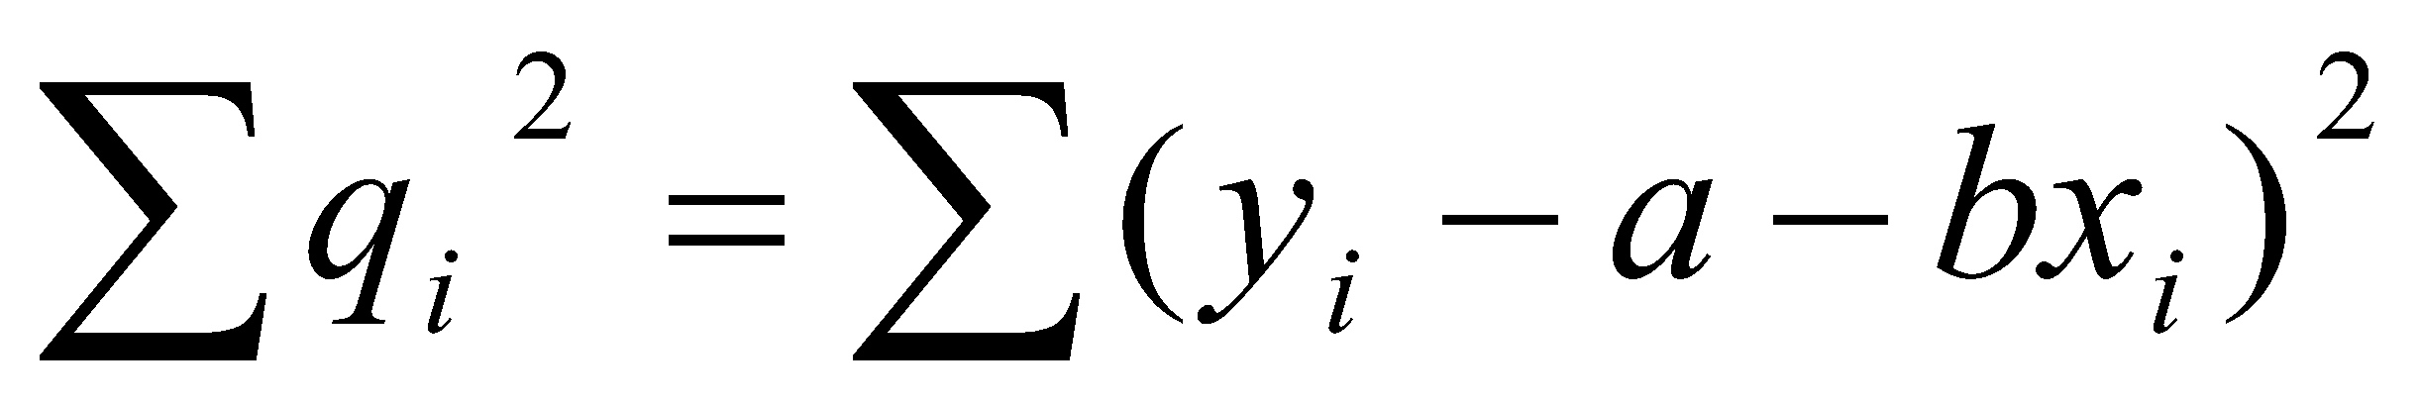
Regression
Fitting Linear Equations
There are various approaches that could be tried for fitting a ‘’best ’’ line through the data. They include:
Minimize the sum of errors,
Minimize the sum of absolute values of errors
Minimize the sum of squares of errors
First two strategies do not yield a unique line for a given set of data.
The third strategy overcomes this problem and guarantees a unique line.
The technique of minimizing the sum of squares of errors is known as least squares regression.

Slide 6
Regression
Least Squares Regression
Lets us consider the mathematical equation for a straight line to describe the data.
y = a + bx = f(x)
a is the intercept of the line and b its slope.
Consider a point (x_{i}, y_{i}) as shown in Fig. The vertical distance of this point from the line f(x) = a + bx is the error q_{i}. Then,
q_{i} = y_{i} – f(x_{i})
= y_{i} – a - bx_{i}
Line f(x) = a + bx
Error, q_{i}
Point (x_{i}, y_{i})

Slide 7
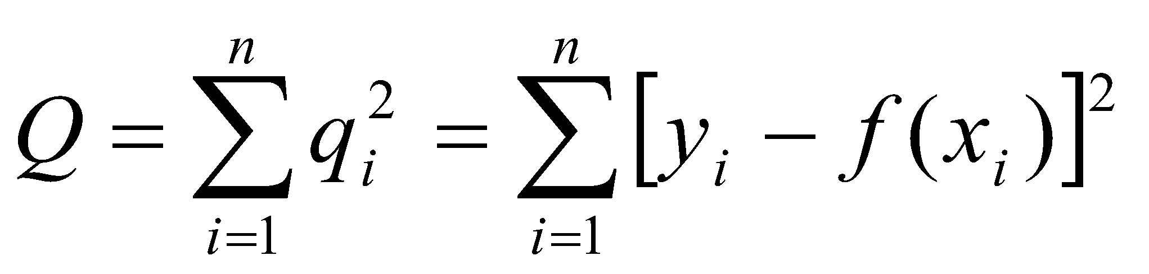
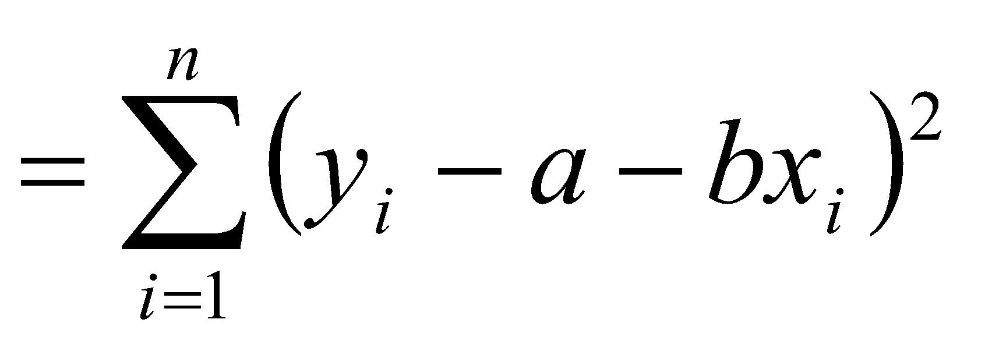
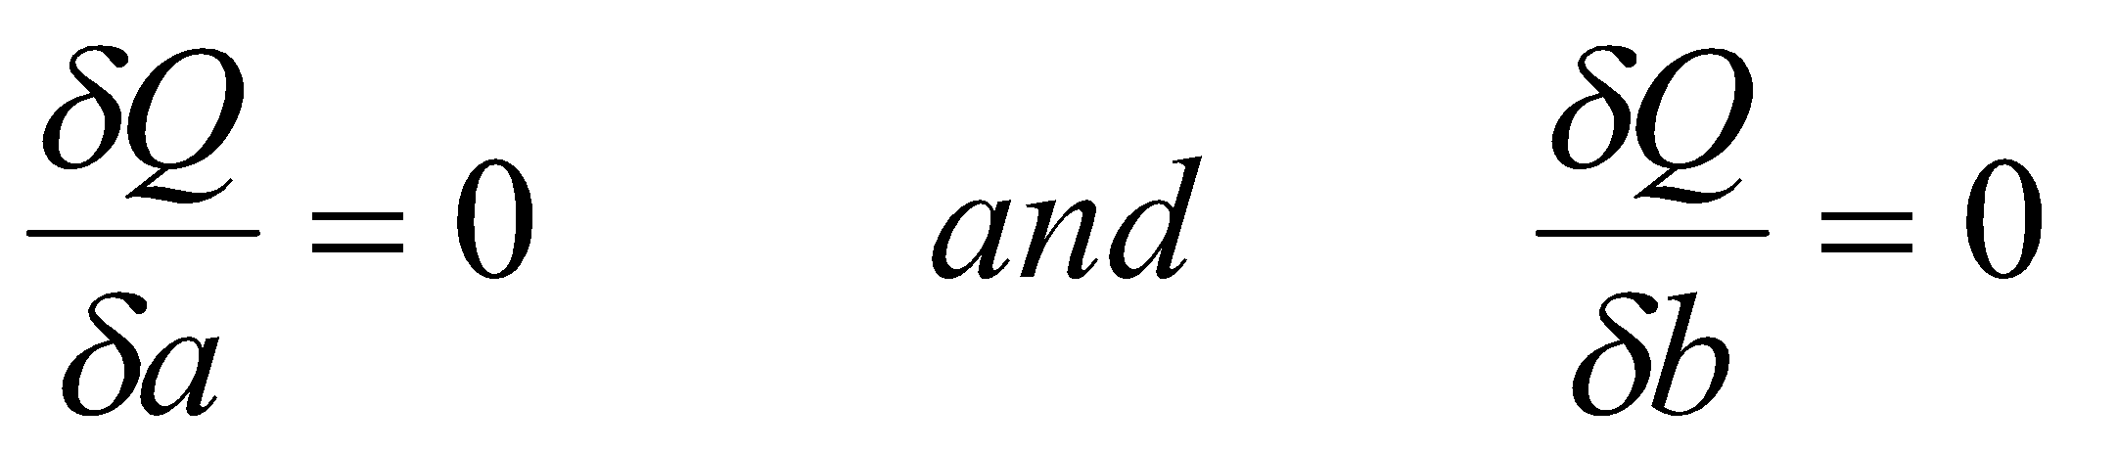
Regression
Least Squares Regression
Let the sum of squares of individual errors be expressed as
Now choose a and b such that Q is minimum. Since Q depends on a and b, a necessary condition for Q to be minimum is

Slide 8
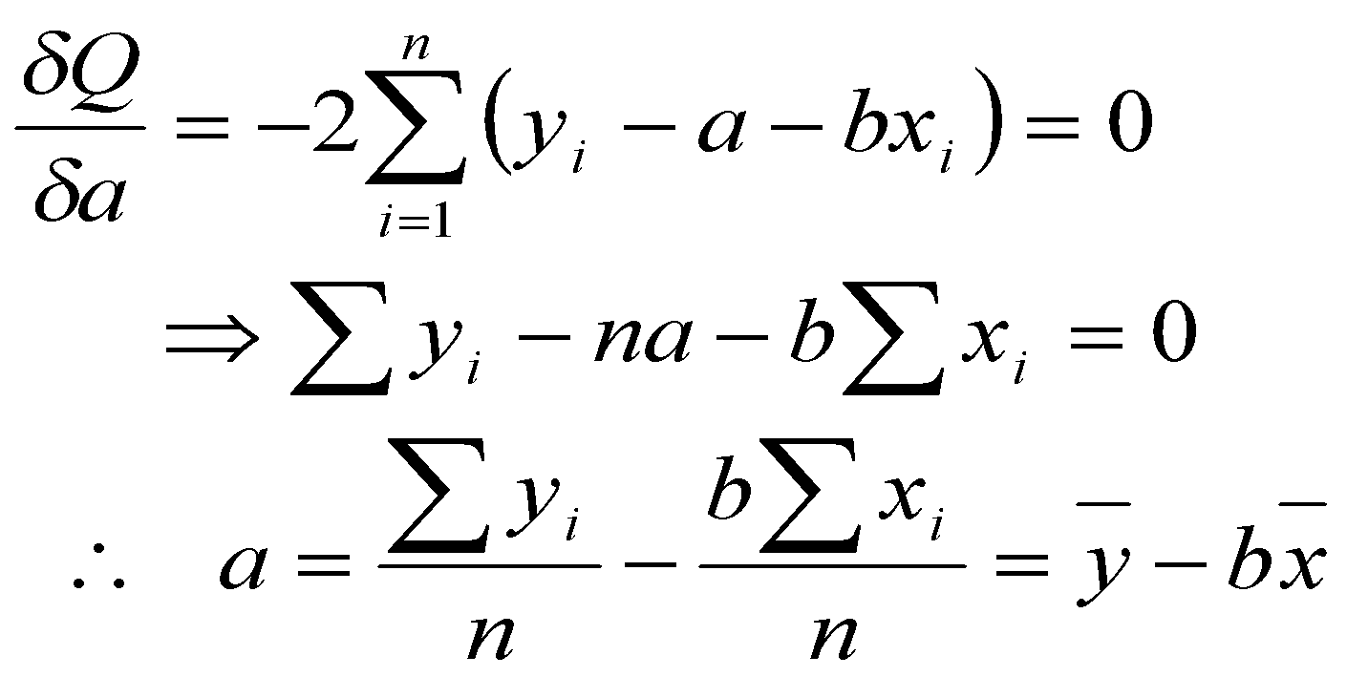
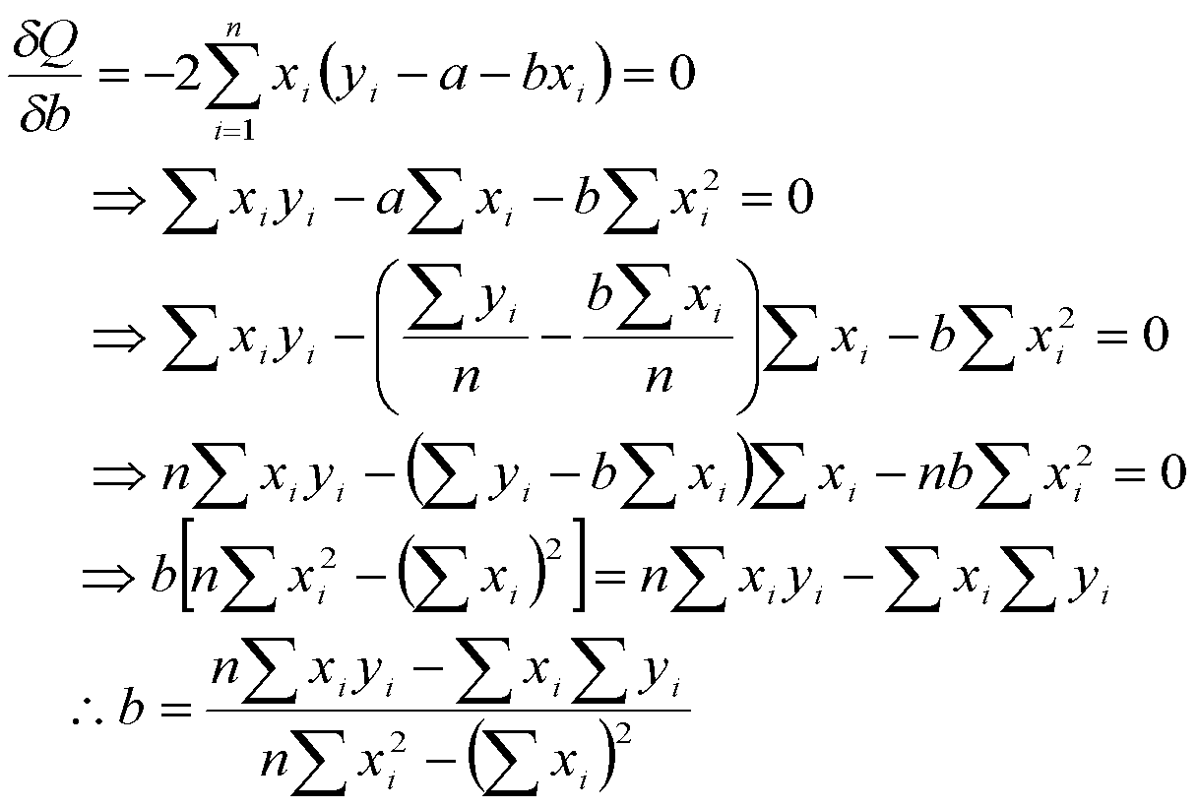
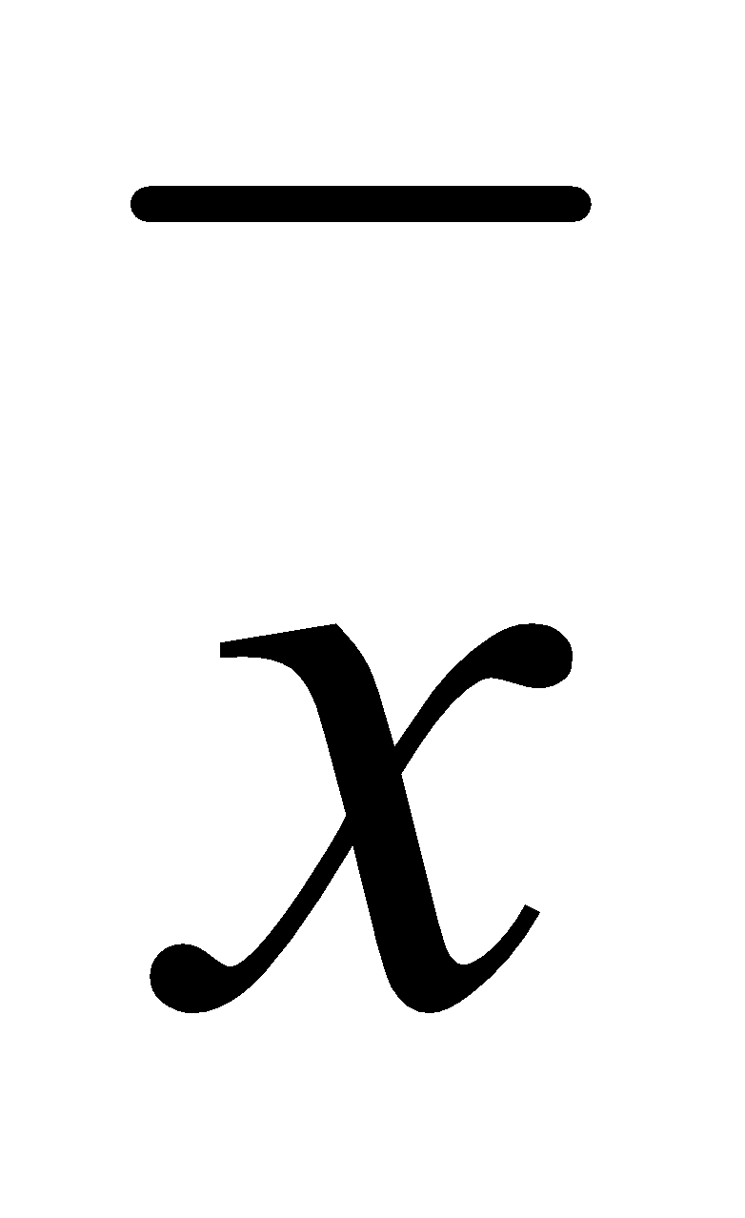
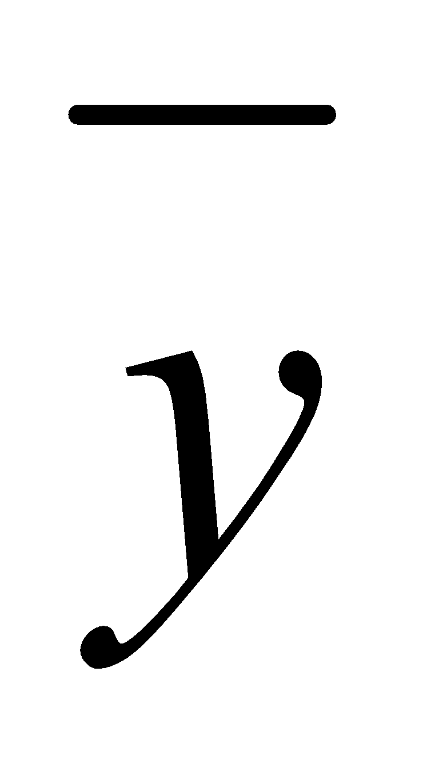
Regression
Least Squares Regression
Then,
and
Where and are the averages of x values and y values respectively.

Slide 9
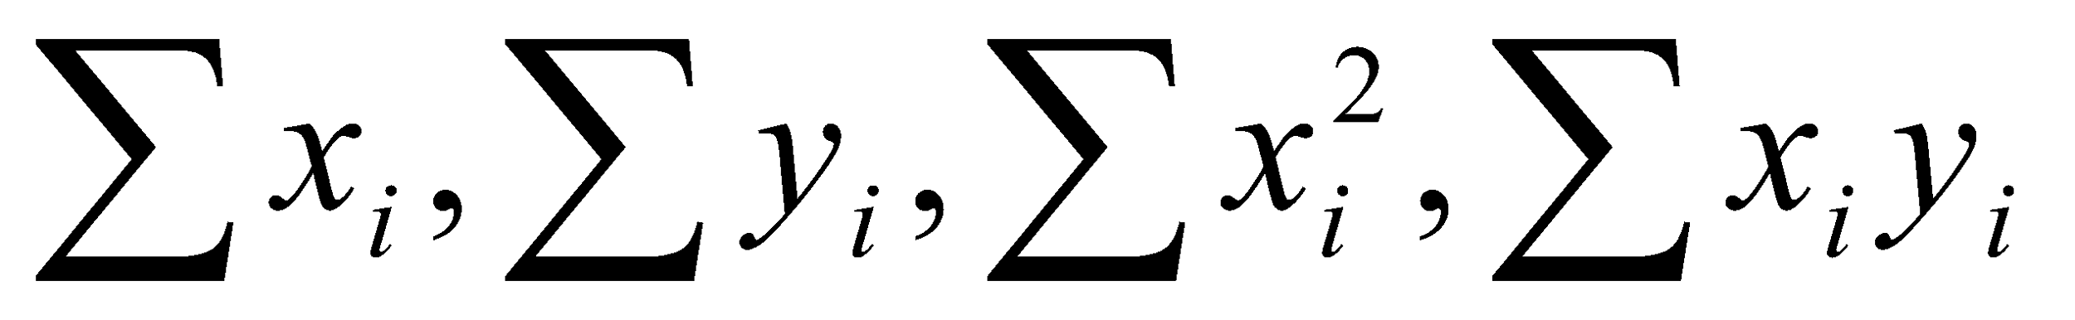
Regression
Least Squares Regression: Algorithm
Read data values.
Compute sum of powers and products
Check whether the denominator of the equation for b is zero.
Compute b and a.
Print out the equation.
Interpolate data, if required.

Slide 10
Regression
Example: Fit a straight line to the following set of data:
Solution:
The various summations are given as follows:
x | 1 | 2 | 3 | 4 | 5
y | 3 | 4 | 5 | 6 | 8
 | x_{i} | y_{i} | x_{i}² | x_{i}y_{i}
 | 1 | 3 | 1 | 3
 | 2 | 4 | 4 | 8
 | 3 | 5 | 9 | 15
 | 4 | 6 | 16 | 24
 | 5 | 8 | 25 | 40
∑ | 15 | 26 | 55 | 90

Slide 11
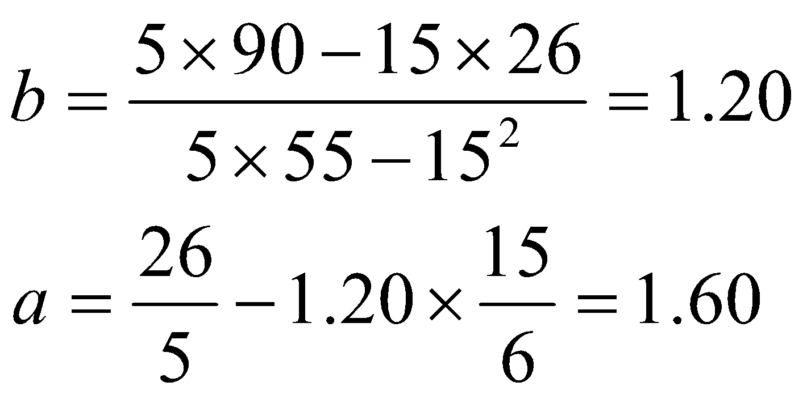
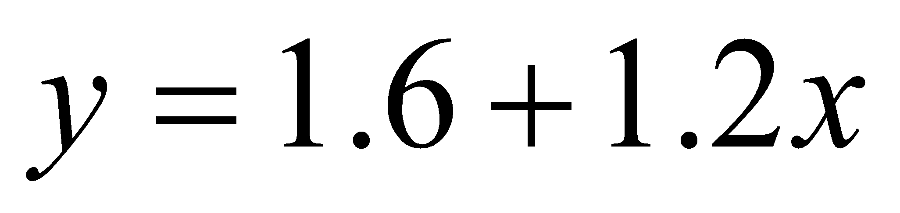
Regression
Example: Fit a straight line to the following set of data:
Solution:
Calculation for b and a:
Therefore, the linear equation is
The regression line along with the data is shown in Fig. above.
x | 1 | 2 | 3 | 4 | 5
y | 3 | 4 | 5 | 6 | 8
8
7
6
y = 1.6 + 1.2x
y
5
4
3
2
1
1
2
3
4
5
6
x
Fig.: Plot of the data and regression line.

Slide 12
Regression
FITTING TRANSCENDENTAL EQUATIONS
The relationship between the dependent and independent variables is not always linear. See the following Fig.
y
x
Fig. Data would fit a nonlinear curve better than a linear one.

Slide 13
Regression
FITTING TRANSCENDENTAL EQUATIONS
The nonlinear relationship between them may exist in the form of transcendental equations. For example, the familiar equation for population growth is given by
P = p₀e^{kt}
Where p₀ is the initial population, k is the rate of growth and t is time.
Another example of nonlinear model is the gas low relating to the pressure and volume, as given by
p = a
This type of problems can be solved by using the method of least squares.
Let us rewrite the equation using the conventional variable x and y as:
y = ax^{b}
Take logarithm on both the sides:
ln y = ln a + b ln x
This equation is similar in form to the linear equation (Least Square Regression) and therefore, using the same procedure we can evaluate the parameters a and b :

Slide 14
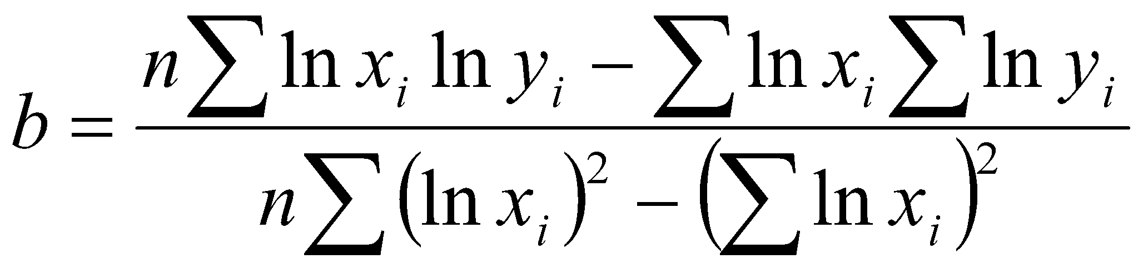
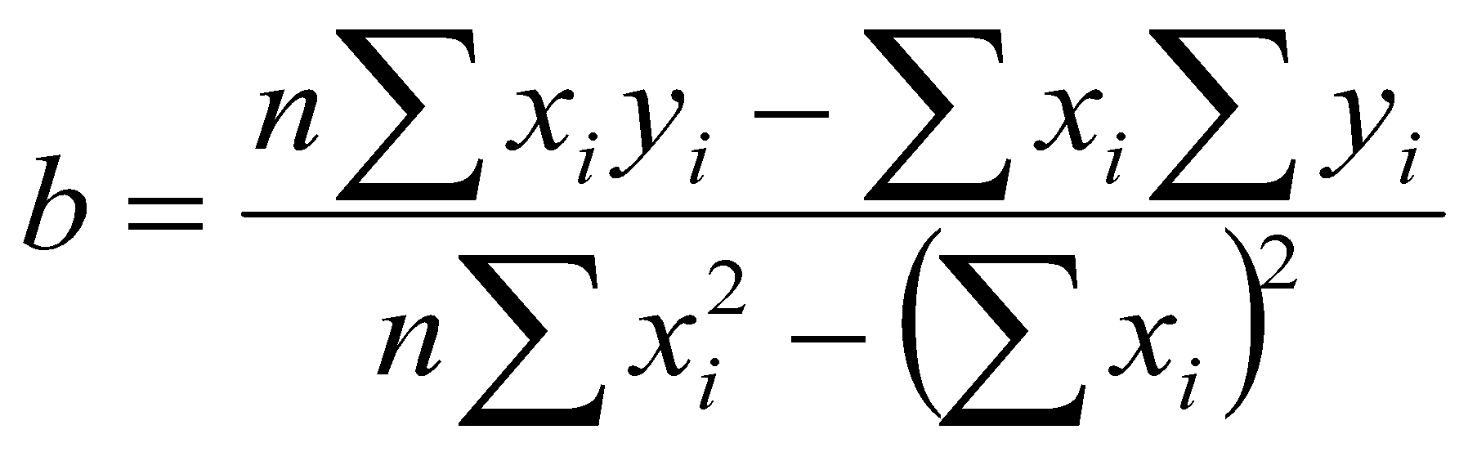
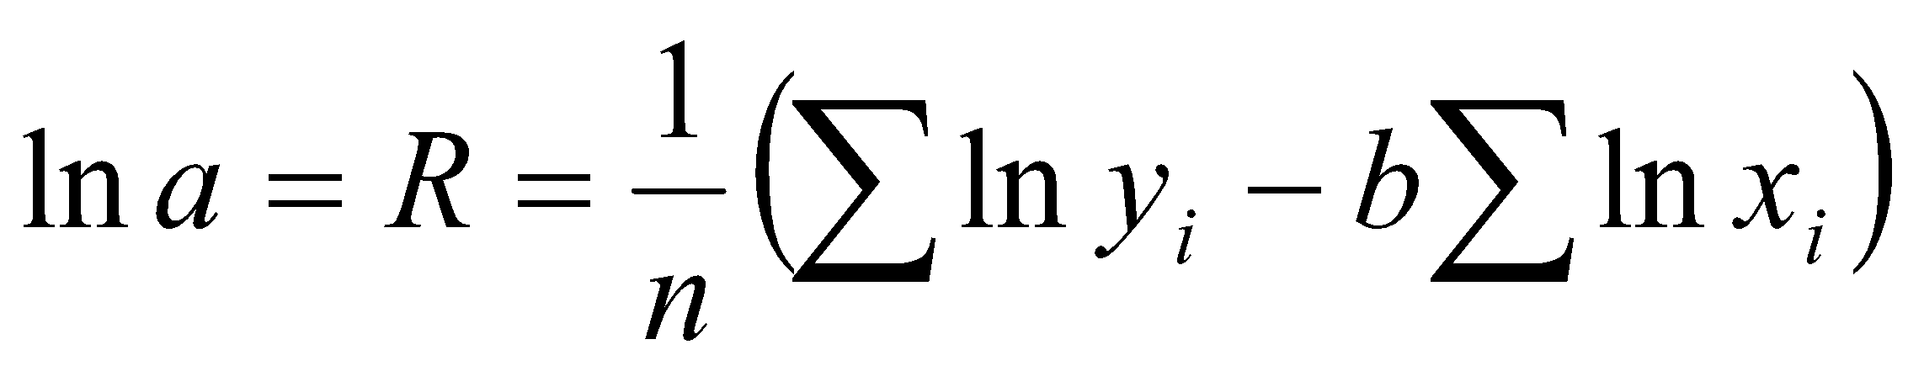
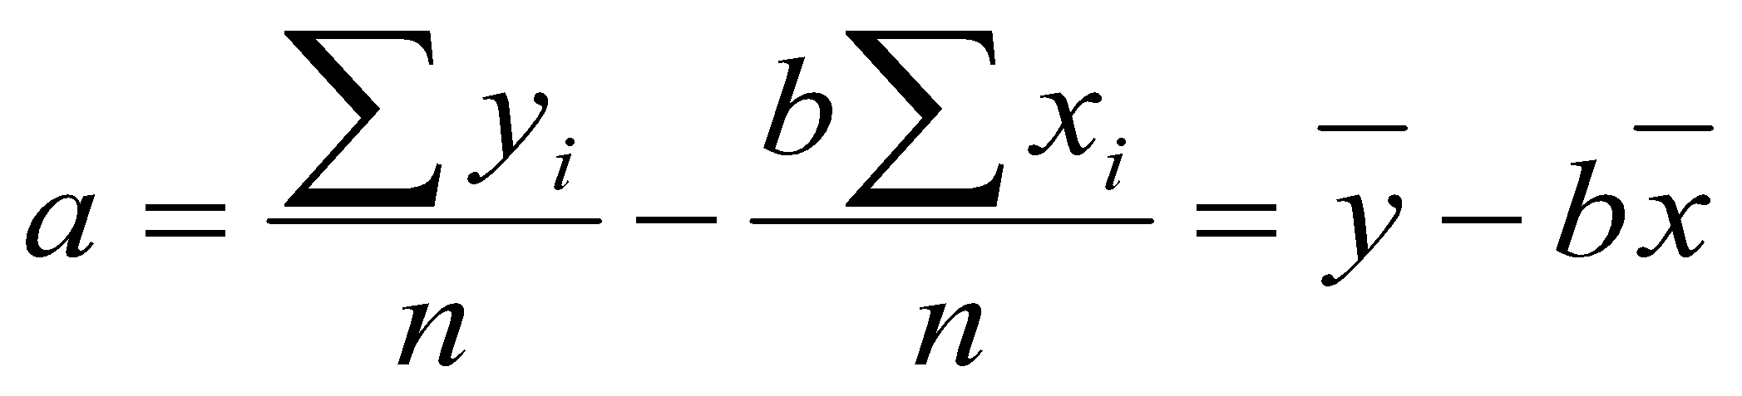
Regression
FITTING TRANSCENDENTAL EQUATIONS
So, a = e^{R}
y = a + bx
ln y = ln a + b ln x

Slide 15
Regression
Example: For the following data table, fit a power-function model of the form,
y = ax^{b}
Solution:
x | 1 | 2 | 3 | 4 | 5
y | 0.5 | 2 | 4.5 | 8 | 12.5
x_{i} | y_{i} | ln x_{i} | ln y_{i} | (ln x_{i})² | (ln x_{i})( ln y_{i})
1 | 0.5 | 0 | -0.6931 | 0 | 0
2 | 2 | 0.6931 | 0.6931 | 0.4805 | 0.4804
3 | 4.5 | 1.0986 | 1.5041 | 1.2069 | 1.6524
4 | 8 | 1.3863 | 2.0794 | 1.9218 | 2.8827
5 | 12.5 | 1.6094 | 2.5257 | 2.5903 | 4.0649
Sum |  | 4.7874 | 6.1092 | 6.1995 | 9.0804

Slide 16
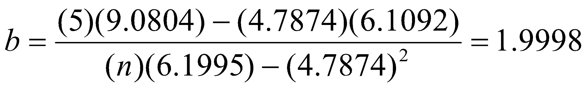
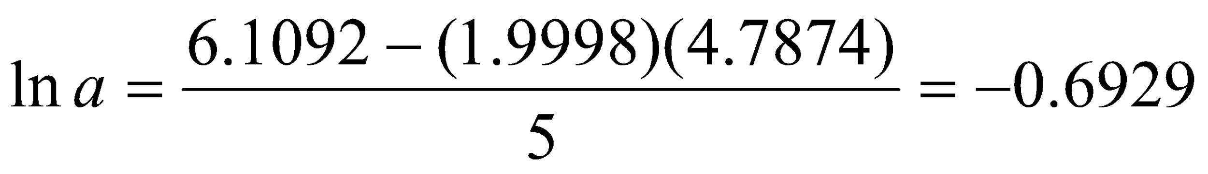
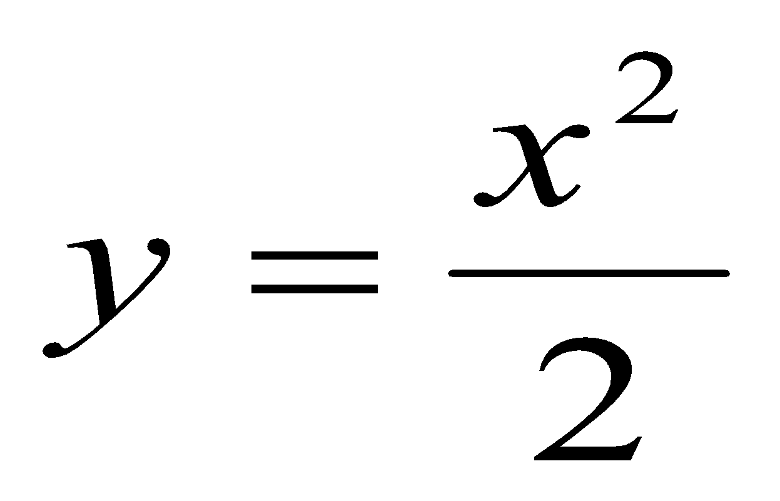
Regression
Example: For the following data table, fit a power-function model of the form,
y = ax^{b}
Solution:
Calculation:
So, a = 0.5001
Therefore, the power function equation is y = 0.5001 x^{1.9998}
Actual equation is
The discrepancy is due to round-off errors.
x | 1 | 2 | 3 | 4 | 5
y | 0.5 | 2 | 4.5 | 8 | 12.5

