Slide 1

Numerical Methods
Lecture 09

Slide 2
Numerical Differentiation
Differentiation
Differentiation is an operation that allows us to find a function that outputs the rate of change of one variable with respect to another variable.
Applications
Need for differentiation of a function arises quite often in engineering and scientific problems.
Sometimes we are given only the values of a function at a discrete set of points. For example, we are given the distance travelled by a moving object at some regular time intervals and asked to determine its velocity at a particular time.
Sometimes, the function is known but it is so complicated that an analytic differentiation is difficult.
In both situations, we seek the help of numerical techniques to obtain function derivatives.
The method of obtaining the derivative of a function using a numerical technique is known as numerical differentiation.

Slide 3
Numerical Differentiation
Differentiation
There are essentially two situations where numerical differential is required:
The function values are known but the function is unknown. Such functions are called tabulated function.
The function to be differentiated is complicated and therefore it is difficult to differentiate.
Errors
Analytical methods give exact answers.
Numerical techniques provide only approximations to derivatives.
Numerical differentiation methods are prone to round off errors and truncation errors.

Slide 4
Numerical Differentiation
Differentiating Continuous Functions
Methods available:
Forward Difference Quotient
Also known as two-point formula.
Backward Difference Quotient
Also known as two-point formula.
Central Difference Quotient
Also known as three-point formula.
Higher-Order Derivatives

Slide 5
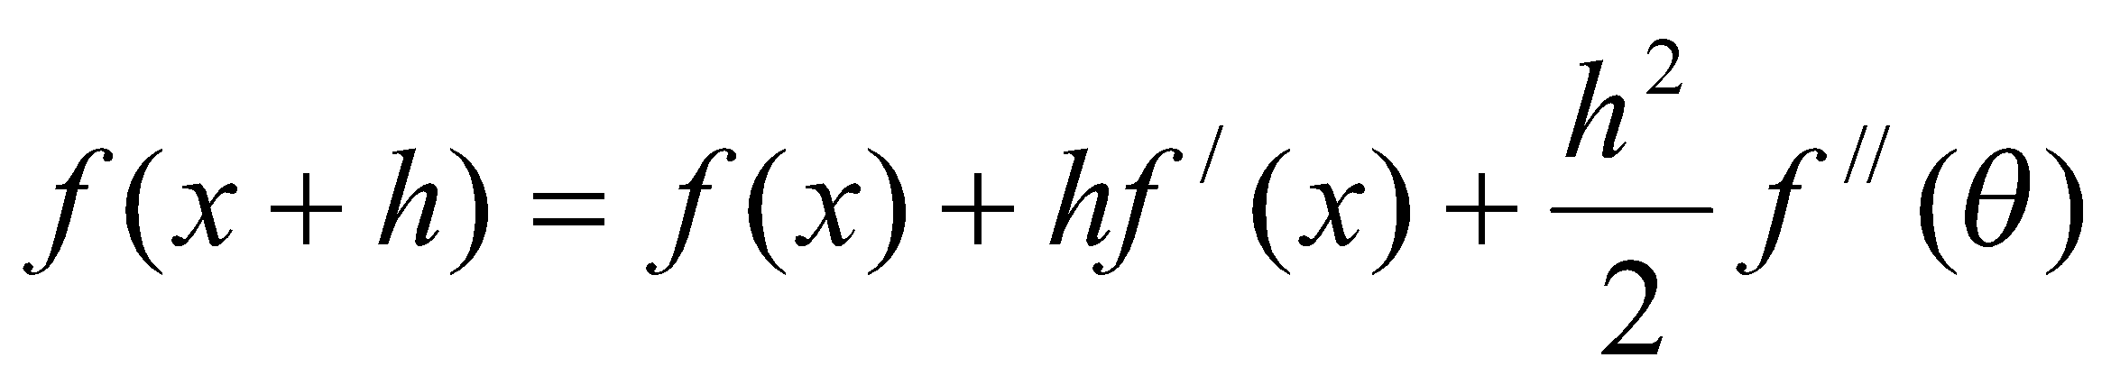
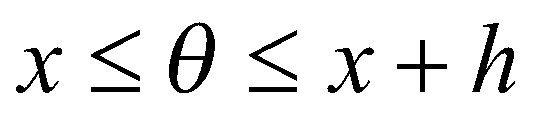
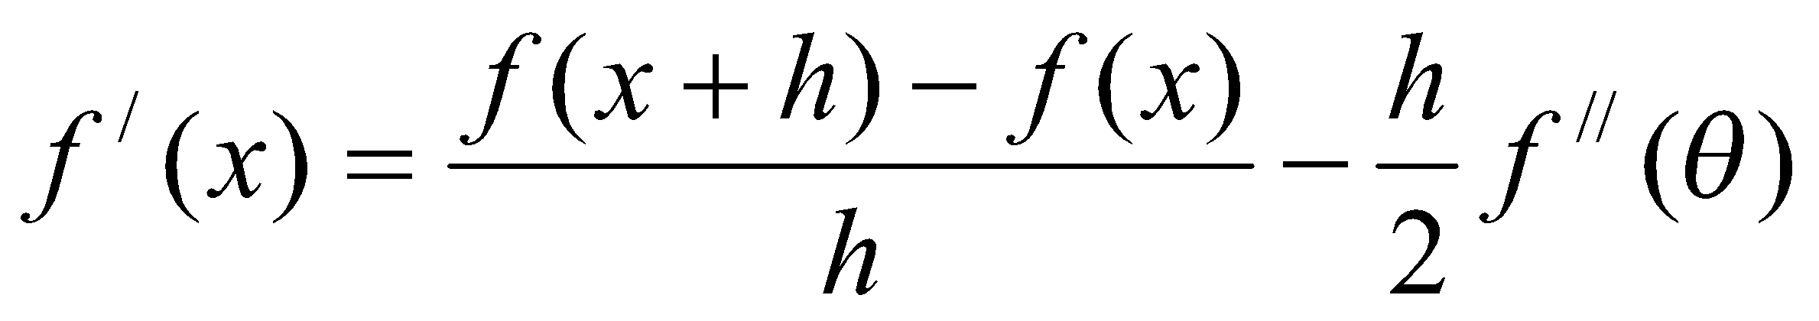
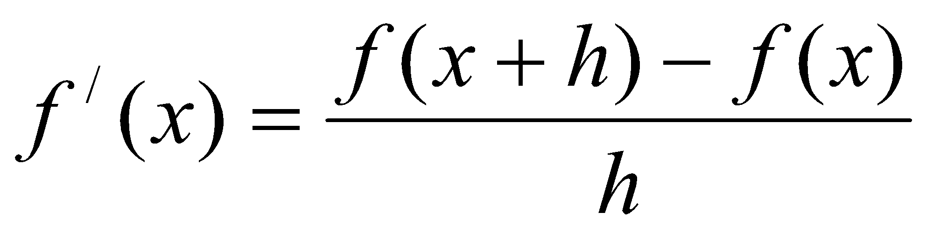
Numerical Differentiation
Forward Difference Quotient
Consider a small increment in x. According to Taylor’s theorem we have,
By rearranging the terms we get,
Thus, if h is chosen to be sufficiently small, f /(x) can be approximated by
This equation is called the first-order forward difference quotient. This is also known as two-point formula.
Truncation Error:
This error is in the order of h and can be decreased by decreasing h.

Slide 6
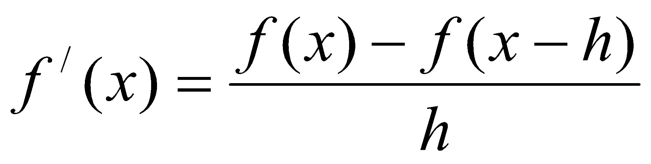
Numerical Differentiation
Backward Difference Quotient
This equation is called the first-order backward difference quotient. This is also known as two-point formula.

Slide 7
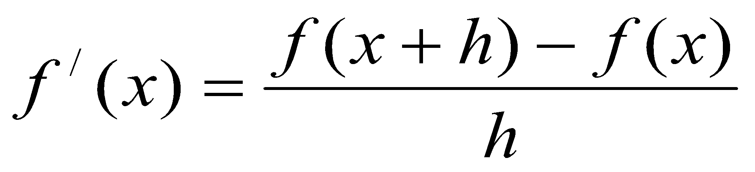
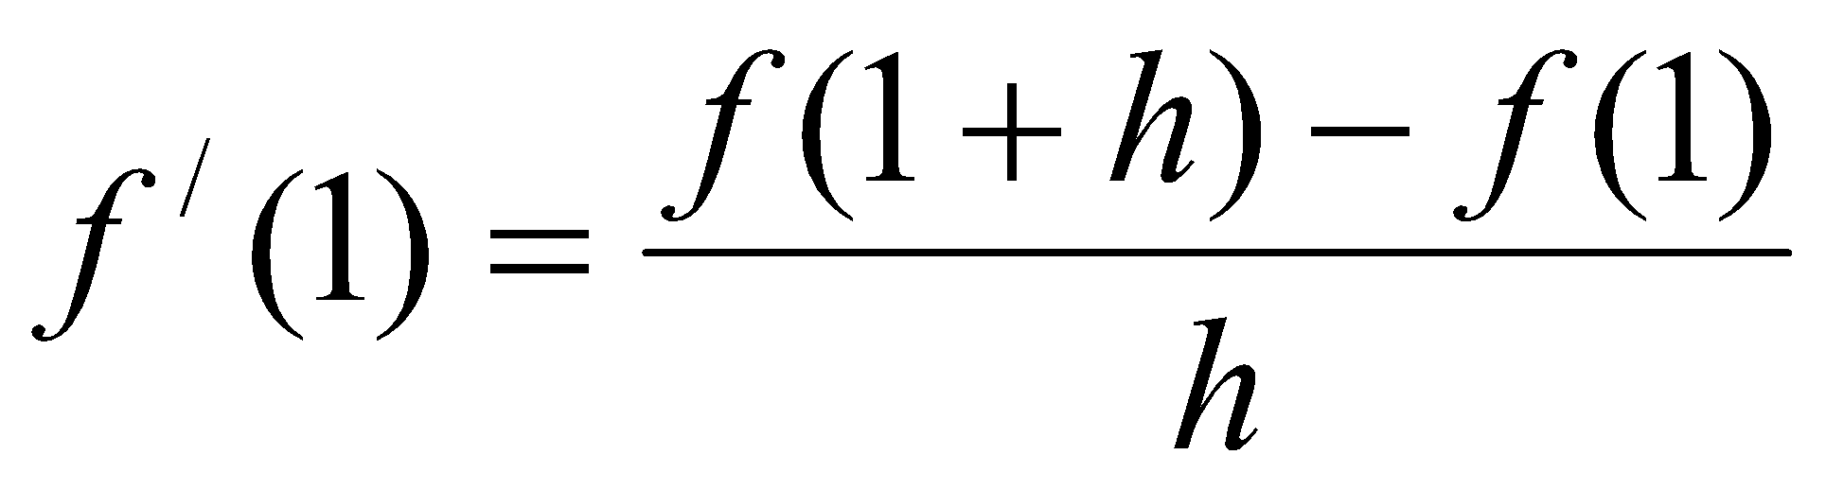
Numerical Differentiation
Example:
Estimate approximate derivative of f(x) = x² at x=1, for h = 0.2, 0.1, 0.05, 0.01 using the first-order forward difference formula.
Solution:
Actual derivative of f(x) = x² is 2x. That is, f /(x) = 2x.
So, Correct answer at x = 1 is 2. That is, f /(x) = 2x = 2.1 = 2.
First-order forward difference formula:
At x = 1,

Slide 8
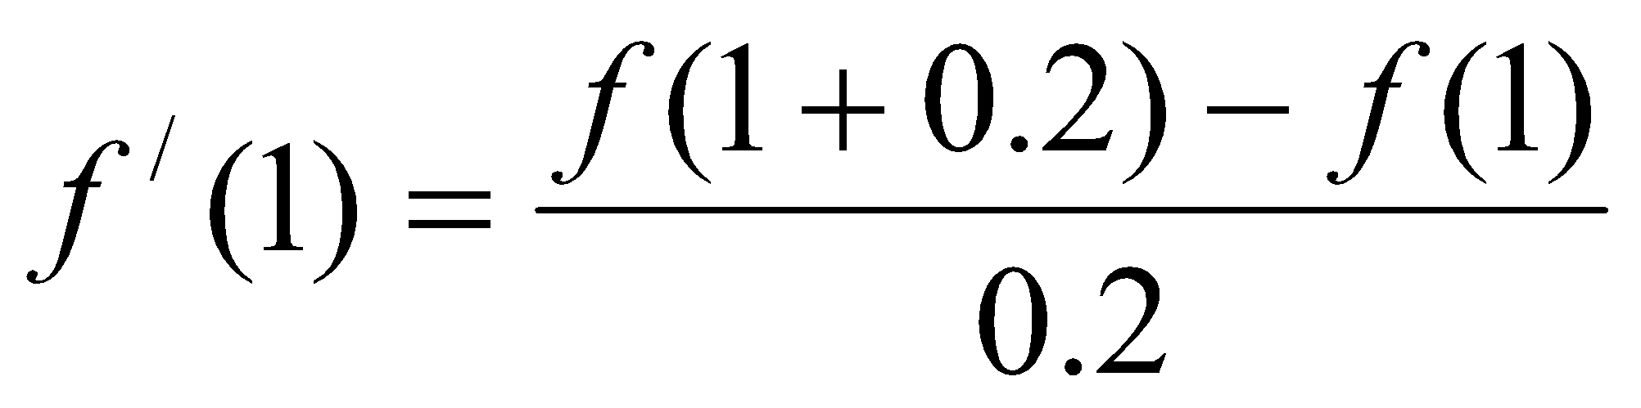
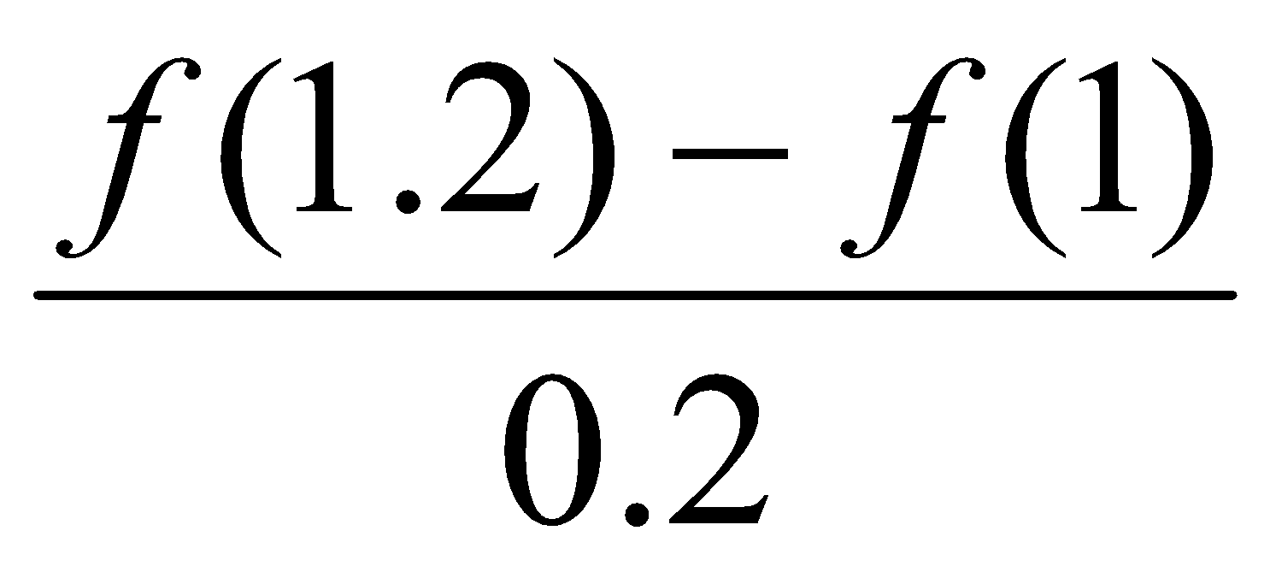
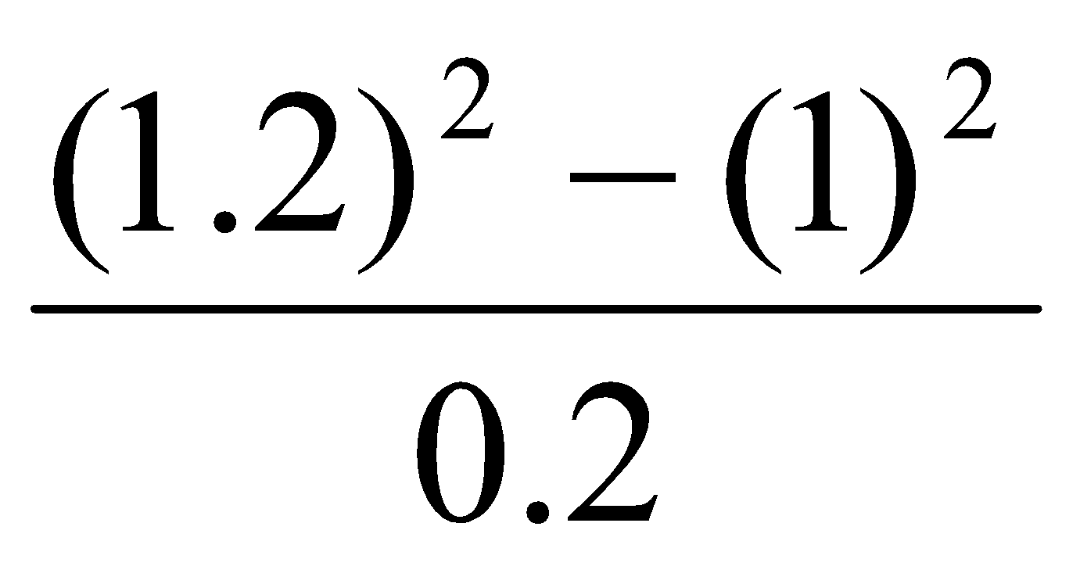
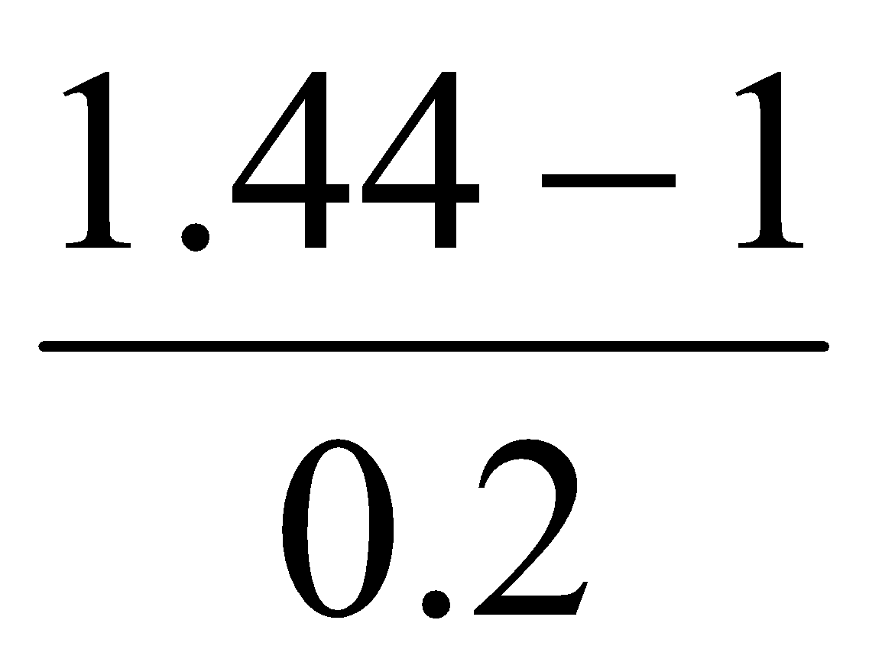
Numerical Differentiation
Example:
Estimate approximate derivative of f(x) = x² at x=1, for h = 0.2, 0.1, 0.05, 0.01 using the first-order forward difference formula.
Solution:
Consider h = 0.2:
=
= , Since f(x) = x².
= = 2.2
Thus, truncation error:
|Correct answer – Approximate answer|
= |2 – 2.2| = 0.2

Slide 9
Numerical Differentiation
Example:
Estimate approximate derivative of f(x) = x² at x=1, for h = 0.2, 0.1, 0.05, 0.01 using the first-order forward difference formula.
Solution:
Consider h = 0.1:
f / (1) = 2.1
Thus, truncation error = 0.1
Derivative for different values of h:
As we see, the truncation error decreases as h decreases. There is no round-off error.
h | f /(1) | Error
0.2 | 2.2 | 0.2
0.1 | 2.1 | 0.1
0.05 | 2.05 | 0.05
0.01 | 2.01 | 0.01

Slide 10
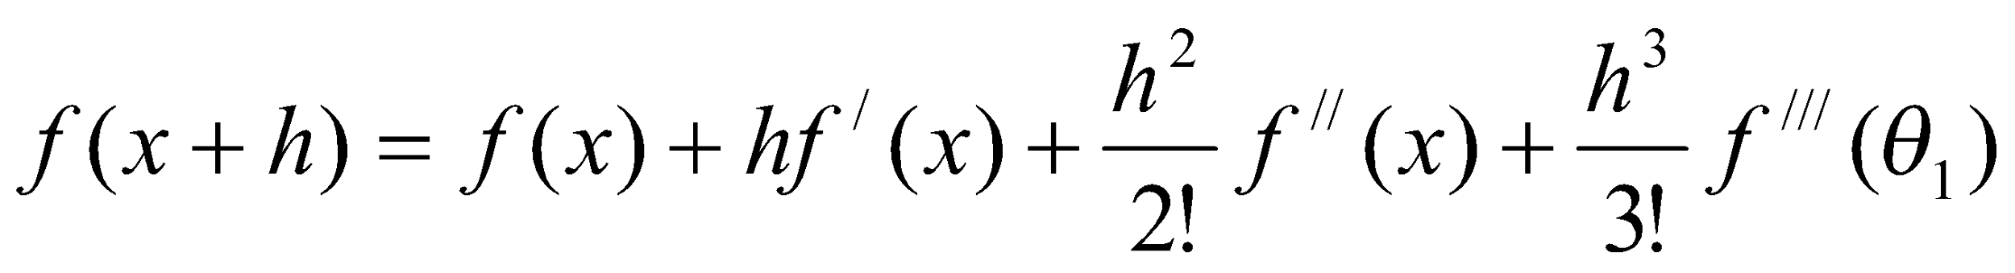
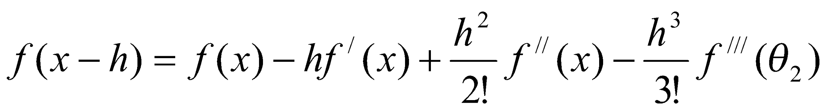
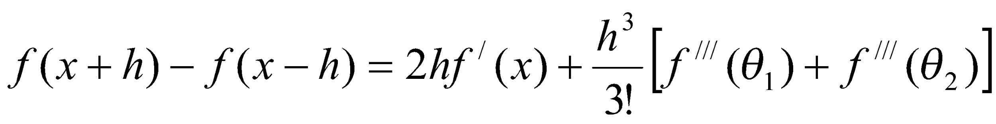
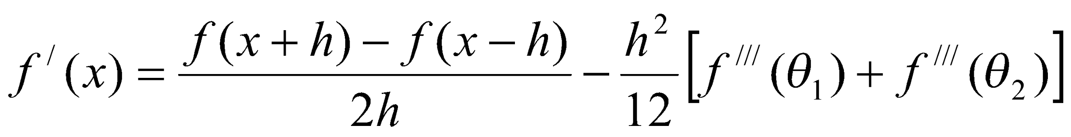
Numerical Differentiation
Central Difference Quotient
Consider a small increment in x. We have another form of Taylor’s expansion,
(1)
Similarly,
(2)
Subtracting (2) from (1):
(3)

Slide 11
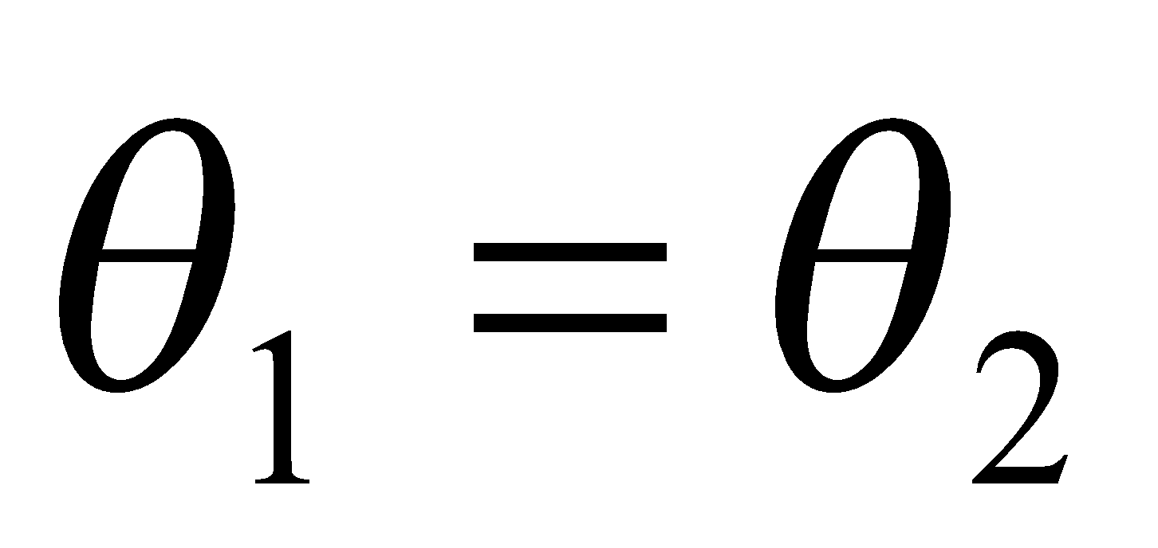
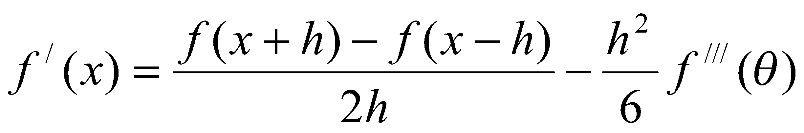
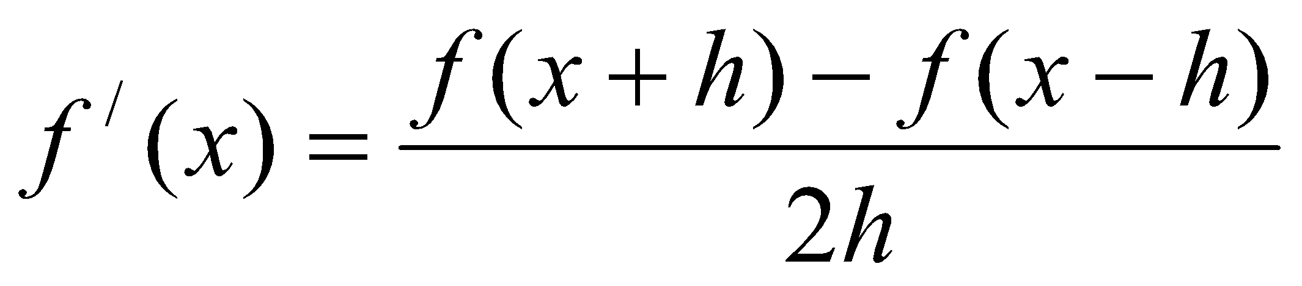
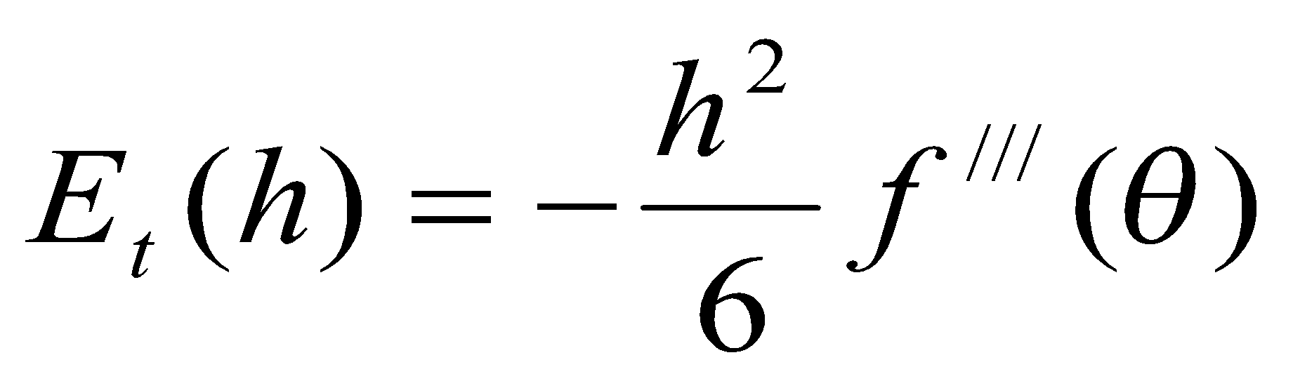
Numerical Differentiation
Central Difference Quotient
For ,
(4)
Thus, we have (approximated),
(5)
This equation is called the second-order central difference quotient. This is also known as three-point formula. This is the average of the forward difference quotient and the backward difference quotient.
Truncation Error:
This error is in the order of h² and can be decreased by decreasing h.

Slide 12
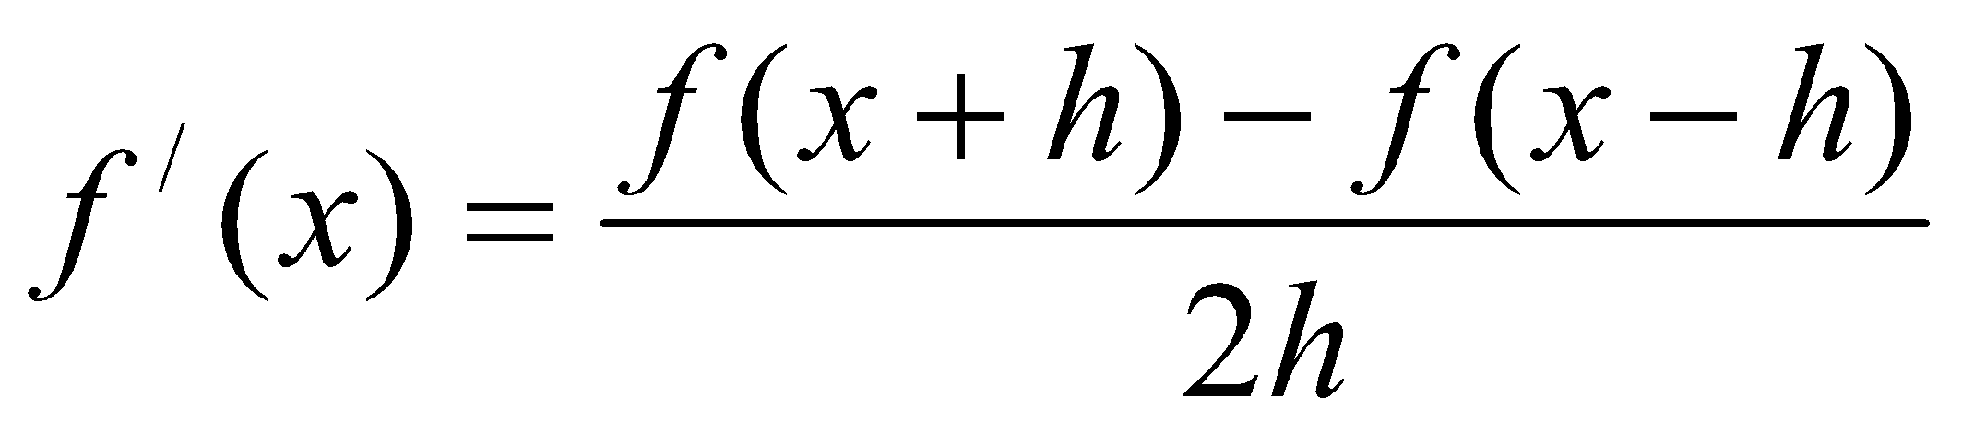
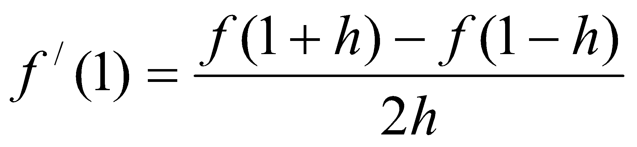
Numerical Differentiation
Example:
Estimate approximate derivative of f(x) = x² at x=1, for h = 0.2, 0.1, 0.05, 0.01 using the second-order central difference formula (or using the three-point formula).
Solution:
Actual derivative of f(x) = x² is 2x. That is, f /(x) = 2x.
So, Correct answer at x = 1 is 2. That is, f /(x) = 2x = 2.1 = 2.
Second-order central difference formula:
At x = 1,

Slide 13
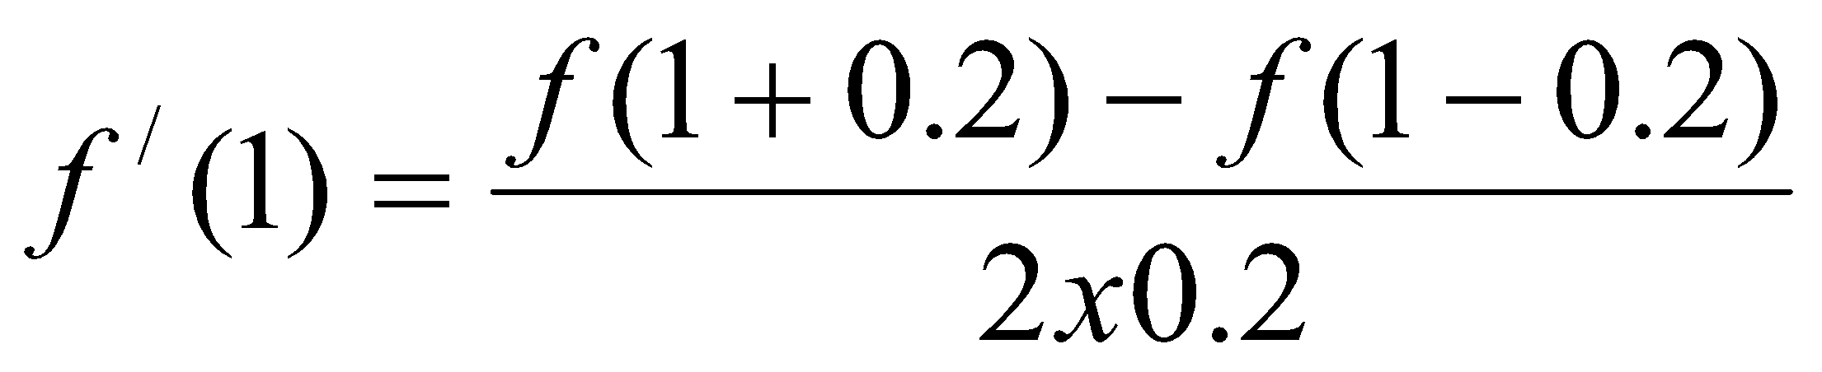
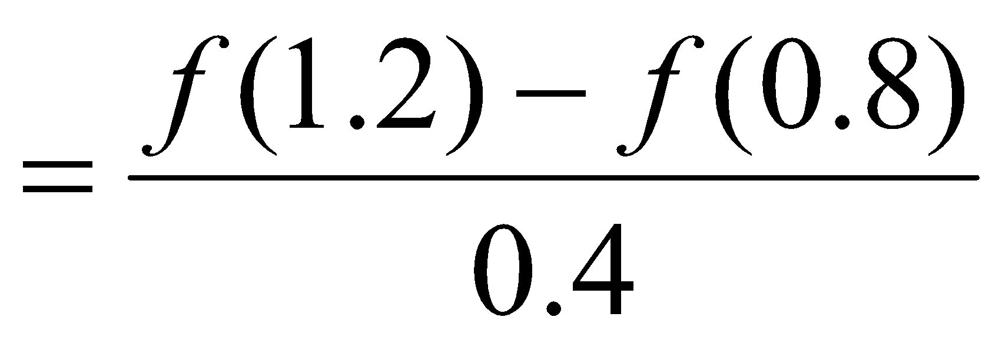
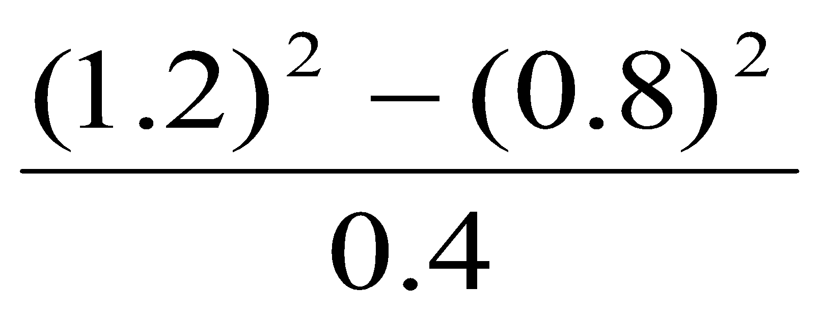
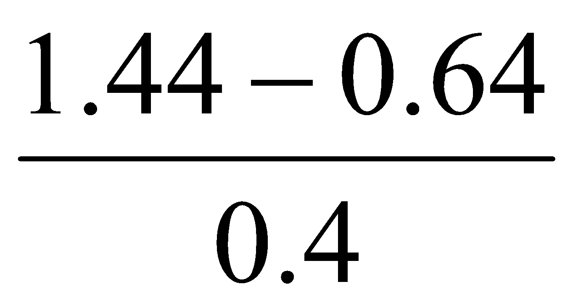
Numerical Differentiation
Example:
Estimate approximate derivative of f(x) = x² at x=1, for h = 0.2, 0.1, 0.05, 0.01 using the second-order central difference formula (or using the three-point formula).
Solution:
Consider h = 0.2:
= , Since f(x) = x².
= = 2.0
Thus, truncation error:
|Correct answer – Approximate answer|
= |2.0 – 2.0| = 0

Slide 14
Numerical Differentiation
Example:
Estimate approximate derivative of f(x) = x² at x=1, for h = 0.2, 0.1, 0.05, 0.01 using the second-order central difference formula (or using the three-point formula).
Solution:
Consider h = 0.1:
f / (1) = 2.0
Thus, truncation error = 0
Derivative for different values of h:
The derivative is exact for all values of h.
h | f /(1) | Error
0.2 | 2.0 | 0
0.1 | 2.0 | 0
0.05 | 2.0 | 0
0.01 | 2.0 | 0

Slide 15
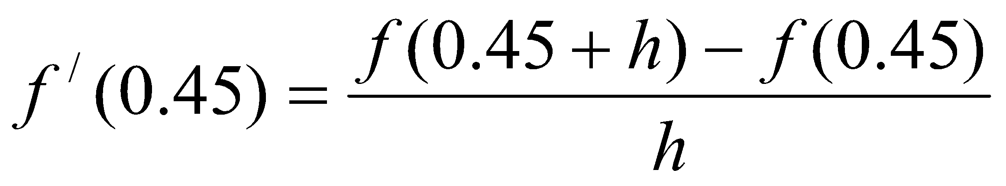
Numerical Differentiation
Example:
Compute the approximate derivatives of f(x) = sinx at x = 0.45 radians, at increasing values of h from 0.01 to 0.04 with a step size of 0.005. Analyze the variation of error in each step.
Solution:
Actual derivative of f(x) = sinx is cosx. That is, f /(x) = cosx
So, Correct answer at x = 0.45 radians is 0.9004
That is, f /(x) = cosx = cos(0.45) =0.9004
First-order forward difference formula:
At x = 0.45 radians,

Slide 16
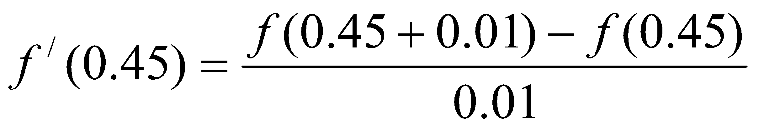
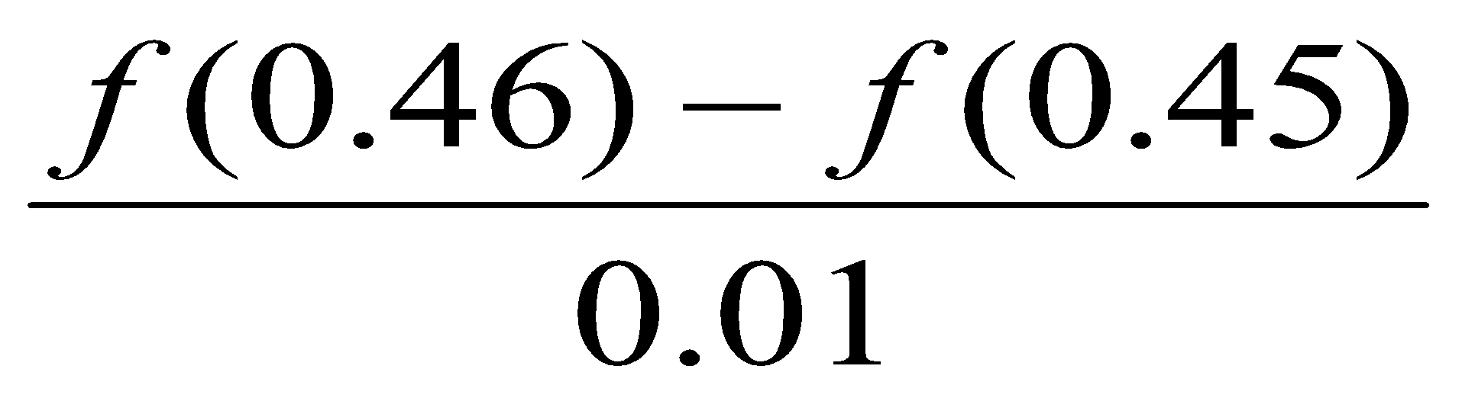
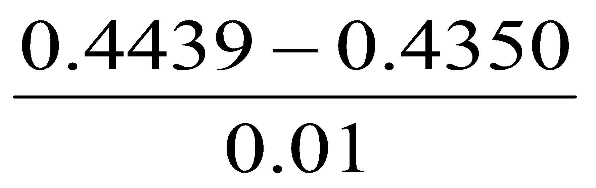
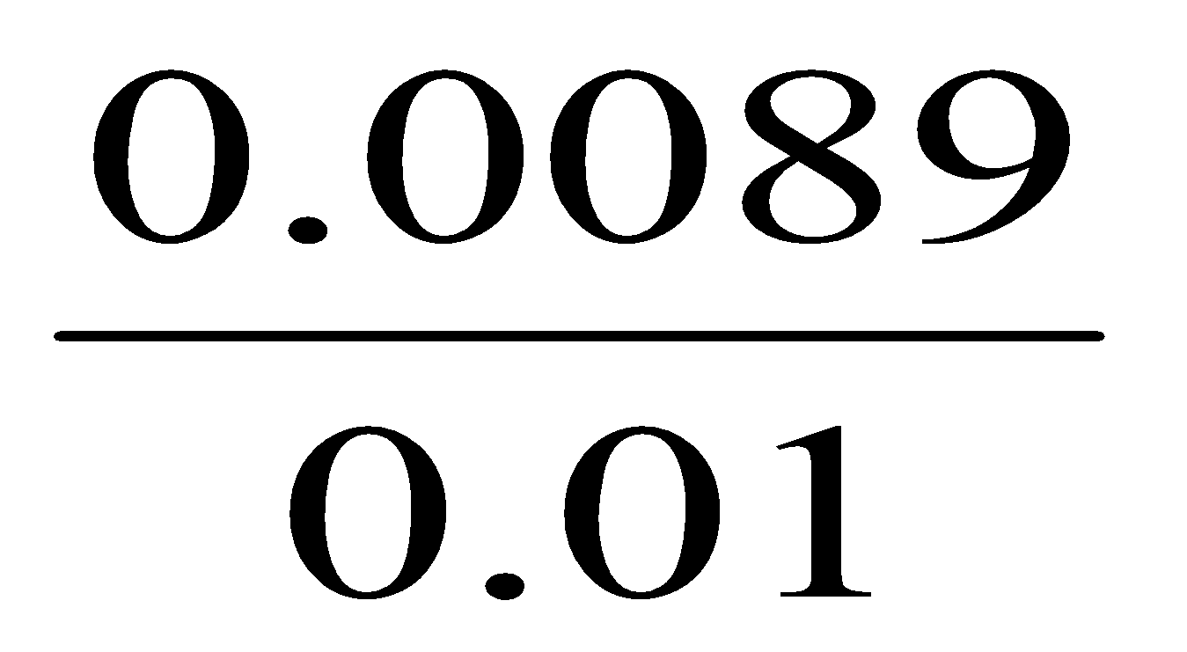
Numerical Differentiation
Example:
Compute the approximate derivatives of f(x) = sinx at x = 0.45 radians, at increasing values of h from 0.01 to 0.04 with a step size of 0.005. Analyze the variation of error in each step.
Solution:
Consider h = 0.01:
=
= , Since f(x) = sinx.
= = 0.89
Thus, truncation error:
|Correct answer – Approximate answer|
= |0.9004 – 0.8900| = 0.0104

Slide 17
Numerical Differentiation
Example:
Compute the approximate derivatives of f(x) = sinx at x = 0.45 radians, at increasing values of h from 0.01 to 0.04 with a step size of 0.005. Analyze the variation of error in each step.
Solution:
Derivative for different values of h:
Here step size = 0.005
The table shows that the total error decreases from 0.0104 (at h = 0.01) till h = 0.02 and again increases when h is increased.
h | f (x+h) | f /(x) | Error
0.010 | 0.4439 | 0.8900 | 0.0104
0.015 | 0.4484 | 0.8933 | 0.0071
0.020 | 0.4529 | 0.8950 | 0.0054
0.025 | 0.4573 | 0.8935 | 0.0069
0.030 | 0.4618 | 0.8933 | 0.0071
0.035 | 0.4662 | 0.8914 | 0.0090
0.040 | 0.4706 | 0.8900 | 0.0104

Slide 18
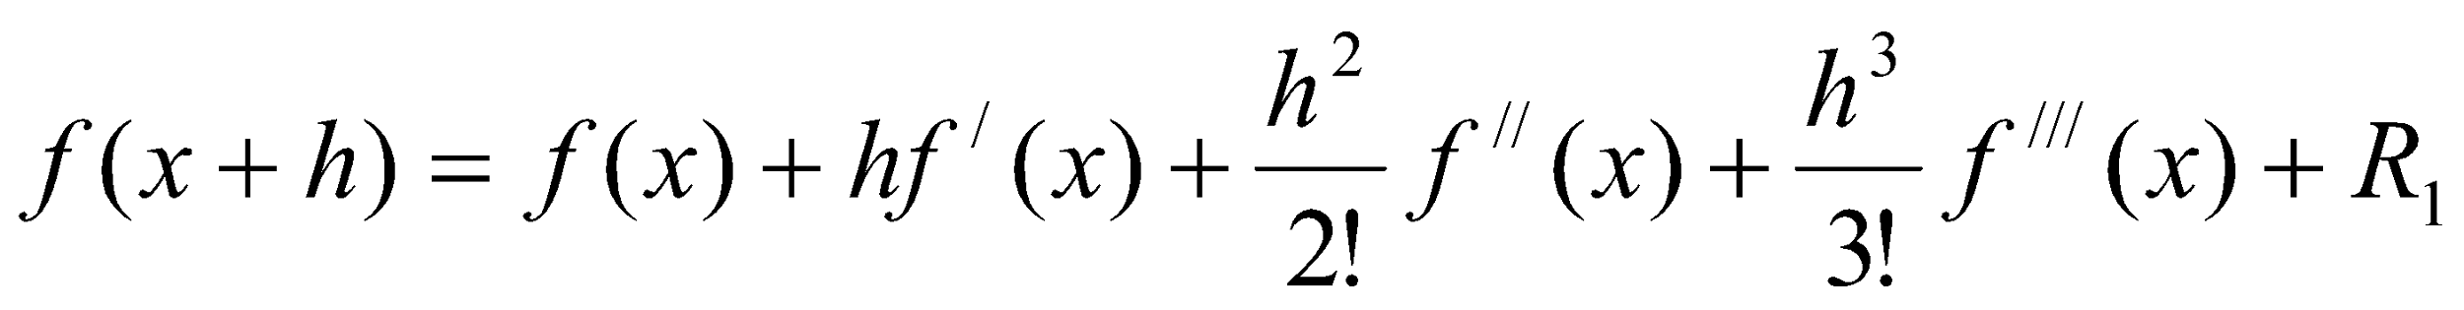
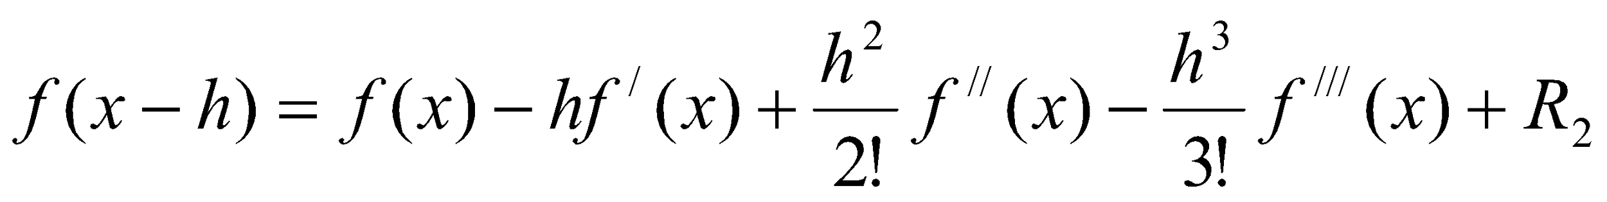
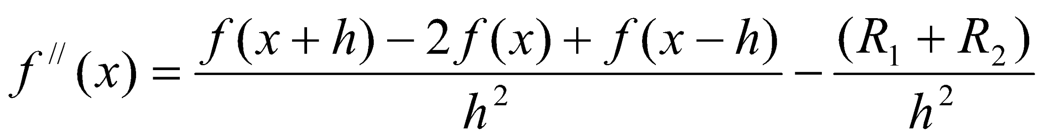
Numerical Differentiation
Higher-Order Derivatives
We can obtain approximations to higher-order derivatives using Taylor’s expansion. To illustrate this, we derive here the formula for f//(x). We know that
and
Adding these two expansions:

Slide 19
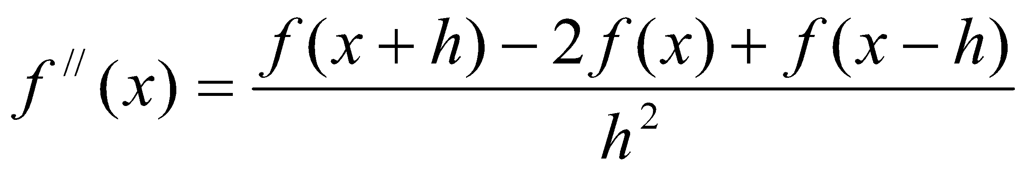
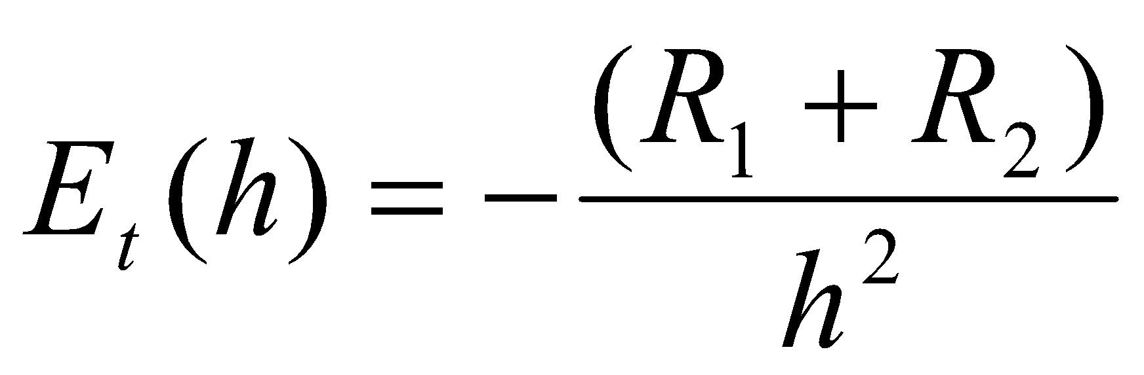
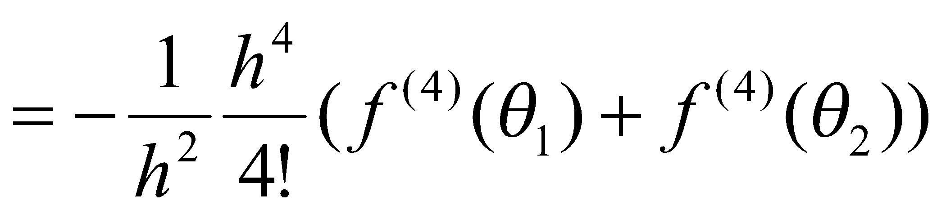
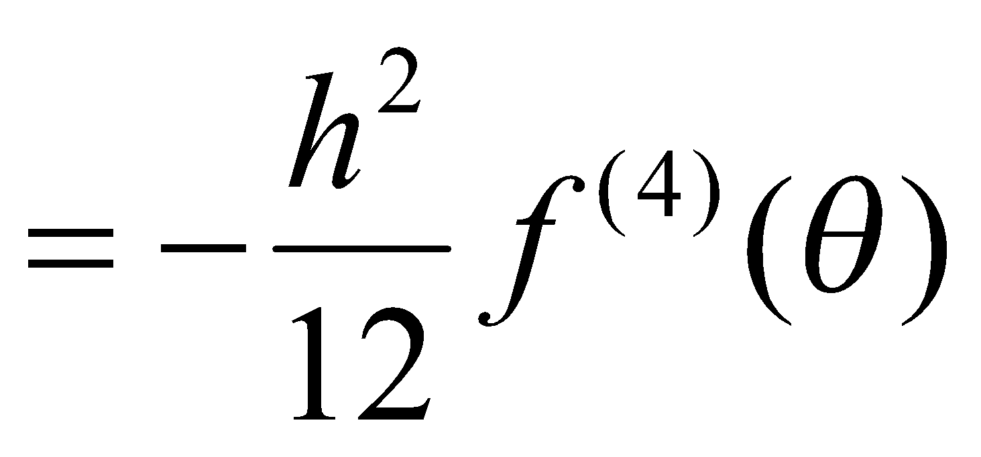
Numerical Differentiation
Higher-Order Derivatives
Thus, the approximation to second derivative is
The truncation error is
The error is of order h².

Slide 20
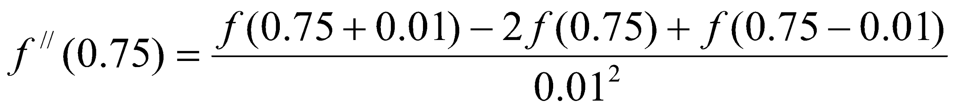
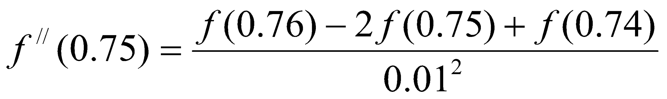
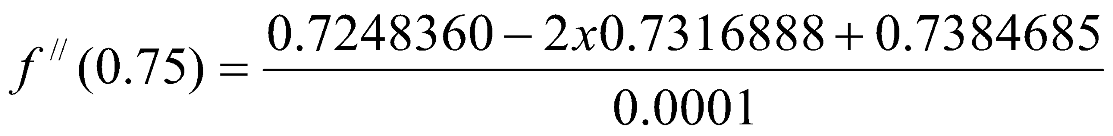

Numerical Differentiation
Example:
Find approximation to second derivative of cos(x) at x = 0.75 with h = 0.01. Compare with the true values.
Solution:
The approximation to second derivative is
Thus, at x = 0.75 with h = 0.01:

Slide 21
Numerical Differentiation
Example:
Find approximation to second derivative of cos(x) at x = 0.75 with h = 0.01. Compare with the true values.
Solution:
Exact value:
Error = -0.0016888
This error includes round-off error as well.

Slide 22
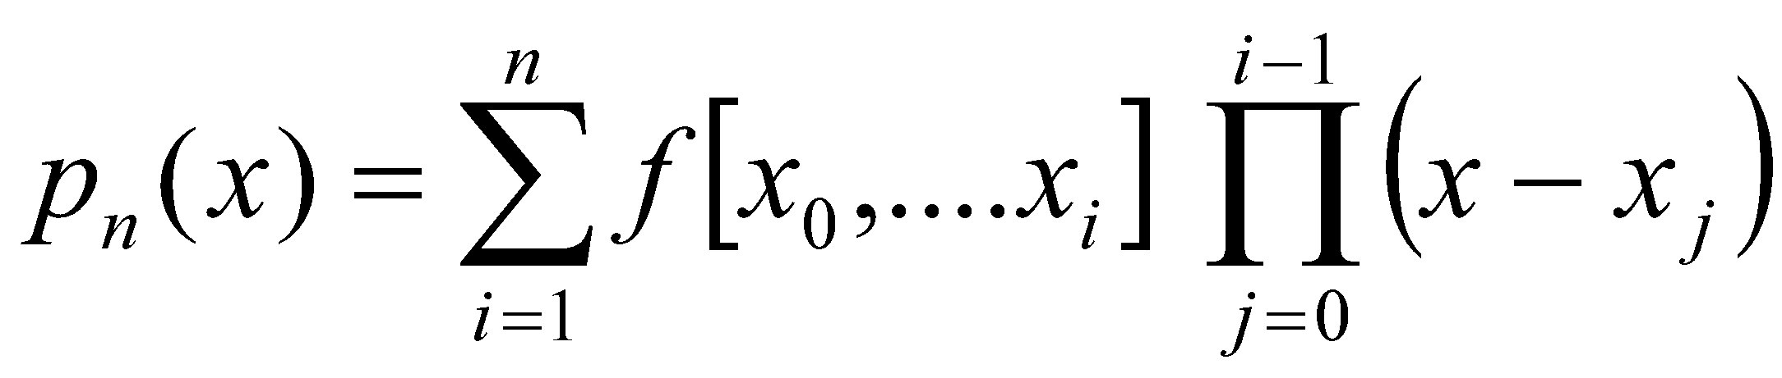
Numerical Differentiation
Differentiating Tabulated Functions
Suppose that we are given a set of data points (x_{i}, f_{i}), i = 0, 1, ……, n which corresponds to the values of an unknown function f(x) and we wish to estimate the derivatives at these points. Assume that these points are equally spaced with a step size of h.
When function values are available in tabulated form, we may approximate the function by an interpolation polynomial p(x). We will use here Newton’s divided difference interpolation polynomial.
p_{n}(x) = a₀ + a₁(x – x₀) + a₂(x – x₀)(x - x₁) + ……. + a_{n}(x – x₀)(x - x₁) …..
(x - x_{n-1})

Slide 23
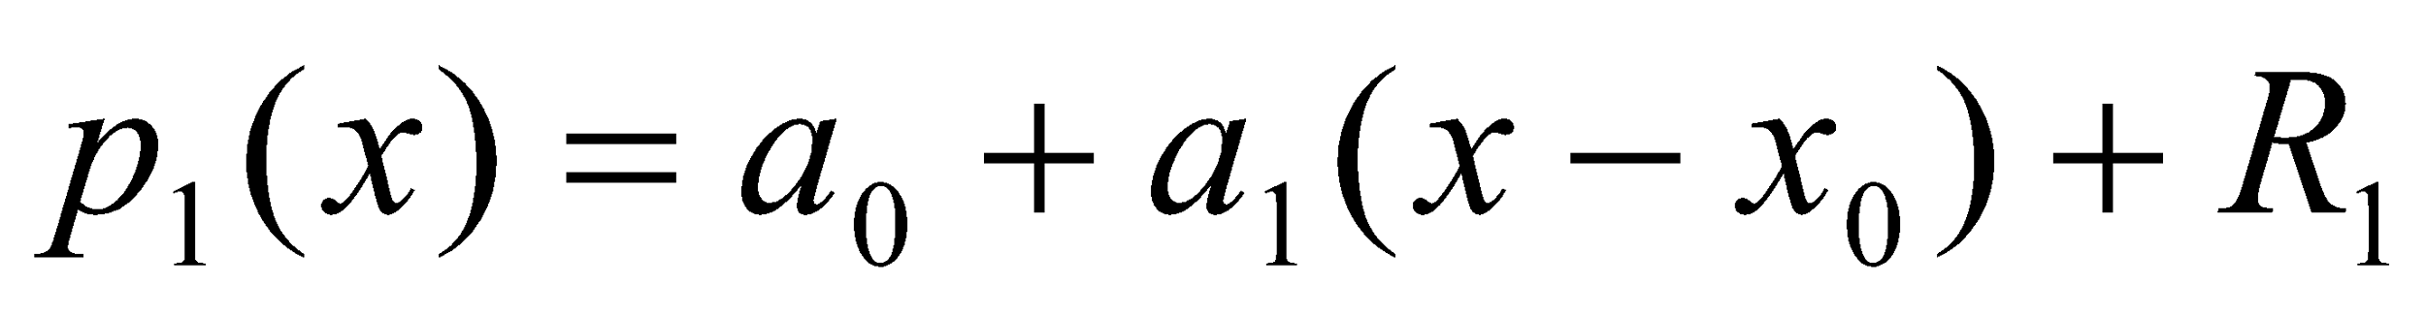
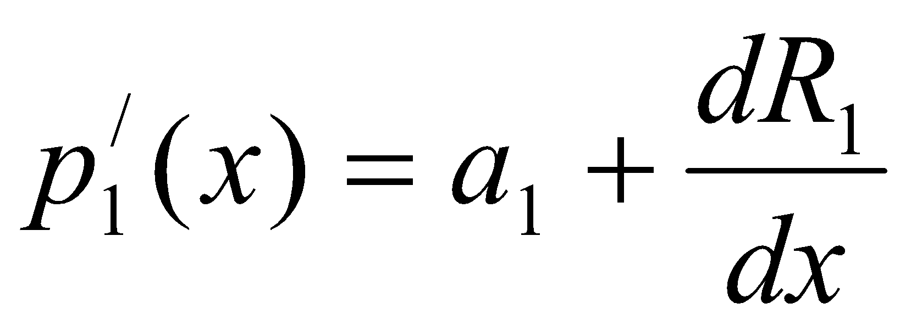
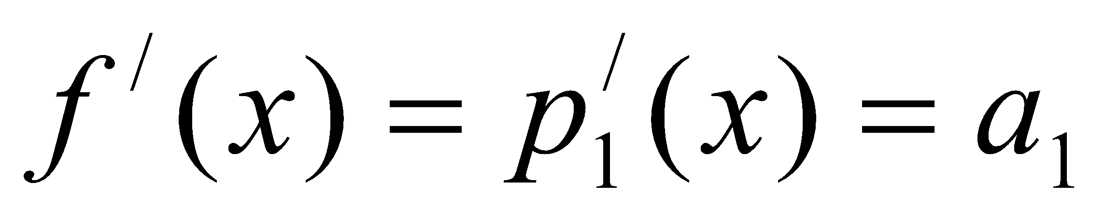
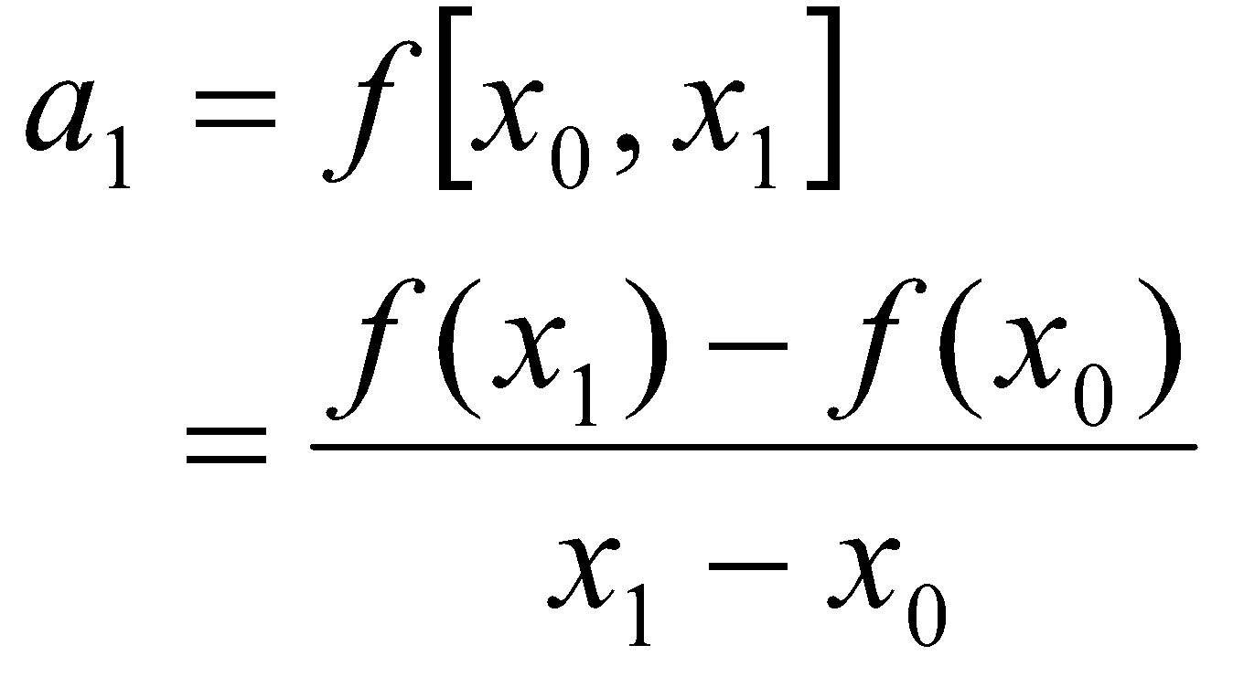
Numerical Differentiation
Differentiating Tabulated Functions
A. Let us first consider the linear equation:
Where R₁ is the remainder term used for estimation. Differentiating we obtain,
Then the approximate derivative of the function f(x) is given by,
We know that

Slide 24
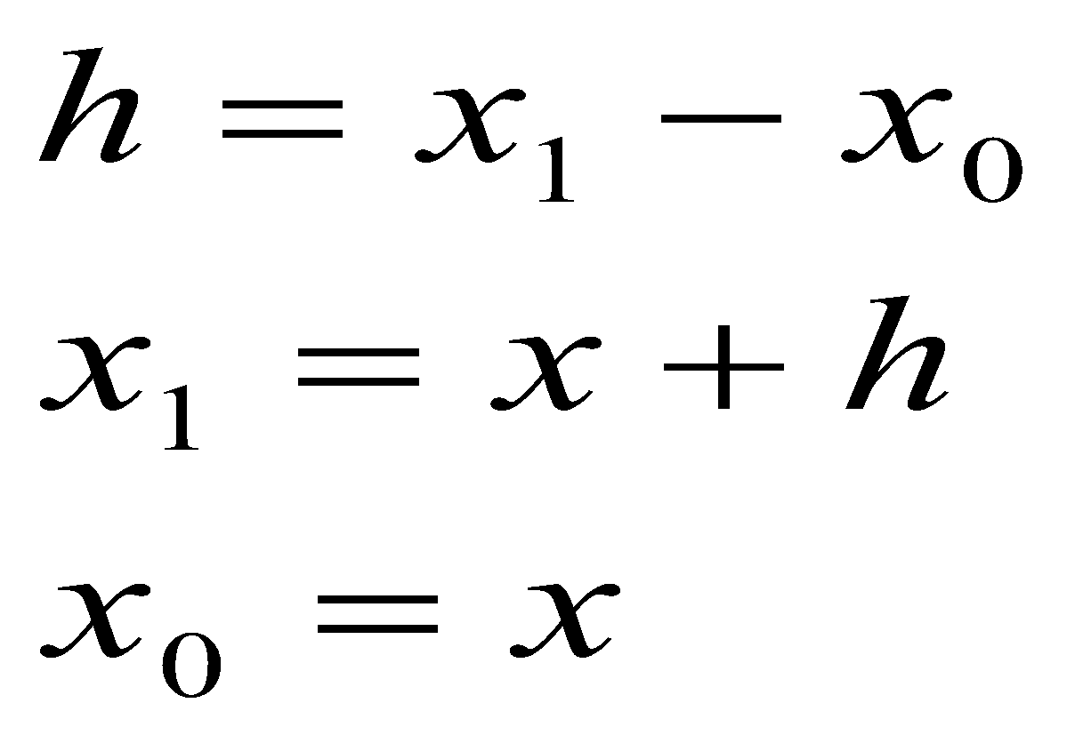
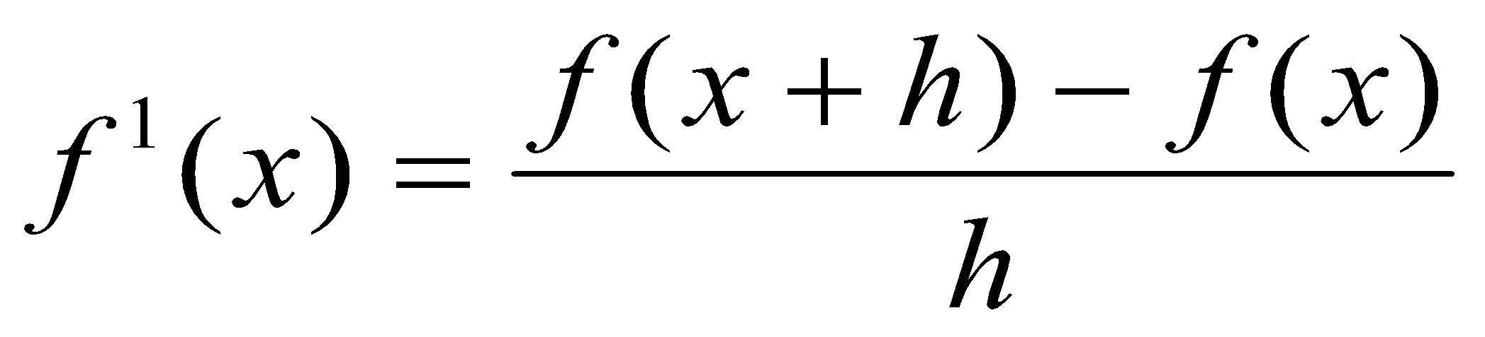
Numerical Differentiation
Differentiating Tabulated Functions
A. Let us first consider the linear equation:
On substituting
We get
This is two-point forward difference formula.

Slide 25
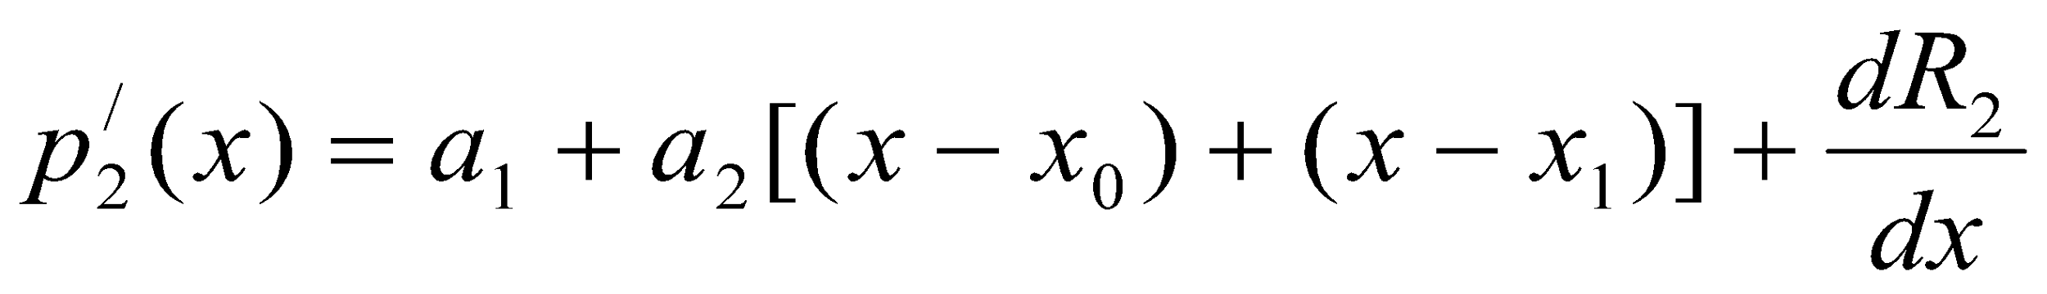
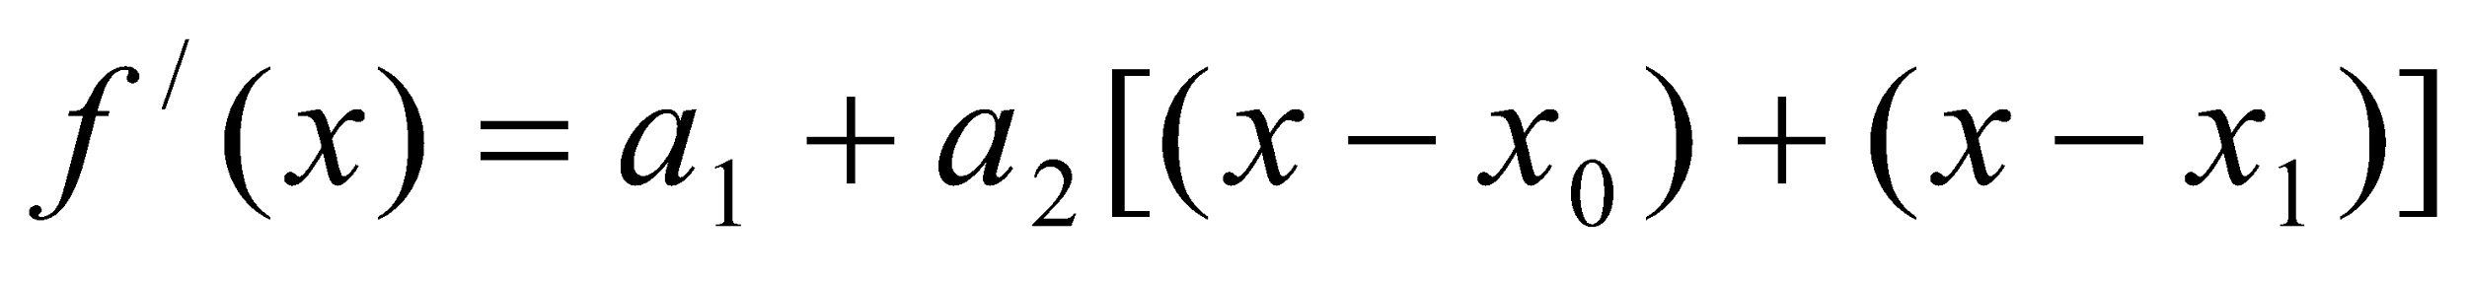
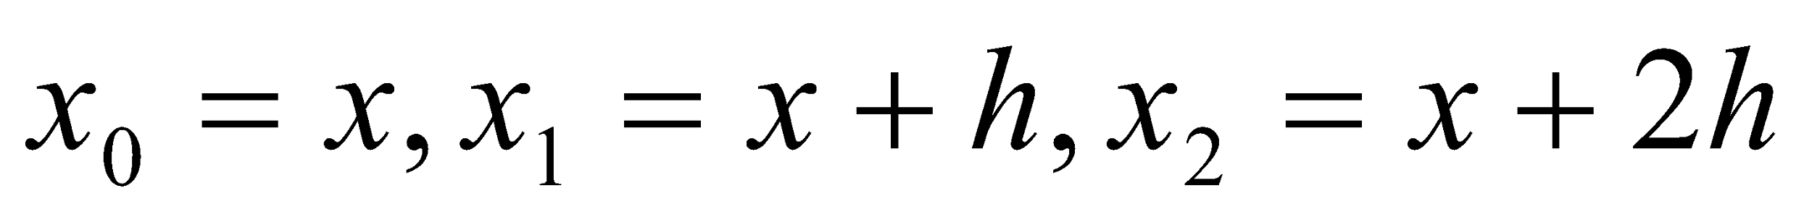
Numerical Differentiation
Differentiating Tabulated Functions
B. Now let us consider the quadratic approximation.
Here we need to use 3 points. Thus,
Then,
Thus, we obtain,
------------------ (1)
Let

Slide 26




Numerical Differentiation
Differentiating Tabulated Functions
B. Now let us consider the quadratic approximation.
Then,

Slide 27


Numerical Differentiation
Differentiating Tabulated Functions
B. Now let us consider the quadratic approximation.
Substituting for a₁ and a₂ in equation (1)
This is a three-point forward difference formula.
We can get a three-point backward difference formula by replacing h by –h. Therefore, the three-point backward difference formula is given by

Slide 28




Numerical Differentiation
Differentiating Tabulated Functions
C. Three-point central difference formula
Similarly we can obtain the three-point central difference formula by letting .
Substituting for a₁ and a₂ in equation (1)

Slide 29


Numerical Differentiation
Example
The values of distance travelled by a car at various time intervals are given in the following table. Estimate the velocity at time t = 5, t = 7 and t = 9.
Solution:
Velocity is given by the first derivative of s(t).
A. At t = 5, we can use the three-point forward difference formula:
Therefore,
Time, t(s) | 5 | 6 | 7 | 8 | 9
Distance travelled, s(t) (km) | 10.0 | 14.5 | 19.5 | 25.5 | 32.0

Slide 30


Numerical Differentiation
Example
The values of distance travelled by a car at various time intervals are given in the following table. Estimate the velocity at time t = 5, t = 7 and t = 9.
Solution:
Velocity is given by the first derivative of s(t).
B. At t = 7, we can use the central difference formula:
Therefore,
Time, t(s) | 5 | 6 | 7 | 8 | 9
Distance travelled, s(t) (km) | 10.0 | 14.5 | 19.5 | 25.5 | 32.0

Slide 31


Numerical Differentiation
Example
The values of distance travelled by a car at various time intervals are given in the following table. Estimate the velocity at time t = 5, t = 7 and t = 9.
Solution:
Velocity is given by the first derivative of s(t).
C. At t = 9, we can use the backward difference formula:
Therefore,
Time, t(s) | 5 | 6 | 7 | 8 | 9
Distance travelled, s(t) (km) | 10.0 | 14.5 | 19.5 | 25.5 | 32.0

