Slide 1
🚀
Amazon Prime: More Than Just Fast Shipping
Unpacking the Ecosystem of Benefits
Generated by ALL AI
1

Slide 2
📌 What is Amazon Prime?
A membership program by Amazon
Founded in 2005 to enhance customer loyalty
Offers a blend of shipping, entertainment, and shopping perks
Continuously evolving to add member value
2

Slide 3
⏳ Evolution of Prime Benefits
2022
Foundation
2023
Growth
2024
Expansion
2025
AI Era
3

Slide 4
⚖️ Prime vs. Non-Prime Shopper
Feature | Current | Future
Speed | Fast | Very Fast
Accuracy | 92% | 98%
Automation | Partial | Full
4

Slide 5
📊 Membership Growth & Engagement
Global Prime Members
US Amazon Orders from Prime Members
Average Annual Spend per Prime Member
5

Slide 6
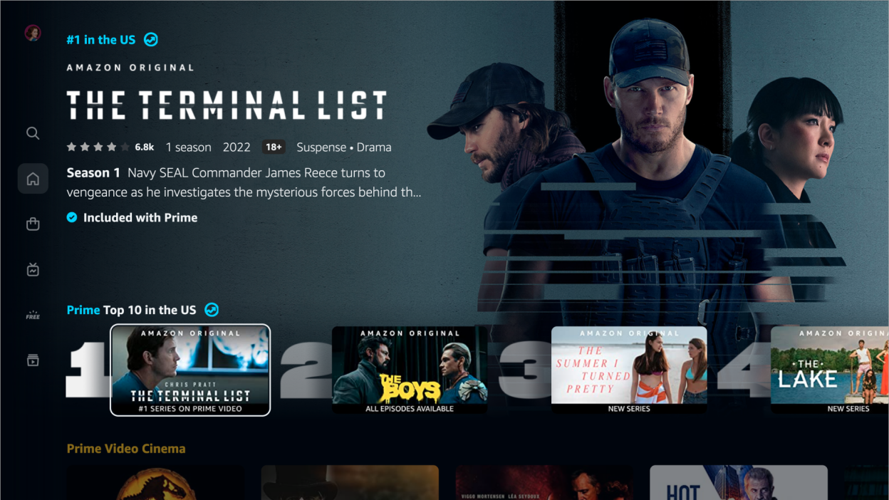
📌 The Entertainment Powerhouse
Prime Video: Award-winning originals and popular movies/TV shows
Prime Music: Millions of ad-free songs and podcasts
Twitch Prime: Free games and in-game content
Prime Reading: Access to a rotating selection of books, magazines, and comics
6

Slide 7
📌 Prime Benefits Usage Breakdown
7

Slide 8
📌 Prime: A Transformative Membership
From shipping to a complete lifestyle ecosystem
Unparalleled value for its subscription fee
Drives customer loyalty and Amazon's market dominance
The future of integrated online services
8

