Slide 1
ALL AI
1

Slide 2
The Genesis of an Idea (Early Concepts)
1943
Warren McCulloch and Walter Pitts publish 'A Logical Calculus of Ideas Immanent in Nervous Activity', proposing the first mathematical model of an artificial neuron.
1950
Alan Turing publishes 'Computing Machinery and Intelligence', introducing the Turing Test and proposing the question 'Can machines think?'
1955
Allen Newell, Herbert Simon, and J.C. Shaw develop the Logic Theorist, considered the first AI program.
1956
The Dartmouth Workshop coins the term 'Artificial Intelligence', marking the formal birth of the field.
ALL AI
3

Slide 3
Early AI Approaches: Symbolic vs. Connectionist
Symbolic AI (GOFAI)
Connectionist AI (Neural Networks)
Emphasizes logical reasoning and rules.
Inspired by biological neural networks.
Relies on explicit knowledge representation.
Learns from data through pattern recognition.
Good for well-defined problems and expert systems.
Effective for complex, fuzzy problems like image recognition.
ALL AI
4

Slide 4

The AI Winters and Resurgences
• Periods of reduced funding and interest due to unmet expectations.
• Early enthusiasm often outpaced computational power and algorithms.
• Key breakthroughs and advancements re-ignited the field.
Conceptual illustration of an AI Winter.

Slide 5
Milestones in Machine Learning and Deep Learning
1980s
Resurgence of neural networks with backpropagation algorithm.
1997
IBM's Deep Blue defeats chess Grandmaster Garry Kasparov.
2011
IBM's Watson wins Jeopardy!, showcasing natural language processing.
2012
AlexNet wins ImageNet competition, marking a breakthrough in deep learning for computer vision.
ALL AI
3

Slide 6
The Exponential Growth of AI Capabilities
2.3x
500M+
$150B+
Increase in AI publications (2010-2020)
AI patents filed globally
Global AI market size projected (2023)

Slide 7
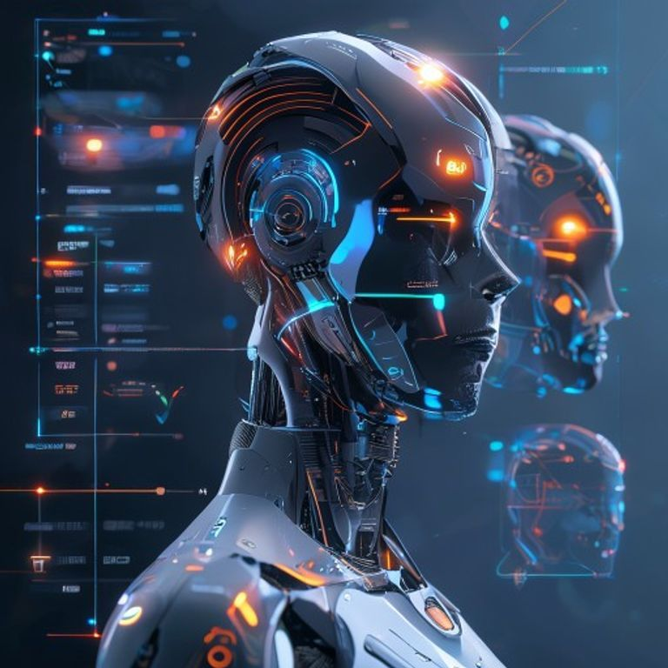
The Age of AI: Modern Applications
• Natural Language Processing (LLMs)
• Computer Vision
• Robotics and Autonomous Systems
• Personalized Recommendations
• Healthcare Diagnostics
Diverse modern AI applications.

Slide 8
The Future of AI
Continued advancements in deep learning and unsupervised learning.
Focus on AI ethics, safety, and explainability.
AI poised to revolutionize every industry and aspect of life.
Thank You
ALL AI
8

