Slide 1
The Evolution of Artificial Intelligence
From Turing's Vision to Generative Frontiers
AI Generated Presentation
Powered by ALL AI
ALL AI
1

Slide 2
Key Milestones in AI History
1950
1956
1997
2011
2012
2017
2020s
Alan Turing proposes the Turing Test, a benchmark for machine intelligence.
The Dartmouth Workshop coins the term 'Artificial Intelligence'.
IBM's Deep Blue defeats Garry Kasparov in chess, a symbolic AI win.
IBM Watson wins Jeopardy!, showcasing natural language processing capabilities.
Deep learning gains traction with AlexNet's image recognition breakthrough.
Google's AlphaGo Zero masters Go without human data.
Rise of Generative AI models like GPT and DALL-E.
ALL AI

Slide 3
Early AI vs. Modern AI
Early AI (Symbolic AI)
Modern AI (Machine Learning)
• Rule-based systems
• Expert systems
• Limited scope and adaptability
• Manual feature engineering
• Data-driven learning
• Neural networks & Deep learning
• Broad capabilities and self-improvement
• Automatic feature learning
ALL AI

Slide 4
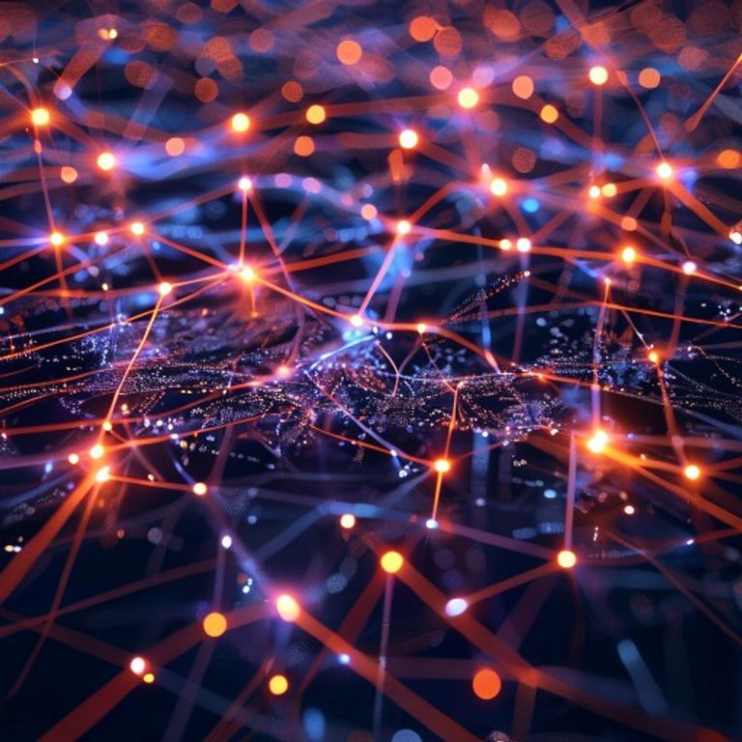
The Power of Deep Learning
• Inspired by the human brain's structure.
• Enables machines to learn from vast datasets.
• Revolutionized image, speech, and natural language processing.
Conceptual representation of a neural network.
ALL AI

Slide 5
Growth in AI Investment
$150+
25%
10x
Billion invested globally in AI (estimated 2023)
Annual growth rate in AI market
Increase in AI patent filings since 2015
Key metrics showing industry growth and adoption
ALL AI

Slide 6
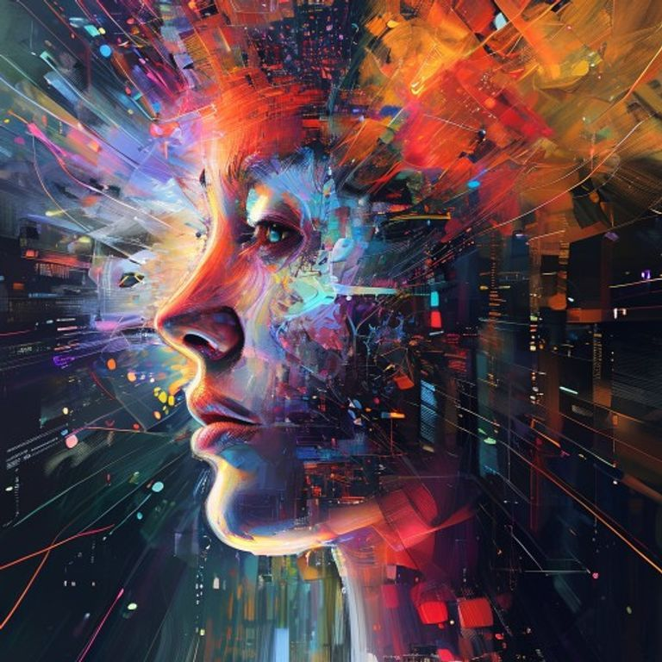
The Generative AI Revolution
• Creating novel content: text, images, music, code.
• Models like GPT-3, DALL-E, and Midjourney.
• Transforming creative industries, customer service, and R&D.
AI generating diverse creative outputs.
ALL AI

Slide 7
“
The key impact of AI will be to augment human intelligence, not replace it.
— Satya Nadella
Innovation begins with ideas that transform the future.
ALL AI

Slide 8
Looking Ahead
✓ AI continues its rapid, transformative journey.
✓ The ethical implications and societal impact are paramount.
✓ The future promises deeper integration and unprecedented possibilities.
Thank You
ALL AI

