Slide 1
ALL AI
1

Slide 2
A Journey Through Time: Key Milestones
1950s
Concept of time-sharing emerges, allowing multiple users to access a single mainframe.
1960s
J.C.R. Licklider envisions an 'Intergalactic Computer Network' – a precursor to the internet and cloud.
1990s
The World Wide Web gains traction, paving the way for web-based services.
1999
Salesforce launches, pioneering the Software as a Service (SaaS) model.
2002
Amazon Web Services (AWS) launches, offering commercial web services.
2006
AWS introduces Elastic Compute Cloud (EC2) and Simple Storage Service (S3), marking the rise of IaaS.
2008
Google App Engine launches, popularizing Platform as a Service (PaaS).
ALL AI
3
2010s-Present
Widespread adoption of public, private, and hybrid cloud models; emergence of serverless computing and AI integration.

Slide 3
On-Premise vs. Cloud: A Paradigm Shift
On-Premise Infrastructure
Cloud Computing
High upfront capital investment
Pay-as-you-go service model
Manual hardware maintenance and upgrades
Managed infrastructure by providers
Limited scalability and flexibility
Scalability and elasticity on demand
Higher operational costs for underutilized resources
Reduced total cost of ownership (TCO)
ALL AI
4

Slide 4
The Cloud's Explosive Growth
$624
94%
70%
Billion: Estimated Cloud Computing Market Size in 2024
Of enterprises have already adopted some form of cloud service.
Of organizations are adopting a multi-cloud strategy.

Slide 5
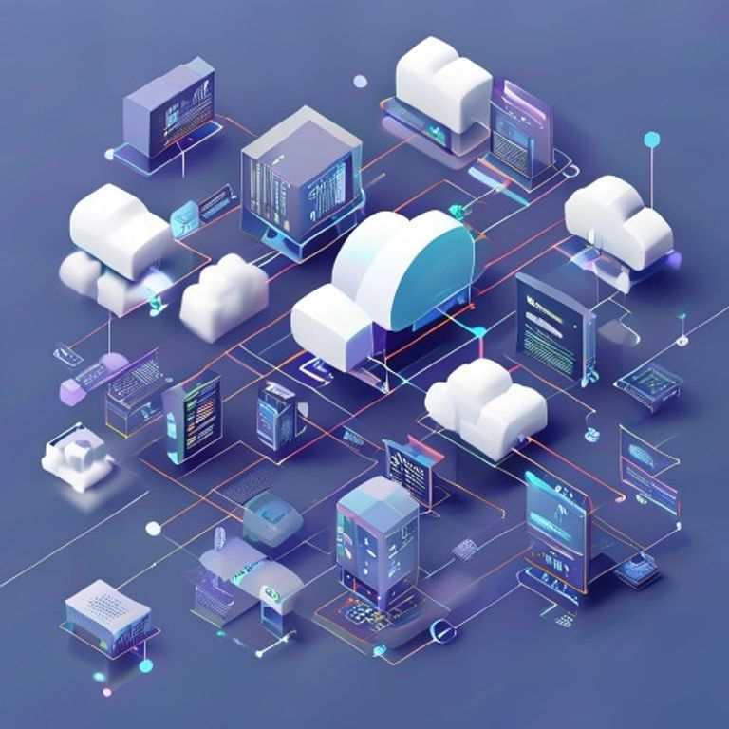
The Pillars of Cloud Computing
• Infrastructure as a Service (IaaS): Virtualized computing resources.
• Platform as a Service (PaaS): Environment for developing and deploying applications.
• Software as a Service (SaaS): Ready-to-use applications delivered over the internet.
Conceptual diagram of cloud service models

Slide 6
“
The cloud is not a place, it's a way of computing.
— Unknown

Slide 7
The Future is Cloudy: Trends and Innovations
Hybrid and Multi-Cloud adoption continues to rise.
Edge Computing brings processing closer to data sources.
Serverless computing for enhanced efficiency and cost savings.
AI and Machine Learning are deeply integrated into cloud services.
ALL AI
2

Slide 8
Conclusion: A Foundation for Innovation
Cloud computing has revolutionized how we store, process, and access information.
It offers unprecedented scalability, flexibility, and cost-efficiency.
The ongoing evolution of cloud technologies will continue to drive digital transformation across all industries.
Thank You
ALL AI
8

