Slide 1
OpenAI
Shaping the Future of Artificial Intelligence
AI Generated Presentation
Powered by ALL AI
ALL AI
1

Slide 2
Agenda
🤖
OpenAI: A Brief History
•
Core Technologies & Innovations
•
The Power of GPT Models
•
GPT-3 vs. GPT-4
•
Global Impact and Adoption
•
The Road Ahead
ALL AI

Slide 3
OpenAI: A Brief History
2015
2018
2019
2020
2022
2022
2023
Founded by Elon Musk, Sam Altman, and others with a mission for safe AGI.
Release of GPT-1, showcasing powerful language generation capabilities.
Transition to a capped-profit structure to attract investment.
Launch of GPT-3, setting new benchmarks in natural language understanding and generation.
Introduction of DALL-E 2, revolutionizing AI image generation.
Public release of ChatGPT, bringing advanced AI conversation to millions.
GPT-4 launch, demonstrating enhanced multimodal capabilities and reasoning.
ALL AI

Slide 4
Core Technologies & Innovations
🤖
Generative Pre-trained Transformers (GPT) for language.
•
Diffusion models for image generation (DALL-E).
•
Reinforcement Learning (RL) for complex tasks.
🤖
Focus on safety, alignment, and ethical AI development.
ALL AI

Slide 5
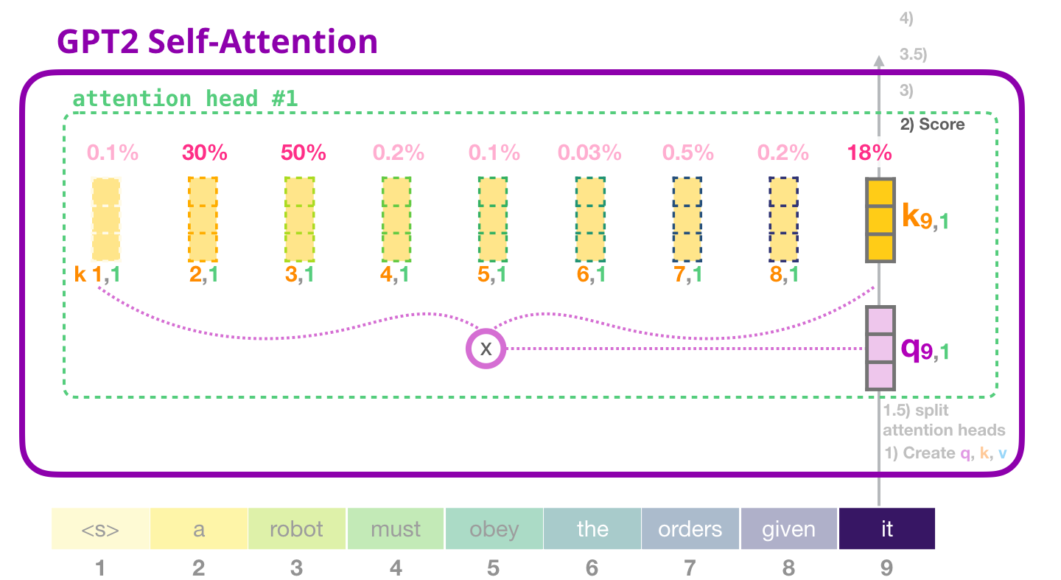
The Power of GPT Models
•
Advanced text generation and summarization.
•
Code generation and debugging.
•
Creative writing and content creation.
🤖
Personalized learning and tutoring aids.
Abstract representation of GPT neural network layers.
ALL AI

Slide 6
GPT-3 vs. GPT-4
GPT-3
GPT-4
✕
Strong text generation.
✓
Multimodal input (text and image).
✕
Understands and generates human-like text.
✓
Superior reasoning and problem-solving.
✕
Widely adopted for diverse applications.
✓
Enhanced creativity and nuance.
✓
More reliable and steerable outputs.
ALL AI

Slide 7
Global Impact and Adoption
100M+
1000+
1.5B+
Weekly ChatGPT Users
API Customers
API Requests Per Day
Key metrics highlight market adoption and business impact.
Growth Trend
ALL AI

Slide 8
“
Our mission is to ensure that artificial general intelligence benefits all of humanity.
— OpenAI Mission Statement
Innovation begins with ideas that transform the future.
ALL AI

Slide 9
The Road Ahead
✓ Continued advancement of AI capabilities.
✓ Emphasis on AI safety and alignment.
✓ Democratizing access to powerful AI tools.
✓ Shaping a future where AI empowers humanity.
Thank You
ALL AI

