Slide 1
Our Solar System
A Journey Through Our Cosmic Neighborhood
AI Generated Presentation
Powered by ALL AI
ALL AI
1

Slide 2
What is the Solar System?
A star, the Sun, and everything that orbits it.
Includes planets, dwarf planets, moons, asteroids, and comets.
Held together by gravity.
A dynamic and ever-changing environment.
ALL AI
2
ALL AI

Slide 3
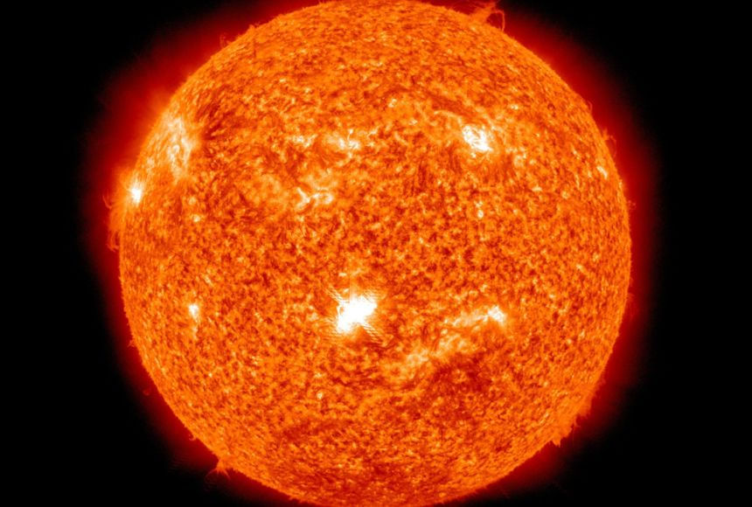
The Sun: Our Star
• A giant ball of hot gas.
• Provides light and heat essential for life on Earth.
• Source of solar winds and magnetic fields.
• Its immense gravity holds the solar system together.
The Sun, our central star

Slide 4
The Planets: A Cosmic Family
Mercury
Closest to the Sun, smallest planet, rocky surface.
Venus
Hottest planet, thick atmosphere, similar size to Earth.
Earth
Our home, supports liquid water and life.
Mars
The Red Planet, potential for past life.
Jupiter
Largest planet, gas giant, Great Red Spot.
Saturn
Famous for its prominent rings, gas giant.
Uranus
Ice giant, rotates on its side.
ALL AI
3
Neptune
Farthest planet, ice giant, strong winds.

Slide 5
Rocky vs. Gas Giants
Inner Planets (Rocky)
Outer Planets (Gas/Ice Giants)
Mercury, Venus, Earth, Mars
Jupiter, Saturn, Uranus, Neptune
Smaller, denser, solid surfaces
Larger, less dense, gaseous/icy composition
Fewer moons, no rings
Many moons, distinct ring systems
ALL AI
4
ALL AI

Slide 6
Beyond the Planets
Over 200
Millions
Hundreds of Billions
Known Moons
Asteroids
Comets (in the Oort Cloud)
ALL AI

Slide 7
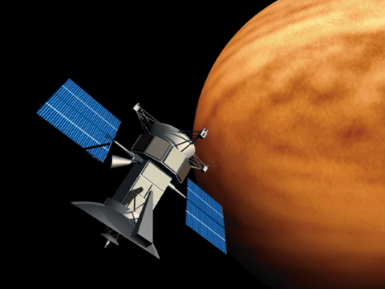
Exploring Our Solar System
• Robotic missions have visited all planets.
• Probes gather data on composition, atmosphere, and geology.
• Hubble and James Webb Space Telescopes provide distant views.
• Ongoing search for exoplanets and signs of life.
Robotic explorers venturing into space

Slide 8
Our Place in the Cosmos
A vast and wondrous system.
Continually being explored and understood.
The Solar System is our home, connecting us to the universe.
Thank You
ALL AI
8
ALL AI

