Slide 1
Class Diagram
DormNorm
Presented By : Sumaiya Sultana
ID : 1805079

Slide 2
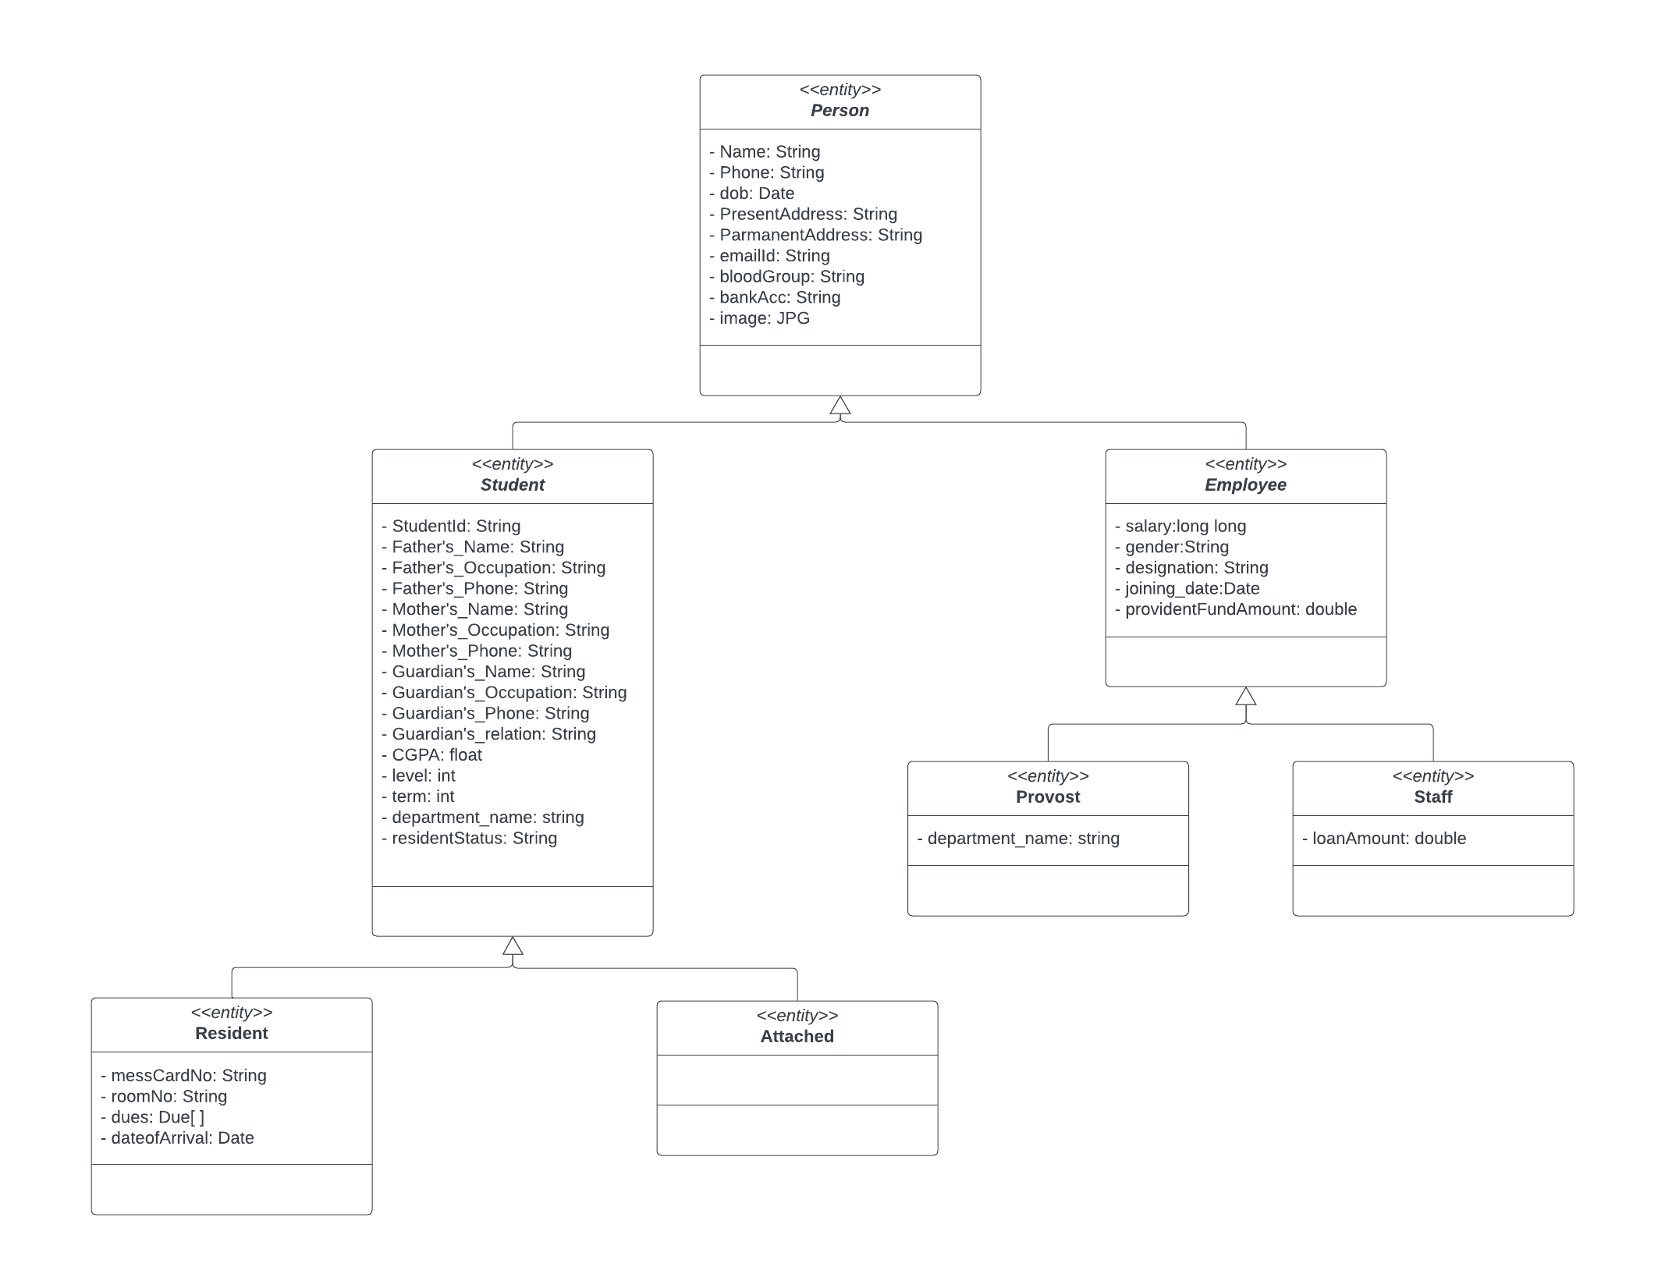
Person :

Slide 3
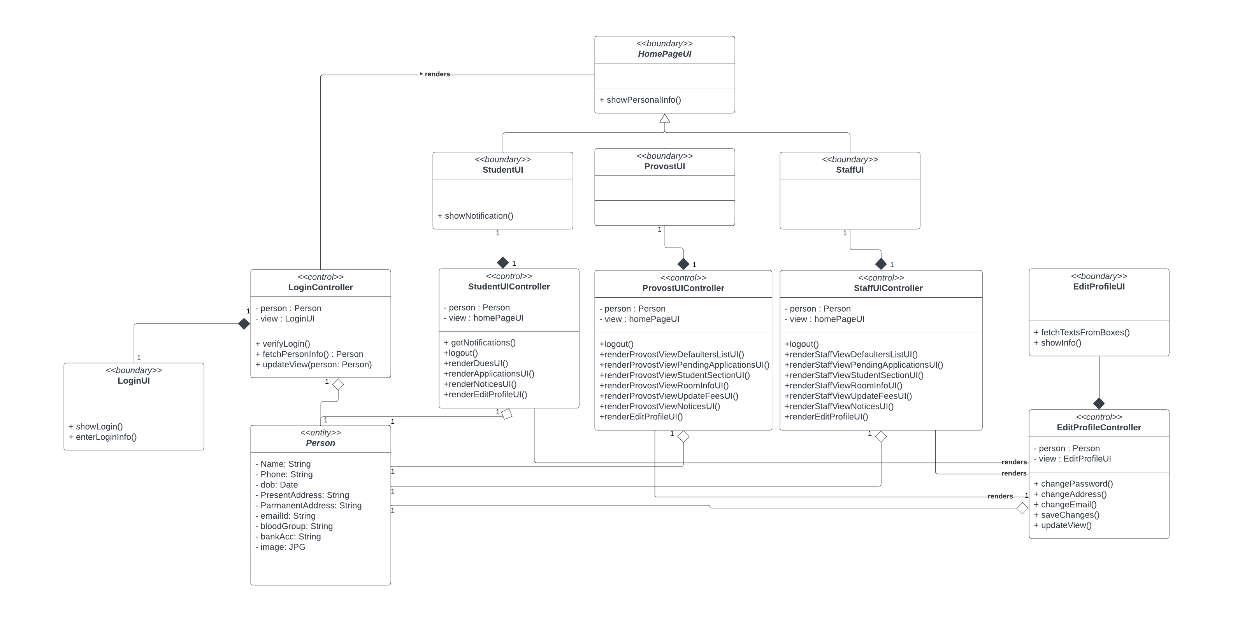
Login and Edit Profile :

Slide 4
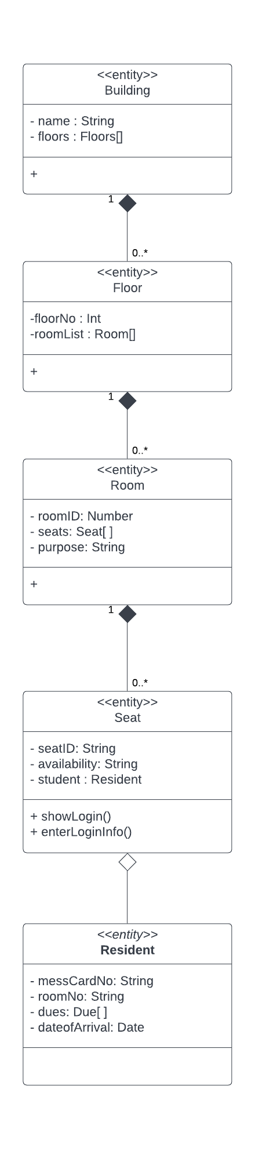
Hall Infrastructure :

Slide 5
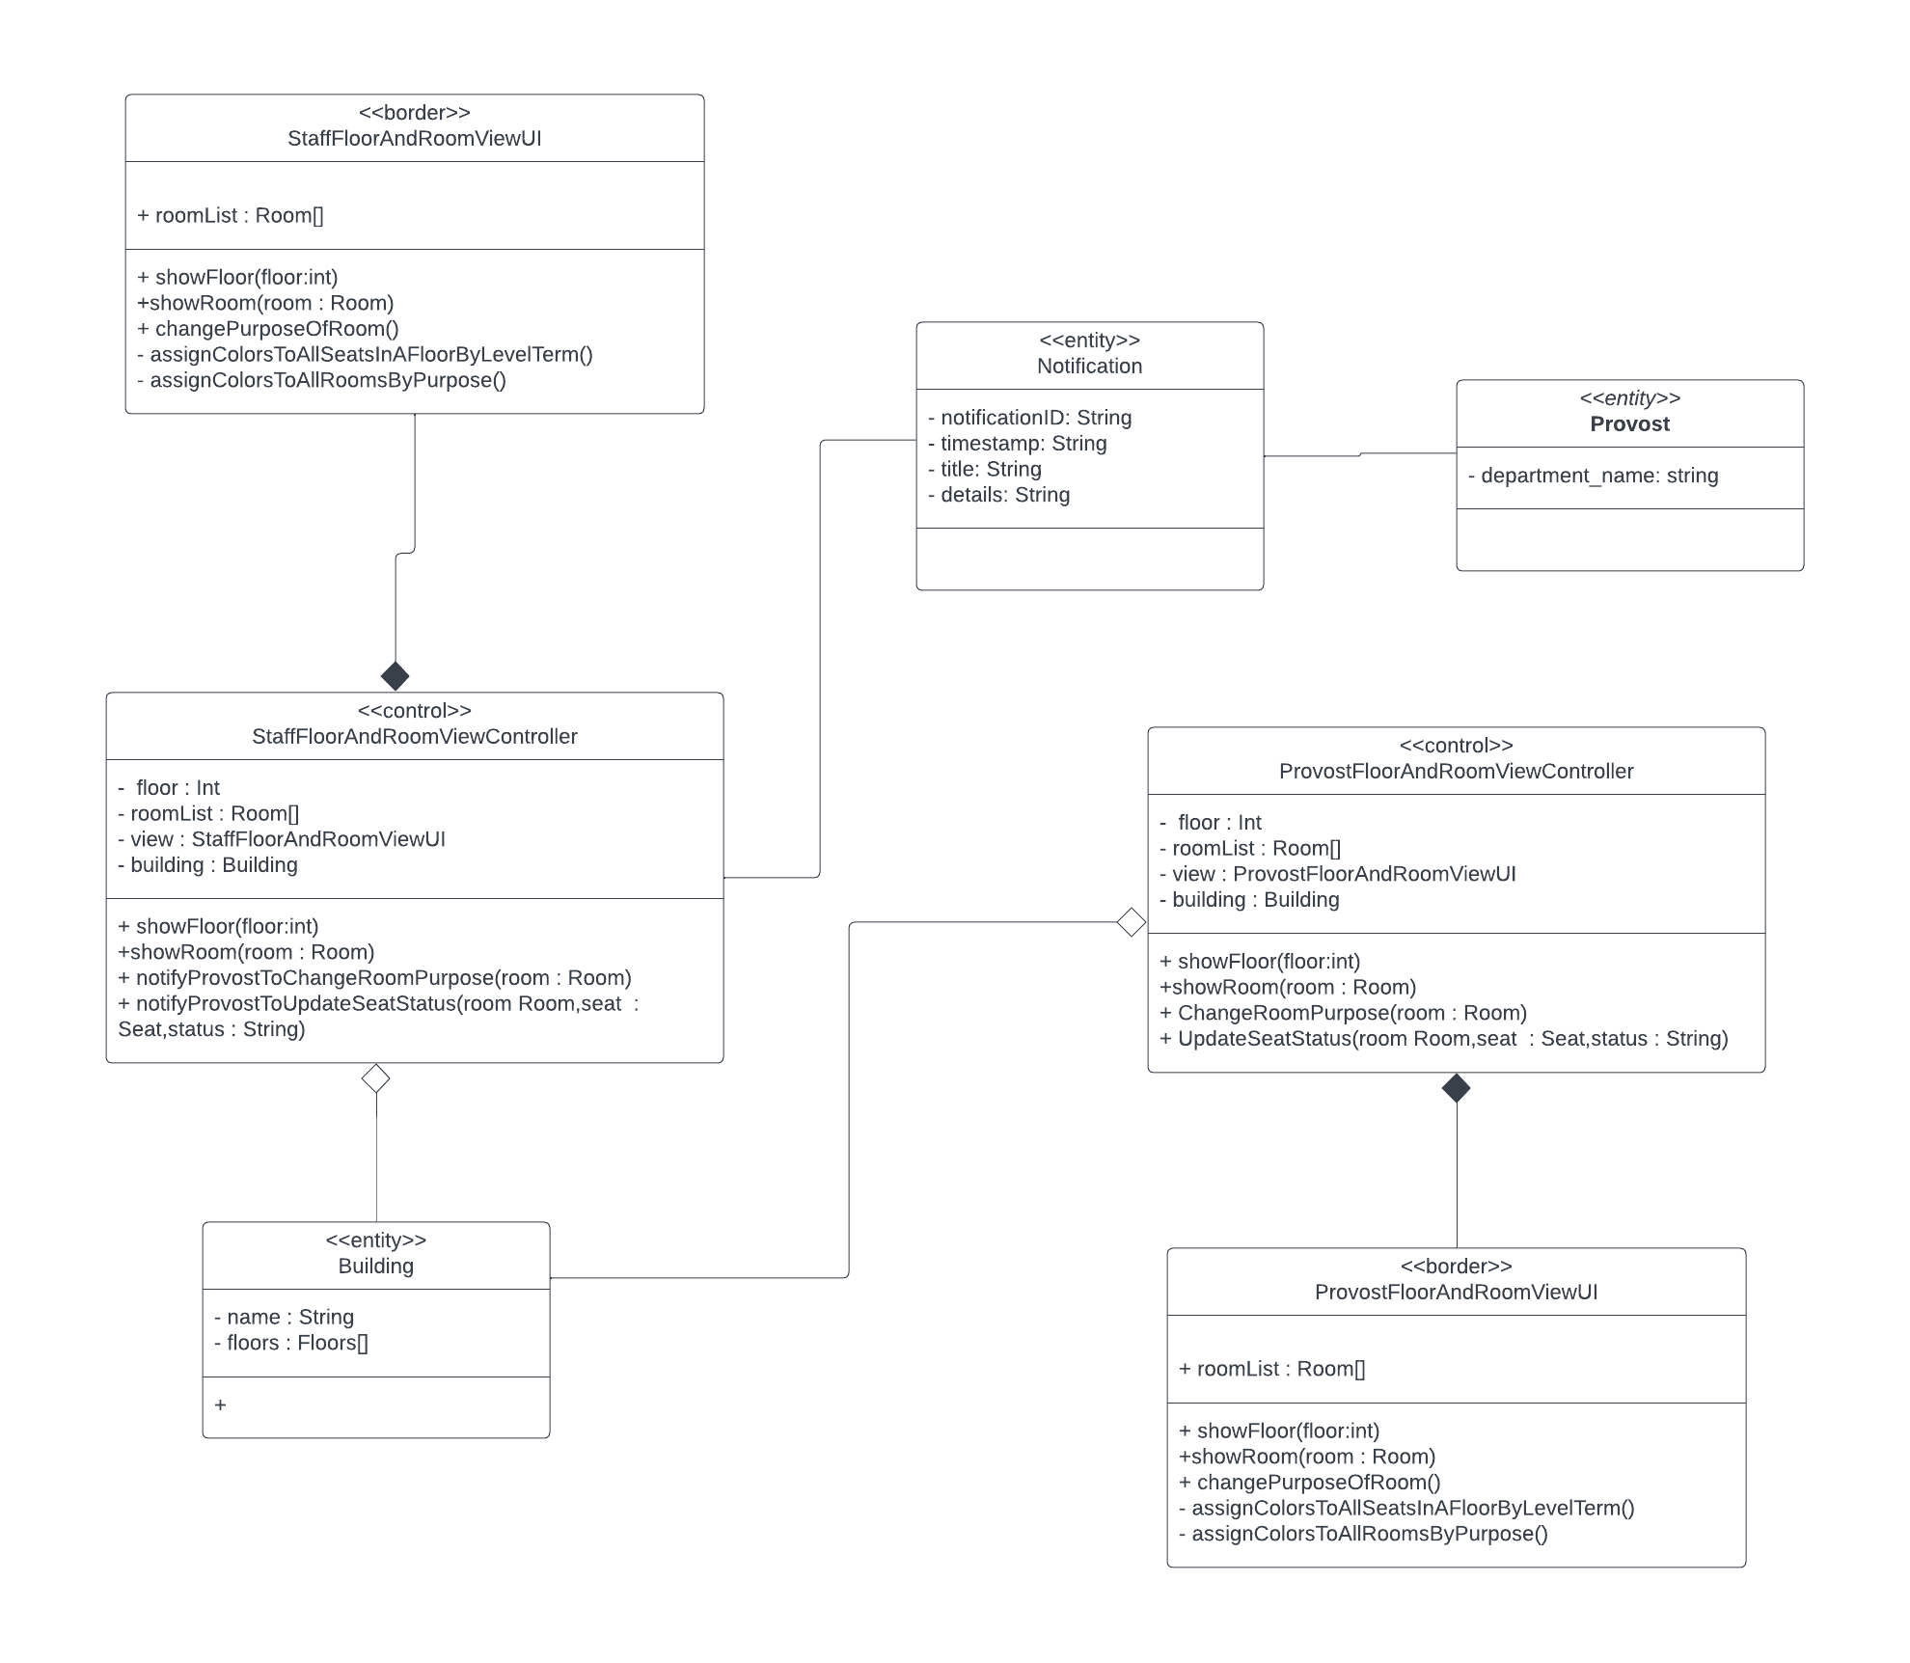
Room Management And Floor Map View:

Slide 6
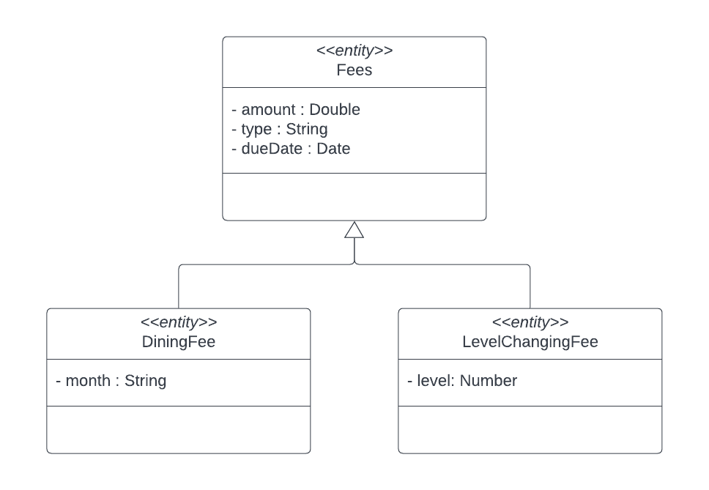
Fees :

Slide 7
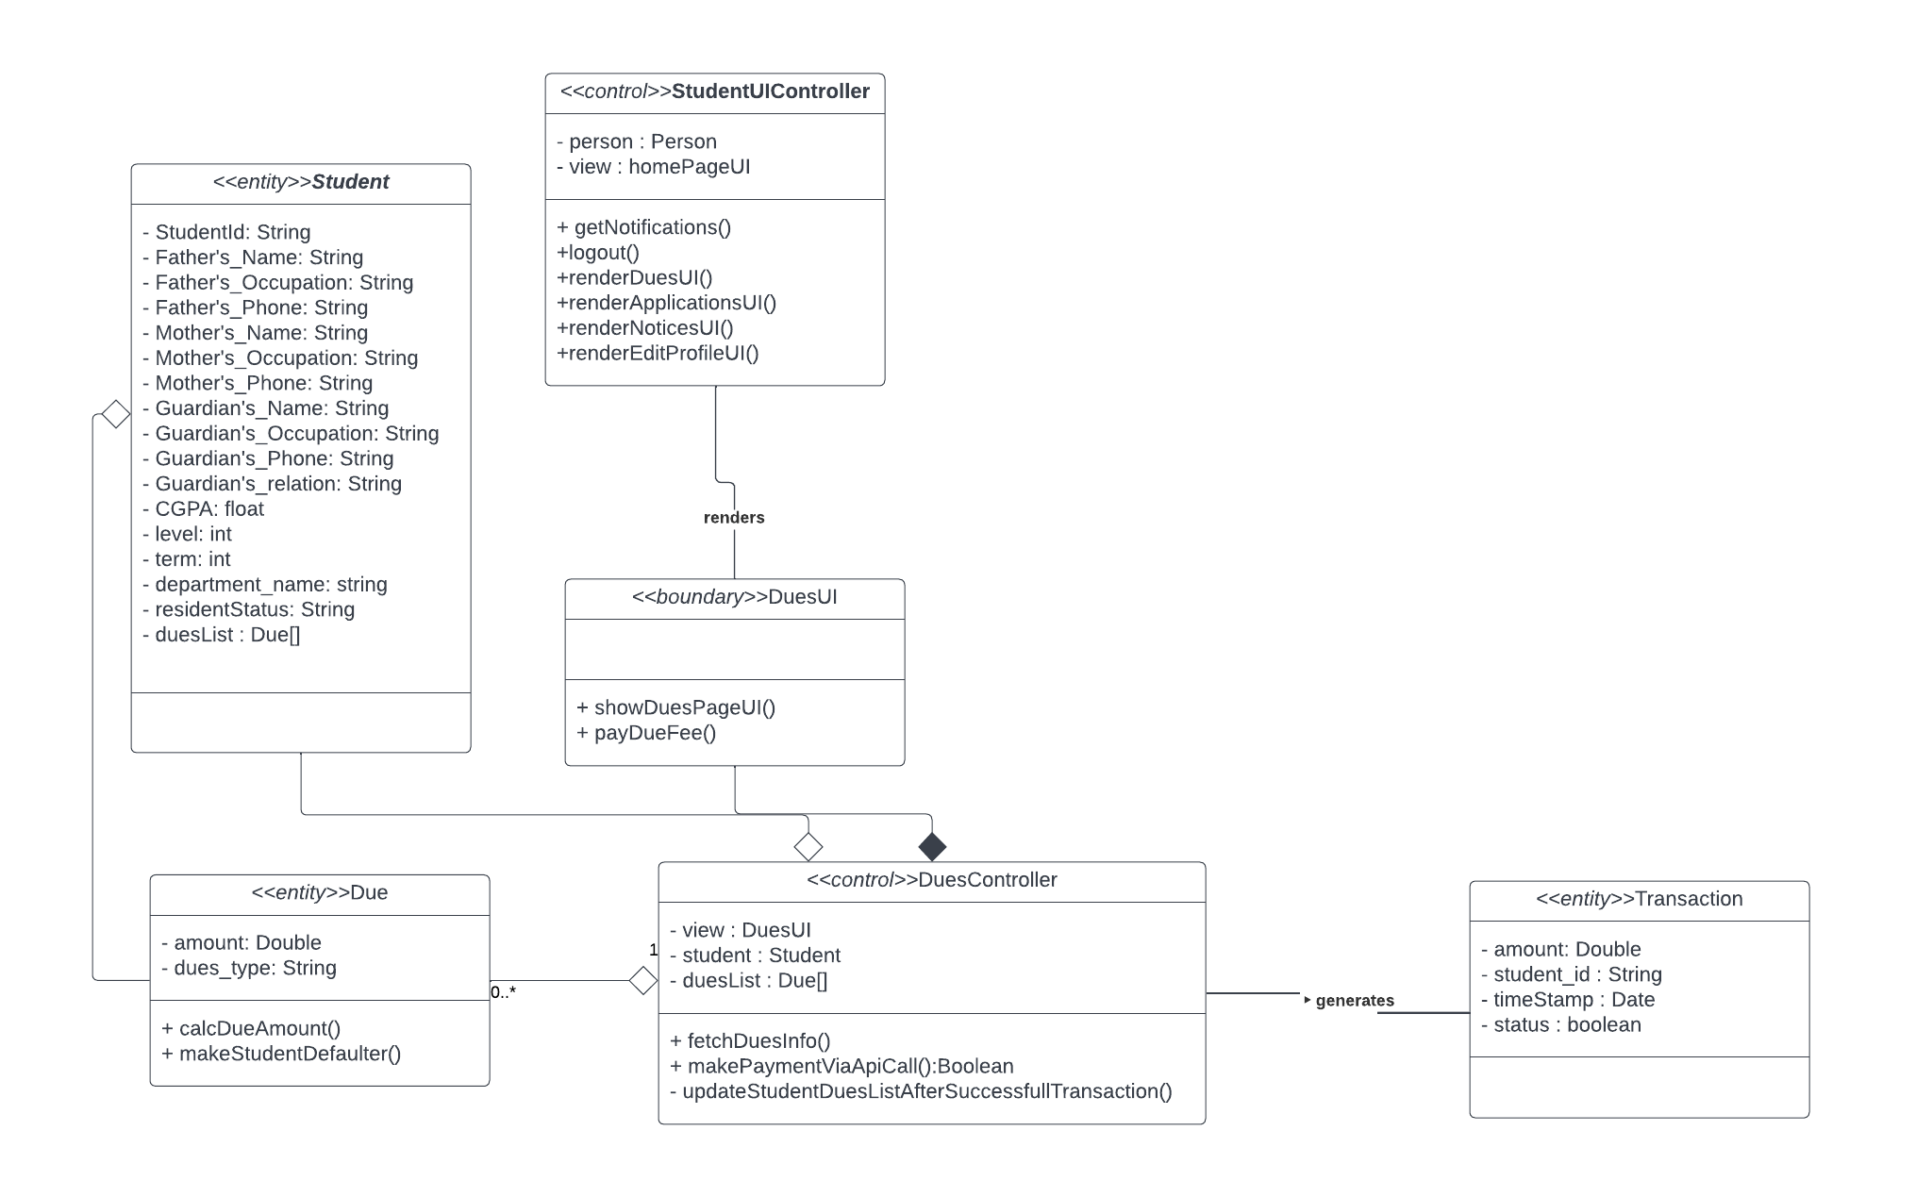
Dues And Payment (Student) :

Slide 8
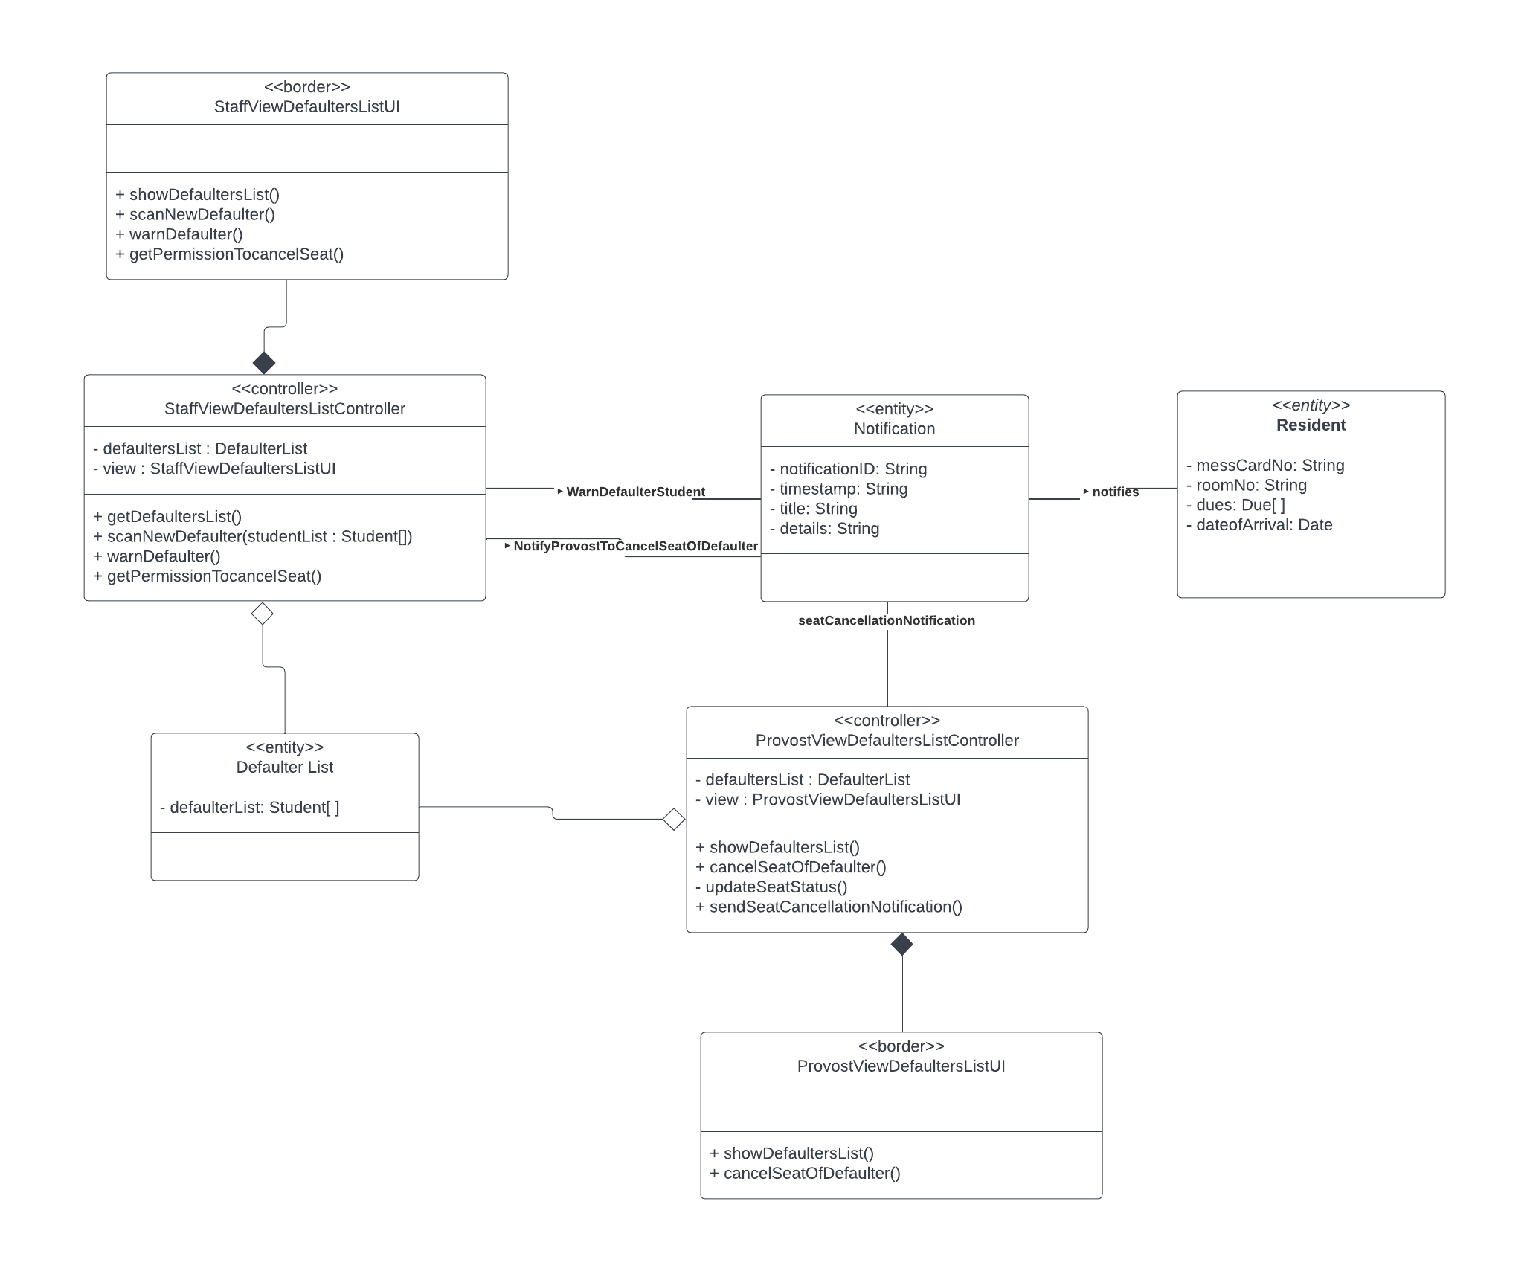
Defaulters List :

Slide 9
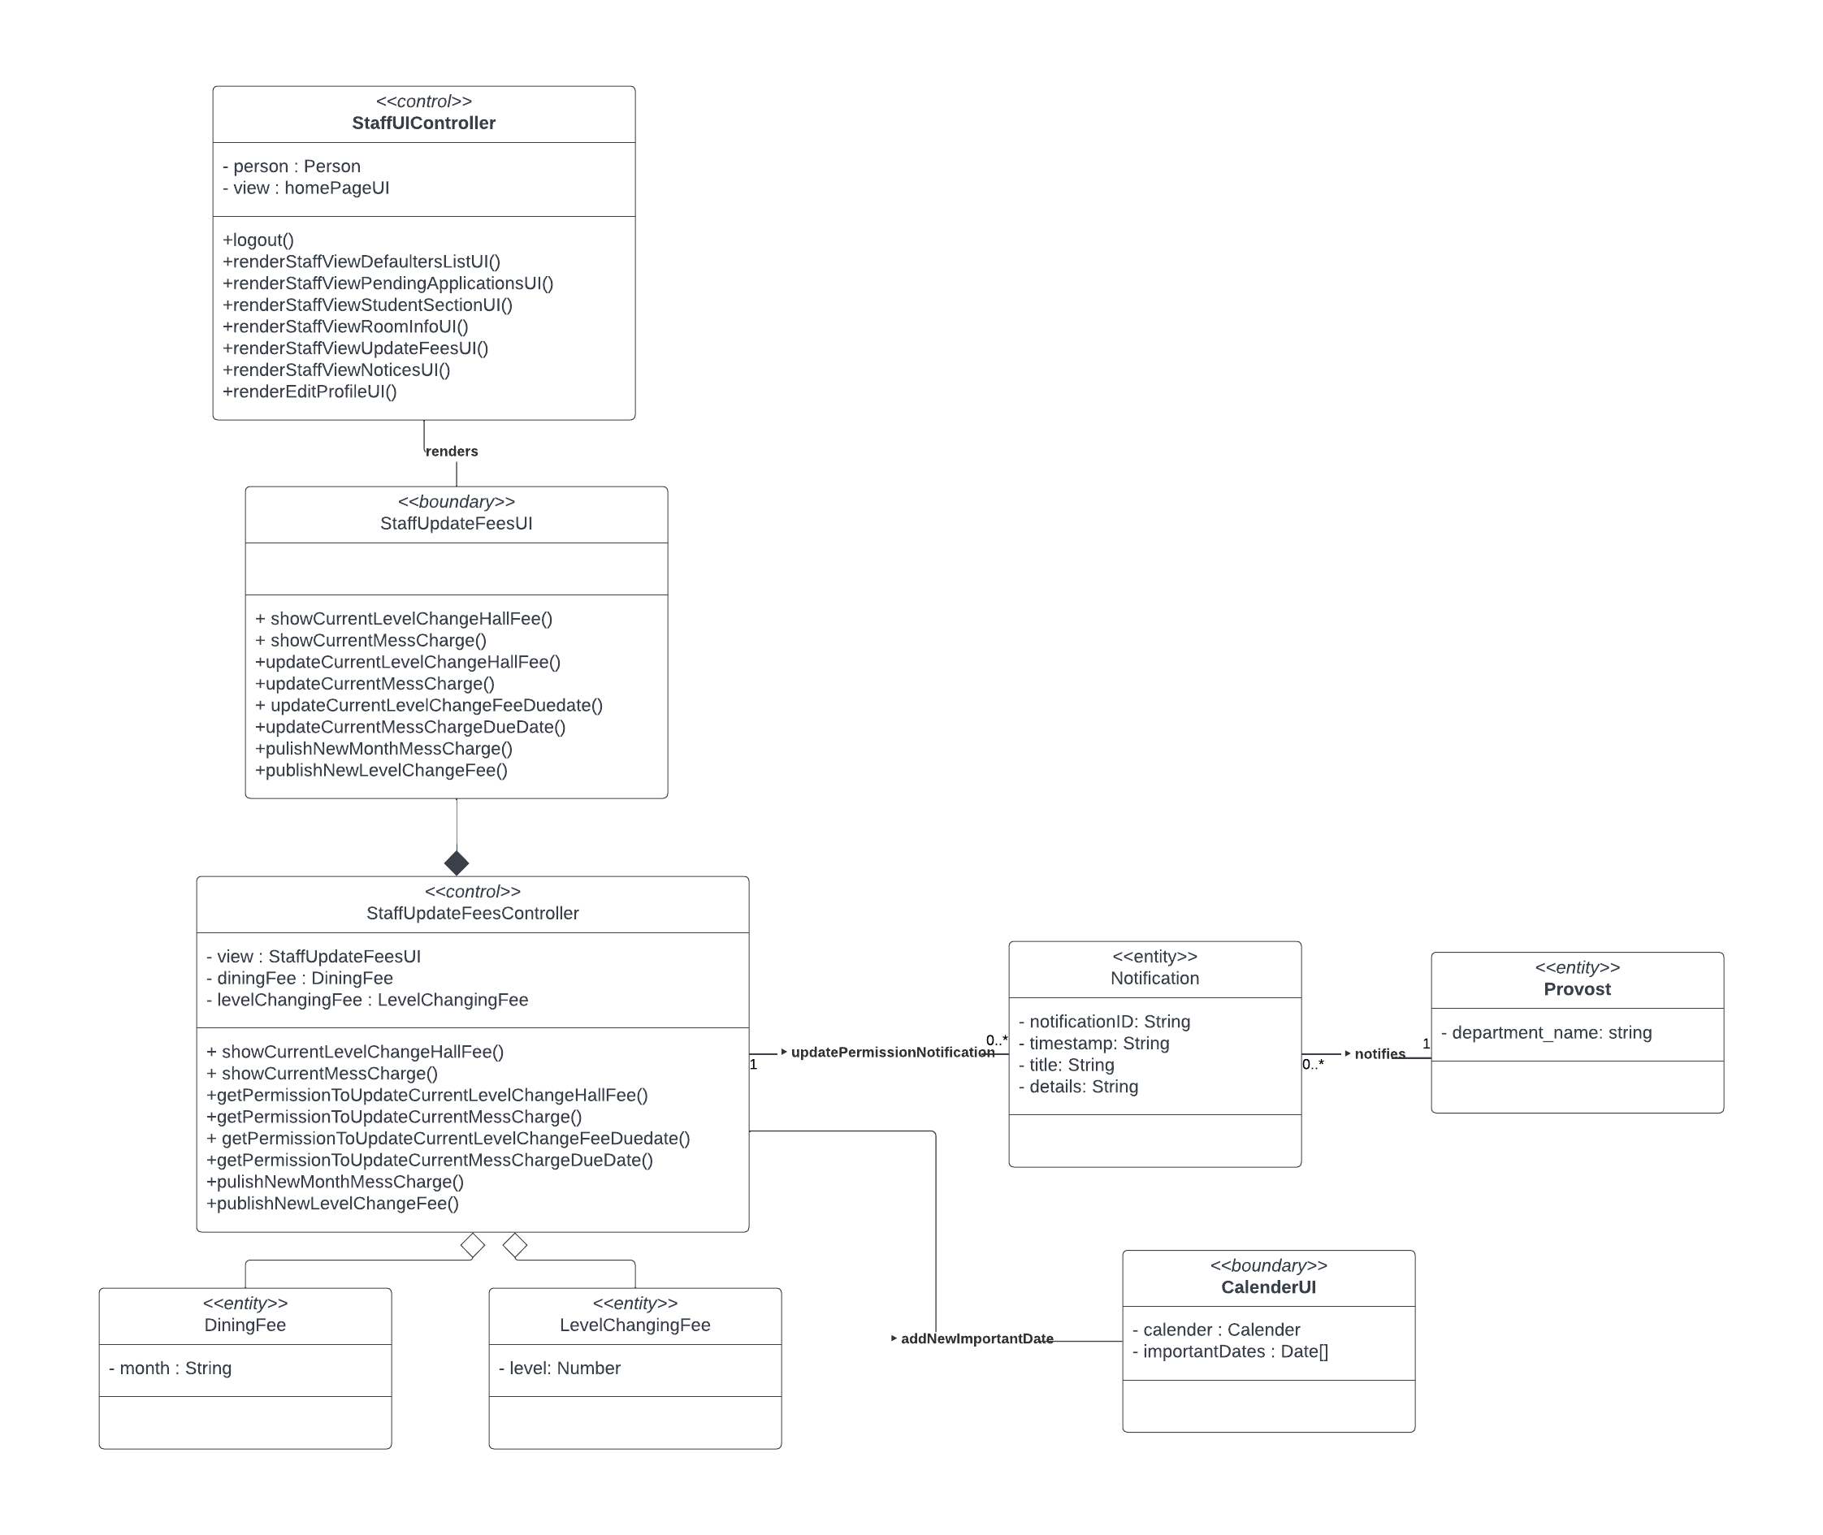
Fees Management (Staff) :

Slide 10
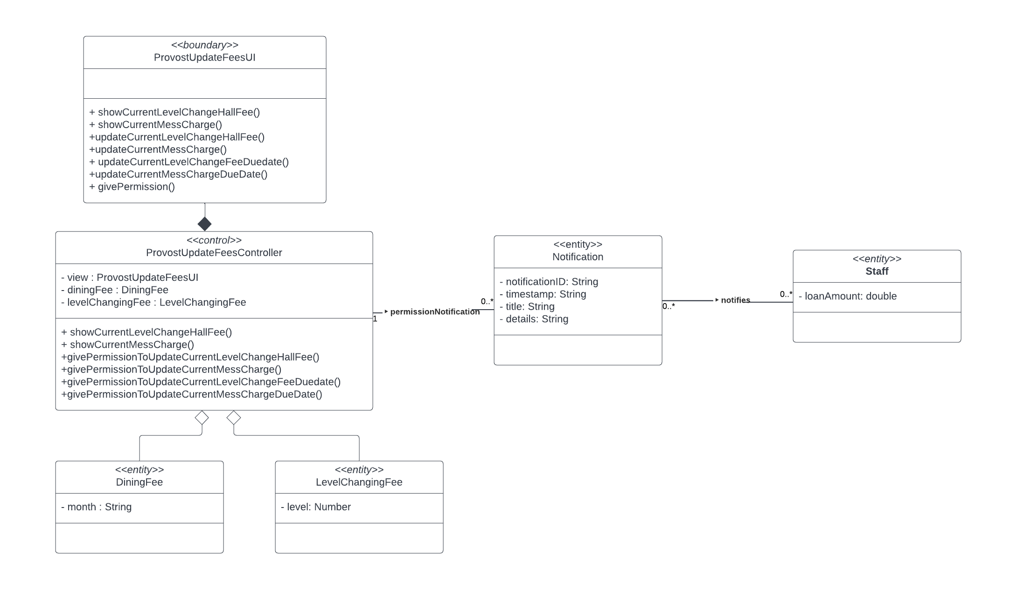
Fees Management ( Provost ):

Slide 11
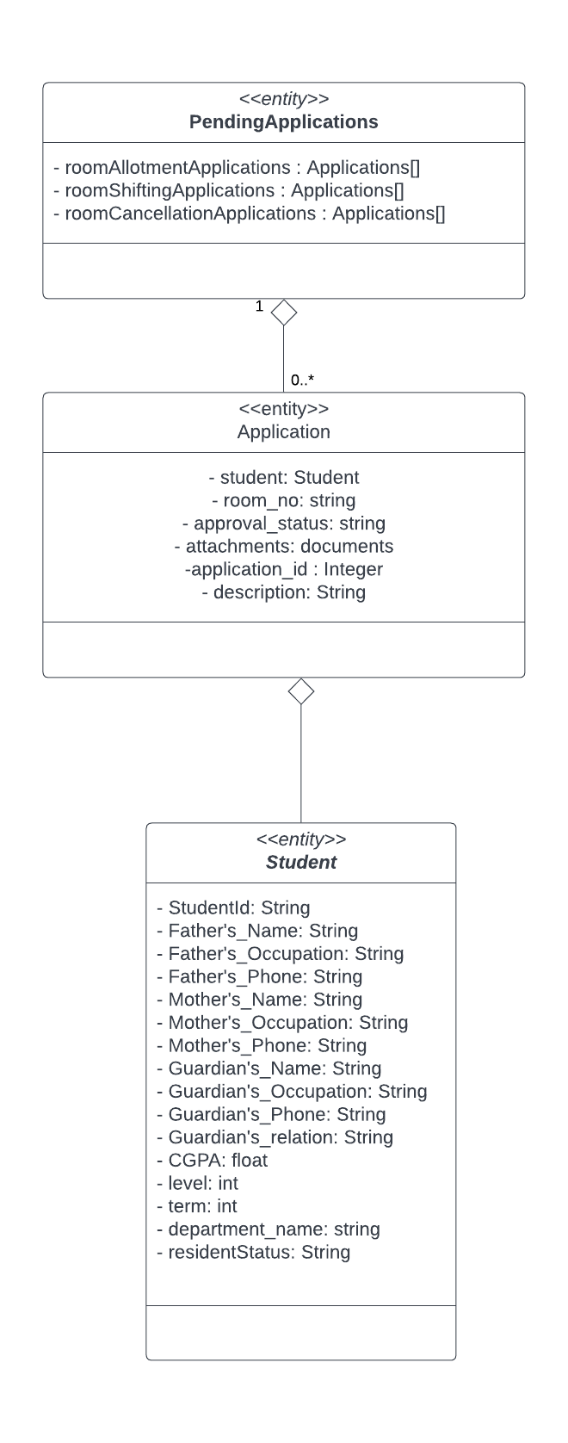
Application :

Slide 12
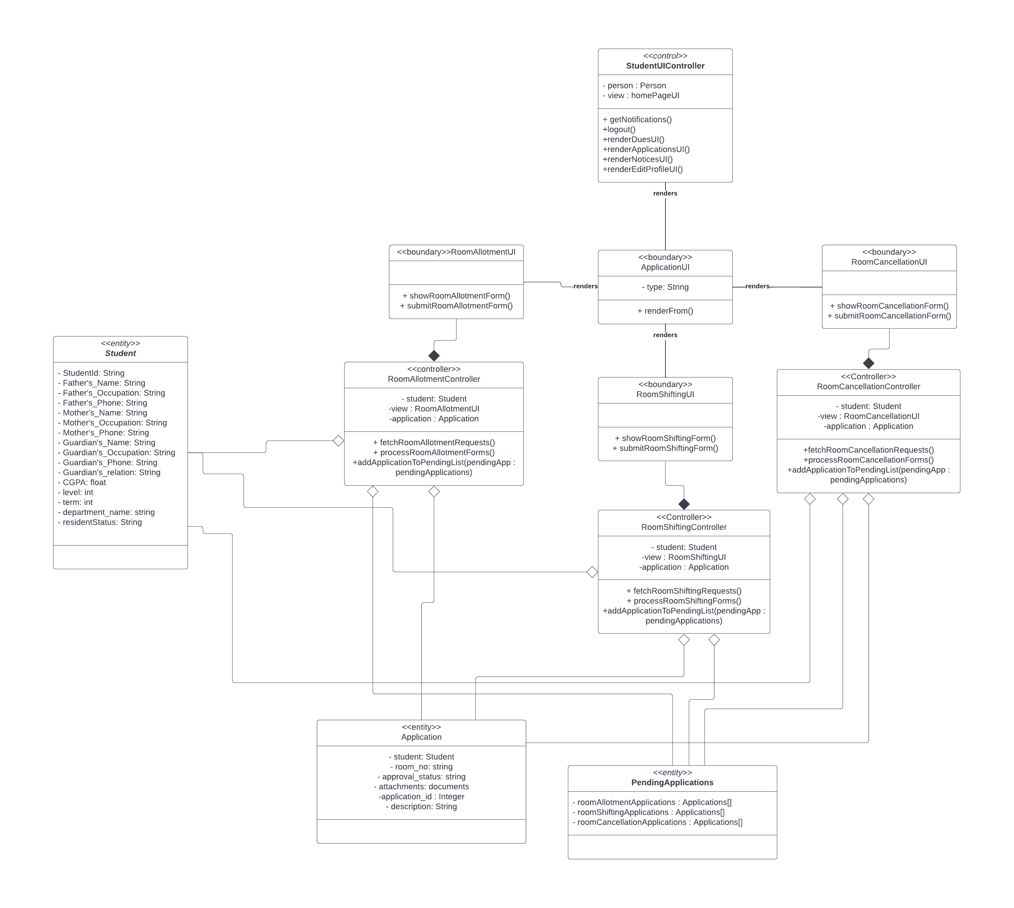
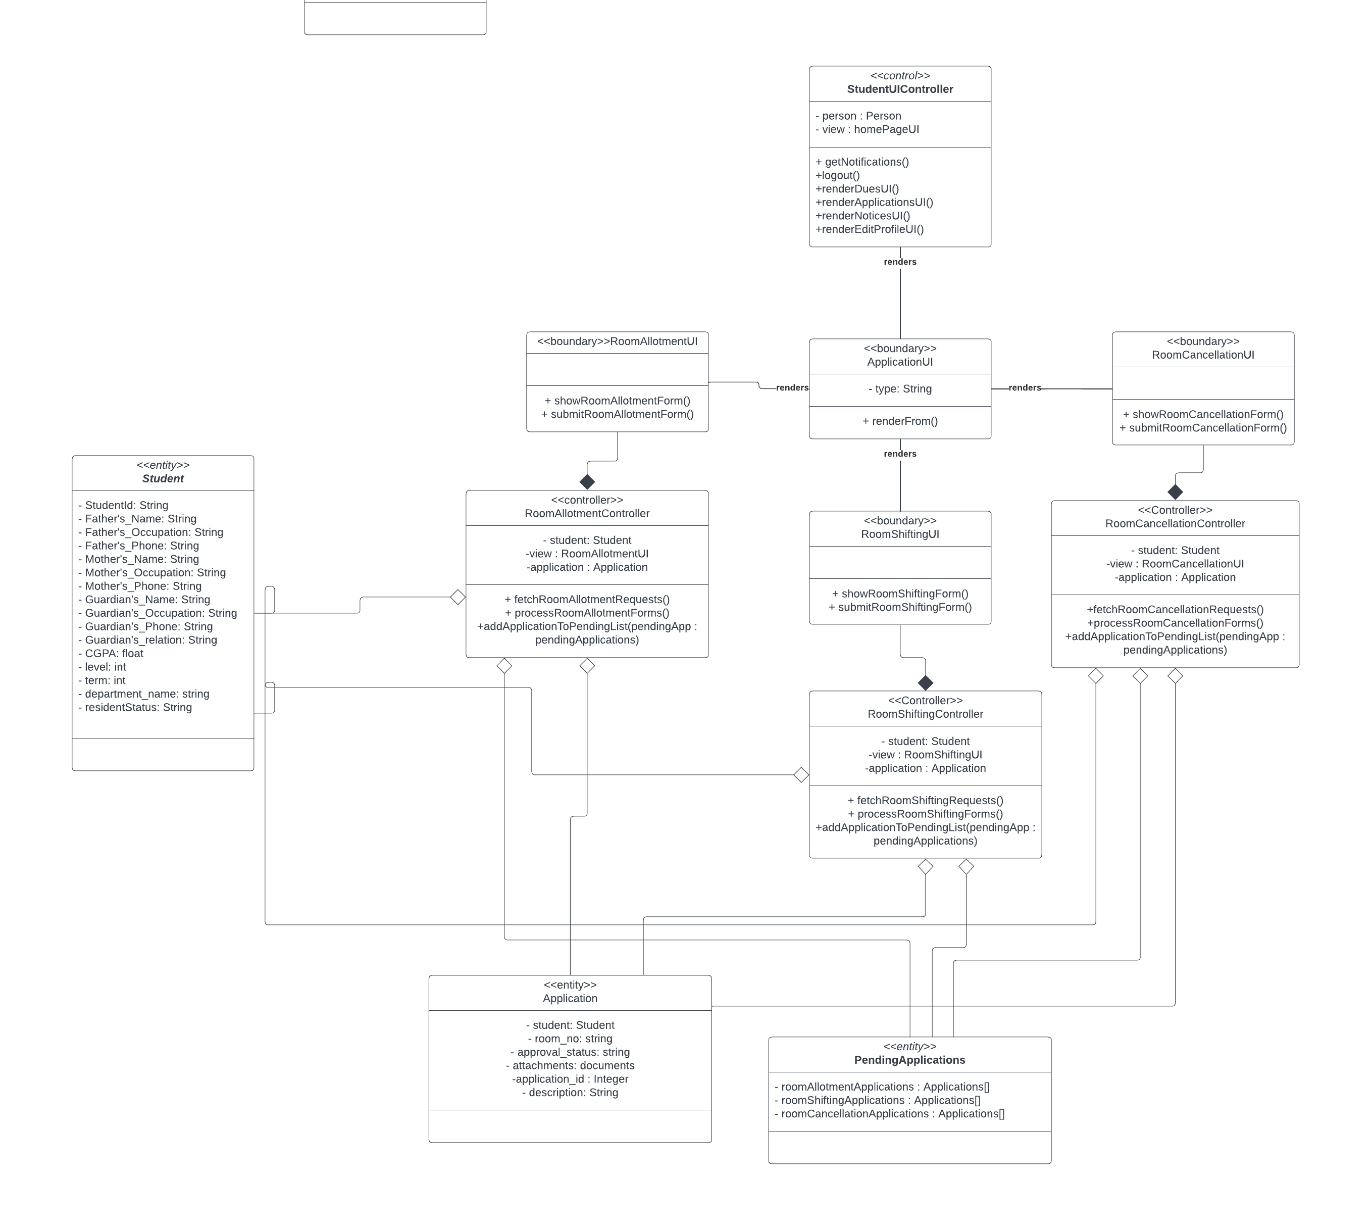
Application Management ( Student ) :

Slide 13
Application Management (Staff & Provost ):

Slide 14
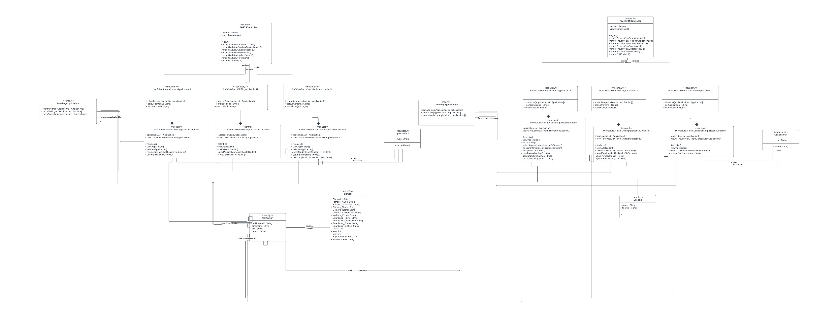

Slide 15
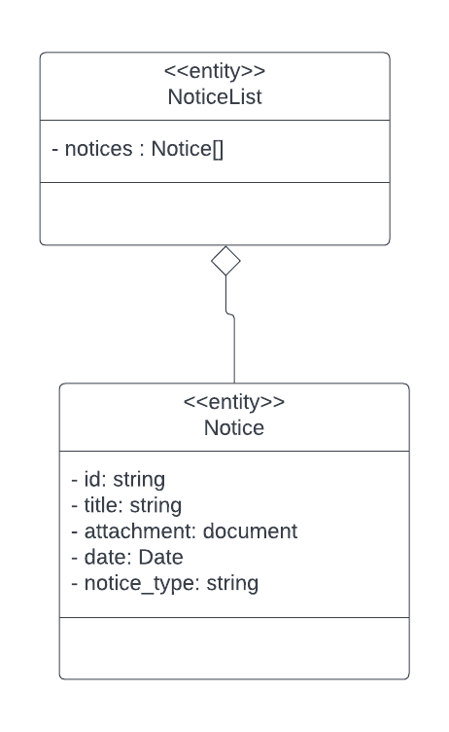
Notice :

Slide 16
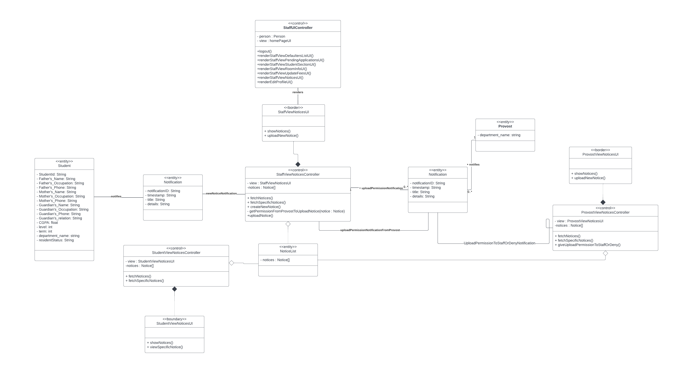
Notice Management :

