Slide 1
Mind Bridge: North South University Student Mental Health Support System
Course Name: Junior Design Project(CSE299)
Presented By: Sumaiya Basher Riyana
ID: 2221686642
Instructor Name: Silvia Ahmed(SvA)
Date: 28 April, 2026

Slide 2

Target Problem
University students often experience academic pressure, stress, anxiety, and emotional challenges.
Many students hesitate to seek professional help due to stigma, lack of awareness, or limited access to counseling services.
Existing support systems in many universities are not easily accessible or confidential for students.
There is a need for a safe, supportive, and accessible platform where students can share concerns and receive guidance.
Goal:
To provide a digital support system that connects students with peer counselors and supervisors for mental health support.

Slide 3

Proposed Solution
To address the mental health challenges
faced by university students, we developed Mind Bridge,
a web-based mental health support platform.
The system provides:
Mental Health Reporting – Students can confidentially report emotional or psychological concerns.
Peer Counseling Support – Students can connect with trained peer counselors for guidance.
Messaging System – Enables communication between students, peer counselors, and supervisors.
Emotional Tracking – Students can monitor their emotional well-being over time.
Mental Health Resources – Access to helpful articles and support materials.
Goal:
To create a safe, accessible, and supportive digital environment that helps students seek help and improve their mental well-being.

Slide 4
Initial Planning
Functional Requirements:
User registration and secure login
Students can submit mental health reports
Peer counseling sessions between students and counselors
Messaging system for communication
Emotional tracking to monitor mood over time
Access to mental health resources
Technology Stack:
Frontend
HTML
CSS
JavaScript
Backend
Node.js
Express.js
Database
MySQL

Slide 5
System Architecture
Presentation Layer (Frontend)
Built using HTML, CSS, and JavaScript
Provides the user interface for students, peer counselors, and supervisors
Handles user interactions such as submitting reports, viewing resources, and messaging
User Interface/Frontend(HTML, CSS, JavaScript)
Backend(Node.js and Express.js)
Database(MySQL)
2. Application Layer (Backend)
Developed using Node.js and Express.js
Processes user requests and handles business logic
Manages authentication, report processing, session scheduling, and messaging
3. Data Layer (Database)
Implemented using MySQL
Stores user data, reports, messages, sessions, and emotional tracking information
Ensures structured and secure data management

Slide 6
Database Design
The system uses a MySQL relational database to store and manage application data.
Main Tables:
Users – Stores user information such as name, email, password, and role (student, peer counselor, supervisor).
Reports – Contains mental health reports submitted by students.
Sessions – Stores scheduled counseling sessions between students and peer counselors.
Messages – Manages communication between users in the system.
Emotional Tracking – Records students’ mood or emotional state over time.
Resources – Stores mental health articles and support materials.
Purpose:
The database structure ensures organized storage of user data, reports, communication, and emotional tracking information while maintaining relationships between different entities.

Slide 7
Backend Implementation
The backend of the system was developed using Node.js and Express.js to handle server-side operations.
Main Responsibilities:
User Authentication – Handles login, registration, and session management.
API Management – Provides RESTful APIs for communication between frontend and database.
Report Handling – Processes and stores mental health reports submitted by students.
Session Management – Manages counseling session scheduling.
Messaging System – Enables communication between students, peer counselors, and supervisors.
Database Interaction – Connects to the MySQL database to store and retrieve data.
Goal:
To ensure secure data processing, efficient request handling, and smooth communication between the frontend and database.

Slide 8
Frontend Implementation
The frontend of the system was developed using HTML, CSS, and JavaScript. It is designed for a clean and user-friendly interface
Main Responsibilities:
User Interface (UI) – Provides an intuitive and visually appealing interface for users to interact with the system.
Navigation Management – Handles smooth navigation between pages such as login, dashboard, and features.
Form Handling – Manages user inputs for registration, login, and report submission.
Dashboard Display – Presents user data, reports, and activities in an organized manner.
Messaging Interface – Displays conversations and enables real-time user interaction.
Emotional Tracking UI – Visualizes user mood and emotional data through interactive elements.
API Integration – Communicates with backend services to send and retrieve data dynamically.
Responsive Design – Ensures compatibility across different devices and screen sizes.

Slide 9
Changes During Development
During development we made improvements:
UI/UX Improvements – Redesigned layouts for better usability and cleaner interface
Backend Optimization – Fixed routing issues and improved API structure
Database Modifications – Updated table structure for better data organization
Feature Adjustments – Refined messaging and report handling features
Bug Fixing & Testing – Identified and resolved errors during development
Integration Improvements – Enhanced communication between frontend and backend

Slide 10
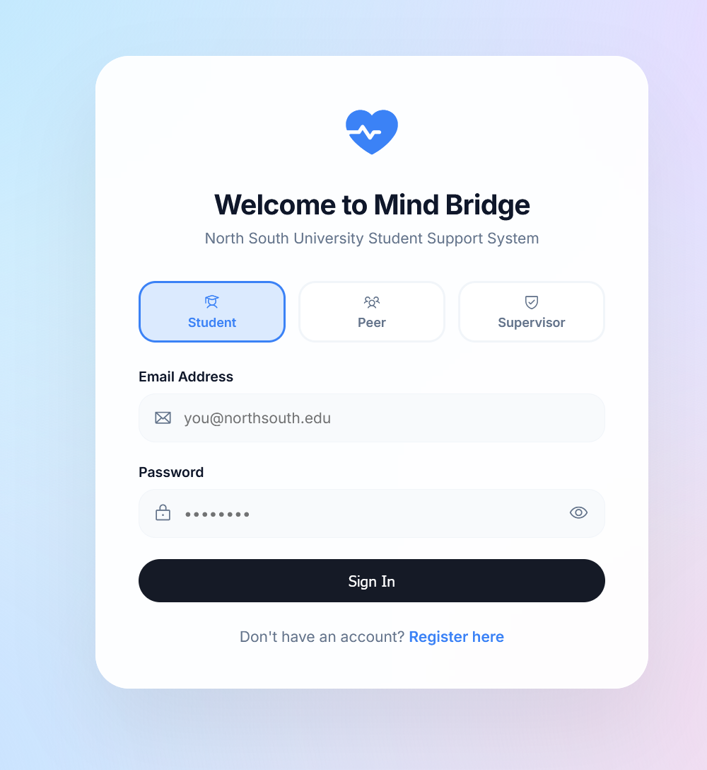
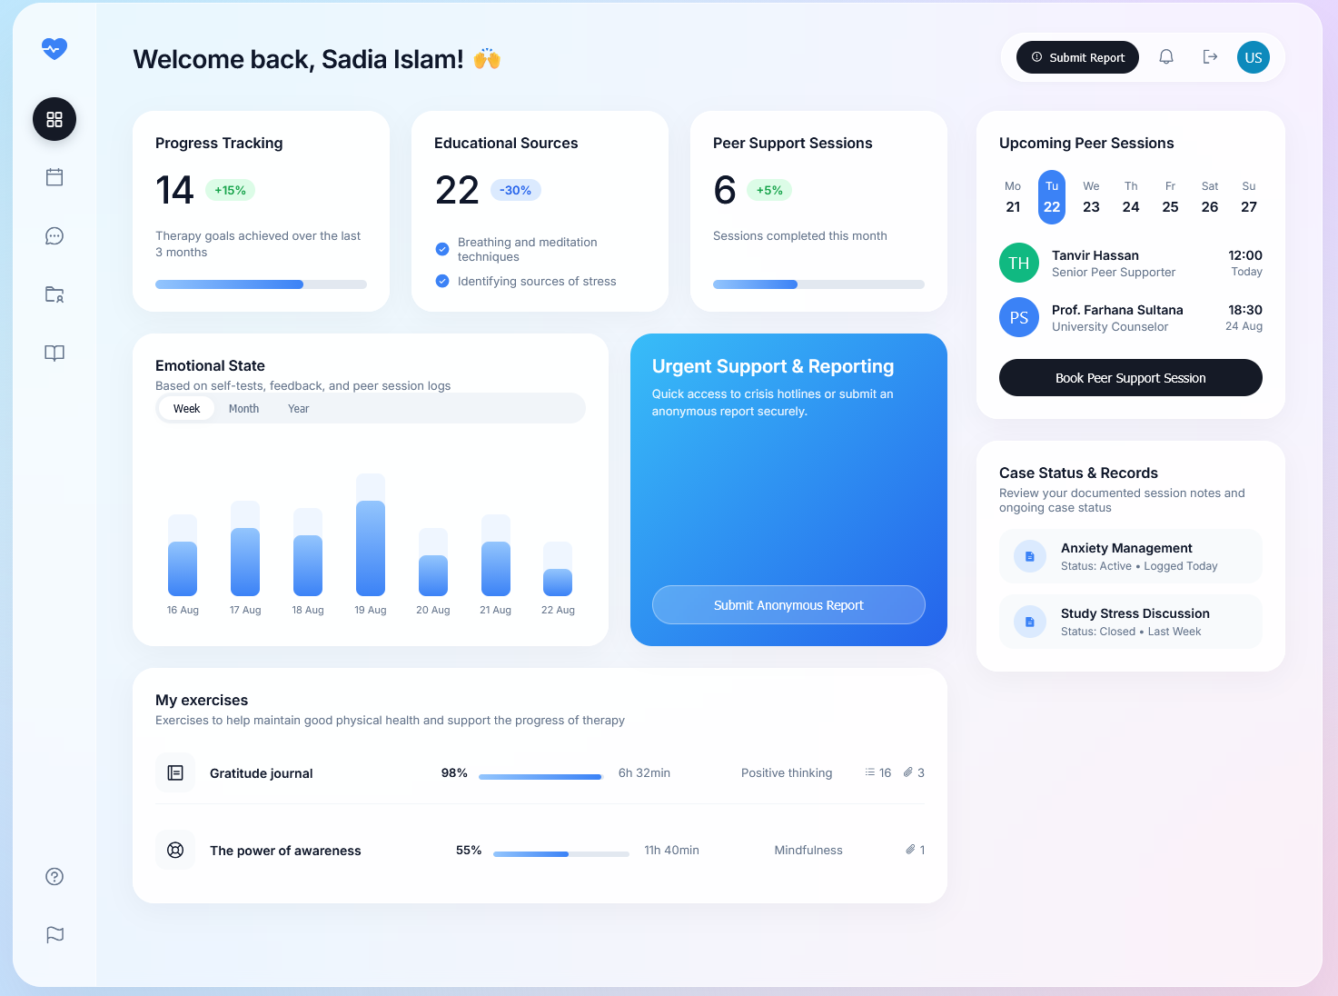
API Interface

Slide 11
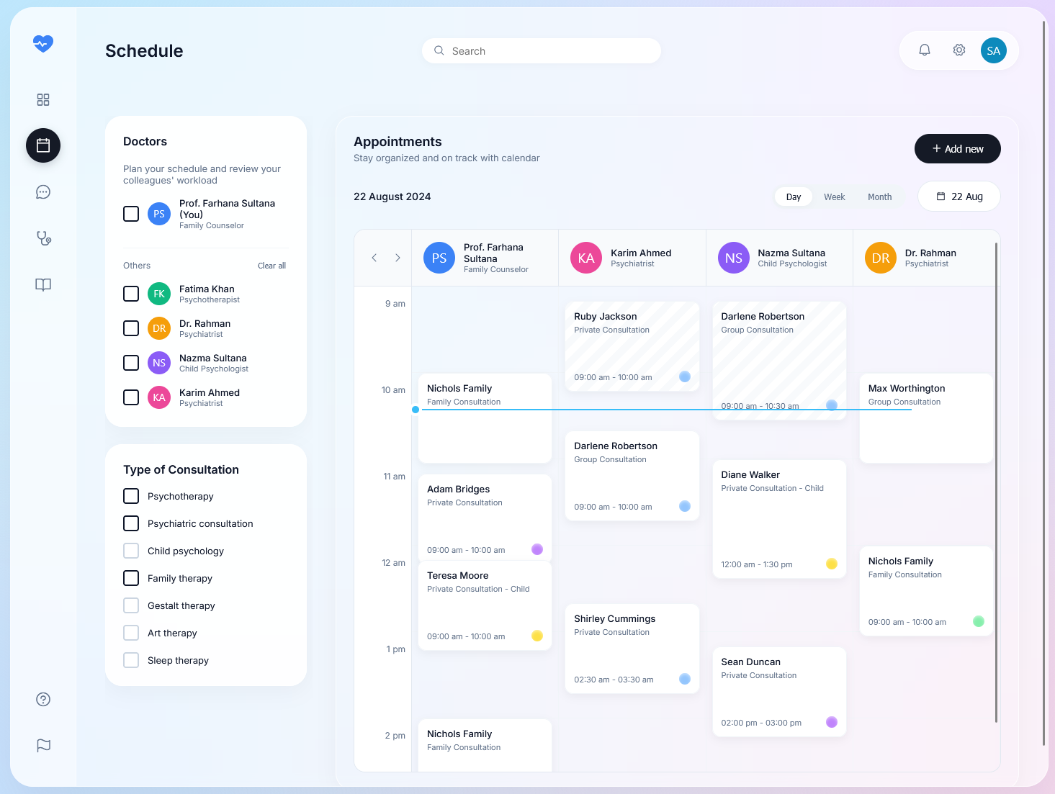
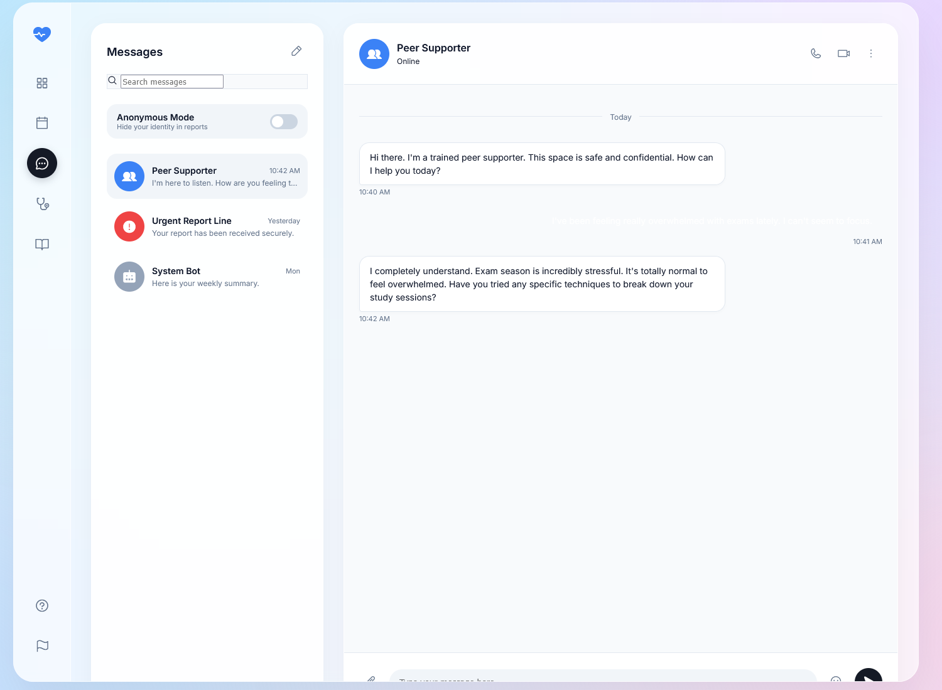

Slide 12
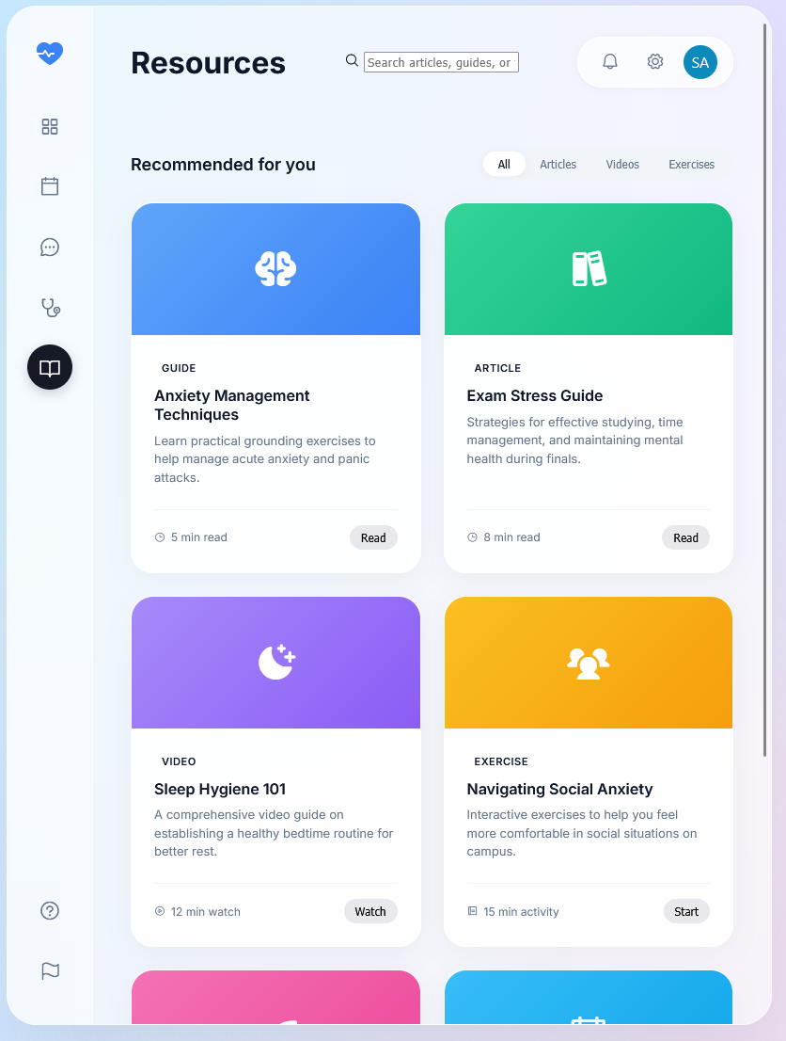
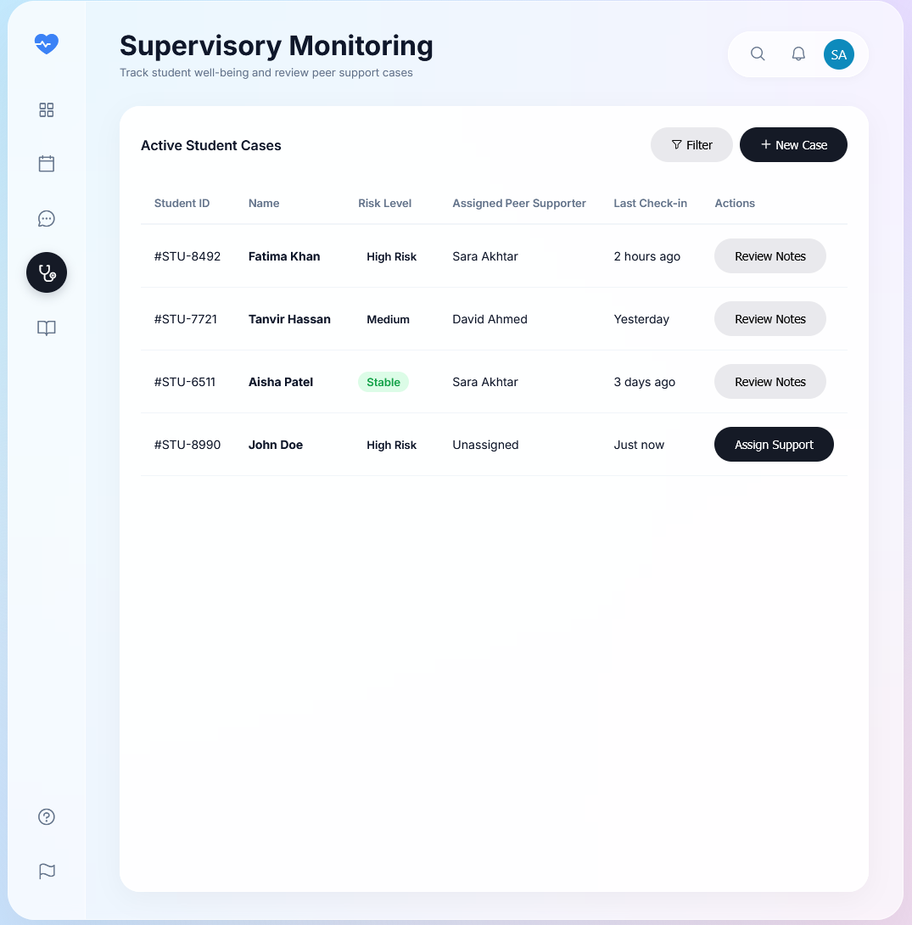

Slide 13
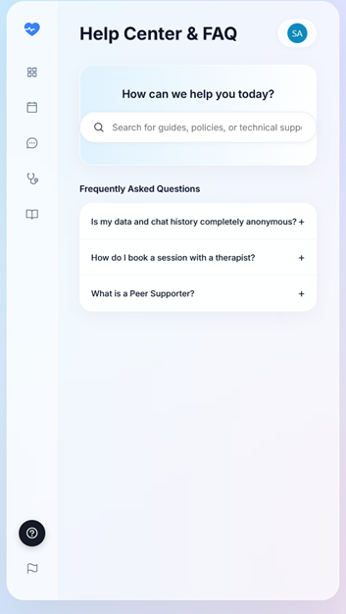
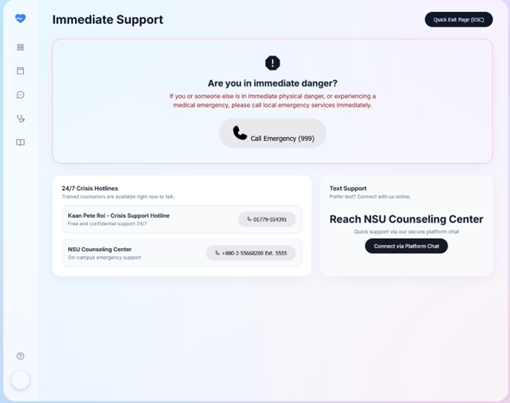

Slide 14
Project Cost
Our project was developed entirely using open-source tools.
Software Used:
Node.js – Free
Express.js – Free
MySQL – Free
VS Code – Free
Total Estimated Cost: $0

Slide 15
User Feedback
We conducted informal testing with several students of different colleges and universities who provided feedback
Feedback highlights:
Easy to use interface
Helpful for reporting concerns
Messaging feature useful for communication
Suggested improvements:
Mobile version
Real-time notifications

Slide 16
Limitations
Due to time constraints and resource limitations, some advanced features could not be implemented.
No mobile application support
Limited AI-based mental health analysis
No real-time notification system
Basic user interface design
Limited scalability for large number of users

Slide 17
Future Work
Possible improvements:
Develop a mobile application version
Integrate AI-based emotion detection and support system
Implement real-time chat functionality
Add notification and alert system
Improve UI/UX design for better user experience
Enable integration with university counseling centers
Enhance system scalability and performance

Slide 18
Thank you!

