Slide 1
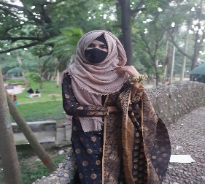

About me
About Me
.
I am an energetic, ambitious person who has developed a mature and responsible approach to any task that I undertake, or situation that I am presented with.
SUMAIYA TASNIM
CSE STUDENT
Professional Skills
PowerPoint
Education
C
JAVA
HTML
2019
HSC
MS Office
MS Excel
Govt. Mujibur Rahman Women’s College, Bogura.
Personal Skills
2020
BSC
Team Work
Rajshahi University
CSE 2nd Year
Networking
Creativity
Teaching
Contract
sumaiya20001234@gmail.com

