Slide 1
Visualizing Employee Attendance Trends With Excel Charts
STUDENT NAME: I. Sumaiya Fathima
REGISTER NO: 312207778
DEPARTMENT: Commerce
COLLEGE: The Quaide Milleth College For Men

Slide 2
PROJECT TITLE
Visualizing Employee Attendance Trends With Excel Charts

Slide 3


AGENDA
Problem Statement
Project Overview
End Users
Our Solution and Proposition
Dataset Description
Modelling Approach
Results and Discussion
Conclusion
3/21/2024 Annual Review

Slide 4

PROBLEM STATEMENT:
1. Monitor attendance rates over time for individual employees and 2. Compare attendance performance across departments and locations. 3. Identify top performers and employees with poor attendance records. 4. Detect patterns and anomalies in attendance data, such as seasonal fluctuations or unusual absences. 5. Communicate insights and trends to management and team leaders to inform data-driven decisions.

Slide 5

PROJECT OVERVIEW
Employee Attendance Trends Visualization
Objective: Track and analyze employee attendance trends
Deliverables: Excel dashboard, user guide, data dictionary
KPIs: Attendance Rate, Absenteeism Rate, Average Days Absent
Top Performers and Poor Attendance Records
Timeline: 10 days
Resources: Excel software, HR attendance data
Project team: HR manager, data analyst, Excel expert
Create an interactive and dynamic Excel dashboard
Enable HR managers to make data-driven decisions
.

Slide 6

WHO ARE THE END USERS?
1. HR Managers 2. Team Leaders 3. Department Heads 4. Operations Managers 5. Business Analysts 6. Management Team 7. Supervisors 8. Employee Relations Specialists 9. Payroll Managers 10. Decision-makers who need attendance insights

Slide 7

OUR SOLUTION AND ITS VALUE PROPOSITION
Solution: Interactive Excel dashboard visualizing employee attendance trends and patterns. Value Proposition: - Improve attendance tracking and analysis - Inform data-driven decisions - Boost productivity and reduce absenteeism - Enhance employee management and insights - Save time and reduce costs

Slide 8
Dataset Description
+ Employee ID + Name + Department + Location + Date + Attendance Status (Present, Absent, Late, Left Early) + Reason for Absence (optional) _Format:_ + Date: MM/DD/YYYY + Attendance Status: Categorical _Volume:_ + 100-1000+ employees + 1000-10,000+ attendance records + 1-2 years of data

Slide 9

THE "WOW" IN OUR SOLUTION
Key "Wow" Elements: 1. Live Attendance Dashboards: Real-time insights into employee attendance trends. 2. Predictive Analytics: Forecast absenteeism and identify areas for improvement. 3. Customizable Charts: Personalized views for HR, management, and employees. 4. Automated Reporting: Scheduled reports for timely decision-making. 5. Data-Driven Insights: Uncover hidden trends and correlations to inform HR strategy.
3/21/2024 Annual Review
9

Slide 10
MODELLING
_Data Modeling:_ - Source: HR attendance records - Transformation: Clean, format, and aggregate data _Key Models:_ - Attendance Rate - Absenteeism - Predictive _Modeling Techniques:_ - Descriptive Analytics - Diagnostic Analytics - Predictive Analytics _Excel Tools:_ - PivotTables - Charts
10

Slide 11
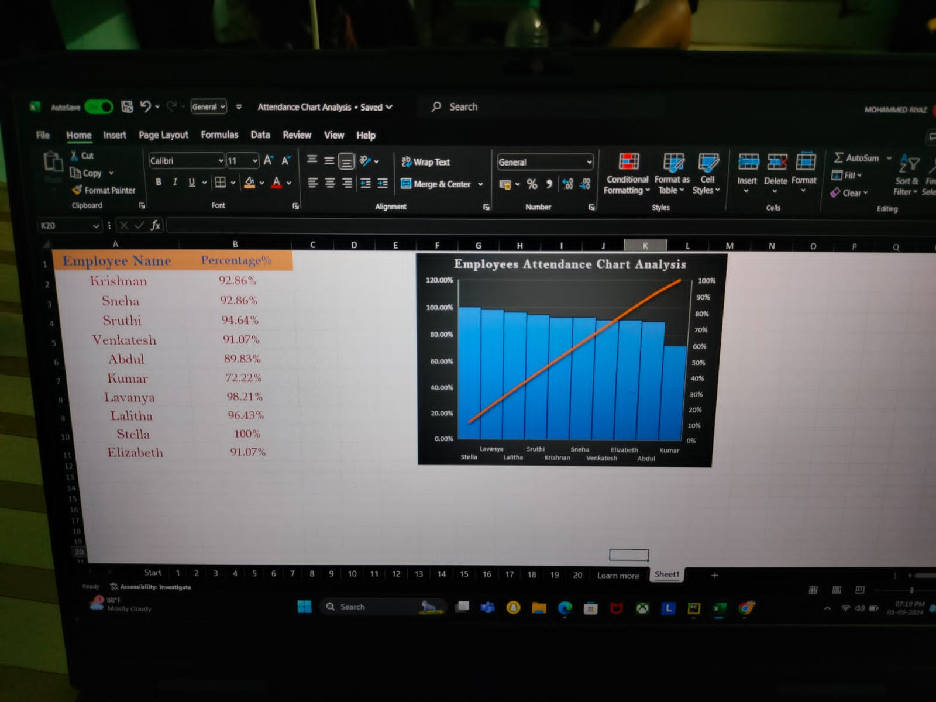
RESULTS
11

Slide 12
conclusion
In conclusion, visualizing employee attendance trends with Excel charts provides a powerful tool for understanding patterns and making informed decisions. By leveraging various chart types and analytical features, organizations can identify trends, detect anomalies, and gain insights into attendance behavior. This not only aids in managing workforce productivity but also helps in strategic planning and improving overall employee engagement. Regularly updating and analyzing these charts ensures that attendance data remains relevant and actionable.

