Slide 1
Enhancing Stroke Risk Prediction: A Comparative Analysis Using Various Machine And Deep Learning Algorithms
SUMAIYAH BANU A
21PCSE09

Slide 2
PROBLEM STATEMENT
Stroke has emerged as a major global cause of mortality and long-term impairment with no proven cure.
Predicting stroke risk based on the hypertension, heart disease and blood glucose level parameters.
Machine and Deep Learning based models are broadly used to extract significant stroke features for prediction.
This work will enhance the performance with using various algorithms such as RF, KNN, CNN, LSTM, and MLP for predicting the stroke.
The experimental results show the Accuracy, Precision, Recall, and f1-score.

Slide 3
OBJECTIVES
The purpose of this research is to predict stroke or non-stroke effectively.
To enhance the overall performance analysis.
To obtain high performance with improved accuracy.
Based on this research, doctors will be able to determine if a stroke can be anticipated or not based on factors including age, hypertension, heart disease, average glucose level, BMI, and smoking status.

Slide 4
LITERATURE SURVEY
PAPER | AUTHOR | YEAR | ALGORITHMS | ACCURACY | INFERENCE
Predicting Stroke from Electronic Health Records | Chidozie Shamrock Nwosu, Soumyabrata Dev, Peru Bhardwaj, Bharadwaj Veeravalli, Deepu John | 2019 | Decision Tree, Random Forest, Neural Network | 74.31, 74.53, 75.02 | Hence the Neural Network model has the best performance.
Chi-Squared Based Feature Selection for Stroke Prediction using AzureML | Sujan Ray, Ali AlGhamdi, Khaldoon Alshouiliy, Dharma P. Agrawal, Anupam Roy | 2020 | Two-Class Boosted Decision Tree, Two-Class Decision Jungle | 97.6, 96.7 | The Two-Class Boosted Decision Tree gives better performance.
Efficient Prediction of Stroke Patients Using Random Forest Algorithm in Comparison to Support Vector Machine | Ritaban Mitraa, T. Rajendran | 2022 | Random Forest, SVM | 95, 94 | The results show that the RF model performs higher than SVM.

Slide 5
PAPER | AUTHOR | YEAR | ALGORITHMS | ACCURACY | INFERENCE
Advanced Random Forest Ensemble for Stroke Prediction | Dipita Paul, Gobinda Gain, Sujit Orang, Priteeranjan Das, Avijit Kumar Chaudhuri | 2022 | Gradient Boosting, Logistic Regression, Random Forest, Naive Bayes, Support Vector Machine, Decision Tree, Extra Tree, Ensembled Random Forest | 94 | Machine learning strategies are used, which gives the overall performance.
Stroke Risk Prediction with Machine Learning Techniques | Elias Dritsas, Maria Trigka | 2022 | Naive Bayes, Random Forest, Logistic Regression, K-Nearest Neighbors, Stochastic Gradient Descent, Decision Tree, Stacking | 84, 97, 79, 81, 88, 91, 98 | Hence the Stacking classifier has the best performance.
Analyzing the Performance of Stroke Prediction using ML Classification Algorithms | Gangavarapu Sailasya, Gorli L Aruna Kumari | 2021 | Logistic Regression, Decision Tree Classification, Random Forest Classification, K-Nearest Neighbors, Support Vector Machine, Naive Bayes Classification | 78, 66, 73, 80, 80, 82 | Overall in these machine learning algorithms, Naive Bayes Classification performs better.

Slide 6
PAPER | AUTHOR | YEAR | ALGORITHMS | ACCURACY | INFERENCE
A predictive analytics approach for stroke prediction using machine learning and neural networks | Soumyabrata Dev, Hewei Wang, Chidozie Shamrock Nwosu, Nishtha Jain, Bharadwaj Veeravalli, Deepu John | 2021 | Decision Tree, Random Forest, Neural Network | 75, 75, 78 | Hence the Neural Network has the best performance.
Performance Analysis of Machine Learning Approaches in Stroke Prediction | Minhaz Uddin Emon, Maria Sultana Keya, Tamara Islam Meghla, Md. Mahfujur Rahman, M Shamim Al Mamun, M Shamim Kaiser | 2020 | Logistics Regression, Stochastic Gradient Descent, Decision Tree Classifier, AdaBoost Classifier, Gaussian Classifier, Quadratic Discriminant Analysis, Multilayer Perceptron Classifier, KNeighbors Classifier, Gradient Boosting Classifier, XGBoost Classifier | 78, 65, 91, 94, 78, 79, 79, 87, 96, 96, 97 | The Weighted Voting Classifier performs better with an accuracy of 97%.
Stroke and Diabetes Prediction using Machine Learning Algorithms | Nehal Mostafa, Aya Ehab, Radwa Abd El-Hakeem | 2021 | Random Forest, KNN | 93.83, 80.08 | The results show that the RF model performs higher than KNN.

Slide 7
PROCESS
FLOW
DIAGRAM

Slide 8
Data Acquisition
Handling missing values
Handling missing values
Data Preprocessing
Data Preprocessing
Label Encoding
Label Encoding
Feature Selection
Feature Selection
Chi Square
Chi Square
Test
Test
Data Splitting
Data Splitting
Train
Random Forest
Train
KNN
Random Forest
Methodology
Methodology
Accuracy
CNN
Accuracy
1D CNN
Precision
Precision
LSTM
Performance Analysis
Recall
Performance Analysis
Recall
MLP
f1- score
f1- score

Slide 9
MODULE DESCRIPTION
Data Preprocessing
Feature Selection
Data Splitting
Methodology
Performance Analysis

Slide 10
DATA ACQUISITION
The stroke dataset is used for detecting stroke risk prediction.
The dataset contains:
- Total number of records is 5110.
- Total number of features is 12.

Slide 11
DATA PREPROCESSING
Data preprocessing is the process of removing unwanted data from the dataset.
It makes the data more efficient.
❏ Checking Null values
❏ Checking Missing values
❏ Encoding Categorical data into Numerical data

Slide 12
FEATURE SELECTION
Feature Selection is to select the best features in the dataset.
To implement feature selection, the techniques used are
❏ Chi-square
❏ SelectKBest

Slide 13
DATA SPLITTING
Data splitting is the act of partitioning available data into two portions, usually for cross-validation purpose.
One portion of the data is used to develop a predictive model and the other to evaluate the model's performance.
❏ 80%- Train Data
❏ 20%- Test Data

Slide 14
METHODOLOGY
Various Machine Learning and Deep Learning Algorithms
RANDOM FOREST
K-NEAREST NEIGHBORS
CONVOLUTIONAL NEURAL NETWORK
LONG SHORT-TERM MEMORY
MULTILAYER PERCEPTRON
ML
DL

Slide 15
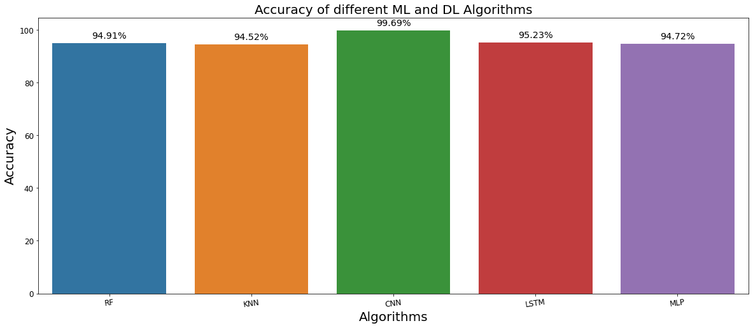
COMPARISON GRAPH

Slide 16
CONCLUSION
It is observed that the Convolutional Neural Network performs exceptionally well and has a significantly higher accuracy which is 99%.

Slide 17
THANK YOU….

