Slide 1
Enhancing Stroke Risk Prediction: A comparative analysis using various machine and deep learning algorithms
Presented By -
Sumaiyah Banu A - 21PCSE09,
II M.Sc Computer Science,
Lady Doak College.
Guided By -
Ms. Japhne A M.Sc., M.Phil., (Ph.D.),
Associate Professor,
Department of Computer Science,
Lady Doak College.

Slide 2
INTRODUCTION
A stroke disrupts the blood supply to a portion of the brain.
Although the risk can be decreased, strokes can be fatal.
Anyone may lower their chance of stroke because many risk factors are lifestyle-related.
The biggest risk factor for stroke is by far high blood pressure.
With no cure, stroke has emerged as a significant global cause of mortality and long-term impairment.

Slide 3
PROBLEM STATEMENT
Predicting stroke risk is a difficult and time-consuming task in the medical field.
Predicting stroke risk based on the hypertension, heart disease and blood glucose level parameters.
Machine and Deep Learning based models are broadly used in this work to extract significant stroke features for prediction.

Slide 4
OBJECTIVES
The purpose of this research is to predict stroke or non-stroke effectively.
Machine and Deep Learning based models are broadly used to extract significant stroke features for prediction.
To enhance the overall performance analysis.
To obtain high performance with improved accuracy.

Slide 5
LITERATURE SURVEY
PAPER | AUTHOR | YEAR | ALGORITHMS | ACCURACY | INFERENCE
Efficient Prediction of Stroke Patients Using Random Forest Algorithm in Comparison to Support Vector Machine | Ritaban Mitraa, T. Rajendran | 2022 | Random Forest, SVM | 95, 94 | The results show that the RF model performs higher than SVM.
Advanced Random Forest Ensemble for Stroke Prediction | Dipita Paul, Gobinda Gain, Sujit Orang, Priteeranjan Das, Avijit Kumar Chaudhuri | 2022 | Gradient Boosting, Logistic Regression, Random Forest, Naive Bayes, Support Vector Machine, Decision Tree, Extra Tree, Ensembled Random Forest | 94 | Machine learning strategies are used, which gives the overall performance.

Slide 6
PAPER | AUTHOR | YEAR | ALGORITHMS | ACCURACY | INFERENCE
Stroke Risk Prediction with Machine Learning Techniques | Elias Dritsas, Maria Trigka | 2022 | Naive Bayes, Random Forest, Logistic Regression, K-Nearest Neighbors, Stochastic Gradient Descent, Decision Tree, Stacking | 84, 97, 79, 81, 88, 91, 98 | Hence the Stacking classifier has the best performance.
A predictive analytics approach for stroke prediction using machine learning and neural networks | Soumyabrata Dev, Hewei Wang, Chidozie Shamrock Nwosu, Nishtha Jain, Bharadwaj Veeravalli, Deepu John | 2021 | Decision Tree, Random Forest, Neural Network | 75, 75, 78 | Hence the Neural Network has the best performance.
Performance Analysis of Machine Learning Approaches in Stroke Prediction | Minhaz Uddin Emon, Maria Sultana Keya, Tamara Islam Meghla, Md. Mahfujur Rahman, M Shamim Al Mamun, M Shamim Kaiser | 2020 | Logistics Regression, Stochastic Gradient Descent, Decision Tree Classifier, AdaBoost Classifier, Gaussian Classifier, Quadratic Discriminant Analysis, Multilayer Perceptron Classifier, KNeighbors Classifier, Gradient Boosting Classifier, XGBoost Classifier | 78, 65, 91, 94, 78, 79, 79, 87, 96, 96, 97 | The Weighted Voting Classifier performs better with an accuracy of 97%.

Slide 7
PAPER | AUTHOR | YEAR | ALGORITHMS | ACCURACY | INFERENCE
Analyzing the Performance of Stroke Prediction using ML Classification Algorithms | Gangavarapu Sailasya, Gorli L Aruna Kumari | 2021 | Logistic Regression, Decision Tree Classification, Random Forest Classification, K-Nearest Neighbors, Support Vector Machine, Naive Bayes Classification | 78, 66, 73, 80, 80, 82 | Overall in these machine learning algorithms, Naive Bayes Classification performs better.
Predicting Stroke from Electronic Health Records | Chidozie Shamrock Nwosu, Soumyabrata Dev, Peru Bhardwaj, Bharadwaj Veeravalli, Deepu John | 2019 | Decision Tree, Random Forest, Neural Network | 74.31, 74.53, 75.02 | Hence the Neural Network model has the best performance.
Long Short-Term Memory Recurrent Neural Network for Stroke Prediction | Pattanapong Chantamit-o-pas, Madhu Goyal | 2018 | RNN, LSTM-RNN | 99 | LSTM-RNN has the good performance.

Slide 8
PROCESS
FLOW
DIAGRAM

Slide 9
Data Acquisition
Handling missing values
Handling missing values
Data Preprocessing
Data Preprocessing
Label Encoding
Label Encoding
Feature Selection
Feature Selection
Chi Square
Chi Square
Test
Test
Data Splitting
Data Splitting
Train
Random Forest
Train
KNN
Random Forest
Methodology
Methodology
Accuracy
CNN
Accuracy
1D CNN
Precision
Precision
LSTM
Performance Analysis
Recall
Performance Analysis
Recall
MLP
f1- score
f1- score

Slide 10
MODULE DESCRIPTION
Data Preprocessing
Feature Selection
Data Splitting
Methodology
Performance Analysis

Slide 11
DATA ACQUISITION
The stroke risk dataset is used from Kaggle as input for detecting stroke risk prediction.
The dataset contains 5110 records and 12 features.
It contains features such as age, hypertension, heart disease, smoking status, average blood glucose level, so on.

Slide 12
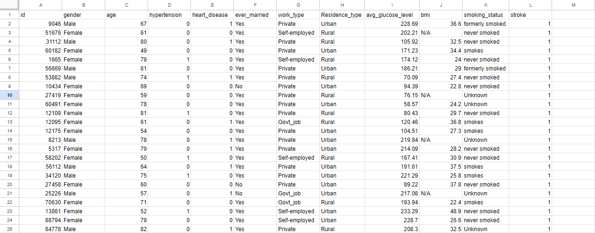

Slide 13
DATA PREPROCESSING
Data preprocessing is the process of removing unwanted data from the dataset.
It makes the data more efficient.
❏ Checking Null values
❏ Checking Missing values
❏ Encoding Categorical data into Numerical data

Slide 14
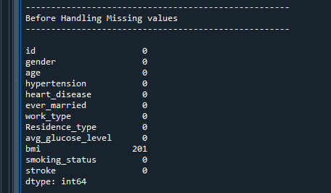
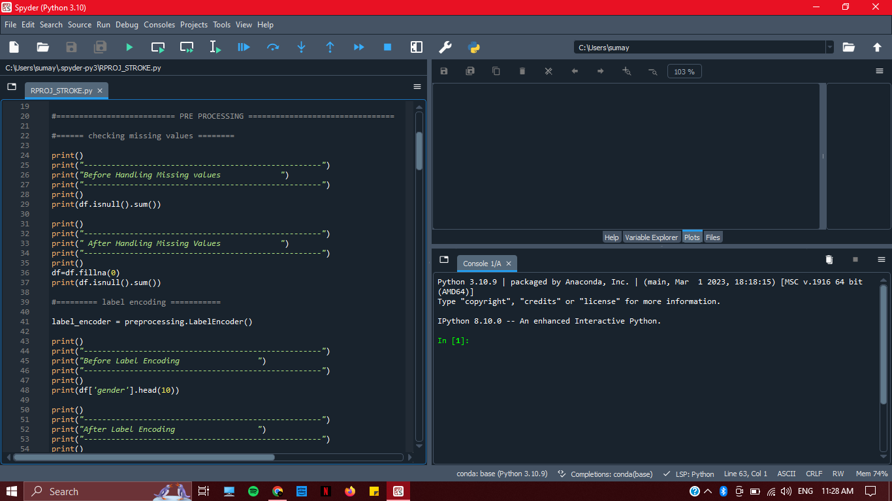
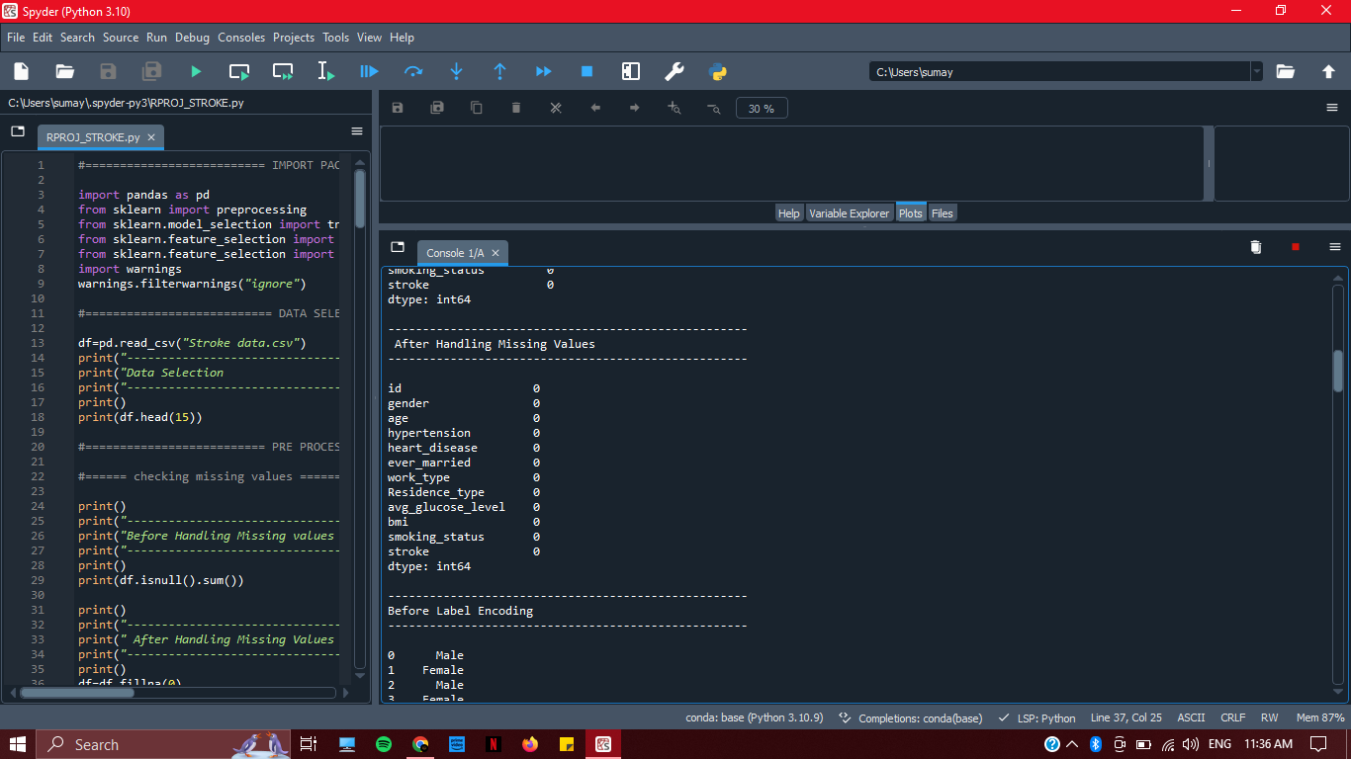

Slide 15
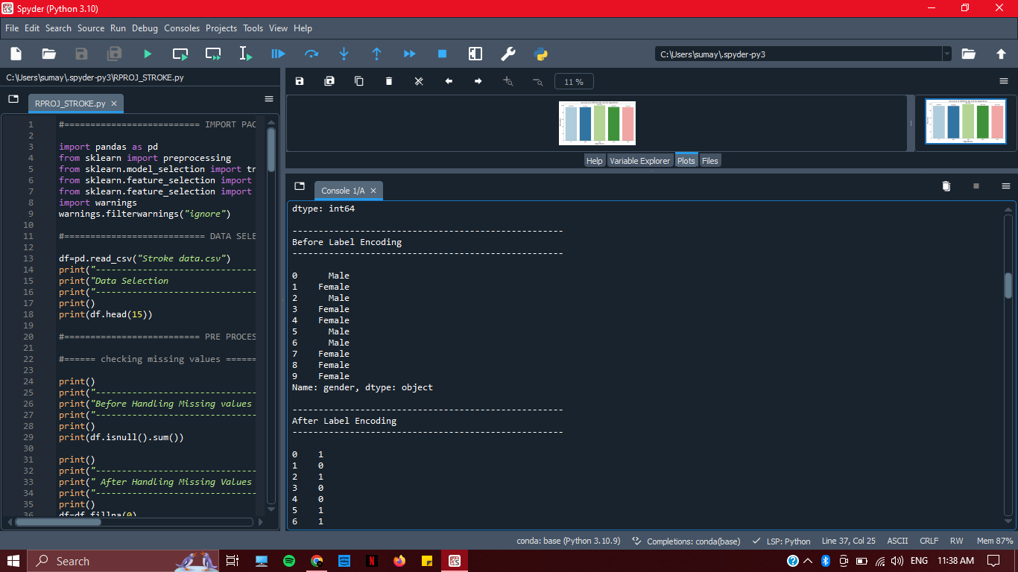
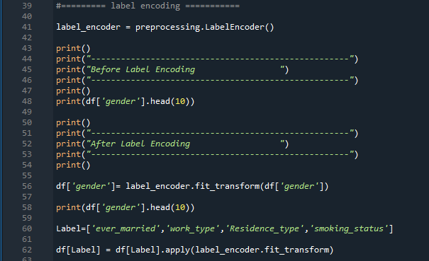
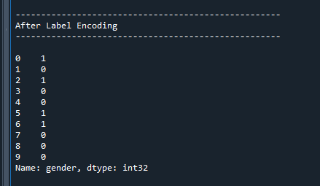

Slide 16
FEATURE SELECTION
Feature Selection is to select the best features in the dataset.
To implement feature selection, the techniques used are
❏ Chi-square
❏ SelectKBest

Slide 17
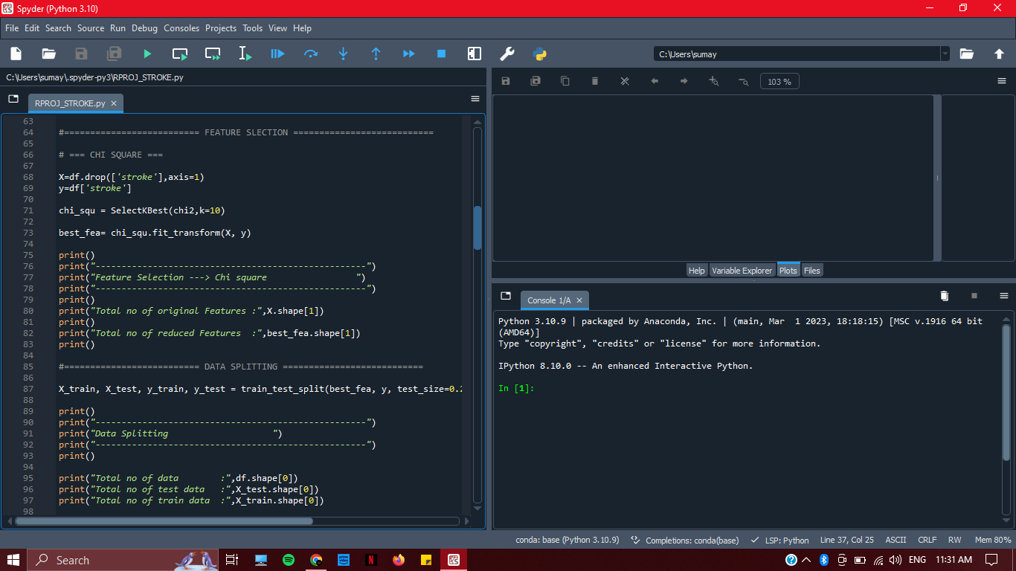
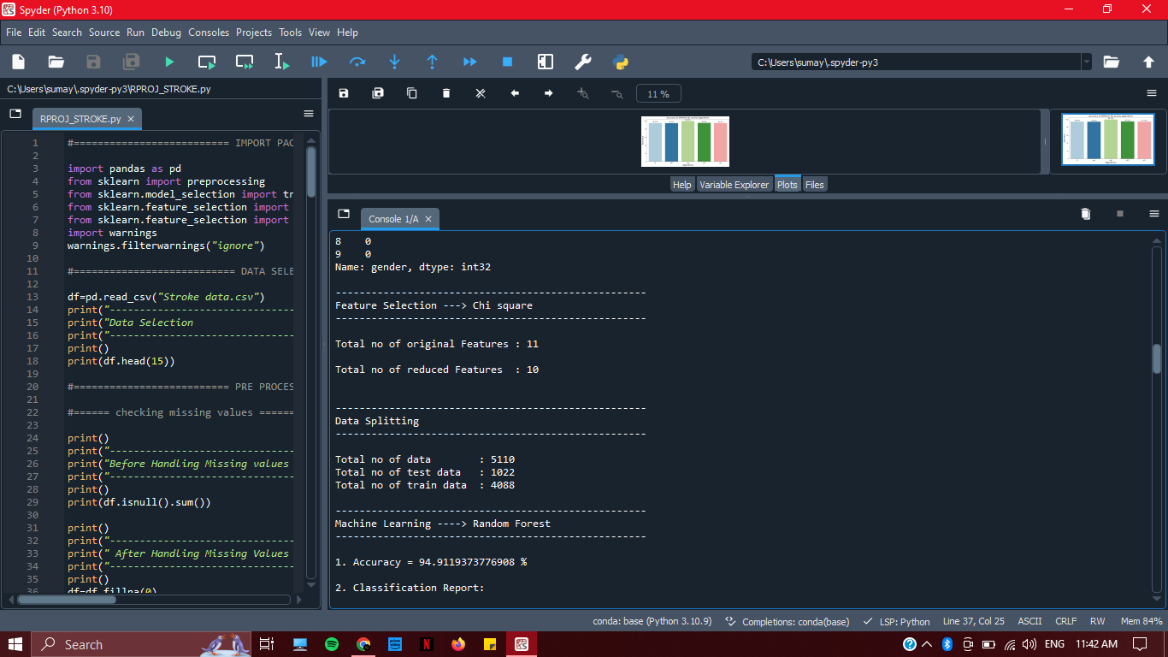

Slide 18
DATA SPLITTING
Data splitting is the act of partitioning available data into two portions, usually for cross-validation purpose.
One portion of the data is used to develop a predictive model and the other to evaluate the model's performance.
❏ 80%- Train Data
❏ 20%- Test Data

Slide 20
METHODOLOGY
Various Machine Learning and Deep Learning Algorithms
RANDOM FOREST
K-NEAREST NEIGHBORS
CONVOLUTIONAL NEURAL NETWORK
LONG SHORT-TERM MEMORY
MULTILAYER PERCEPTRON
ML
DL

Slide 21
COMPARING PROPOSED MODEL WITH EXISTING WORKS
AUTHOR | APPROACH TO ANALYSIS FOR STROKE RISK | ACCURACY
Proposed Model | Random Forest, K-Nearest Neighbors, Convolutional Neural Network, Long Short-Term Memory, Multilayer Perceptron | 99 (CNN)
Ritaban Mitraa et al.[1] | Random Forest, Support Vector Machine | 95 (RF)

Slide 22
PERFORMANCE ANALYSIS
MODEL | ACCURACY | PRECISION | RECALL | F1-SCORE
RANDOM FOREST | 94.91% | 0.95 | 1.00 | 0.97
K- NEAREST NEIGHBORS | 94.52% | 0.95 | 1.00 | 0.97
CONVOLUTIONAL NEURAL NETWORK | 99.69% | 0.96 | 0.96 | 0.96
LONG SHORT-TERM MEMORY | 95.22% | 0.96 | 0.96 | 0.96
MULTILAYER PERCEPTRON | 94.71% | 0.95 | 1.00 | 0.97

Slide 23

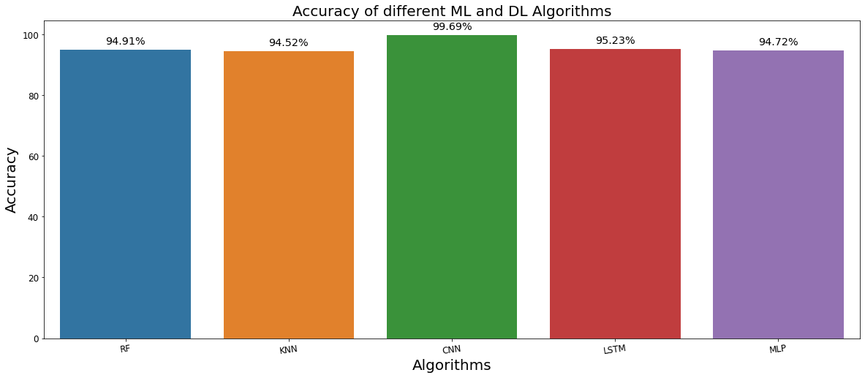
COMPARISON GRAPH

Slide 24
RESULTS AND DISCUSSION
This has a comparative analysis of Random Forest, K-Nearest Neighbors, Convolutional Neural Network, Long Short Term Memory, and Multilayer Perceptron algorithms.
It has been observed that the Convolutional Neural Network Algorithm performs better in terms of accuracy than the other algorithms used.
The data was gathered through a series of iterations to determine distinct ranges of accuracy rates.
In this study of stroke prediction, the Convolutional Neural Network has an accuracy of approximately 99%, which is higher than that of the other machine learning and deep learning algorithms.
Convolutional Neural Network has a better performance.

Slide 25
CONCLUSION
It is observed that the Convolutional Neural Network performs exceptionally well and has a significantly higher accuracy which is 99%.
The test results show that CNN is more effective in improving performance metrics than compared to others.

Slide 26

FUTURE ENHANCEMENTS
Future research will examine with hybridization of two machine learning algorithms or two deep learning algorithms or machine learning with deep learning algorithms that can be made for even better performance.
It can be also implemented in web applications for further enhancement.
Combining two or more datasets can also give better results for further work.

Slide 27
REFERENCES
[1] Ritaban Mitraa, T. Rajendran, "Efficient Prediction of Stroke Patients Using Random Forest Algorithm in Comparison to Support Vector Machine", Advances in Parallel Computing Algorithms, Tools and Paradigms, doi:10.3233/APC220075
[2] Dipita Paul, Gobinda Gain, Sujit Orang, Priteeranjan Das, Avijit Kumar Chaudhuri, "Advanced Random Forest Ensemble for Stroke Prediction", International Journal of Advanced Research in Computer and Communication Engineering, DOI: 10.17148/IJARCCE.2022.11343
[3] Elias Dritsas, Maria Trigka, "Stroke Risk Prediction with Machine Learning Techniques", DOI: 10.3390/s22134670
[4] Soumyabrata Dev, Hewei Wang, Chidozie Shamrock Nwosu, Nishtha Jain, Bharadwaj Veeravalli, Deepu John, "A predictive analytics approach for stroke prediction using machine learning and neural networks", https://doi.org/10.1016/j.health.2022.100032

Slide 28
[5] Minhaz Uddin Emon, Maria Sultana Keya, Tamara Islam Meghla, Md. Mahfujur Rahman, M Shamim Al Mamun, M Shamim Kaiser, "Performance Analysis of Machine Learning Approaches in Stroke Prediction", Fourth International Conference on Electronics, Communication and Aerospace Technology, DOI: 10.1109/ICECA49313.2020.9297525
[6] Gangavarapu Sailasya, Gorli L Aruna Kumari, "Analyzing the Performance of Stroke Prediction using ML Classification Algorithms", International Journal of Advanced Computer Science and Applications, DOI:10.14569/IJACSA.2021.0120662
[7] Chidozie Shamrock Nwosu, Soumyabrata Dev, Peru Bhardwaj, Bharadwaj Veeravalli, Deepu John, "Predicting Stroke from Electronic Health Records", 41st Annual International Conference of the IEEE Engineering in Medicine and Biology Society, DOI: 10.1109/EMBC.2019.8857234
[8] Pattanapong Chantamit-o-pas, Madhu Goyal, "Long Short-Term Memory Recurrent Neural Network for Stroke Prediction", Machine Learning and Data Mining in Pattern Recognition (pp.312-323), DOI:10.1007/978-3-319-96136-1_25
DATASET LINK: https://www.kaggle.com/datasets/fedesoriano/stroke-prediction-dataset

Slide 29
THANK YOU….

