Slide 1
PYTHIA · OR_Pythia_26
Oracle Fusion Manufacturing
RFP-Winning System
From an RFP to a grounded, data-backed win decision — in minutes, not days.
A grounded multi-agent system · Production-ready POC · Oracle Practice

Slide 2
The problem with the traditional way
How pursuit teams qualify and respond to an Oracle bid today
3–5 days
Inconsistent
Gut-feel
of analyst effort spent on manual competitive research per RFP
every analyst covers different competitors, at different depth
Go / No-Go decisions made on instinct, not historical data
The result: slow, expensive bid prep and proposals that can't prove why we win.
Oracle Fusion Manufacturing — RFP-Winning System
2

Slide 3
The solution
Upload an RFP — seven AI agents produce the full pursuit pack, grounded in real data
1
RFP intelligence
2
Competitor battlecards
Scope, must-haves and evaluation factors, extracted automatically
Honest strengths and weaknesses for every likely competitor
3
Winning positioning
4
Win probability + plan
The pitch, built from proven win themes and past results
A data-backed Go / No-Go with the gaps to close
Oracle Fusion Manufacturing — RFP-Winning System
3

Slide 4
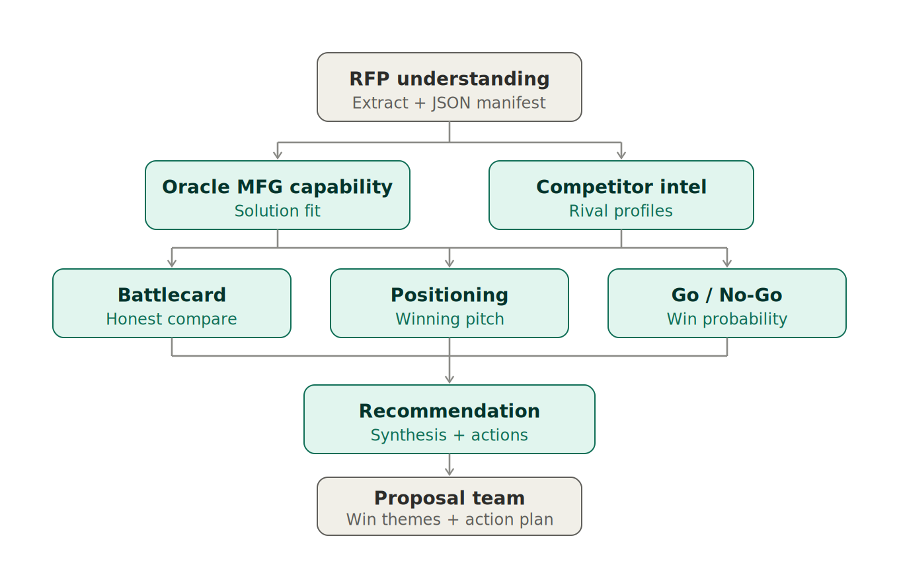
How it works
Four phases, seven agents — each phase builds on the last
Oracle Fusion Manufacturing — RFP-Winning System
4

Slide 5
The differentiator: grounded, not guessed
Why our answers are credible — and reproducible
Typical AI tool
This system
Invents competitor facts from model memory
Different answer every run
Win probability is a guess
Pulls from the open internet (data + compliance risk)
Every claim grounded in curated internal data (RAG)
Same RFP → same answer, with cited sources
Win probability from real historical win rates
No internet at runtime — governed, Blueverse-safe
Grounding is the moat: a probability backed by 5 of 8 past bids beats any number a model invents.
Oracle Fusion Manufacturing — RFP-Winning System
5

Slide 6
What it replaces
Traditional pursuit prep vs. the RFP-Winning System
Dimension | Traditional approach | RFP-Winning System
Time per RFP | 3–5 analyst-days | Under 10 minutes
Competitor coverage | Ad-hoc, varies by analyst | Every likely competitor, consistently
Basis for claims | Memory and opinion | Curated data + cited sources
Go / No-Go | Gut feel | Win probability from historical base rates
Output | Hand-built documents | 7 structured, reusable reports
Repeatability | One-off each time | Reproducible, auditable runs
Oracle Fusion Manufacturing — RFP-Winning System
6

Slide 7
What it produces
A real run on the sample Oracle Fusion Manufacturing RFP
Competitor battlecards
80%
6 competitors profiled — honest win/lose view each
Positioning pitch
Win probability
Win themes drawn from past wins and losses
GO
Grounded in 5 of 8 historical bids
vs. this competitor set
Action plan
Prioritised gaps to close, with owner roles
Oracle Fusion Manufacturing — RFP-Winning System
7

Slide 8
The business value
What the gain looks like — illustrative targets for the POC
~90%
100%
Every bid
less time on competitive research
of competitors covered, every run
qualified on data, not instinct
days → minutes per RFP
no analyst-to-analyst gaps
fewer wasted pursuits
The leverage: on a typical $10–20M Oracle Fusion bid, even a few points of win-rate lift returns many times the cost of building and running this system. Faster qualification also frees senior pre-sales time for the bids worth chasing.
Oracle Fusion Manufacturing — RFP-Winning System
8

Slide 9
Why this POC stands out
Six advantages that carry into production
1
Grounded
2
Reproducible
3
Secure
Real data behind every claim and number
Same input, same cited answer — every time
No internet at runtime; governed Blueverse data
4
Fast
5
Resilient
6
Production-ready
Full pursuit pack in minutes, runs in parallel
One agent failing never crashes the run
Async jobs, persistence, tests, prod server
Oracle Fusion Manufacturing — RFP-Winning System
9

Slide 10
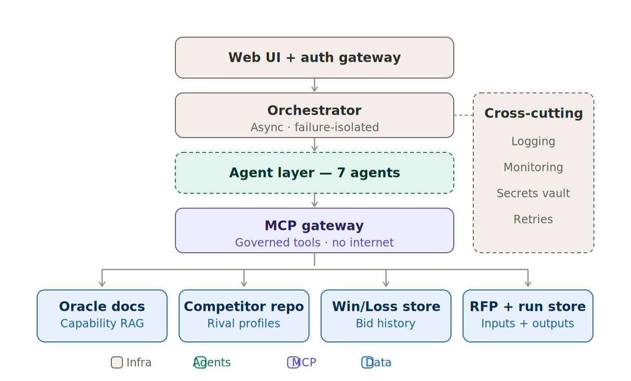
Built production-ready
Layered planes, governed data, operational from day one
Async + isolated
background jobs, one failure degrades gracefully
Governed data
MCP/RAG only — no internet egress
Persisted runs
every analysis saved and auditable
Observable
logging, monitoring, retries, secrets vault
Oracle Fusion Manufacturing — RFP-Winning System
10

Slide 11
Why it wins the bid — and the prize
Mapped to the RFP's 1000-point evaluation
Innovation & Differentiation
Functional Fit
Grounded agents + a movable win probability
Oracle capability mapped to documented modules
Vendor Qualifications
ROI & Value
Battlecards cite verifiable prior wins
Recommendations built on real outcomes
Oracle Fusion Manufacturing — RFP-Winning System
11

Slide 12
From POC to production
Three steps, already designed and documented
1
2
3
Host agents in Blueverse
Load real data
Go live
Create the 7 agents, attach RAG/MCP grounding, wire the flow IDs
Replace seeded profiles with your true competitor and win/loss records
Serve behind auth + HTTPS, monitor, and refresh data on a schedule
Oracle Fusion Manufacturing — RFP-Winning System
12

Slide 13
From RFP to a winning decision — grounded, fast, repeatable.
Thank you
Oracle Fusion Manufacturing RFP-Winning System · Pythia / OR_Pythia_26

