Slide 1
BROWSERSTACK DEMO WEBSITE
Under Guidance of Mrs. Vaishali sonanis mam
by KOTHAPALLI SUMALATHA

Slide 2
Introduction :
IN THIS PROJECT, I WORKED ON TESTING THE BROWSERSTACK WEBSITE. I STRATED BY UNDERSTANDING ITS FEATURES AND BREAKING THE APPLICATION INTO TESTABLE MODULES LIKE USER LOGIN, PRODUCT SEARCH, ADD TO CART, AND CHECKOUT. I MANAGED TASKS USING MANAUAL TESTING, CREATED TEST PLANS AND STRATEGIES, AND EXECUTED BOTH MANUAL AND AUTOMATED TEST CASES.
I LOGGED AND TRACKED DEFECTS, GENERATED REPORTS SUCH AS TEST SUMMARIES AND DEFECT ANALYSIS, AND FINALLY PRESENTED THE PROJECT OUTCOME TO THE TRAINER, SHOWCASING MY TESTING APPROACH AND FINDINGS ON THE BROWSERSTACK PLATFORM.

Slide 3
Modules of BSTACK DEMO website
Sign in
SEARCH
ADD TO CART
DELETE FROM CART
CHECKOUT
ORDERS
ORDERBY
OFFERS
VENDORS
FAVOURITES
LOGOUT

Slide 4
Responsibilities
Understanding project requirements.
Dividing the application into testable modules.
Creating and managing tasks in tools like JENKINS AND FRAMEWORKS LIKE CUCUMBER BDD.
Preparing test plans and strategies.
Writing and executing test cases (manual + automated).
Logging and tracking defects.
Generating reports (Test Reports, Defect Reports, Analysis Reports).
Presenting the project outcome to TRAINER.

Slide 5
Overview
What is BROWSERSTACK DEMO?
Browser stack Demo is a sample e-commerce website designed to showcase online shopping features and workflows for demo and testing purposes.
It features a simple storefront offering products from various vendors such as Apple, Samsung, Google, and OnePlus, along with typical functionalities like product search, customer sign-in, favorites, orders, and offers.
This site is commonly used for automation testing, demonstrations, and learning web retail platform functionalities in a controlled environment

Slide 6
Modules
Module 1 : Sign in page
Allows users to log into BROWSERSTACK DEMO WEBSITE.
Module 2 :sEARCH
Enables product discovery using keywords.
Module 4 : ADD TO CART
Lets users choose items to buy and collect them in a shopping cart.
Module 4 : DELETE FROM CART
Permits removal of selected items from the shopping cart before checkout.
Module 5 : CHECKOUT
Processes the order and payment to complete a purchase securely.
Notes:
Module 1: Signn in page
Checked all the functionalities on Sign in page which included personal info as email
address, password
Module 2: Women page
Checked all the functionalities on Women page which included item details, Quantity, Filters,compare button,Add to cart button,product info,grid,list button
Module 3: Tshirt page
Checked all the functionalities on T-Shirt page which included item details, Quantity, Filters,compare button,Add to cart button,product info,grid,list button
Module 4: All Buttons and Drop Down Arrow :
team checked if all the buttons and drop down arrows of different fields are functioning properly or not

Slide 7
Module 6 : ORDERS
Displays past and current orders for tracking and reference.
Module 7 : ORDERBY
Offers sorting options for products based on criteria such as price.
Module 8 : OFFERS
Showcases special deals, discounts, or promotional items available to users.
Module 9 : VENDORS
Lists available brands or merchants featured in the store.
Module 10 : FAVOURITES
Lets users save and review preferred products for future purchases.
Module 11 : LOGOUT
Allows users to securely end their session on the platform.

Slide 8
Defects
While running a testcase at certain point some fields are not working as it is expected which is nothing but a defect, so i had created a Defect report on those defects.

Slide 9
Defect identifier :- d_001 ➤ DEFECT SUMMARY :- Profile links on the BROWSERSTACK DEMO website are not clickable or viewable, preventing users from accessing linked profiles. ➤ TEST ID :- TC_01 ➤ TEST CASE NAME :- TC_PROFILE_LINKS_NOT_CLICKABLE ➤ MODULE NAME :- SIGN IN ➤ REPRODUCIBLE :- YES ➤ SEVERITY :- MEDIUM ➤ PRIORITY :- HIGH ➤ RAISED BY :- KOTHAPALLI SUMALATHA ➤ ASSIGNED TO :- TL ➤ DATE OF ASSIGNMENT :- 01/09/2025 ➤ STATUS :- PENDING ➤ SNAP SHOTS :- BELOW ➤ FIXED BY :- DEVELOPER

Slide 10
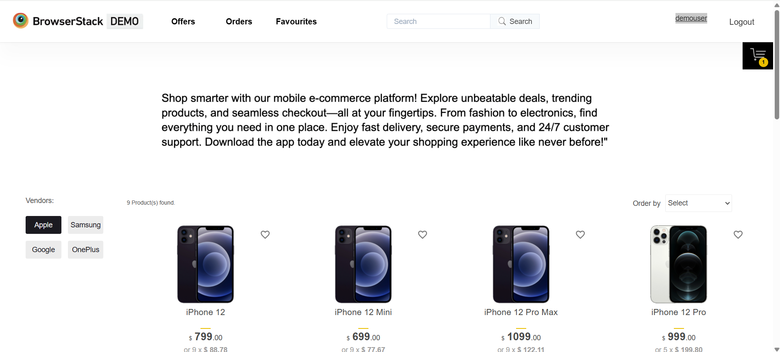

Slide 11
DEFECT IDENTIFIER :- D_002
DEFECT SUMMARY :-privacy policy link is not working by clicking read more it is navigating to home mage instead of opening privacy policy.
TEST ID :- TC_02
TEST CASE NAME :-TC _ privacy _ policy
MODULE NAME :- HOME PAGE
REPRODUCIBLE :- YES
SEVERITY :- HIGH
PRIORITY :- medium
RAISED BY :- KOTHAPALLI SUMALATHA
ASSIGNED TO :-TL
DATE OF ASSIGNMENT :-01/09/2025
STATUS :- OPEN
SNAP SHOTS :- BELOW
FIXED BY :-DEVELOPER

Slide 12
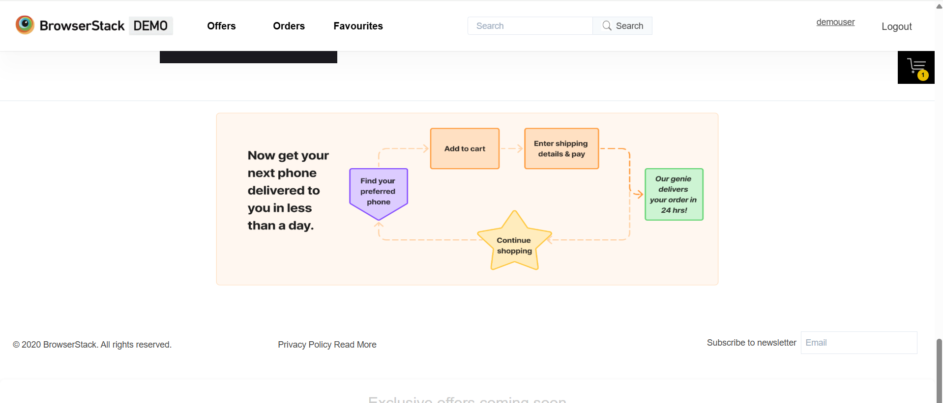
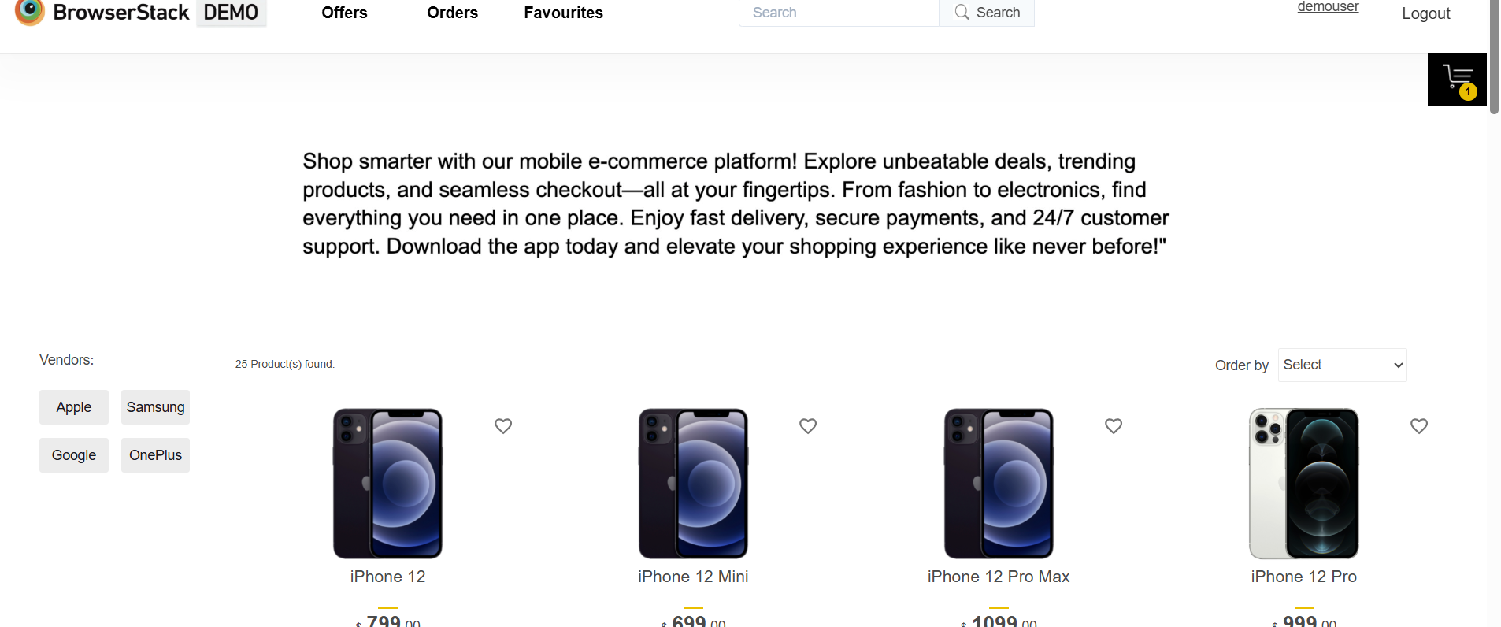

Slide 13
Challenges
1.DURING AUTOMATION TESTING I FACED SOME UI TESTING PROBLEMS BECAUSE IN THIS WEBSITE SOME LINKS AND BUTTONS ARE NOT CLICKABLE.
2.SOMETIMES DUE TO AUTOMATION TOOLS MY SYSTEM STRUCKS IN MIDDLE OF EXECUTION.
3.DURING AUTOMATION TESTING IT TAKES SOME TIME FOR LOADING DUE TO NETWORK SPEED ISSUES.

Slide 14
Experience
CAPSTONE PROJECT HANDLED AND TESTED SMOOTHLY Because of HANDS ON EXPERINCE IN DOING MINI PROJECTS GIVEN BY TRAINER.
IT Helps to find out bugs and clarify my doubts.
Manual testing needs strong observation and in that we need to apply all possibilities in test cases.

Slide 15
Thank You!!!
Vaishali Mam For Guiding Us through out the Project.

