Slide 1
EBAY WEBSITE
Under Guidance of Mrs. Vaishali Sonawane Mam.
by KOTHAPALLI SUMALATHA

Slide 2
Introduction :
IN THIS PROJECT, I WORKED ON TESTING THE EBAY WEBSITE. I STRATED BY UNDERSTANDING ITS FEATURES AND BREAKING THE APPLICATION INTO TESTABLE MODULES LIKE USER LOGIN, PRODUCT SEARCH, BIDDING, AND CHECKOUT. I MANAGED TASKS USING JIRA, CREATED TEST PLANS AND STRATEGIES, AND EXECUTED BOTH MANUAL AND AUTOMATED TEST CASES.
I LOGGED AND TRACKED DEFECTS, GENERATED REPORTS SUCH AS TEST SUMMARIES AND DEFECT ANALYSIS, AND FINALLY PRESENTED THE PROJECT OUTCOME TO THE CLASS, SHOWCASING MY TESTING APPROACH AND FINDINGS ON THE EBAY PLATFORM.

Slide 3
Modules of ebay website
Sing In
Daily Deals
Brand Outlet
Gift Cards
Help & Contact
Sell
Watchlist
My eBay
Notification
Cart

Slide 4
Shop By Category
All Deals
Search Bar
Advanced
Featured
Tech
Fashion
Home
More

Slide 5
Responsibilities
Understanding project requirements.
Dividing the application into testable modules.
Creating and managing tasks in tools like Jira.
Preparing test plans and strategies.
Writing and executing test cases (manual + automated).
Logging and tracking defects.
Generating reports (Test Reports, Defect Reports, Analysis Reports).
Presenting the project outcome to class.

Slide 6
Overview
What is EBAY?
EBAY IS AN E-COMMERCE PLATFORM THAT ALLOWS USERS TO BUY AND SELL PRODUCTS AND SERVICES ONLINE.
IT IS A GLOBAL ONLINE MARKETPLACE OFFERING A WIDE RANGE OF PRODUCTS.
EBAY CONNECTS INDIVIDUAL BUYERS, SELLERS, AND BUSINESSES WORLDWIDE THROUGH A SECURE AND USER-FRIENDLY PLATFORM.
THE PLATFORM HELPS USERS DISCOVER PRODUCTS, MAKE PURCHASES, AND MANAGE THEIR ONLINE BUYING AND SELLING ACTIVITIES EASILY.

Slide 7
Modules
Module 1 : Sign in page
Allows users to log into their personal eBay account
Module 2 : Daily Deals
Offers time-limited promotions and discounts on selected products
Module 4 : Brand Outlet
Provides access to official brand stores with discounted prices
Module 4 : gift cards
Lets users purchase eBay gift cards for personal use or gifting
Module 5 : Help & Contact
Directs users to eBay’s support center for common questions, FAQs, and contact options
Notes:
Module 1: Signn in page
Checked all the functionalities on Sign in page which included personal info as email
address, password
Module 2: Women page
Checked all the functionalities on Women page which included item details, Quantity, Filters,compare button,Add to cart button,product info,grid,list button
Module 3: Tshirt page
Checked all the functionalities on T-Shirt page which included item details, Quantity, Filters,compare button,Add to cart button,product info,grid,list button
Module 4: All Buttons and Drop Down Arrow :
team checked if all the buttons and drop down arrows of different fields are functioning properly or not

Slide 8
Module 6 : Sell
Entry point for users or businesses to list and sell their products
Module 7 : Watchlist
Stores user-saved items for future viewing or purchase
Module 8 : My eBay
Personal dashboard with access to purchase saved searches
Module 9 : Notification
Displays alerts such as order updates, messages or system announcements
Module 10 : Cart
Shows items the user has added and is ready to buy

Slide 9
Module 11 : Shop by Category
Dropdown menu to browse products by categories like Electronics, Fashion, Collectibles, etc.
Module 12 : All CATEGORIES
View all different types of categories available in website
Module 13 : Search Bar
Main search functionality to find products by name, brand, or keywords.
Module 14 : Advanced
Opens advanced search filters like seller, price range, location, and item condition

Slide 10
Module 15 : Tech
Direct link to electronics and gadgets like phones, laptops, and accessories
Module 16 : Fashion
Browse clothing, shoes, and accessories for men, women, and kids
Module 17 : Home
Find furniture, decor, kitchen tools, and other home essentials
Module 18 : More
Expands additional popular categories not listed in the top menu
Module 18 : header Navigation
Contains all top-level links like Sign In, Daily Deals, Sell, Cart, My eBay , Etc. It provides direct access to all major user actions and sections from any page on the website.

Slide 11
Defects
While running a testcase at certain point some fields are not working as it is expected which is nothing but a defect, so i had created a Defect report on those defects.

Slide 12
Defect identifier :- d_001
➤DEFECT SUMMARY :- SOME TOP MENU ITEMS LIKE "DAILY DEALS" AND "BRAND OUTLET" DON’T SHOW A LIST WHEN THE MOUSE IS PLACED OVER THEM, WHILE OTHERS LIKE “SHOP BY CATEGORY” DO. ➤ TEST ID :- TC_01 ➤ TEST CASE NAME :- Tc_nAVIGATIOn_mousecursor_INCONSISTENT ➤ MODULE NAME :- HEADER NAVIGATION ➤ REPRODUCIBLE :- YES ➤ SEVERITY :- LOW ➤ PRIORITY :- MEDIUM ➤ RAISED BY :- KOTHAPALLI SUMALATHA ➤ ASSIGNED TO :- TL ➤ DATE OF ASSIGNMENT :- ➤ STATUS :- PENDING ➤ SNAP SHOTS :-BELOW ➤ FIXED BY :- DEVELOPER ➤ DATE OF FIXING :-

Slide 13

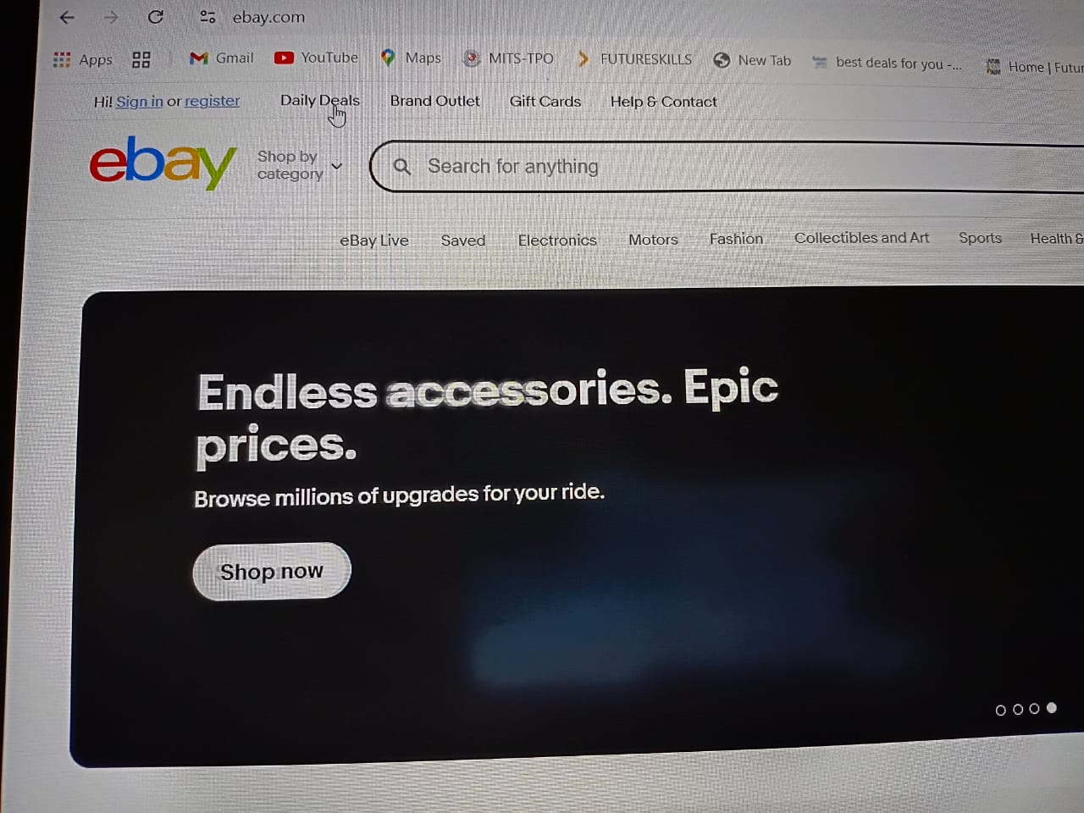
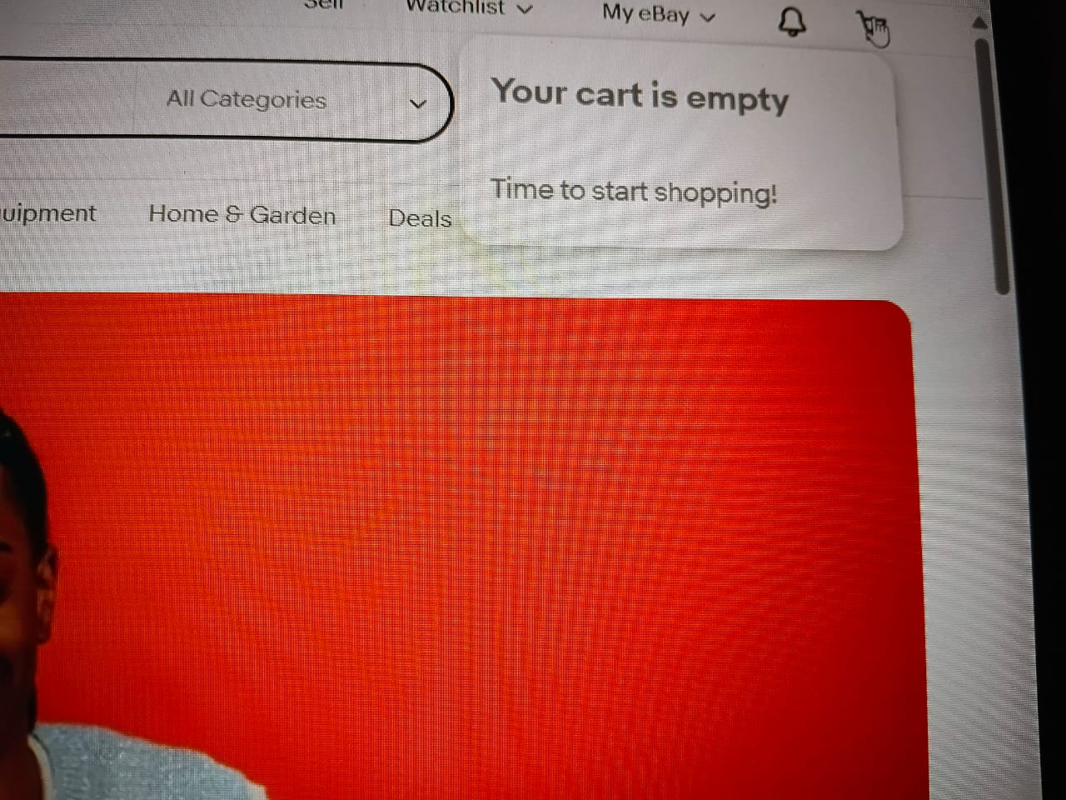

Slide 14
DEFECT IDENTIFIER :- D_002
DEFECT SUMMARY :- UNDER DAILY DEALS MODULE THERE IS NO FILTER OPTION.
TEST ID :- TC_02
TEST CASE NAME :- TC_SEARCH_FILTER_NOT_DISPLAYED
MODULE NAME :- DAILY DEALS
REPRODUCIBLE :- YES
SEVERITY :- MEDIUM
PRIORITY :- HIGH
RAISED BY :- KOTHAPALLI SUMALATHA
ASSIGNED TO :-TL
DATE OF ASSIGNMENT :-
STATUS :- OPEN
SNAP SHOTS :- BELOW
FIXED BY :-DEVELOPER
DATE OF FIXING :-

Slide 15
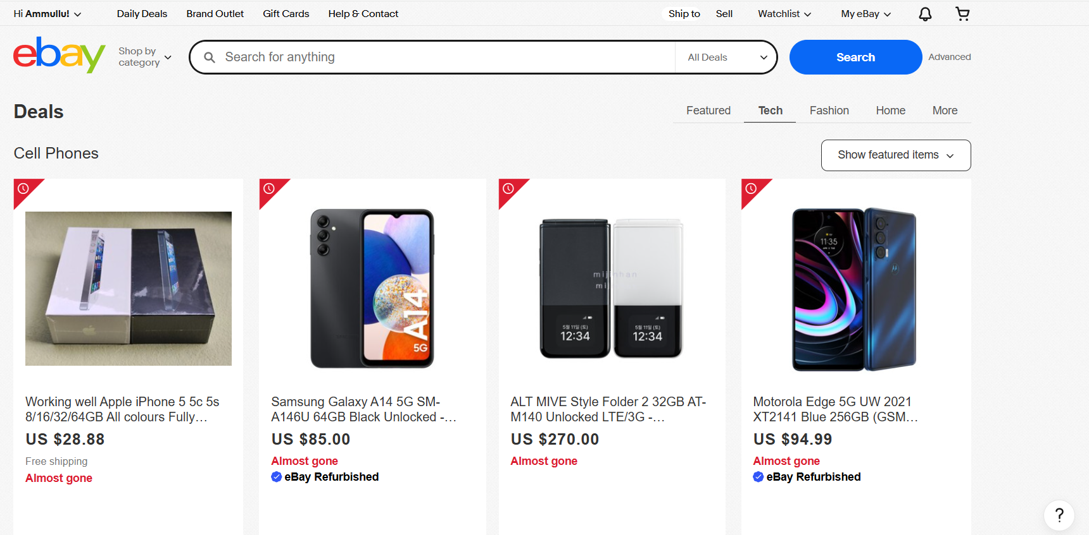

Slide 16
Challenges
1.While testing classes started I faces some challenges in understanding the selenium tools AS I DON’T HAVE ANY PRIOR KNOWLEDGE IN TESTING.so There comes difference in SETTING SELINIUM TOOLS and while running it.
2.SOMETIMES DUE TO AUTOMATION TOOLS MY SYSTEM STRUCKS IN MIDDLE OF EXECUTION.
3.IF I DON’T UNDERSTAND THE CONCEPT COMPLETELY I USED RECORDING SESSIONS FOR BETTER UNDERSTANDING.

Slide 17
Experience
Because of communication And discussion with mam in class helps me to write taste cases in easy way.
IT Helps to find out bugs and clarify my doubts.
Manual testing needs strong observation and in that we need to apply all possibilities in test cases.

Slide 18
Thank You!!!
Vaishali Mam For Guiding Us through out the Project.

