Slide 1

MICROSOFT ENGAGE PROGRAMME 2022
PROJECT ON ALGORITHMS:
A MOVIE RECOMMENDER SYSTEM
MADE BY : SUSHREE SUMAN SAHU
(A 2ND YEAR STUDENT,NIT ROURKELA)

Slide 2
ABOUT:
THIS IS BASICALLY A CONTENT BASED MOVIE RECOMMENDER SYSTEM.I HAVE TAKEN THE DATASETS OF MOVIES FROM TMDB WEBSITE.THIS PROJECT RECOMMENDS THE AVAILABLE SIMILAR MOVIES FROM THE DATASET AFTER THE USER MAKES A CHOICE FROM THE AVAILABLE OPTIONS.

Slide 3
IDEs USED:
ALGORITHMS USED:
JUPYTER
PYCHARM
BAG OF WORDS
VECTORIZATION
STEMMING
PROGRAMMING LANGUAGE USED: PYTHON

Slide 4
USE OF ALGORITHMS:
1.BAG OF WORDS: I used it to preprocess the text by converting it into a bag of words and to keep a count of the total occurrences of most frequently used words.
2.VECTORIZATION: I used it to get the unique features of the text by converting the text into vectors, so that it would be easier to find the similar movies from the
datasheet.
3.STEMMING: I used this algorithm to extract the root or base words from the words by removing their affixes.

Slide 5
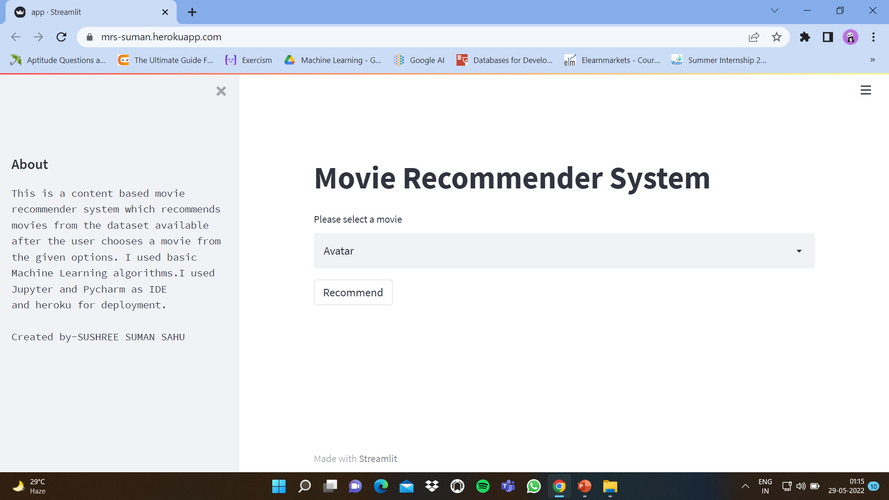
BASIC DESIGN

Slide 6
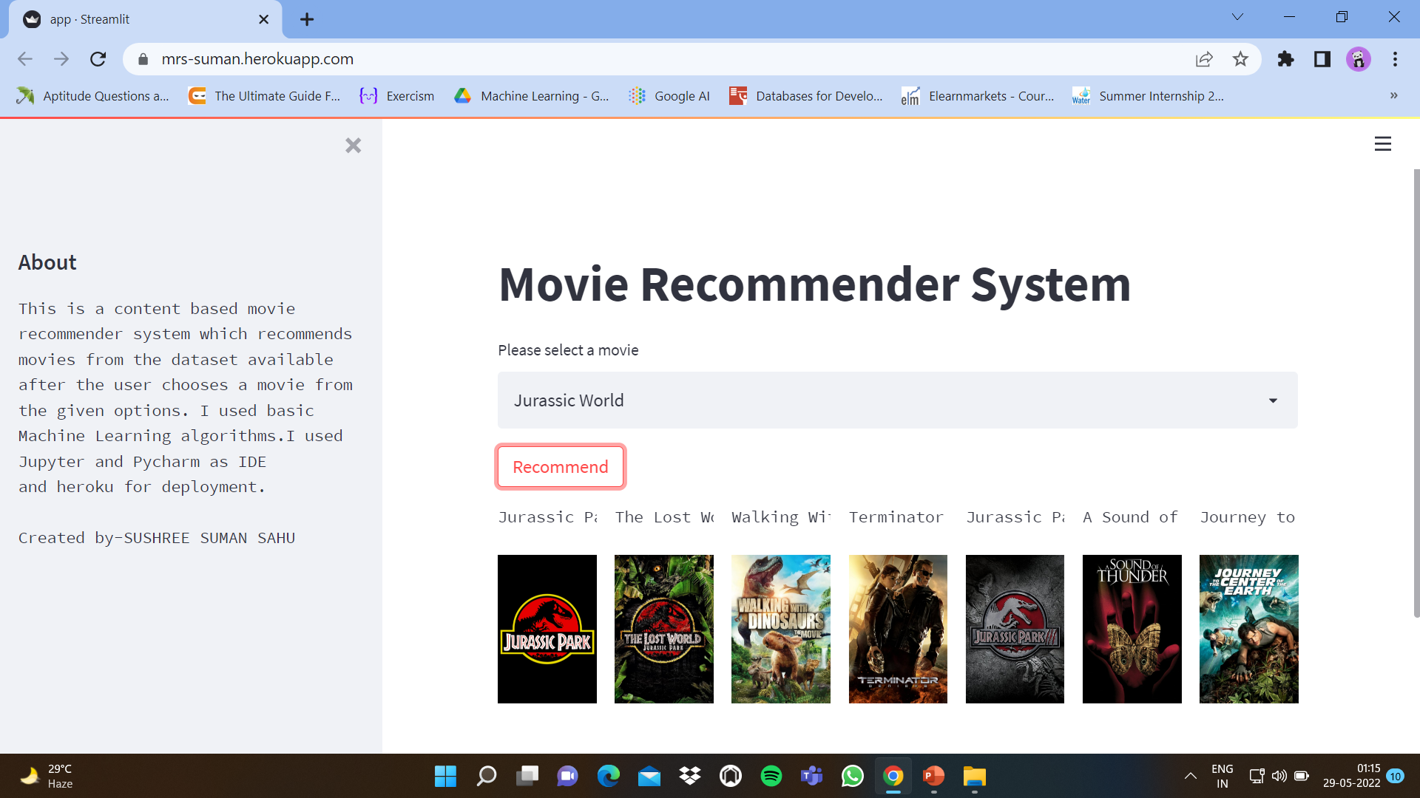
RESULTS AFTER DEPLOYMENT

Slide 7
THANK YOU

