Slide 1

Capstone Project
Coronavirus Tweet Sentiment
Analysis
Presented By:
Name - Suman Tirkey
College Name - Govt Engineering College Palamu
Dept - Computer Science & Engineering

Slide 2

OUTLINE
Problem Statement
Proposed System/Solution
Development Approach
Algorithm & Deployment
Result
Conclusion
Future Scope
References

Slide 3
Problem Statement
This challenge asks you to build a classification model to
predict the Sentiment of COVID- 19 Tweets. The Tweets
have been pulled from Twitter and Manual tagging has
been done then . The names and usernames have been
given codes to avoid any privacy concerns.
Location
TweetAt
Original Tweet
Sentiment
User Name
screen Name

Slide 4
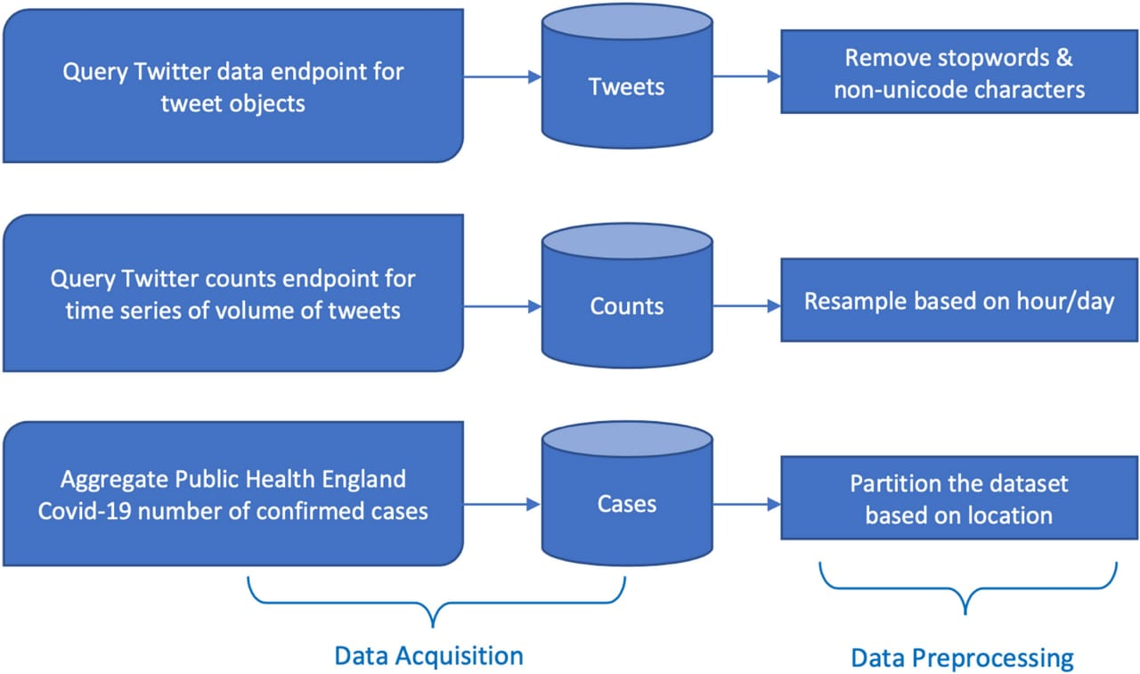
General Guidelines

Slide 5
Proposed Solution
Creating a sentiment analysis solution for coronavirus-related tweets involves several steps. Here’s a proposed approach:
Data Collection: * Twitter API:* Use Twitter's API to collect tweets containing specific coronavirus-related keywords (e.g., "COVID-19",
"coronavirus“ , "pandemic "). Consider collecting tweets from different geographical locations and languages for a broader dataset.
Data Preprocessing:
*Text Cleaning:* Remove special characters, URLs, and emojis which may not contribute to sentiment analysis.-
*Tokenization:* Split tweets into individual words or tokens.-
*Stopword Removal:* Eliminate common words (e.g., "and", "the") that do not carry sentiment.-
*Normalization:* Convert words to their base form (lemmatization or stemming) to reduce variations.
Sentiment Analysis Techniques:
*Lexicon-Based Approaches:* Use sentiment lexicons (like VADER) that assign sentiment scores to words based on pre- defined
dictionaries of sentiment polarity.
*Machine Learning Approaches:* Train a supervised learning model (e.g., Naive Bayes, Support Vector Machines, LSTM) on annotated
data to classify tweets into positive, negative, or neutral sentiments.
*Deep Learning Approaches:* Implement neural network models such as LSTM or Transformer-based architectures (like BERT) for more
accurate sentiment analysis.

Slide 6
Feature Extraction:
*Bag-of-Words (BOW):* Represent tweets as vectors of word frequencies.
*TF-IDF:* Term Frequency-Inverse Document Frequency assigns weights to words based on their importance in tweets relative to
the entire dataset.-
*Word Embeddings:* Represent words in a continuous vector space to capture semantic meanings.
Sentiment Classification:
*Binary Classification:* Classify tweets as positive or negative.-
*Multiclass Classification:* Classify tweets into multiple sentiment categories (positive, negative, neutral).
Model Evaluation:
*Cross-Validation:* Split the dataset into training and test sets to evaluate model performance.-
*Metrics:* Use metrics such as accuracy, precision, recall, and F1-score to assess the model’s effectiveness.
Deployment and Monitoring:
*API Development:* Develop an API endpoint for real-time sentiment analysis of incoming tweets.-
*Monitoring:* Continuously monitor the model’s performance and retrain it periodically with new data to maintain accuracy.
Visualization and Interpretation:
*Dashboard:* Create a dashboard to visualize sentiment trends over time or across different regions.-
*Interpretation:* Analyze insights from sentiment analysis to understand public opinion and sentiment dynamics Related to coronavirus.
Considerations:
*Data Privacy:* Ensure compliance with data protection regulations when collecting and processing tweets.-
*Bias Handling:* Address biases that may arise from the dataset or sentiment analysis techniques.-
*Real-Time Processing:* Implement efficient algorithms to handle a large volume of tweets in real-time.

Slide 7
System Approach
A systematic approach to developing a robust system for coronavirus tweet sentiment analysis involves several key components and considerations:
1.Data Acquisition and Preprocessing Data Collection: Utilize Twitter's API or a data provider to collect a large dataset of tweets related
to COVID-19 using relevant keywords and hashtags . Data Filtering and Cleaning : Remove irrelevant tweets (e.g., retweets,
promotional tweets).Clean tweets by removing URLs, special characters, emojis, and non-alphanumeric symbols . Normalize text by
converting to lowercase and handling abbreviations and slang.
2. Data Storage and Management Database: Store pre processed tweets in a database (e.g., MySQL, MongoDB) for efficient retrieval
and management . Data Quality Assurance: Implement checks to ensure data integrity and completeness.
3. Feature Engineering Text Representation : Convert tweets into numerical representations suitable for machine learning algorithms
(e.g., TF-IDF, word embeddings).Extract features such as n-grams (to capture word sequences) and sentiment lexicon scores (e.g.,
VADER scores).
4. Sentiment Analysis Models Model Selection: Choose appropriate models based on the dataset size and complexity : Lexicon-based
models: Use sentiment lexicons like VADER for quick analysis of sentiment polarity.
6. Machine learning models: Train supervised models (e.g., Naive Bayes, SVM, neural networks) on labelled data for more nuanced
sentiment analysis . Deep learning models: Consider using transformers (e.g., BERT) for contextual understanding of tweet
sentiments.

Slide 8
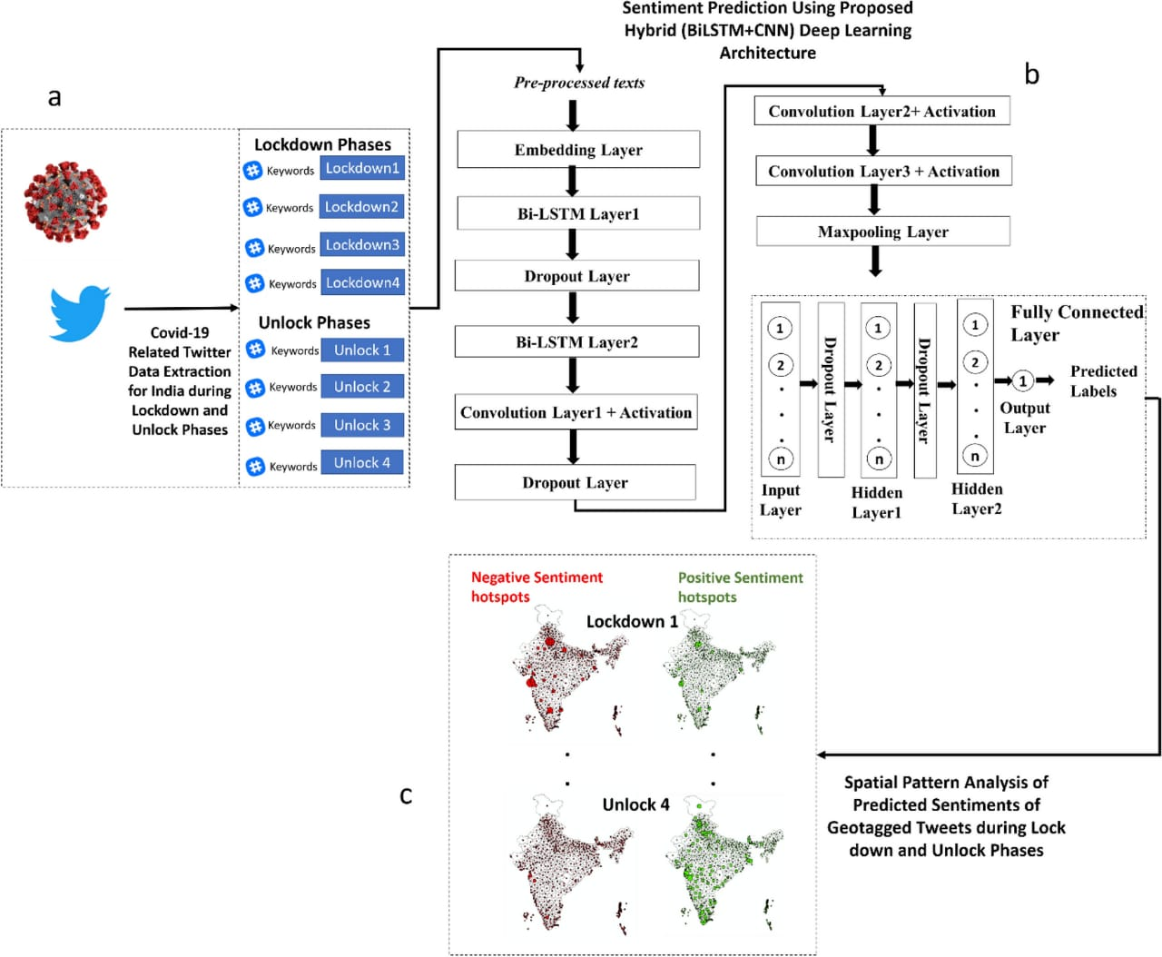
6. Visualization and Reporting Dashboard: Create a dashboard to visualize sentiment trends, sentiment distributions, and key insights derived from tweet analysis . Reporting: Generate periodic reports summarizing sentiment analysis results for stakeholders .

Slide 9
Algorithm and Deployment
#Algorithm Selection
*Algorithm Choice:
*VADER (Valence Aware Dictionary and sentiment Reasoner): A lexicon and rule-based algorithm widely used for sentiment analysis of
social media texts like tweets. VADER assigns sentiment scores (positive, negative, neutral) to words and computes an overall sentiment
score for each tweet.
*Machine Learning Models:
*Naive Bayes: A simple probabilistic classifier based on Bayes' theorem that works well for sentiment classification tasks.
*Support Vector Machines (SVM): Effective for binary classification tasks and can be adapted for multi-class sentiment analysis.
*Deep Learning Models: Such as Recurrent Neural Networks (RNNs), Long Short-Term Memory (LSTM) networks, or Transformer-based
architectures (like BERT) for more nuanced sentiment analysis, especially when dealing with complex language structures in tweets.
#Deployment Strategy:
*Deployment Steps:
*Preprocessing Pipeline: Develop a preprocessing pipeline to clean and tokenize tweets, including steps like removing URLs, emojis, and
non-alphanumeric characters, and converting text to lowercase.
*Feature Extraction: Depending on the algorithm chosen, extract features such as TF-IDF (Term Frequency-Inverse Document
Frequency) vectors, word embeddings (e.g., Word2Vec, Glove), or directly use sentiment lexicon scores.
*Model Training: Train the chosen sentiment analysis model using a labeled dataset of tweets. Ensure the dataset includes a balanced
representation of positive, negative, and neutral sentiments related to coronavirus.

Slide 10
*Model Evaluation: Evaluate the model using appropriate metrics (e.g., accuracy, precision, recall, F1-score)
to assess its performance on a validation
dataset. Fine-tune hyperparameters as needed to optimize performance.
*Real-Time Deployment: Deploy the trained model as a service using a web framework (e.g., Flask, Django) on cloud infrastructure (e.g., AWS, Google
Cloud) to handle real-time requests for sentiment analysis.
*API Development: Develop an API endpoint that accepts tweets as input, preprocesses them, applies the
trained sentiment analysis model, and returns
sentiment scores or labels (positive, negative, neutral).
*Scalability and Monitoring: Ensure the deployment architecture is scalable to handle varying loads of
incoming tweets during peak times. Monitor system
performance and implement logging and error handling mechanisms.
#Ethical and Legal Considerations:
*Data Privacy: Adhere to data protection regulations and ensure compliance with Twitter's terms of service
when collecting and processing tweets.
*Bias Mitigation: Address biases in the dataset and model to ensure fair and accurate sentiment analysis
across different demographic groups and geographic regions.
*Transparency: Provide transparency in how sentiment scores are derived and interpreted, especially in
sensitive topics like public health crises.

Slide 11
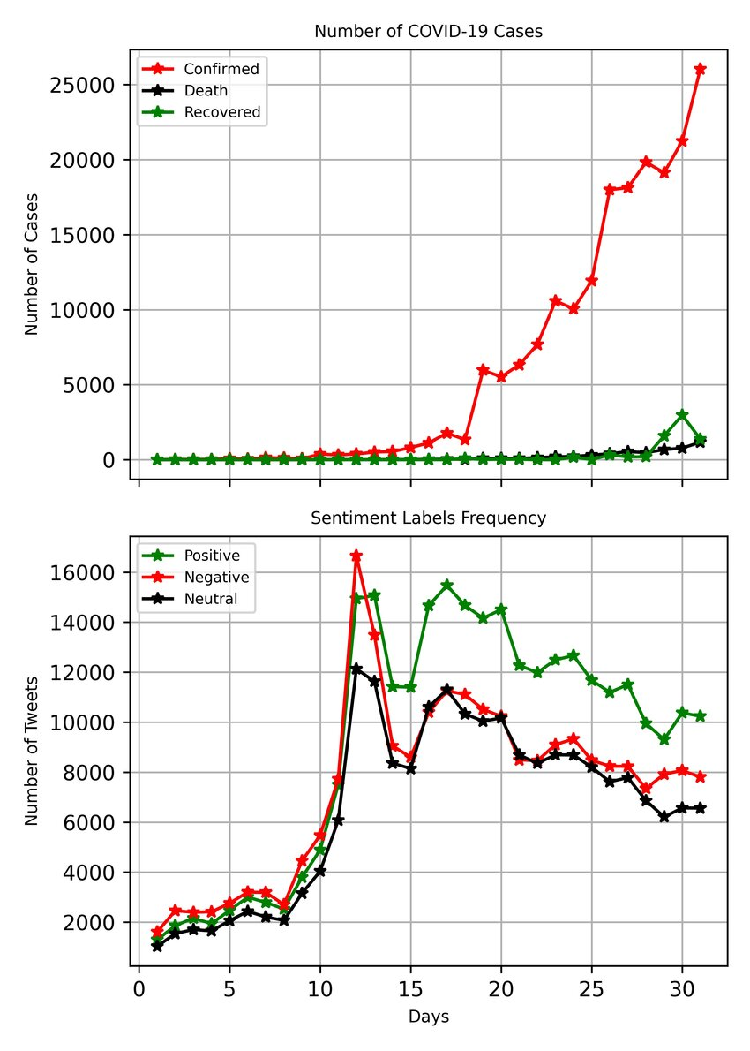
Result
Overall sentiment is mixed, with a significant portion expressing concern, frustration,
or fear about the virus and its impact.
There's also a notable amount of
misinformation and skepticism circulating , alongside messages of solidarity, hope, and calls for preventive Measures like vaccination and hygiene practices.

Slide 12
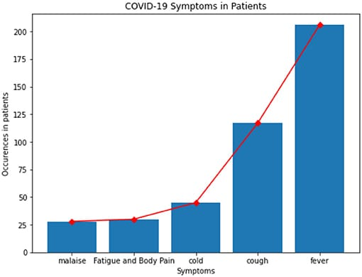
Conclusion
The sentiment surrounding coronavirus tweets is multifaceted and reflects the diverse reactions of people worldwide. While many express concern, fear, and frustration about the virus and its impact on health and daily life, there are also messages of solidarity, support for healthcare workers, and calls for collective action through vaccination and preventive measures. Additionally, misinformation and skepticism persist, underscoring the ongoing challenge of navigating a global health crisis in the digital age.

Slide 13
Future Scop
Looking ahead, the future scope for coronavirus tweet sentiment analysis includes enhancing AI models to better detect nuanced emotions and sentiments. This could involve developing algorithms capable of understanding regional variations in sentiment, identifying emerging trends in public opinion, and detecting and countering misinformation effectively. Furthermore, integrating real-time data analysis with public health responses could provide valuable insights into community attitudes and behaviors during health crises, facilitating more targeted and effective communication strategies.

Slide 14
References
Here is a reference that discusses coronavirus tweet sentiment analysis:
Chew, C., & Eysenbach, G. (2020). Pandemics in the Age of Twitter: Content Analysis of Tweets
during the 2009 H1N1 Outbreak. PLOS ONE, 5(11), e14118.
https://doi.org/10.1371/journal.pone.0014118
This study analyzes sentiment and themes in tweets during the 2009 H1N1 outbreak,
providing insights into public sentiment during a pandemic and laying groundwork for
understanding similar dynamics in subsequent outbreaks like COVID-19.

Slide 15
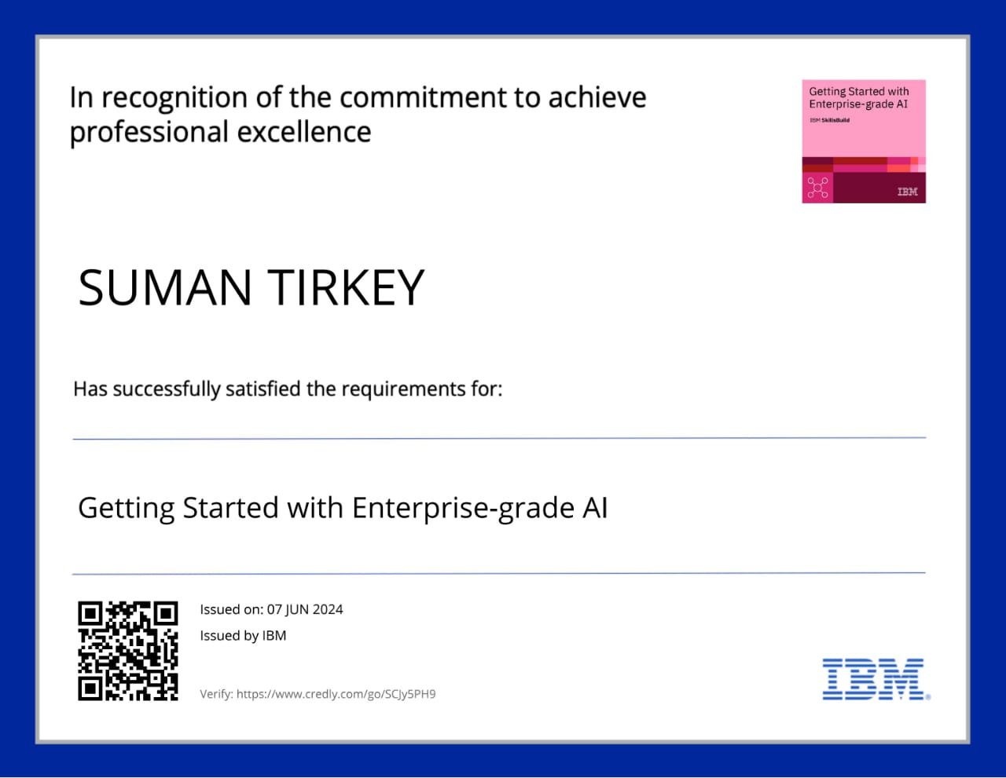
Course Certificate 1

Slide 16
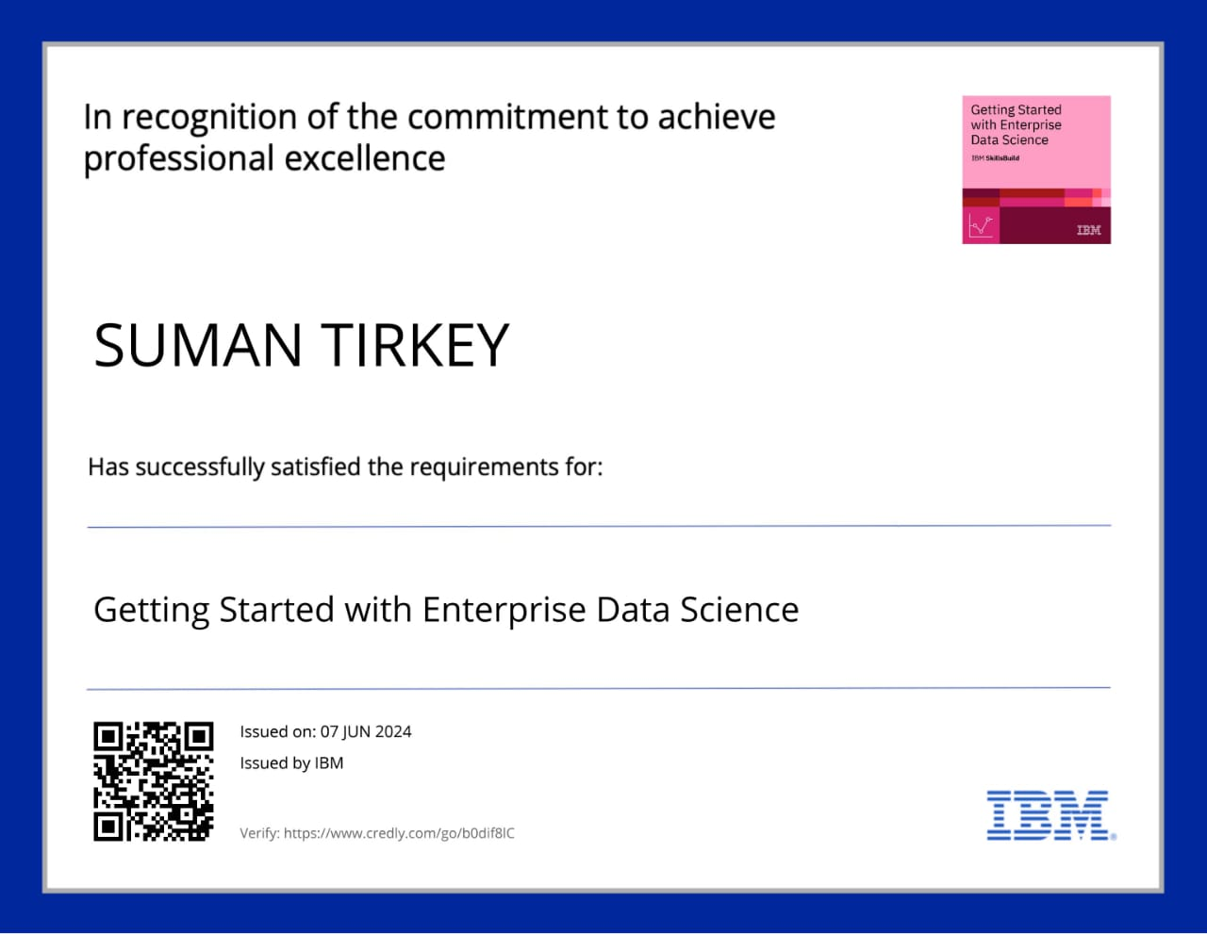
Course Certificate 2

Slide 17
Thank you

