Slide 1

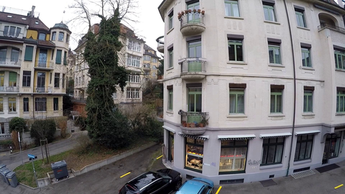
VoxelFlight
SMART INDIA HACKATHON 2026
SMART INDIA
HACKATHON 2026
VOXELFLIGHT
A drone video you can
explore in three dimensions.
For missions where another flight
may not be possible.
Single-Pass Drone Video to Accurate 3D
Model Generation System
ACTUAL INPUT FRAME
SIH26158
National Technical Research Organisation
Team name: [To be added] Team ID: [To be added]
SIH26158 / SOFTWARE / DRONE & ROBOTICS
01 / 06
Notes:
VoxelFlight addresses the software challenge of generating a georeferenced scene model from one moving-drone video. A single pass still supplies multiple images of the scene, but viewing angles and overlap can be limited. Mandatory inputs are 1080p/4K video, GPS coordinates and flight metadata. Optional inputs are IMU, barometric altitude, camera intrinsics and RTK/PPK corrections. The requested scene includes terrain, structures, façades, rooftops, roads, infrastructure, vegetation and obstacles. The goal is an output suitable for visualization, measurement and analysis without extensive ground control. Manufacturing a drone is outside the proposed software scope.
The working prototype combines pretrained geometry with visual tracking and telemetry. A browser exposes source frames, the exported mesh and point cloud, appearance comparisons and downloadable files. The current saved geometry remains partial. Independent spatial validation is necessary before operational measurement. The input image on the cover is a real observed frame, not a reconstruction. Team registration details await confirmation.
SOURCES
Recorded experiment: work/sih3d-gpu/viewer/assets/evaluation.json, asset_report.json and stage_timings.json. Source flight: Zurich Urban MAV. Input duration 60 seconds, 180 keyframes, NVIDIA L40S GPU. Ground truth enters evaluation only. SIH requirements source: supplied tmp/pdfs/SIH26158.pdf, document pages 37-39. SIH emblem comes from the supplied prior-year reference PDF.
https://arxiv.org/abs/2412.12392
https://map-anything.github.io/
https://repo-sam.inria.fr/fungraph/3d-gaussian-splatting/
https://arxiv.org/abs/2105.15203
https://colmap.github.io/
https://rpg.ifi.uzh.ch/zurichmavdataset.html

Slide 2
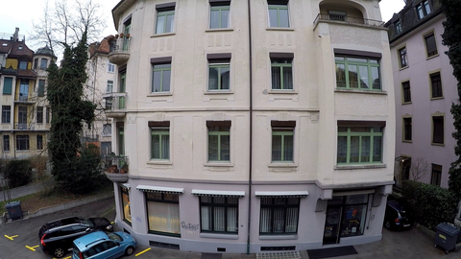
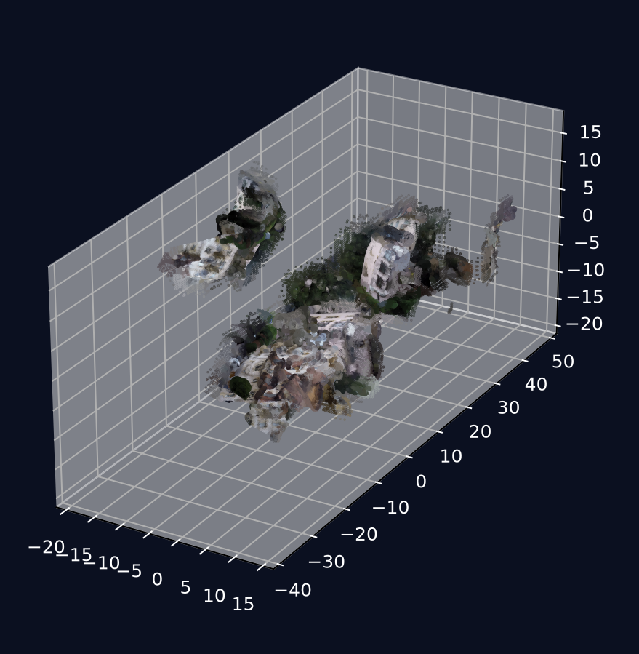
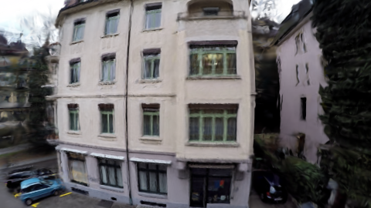
VoxelFlight
PROPOSED SOLUTION
SMART INDIA
HACKATHON 2026
Single-pass scene reconstruction
Video and telemetry support reconstruction of visible terrain, structures, roads, vegetation and obstacles.
01
Read the flight
02
Build geometry
03
Review appearance
Video + GPS + flight metadata
Optional Gaussian splatting
Required video: 1080p or 4K
Recorded demo: 60 s, 180 keyframes
Mesh / point cloud
Fits the scene for realistic rendering.
Appearance cannot certify dimensions.
Partial scene with fusion artifacts.
Spatial accuracy still needs validation.
Optional: IMU, altitude, calibration,
RTK/PPK corrections.
W000: PSNR 20.41 dB, SSIM 0.631
LPIPS 0.226
SIH26158 / SOFTWARE / DRONE & ROBOTICS
02 / 06
Notes:
The workflow produces two complementary representations. The mesh and point cloud describe estimated geometry. Optional 3D Gaussian Splatting optimises an appearance representation from local images, camera poses and points. It does not derive survey accuracy from photorealism, and it is not generated from the final mesh. The core pretrained inference path needs no foundation-model training on the evaluation flight. The optional appearance stage performs scene-specific optimisation.
The images show a real source frame, a diagnostic rendering of the actual partial geometry and the saved Gaussian render for window W000. The rendered half is cropped from photoreal_preview_w000.png. Its held-out-view metrics are PSNR 20.41 dB, SSIM 0.631 and LPIPS 0.226. These evaluate appearance rather than surface geometry. The mesh has holes and disconnected regions; completely hidden surfaces must not be described as observed measurements.
The stated spatial target is ≤1 m with coverage of the entire visible scene. The statement does not specify the exact error statistic, allowable alignment or reference sensor. These must be fixed in the evaluation protocol.
SOURCES
Recorded experiment: work/sih3d-gpu/viewer/assets/evaluation.json, asset_report.json and stage_timings.json. Source flight: Zurich Urban MAV. Input duration 60 seconds, 180 keyframes, NVIDIA L40S GPU. Ground truth enters evaluation only. SIH requirements source: supplied tmp/pdfs/SIH26158.pdf, document pages 37-39. SIH emblem comes from the supplied prior-year reference PDF.
https://arxiv.org/abs/2412.12392
https://map-anything.github.io/
https://repo-sam.inria.fr/fungraph/3d-gaussian-splatting/
https://arxiv.org/abs/2105.15203
https://colmap.github.io/
https://rpg.ifi.uzh.ch/zurichmavdataset.html

Slide 3
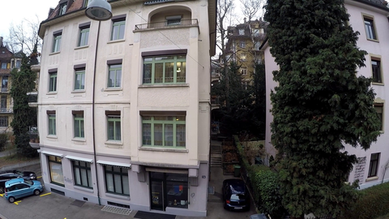
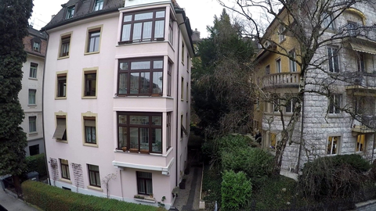
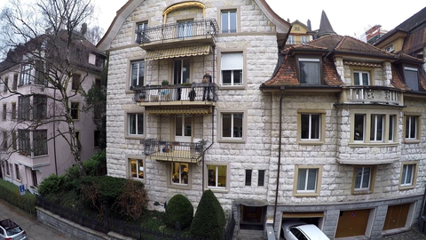
VoxelFlight
TECHNICAL APPROACH
SMART INDIA
HACKATHON 2026
Multimodal reconstruction pipeline
Camera-motion estimates, depth predictions and flight telemetry combine in a shared scene coordinate system.
Where did the camera move?
01
MASt3R-SLAM [1]
02
03
Track the route through the images
Prepare frames
Align + join
Inspect + export
How far away are the surfaces?
MapAnything [2]
Align local windows
Use shared frames
Fuse the 3D points
Filter + mesh
3D viewer
Point cloud / mesh
Geospatial files
Predict depth and camera poses
Sample, timestamp
and calibrate
Which pixels should we exclude?
SegFormer [4]
Mask sky and potentially moving classes
3 windows of 72 frames
18 shared frames link neighbours
Flight telemetry
GNSS velocity + altitude guide the route. GPS places it on the map.
Cached weights. No ground-truth input to reconstruction. Optional 3DGS fits appearance separately.
SIH26158 / SOFTWARE / DRONE & ROBOTICS
03 / 06
Notes:
Frame preparation samples images, timestamps them and normalises available calibration. MASt3R-SLAM supplies camera-motion anchors. MapAnything predicts metric geometry and camera poses. SegFormer supplies semantic masks to exclude sky and potentially moving classes. Semantic masking is not a complete motion detector.
The recorded run uses three 72-frame windows: 0-71, 54-125 and 108-179. Neighbours share 18 frames. Similarity registration uses P′k = sk Rk Pk + tk to align camera centres with a shared trajectory. A position-only weighted least-squares graph combines visual anchors, relative motion, GNSS velocity and altitude. This is not a full inertial-state estimator. Each cloud is then aligned to the solved camera centres, filtered and meshed. Raw GPS supplies the final map translation. Outputs use local ENU and UTM zone 32N metadata (EPSG:32632).
The implementation is scripts/run_sih_pipeline.py and scripts/fuse_visual_gnss_baro.py. Cached checkpoints and bounded windows limit repeated setup and workload. Motion blur, compression, shadows, weak texture, dynamic objects, GPS noise and occlusions remain important stress-test conditions. Higher-quality depth consistency and uncertainty-aware sensor fusion are development directions.
SOURCES
Recorded experiment: work/sih3d-gpu/viewer/assets/evaluation.json, asset_report.json and stage_timings.json. Source flight: Zurich Urban MAV. Input duration 60 seconds, 180 keyframes, NVIDIA L40S GPU. Ground truth enters evaluation only. SIH requirements source: supplied tmp/pdfs/SIH26158.pdf, document pages 37-39. SIH emblem comes from the supplied prior-year reference PDF.
https://arxiv.org/abs/2412.12392
https://map-anything.github.io/
https://repo-sam.inria.fr/fungraph/3d-gaussian-splatting/
https://arxiv.org/abs/2105.15203
https://colmap.github.io/
https://rpg.ifi.uzh.ch/zurichmavdataset.html

Slide 4
VoxelFlight
FEASIBILITY AND VIABILITY
SMART INDIA
HACKATHON 2026
Prototype performance and engineering strategy
Recorded reconstruction of a 60-second Zurich flight with 180 keyframes on an NVIDIA L40S GPU.
Measured property | Recorded result
Core reconstruction | 3 min 29 s
With appearance refinement | 5 min 34 s total
Clean point cloud | 518,786 points
Exported mesh | 450,000 triangles
Trajectory RMSE, Sim(3)-aligned | 0.810 m
Trajectory RMSE, absolute | 8.797 m
Limited views and scene motion
Overlapping windows retain shared observations.
Semantic masks exclude sky and potentially
moving classes.
Metric scene placement
Visual anchors and GNSS/altitude constrain
window placement. Reference poses enter
evaluation only.
Execution and deployment
Cached model weights and bounded windows
control the workload. A separate processing
service supports the web interface.
Geospatial output package
OBJ, PLY, LAS, GLB and GeoTIFF
Local ENU geometry with UTM-referenced exports
Validation scope
Geometry is partial. Independent spatial accuracy and
the 10-minute-video benchmark remain pending.
Trajectory RMSE does not measure surface accuracy.
SIH26158 / SOFTWARE / DRONE & ROBOTICS
04 / 06
Notes:
The recorded core stages total 208.670 seconds. Including optional appearance fitting yields 333.935 seconds. Both timings describe a 60-second input on NVIDIA L40S hardware, roughly 45 GB VRAM, two CPU threads and 30 GB RAM. They exclude upload and deployment queue delay. No extrapolation establishes the ≤15-minute target for a 10-minute video.
The output contains 518,786 clean points and 450,000 mesh triangles. The trajectory shape RMSE is 0.809918395 m after one global Sim(3) alignment. Absolute unaligned trajectory RMSE is 8.797431254 m. A similarity alignment corrects global scale, orientation and translation against the reference for evaluation. Consequently the aligned score cannot demonstrate absolute georeferencing or surface accuracy. The construction_uses_ground_truth flag is false.
Available exports are OBJ, PLY, LAS, GLB and GeoTIFF. The statement additionally lists FBX; that export is not demonstrated. The 0.25 m DSM grid spacing is a resolution setting, not an accuracy score. Current validation priorities are independent surface error, full visible-surface completeness, robustness across unseen flights and the longer-video runtime benchmark.
SOURCES
Recorded experiment: work/sih3d-gpu/viewer/assets/evaluation.json, asset_report.json and stage_timings.json. Source flight: Zurich Urban MAV. Input duration 60 seconds, 180 keyframes, NVIDIA L40S GPU. Ground truth enters evaluation only. SIH requirements source: supplied tmp/pdfs/SIH26158.pdf, document pages 37-39. SIH emblem comes from the supplied prior-year reference PDF.
https://arxiv.org/abs/2412.12392
https://map-anything.github.io/
https://repo-sam.inria.fr/fungraph/3d-gaussian-splatting/
https://arxiv.org/abs/2105.15203
https://colmap.github.io/
https://rpg.ifi.uzh.ch/zurichmavdataset.html

Slide 5

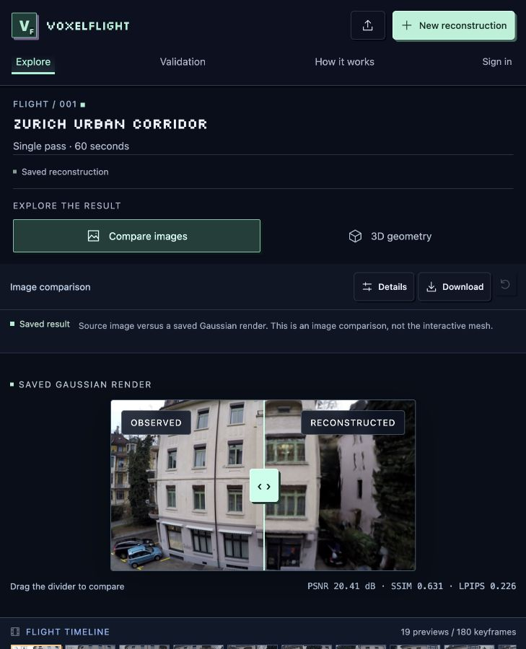
VoxelFlight
IMPACT AND BENEFITS
SMART INDIA
HACKATHON 2026
Spatial context for inspection and planning
A browser workspace connects source imagery, reconstructed geometry and geospatial downloads.
Infrastructure inspection
Review façade and road context
before a targeted follow-up survey.
Disaster assessment
Review visible damage remotely.
Keep unseen regions explicit.
Planning and documentation
Reuse scene files with their
coordinate reference information.
voxelflight-3d.web.app
Entrance + sign-in
Reconstruction workspace
Public prototype interface with saved reconstruction.
Inference runs through a separate processing service.
SIH26158 / SOFTWARE / DRONE & ROBOTICS
05 / 06
Notes:
Potential applications include infrastructure inspection, disaster damage review, planning and archaeological documentation. Source-image links help reviewers distinguish measured observations from estimated geometry. A scene record can support remote review and targeted follow-up surveys, but it cannot certify structural safety without validated geometry and qualified assessment.
The screenshots are actual public pages captured on 10 September 2026: https://voxelflight-3d.web.app/ and https://voxelflight-3d.web.app/workspace#workspace. The entrance artwork is decorative. The workspace displays saved image comparisons; the 3D geometry is a separate interactive view. Google sign-in is offered, while GitHub was not connected in the captured interface. No complete OAuth or new-upload reliability claim follows from a screenshot. Firebase serves the web interface and identity layer. Reconstruction runs through a separate processing worker.
Pilot validation should measure operator time, recapture frequency, export usability and verified spatial error. Economic or environmental savings have not yet been measured. Authorised acquisition, data retention and model/checkpoint licensing require review before deployment.
SOURCES
Recorded experiment: work/sih3d-gpu/viewer/assets/evaluation.json, asset_report.json and stage_timings.json. Source flight: Zurich Urban MAV. Input duration 60 seconds, 180 keyframes, NVIDIA L40S GPU. Ground truth enters evaluation only. SIH requirements source: supplied tmp/pdfs/SIH26158.pdf, document pages 37-39. SIH emblem comes from the supplied prior-year reference PDF.
https://arxiv.org/abs/2412.12392
https://map-anything.github.io/
https://repo-sam.inria.fr/fungraph/3d-gaussian-splatting/
https://arxiv.org/abs/2105.15203
https://colmap.github.io/
https://rpg.ifi.uzh.ch/zurichmavdataset.html

Slide 6
VoxelFlight
RESEARCH AND REFERENCES
SMART INDIA
HACKATHON 2026
Technical foundations and implementation contribution
Published reconstruction methods form the basis of the integrated VoxelFlight workflow.
[1] MASt3R-SLAM
Sensor-guided alignment
CVPR 2025 / Visual camera tracking
Combines visual motion, metric predictions and
flight telemetry to place overlapping windows
in a common coordinate system.
[2] MapAnything
3DV 2026 / Feed-forward metric geometry
[3] 3D Gaussian Splatting
Geometry and appearance
SIGGRAPH 2023 / Optional appearance refinement
Keeps mesh and point-cloud outputs separate
from optional Gaussian rendering, with their
respective validation results.
[4] SegFormer
NeurIPS 2021 / Semantic segmentation and exclusion masks
Connected geospatial delivery
[5] COLMAP
CVPR / ECCV 2016 / Classical reconstruction baseline
Packages scene files with coordinate metadata
and source imagery for browser inspection
and downstream GIS workflows.
[6] Zurich Urban MAV
IJRR 2017 / Public imagery, telemetry and reference poses
Technical focus: integrating complementary models with
sensor-aware placement and inspectable scene outputs.
SIH26158 / SOFTWARE / DRONE & ROBOTICS
06 / 06
Notes:
The project integrates published research rather than claiming invention of its underlying models. MASt3R-SLAM provides visual tracking with dense 3D priors. MapAnything provides feed-forward metric geometry. SegFormer provides semantic segmentation. Gaussian splatting provides an optional representation for realistic rendering. COLMAP is an established classical baseline. Zurich Urban MAV supplies the recorded imagery, telemetry and reference camera positions. Its reference trajectory derives from photogrammetric reconstruction; it is not an independently surveyed surface ground truth.
The implementation contribution is the combination of sensor-guided window alignment, separate geometry and appearance outputs, geospatial packaging and a connected inspection interface. A controlled comparison on identical inputs and hardware is needed before claiming superiority over existing methods. Reproducible experiments should separate tuning and test flights, retain fixed checkpoints, prohibit reference geometry from entering construction and report geometry completeness, surface error, trajectory error, runtime, memory and failure rate.
MASt3R-Fusion (https://arxiv.org/abs/2509.20757) is a relevant future sensor-coupling experiment rather than a current component. Review all code and checkpoint licences for the intended use. In particular, the NVlabs SegFormer implementation states non-commercial research/evaluation terms. Open download availability does not imply unrestricted commercial rights.
SOURCES
Recorded experiment: work/sih3d-gpu/viewer/assets/evaluation.json, asset_report.json and stage_timings.json. Source flight: Zurich Urban MAV. Input duration 60 seconds, 180 keyframes, NVIDIA L40S GPU. Ground truth enters evaluation only. SIH requirements source: supplied tmp/pdfs/SIH26158.pdf, document pages 37-39. SIH emblem comes from the supplied prior-year reference PDF.
https://arxiv.org/abs/2412.12392
https://map-anything.github.io/
https://repo-sam.inria.fr/fungraph/3d-gaussian-splatting/
https://arxiv.org/abs/2105.15203
https://colmap.github.io/
https://rpg.ifi.uzh.ch/zurichmavdataset.html

