Slide 1


K.RAMAKRISHNAN COLLEGE OF TECHNOLOGY
(AUTONOMOUS), TRICHY.
AUCTION MANAGEMENT SYSTEM
SUPERVISOR
Mr .A.Malarmannan M.E.,
AP/CSE.
PRESENTED
SUMAN S
2303811710421161

Slide 2
PRESENTATION OVERVIEW
Objective
Project Introduction
Problem Statement
Methodologies (Programming concepts relevant to problem statement)
Architecture of the proposed system
List of Modules
Merits
Results and Discussion
Queries

Slide 3
OBJECTIVE
The objective of this Java program is to create an intuitive Auction Management System using Swing, enabling sellers to list items and manage auctions, while allowing bidders to place competitive bids in real-time. The system ensures transparency by logging auction activities and promotes fair bidding by validating inputs and awarding items to the highest bidder. It simplifies the auction process, making it efficient and user-friendly for all participants.

Slide 4
PROJECT INTRODUCTION
This Java program implements an Auction Management System using Swing for graphical user interface (GUI). It provides a platform for sellers to add items for auction, set starting prices, and sell items, while bidders can select items, place bids, and compete to win. The system ensures smooth operation by maintaining real-time updates of the highest bids and tracking the highest bidders. An integrated auction log keeps a detailed record of all activities, offering a transparent and efficient auctioning experience.

Slide 5
PROBLEM STATEMENT
Managing auctions manually can be inefficient, prone to errors, and lacks transparency. Sellers face challenges in tracking bids, while bidders may not have real-time updates on the highest offers. There is a need for a system that streamlines the auction process, ensures accurate tracking of bids, and provides a transparent platform for sellers and bidders to interact efficiently. This project addresses these issues by developing an automated Auction Management System using Java Swing.

Slide 6
METHODOLOGIES
GUI Design: Built with Java Swing for user-friendly interaction.
Data Storage: Used HashMap to manage items and bids.
Event Handling: Implemented ActionListeners for user actions.
Validation: Ensured correct input for bids and prices.
Real-Time Updates: Dynamic updates for bids and auction status.
Activity Logging: Maintained an auction log for transparency.

Slide 7
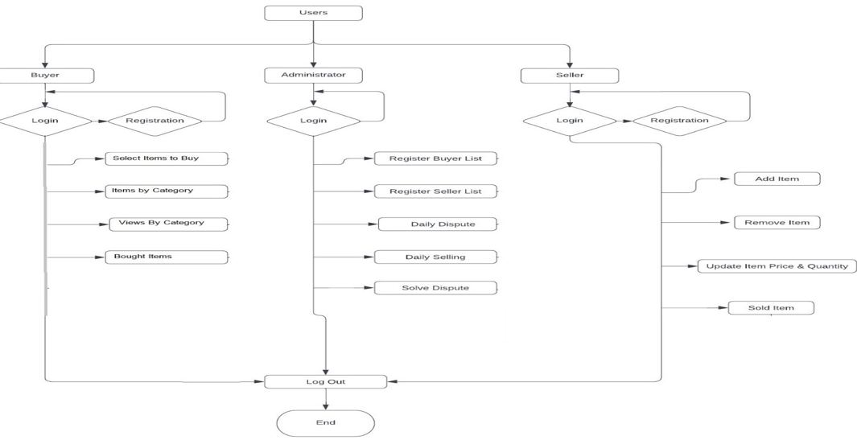
ARCHITECTURE OF THE PROPOSED SYSTEM

Slide 8
LIST OF MODULES
User Management Module
User profile management (e.g., name, email, Registration and login for bidders, administrators, and other users.
address, payment methods).
Item Management Module:
Item listing (title, description, images, categories).
Setting reserve prices, starting bids, and auction duration.
Bidding Module:
Allow bidders to place bids on available items.
Display live bid updates and auction countdown.

Slide 9
LIST OF MODULES
Auction Management Module:
Create, schedule, and close auctions.
Set auction rules (e.g., reserve prices, bidding increments).
Monitor real-time auction progress.
Bidder Module:
Search and filter available auction items.
View live auction results and status.
Place, update, and retract bids.

Slide 10
MERITS
User-Friendly Interface: Easy-to-use GUI for sellers and bidders. Real-Time Updates: Dynamic updates for bids and auction status. Error Handling: Validates inputs to ensure smooth operation. Transparency: Auction log ensures full transparency. Scalability: Easy to add more features in the future.

Slide 11
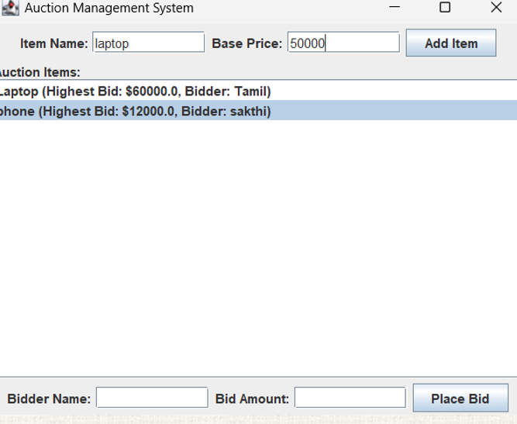
RESULTS AND DISCUSSION

Slide 12
QUERIES ?

