Slide 1
STUDENT INFORMATION SYSTEM

Slide 2
ABSTRACT
The main objective of this project is to provide the hand free access to see their information for students and teachers through web interface.
This project “STUDENT INFORMATION SYSTEM” gives us the complete information about the teachers and students
We can add information about students and teachers and retrieve the details of students and teachers. Student can able to see their arrears, current CGPA, attendance percentage,fee structure etc
In this project student and teacher can able to download their subject resources, and able to see their time table.

Slide 3
PROBLEM STATEMENT
In many educational institutions, the management of student data such as fee payments, attendance, academic performance, and communication between faculty and students is still handled through manual or semi-digital processes. This results in several challenges including data inconsistency, lack of transparency, time-consuming administrative tasks, and difficulty in tracking academic progress.
Students often face difficulties in accessing their academic records, tracking project submissions, and staying updated on college circulars or time tables. Similarly, faculty members struggle with manually managing marks, attendance, and internal assessments, while administrators lack a centralized system to monitor fee collections, academic performance, and overall student data.

Slide 4
EXISTING SYSTEM
In the existing system the details are stored manually, only a faculty can view the details.
The following are the disadvantages of the existing system
  More man power.
  Lots of paper work.
  Time consuming.
  Data Inconsistency.

Slide 5
PROPOSED SYSTEM
The proposed system is a web application that is accessible anywhere provided you have internet connection.
The following are the advantages of the proposed system
  Well-designed user interface.
  Scalability.
  Data integrity.
  More effective and efficient.
  Improves communication between students, faculty, and administration.
  Offer user friendly and secure environment

Slide 6
TECHNOLOGIES USED:
These are the following technologies used to build the app
  React js
  Node js
  Express js
  Mongo db
  Typescript
  Git

Slide 7
SYSTEM ANALYSIS
HARDWARE REQUIREMENTS
  Processor : Intel/Amd
  Ram : 4.00 GB (3.89 GB usable)
  Hard disk : 40 GB
  Monitor : 15’’mVGA monitor
  Keyboard : 104 keys Keyboard
  Mouse : Optical mouse
SOFTWARE REQUIREMENTS
  Operating System : 64-bit OS
  Local Host Server : MongoDB-Node.js Database Connectivity : MongoDB
  Front End : React
  Back End : Express.js

Slide 8
PROJECT FUNCTIONALITY
Student Information system performs the following tasks
  View student details
  View teacher details
  View timetable for students and teachers
  Download subject resource
  View fee structure
  Feel payment
  View Circulars and Events
  QR code Authentication

Slide 9
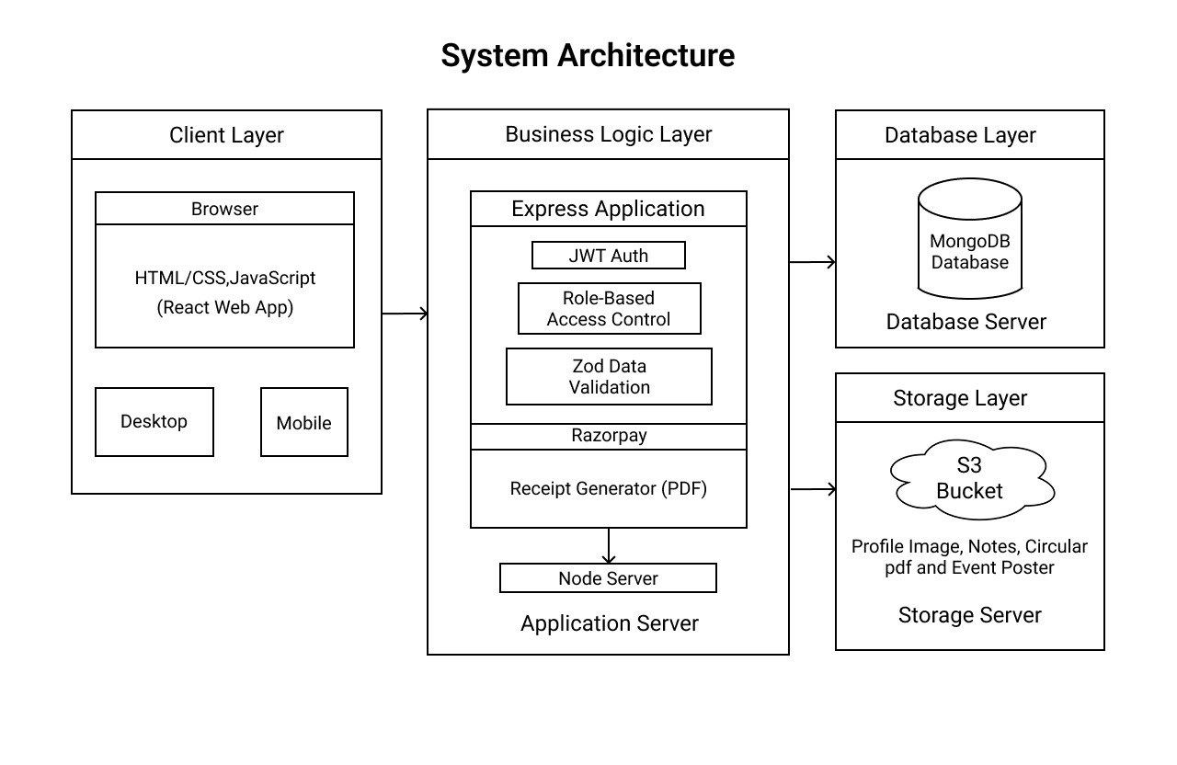
SYSTEM DESIGN

Slide 10
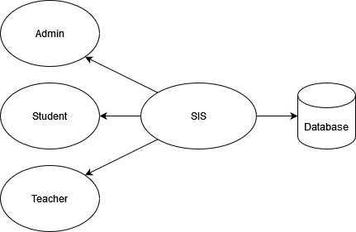
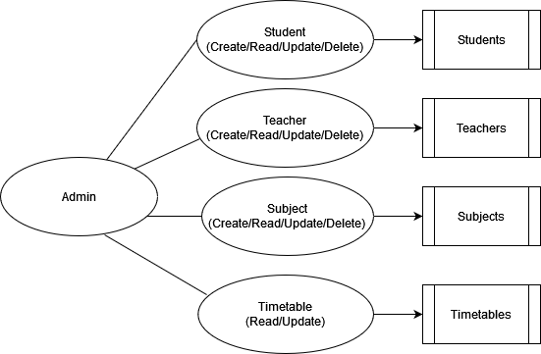
DATA FLOW DIAGRAM

Slide 11
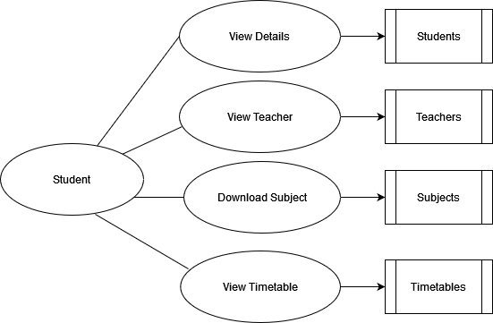
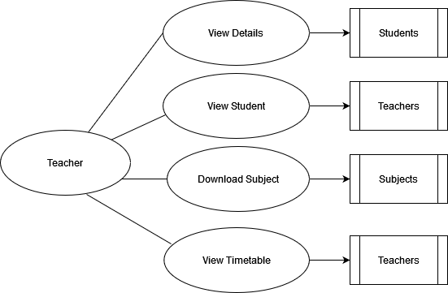
DATA FLOW DIAGRAM

Slide 12
PROJECT IMAGES

Slide 13
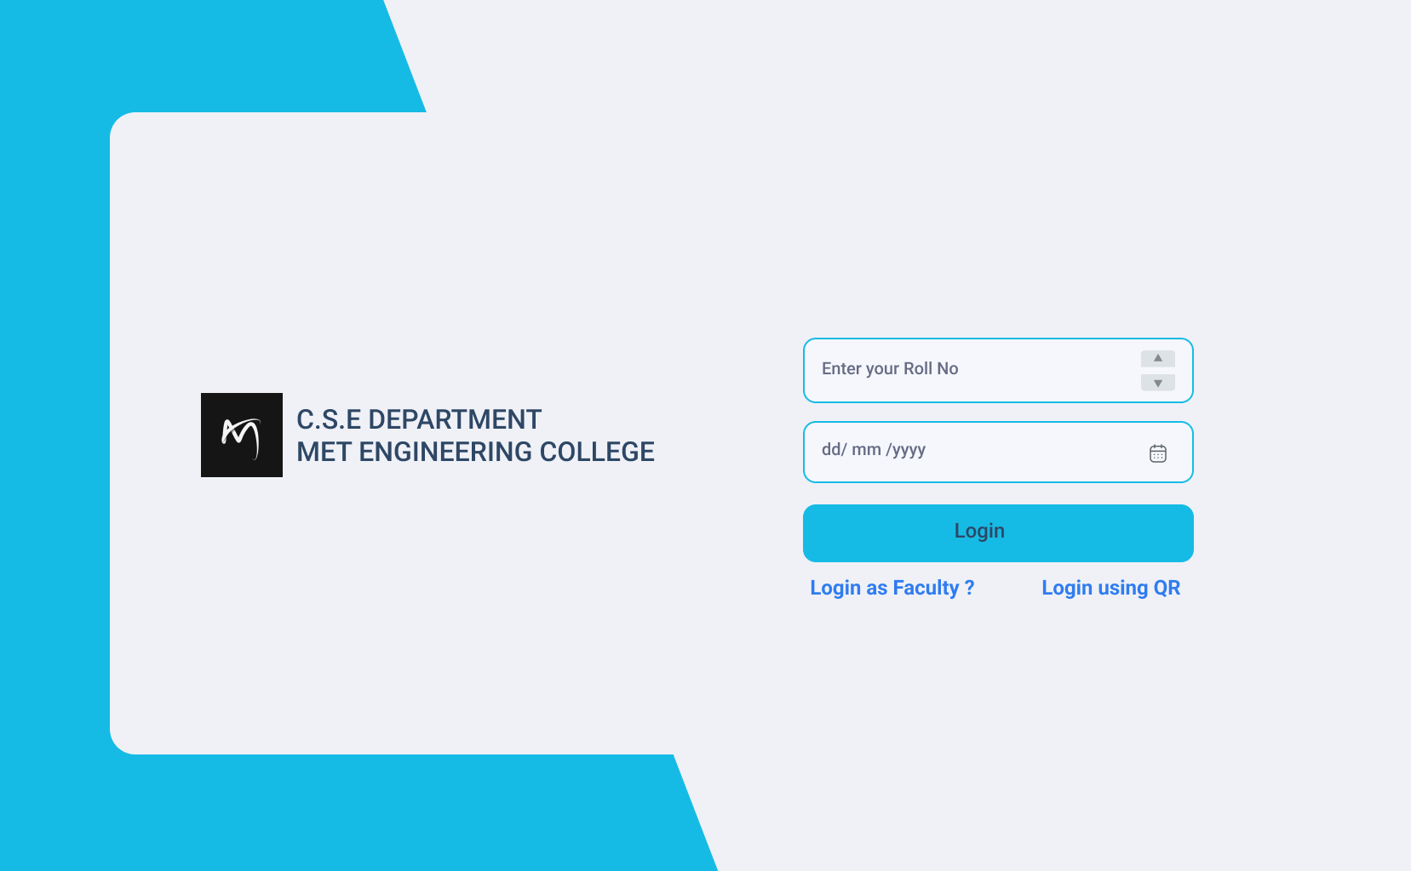

Slide 14
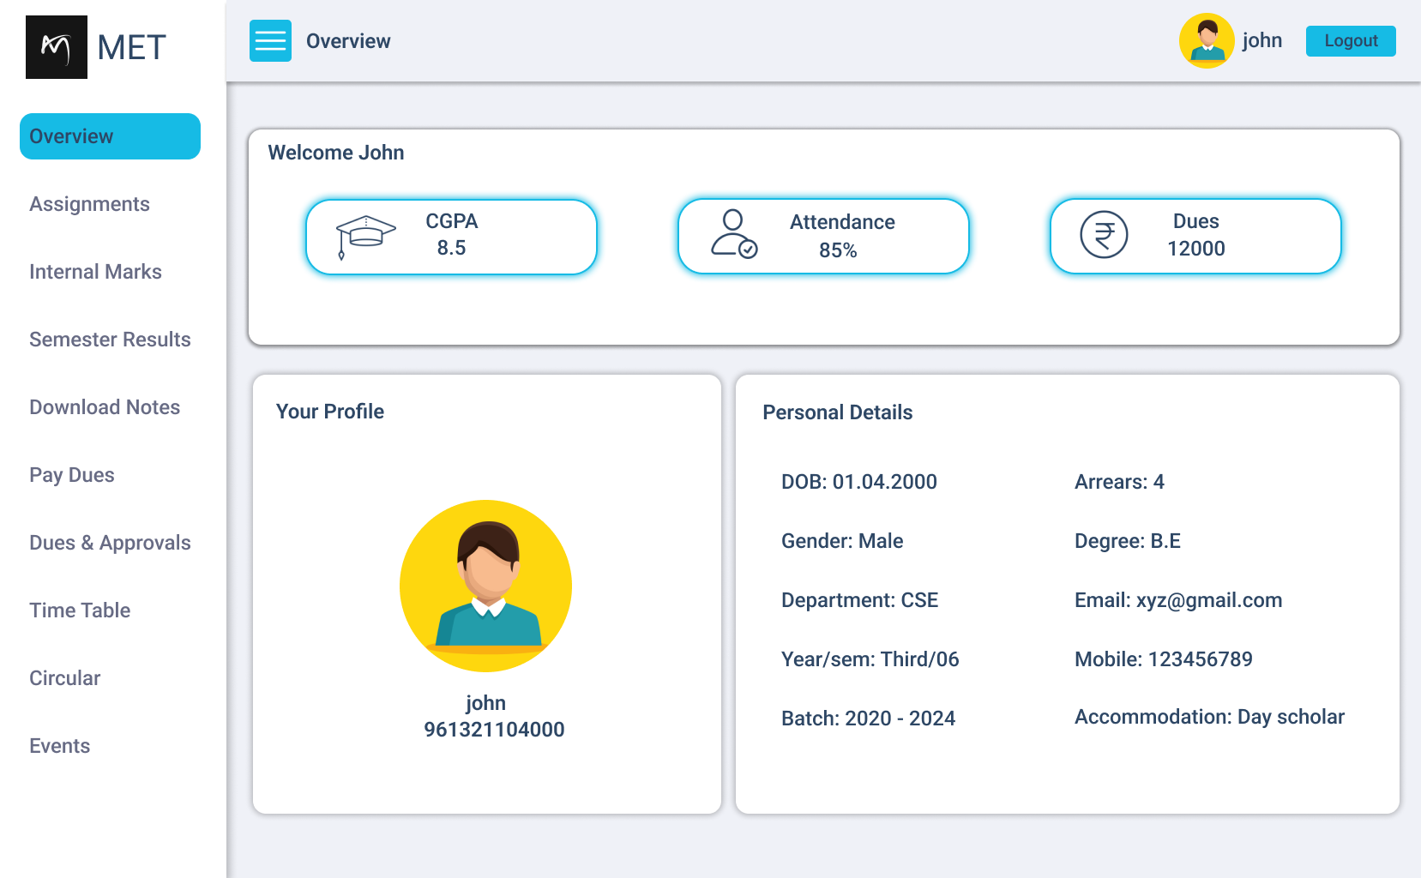

Slide 15
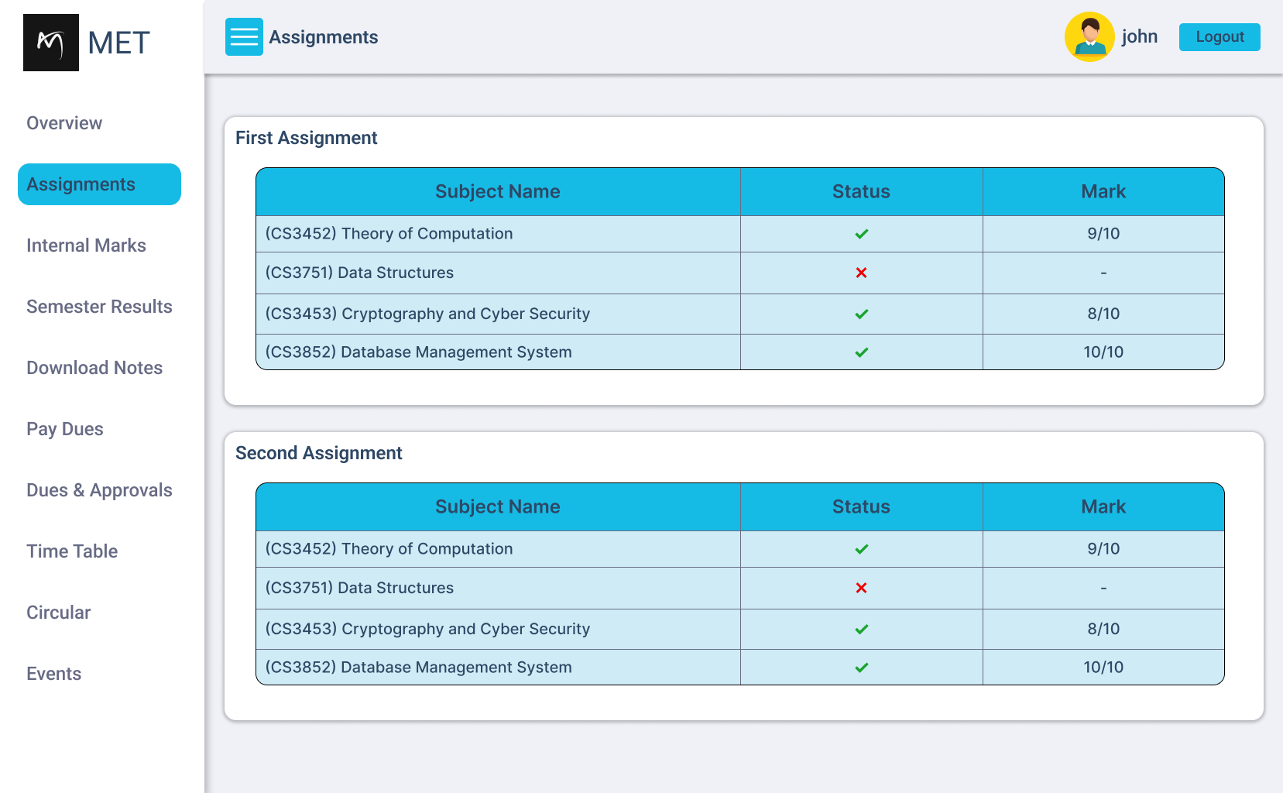

Slide 16
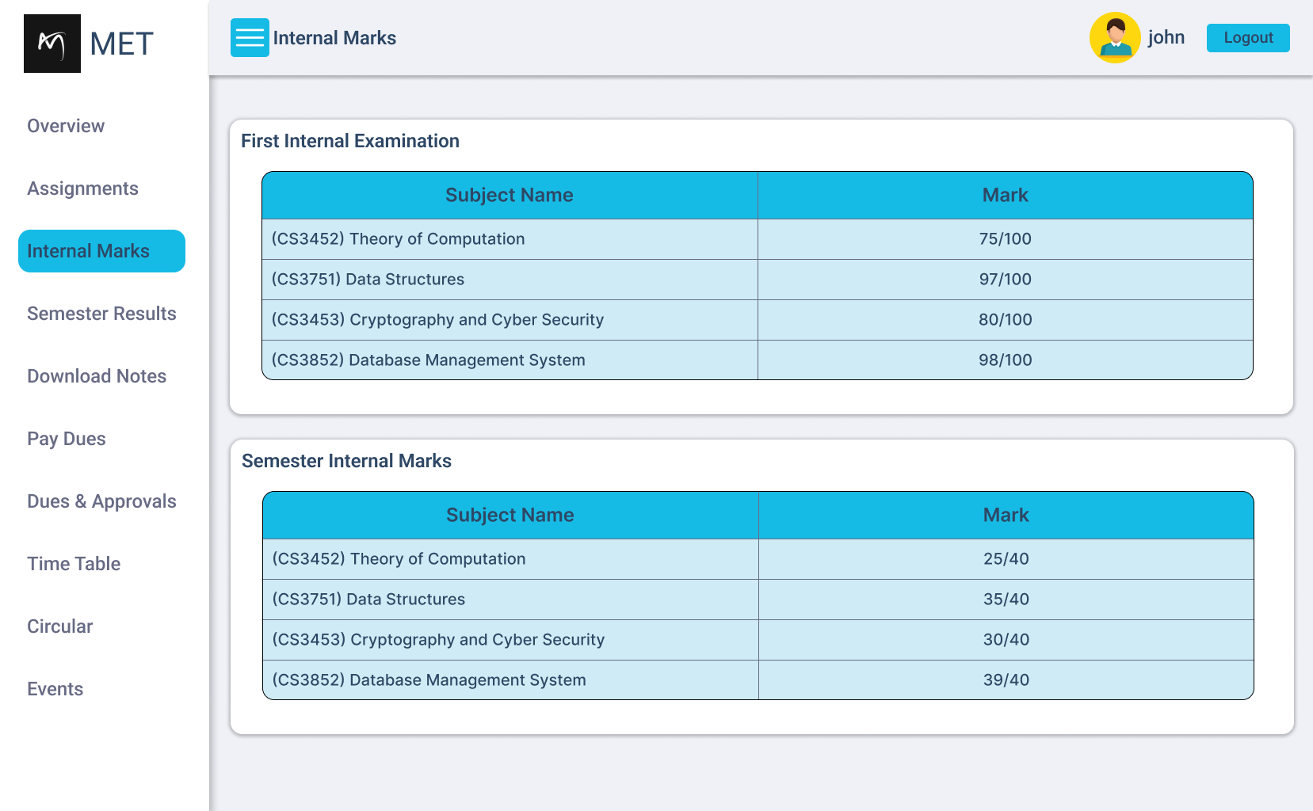

Slide 17
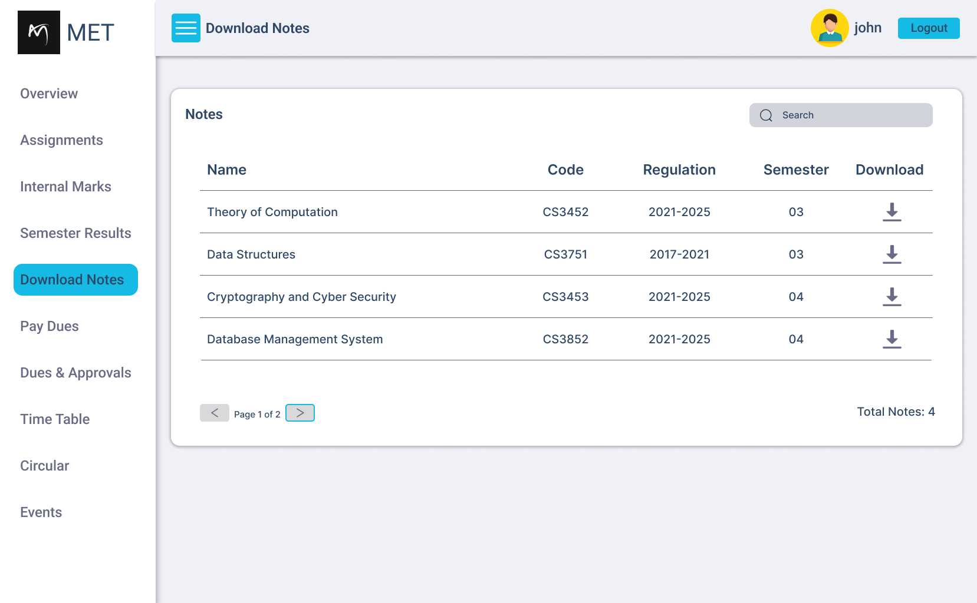

Slide 18
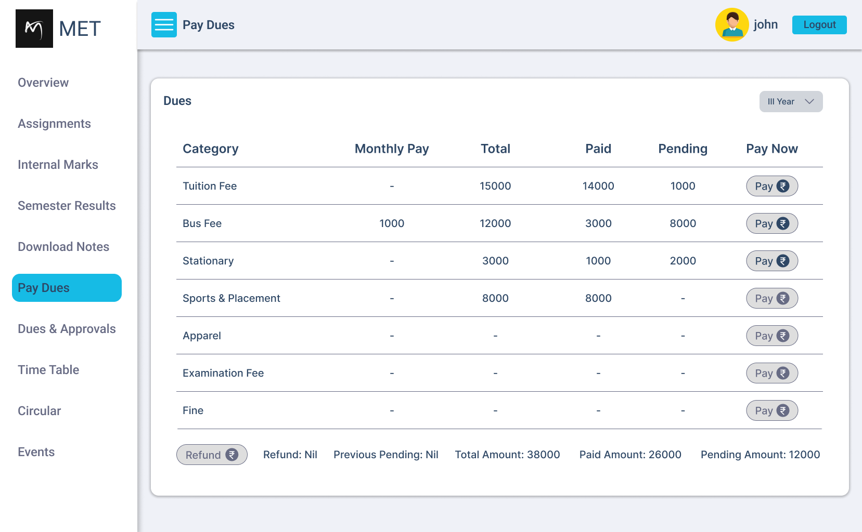

Slide 19
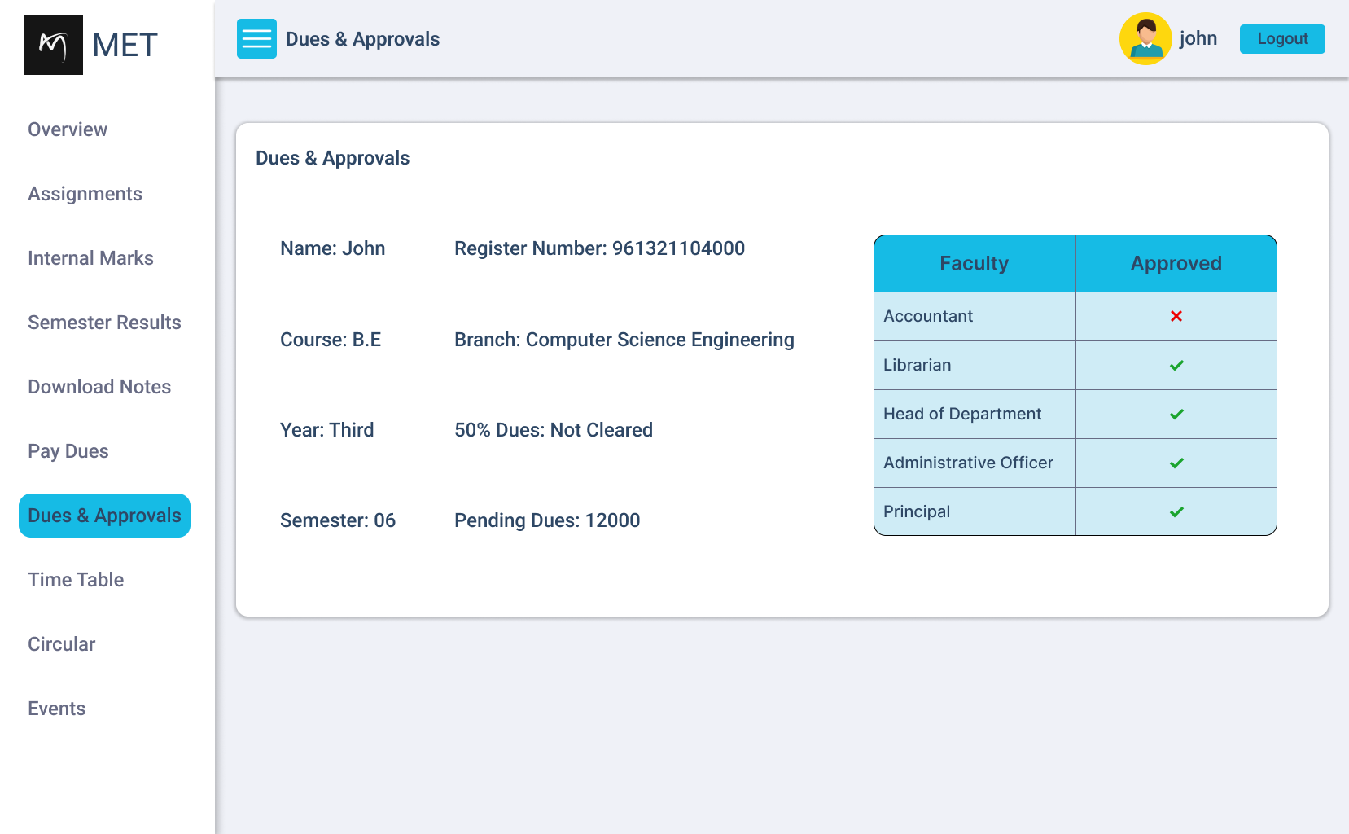

Slide 20
FUTURE ENHANCEMENT
AI & Analytics Integration
Mobile App Development
Integration with Learning Management Systems (LMS)
Student and Parent Portals
Multi-Language Support

Slide 21
CONCLUSION
The arrival of technology and the escalating use of internet have reduced our burden of work.
The user can get attendance percentage, CGPA, etc. and download their subject resource anywhere and at any time.
In comparison with the manual system, the benefit under a computer systems considerable in saving man power, working hours and efforts.

Slide 22
BY:
G.SUMAN
D SHIJIN KUMAR
JAFFIN DURAI
VISHNU
UI&UX: https://www.figma.com/community/file/1467196201248983459
GitHub Repository: https://github.com/SumanAdithan/student-information-system

